Slide 1
Chapter 7
Deadlocks

Slide 2
Outline
System Model
Deadlock Characterization
Methods for Handling Deadlocks
Deadlock Prevention
Deadlock Avoidance
Deadlock Detection
Recovery from Deadlock
Combined Approach to Deadlock Handling

Slide 3
Objectives
To develop a description of deadlocks, which prevent sets of concurrent processes from completing their tasks
To present a number of different methods for preventing or avoiding deadlocks in a computer system

Slide 4
The Deadlock Problem
A set of blocked processes each holding a resource and waiting to acquire a resource held by another process in the set.
Example
  System has 2 tape drives.
  P₁ and P₂ each hold one tape drive and each needs another one.
Example
  semaphores A and B, initialized to 1
        P₀ P₁
        wait (A); wait(B);
        signal (B); signal (A);

Slide 5
Bridge Crossing Example
Traffic only in one direction
Each section of a bridge can be viewed as a resource
If a deadlock occurs, it can be resolved if one car backs up (preempt resources and rollback)
Several cars may have to be backed up if a deadlock occurs
Starvation is possible

Slide 6
System Model
Resource types R₁, R₂, . . ., R_{m}
    CPU cycles, memory space, I/O devices
Each resource type R_{i} has W_{i} instances
Each process utilizes a resource as follows:
  request
  use
  release

Slide 7
Multithreaded Pthread using mutex Locks
An example: P313-314
thread_one
Void *do_work_one(Void *param)
{
pthread_mutex_lock(&first_mutex);
pthread_mutex_lock(&second_mutex);
/**
* Do some work
*/
pthread_mutex_unlock(&second_mutex);
pthread_mutex_unlock(&first_mutex);
pthread_exit(0);
}
thread_two
Void *do_work_one(Void *param)
{
pthread_mutex_lock(&second_mutex);
pthread_mutex_lock(&first_mutex);
/**
* Do some work
*/
pthread_mutex_unlock(&first_mutex);
pthread_mutex_unlock(&second_mutex);
pthread_exit(0);
}

Slide 8
Deadlock Characterization
Mutual exclusion: only one process at a time can use a resource
Hold and wait: a process holding at least one resource is waiting to acquire additional resources held by other processes
No preemption: a resource can be released only voluntarily by the process holding it, after that process has completed its task.
Circular wait: there exists a set {P₀, P₁, …, P_{n}} of waiting processes such that P₀ → P₁ → P₂ → ... → P_{n} → P₀
When deadlock occurs, all four conditions hold
Not sufficient conditions
Not completely independently (4 implies 2)

Slide 9
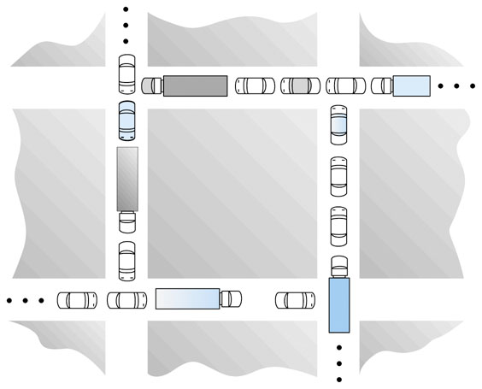
Circular wait

Slide 10
Resource-Allocation Graph (1)
A set of vertices V and a set of edges E
V is partitioned into two types:
  P = {P₁, P₂, …, P_{n}}, the set consisting of all the processes in the system
  R = {R₁, R₂, …, R_{m}}, the set consisting of all resource types in the system
request edge – directed edge P_{i} → R_{j}
assignment edge – directed edge R_{j} → P_{i}

Slide 11
Resource-Allocation Graph (2)
Process
Resource Type with 4 instances
P_{i} requests instance of R_{j}
P_{i} is holding an instance of R_{j}
P_{i}
R_{j}
P_{i}
R_{j}

Slide 12
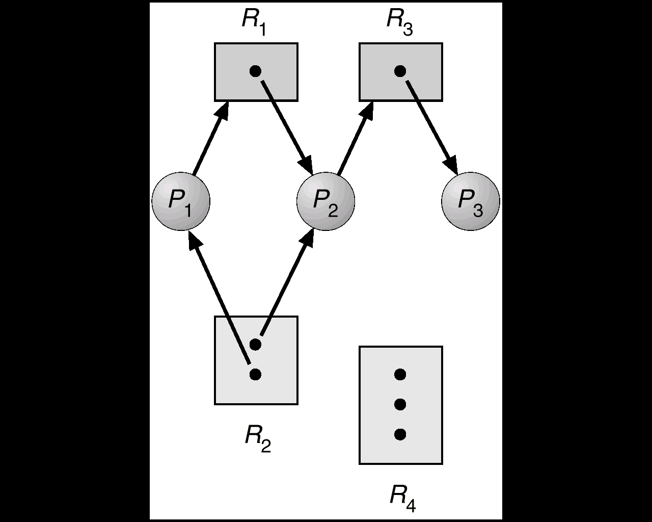
Example of a Resource Allocation Graph
request edge
assignment edge

Slide 13
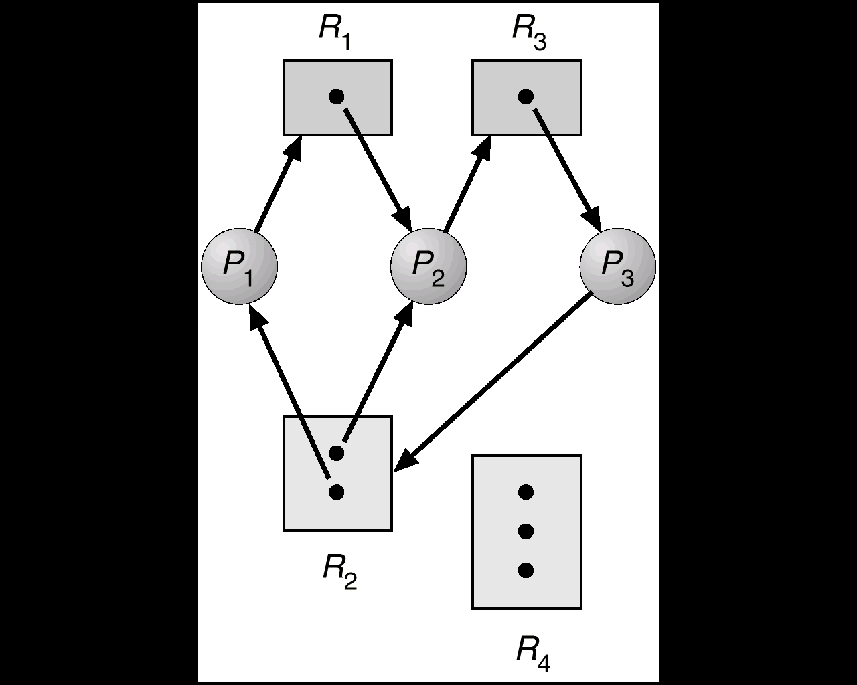
Resource Allocation Graph With A Deadlock
(P₁, P₂, P₃) is in deadlock state

Slide 14
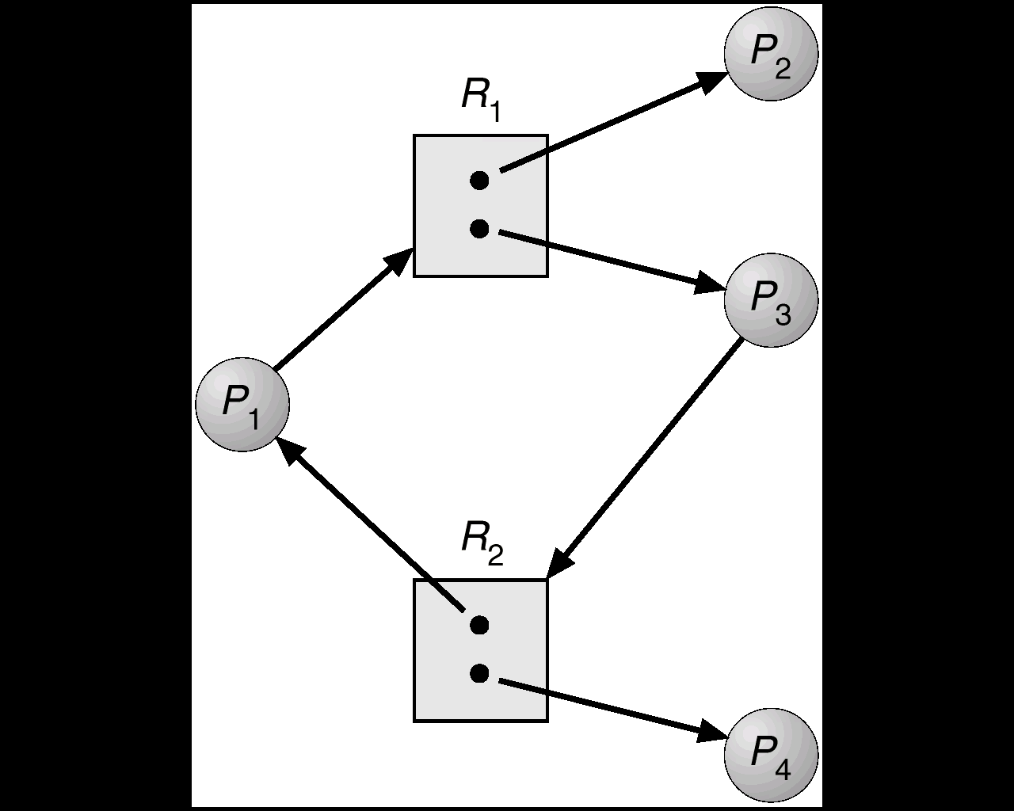
Resource Allocation Graph With A Cycle But No Deadlock

Slide 15
Deadlock Example
/* thread one runs in this function */
void *do_work_one(void *param)
{
pthread_mutex_lock(&first_mutex);
pthread_mutex_lock(&second_mutex);
/** * Do some work */
pthread_mutex_unlock(&second_mutex);
pthread_mutex_unlock(&first_mutex);
pthread_exit(0);
}
/* thread two runs in this function */
void *do_work_two(void *param)
{
pthread_mutex_lock(&second_mutex);
pthread_mutex_lock(&first_mutex);
/** * Do some work */
pthread_mutex_unlock(&first_mutex);
pthread_mutex_unlock(&second_mutex);
pthread_exit(0);
}

Slide 16
Deadlock Example with Lock Ordering
void transaction(Account from, Account to, double amount)
{
mutex lock1, lock2;
lock1 = get_lock(from);
lock2 = get_lock(to);
acquire(lock1);
acquire(lock2);
withdraw(from, amount);
deposit(to, amount);
release(lock2);
release(lock1);
}
Transactions 1 and 2 execute concurrently.
Transaction 1 transfers $25 from account A to account B, and
Transaction 2 transfers $50 from account B to account A
transaction(checking account, savings account, 25)
transaction(savings account, checking account, 50)

Slide 17
Basic Facts
If graph contains no cycles ⇒ no deadlock
If graph contains a cycle ⇒
  if only one instance per resource type, then deadlock
  if several instances per resource type, possibility of deadlock
In general, deadlock ⇒ cycle
    cycle ⇒ may deadlock
    no cycle ⇒ no deadlock
    no deadlock ⇒ may have cycle
cycle + each resource in the cycle has only an instance
⇒ deadlock

Slide 18
Methods for Handling Deadlocks
Ensure that the system will never enter a deadlock state
  deadlock prevention
  deadlock avoidance
Allow the system to enter a deadlock state and then recover
  deadlock detection
  deadlock recovery
Ignore the problem and pretend that deadlocks never occur in the system; used by most operating systems, including UNIX.

Slide 19
Deadlock Prevention (1)
Check for all possibilities & Restrain the ways request can be made
A set of methods for ensuring that at least one of the four necessary conditions cannot hold.
These methods prevent deadlocks by constraining how requests for resources are made.
Mutual Exclusion – must hold for non-sharable resources
  ☹ Some resources are intrinsically non-sharable

Slide 20
Deadlock Prevention (2)
Hold and Wait
  must guarantee that whenever a process requests a resource, it does not hold any other resources.
  Require process to request and be allocated all its resources before it begins execution, or allow process to request resources only when the process has none.
  LLow resource utilization; starvation possible

Slide 21
Deadlock Prevention (3)
No Preemption –
  If a process must wait then all resources currently being held are preempted.
  Process will be restarted only when it can regain its old resources, as well as the new ones that it is requesting.
  Only apply to resources whose state can be easily saved/restored (such as CPU, registers, memory)

Slide 22
Deadlock Prevention (4)
Circular Wait –
  impose a total ordering of all resource types, and
  require that each process requests resources in an increasing order of enumeration.
  when request R_{k}, should release all R_{i}, i ≥ k.
Correctness (proof by contradiction)
    F(R₁) = r₁ < r₂ = F(R₂)
    F(R₂) = r₂ < r₃ = F(R₃)
    ...
    F(R₀) = r₀ < r₁ = F(R₁)
F: R → N
P_{i-1} → R_{i} → P_{i}
R₁
R₂
R₀
P₀ → P₁ → P₂ → ... → P_{n} → P₀
P_{i} → R_{i+1} → P_{i+1}
F(R_{i})< F(R_{i+1}), ∀i
r₁< r₀< r₁
→←

Slide 23
Deadlock Avoidance
Check for the given cases & requires that the system has some additional a priori information available.
Simplest and most useful model requires that each process declare the maximum number of resources of each type that it may need.
The deadlock-avoidance algorithm dynamically examines the resource-allocation state to ensure that there can never be a circular-wait condition.
Resource-allocation state is defined by # of available and allocated resources, and the maximum demands of the processes.

Slide 24
Safe State (1)
When a process requests an available resource, system must decide if immediate allocation leaves the system in a safe state.
System is in safe state if there exists a safe sequence of all processes.
Sequence <P₁, P₂, …, P_{n}> is safe if for each P_{i}, the resources that P_{i} can still request, can be satisfied by currently available resources + resources held by all the P_{j}, with j < i.

Slide 25
Safe State (2)
Formally, there is a safe sequence
  <P₁, P₂, ..., P_{n}> such that for all i =1, 2, ..., n,
  Available + Σ_{1≤k≤ i}(Allocated_{k}) ≥ MaxNeed_{i}
If P_{i} resource needs are not immediately available, then P_{i} can wait until all P_{j} (j < i) have finished.
When P_{j} (j < i) is finished, P_{i} can obtain needed resources, execute, return allocated resources, and terminate.
When P_{i} terminates, P_{i+1} can obtain its needed resources, and so on.

Slide 26
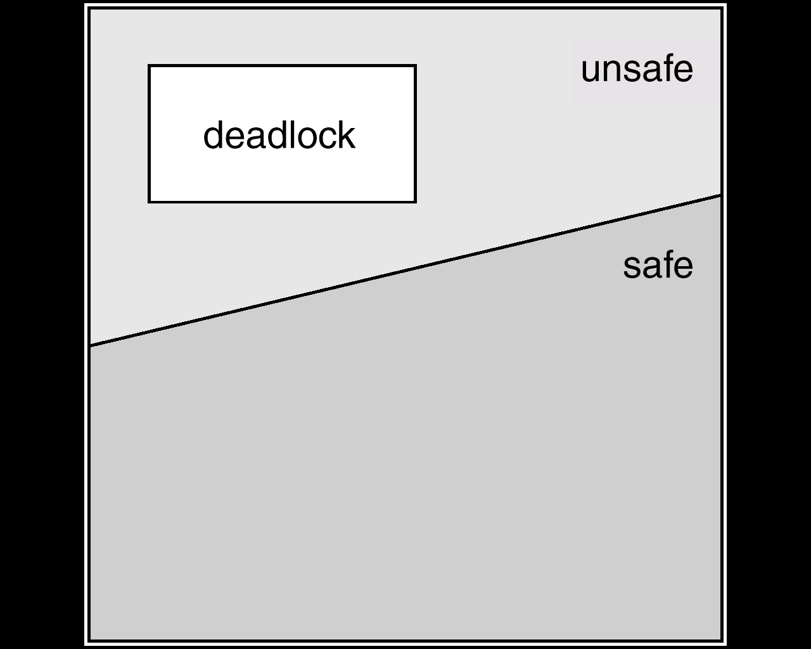
Safe State (3)
unsafe State
  no safe sequence exists
  may lead to a deadlock (not must)

Slide 27
Basic Facts
If a system is in safe state ⇒ no deadlocks
If a system is in unsafe state ⇒ possibility of deadlock
Avoidance ⇒ ensure that a system will never enter an unsafe state

Slide 28
An Example
    12 tape drivers in total
    maximum needs holds Available
    P₀ 10 5 3
    P₁ 4 2
    P₂ 9 2
2
3
A safe sequence: (P₁, P₀, P₂)
If one more is allocated to P₂,
  ⇒ unsafe ⇒ may (not must) deadlock

Slide 29
Avoidance algorithms
Single instance of a resource type
  Use a resource-allocation graph
Multiple instances of a resource type
  Use the banker’s algorithm

Slide 30
Resource-Allocation Graph Algorithm
Use a variant of resource-allocation graph
  claim edge P_{i} → R_{j} indicated that process P_{j} may request resource R_{j}; represented by a dashed line.
  Claim edge converts to request edge when a process requests a resource.
  When a resource is released by a process, assignment edge reconverts to a claim edge.
Resources must be claimed a priori in the system. Grant a request only if no cycle created.
Check for safety using a cycle-detection algorithm, O(n²).

Slide 31
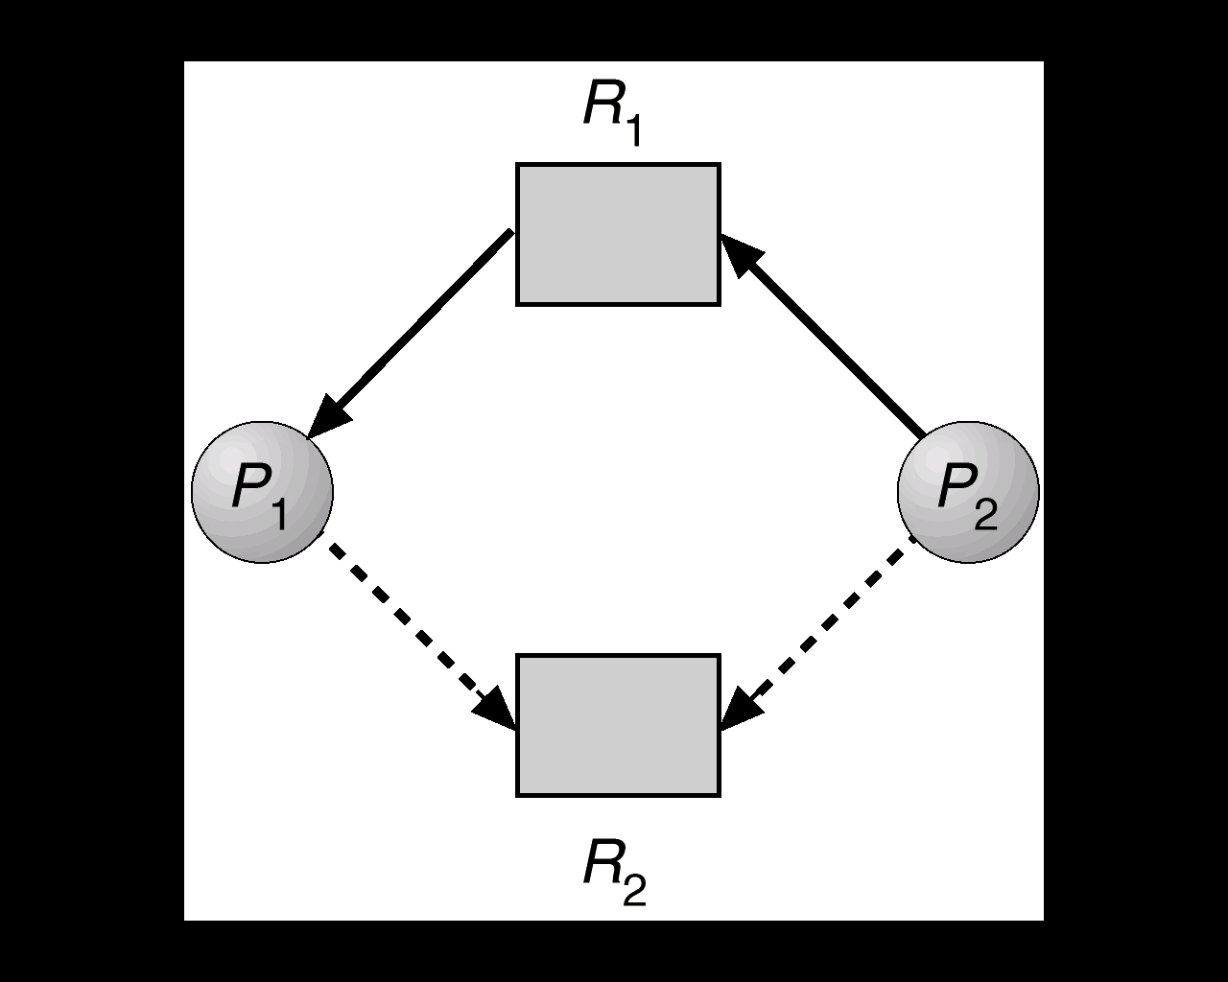
Resource-Allocation Graph for Deadlock Avoidance
assignment edge
request edge
claim edge
claim edge

Slide 32
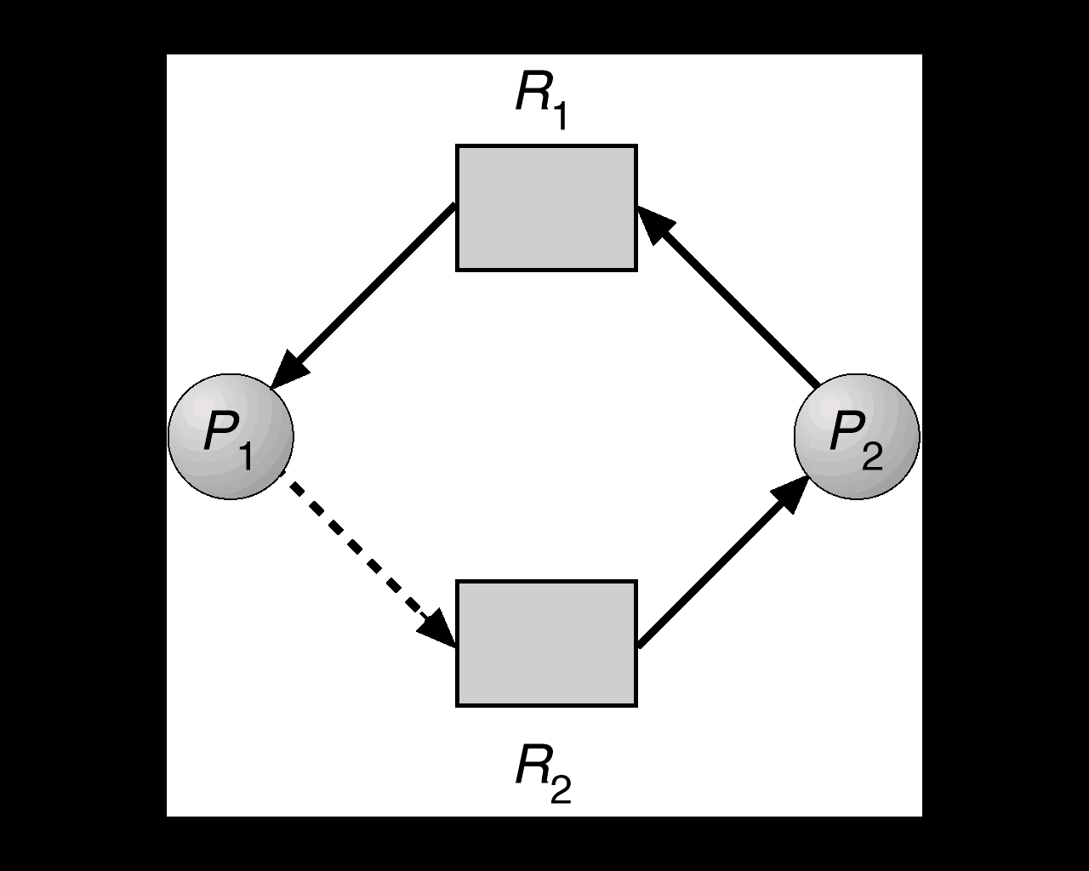
Unsafe State In Resource-Allocation Graph

Slide 33
Banker’s Algorithm
Multiple instances
Each process must a priori claim maximum use
When a process requests a resource it may have to wait
When a process gets all its resources it must return them in a finite amount of time

Slide 34
Data Structures for the Banker’s Algorithm
n = # of processes, and m = # of resources types
Available: vector of length m. If available [j] = k, there are k instances of resource type R_{j} available.
Max: n × m matrix. If Max [i,j] = k, then process P_{i} may request at most k instances of resource type R_{j}.
Allocation: n × m matrix. If Allocation[i,j] = k then P_{i} is currently allocated k instances of R_{j.}
Need: n × m matrix. If Need[i,j] = k, then P_{i} may need k more instances of R_{j} to complete its task.
Need[i,j] = Max[i,j] – Allocation[i,j]

Slide 35
Safety Algorithm: O(mn²)
1. Let Work and Finish be vectors of length m and n, respectively. Initialize:
      Work = Available
      Finish [i] = false for i = 1,2,3, …, n.
2. Find an i such that both:
  (a) Finish [i] = false
  (b) Need_{i} ≤ Work
  If no such i exists, go to step 4.
3. Work = Work + Allocation_{i}
Finish[i] = true
go to step 2.
4. If Finish [i] == true for all i, then the system is in a safe state.

Slide 36
Resource-Request Algorithm for Process P_{i}
Request_{i} = request vector for process P_{i}.
If Request_{i} [j] = k then process P_{i} wants k instances of resource type R_{j.}
If Request_{i} ≤ Need_{i} go to step 2. Otherwise, raise error condition, since process has exceeded its maximum claim.
If Request_{i} ≤ Available, go to step 3. Otherwise P_{i} must wait, since resources are not available.
Pretend to allocate requested resources to P_{i} by modifying the state as follows:
      Available = Available - Request_{i};
      Allocation_{i} = Allocation_{i} + Request_{i};
      Need_{i} = Need_{i} – Request_{i.}
If safe ⇒ the resources are allocated to P_{i}.
If unsafe ⇒ P_{i} must wait, and the old resource-allocation state is restored.

Slide 37
Example of Banker’s Algorithm
5 processes P₀ through P₄; 3 resource types A
(10 instances), B(5 instances), and C(7 instances).
Snapshot at time T₀:
Allocation Max Available Need
ABC ABC ABC (3 3 2) ABC
P0 0 1 0 7 5 3 7 4 3
P1 2 0 0 3 2 2 1 2 2
P2 3 0 2 9 0 2 6 0 0
P3 2 1 1 2 2 2 0 1 1
P4 0 0 2 4 3 3 4 3 1
<P₁, P₃, P₄, P₂, P₀> satisfies safety criteria
10 4 7
7 4 5
5 3 2
7 4 3

Slide 38
Example P₁ Request (1,0,2)
Check that Request ≤ Available
  (that is, (1,0,2) ≤ (3,3,2) ⇒ True)
Allocation Need Available Max
A B C A B C 3,3,2 P₀ 0 1 0 7 4 3 7 5 3
P₁ 2 0 0 1 2 2 3 2 2
P₂ 3 0 2 6 0 0 9 0 2
P₃ 2 1 1 0 1 1 2 2 2
P₄ 0 0 2 4 3 1 4 3 3
Executing safety algorithm shows that sequence <P₁, P₃, P₄, P₀, P₂> satisfies safety requirement.
Can request for (3,3,0) by P₄ be granted?
2 3 0
3 0 2
0 2 0

Slide 39
Example P₀ Request (0,2,0)
After P₁ Request (1,0,2)
Allocation Max Available Need
ABC ABC ABC
P0 7 4 3 7 3 3
P1 3 0 2 3 2 2 0 2 0
P2 3 0 2 9 0 2 6 0 0
P3 2 1 1 2 2 2 0 1 1
P4 0 0 2 4 3 3 4 3 1
no safe sequence ⇒ unsafe
⇒ P₀ must wait and the old state is restored.
2 3 0
2 1 0
0 1 0
7 1 3
0 3 0

Slide 40
Deadlock Detection
Allow system to enter deadlock state
  Detect whether deadlocks occur
  if so, recover from the deadlock
Detection algorithms
Recovery scheme
Disadvantages of detection/recovery scheme
  run-time costs of maintaining necessary information and the detection algorithm
  potential losses inherent in recovery

Slide 41
Single Instance of Each Resource Type
Maintain wait-for graph
  Nodes are processes
  P_{i} → P_{j} if P_{i} is waiting for P_{j}
Periodically invoke an algorithm that searches for a cycle in the graph.
An algorithm to detect a cycle in a graph requires an order of n² operations, where n is the number of vertices in the graph.

Slide 42
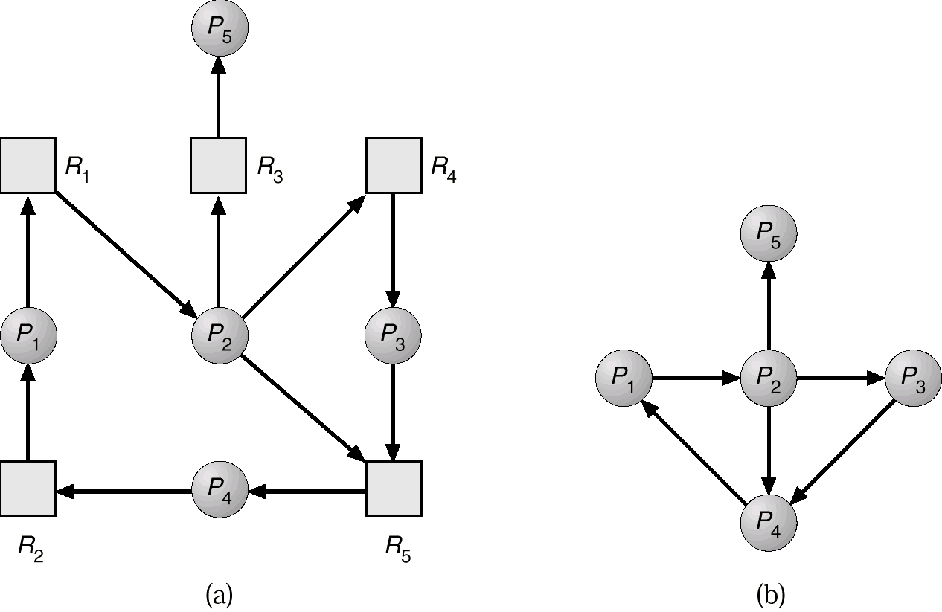
Resource-Allocation Graph and Wait-for Graph
Resource-Allocation Graph
Corresponding wait-for graph

Slide 43
Several Instances of a Resource Type
Available: A vector of length m indicates the number of available resources of each type.
Allocation: An n × m matrix defines the number of resources of each type currently allocated to each process.
Request: An n × m matrix indicates the current request of each process. If Request [i,j] = k, then process P_{i} is requesting k more instances of resource type R_{j}.

Slide 44
Detection Algorithm (1)
Let Work and Finish be vectors of length m and n, respectively. Initialize:
  (a) Work = Available
  (b) For i = 1,2, …, n, if Allocation_{i} ≠ 0, then
  Finish[i] = false; otherwise, Finish[i] = true.
Find an index i such that both:
  (a) Finish[i] == false
  (b) Request_{i} ≤ Work
  If no such i exists, go to step 4.

Slide 45
Detection Algorithm (2)
3. Work = Work + Allocation_{i}
Finish[i] = true
go to step 2.
4. If Finish[i] == false, for some i, 1 ≤ i ≤ n, then the system is in deadlock state. Moreover, if Finish[i] == false, then P_{i} is deadlocked.
Assume P_{i} will require no more
resources. If incorrect, a deadlock
may occur later.
Algorithm requires an order of O(m × n²) operations to detect whether the system is in deadlocked state.

Slide 46
Example of Detection Algorithm
P₀, P₁, P₂, P₃, P₄,
A(7 instances), B (2 instances), and C (6 instances)
Snapshot at time T₀:
Allocation Request Available
A B C A B C 0 0 0
P₀ 0 1 0 0 0 0
P₁ 2 0 0 2 0 2
P₂ 3 0 3 0 0 0
P₃ 2 1 1 1 0 0
P₄ 0 0 2 0 0 2
Sequence <P₀, P₂, P₃, P₁, P₄> will result in Finish[i] = true for all i.

Slide 47
Example (Cont’d)
P₂ requests an additional instance of type C, (0 0 1).
Allocation Request Available
A B C A B C 0 0 0
P₀ 0 1 0 0 0 0
P₁ 2 0 0 2 0 2
P₂ 3 0 3 0 0 1
P₃ 2 1 1 1 0 0
P₄ 0 0 2 0 0 2
State of system
  Can reclaim resources held by process P₀,
  but insufficient resources to fulfill other processes’ requests.
    Deadlock exists, consisting of processes P₁, P₂, P₃, and P₄.
0 1 0

Slide 48
Detection-Algorithm Usage
When, and how often, to invoke depends on:
  How often a deadlock is likely to occur?
  How many processes will need to be rolled back?
    one for each disjoint cycle
If the detection algorithm is invoked arbitrarily, there may be many cycles in the resource graph and so we would not be able to tell which of the many deadlocked processes “caused” the deadlock.

Slide 49
Recovery from Deadlock: Process Termination
Abort all deadlocked processes
Abort one process at a time until the deadlock cycle is eliminated
In which order should we choose to abort?
  Priority of the process
  How long process has computed, and how much longer to completion
  Resources the process has used
  Resources process needs to complete
  How many processes will need to be terminated
  Is process interactive or batch?

Slide 50
Recovery from Deadlock: Resource Preemption (1)
Resource preemption
  successively preempt some resources and give them to other processes until the deadlock cycle is broken.
Three issues should be considered
  selecting a victim
    How to minimize the cost?
      what types and how many resources are held
      how much time has run
      how much time to end, ...

Slide 51
Recovery from Deadlock: Resource Preemption (3)
  rollback
    rollback a process to a safe state, and
    restart it (some resources are released)
    Two implementations
      totally rollback: simple but expensive
      as far as necessary
      (OS should maintain “checkpoints”)
    checkpoint: a recording of the state of a
    process to allow rollback
  starvation
    not always select the same process for
    preemption

Slide 52
Combined Approach to Deadlock Handling
Combine the three basic approaches
  prevention
  avoidance
  detection
allowing the use of the optimal approach for each of resources in the system.
Partition resources into hierarchically ordered classes
Use most appropriate technique for handling deadlocks within each class
M. J. Bach, The Design of the UNIX Operating System, Prentice Hall (1987).

Slide 53
Example of a Combined Approach
Resources are partitioned into four classes (in order)
  1. internal resource: resources used by OS (e.g., PCB)
    resource-ordering (avoid running-time choices between pending requests)
  2. central memory: memory used by user jobs
    prevention through preemption
  3. job resource: files, tape drivers
    avoidance (claim maximum request first)
  4. swappable space: space on backing store
    pre-allocation (prevention from hold-and-wait)
Ordinary users cannot create a process that would occupy the last remaining slot in PCB.

