Slide 1
Chapter 8
Memory Management

Slide 2
Outline
Background
Swapping
Contiguous Allocation
Segmentation
Paging
Structure of the Page Table
Example: The Intel 32 and 64-bit Architectures
Example: ARM Architecture

Slide 3
Objectives
To provide a detailed description of various ways of organizing memory hardware
To discuss various memory-management techniques, including paging and segmentation
To provide a detailed description of the Intel Pentium, which supports both pure segmentation and segmentation with paging

Slide 4
Background
Input queue – collection of processes on the disk that are waiting to be brought into memory to run the program.
User programs go through several steps before being run.
Main memory and registers are only storage CPU can access directly
Register access in one CPU clock (or less); Main memory can take many cycles
Cache sits between main memory and CPU registers
Protection of memory required to ensure correct operation

Slide 5
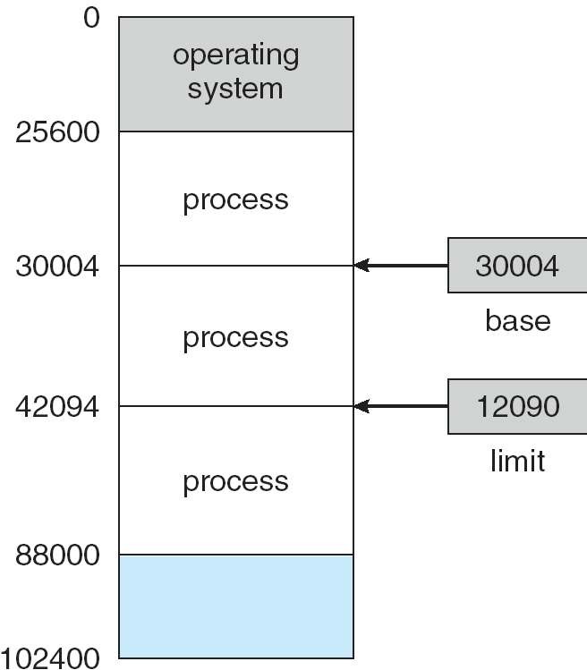
Base and Limit Registers
A pair of base and limit registers define the logical address space

Slide 6
Binding of Instructions and Data to Memory
Address binding of instructions and data to memory addresses can happen at three different stages.
Compile time: If memory location known a priori, absolute code can be generated; must recompile code if starting location changes.
Load time: Must generate relocatable code if memory location is not known at compile time.
Execution time: Binding delayed until run time if the process can be moved during its execution from one memory segment to another. Need hardware support for address maps (e.g., base and limit registers).

Slide 7
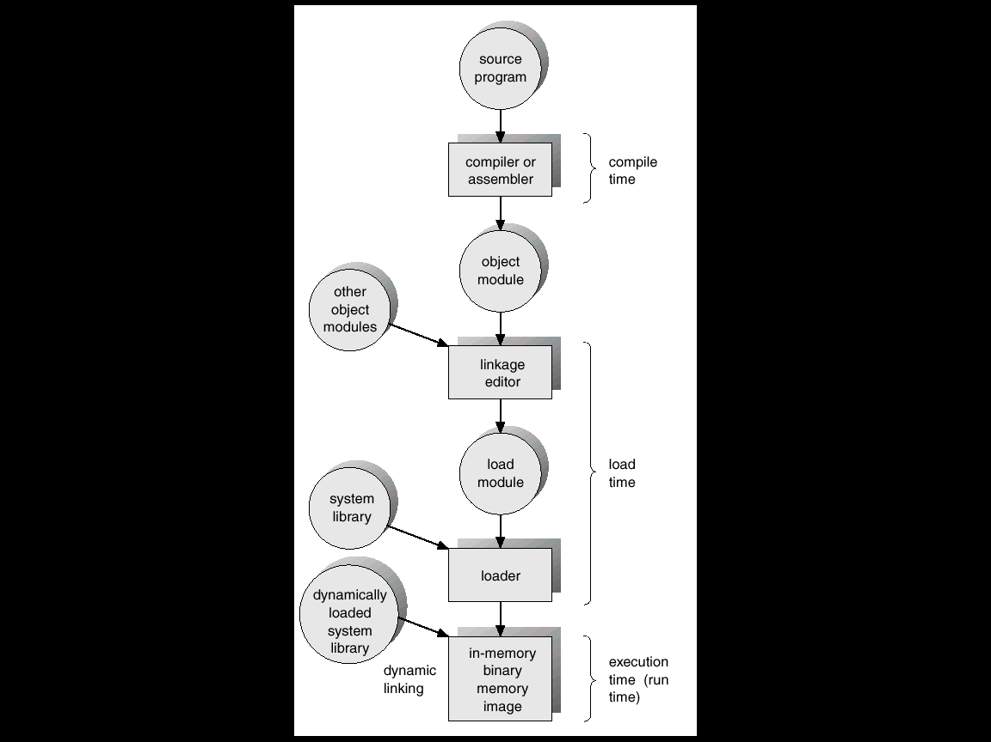
Multistep Processing of a User Program

Slide 8
Logical vs. Physical Address Space
The concept of a logical address space that is bound to a separate physical address space is central to proper memory management.
  Logical address – generated by the CPU; also referred to as virtual address.
  Physical address – address seen by the memory unit.
Logical and physical addresses are the same in compile-time and load-time address-binding schemes; logical (virtual) and physical addresses differ in execution-time address-binding scheme.
compiler: symbol --> relocatable address
loader: relocatable address -> absolute address

Slide 9
Memory-Management Unit (MMU)
Hardware device that maps virtual to physical address.
In MMU scheme, the value in the relocation register is added to every address generated by a user process at the time it is sent to memory.
The user program deals with logical addresses; it never sees the real physical addresses.

Slide 10
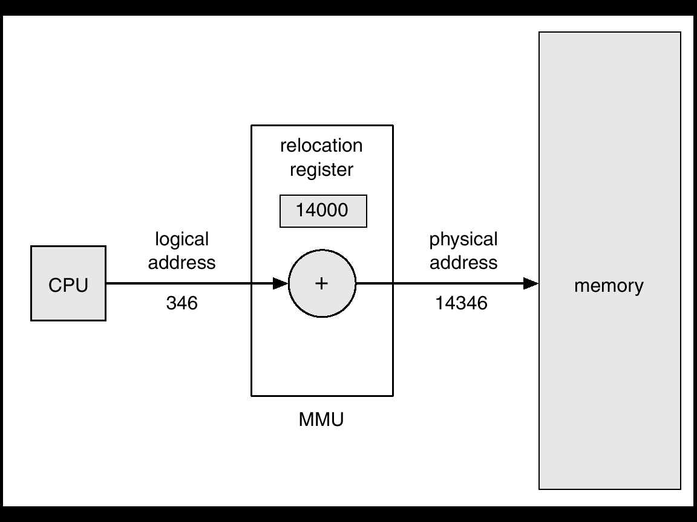
Dynamic Relocation using a Relocation Register

Slide 11
Dynamic Loading
Routine is not loaded until it is called.
Better memory-space utilization; unused routine is never loaded.
Useful when large amounts of code are needed to handle infrequently occurring cases.
No special support from OS is required implemented through program design.

Slide 12
Dynamic Linking
Linking postponed until execution time.
  used with system libraries (language subroutines)
Small piece of code, stub, used to locate the appropriate memory-resident library routine.
Stub replaces itself with the address of the routine, and executes the routine.
  First time a stub is performed
      1. Locate or load the routine
      2. Replace itself with address of the routine
OS needed to check if routine is in processes’ memory address.
Dynamic linking is particularly useful for libraries.
  One copy of library code
solve protection if in another space

Slide 13
Dynamic Linking
Shared libraries:
  A library may be replaced by a new version, and all programs that reference the library will automatically use the new version.
  Without dynamic linking, all such programs would need to be relinked to gain access to the new library. So that programs will not accidentally execute new, incompatible versions of libraries, version information is included in both the program and the library.
  Programs linked before the new library will continue using the older library.
Unlike dynamic loading, dynamic linking and shared libraries generally require help from the operating system.

Slide 14
Overlays
Keep in memory only those instructions and data that are needed at any given time.
Needed when process is larger than amount of memory allocated to it.
Implemented by user, no special support needed from OS, programming design of overlay structure is complex

Slide 15
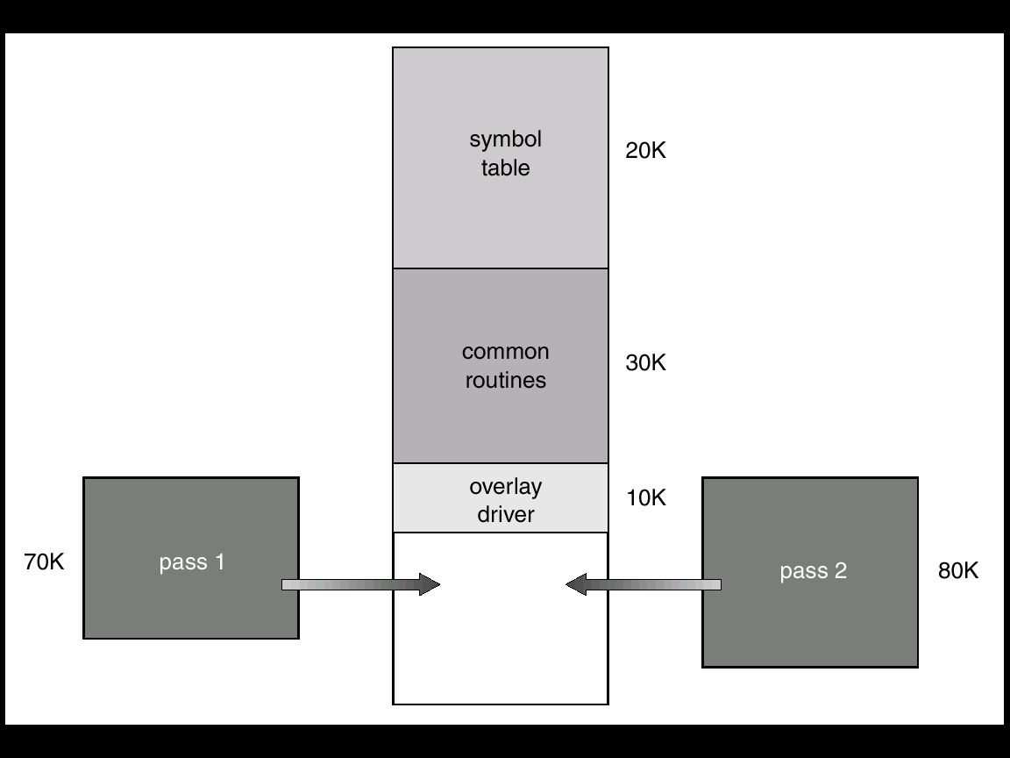
Overlays for a Two-Pass Assembler

Slide 16
Swapping (1)
A process can be swapped temporarily out of memory to a backing store, and then brought back into memory for continued execution.
Backing store – fast disk large enough to accommodate copies of all memory images for all users; must provide direct access to these memory images.
Roll out, roll in – swapping variant used for priority-based scheduling algorithms; lower-priority process is swapped out so higher-priority process can be loaded and executed.

Slide 17
Swapping (2)
Context-switch time is fairly high
Major part of swap time is transfer time; total transfer time is directly proportional to the amount of memory swapped.
Modified versions of swapping are found on many systems, i.e., UNIX, Linux, and Windows.
System maintains a ready queue of ready-to-run processes which have memory images on disk.
related to binding methods

Slide 18
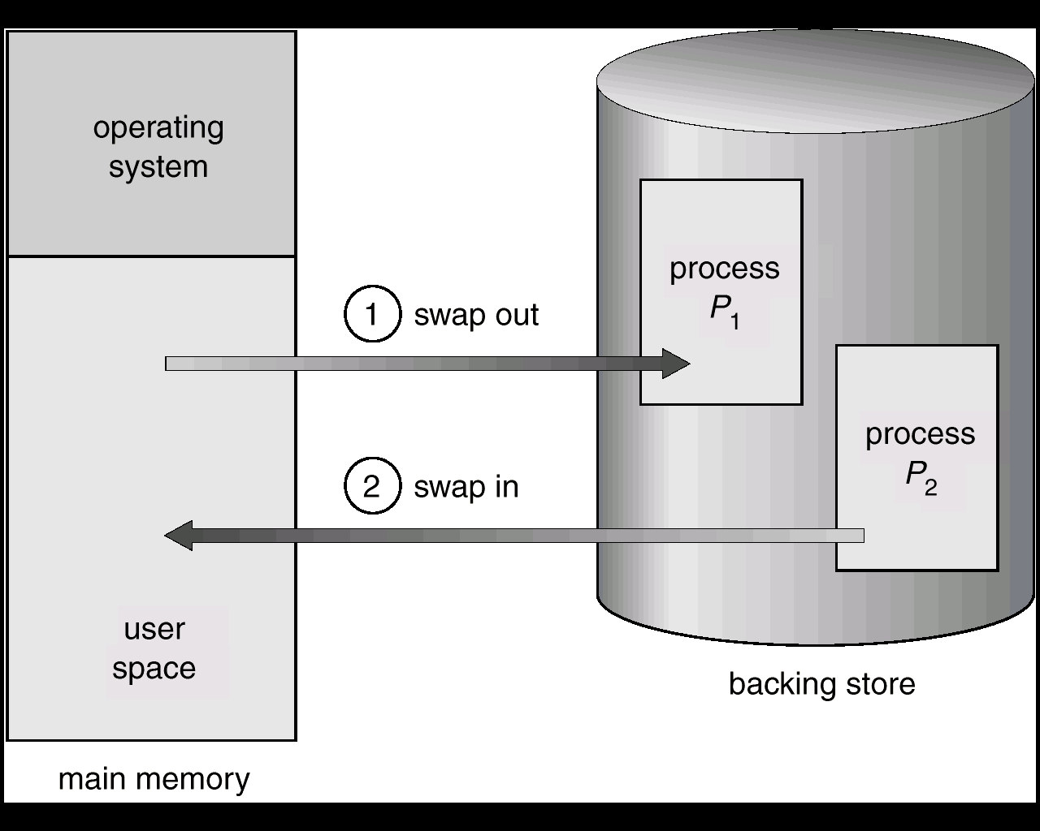
Schematic View of Swapping

Slide 19
Context Switch Time including Swapping
Context switch time can be very high
  if there is no free memory, the dispatcher swaps out a process currently in memory and swaps in the desired process. Then reloads registers and transfers control to the selected process.
100MB process swapping to hard disk with transfer rate of 50MB/sec
  Swap out time of 2s
  Plus swap in of same sized process
  Total context switch swapping component time of 4 seconds

Slide 20
Context Switch Time including Swapping
The major part of the swap time is transfer time, which
  can be reduced if the size of memory swapped is contracted – by knowing how much memory really being used
  System calls to inform the OS of its changing memory needs via request_memory() and release_memory()
Other constraints: if the I/O is asynchronously accessing the user memory for I/O buffers, then the process cannot be swapped

Slide 21
Context Switch Time including Swapping
  Pending I/O – can’t swap out as I/O would occur to wrong process
  Or always transfer I/O to kernel space, then to I/O device
    Known as double buffering, adds overhead
Standard swapping not used in modern operating systems
  swapping is normally disabled but will start if the amount of free memory (unused memory available for the OS or processes to use) falls below a threshold amount.
Another variation: swapping portions of processes

Slide 22
Swapping on Mobile Systems
Mobile systems typically do not support swapping
  no hard disk, only flash memory
  small amount of space
  limited number of writes that flash memory can tolerate
  poor throughput between main memory and flash memory
When free memory falls below a certain threshold,
  iOS asks apps to voluntarily relinquish allocated memory
  Read-only data (codes) thrown out and reloaded from flash if needed; Data that have been modified are never removed
  Any applications that fail to free up sufficient memory may be terminated

Slide 23
Swapping on Mobile Systems
Android does not support swapping and adopts a strategy similar to that used by iOS.
  It may terminate a process if insufficient free memory is available.
  However, before terminating a process, Android writes its application state to flash memory so that it can be quickly restarted.
  Because of these restrictions, developers for mobile systems must carefully allocate and release memory to ensure that their applications do not use too much memory or suffer from memory leaks.
  Note that both iOS and Android support paging, so they do have memory-management abilities.

Slide 24
Contiguous Memory Allocation (1)
relocation register + limit register
MMU:
OS
limit
relocation
register
register
relocation
register
logical
address
yes
physical
address
CPU
<
no
limit
register
trap; address error
memory

Slide 25
Contiguous Allocation (2)
Multiple-partition allocation
  Hole – block of available memory; holes of various size are scattered throughout memory
  When a process arrives, it is allocated memory from a hole large enough to accommodate it
  Operating system maintains information about:
  a) allocated partitions b) free partitions (hole)
OS
OS
OS
OS
process 5
process 5
process 5
process 5
process 9
process 9
process 8
process 10
process 2
process 2
process 2
process 2

Slide 26
Multiple-Partition Allocation
multiple contiguous variable partition allocation
allocation problem: search a hole big enough for a request
      first-fit
      best-fit
      worst-fit
  By simulation, FF and BF are better than WF.
  FF is faster than BF.

Slide 27
An Scheduling Example
job queue
0
400K
2560 K
OS
process memory time
P1 600K 10
P2 1000K 5
P3 300K 20
P4 700K 8
P5 500K 15
2160 K

Slide 28
Memory Allocation and
Long-term Scheduling (FCFS)
0
0
0
OS
OS
OS
400
400
400
P1
P1
P5
P2 terminates
P1 terminates
900
1000
1000
1000
P2
P4
P4
allocate P4
allocate P5
1700
1700
2000
2000
2000
P3
P3
P3
2300
2300
2300
2560
2560
2560
external fragmentation

Slide 29
Fragmentation
internal fragmentation: memory is internal to a partition, but is not being used.
external fragmentation: free memory is enough but not contiguous.
Compaction: shuffle the memory contents to make all free memory together
  a solution to external fragmentation problem
  Selecting an optimal compaction is difficult.
  Swapping can also be combined with compaction
    compact if necessary, and then roll in a process (into a different location)

Slide 30
Compaction
0
0
OS
OS
400
400
P5
P5
900
100K
900
1000
P4
P4
Compact
1600
P3
1700
300K
1900
2000
P3
660K
2300
260K
2560
2560

Slide 31
Comparison of some Different Ways to Compact Memory
0
0
0
0
OS
OS
OS
OS
300
300
300
300
P1
P1
P1
P1
500
500
500
500
P2
P2
P2
P2
600
600
600
600
400K
P3
P4
1000
1000
P4
1000
1000
900K
P3
P3
1200
1200
1200
1200
300K
1500
1500
900K
1500
900K
1500
P4
P4
1900
1900
1900
1900
P3
2100
200K
2100
2100
2100
original allocation moved 600K moved 400K moved 200K

Slide 32
Paging
Logical address space of a process can be noncontiguous
Divide physical memory into fixed-sized blocks called frames (size is power of 2, between 512 bytes and 8192 bytes).
Divide logical memory into blocks of same size called pages.
Keep track of all free frames.
To run a program of size n pages, need to find n free frames and load program.
Set up a page table to translate logical to physical addresses.
Internal fragmentation

Slide 33
Address Translation Scheme
Address generated by CPU is divided into:
  Page number (p) – used as an index into a page table which contains base address of each page in physical memory.
  Page offset (d) – combined with base address to define the physical memory address that is sent to the memory unit.
  logical address:
  page number (p) + page offset (d)
J:
  No external fragmentation
  shared pages

Slide 34
Paging model of logical and physical memory
frame number
page table
page 0
0
0
1
page 1
1
4
1
page 0
page 2
2
3
2
page 3
3
7
3
page 2
logical memory
4
page 1
5
6
7
page 3
Example: page size = 1 K
(2, 13) ----------------> (3*1K + 13)
----------------> 0110000000000 + 0000001101
----------------> 0110000001101

Slide 35
Paging Hardware for Address Translation
(dynamic relocation)
logical
address
physical
address
CPU
page table
p d
f d
physical
memory
p
f

Slide 36
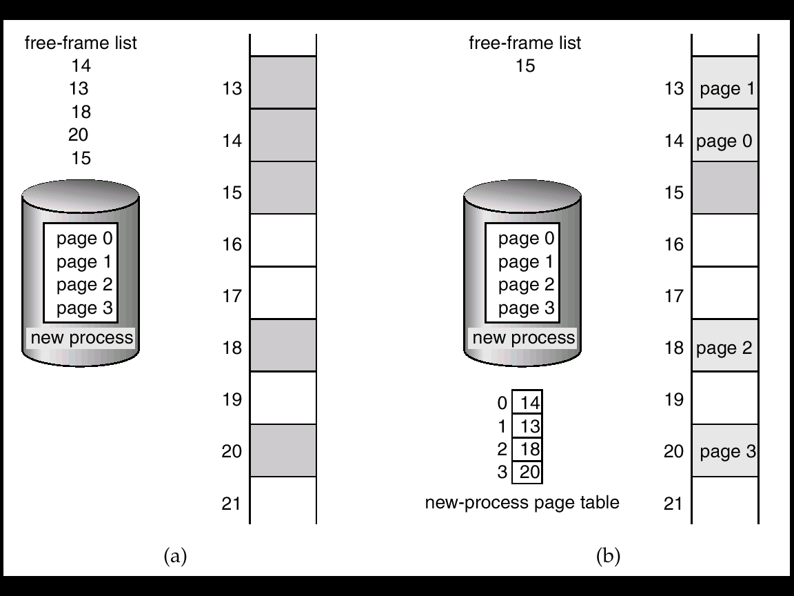
Free Frames
Before allocation
After allocation

Slide 37
Discussions
☺No external fragmentation
☹Internal fragmentation: 1/2 page in average
    suggesting a smaller page size in the past
Page sizes have grown over time (2~4 Kbyte today)
  memory, process, data sets have become larger
  better I/O performance
  page table is smaller
Frame table: an entry for each physical frame
    free or allocated
    (if allocated) to which page of which process

Slide 38
Implementation of Page Table
Page table is kept in main memory
Page-table base register (PTBR) points to the page table.
Page-table length register (PRLR) indicates size of the page table.
In this scheme every data/instruction access requires two memory accesses. One for the page table and one for the data/instruction.
The two memory access problem can be solved by the use of a special fast-lookup hardware cache called associative memory or translation look-aside buffers (TLBs)
Some TLBs store address-space identifiers (ASIDs) in each TLB entry – uniquely identifies each process to provide address-space protection for that process

Slide 39
Associative Memory, Translation Look-aside Buffer
Associative memory – parallel search
Address translation (p, d)
  If p is in associative register, get frame # out
  Otherwise get frame # from page table in memory
  hit ratio, 16-512 registers have a hit ratio about 80-98%.
Address-space identifiers (ASIDs): uniquely identifies each process for protection.
  TLB must flushed to ensure next process does not use the wrong info if does not support separate ASIDs.
Page #
Frame #

Slide 40
Paging Hardware with TLB
logical
address
CPU
p d
page frame
no. no.
recently accessed pages
p
f
physical
address
physical
memory
f d
TLB
p
f
TLB miss
page table

Slide 41
Effective Access Time
Associative Lookup = ε time unit
Assume memory cycle time is 1 microsecond
Hit ratio – percentage of times that a page number is found in the associative registers.
Hit ratio = α
Effective Access Time (EAT)
EAT = (1 + ε) α + (2 + ε)(1 – α)
= 2 + ε – α

Slide 42
Memory Protection
Memory protection implemented by associating protection bit with each frame.
Valid-invalid bit attached to each entry in the page table:
  “valid” indicates that the associated page is in the process’ logical address space, and is thus a legal page.
  “invalid” indicates that the page is not in the process’ logical address space.

Slide 43
An example
0
1
frame No.
2
page 0
00000
0
2
v
3
page 1
page 0
1
3
v
4
page 2
page 1
2
4
v
5
page 2
3
7
v
6
4
8
v
page 3
7
page 3
5
9
v
page 4
i
8
page 4
10468
6
0
12287
page 5
7
0
i
9
page 5
page table
12290
valid but illegal
logical memory
n

Slide 44
Shared Pages
Another advantage of paging is the possibility of sharing common code, which must be reentrant.
reentrant code (pure code): It never change during execution.
Only one copy of the shared code needs to be kept in physical memory.
Two (several) virtual addresses are mapped to one physical address.
☹ system using inverted page table is difficult to implement shared pages (memory).
One entry per physical frame

Slide 45
Shared Pages
ed 1
0
3
0
1
4
ed 2
1
data 1
2
6
ed 3
3
1
2
data 3
data 1
ed 1
0
3
3
ed 1
page table
for P1
1
4
process P1
ed 2
4
ed 2
2
6
ed 3
3
7
5
ed 1
0
3
data 3
page table
6
ed 3
1
4
process P3
for P3
ed 2
7
data 2
2
6
ed 3
3
2
8
data 2
page table
process P2
for P2

Slide 46
Page Table Structure
Hierarchical Paging
Hashed Page Tables
Inverted Page Tables
Issues: Page tables can not be swapped out to disk, and one page table for one process.

Slide 47
Hierarchical Page Tables
Break up the logical address space into multiple page tables.
A simple technique is a two-level page table.

Slide 48
Multilevel Paging
Two-level paging: the page table itself is also paged.
SPARC: 2-level, Motorola 68030: 3-level
page number page offset
logical address
p1 p2 d
p1
.
.
p2
.
d
outer-page table
page of
page table
desired page

Slide 49
Two-Level Paging
page 0
516
page 1
.
.
.
.
.
.
0
123
page 123
.
.
.
1
1
2
708
page 516
.
.
.
.
.
.
outer-page table
page 708
.
.
.
929
.
.
.
page 900
Example: (1K page size)
(1, 2, 121)
-> (708*1K +121)
.
.
.
900
page 929
.
.
.
page table in memory
process in memory

Slide 50
Hashed Page Tables
Common approach for handling address spaces > 32 bits.
The virtual page number is hashed into a page table. This page table contains a chain of elements hashing to the same location.
Virtual page numbers are compared in this chain searching for a match. If a match is found, the corresponding physical frame is extracted.

Slide 51
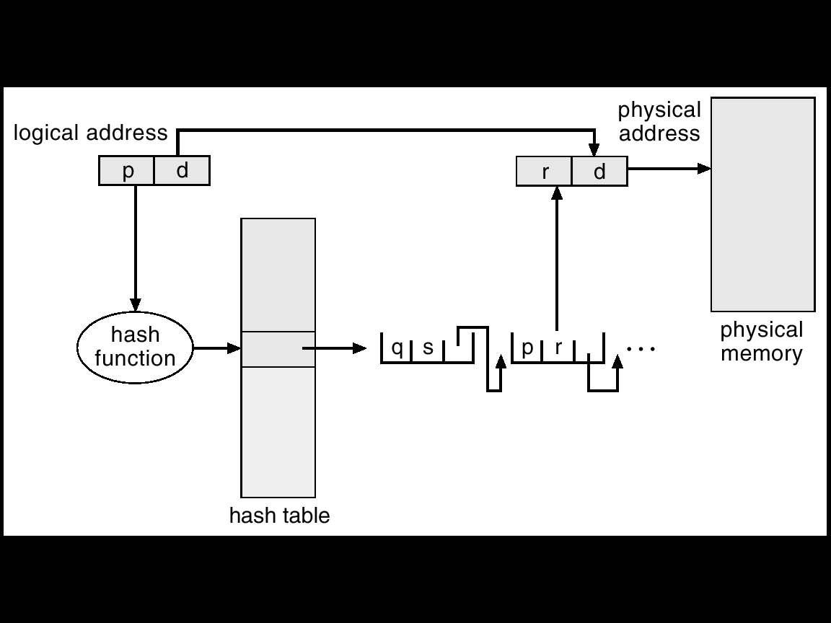
Hashed Page Table
Clustered page table:
Several pages in one entry

Slide 52
Inverted Page Table
Each process has a page table, which may consist of millions entries. This may consumes large amounts of physical memory.
Solution: inverted page table
  one entry for each frame, storing the virtual address of the page stored in it.
    (process-id, page number)
  A virtual address:
    (process-id, page number, offset)
  J: only one table is used
  L: table searching time is larger
    Solution: hash + associative register (cache)

Slide 53
Inverted Page Table
logical
address
physical
address
CPU
pid p d
i d
physical
memory
i
pid p
search
inverted page table

Slide 54
Segmentation
Memory-management scheme that supports user view of memory.
A program is a collection of segments. A segment is a logical unit such as:
main program,
procedure,
function,
method,
object,
local variables, global variables,
common block,
stack,
symbol table, arrays

Slide 55
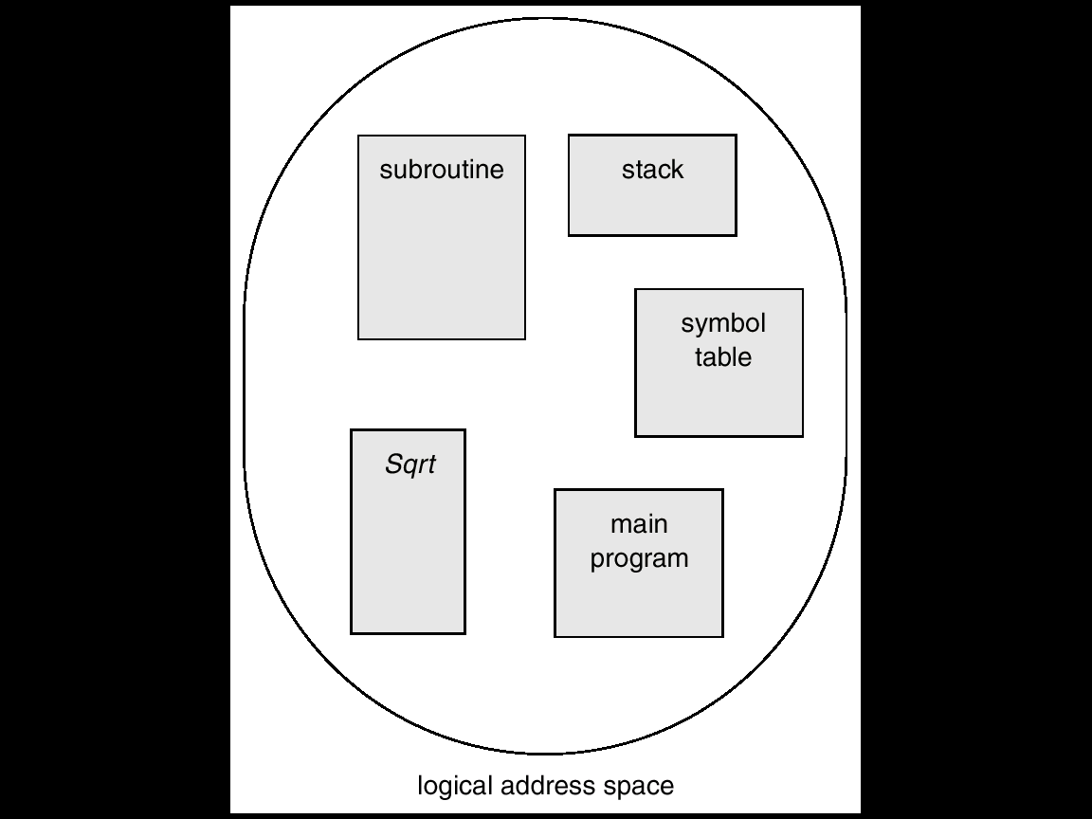
User’s View of a Program

Slide 56
Logical View of Segmentation
1
1
4
2
3
4
2
3
user space
physical memory space

Slide 57
Segmentation Architecture (1)
Logical address consists of a two tuple:
<segment-number, offset>
Segment table – maps two-dimensional physical addresses; each table entry has:
  base – contains the starting physical address where the segments reside in memory.
  limit – specifies the length of the segment.
Segment-table base register (STBR) points to the segment table’s location in memory.
Segment-table length register (STLR) indicates number of segments used by a program;
segment number s is legal if s < STLR.

Slide 58
Segmentation Architecture (2)
Relocation
  dynamic
  by segment table
Sharing
  shared segments
  same segment number
Allocation
  first fit/best fit
  external fragmentation

Slide 59
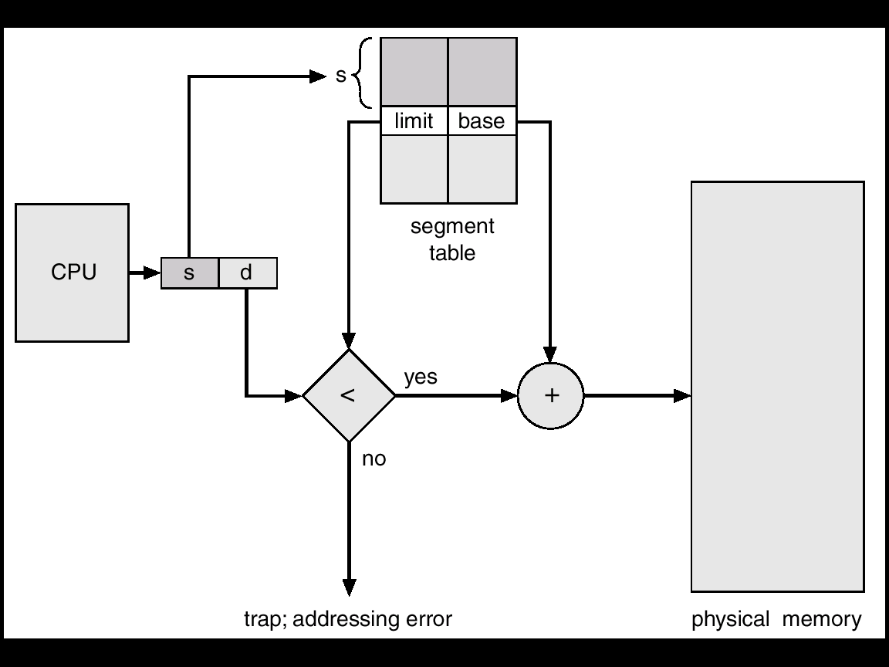
Segmentation Hardware

Slide 60
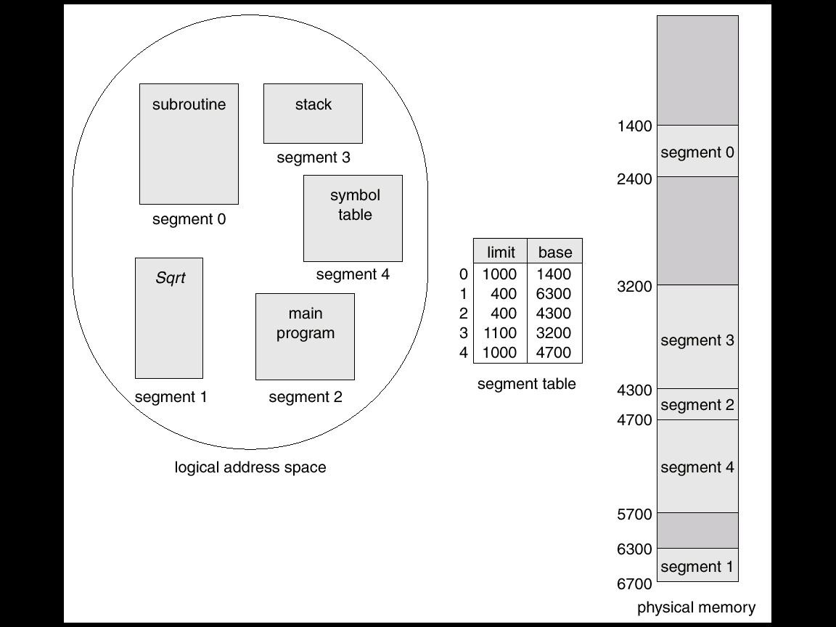
Example of Segmentation

Slide 61
Oracle SPARC Solaris
Solaris running on the SPARC CPU is a fully 64-bit OS and as such has to solve the problem of virtual memory without using up all of its physical memory by keeping multiple levels of page tables.
Efficiency: using multiple (two) hashed page tables
  One kernel and one for all user processes
  Each maps memory addresses from virtual to physical memory
  Each entry represents a contiguous area of mapped virtual memory,
    More efficient than having a separate hash-table entry for each page
  Each entry has base address and span (indicating the number of pages the entry represents)

Slide 62
Oracle SPARC Solaris
TLB holds translation table entries (TTEs) for fast hardware lookups
  A cache of TTEs reside in a translation storage buffer (TSB)
    Includes an entry per recently accessed page
Virtual address reference causes TLB search
  If miss, hardware walks the in-memory TSB looking for the TTE corresponding to the address
    If match found, the CPU copies the TSB entry into the TLB and translation completes
    If no match found, kernel interrupted to search the hash table
    The kernel then creates a TTE from the appropriate hash table and stores it in the TSB, Interrupt handler returns control to the MMU, which completes the address translation.

Slide 63
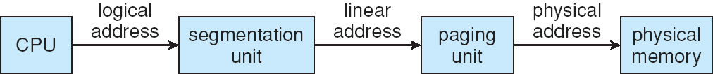
The Intel Pentium: IA-32
Supports both segmentation and segmentation with paging
CPU generates logical address
  Given to segmentation unit
    produces linear addresses
  Linear address given to paging unit
    generates physical address in main memory
    Segmentation and paging units form equivalent of MMU

Slide 64
Intel Pentium Segmentation (1)
max # of segments per process = 16K = 2¹⁴
size of a segment ≤ 4GB
Logical-address space is divided into 2 partitions:
1st: 8K segments (private), local descriptor table (LDT)
2nd: ≤ 8K segments (shared), global descriptor table (GDT)
Each entry in the LDT and GDT consists of an 8-byte segment
descriptor including base and limit info
Logical address is a pair (selector, offset),
selector is a 16-bit:
s
g
4 modes
Linux: user, kernel
2 modes only
p
13
segment #
1
GDT or LDT
2
protection info
Pentium CPU has 6 segment registers, allowing 6 segments addressed concurrently.
Another 6 8-byte registers to hold the corresponding descriptors from LDT or GDT

Slide 65
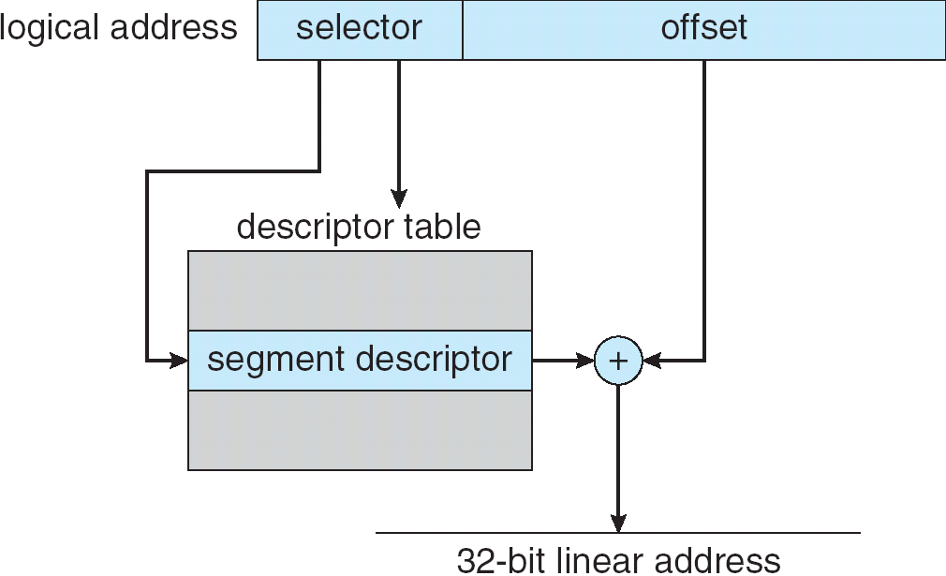
Intel Pentium Segmentation (2)
32-bit

Slide 66
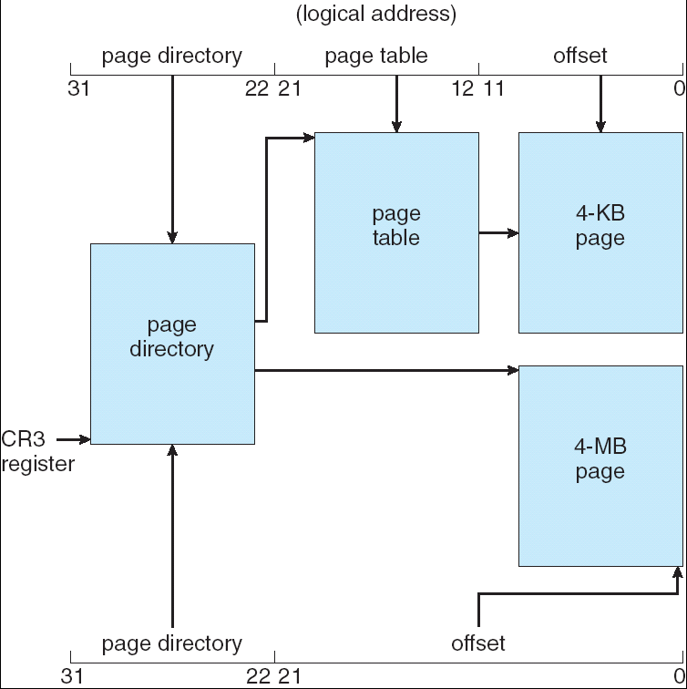
Pentium Paging Architecture
4kB
Page size:
4kB or 4 MB
outer
4MB

Slide 67
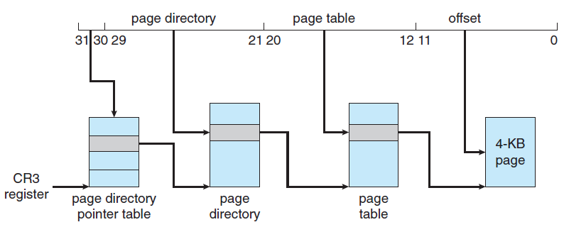
Pentium Paging Architecture
Intel adopted a page address extension (PAE), which allows 32-bit processors to access a physical address space larger than 4 GB.
Paging went from a two-level scheme (Page 66) to a three-level scheme, where the top two bits refer to a page directory pointer table.
12
Entry: 4B→8B

Slide 68
Pentium Paging Architecture
PAE also increased the page-directory and page-table entries from 32 to 64 bits in size, which allowed the base address of page tables and page frames to extend from 20 to 24 bits.
Combined with the 12-bit offset, adding PAE support to IA-32 increased the address space to 36 bits, up to 64 GB.
Both Linux and Intel Mac OS X support PAE.
However, 32-bit versions of Windows desktop operating systems still provide support for only 4 GB of physical memory, even if PAE is enabled.

Slide 69
x86-64
IA-64 (lntel’s Itanium) architecture, but the architecture was not widely adopted.
IA-32 instruction set → AMD’s x86-64 → Intel 64 ≡ x86-64.
  AMD developed a 64-bit architecture, AMD x86-64, based on extending the IA-32 instruction set. Historically, AMD had often developed chips based on Intel’s architecture, but now the roles were reversed as Intel adopted AMD’s x86-64 architecture.
x86-64: 64-bit address space yields 2⁶⁴ bytes of addressable memory — a number greater than 16 quintillion (or 16 exabytes 10¹⁸).

Slide 70
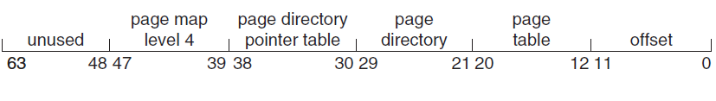
x86-64
In practice far fewer than 64 bits are used for address representation in current designs.
The x86-64 architecture currently provides a 48-bit virtual address with support for page sizes of 4 KB, 2 MB, or 1 GB using four levels of paging hierarchy.
Because this addressing scheme can use PAE, virtual addresses are 48 bits in size but support 52-bit physical addresses (4096 terabytes).

Slide 71
Example: ARM Architecture
Dominant mobile platform chip
Modern, energy efficient, 32-bit CPU
4 KB and 16 KB pages
1 MB and 16 MB pages (termed sections)
One-level paging for sections, two-level for smaller pages
Two levels of TLBs
  Outer level has two micro TLBs (one data, one instruction)
  Inner is single main TLB
  First outers are checked, on miss main is checked, and on miss page table walk performed by CPU

Slide 72
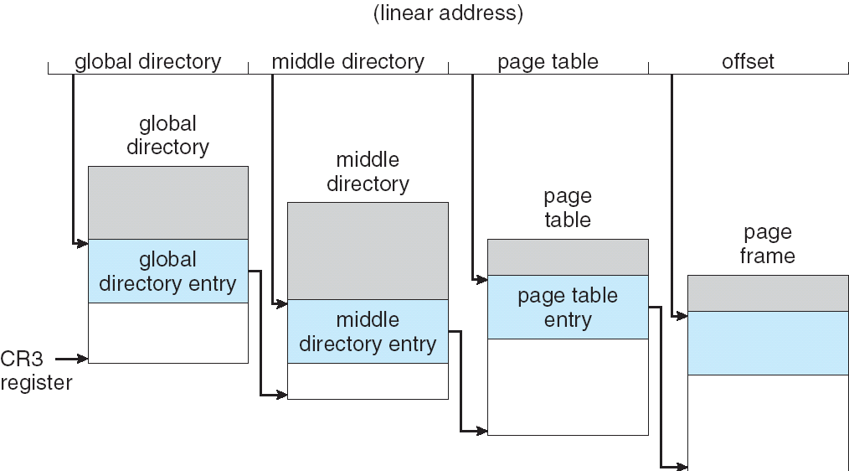
Three-level Paging in Linux
32-bit platform: middle directory is 0-bit for 32-bit Pentium

Slide 73
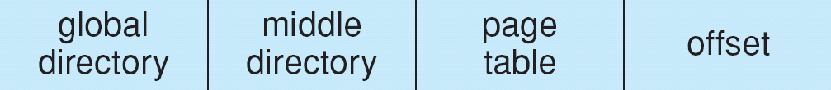
Linear Address in Linux
Linux is designated for 64-bit or 32-bit platform.
3-level paging strategy
The linear address is broken into 4 parts:

Slide 74
Protection and Sharing
Easy association of protection
  A segment represents a semantic portion and thus all entries should be used in the same way.
    Instruction section: read-only or execute-only
    put array in a segment: MMU automatically check each array index.
  Errors can be checked by hardware.
Easy to share a segment
  Problem: code segment refer to itself
  Solution
    all processes use the same segment number.
    indirect reference (offset)
e.g. P1 and P2 share the sqrt, one is S4 and another is
S17, how should the sqrt refer to itself?

