Slide 1
Chapter 9
Virtual Memory

Slide 2
Outline
Background
Demand Paging
Process Creation
Page Replacement
Allocation of Frames
Thrashing
Allocating Kernel Memory
Other Considerations
Operating System Examples

Slide 3
Background (1)
Virtual memory is a technique
  allows the execution of processes that may not completely in memory
  allows a large logical address space to be mapped onto a smaller physical memory
Virtual memory is commonly implemented by
  demand paging
  demand segmentation: more complicated due to variable sizes.

Slide 4
Background (2)
Benefits: (both system and user)
  To run a extremely large process
  To raise the degree of multiprogramming degree and thus increase CPU utilization
  To simplify programming tasks
    Free programmer from concerning over memory limitation
    Once system supporting virtual memory, overlays have disappeared
  Programs run faster (less I/O would be needed to load or swap)

Slide 5
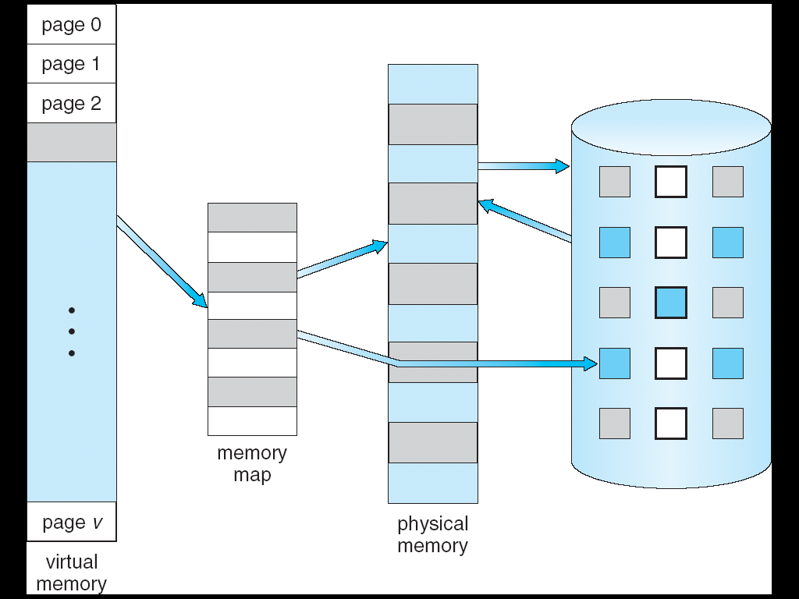
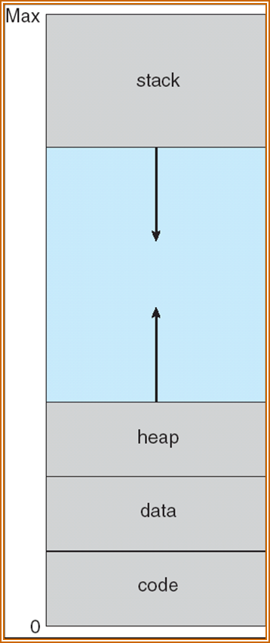
Virtual Memory
Virtual-address Space
⇒

Slide 6
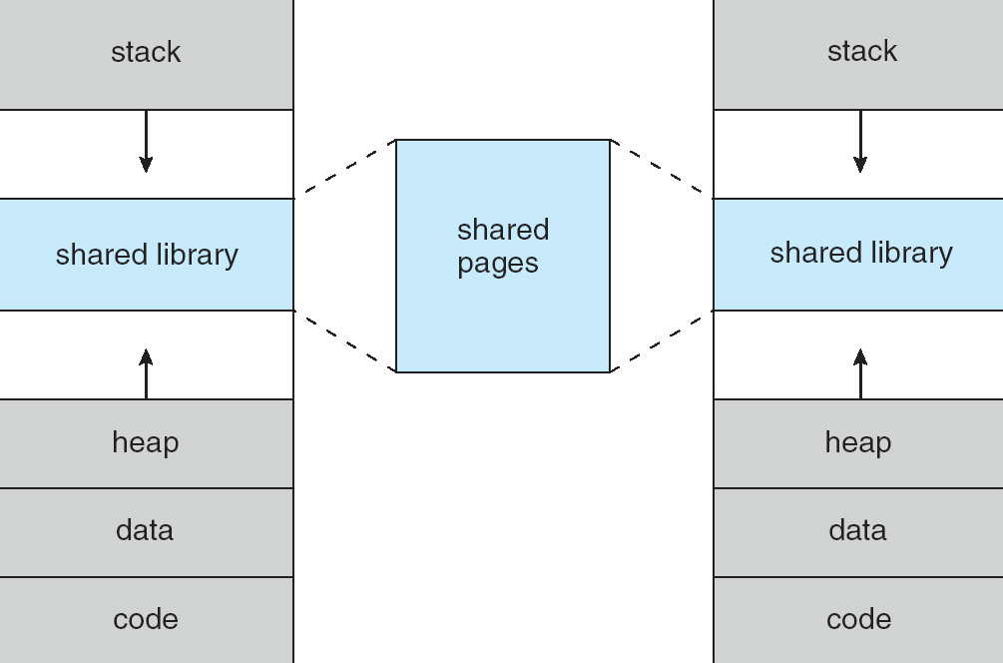
Shared Library Using Virtual Memory
Allow pages to be shared during creation with fork(),
thus speeding up process creation.

Slide 7
Demand Paging (1)
Bring a page into memory only when it is needed
  Less I/O needed
  Less memory needed
  Faster response
  More users
Page is needed
  invalid reference ⇒ abort
  not-in-memory ⇒ bring into memory
lazy swapper: Never swap a page into memory unless that page will be needed.

Slide 8
Demand Paging (2)
A swapper manipulates the entire process, whereas a pager is concerned with the individual pages of a process
Hardware support
  Page Table: a valid-invalid bit
  Secondary memory (swap space, backing store): Usually, a high-speed disk (swap device) is used.
Page-fault trap: when access to a page marked invalid

Slide 9
valid-invalid bit
physical memory
0
1
2
3
frame
4
A
5
0
A
0
4
v
1
6
C
B
1
i
7
2
C
2
6
v
A
B
3
8
D
3
i
4
i
9
F
C
D
E
4
E
5
9
v
10
5
F
6
i
11
F
6
G
7
i
7
12
H
page table
13
logical
memory
v ⇒ in-memory,
i ⇒ not-in-memory
14
15

Slide 10
Page Fault
If there is a reference to a page, first reference will trap to
OS ⇒ page fault
OS looks at internal table (in PCB) to decide:
  Invalid reference ⇒ abort the process
  not in memory
Get empty frame
Swap page into frame
Reset tables, validation bit = v
Restart the instruction interrupted by illegal address trap

Slide 11
Steps in handling a page fault
in backing store
(terminate if invalid)
OS
3
2
page fault
trap
reference
1
load M
v
i
6
4
restart
page table
free frame
bring in
5
reset page table
physical
memory

Slide 12
What happens if there is no free frame?
Page replacement – find some page in memory, but not really in use, swap it out.
  replacement algorithms
  performance – want an algorithm which will result in minimum number of page faults.
Same page may be brought into memory several times.

Slide 13
Software Support
Able to restart any instruction after a page fault
Difficulty: when one instruction modifies several different locations
    e.g., IBM 390/370 MVC move block2 to block1
ADD A+B→C
Fetch and decode ADD
Fetch A.
Fetch B.
ADD A and B.
Store the sum in C.
block1
block2
page fault
  Solutions
  Access both ends of both blocks before moving
  Use temporary registers to hold the values
  of overwritten locations – for the undo
Fetch the instruction again
After handling page fault.

Slide 14
Demand Paging
Programs tend to have locality of reference
  ⇒ reasonable performance for demand paging
pure demand paging
  Start a process with no page.
  Never bring a page into memory until it is required.

Slide 15
Performance of Demand Paging (1)
effective access time
  =(1-p)×200ns + p × 8ms
        = 200 + 7,999,800 × p ns
  major components of page fault time (about 8 ms)
    serve the page-fault interrupt
    read in the page (most expensive)
    restart the process
    The 1st and 3rd can be reduced to several hundread instructions.
    The page switch time is close to 8ms. (latency 3ms, seek time 5ms, transfer time 0.05ms)

Slide 16
Performance of Demand Paging (2)
Directly proportional to the page-fault rate p.
If one access out of 1,000 causes a page fault, then
EAT = 8.2 microseconds.
This is a slowdown by a factor of 40!
For degradation less then 10%:
  220 > 200+ 7,999,800 × p ,
  p < 0.0000025, or
  one memory access out of 399,990 to page fault.
25 × 10⁻⁷

Slide 17
Performance of Demand Paging (3)
Handle and overall use of swap space
  Disk I/O to swap space is generally faster than that to the file system. Because
    much larger blocks
    file lookup and indirect allocation methods are not used.
  Another option is to demand pages from the file system initially but to write the pages to swap space as they are replaced.
    ensure that only needed pages are read from the file system.
Demand pages are brought directly from the file system. Solaris, BSD UNIX
  The file system itself serves as backing store.
  However swap space must still be used for the stack and heap.

Slide 18
Page Fault Processing: Details (1)
Trap to the OS
Save the user registers and process state
Determine that the interrupt was a page fault
Check that the page reference was legal and determine the location on the disk
Issue a read from the disk to a free frame:
  Wait in a queue for this device until the read request is serviced
  Wait for the device seek and/or latency time
  Begin the transfer of the page to a free frame

Slide 19
Page Fault Processing: Details (2)
While waiting, allocate the CPU to some other user (CPU scheduling)
Receive an interrupt from the disk I/O subsystem (I/O completed)
Save the registers and process state for the other user (if step 6 is executed)
Determine that the interrupt was from the disk
Correct the page table and other tables to show that the desired page is now in memory
Wait for the CPU to be allocated to this process again
Restore the user registers, process state, and new page table, and then resume the interrupted instruction

Slide 20
Process Creation
Virtual memory allows other benefits during process creation:
- Copy-on-Write
- Memory-Mapped Files

Slide 21
Copy-on-Write
Copy-on-Write (COW) allows both parent and child processes to initially share the same pages in memory.
If either process modifies a shared page, only then is the page copied.
COW allows more efficient process creation as only modified pages are copied.
Free pages are allocated from a pool of zeroed-out pages.

Slide 22
vfork (): Virtual Memory Fork
vfork(): without COW capability
fork(): with COW capability
With vfork(), the parent process is suspended, and the child process uses the address space of the parent
vfork() is intended to be used when the child process calls exec() immediately after creation
Because no copying of pages takes place, vfork() is an extremely efficient method of process creation

Slide 23
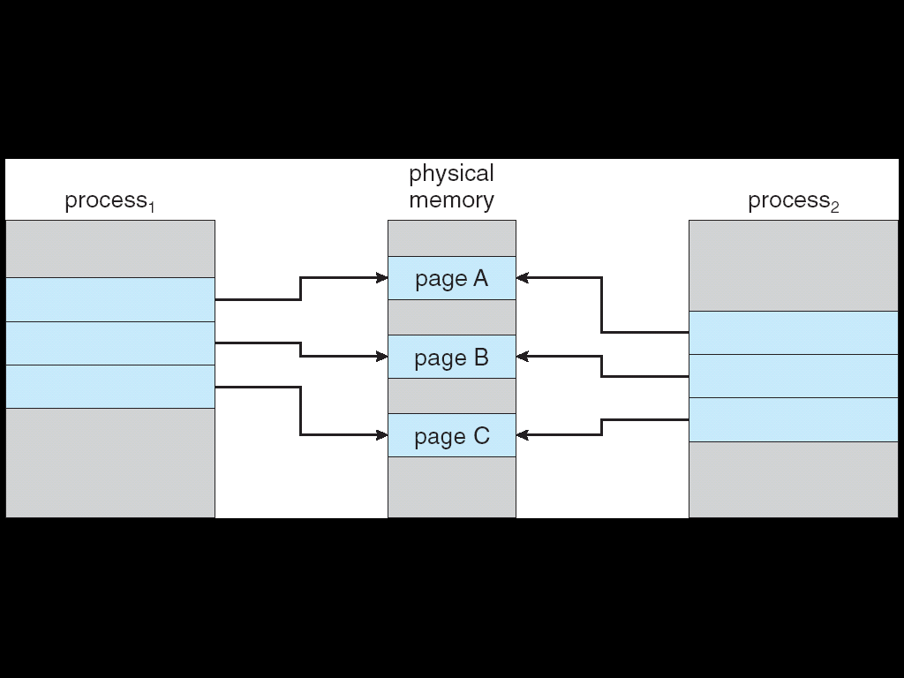
Before Process 1 Modifies Page C

Slide 24
After Modified Page C
Copy of page C

Slide 25
Page Replacement
When a page fault occurs with no free frame
  swap out a process, freeing all its frames, or
  page replacement: find one not currently used and free it.
    ☹: two page transfers
    Solution: modify bit (dirty bit)
Solve two major problems for demand paging
  frame-allocation algorithm:
    how many frames to allocate to a process
  page-replacement algorithm:
    select the frame to be replaced

Slide 26
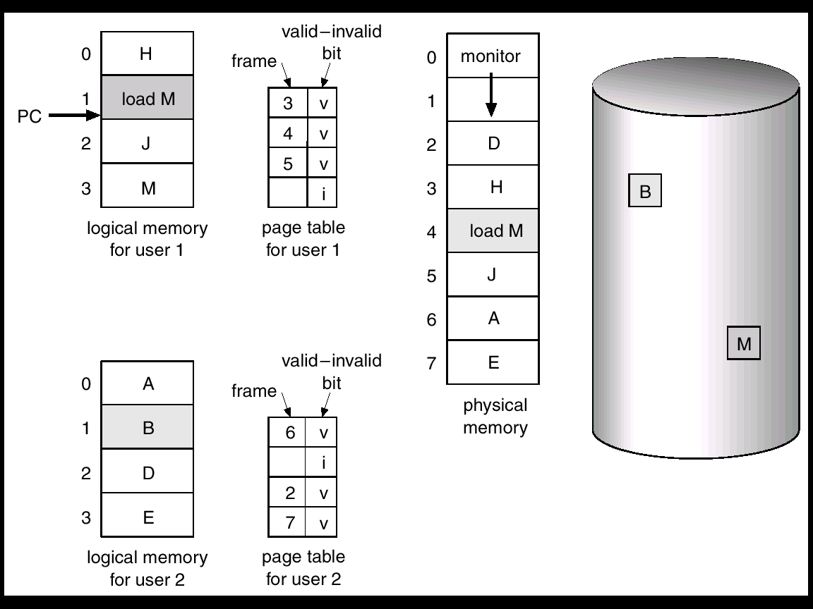
Need For Page Replacement

Slide 27
Basic Page Replacement
Find the location of the desired page on disk.
Find a free frame:
  If there is a free frame, use it.
  If there is no free frame, use a page replacement algorithm to select a victim frame.
Read the desired page into the (newly) free frame. Update the page and frame tables.
Restart the process.

Slide 28
Page replacement
frame
swap out
change to
invalid
f->0
v->i
1
2
f
victim
0->f
i->v
4
reset page
table
3
page table
swap in
physical
memory

Slide 29
Page Replacement Algorithms
Goal: lowest page-fault rate
Evaluate algorithm by running it on a particular string of memory references (reference string) and computing the number of page faults on that string
In all our examples, the reference string is 1, 2, 3, 4, 1, 2, 5, 1, 2, 3, 4, 5

Slide 30
# of Page Faults VS. # of Frames
Expected curve
# of
page faults
number of frames

Slide 31
Page Replacement Algorithms
FIFO algorithm
Optimal algorithm
LRU algorithm
LRU approximation algorithms
  additional-reference-bits algorithm
  second-chance algorithm
  enhanced second-chance algorithm
Counting algorithm
  LFU
  MFU
Page buffering algorithm

Slide 32
The FIFO Algorithm
Simplest
Performance is not always good
  Page out a sequence of active pages
    1, 2, 3, 4, 1, 2, 5, 1, 2, 3, 4, 5
  Belady’s anomaly
allocated frames ↑ ⇒ page-fault rate ↑
2, 3, 4, 5
3, 4, 5, 1
12
12
10
9
6 6 6
1 2 3 4 5 6 7

Slide 33
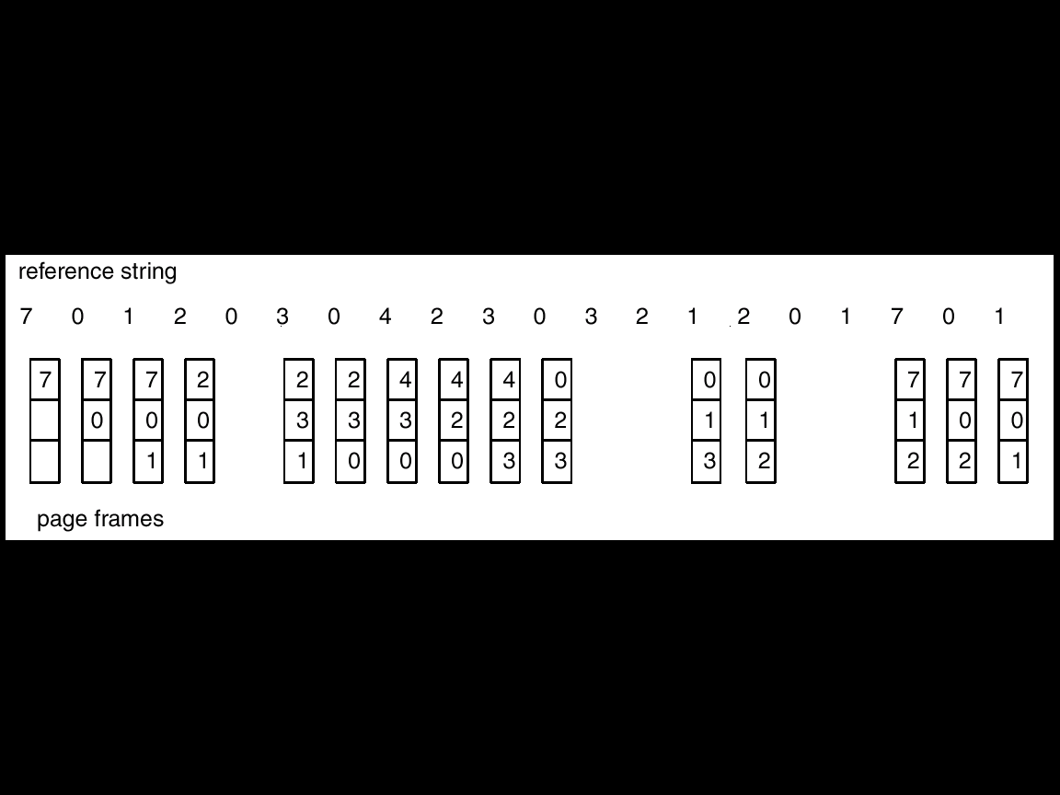
An Example

Slide 34
Optimal Algorithm
Has the lowest page-fault rate of all algorithms
It replaces the page that will not be used for the longest period of time.
difficult to implement, because it requires future knowledge
used mainly for comparison studies
7 0 1 2 0 3 0 4 2 3 0 3 2 1 2 0 1 7 0 1
7
7
7
2
2
2
2
2
7
0
0
0
0
4
0
0
0
1
1
3
3
3
1
1

Slide 35
LRU Algorithm (Least Recently Used)
An approximation of optimal algorithm:
  looking backward, rather than forward.
It replaces the page that has not been used for the longest period of time.
It is often used, and is considered as quite good.
7 0 1 2 0 3 0 4 2 3 0 3 2 1 2 0 1 7 0 1
7
7
7
2
2
4
4
4
0
1
1
1
0
0
0
0
0
0
3
3
3
0
0
1
1
3
3
2
2
2
2
2
7

Slide 36
Two implementation
counter (clock):
  time-of-used field for each page table entry
    ☹: 1. write counter to the field for each access
      2. search for the LRU
Stack: a stack of page number
  move the reference page form middle to the top
  best implemented by a doubly linked list
    ☺ : no search
    ☹ : change six pointers per reference at most
2
7
Head
1
reference 7
2
0
1
7
0
4
4
Tail

Slide 37
Stack Algorithm
a property of algorithms
Stack algorithm: the set of pages in memory for n frames is always a subset of the set of pages that would be in memory with n +1 frames.
Stack algorithms do not suffers from Belady's anomaly.
Both optimal algorithm and LRU algorithm are stack algorithm. (Prove it as an exercise!)
Few systems provide sufficient hardware support for the LRU page-replacement.
  ⇒ LRU approximation algorithms

Slide 38
LRU Approximation Algorithms
reference bit: When a page is referenced,
  its reference bit is set by hardware. (every 100 ms)
We do not know the order of use,
  but we know which pages were used and which were not used.

Slide 39
Additional-reference-bits Algorithm
Keep a k-bit byte for each page in memory
At regular intervals,
  shift right the k-bit (discarding the lowest)
  copy reference bit to the highest
Replace the page with smallest number (byte)
  if not unique, FIFO or replace all

Slide 40
(k=8)
×
1
1
0
1
1
0
1
history
1101011
0011001
1010000
0000111
0010000
1000000
0000000
history
1101011
0011001
1010000
0000111
0010000
1000000
0000000
+
1
0
1
1
0
0
1
reference bit
1
0
1
1
0
0
1
LRU
Every 100 ms, a timer interrupt transfers control to OS.

Slide 41
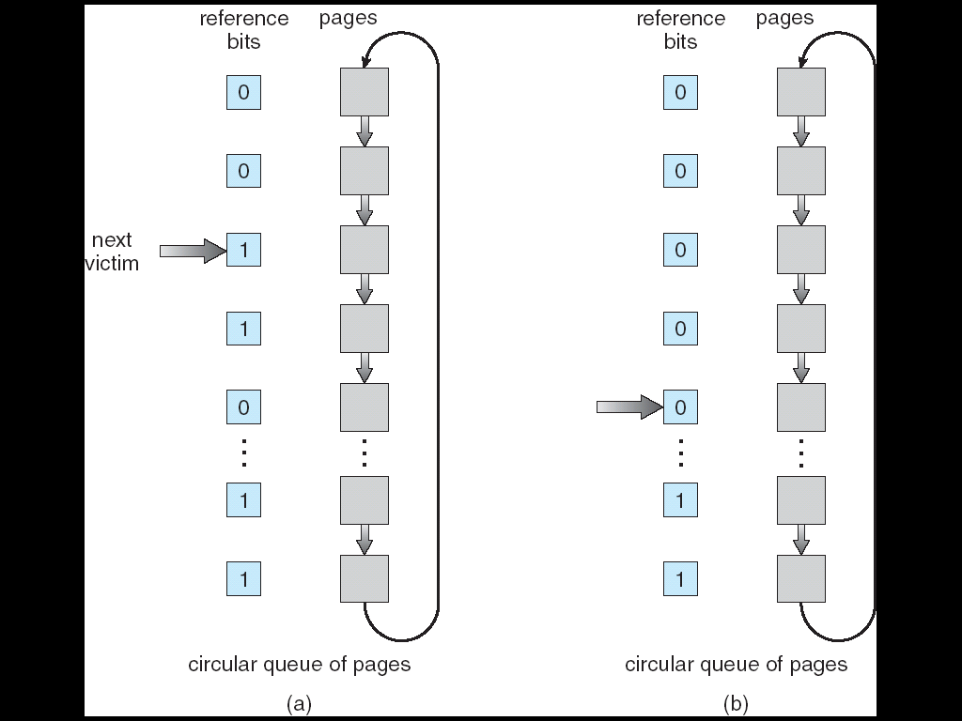
Second-chance Algorithm
  Check pages in FIFO order (circular queue)
  If reference bit = 0, replace it
else set to 0 and check next.

Slide 42
Enhanced Second Chance Algorithm
Consider the pair (reference bit, modify bit), categorized into four classes
  (0,0): neither used and dirty
  (0,1): not used but dirty
  (1,0): used but clean
  (1,1): used and dirty
The algorithm: replace the first page in the lowest nonempty class
☹ : search time
☺: reduce I/O (for swap out)

Slide 43
Counting Algorithms
LFU Algorithm (least frequently used)
  keep a counter for each page
  Idea: An actively used page should have a large reference count.
  ☹ Used heavily -> large counter -> may no longer needed but in memory
MFU Algorithm (most frequently used)
  Idea: The page with the smallest count was probably just brought in and has yet to be used.
Both counting algorithm are not common
  implementation is expensive
  do not approximate OPT algorithm very well

Slide 44
Page Buffering Algorithms
(used in addition to a specific replacement algorithm)
Keep a pool of free frames
  the desired page is read before the victim is written out
  allows the process to restart as soon as possible
Maintain a list of modified pages
  When paging device is idle, a modified page is written to the disk and its modify bit is reset.
Keep a pool of free frames but to remember which page was in each frame
  possible to reuse an old page

Slide 45
Allocation of Frames
Each process needs minimum number of pages
Example: IBM 370 – 6 pages to handle Storage to Storage MOVE instruction:
  instruction is 6 bytes, might span 2 pages.
  2 pages to handle from
  2 pages to handle to
Two major allocation schemes
  fixed allocation
  priority allocation

Slide 46
Fixed Allocation
Equal allocation – e.g., if 100 frames and 5 processes, give each 20 pages.
Proportional allocation – Allocate according to the size of process.

Slide 47
Priority Allocation
Use a proportional allocation scheme using priorities rather than size
If process P_{i} generates a page fault,
  select for replacement one of its frames
  select for replacement a frame from a process with lower priority number

Slide 48
Global vs. Local Allocation
Global replacement – process selects a replacement frame from the set of all frames; one process can take a frame from another.
  e.g., allow a high-priority process to take frames from a low-priority process
  good system performance and thus is common used
Local replacement – each process selects from only its own set of allocated frames.

Slide 49
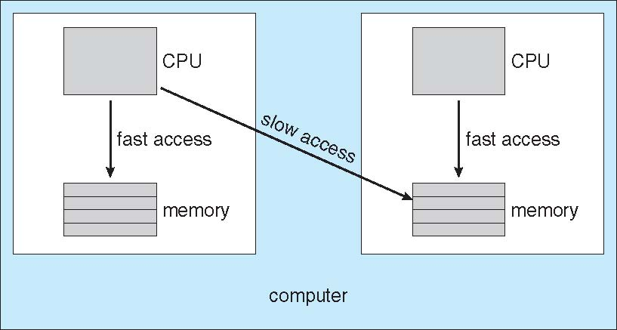
NUMA: Non-Uniform Memory Access (1)
Memory access times vary significantly
  Occurs in systems containing combined CPU and memory boards. Without exception, they are slower than systems in which memory and CPUs are located on the same motherboard.
  Managing which page frames are stored at which locations can significantly affect performance.
  (CPU scheduler and memory-placement works together) (assigned affinity to a CPU) allocated memory frames “as close as possible” to the CPU board on which the process is running.
  The scheduler tracks the last CPU on which each process ran.
Minimize overall (all threads) memory latency,
Maximize CPU cache hit rates

Slide 50
NUMA: Non-Uniform Memory Access (2)
More complicated once threads are added
  threads are scheduled on many different system boards
  Solaris solution, lgroup in the kernel: each lgroup gathers together close CPUs and memory.
    There is a hierarchy of lgroups based on the amount of latency between the groups.
  Solaris tries to schedule all threads of a process and allocate all memory of a process within an lgroup.

Slide 51
Thrashing (1)
If allocated frames < minimum number
  ⇒ Very high paging activity
A process is thrashing if it is spending more time paging than executing.
thrashing
CPU utilization
degree of multiprogramming

Slide 52
Thrashing (2)
Performance problem caused by thrashing
(Assume global replacement is used)
  all processes queued for I/O to swap (page fault)
  CPU utilization is low
  OS increases degree of multiprogramming
  new processes take frames from old processes
  more page faults and thus more I/O
  CPU utilization drops even further
To prevent thrashing
  working-set model
  page-fault frequency

Slide 53
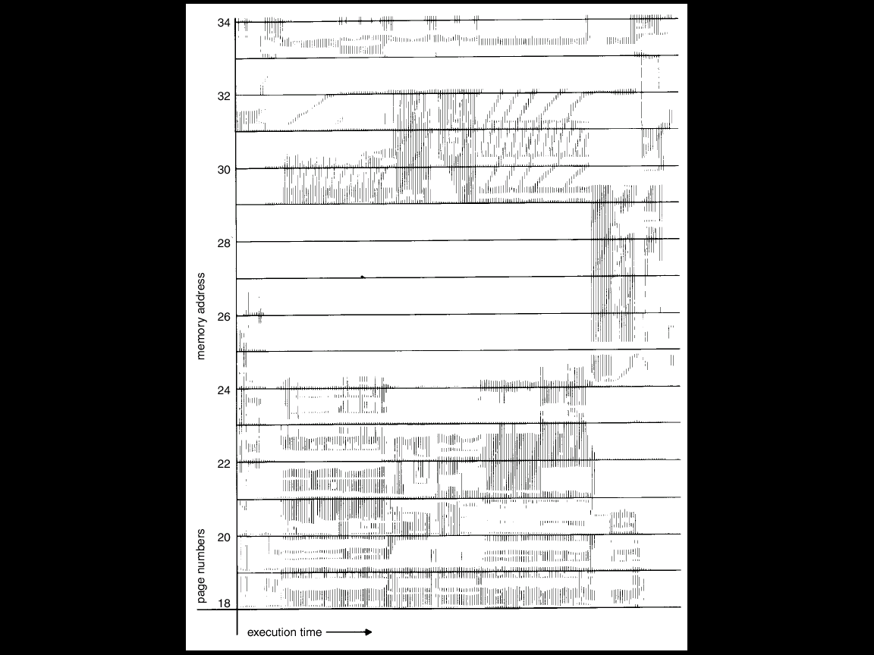
Locality in a Memory-Reference Pattern

Slide 54
Working-Set Model (1)
Locality: a set of pages that are actively used together
Locality model: as a process executes, it moves from locality to locality
  program structure (subroutine, loop, stack)
  data structure (array, table)
Working-set model (based on locality model)
  working-set window: a parameter Δ (delta)
  working set: set of pages in most recent Δ page references (an approximation locality)

Slide 55
An Example
2 6 1 5 7 7 7 7 5 1 6 2 3 4 1 2 3 4 4 4 3 4 3 4 4 4 1 3 2 3 4 4 4 4 3 4 4 . . .
Δ
Δ
t₁
t₂
WS(t₁) ={1,2,5,6,7}
WS(t₂) ={3,4}

Slide 56
Working-Set Model (2)
Prevent thrashing using the working-set size
  D = ∑ WSS_{i} (total demand frames)
  If D > m (available frames) ⇒ thrashing
  The OS monitors the WSS_{i} of each process and allocates to the process enough frames
    if D << m, increase degree of MP
    if D > m, suspend a process
  ☺: 1. prevent thrashing while keeping the degree of multiprogramming as high as possible.
  2. optimize CPU utilization
  ☹ : too expensive for tracking

Slide 57
Approximate working set by using a fixed interval timer interrupt and a reference bit
  Δ = 10,000 references, a timer interrupt every 5000 references, 2-bit history
    copy and clear the reference bit for each interrupt
    In case of page fault,
      a page is referenced within last 10,000 to 15,000 references can be identified
page fault
time 0 ~ 5,000 ~ 10,000~
reference P1 1 0
bits P2 0 0
P3 0 1
Δ = 10,000
WS={P1, P3}

Slide 58
Page Fault Frequency Scheme
The knowledge of the working set can be useful for prepaging (page 72), but it seems a rather clumsy way to control thrashing.
Page fault frequency directly measures and controls the page-fault rate to prevent thrashing.
  Establish upper and lower bounds on the desired page-fault rate of a process.
  If page fault rate exceeds the upper limit
    allocate the process another frame
  If page fault rate falls below the lower limit
    remove the process a frame

Slide 59
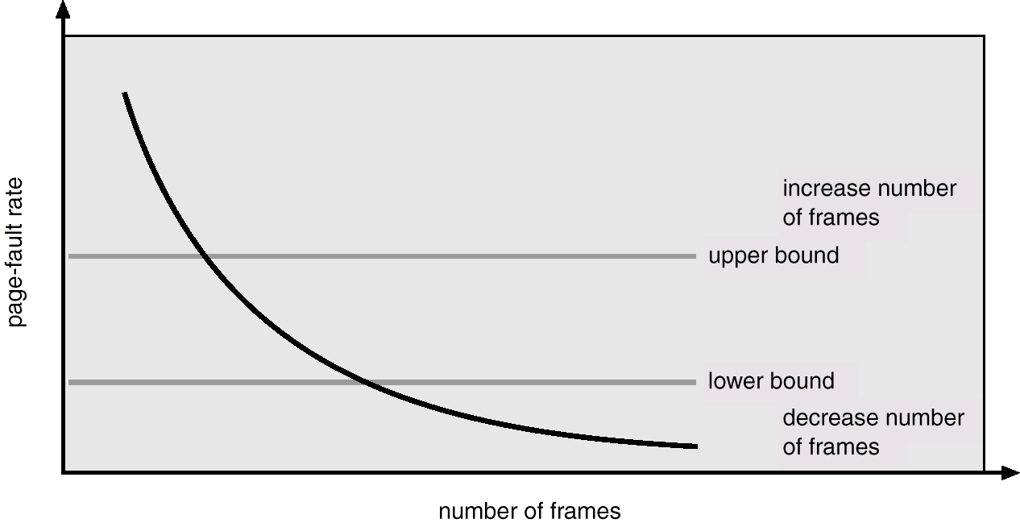
Page-Fault Frequency Scheme
Establish “acceptable” page-fault rate

Slide 60
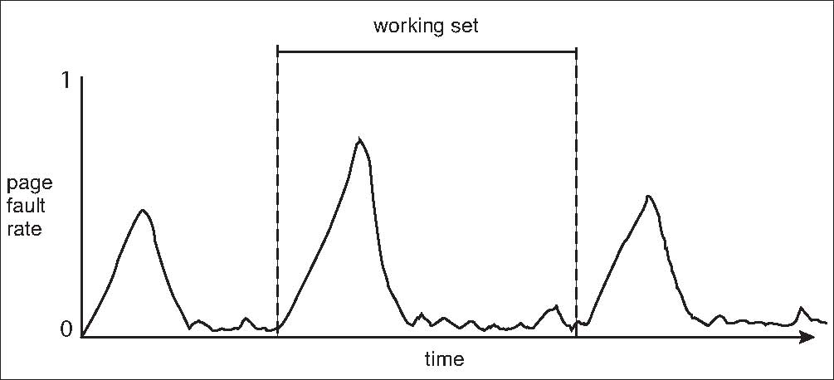
Working Sets and Page Fault Rates
peak of new locality
When the process moves to a new WS, the PF rate rises toward a peak.

Slide 61
Memory-Mapped Files
Memory-mapped file I/O allows file I/O to be treated as routine memory access by mapping a disk block to a page in memory.
A file is initially read using demand paging. A page-sized portion of the file is read from the file system into a physical page. Subsequent reads/writes to/from the file are treated as ordinary memory accesses.
Simplifies file access by treating file I/O through memory rather than read(), write() system calls.
Also allows several processes to map the same file allowing the pages in memory to be shared.

Slide 62
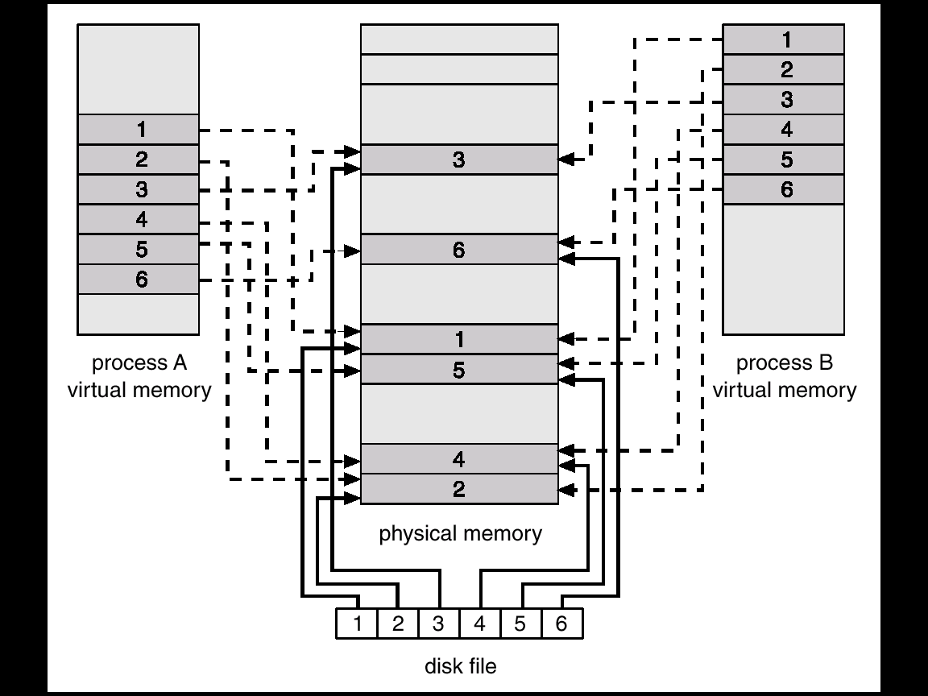
Memory Mapped Files

Slide 63
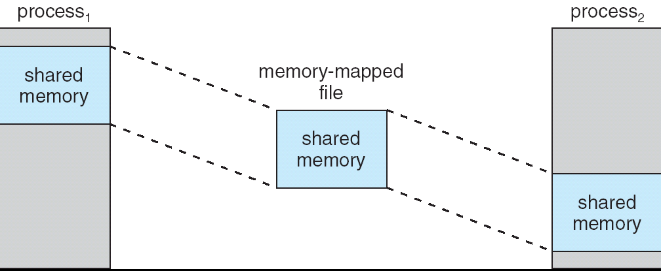
Memory-Mapped Shared Memory in Windows

Slide 64
Allocating Kernel Memory
Treated differently from user memory
Often allocated from a free-memory pool
  Kernel requests memory for structures of varying sizes
  Some kernel memory needs to be contiguous

Slide 65
Buddy System
Allocates memory from fixed-size segment consisting of physically-contiguous pages
Memory allocated using power-of-2 allocator
  Satisfies requests in units sized as power of 2
  Request rounded up to next highest power of 2
  When smaller allocation needed than is available, current chunk split into two buddies of next-lower power of 2
    Continue until appropriate sized chunk available

Slide 66
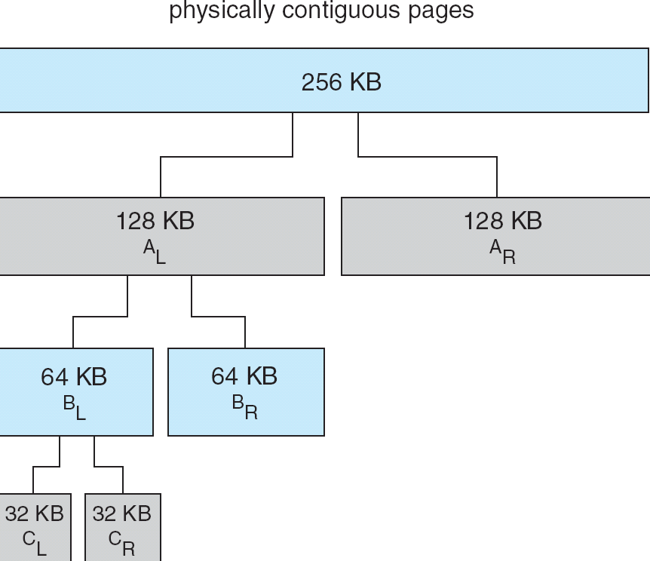
Buddy System Allocator
A request
of 23 KB

Slide 67
Slab Allocator
Slab is one or more physically contiguous pages
Cache consists of one or more slabs
Single cache for each unique kernel data structure (semaphores, process descriptors, file objects, …)
  Each cache filled with objects – instantiations of the data structure
When cache created, filled with objects marked as free
When structures stored, objects marked as used
If slab is full of used objects, next object allocated from empty slab
  If no empty slabs, new slab allocated
Benefits include no fragmentation, fast memory request satisfaction

Slide 68
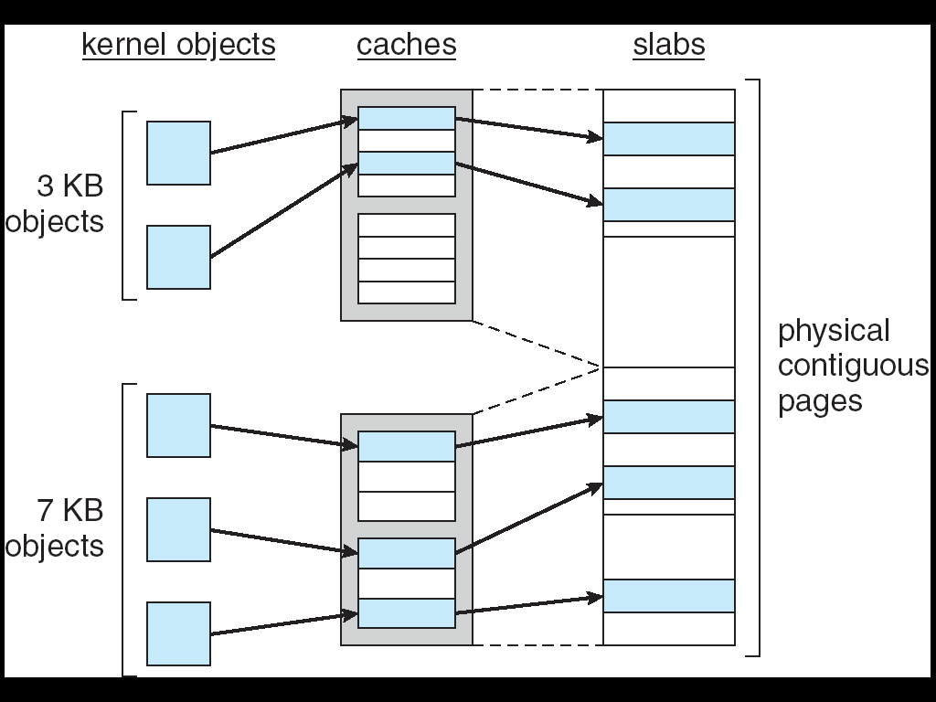
Slab Allocation
9KB

Slide 69
Slab Allocator in Linux
A process descriptor is of the type struct task_struct, which requires approximately 1.7 KB.
When the Linux kernel creates a new task,
  will use existing free struct task_struct
A slab may be in three possible states:
  Full – all used
  Empty – all free
  Partial – mix of free and used
Upon request, slab allocator
  first attempts uses free struct in partial slab,
  if none exists, takes one from empty slab
  If no empty slabs are available, a new slab is allocated from contiguous physical pages and assigned to a cache.

Slide 70
Slab Allocator in Linux
Two slab implementation as SLAB: the SLOB and SLUB allocators.
The SLOB is designed for systems with a limited amount of memory, such as embedded systems.
  SLOB (Simple List of Blocks): maintains 3 list objects for small (< 256 bytes), medium (< 1,024 bytes), and large (for objects ≥1,024 bytes) objects, using a first-fit.
Version 2.6.24: the SLUB allocator replaced SLAB as the default allocator. (For large systems)
  One change is to move the metadata that is stored with each slab under SLAB allocation to the page structure.
  SLUB removes the per-CPU queues that the SLAB allocator maintains for objects in each cache.
array
noncontinous
A 128 byte object will be aligned at 128 byte boundaries and can fit tightly into a 4k page with no bytes left over.

Slide 71
Other Considerations
Prepaging
Page size selection
  fragmentation
  table size
  I/O overhead
  Locality
Program structure
Inverted page table
I/O interlock

Slide 72
Prepaging
Prepaging
  To reduce the large number of page faults that occurs at process startup (e.g., pure demand-paging)
  Prepage all or some of the pages a process will need, before they are referenced.
    e.g., whole working set for a swapping-in process
  ☹ But if prepaged pages are unused, I/O and memory was wasted.
  Assume s pages are prepaged and α% of the pages is used
    s×α saves page faults VS.
    prepaging s×(1-α) unnecessary pages
    α near zero ⇒ prepaging loses

Slide 73
Page size
usually, 2¹²(4K) ~ 2²² (4M) size
  memory utilization (small internal fragmentation)
      ⇒ small size
  minimize I/O time (less seek, latency)
  ⇒ large size
  reduce total I/O (improve locality) ⇒ small size better resolution, allowing us to isolate only the memory that is actually needed.
  minimize number of page faults ⇒ large size
Trend: larger
  CPU speed/memory capacity increase faster than disks. Page faults are more costly today.

Slide 74
TLB Reach
TLB Reach - The amount of memory accessible from the TLB
TLB Reach = (TLB Size) X (Page Size)
Ideally, the working set of each process is stored in the TLB
  Otherwise there is a high degree of page faults
Increase the Page Size
  This may lead to an increase in fragmentation as not all applications require a large page size
Provide Multiple Page Sizes (8KB, 4MB in Solaris)
  This allows applications that require larger page sizes the opportunity to use them without an increase in fragmentation

Slide 75
Program Structure
  Careful selection of data/programming structure can increase locality
  var A: array[1..128, 1..128] of integer;
for j := 1 to 128 do
for i := 1 to 128 do
A[i,j] := 0;
for i := 1 to 128 do
for j := 1 to 128 do
A[i,j] := 0;
  Stack is better than hash
    Stack: good locality since access is always
    made to the top
    Hash: bad locality since designed to
    scatter references
A[1,1]
A[1,2]
.
A[1,128]
Page 1
A[2,1]
A[2,2]
.
A[2,128]
Page 2
A[3,1]
A[3,2]
.
A[3,128]
Page 3

Slide 76
Inverted Page Table
Reduce the amount of physical memory that is needed to track virtual-to-physical address translations. <pid, page#>
The table no longer contains complete information about the logical address of a process and that information is required if a referenced page is not currently in memory.
Demand paging requires this to process page faults. An external page table (one per process) must be kept.
Do external page tables negate the utility of inverted page tables?
  They do not need to be available quickly → paged in and out memory as necessary → Another page fault may occur as it pages in the external page table

Slide 77
I/O Interlock
Sometimes, we need to allow some of the pages to be locked in memory
  An example
    Process A prepare a page as I/O buffer and then waiting for an I/O device
    Process B takes the frame of A’s I/O page
    I/O device ready for A, a page fault occurs
  Solutions:
    Never execute I/O to user memory
  (system memory ⇔ I/O device)
    Allow pages to be locked (using a lock bit)

Slide 78
Windows
Uses demand paging with clustering. Clustering brings in pages surrounding the faulting page.
Processes are assigned working set minimum and working set maximum.
Working set minimum is the minimum number of pages the process is guaranteed to have in memory.
A process may be assigned as many pages up to its working set maximum.
When the amount of free memory in the system falls below a threshold, automatic working set trimming is performed to restore the amount of free memory.
Working set trimming removes pages from processes that have pages in excess of their working set minimum.

Slide 79
Solaris (1)
Maintains a list of free pages to assign faulting processes.
Lotsfree – threshold parameter to begin paging.
Paging is performed by pageout process.
Pageout process is similar to the second-chance algorithm but with two hands (pointers)
  front hand: scan all pages in memory, setting the reference bit to 0.
  back hand: check the reference bit (Rb), collect the pages if Rb are still 0 and write to disk if modified.
1/64 of MM

Slide 80
Solaris (2)
Solaris maintains a cache list of pages that have been freed. Pages can be reclaimed if they are accessed before being moved to the free list.
Scanrate is the rate at which pages are scanned. This ranged from slowscan (100 pages/s) to fastscan (8192 pages/s).
Pageout is called more frequently depending upon the amount of free memory available.
The distance between the hands of clock is determined by handspread, usually a few seconds.

Slide 81
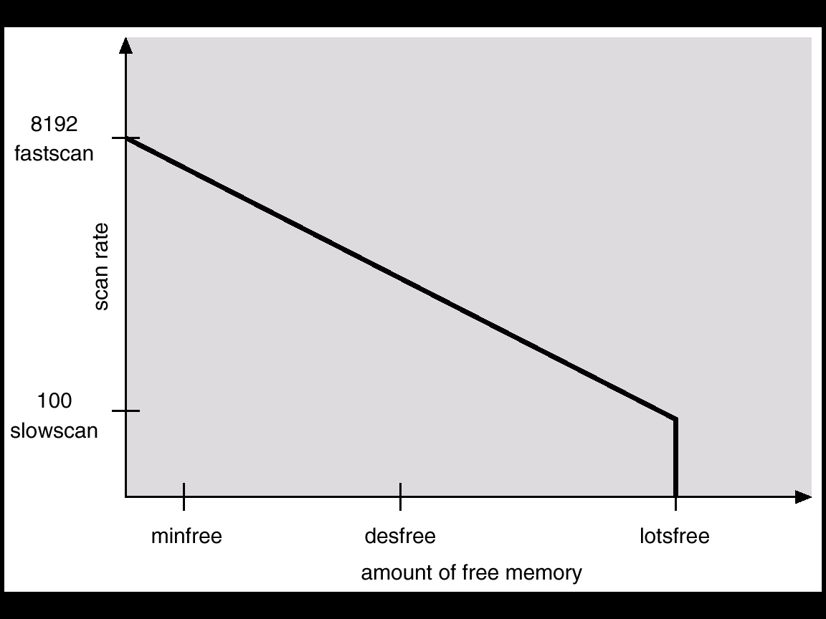
Solar Page Scanner

Slide 82
Solaris (3)
Enhancement 1, recognizing pages from shared libraries. Skipped during the scanning if shared.
Enhancement 2, priority paging. Distinguish pages that have been allocated to processes from pages allocated to regular files.

Slide 83
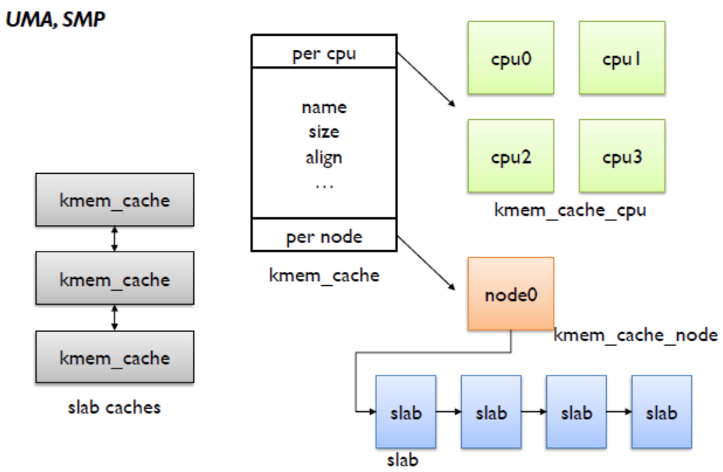
SLUB, overall structure
Joonsoo Kim

Slide 84
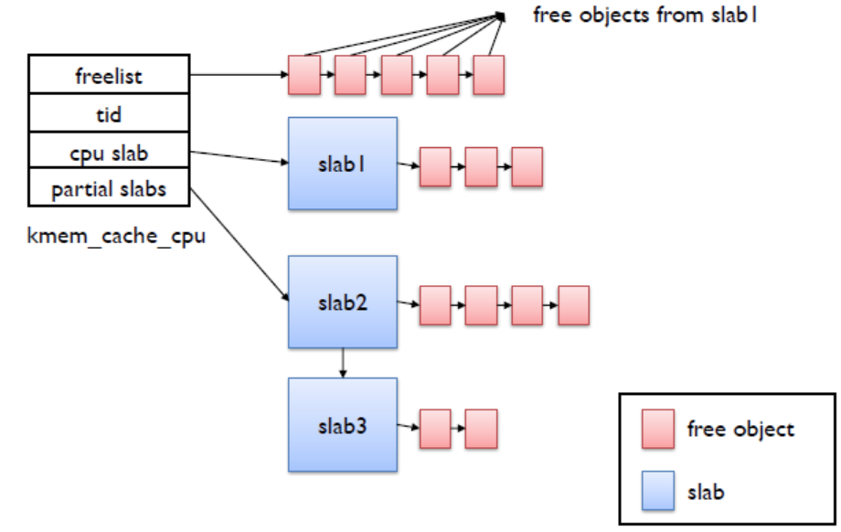
SLUB, Per cpu structure
Joonsoo Kim

