Slide 1
Chapter 10
Mass-Storage Systems

Slide 2
Outline
Overview of Mass Storage Structure
Disk Structure
Disk Attachment
Disk Scheduling
Disk Management
Swap-Space Management
RAID Structure
Stable-Storage Implementation

Slide 3
Overview of Mass Storage Structure
Magnetic disks provide bulk of secondary storage
  Transfer rate is the rate at which data flow between drive and computer
  Positioning time (random-access time) is the time to move disk arm to desired cylinder (seek time) and time for desired sector to rotate under the disk head (rotational latency)
  Head crash
Disks can be removable
Drive attached to computer via I/O bus
  Busses vary, including EIDE, ATA, SATA, eSATA, USB, Fibre Channel, SCSI, SAS, Firewire, PCIe
  Host controller in computer uses bus to talk to disk controller built into drive or storage array

Slide 4
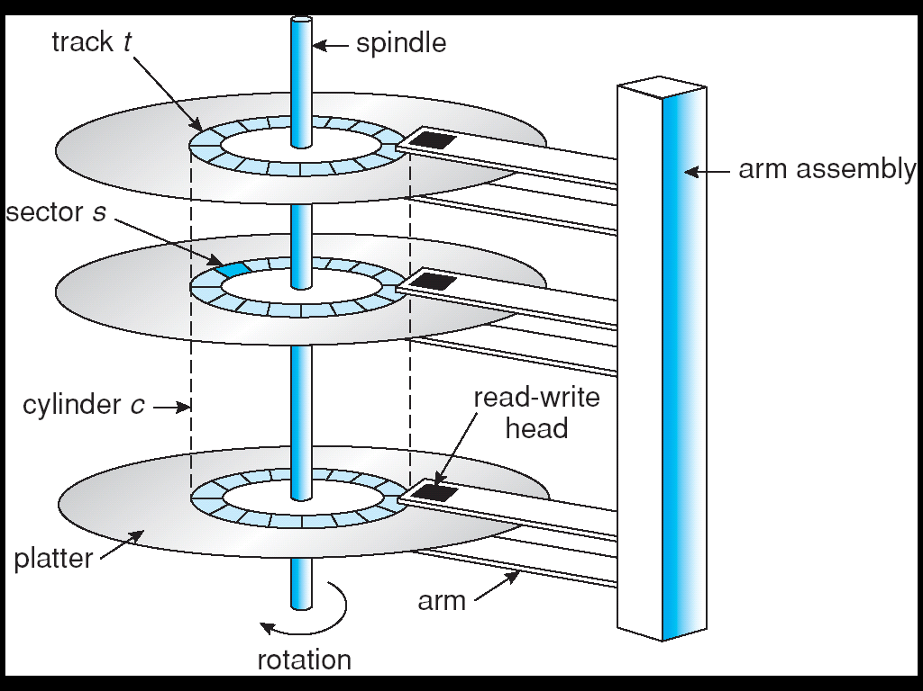
Moving-head Disk Mechanism

Slide 5
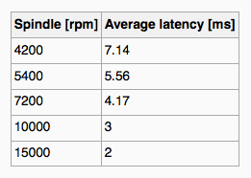
Hard Disk Performance
Transfer Rate –6 Gb/sec (theoretical )
Effective Transfer Rate –1Gb/sec (real )
Seek time from 3ms to 12ms, 9ms common for desktop drives
Average seek time measured based on 1/3 of tracks
Latency based on spindle speed
Average latency = ½ latency

Slide 6
Hard Disk Performance
Access Latency = Average access time = average seek time + average latency
  fastest disk: 3ms + 2ms = 5ms
  slow disk: 9ms + 5.56ms = 14.56ms
Average I/O time = average access time + (amount to transfer / transfer rate) + controller overhead
  Example: transferring a 4KB block on a 7200 RPM disk with a 5ms average seek time, 1Gb/sec transfer rate with a 0.1ms controller overhead ,
  5ms + 4.17ms + 0.1ms + Transfer time,
  Transfer time = 4KB / 1Gb/s * 8Gb / GB * 1GB / 1024²KB = 32 / (1024²) = 0.031 ms
  Average I/O time = 9.27ms + .031ms = 9.301ms

Slide 7
Solid-State Disks
Sometimes old technologies are used in new ways as economics change or the technologies evolved.
Nonvolatile memory used like a hard drive
  many technology variations, e.g., flash-memory
  more reliable than HDDs (no moving parts), more expensive per MB, maybe have shorter life span
  less capacity, but much faster
  no moving parts, so no seek time or rotational latency
One use for SSDs is in storage arrays, where they hold file-system metadata that require high performance.

Slide 8
Disk Structure
Physical: cylinder, track, sector (I/O unit)
Logical: Disk drives are addressed as large 1-dimensional arrays of logical blocks, where the logical block is the smallest unit of transfer
The 1-D array of logical blocks is mapped into the sectors of the disk sequentially
  Sector 0 is the first sector of the first track on the outermost cylinder
  Mapping proceeds in order through that track, then the rest of the tracks in that cylinder, and then through the rest of the cylinders from outermost to innermost

Slide 9
Disk Attachment
Host-attached storage accessed through I/O ports talking to I/O buses
SCSI itself is a bus, up to 16 devices on one cable, SCSI initiator requests operation and SCSI targets perform tasks
  Each target can have up to 8 logical units (disks attached to device controller)
FC is high-speed serial architecture
  Can be switched fabric with 24-bit address space – the basis of storage area networks (SANs) in which many hosts attach to many storage units
  Can be arbitrated loop (FC-AL) of 126 devices

Slide 10
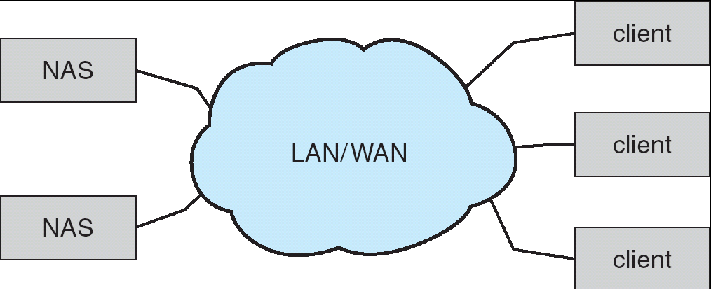
Network-Attached Storage (NAS)
Network-attached storage (NAS) is storage made available over a network rather than over a local connection (such as a bus)
NFS and CIFS are common protocols
Implemented via remote procedure calls (RPCs) between host and storage
New iSCSI protocol uses IP network to carry the SCSI protocol

Slide 11
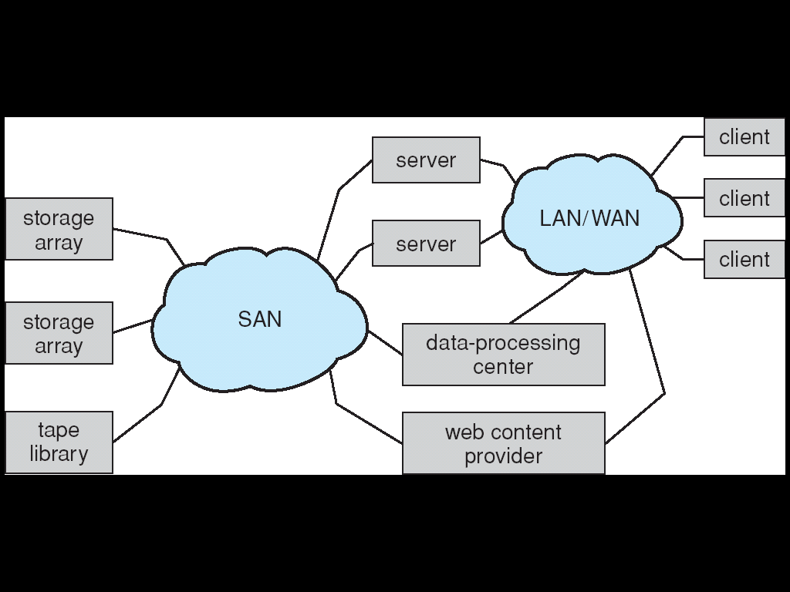
Storage Area Network (SAN)
Common in large storage environments (and becoming more common)
Multiple hosts attached to multiple storage arrays - flexible

Slide 12
Disk Scheduling (1)
The OS is responsible for using hardware efficiently — for the disk drives, fast access time and disk bandwidth
  Disk bandwidth is the total number of bytes transferred, divided by the total time between the first request for service and the completion of the last transfer
Access time has two major components
  Seek time: move the heads to the cylinder containing the desired sector.
  Rotational latency: rotate the desired sector to the disk head.
  seek time + rotational latency + transfer time

Slide 13
Disk Scheduling (2)
Minimize seek time
Seek time ≈ seek distance
Several algorithms exist to schedule the servicing of disk I/O requests
  FCFS (first-come, first-served)
  SSTF (shortest-seek-time-first)
  SCAN
  C-SCAN (circular SCAN)
  LOOK and C-LOOK
We illustrate them with a request queue (0-199)
98, 183, 37, 122, 14, 124, 65, 67
Head pointer 53

Slide 14
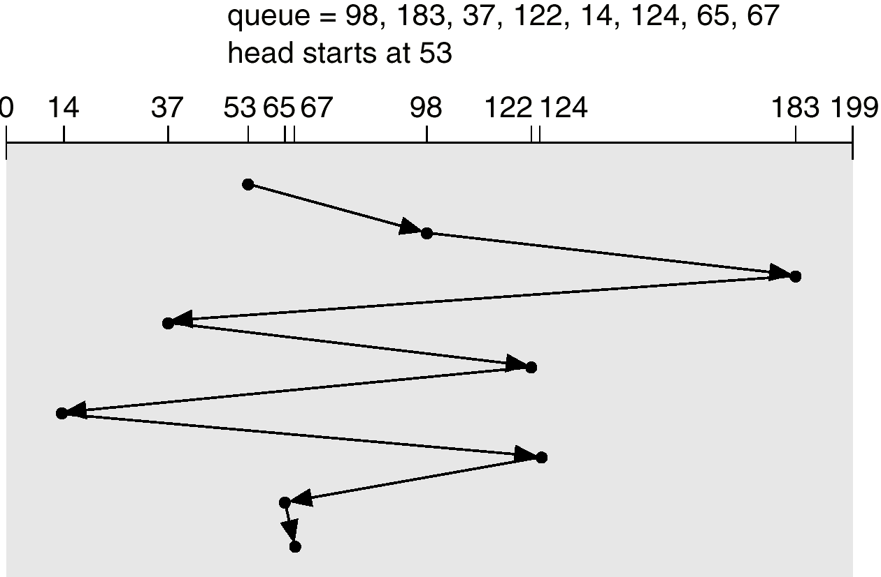
FCFS
Illustration shows total head movement of 640 cylinders.

Slide 15
SSTF (1)
Selects the request with the minimum seek time from the current head position
SSTF scheduling is a form of SJF scheduling; may cause starvation of some requests.
Illustration shows total head movement of 236 cylinders.
  Not an optimal solution.
  Optimal is 208:
If we move the head from 53 to 37, then to 14, …

Slide 16
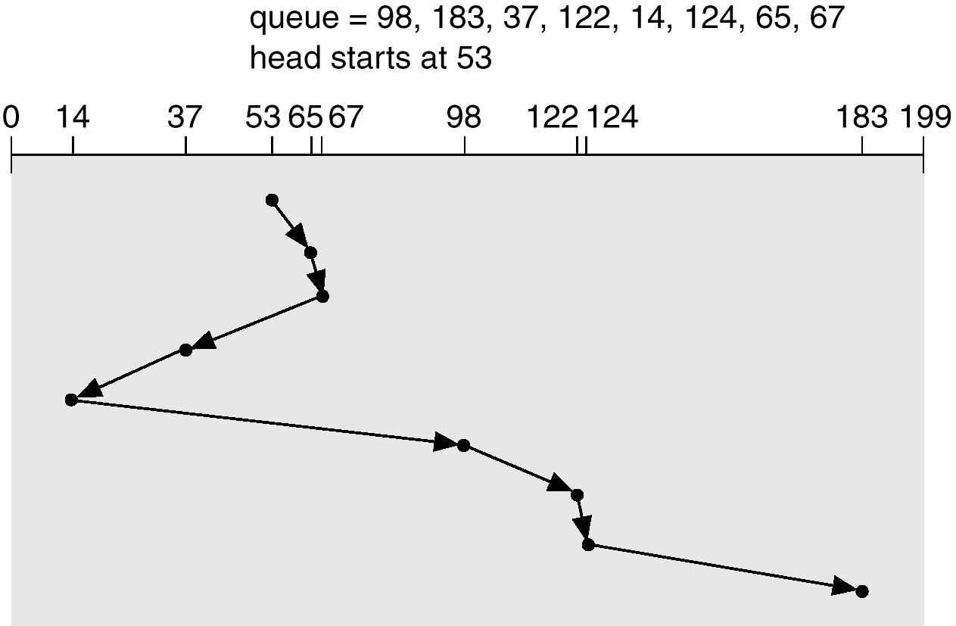
SSTF (2)
236

Slide 17
SCAN (1)
The disk arm starts at one end of the disk, and moves toward the other end, servicing requests until it gets to the other end of the disk, where the head movement is reversed and servicing continues
Sometimes called the elevator algorithm
Illustration shows total head movement of 236 cylinders

Slide 18
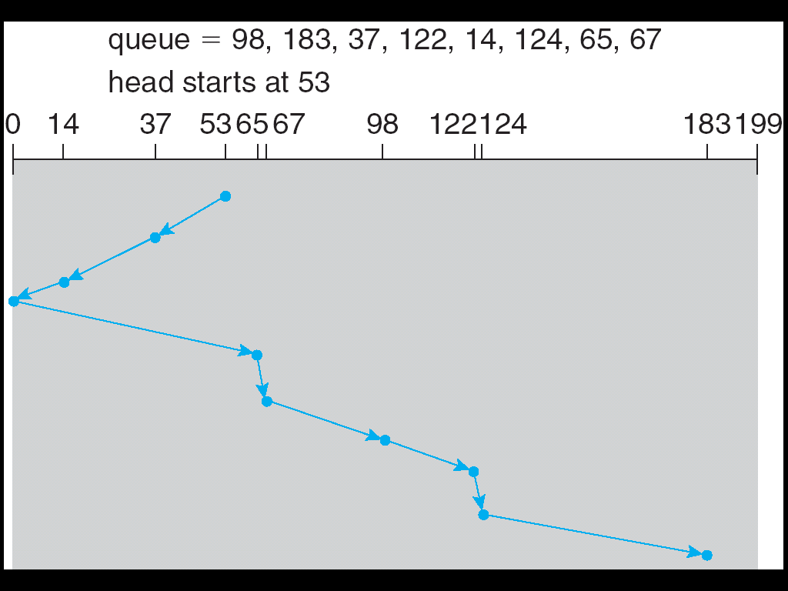
SCAN (2)
236

Slide 19
C-SCAN (1)
Provides a more uniform wait time than SCAN
The head moves from one end of the disk to the other, servicing requests as it goes. When it reaches the other end, however, it immediately returns to the beginning of the disk, without servicing any requests on the return trip
Treats the cylinders as a circular list that wraps around from the last cylinder to the first one

Slide 20
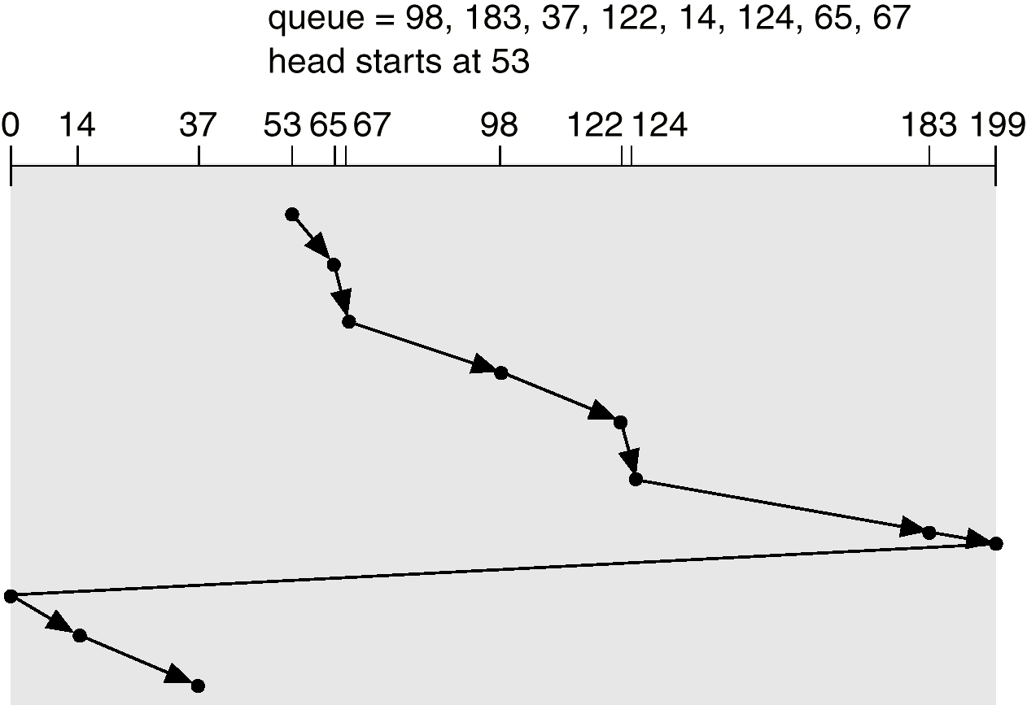
C-SCAN (2)

Slide 21
C-LOOK (1)
Version of C-SCAN
Arm only goes as far as the last request in each direction, then reverses direction immediately, without first going all the way to the end of the disk

Slide 22
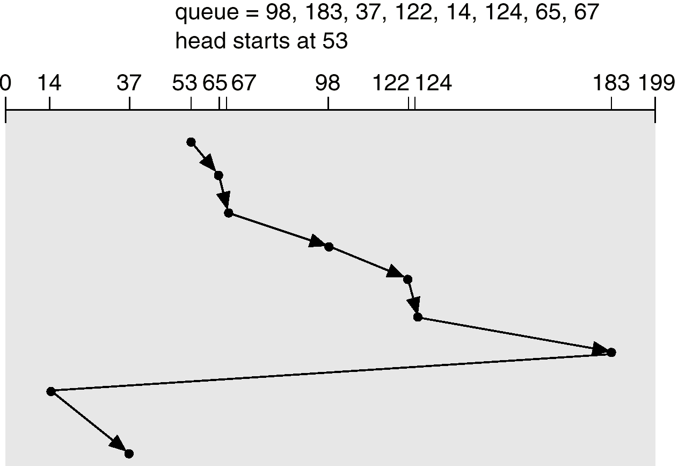
C-LOOK (2)

Slide 23
Selecting a Disk-Scheduling Algorithm (1)
SSTF is common and has a natural appeal
SCAN and C-SCAN
  perform better for disks with heavy load
  no starvation problem
Requests for disk services can be greatly influenced by the file-allocation method
  requests to a contiguously allocated file
    small head movements
  requests to a linked or indexed file
    greater head movements
but not optimal

Slide 24
Selecting a Disk-Scheduling Algorithm (2)
Location of directories and index blocks is important
  They are required frequently
  Put directory on the middle cylinder
    one-half the width in the worst case
  Cache the directories and index blocks in memory
For modern disks
  rotational latency is nearly as large as seek time
  not disclosing the physical location of logical blocks, manufacturers implement disk-scheduling in controller
  OS does not need to schedule disk requests
  To guarantee an order of requests, OS should “spoon-feed” the controller, one-by-one

Slide 25
Disk Management
Physical formatting — Dividing a disk into sectors that the disk controller can read and write
To use a disk to hold files, the operating system still needs to record its own data structures on the disk
  Partition the disk into one or more groups of cylinders
  Logical formatting or “making a file system”
Boot block initializes the system
  The bootstrap is stored in ROM
  Bootstrap loader program
Methods such as sector sparing used to handle bad blocks

Slide 26
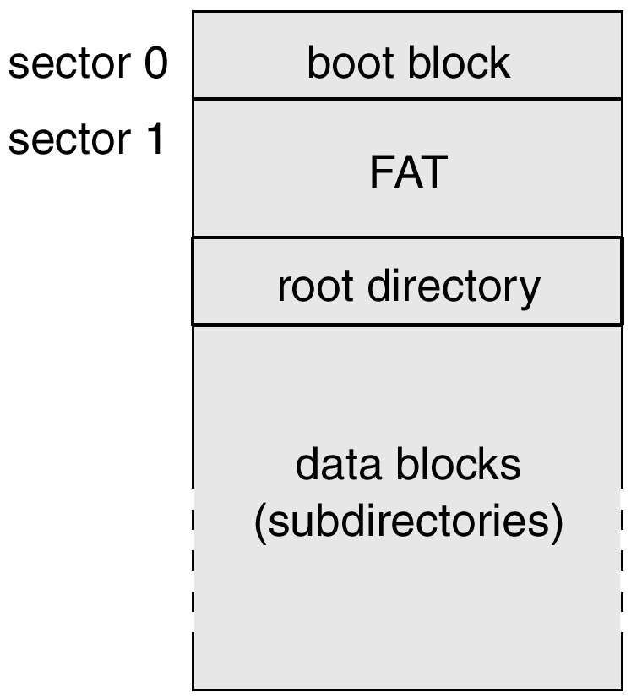
MS-DOS Disk Layout
bootstrap program

Slide 27
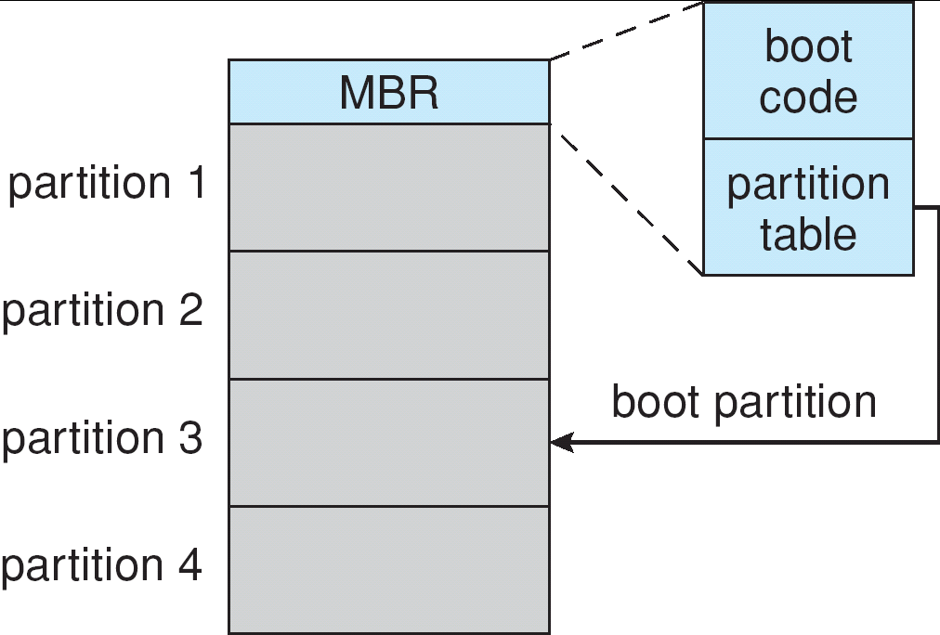
Booting from a Disk in Windows 2000
bootstrap program
OS and device drivers

Slide 28
Swap-Space Management
Swap-space — Virtual memory uses disk space as an extension of main memory
Swap-space can be carved out of the normal file system, or, more commonly, it can be in a separate disk partition
Swap-space management
  4.3BSD allocates swap space when process starts; holds text segment (the program) and data segment
  Kernel uses swap maps to track swap-space use
  Solaris 2 allocates swap space only when a page is forced out of physical memory, not when the virtual memory page is first created

Slide 29
Swap-Space Management
Swap file vs. Swap partition
Swap File
Fragmentation: Swap file will get fragmented, especially when the hard disk space become full. The system performance will decrease then.
Overhead: The overhead of directory search and indirect access should be acceptable.
Flexibility: increase the swap space immediately.
Particular location: Keep the swap file on external device, such as SSD.
Anonymous memory being solved.
Linux 2.6 and later: The performance becomes closer.
Program code is better than data because the size changes less. Fragmentation issue
Swap Partition
Fragmentation is less comparing to swap file. Normally, the system performance is better.
Accident loss or corruption is not a big issue.
Multiple OSs on a single machine can share the same partition.
System performance: light load (access less frequently), disk not full, …
stack, heap, etc.
This manager uses algorithms optimized for speed rather than for storage efficiency, because swap space is accessed much more frequently than file systems (when it is used).
Any fragmentation is short-lived.

Slide 30
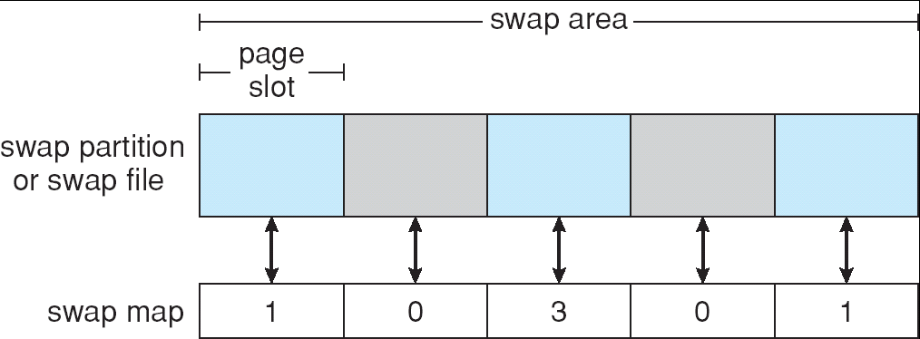
Data Structures for Swapping on Linux Systems
3 different processes

Slide 31
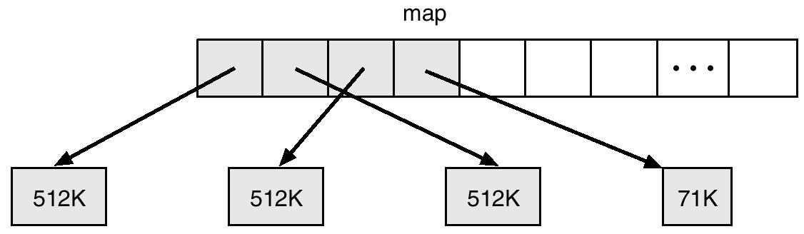
BSD Text-Segment Swap Map

Slide 32
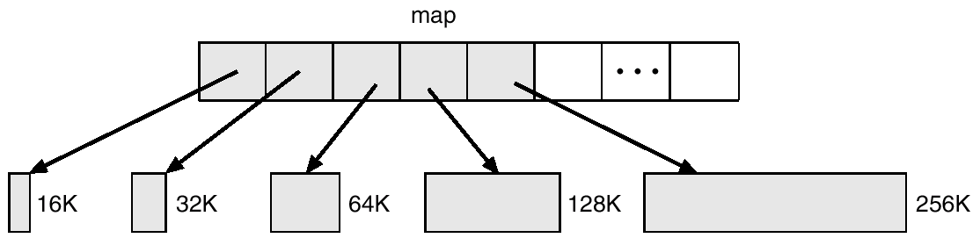
BSD Data-Segment Swap Map

Slide 33
RAID Structure (1)
Redundant Array of Independent Disks
RAID – multiple disk drives provides reliability via redundancy
RAID is arranged into different levels
  Disk Stripping combined with “parity” bits
  Redundancy at lowest cost
1st disk
parity disk
7th disk

Slide 34
RAID (2)
mean time to failure, mean time to data loss
Several improvements in disk-use techniques involve the use of multiple disks working cooperatively
Disk striping uses a group of disks as one storage unit (bit-level striping, block-level striping)
RAID schemes improve performance and improve the reliability of the storage system by storing redundant data
  Mirroring or shadowing keeps duplicate of each disk
  Block interleaved parity uses much less redundancy

Slide 35
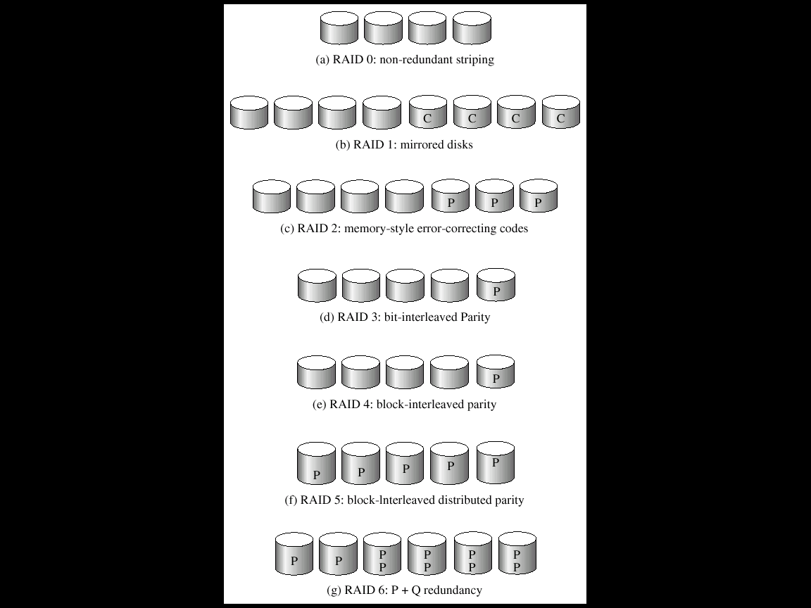
RAID Levels
single block write requires 4 disk accesses:
2 to read 2 old blocks, and 2 to write 2 new blocks
apply if data loss is not critical
high reliability and fast recovery
ECC code
P: error correction bits
C: second copy
for one disk fail
Small write: cannot in parallel
read-modify-write
Block read, Large
read (write): in parallel
for large volume of data
spreading the parity
better reliable then 5
>1 disk fail,
use RS code
Reed-Solomon
4+2 code

Slide 36
Reed-Solomon Code
RS (n, k)
  Can correct t = ⎣(n-k)/2⎦ symbol errors
  Can correct t = n-k symbol erasures
  The coding rate is k/n
k
Source data
n
Galois Field GF(p^{k})

Slide 37
Correct/detect Packet Losses using across-packet FEC
source coding
to ATM cells
47
redundancy
28
4

Slide 38
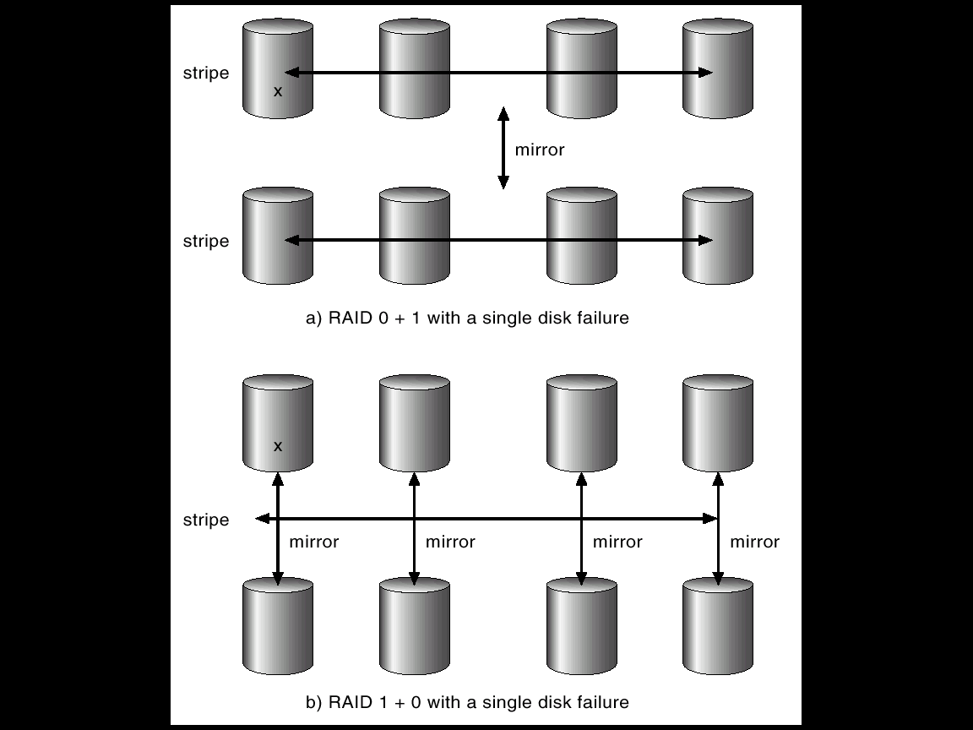
RAID (0 + 1) and (1 + 0)
Performance
Reliability
Copy the whole stripe
One disk fails,
all stripe fail
For both reliability &
performance are important

Slide 39
Selecting a RAID Level
One consideration: rebuild performance
  It influences the mean time to failure
  RAID 1: easiest
  RAID 5: can be hours for large disk sets (for rebuild)
  RAID 5 is often preferred for storing large volumes of data
  RAID 6 is not supported currently, but it should offer better reliability then level 5
Other decisions:
  How many disks should be in a given RAID set?
  How many bits should be protected by each parity bit?

Slide 40
Problems with RAID
Not always available: RAID protects against physical media errors, but not other h/w and s/w errors.
Lack of flexibility: what if one file system is too large? And what if another file system need very little space? Where disk use and requirements change over time.
  Some volume managers do not allow us to change a volume’s size. And if it’s OK, the file systems would need to be recreated.
Solution: ZFS

Slide 41
Other Features
Regardless of where RAID implemented, other useful features can be added
Snapshot is a view of file system before a set of changes take place (i.e. at a point in time)
Replication is automatic duplication of writes between separate sites
  For redundancy and disaster recovery
  Can be synchronous or asynchronous
Hot spare disk is unused (standby), automatically used by RAID production if a disk fails to replace the failed disk and rebuild the RAID set if possible
  Decreases mean time to repair
RAID 5 + Hot Spare vs. RAID 6

Slide 42
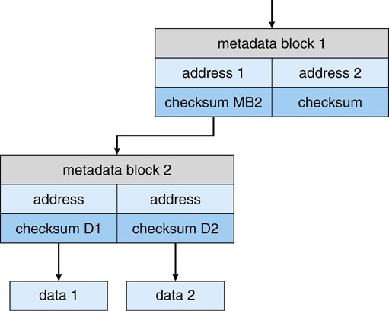
Solaris ZFS: Not always available
Checksums: a technique which is used to verify the integrity of data and metadata.
  These checksums are not kept with the block that is being checksummed. Rather, they are stored with the pointer to that block.
  If there is a problem with the data, the checksum will be incorrect.
  If the data are mirrored, and there is one (another) block with a correct (incorrect) checksum, ZFS will update the bad one.

Slide 43
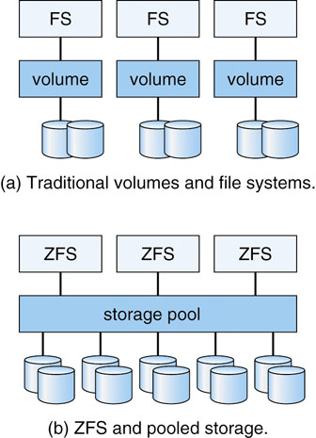
Solaris ZFS: Lack of flexibility
ZFS combines file-system management and volume management into a unit providing greater functionally then the traditional separation of those functions allows.
  Disks, or partitions of disks, are gathered together via RAID sets into pools of storage.
  A pool can hold one or more ZFS file systems.
  The entire pool’s free space is available to all file systems within the pool.
  There is no artificial limits on storage use and no need to relocate file systems between volumes.

Slide 44
Stable-Storage Implementation
Write-ahead log scheme requires stable storage
To implement stable storage
  Replicate information on more than one nonvolatile storage media with independent failure modes
  Update information in a controlled manner to ensure that we can recover the stable data after any failure during data transfer or recovery

Slide 45
Stable-Storage Implementation
Disk write has 1 of 3 outcomes
  Successful completion - The data were written correctly on disk
  Partial failure - A failure occurred in the midst of transfer, so only some of the sectors were written with the new data, and the sector being written during the failure may have been corrupted
  Total failure - The failure occurred before the disk write started, so the previous data values on the disk remain intact

Slide 46
Stable-Storage Implementation
If failure occurs during block write, recovery procedure restores block to consistent state
  System maintains 2 physical blocks per logical block and does the following:
  Write to 1st physical
  When successful, write to 2nd physical
  Declare complete only after second write completes successfully

