Slide 1
Chapter 11
File-System Interface

Slide 2
Outline
File Concept
Access Methods
Directory Structure
File System Mounting
File Sharing
Protection

Slide 3
File Structure
None - sequence of words, bytes
Simple record structure
  Lines
  Fixed length
  Variable length
Complex Structures
  Formatted document
  Relocatable load file, .Obj
Can simulate last two with first method by inserting appropriate control characters.

Slide 4
File Attributes
Name
Type – needed for systems that support different types.
Location – pointer to file location on device
Size – current file size
Protection – controls who can do reading, writing, executing
Time, date, and user identification – data for protection, security, and usage monitoring
Information about files are kept in the directory structure, which is maintained on the disk

Slide 5
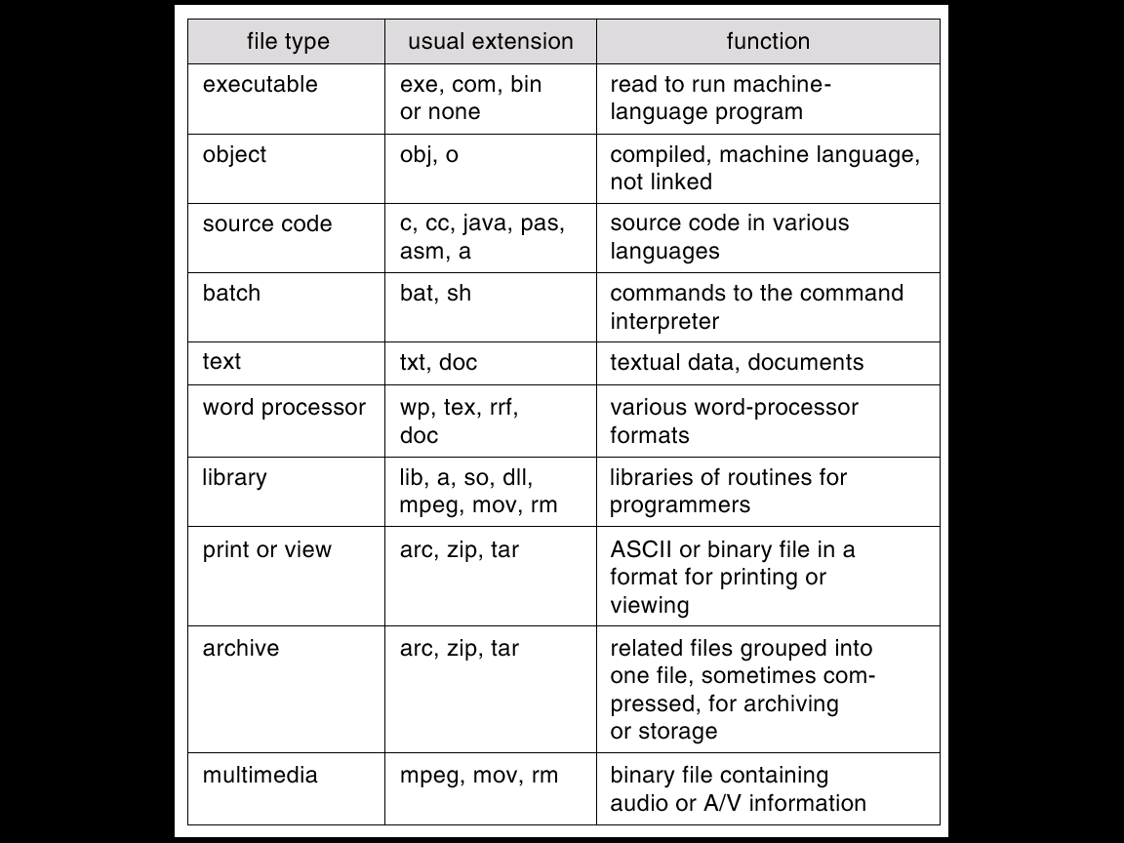
File Types – Name, Extension

Slide 6
File Operations
Create
Write
Read
Reposition within file – file seek
Delete
Truncate
Open(F_{i}) – search the directory structure on disk for entry F_{i} and move the content of entry to memory.
Close (F_{i}) – move the content of entry F_{i} in memory to directory structure on disk.

Slide 7
Open Files
Issues in open files
  File pointer: pointer to last read/write location
  File-open count: # of times a file is open
    allow removal of data from open-file table when the last process closes it.
  Disk location of the file: cache of data access information
  Access rights: per-process access mode information
Notes:
7

Slide 8
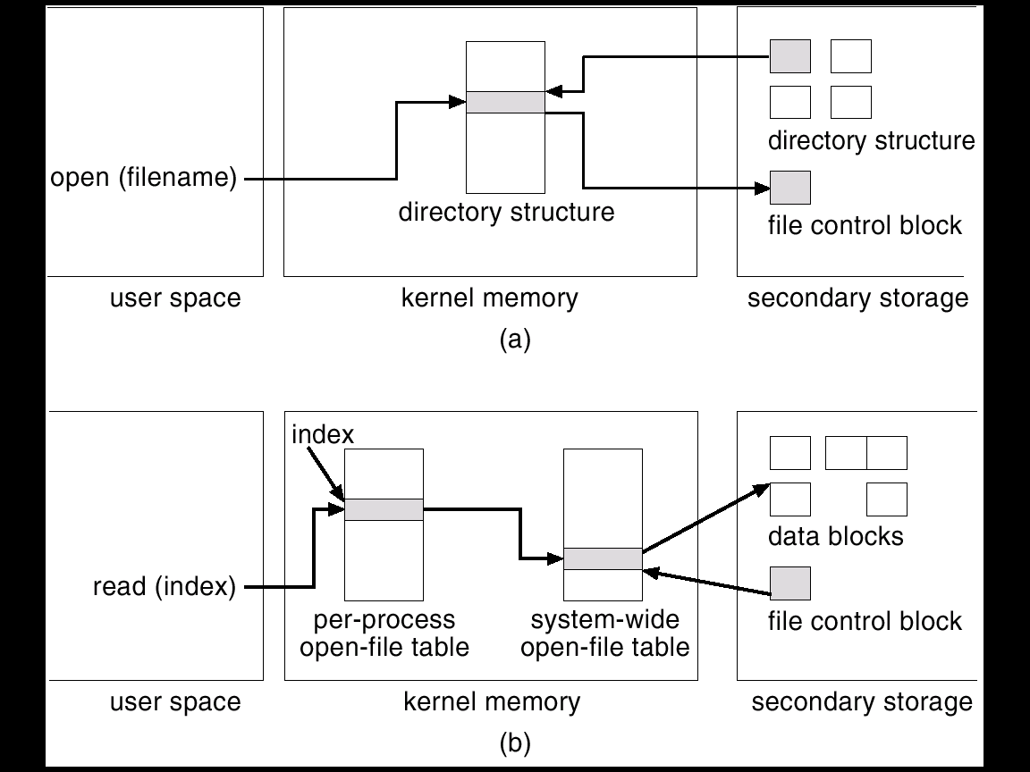
In-Memory File System Structures

Slide 9
Open File Locking
Lock a open file: Allows one process to lock file and prevent other processes from gaining access to it.
Similar to readers-writers locks: shared lock and exclusive lock (write lock)
Mandatory or advisory:
  Mandatory – access is denied depending on locks held and requested
  Advisory – processes can find status of locks and decide what to do
Notes:
9

Slide 10
OS and Disk I/O
Advantages for OS to know the file type
  avoid some mistakes (e.g., print a binary-object)
  TOPS-20: if source program has been modified, running an old .obj file causes re-compiling automatically
  Windows: doubling clicking a .doc file invokes MS Words
Disk I/O performs in units of one block
  logical records ⇒ packing ⇒ a physical block
  all file systems have internal fragmentation
    larger block ⇒ larger internal fragmentation

Slide 11
Access Methods
Sequential access: records are processed in order
  read/write (next)
  reset to beginning, skip forward/backward
Direct access (disks)
  position (seek) to the n-th record
  read/write
Other (direct access+index)
  index table (in memory if necessary)
    the index, like an index in the back of a book, contains pointers to the various blocks.
  file in disk
  J: reduce I/O for searching on a large file
content search
keyword, … etc.

Slide 12
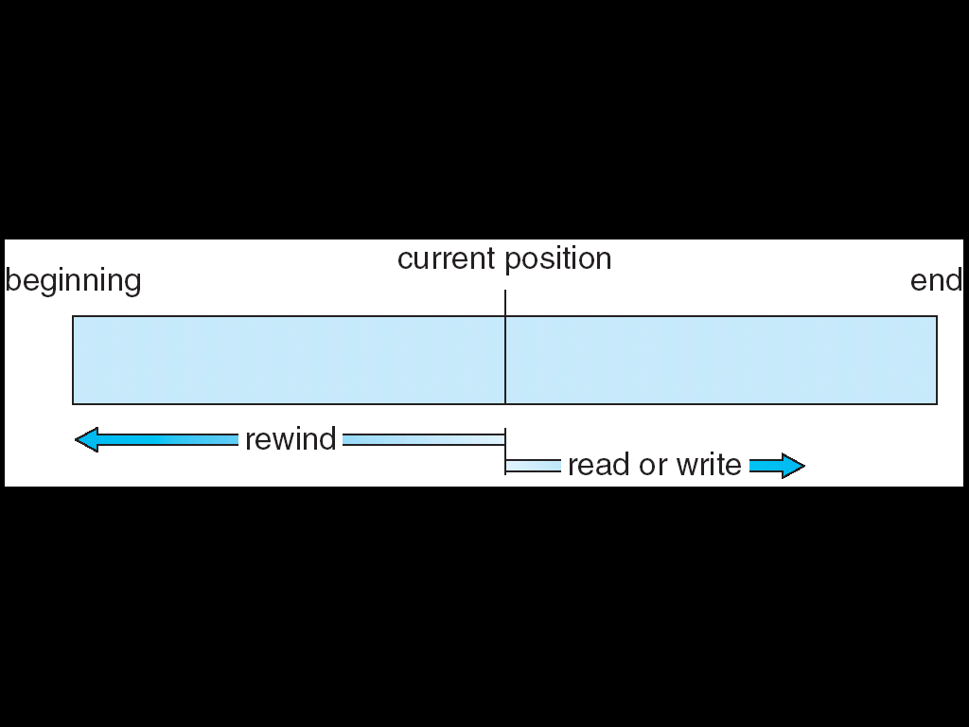
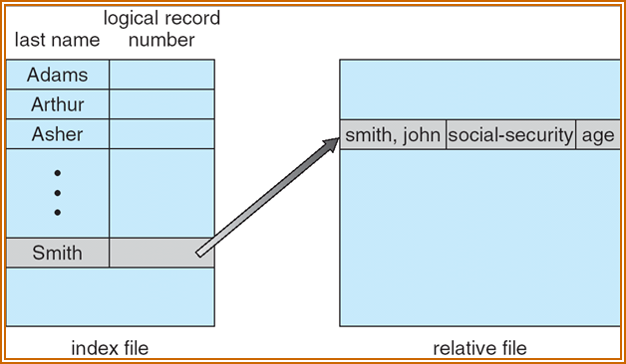
Sequential-access File
Index and Relative Files

Slide 13
Directory Structure (1)
A collection of nodes containing information about all files
Directory
Files
F 1
F 2
F 3
F 4
F n
Both the directory structure and the files reside on disk.
Backups of these two structures are kept on tapes.

Slide 14
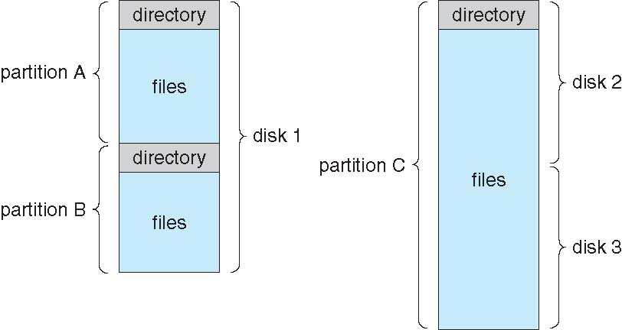
Directory Structure (2)
Typical file-system organization
  disk → partitions (IBM: minidisk, PC: volume)
      → files (including directories)

Slide 15
Directory Structure (3)
Directory structures
  Single-level directory
  Two-level directory
  Tree-structured directory (more common)
  Acyclic-graph directory
  (cycle-detection is expensive)
  General graph directory
  (garbage collection is expensive)
flexible
complicated

Slide 16
Operations Performed on Directory
Search for a file
Create a file
Delete a file
List a directory
Rename a file
Traverse the file system

Slide 17
Organize the Directory (Logically)
Efficiency – locating a file quickly
Naming – convenient to users
  Two users can have same name for different files.
  The same file can have several different names.
Grouping – logical grouping of files by properties, (e.g., all Java programs, all games, …)

Slide 18
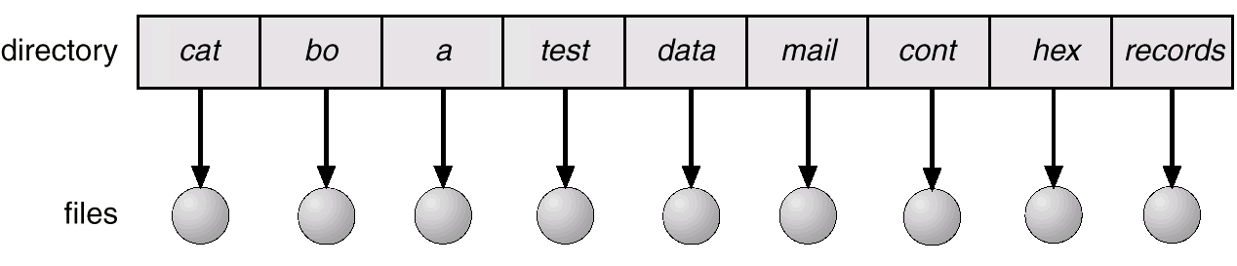
Single-Level Directory
A single directory for all users
Naming problem
L:1. difficult to remember all names
2. not easy to give a new name
3. confusion between different users
Grouping problem

Slide 19
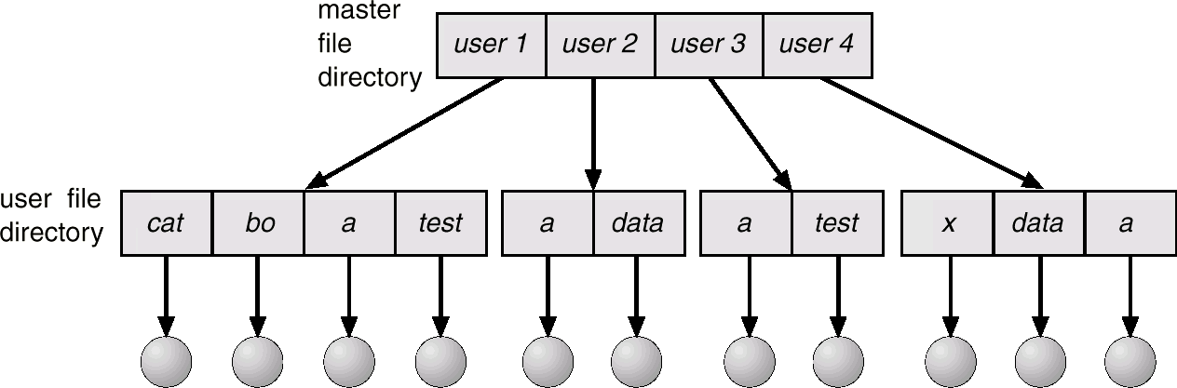
Two-Level Directory
Separate directory for each user
path name: user name + file name
the same file name for different users
efficient searching
no grouping capability

Slide 20
Tree-structured Directory
each user has a current directory
absolute path name vs. relative path name
search path
root
spell obj program
current
directory
stat mail dist test
pe2 cc
pas a
jaja ab
cat bo a test
mail\jaja, or
\spell\mail\jaja

Slide 21
Acyclic-Graph Directory (1)
root
spell obj program
cat mail dist pe2
pe2 cc
pasc a
cat bo a test
shared files or directories: any changes
are immediately visible to others
Version control mechanism

Slide 22
Acyclic-Graph Directory (2)
Two different names (aliasing), cause some problems:
  traverse the entire file system,
  copy all files to backup storage, …
dangling pointer
Solutions:
  Backpointers, so we can delete all pointers
  Entry-hold-count
Do not want to traverse shared files twice
find, statistics on all files, backup

Slide 23
General Graph Directory
  L: How do we guarantee no cycle?
    Searching/traversing is difficult
      search a directory twice
      Solution: limit # of directories that can be accessed.
      infinite loop
    Deletion is more complicated
      Self-reference: a set of files with nonzero reference-count that are impossible to refer, the possibility of self-referencing (a cycle) in the directory structure.
      Solution: garbage collection (very expensive)
If cycles exist

Slide 24
General Graph Directory
root
spell obj program
cat mail dist pe2
pe2 cc
pasc a
root bo a test

Slide 25
File System Mounting
A file system must be mounted before it can be accessed
A unmounted file system is mounted at a mount point

Slide 26
File Sharing and Naming
Sharing of files on multi-user systems is desirable. (shared READ, shared WRITE?)
Sharing may be done through a protection scheme.
On distributed systems, files may be shared across a network
Network File System (NFS) is a common distributed file-sharing method
Domain Name System (DNS)
Distributed Naming Mechanism, LDAP
www.xx.nthu.tw → 140.114.yyy.zzz
Lightweight directory access protocol

Slide 27
File Sharing – Remote File Systems
Uses networking to allow file system access between systems
  Manually via programs like FTP
  Semi automatically via the world wide web
  Automatically, seamlessly using distributed file systems

Slide 28
File Sharing – Client-server model
Allows clients to mount remote file systems from servers
  Server can serve multiple clients
  Standard OS file calls are translated into remote calls
  Client and user-on-client identification is insecure or complicated
  NFS is standard UNIX client-server file sharing protocol
  CIFS is standard Windows protocol
single sign-on

Slide 29
File Sharing
Distributed Information Systems
Distributed Information Systems (distributed naming services) such as LDAP, DNS, NIS, Active Directory implement unified access to information needed for remote computing
  NIS (Network Information Service): Sun Micro introduced yellow pages

Slide 30
File Sharing – Failure Modes
Remote file systems add new failure modes, due to network failure, server failure
Recovery from failure can involve state information about status of each remote request
Stateless protocols such as NFS include all information in each request, allowing easy recovery but less security
State info maintained on both
The client and the server
No requisite mount and
permission check

Slide 31
File Sharing–Consistency Semantics(1)
Specify how multiple users are to access a shared file simultaneously
  Similar to Ch. 5 process synchronization algorithms (complex)
  Tend to be less complex due to disk I/O and network latency
  Andrew File System (AFS) implemented complex remote file sharing semantics
    AFS has session semantics: writes only visible to sessions starting after the file is closed
use simple version
e.g. file session: (open(), …, close())
CMU, 1983
Writes to an open file are not visible immediately to others
that have the same file open.
Perform read and write
access without delay

Slide 32
File Sharing–Consistency Semantics(2)
  Unix file system (UFS) implements
    Writes to an open file visible immediately to other users of the same open file
    Sharing file pointer to allow multiple users to read and write concurrently
Perform read and write
access with delay if contention occurs

Slide 33
Protection
File owner/creator should be able to control
  what can be done
  by whom
Types of access
  Read
  Write
  Execute
  Append
  Delete
  List

Slide 34
Access Lists and Groups
Mode of access: read, write, execute
Three classes of users
RWX
a) owner access 7 ⇒ 1 1 1
RWX
b) group access 6 ⇒ 1 1 0
RWX
c) public access 1 ⇒ 0 0 1
Ask manager to create a group (unique name), say G, and add some users to the group
For a particular file (say game) or subdirectory, define an appropriate access
owner
group
public
chmod
761
game

Slide 35
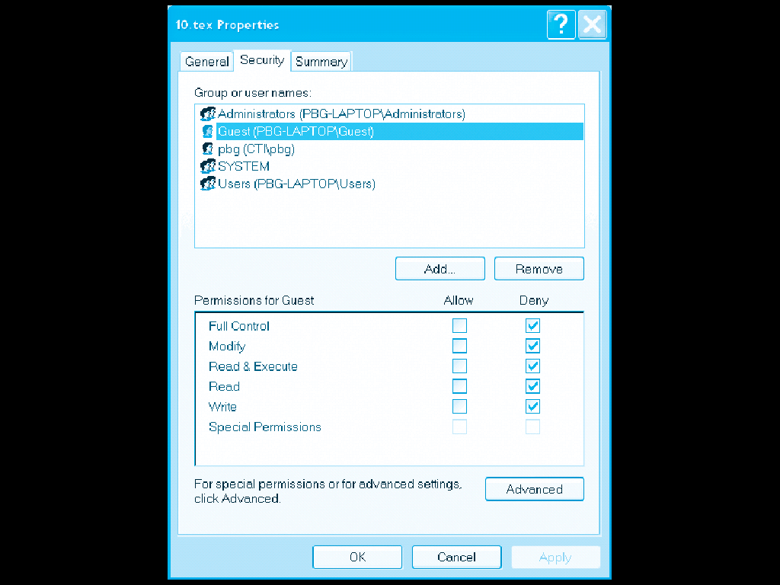
Windows XP Access-control List Management

Slide 36
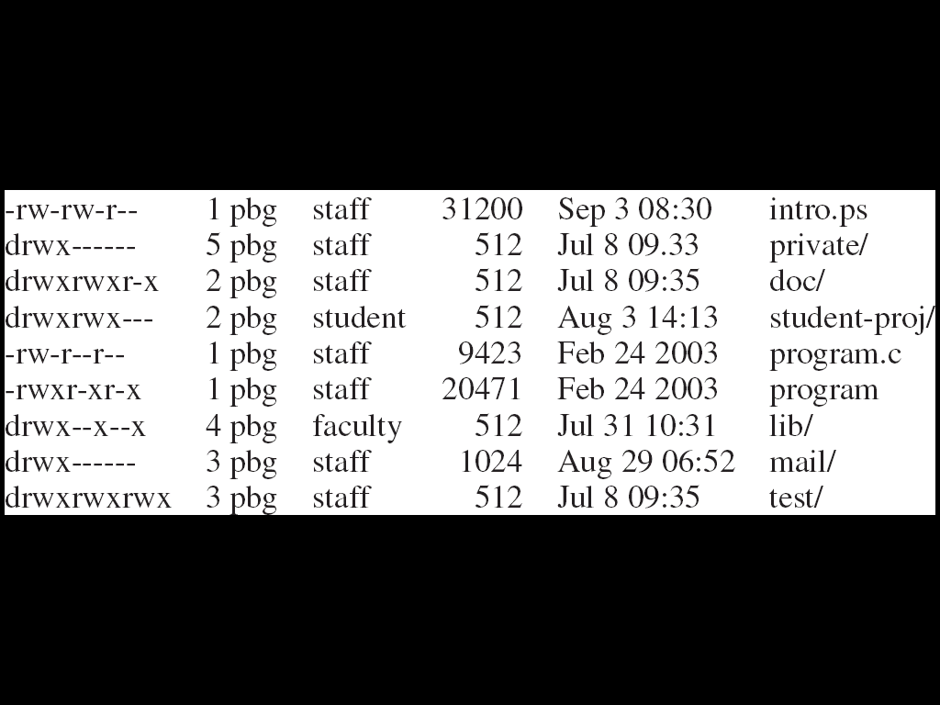
A Sample UNIX Directory Listing

