Slide 1
Chapter 12
File-System Implementation

Slide 2
Outline
File System Structure
File System Implementation
Directory Implementation
Allocation Methods
Free-Space Management
Efficiency and Performance
Recovery
Log-Structured File Systems
NFS
Example: WAFL File System

Slide 3
File-System Structure
File structure
  Logical storage unit
  Collection of related information
File system resides on secondary storage (disks)
File system organized into layers
File control block – storage structure consisting of information about a file

Slide 4
Layered File System
file name
Application Programs
write(data_file, item)
Given a symbolic file name,
use directory to provide
values needed by FOM
Logical File System
information
of data_file
Transform logical address to
physical block address
File-Organization Module
2144th block
Basic File System
Numeric disk address
driver 1, cylinder 73,
surface 2, sector 10
I/O Control
Driver: hardware instructions
Devices

Slide 5
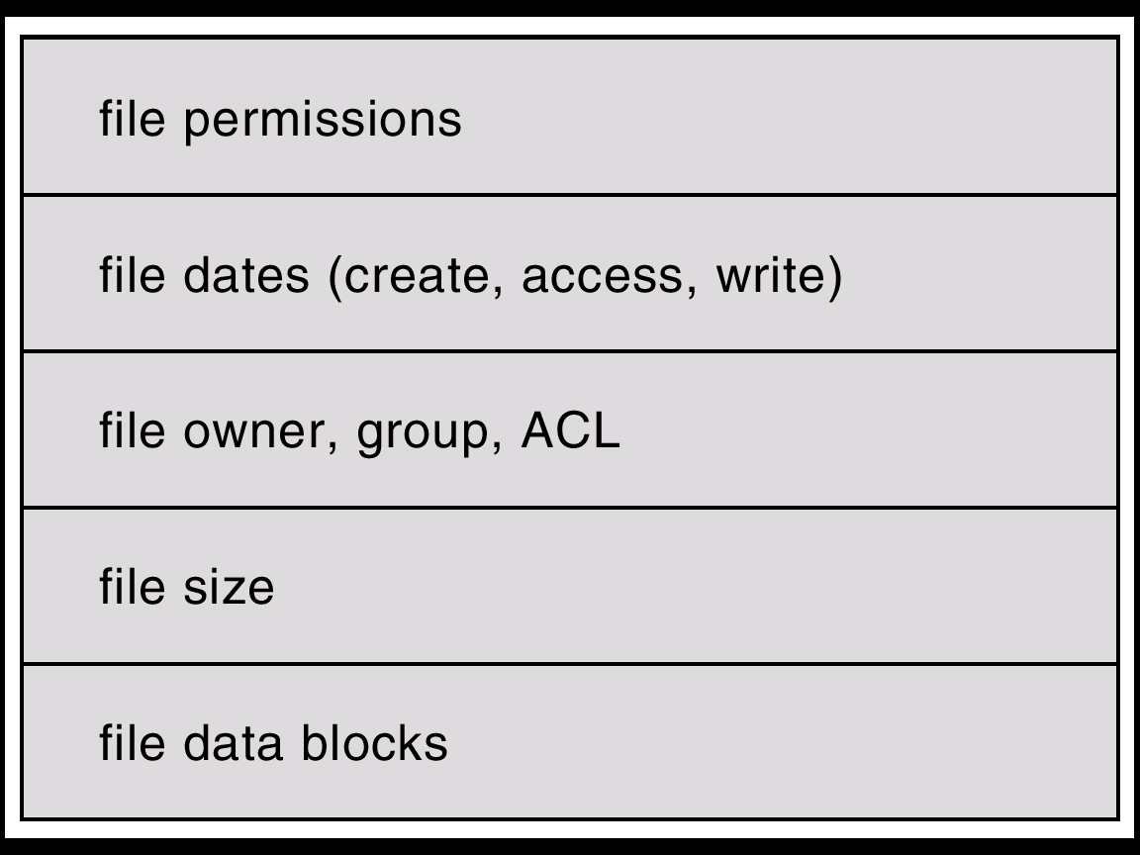
A Typical File Control Block

Slide 6
On-Disk and In-Memory
On-disk: boot control block, partition control block, directory structure, FCB (inode)
  Partition control block (superblocks in UFS, Master File Table in NTFS): # of blocks, size of the blocks, free-block count and pointers, and free FCB count and pointers.
In-memory: in-memory partition table (mounted), in-memory directory structure (recently accessed), system-wide open-file table (FCB for each open file), per-process open-file table

Slide 7
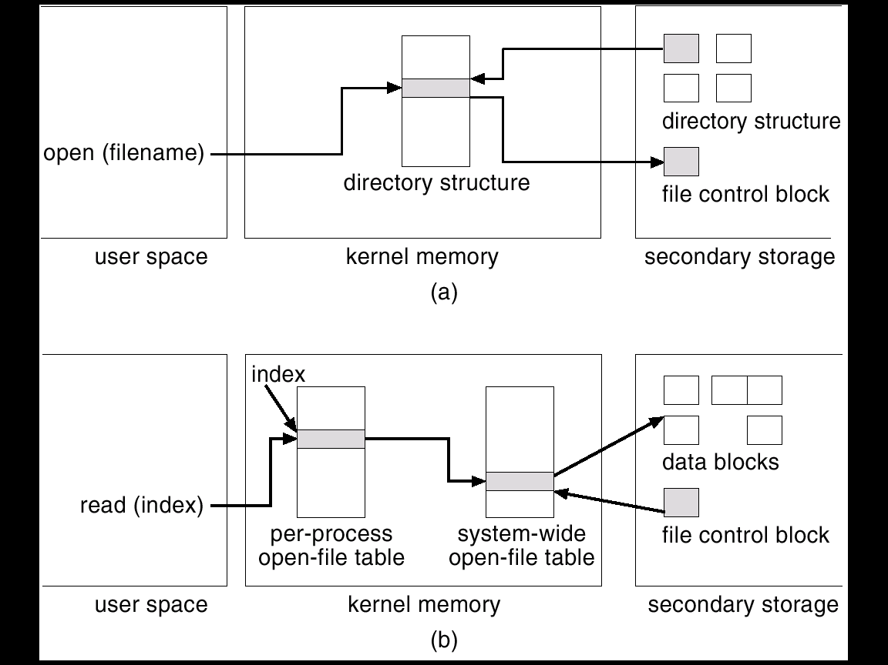
In-Memory File System Structures

Slide 8
Virtual File Systems
Virtual File Systems (VFS) provide an object-oriented way of implementing file systems.
VFS allows the same system call interface (the API) to be used for different types of file systems.
The API is to the VFS interface, rather than any specific type of file system.

Slide 9
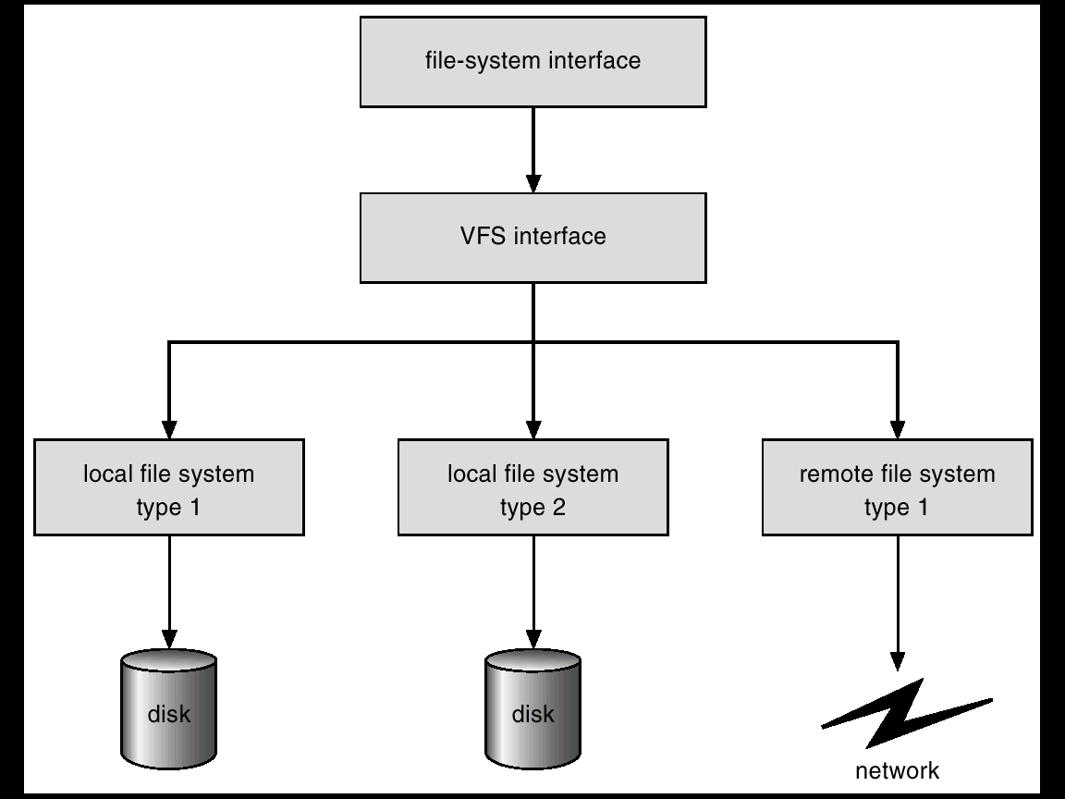
Schematic View of Virtual File System
generic operations
vnode: network-wide uniqueness

Slide 10
Directory Implementation
Linear list of file names with pointer to the data blocks
  simple to program
  ☹ time-consuming to execute
Hash Table – linear list with hash data structure
  f(file name) = pointer of the list
  fixed size
  decreases directory search time
  ☹ collisions – situations where two file names hash to the same location
Advanced structures: B-tree, …

Slide 11
Allocation Methods
An allocation method refers to how disk blocks are allocated for files
Contiguous allocation
Linked allocation
  FAT
Indexed allocation
Block = 32 ~ 4096 bytes, 512 usually

Slide 12
Contiguous Allocation
J: 1. Reduce seek time for contiguous access
    2. Access is easy
    3. Support both sequential and direct access
L: 1. dynamic allocation problem
      first-fit, best-fit, worst-fit
    2. external fragmentation
      compaction (expensive)
    3. file cannot grow
    4. size estimation (for extension later)
      declaration and pre-allocation (inefficient usage of space)

Slide 13
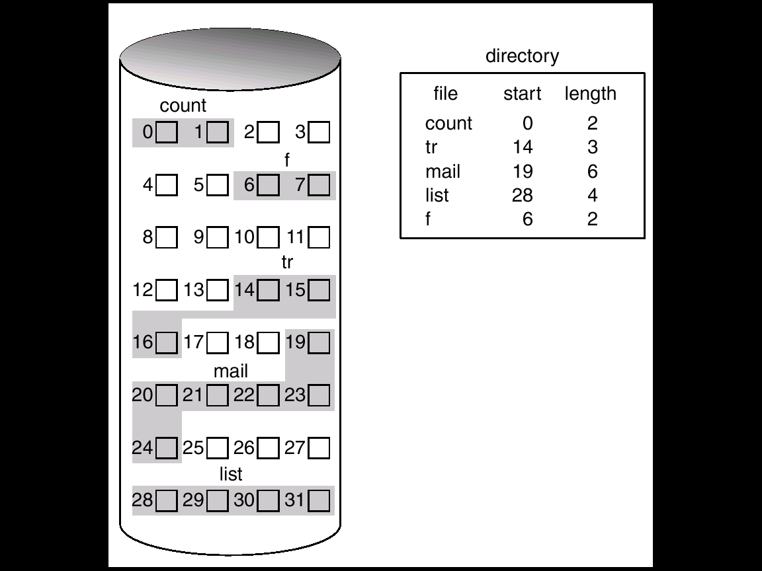
Contiguous Allocation of Disk Space

Slide 14
Extent-Based Systems
Many newer file systems (i.e. Veritas File System) use a modified contiguous allocation scheme
Extent-based file systems allocate disk blocks in extents
An extent is a contiguous block of disks. Extents are allocated for file allocation. A file consists of one or more extents
Internal fragmentation and external fragmentation

Slide 15
Linked Allocation (1)
Each file is a linked list of disk blocks: blocks may be scattered anywhere on the disk
J: 1. Simple – need only starting address
2. Free-space management system – no waste of space
3. No external fragmentation
    2. Easy to create a file (no allocation problem)
L: 1. only better for sequentially access
    2. pointers require space
    3. reliability (damaged pointers)

Slide 16
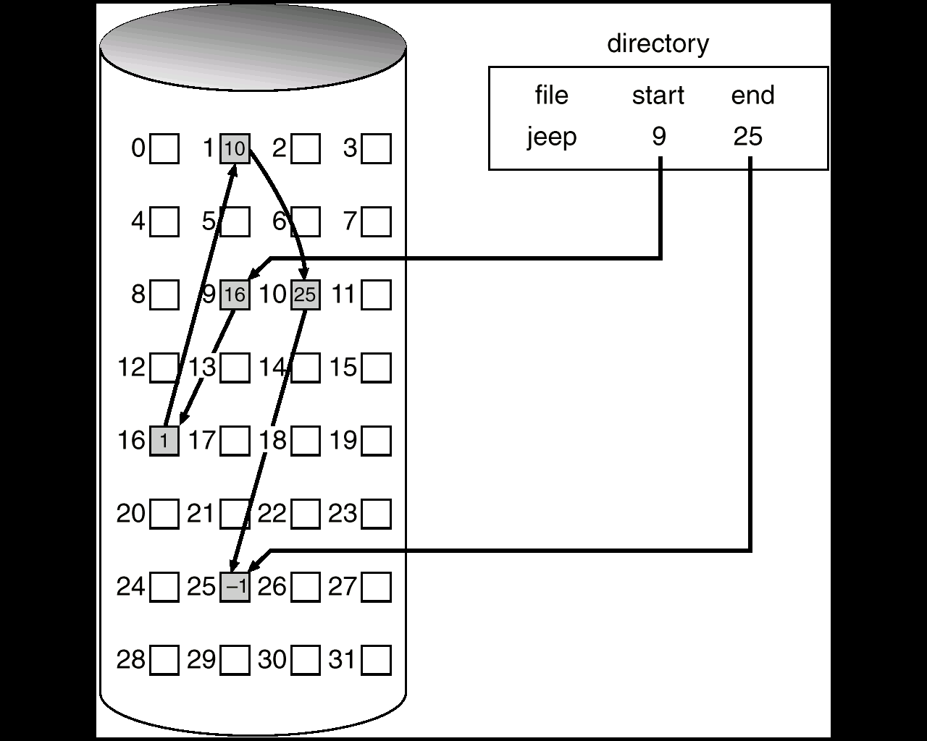
Linked Allocation (2)

Slide 17
File-Allocation Table
the simple but efficient method
an variation used by DOS and OS/2
one entry for each disk block, indexed by block number
the table is used as a linked list

Slide 18
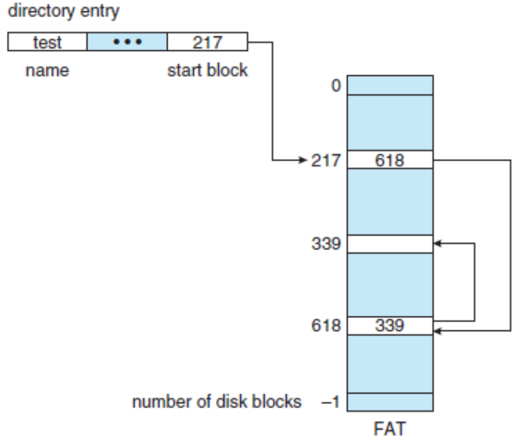
File Allocation Table
1
7
9
12
14
0 1 2 3 4 5 6 7 8 9 10 11 12 13 14 15
7 14 12 1 -1
directory
file start
jeep 9
0
1
(3)
2
3
4
5
6
7
(4)
8
9
(1)
10
11
12
(2)
13
14
(5)
15

Slide 19
Indexed Allocation
Bring all the pointers together into one location: the index block (one for each file)
J: 1. Direct access
    2. No external fragmentation
    2. Easy to create a file (no allocation problem)
    3. Support both sequential and direct access
L: 1. Space for index blocks
    2. How large the index block should be ?
      linked scheme
      multilevel index
      combined scheme (BSD UNIX)

Slide 20
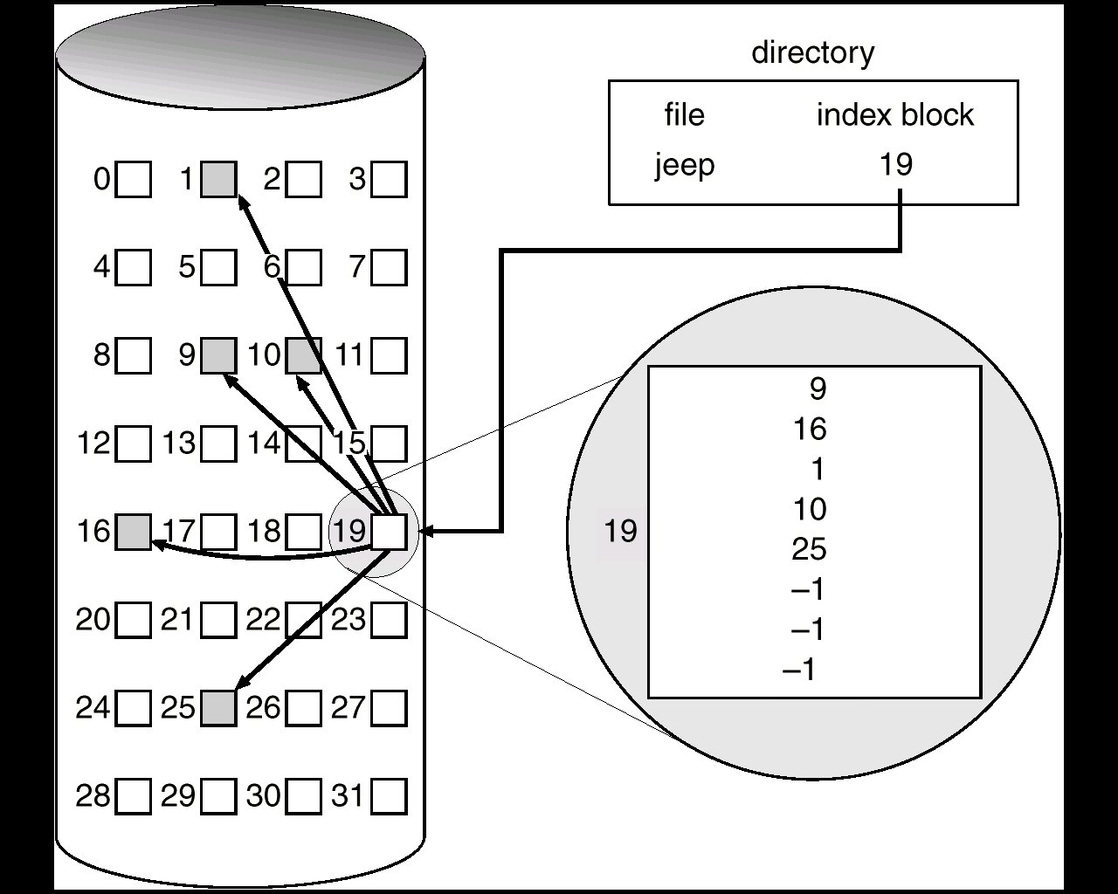
Example of Indexed Allocation

Slide 21
Indexed Scheme
directory
file first index block
jeep 19
φ
next
next
next
data
data
data
data
data
data
data
data
data
data
data
data
19
24
8

Slide 22
19
Multilevel Scheme
(two-level)
data
data
directory
file first index block
jeep 16
data
16
24
data
19
24
8
-1
-1
-1
data
8
data
data
data
data

Slide 23
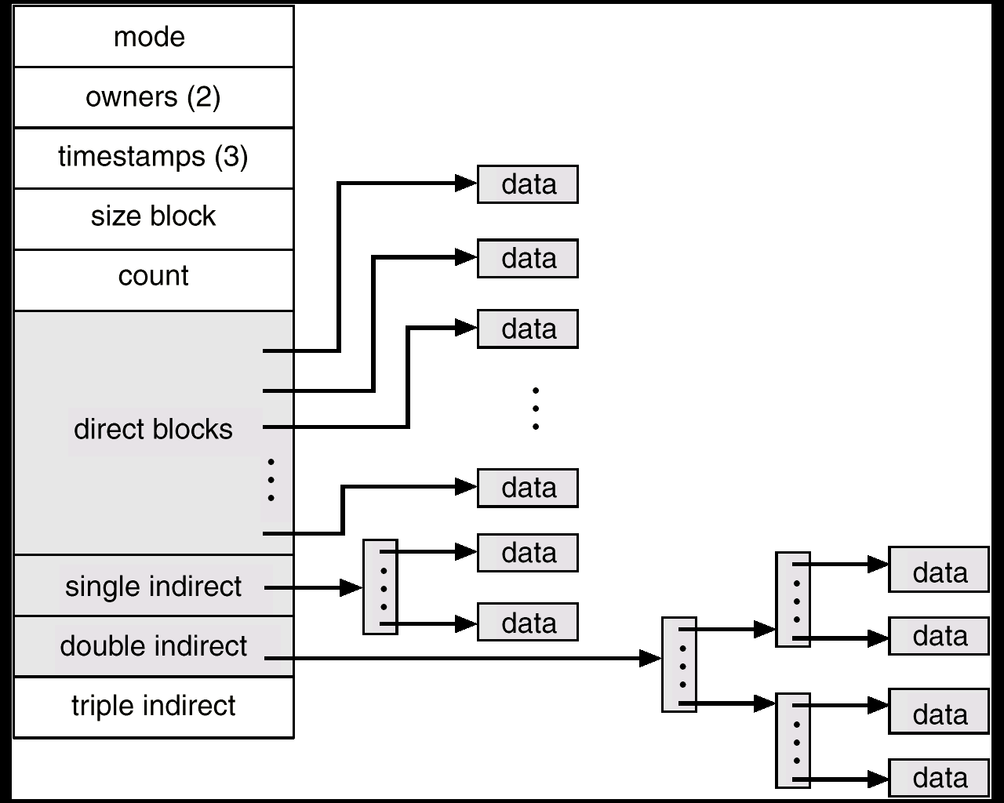
Combined Scheme: UNIX (4K bytes per block)
4B = 32 bits per file pointer
A 32-bit file pointer reaches only 2³²=4×2³⁰=4GB
12×4KB=48KB
12
(4096/4)×4KB=2¹⁰ ×2¹² B
>> 2³² (4GB) for 32-bit file system
2¹⁰ × 2¹⁰ × 2¹² B
2¹⁰ × 2¹⁰ × 2¹⁰ ×2¹² B

Slide 24
Performance (1)
Contiguous vs. Indexed allocation
  Contiguous: one access to get a disk block
  Indexed: read (2 for two-level) first the index block then desired data block
  extremely large file, accessing a block near the end: require reading in all the index blocks
  The performance depend on: index structure, the size of the file, and on the position of the block desired.

Slide 25
Performance (2)
Combine contiguous allocation with indexed allocation
  Contiguous allocation for small files (3 or 4 blocks) and
  Automatically switch to an indexed allocation if the file grows large
  Since most files are small, and contiguous allocation is efficiency for small files, average performance can be quite good.

Slide 26
Free-Space Management (1)
free-space list: used to keep track of free disk space
  Bit vector (bit map)
    one bit for a block (1: free, 0: allocated)
    J: easy to get contiguous files
  Linked list: each free block points to the next
    L: not easy to traverse the list (infrequent action)
    J: No waste of space

Slide 27
Free-Space Management (2)
  Grouping:
      first: store n free blocks;
      n-th free block: store another n free blocks
    J: find a large number of free blocks quickly
  Counting: several contiguous blocks may be allocated or free simultaneously
      a list of (first + no. of free blocks)

Slide 28
Bit Map/Linked List/Grouping/Counting
free-list head
0
grouping (n=3)
1 2,3,7
7 8,9,12
12 14,15,16
16 17,18,-1
1
2
3
4
5
6
7
8
9
10
11
12
13
14
15
16
17
18
19
20
21
22
23
bit map: 011100011100101111100000
counting: (1,3), (7, 3), (12, 1), (14, 5)

Slide 29
Free-Space Management (3)
Space Maps (ZFS)
  ZFS creates metaslabs to divide the space into chunks of manageable size. Each metaslab has an associated space map.
  ZFS uses the counting algorithm to store info about free blocks. Rather than write count structures to disk, it uses log-structured file-system to record them.
  The space map is a log of all block activity (allocating and freeing), in time order, in counting format.
  When ZFS decides to allocate or free space from a metaslab, it loads the associated space map into memory in a balanced-tree structure, indexed by offset, and replays the log into that structure.
  The in-memory space map is then an accurate representation of the allocated and free space in the metaslab.

Slide 30
Free-Space Management (4)
Bit map requires extra space
block size = 2¹² bytes (4 KB)
disk size = 2³⁰ bytes (1 GB)
n = 2³⁰/2¹² = 2¹⁸ bits (or 32K bytes)
Clustering the blocks in groups of four reduces this number.
1-TB disk with 4-KB blocks requires 256 MB

Slide 31
Free-Space Management (5)
Need to protect
  Pointer to free list
  Bit map
    Must be kept on disk
    Copy in memory and disk may differ

Slide 32
Efficiency and Performance
efficient use of disk space
optimize I/O performance
Efficiency dependent on
  disk allocation and directory algorithms
  types of data kept in file’s directory entry
  Pointer size
Performance
  disk cache – separate section of main memory for frequently used blocks (e.g., LRU)
  free-behind and read-ahead – techniques to optimize sequential access
  improve PC performance by dedicating section of memory as virtual disk, or RAM disk.
Last write (access) date
Directory entry must be read and rewritten also.
32-bit? 64-bit? 128-bit (ZFS)

Slide 33
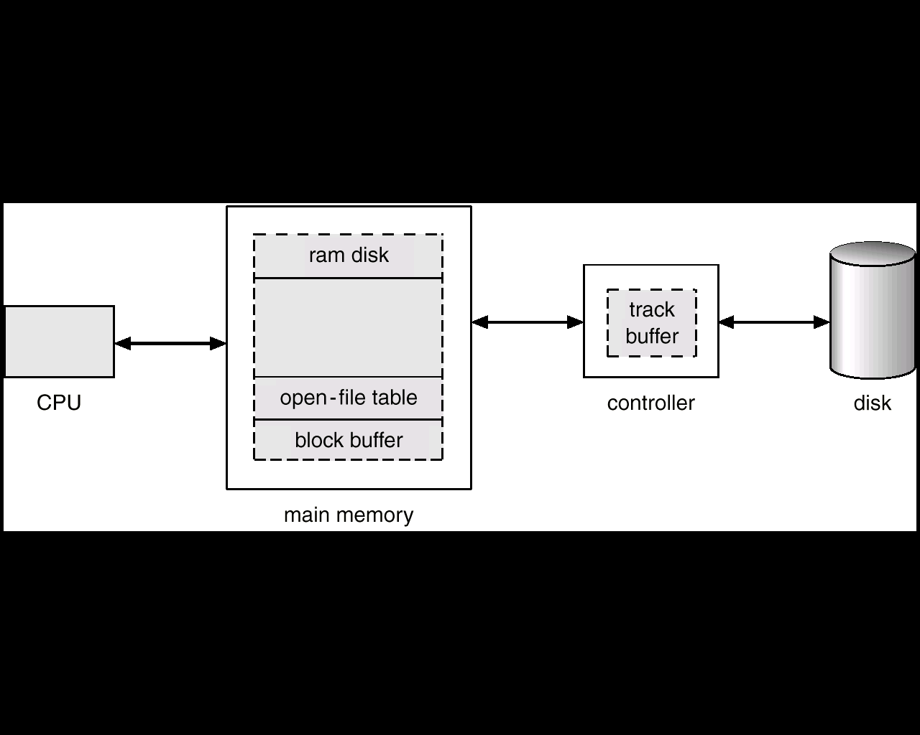
Various Disk-Caching Locations
totally user controlled
Page Cache

Slide 34
Page Cache
A page cache caches pages rather than disk blocks using virtual memory techniques
Memory-mapped I/O uses a page cache
Routine I/O through the file system uses the buffer (disk) cache
Unified VM: process pages and file data

Slide 35
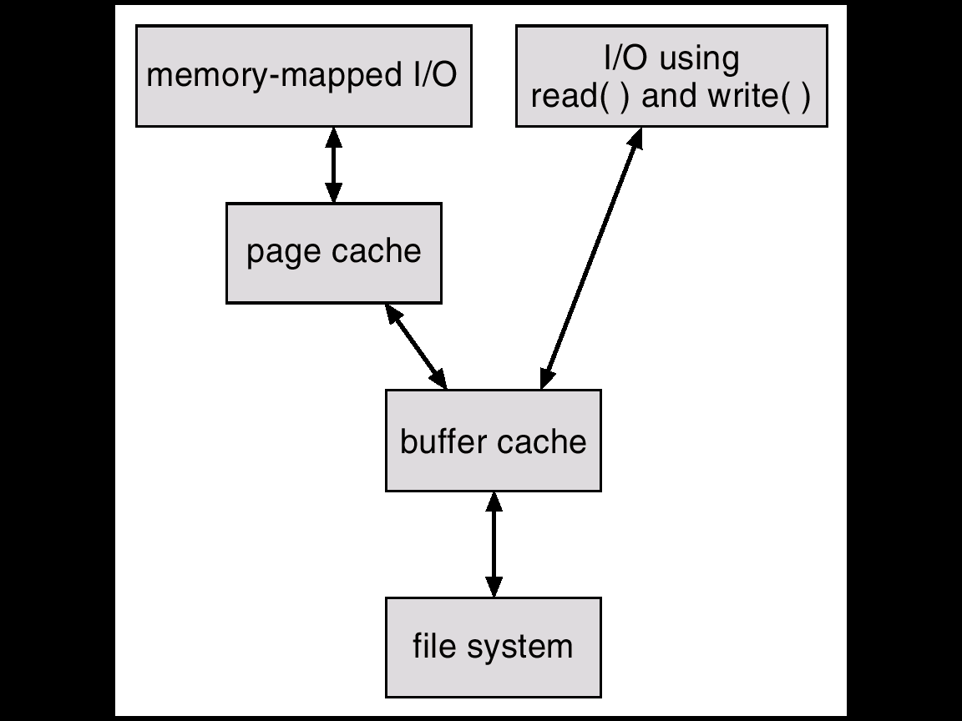
I/O Without a Unified Buffer Cache
Virtual memory controlled
Drawbacks:
inconsistencies
waste MM
waste CPU&I/O
Double caching
I/O controlled

Slide 36
Unified Buffer Cache
Uses the same page cache to cache both memory-mapped pages and ordinary file system I/O
Solaris 7: (when free memory runs low) Priority paging
  Page scanner gives priority to process pages over the page cache
Solaris 8: a fixed limit to process pages and the page cache, preventing either from forcing other out of memory.
Solaris 9, 10: changes the algorithm to maximize memory use and minimize thrashing.

Slide 37
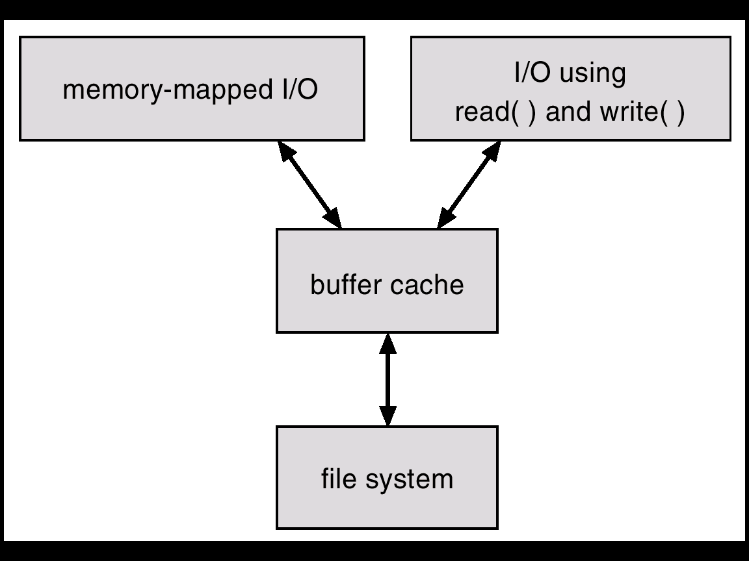
I/O Using a Unified Buffer Cache

Slide 38
Recovery
Consistency checking – compares data in directory structure with data blocks on disk, and tries to fix inconsistencies.
Use system programs to back up data from disk to another storage device (floppy disk, magnetic tape)
Recover lost file or disk by restoring data from backup

Slide 39
Log Structured File Systems
Log structured (or journaling) file systems record each update to the file system as a transaction
All transactions are written to a log. A transaction is considered committed once it is written to the log. However, the file system may not yet be updated
The transactions in the log are asynchronously written to the file system. When the file system is modified, the transaction is removed from the log
If the file system crashes, all remaining transactions in the log must still be performed

Slide 40
The Sun Network File System Client-Server
An implementation and a specification of a software system for accessing remote files across LANs (or WANs)
The implementation is part of the Solaris and SunOS operating systems running on Sun workstations using an unreliable datagram protocol (UDP/IP) or TCP/IP protocol and Ethernet

Slide 41
NFS (1)
Interconnected workstations viewed as a set of independent machines with independent file systems, which allows sharing among these file systems in a transparent manner
  A remote directory is mounted over a local file system directory. The mounted directory looks like an integral subtree of the local file system, replacing the subtree descending from the local directory
  Specification of the remote directory for the mount operation is nontransparent; the host name of the remote directory has to be provided. Files in the remote directory can then be accessed in a transparent manner
  Subject to access-rights accreditation, potentially any file system (or directory within a file system), can be mounted remotely on top of any local directory

Slide 42
NFS (2)
NFS is designed to operate in a heterogeneous environment of different machines, operating systems, and network architectures; the NFS specifications independent of these media
This independence is achieved through the use of RPC primitives built on top of an External Data Representation (XDR) protocol used between two implementation-independent interfaces
The NFS specification distinguishes between the services provided by a mount mechanism and the actual remote-file-access services
  Two protocols: mount protocol and NFS protocol

Slide 43
NFS Mount Protocol (1)
Establishes initial logical connection between server and client
Mount operation includes name of remote directory to be mounted and name of server machine storing it
  Mount request is mapped to corresponding RPC and forwarded to mount server running on server machine
  Export list – specifies local file systems that server exports for mounting, along with names of machines that are permitted to mount them
server maintains, such as /etc/dfs/dfstab

Slide 44
NFS Mount Protocol (2)
Following a mount request that conforms to its export list, the server returns a file handle—a key for further accesses
File handle – a file-system identifier, and an inode number to identify the mounted directory within the exported file system
The mount operation changes only the user’s view and does not affect the server side
to the client

Slide 45
NFS Protocol
Provides a set of remote procedure calls for remote file operations. The procedures support the following operations:
  searching for a file within a directory
  reading a set of directory entries
  manipulating links and directories
  accessing file attributes
  reading and writing files
NFS servers are stateless; each request has to provide a full set of arguments
Modified data must be committed to the server’s disk before results are returned to the client (lose advantages of caching)
The NFS protocol does not provide concurrency-control mechanisms
stateless server
validity check

Slide 46
Three Major Layers of NFS Architecture
UNIX file-system interface (based on the open, read, write, and close calls, and file descriptors)
Virtual File System (VFS) layer – distinguishes local files from remote ones, and local files are further distinguished according to their file-system types.
  The VFS activates file-system-specific operations to handle local requests according to their file-system types.
  Calls the NFS protocol procedures for remote requests.
NFS service layer – bottom layer of the architecture; implements the NFS protocol

Slide 47
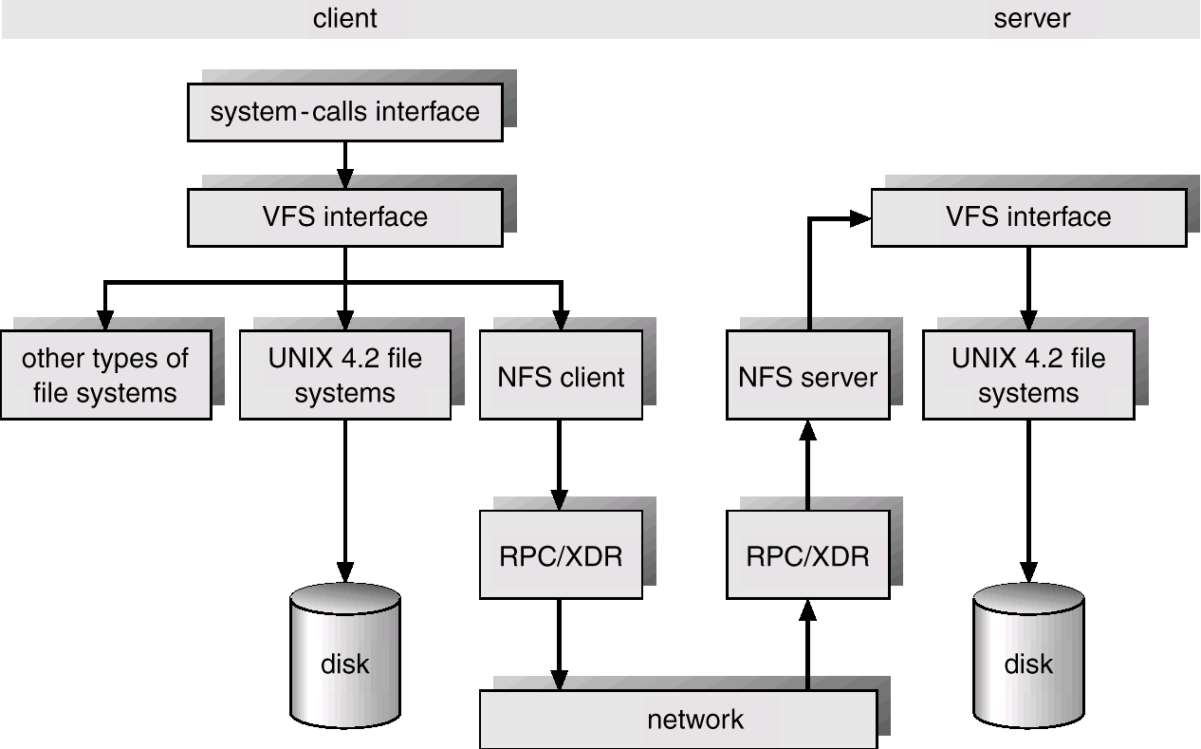
Schematic View of NFS Architecture
UNIX file-system interface
Mount Protocol
❶
stateless
❷
file handle
❸

Slide 48
NFS Path-Name Translation
Performed by breaking the path into component names and performing a separate NFS lookup call for every pair of component name and directory vnode
To make lookup faster, a directory name lookup cache on the client’s side holds the vnodes for remote directory names

Slide 49
NFS Remote Operations
Nearly one-to-one correspondence between regular UNIX system calls and the NFS protocol RPCs (except opening and closing files)
NFS adheres to the remote-service paradigm, but employs buffering and caching techniques for the sake of performance
File-blocks cache – when a file is opened, the kernel checks with the remote server whether to fetch or revalidate the cached attributes. Cached file blocks are used only if the corresponding cached attributes are up to date
File-attribute cache – the attribute cache is updated whenever new attributes arrive from the server.
Clients do not free delayed-write blocks until the server confirms that the data have been written to disk
inode info

Slide 50
Example: WAFL File System
NetApp
Used on Network Appliance “Filers” – distributed file system appliances
“Write-anywhere file layout”
Serves NFS, CIFS, http, ftp to the clients
Random I/O optimized, write optimized
  NVRAM for write caching
Similar to Berkeley Fast File System, with extensive modifications
non-volatile memory

Slide 51
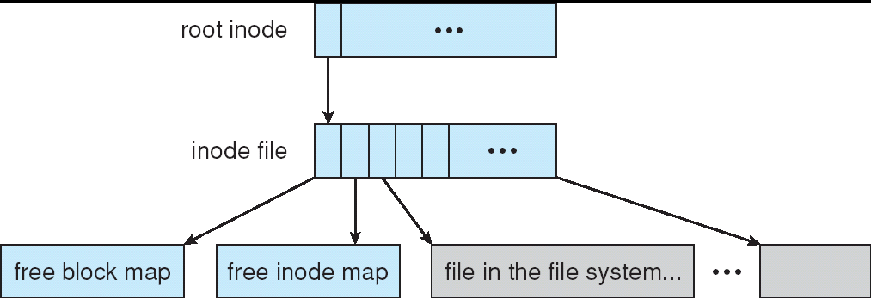
The WAFL File Layout
Each inode contains 16 pointers to blocks (or indirect blocks)
All of the metadata lives in files
Free-block map has more than one bit per block,
a bit set for each snapshot.
Used blocks are never overwritten, so writes are very fast.

Slide 52
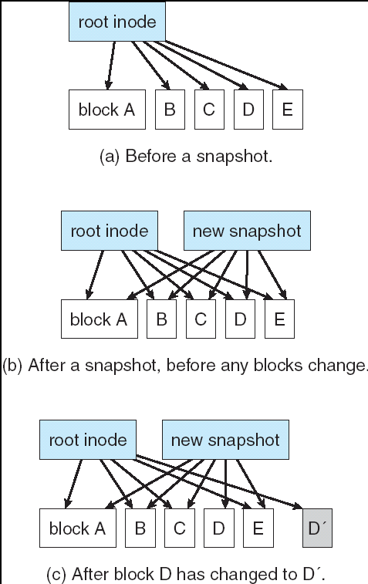
Snapshots in WAFL
Any updates (file or metadata) go to
new blocks rather than overwriting
their existing blocks.
Clone: read-write snapshot
replication: the duplication and
synchronization of a set of data
over a network to another system.

Slide 53
Representational State Transfer (REST)
In computing, representational state transfer (REST) is an architectural style of application programming interfaces consisting of a coordinated set of components, connectors, and data elements.
RESTful systems: communicate over HTTP with the same HTTP verbs (GET, POST, PUT, DELETE, etc.) that web browsers use to retrieve web pages and to send data to remote servers.
REST constraints: Client–server, Stateless, Cacheable, Layered system, Code on demand (optional), Uniform interface, Identification of resources (URI), …
REST vs. RPC(SOAP, XML-RPC)
  REST is an architectural style, while SOAP is a protocol
  REST is more predictable than RPC as it relies on the shared semantic of HTTP verbs.

Slide 54
Stateless Servers, NFS
Each request must be self-contained
Each request identifies the file and position in the file
No need to establish and terminate a connection by open and close operations
Advantages:
  A file server crash does not affect clients
  Simple
Disadvantage:
  Impossible to enforce consistency
  RPC needs to contain all state, longer

Slide 55
Stateful Servers, AFS
Mechanism
  Client opens a file
  Server fetches information about the file from its disk, store in memory, gives client a unique connection id and open file
  id is used for subsequent accesses until the session ends
Advantages:
  Fewer disk access
  Read-ahead possible
  RPCs are small, contains only an id
  File may be cached entirely on client, invalidated by the server if there is a conflicting write
Disadvantage:
  Server loses all its volatile state in crash
  Restore state by dialog with clients, or abort operations that underway when crash occurred
  Server needs to be aware of client failures

Slide 56
Write-on-close
Modification written back to server when file close
  Reduces intermediate read and write traffic while file is open
Write-on-close
  Server load and network traffic reduced
  Contacts server only on open and close
  Retain across reboots
  Require local disk, large enough

