Slide 1
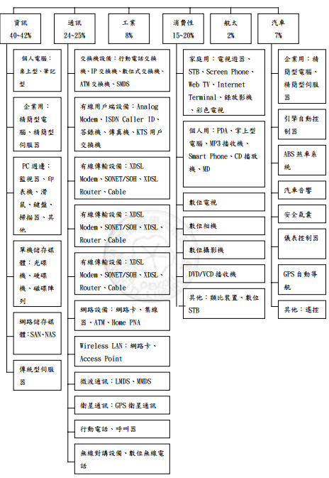
Chapter 13
I/O Systems

Slide 2
Outline
I/O Hardware
Application I/O Interface
Kernel I/O Subsystem
Transforming I/O Requests to Hardware Operations
Streams
Performance

Slide 3
I/O Hardware
Incredible variety of I/O devices
Common concepts
  Port
  Bus (daisy chain or shared direct access)
  Controller (host adapter)
I/O instructions control devices
Devices have addresses, used by
  Direct I/O instructions
  Memory-mapped I/O: registers are mapped into the address space of CPU, READ and WRITE by standard data-transfer instructions

Slide 4
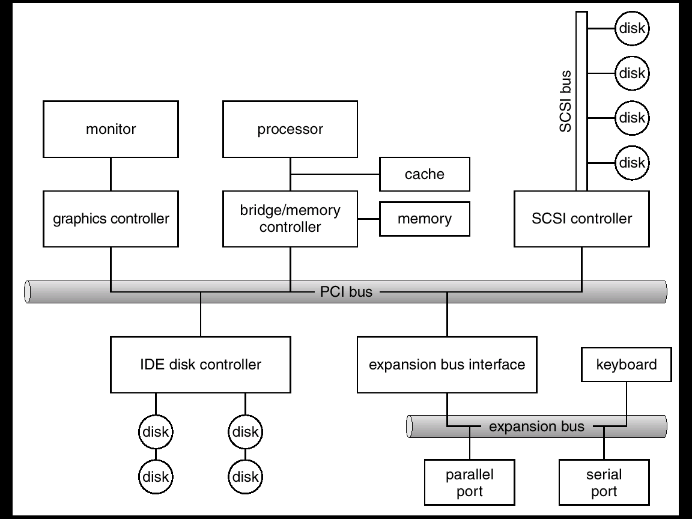
A Typical PC Bus Structure
co-processors
PCIx, PCIe, HyperTransport

Slide 5
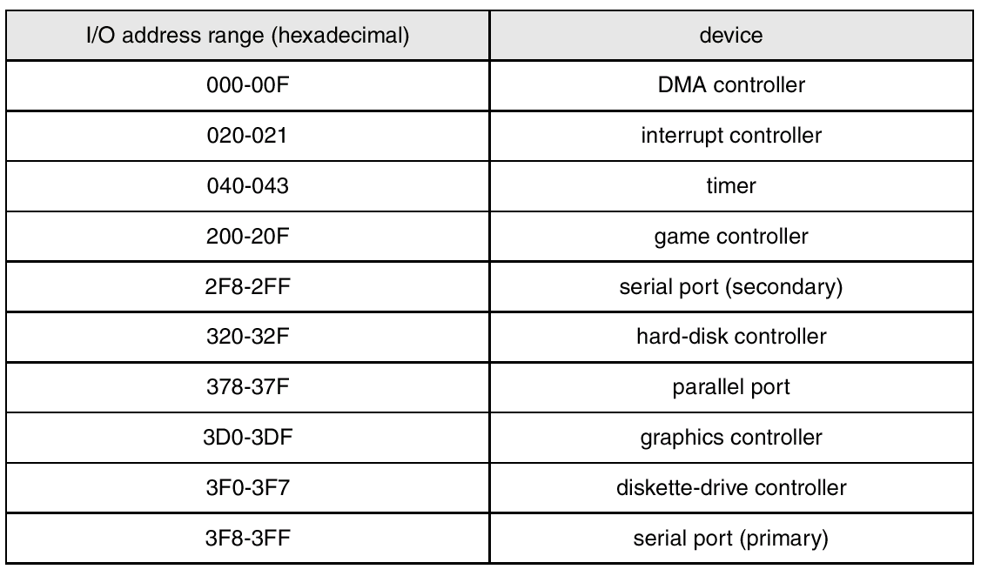
Device I/O Port Locations on PCs (partial)
4 registers: data-in, data-out,
status and control

Slide 6
Polling
Determines state of device
  command-ready bit (in status register)
    Busy
    clear
    Error
Busy-wait cycle to wait for I/O from device
  The host repeatedly reads the busy bit until that bit becomes clear
  The host sets the write bit and write a byte into the data-out register

Slide 7
Interrupts
CPU Interrupt request line triggered by I/O device
Interrupt handler receives interrupts
Maskable to ignore or delay some interrupts
Interrupt vector to dispatch interrupt to correct handler
  Based on priority
  Some unmaskable, such as unrecoverable memory errors
Interrupt mechanism also used for exceptions

Slide 8
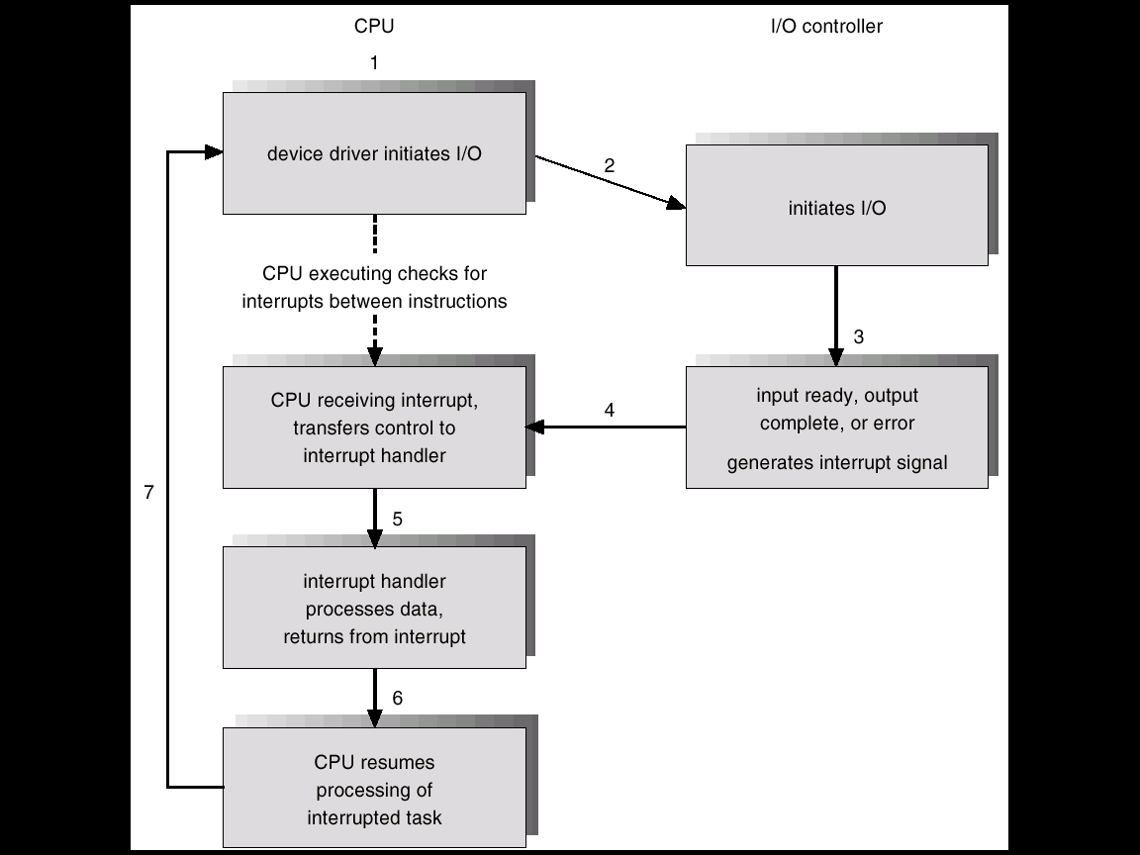
Interrupt-Driven I/O Cycle
Asserting a signal on the interrupt request line
Ability to defer INT during critical processing
Efficient way to dispatch without polling
Multilevel INT, distinguish high- and low- INT

Slide 9
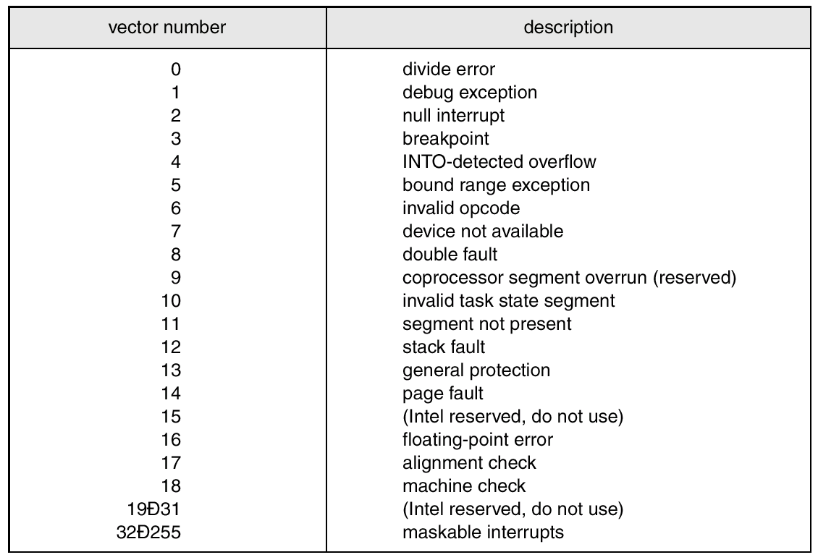
Intel Pentium Processor
Event-Vector Table
interrupt chaining
interrupt priority

Slide 10
Direct Memory Access
Used to avoid programmed I/O for large data movement
Requires DMA controller
Bypasses CPU to transfer data directly between I/O device and memory

Slide 11
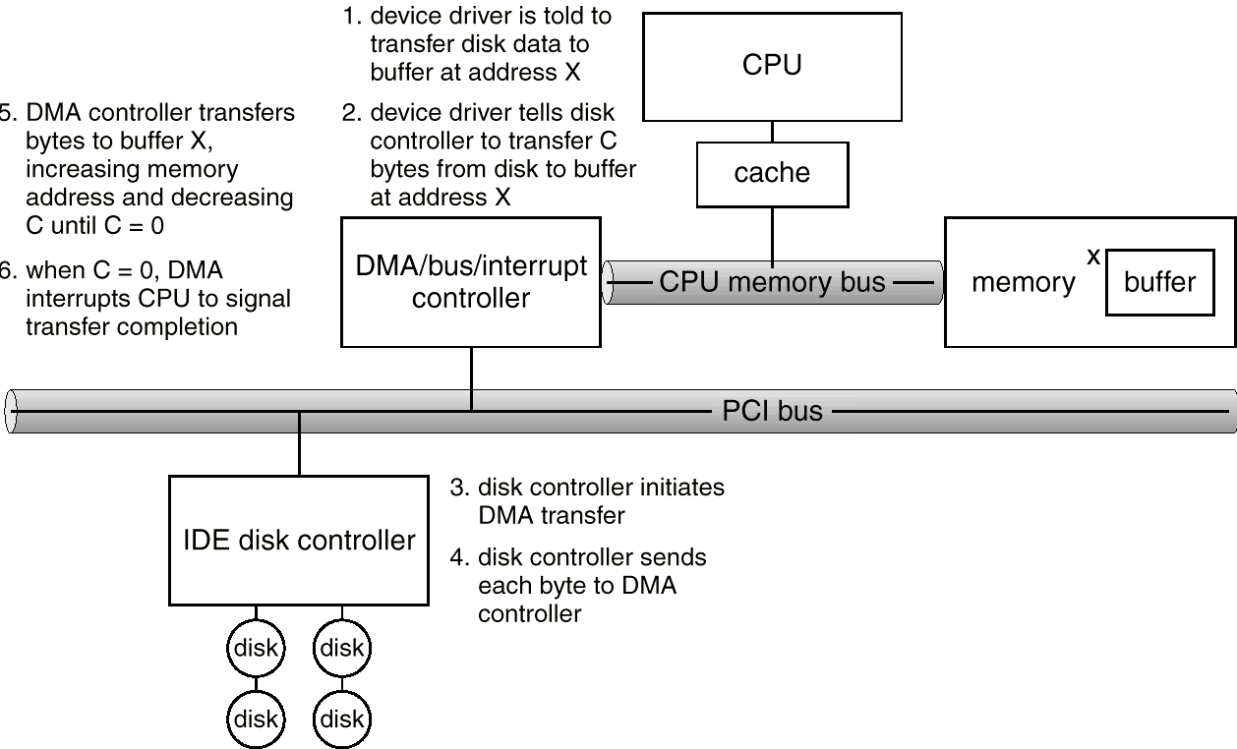
Six-Step Process to Perform DMA

Slide 12
Application I/O Interface
I/O system calls encapsulate device behaviors in generic classes
Device-driver layer hides differences among I/O controllers from kernel
Devices vary in many dimensions
  Character-stream or block
  Sequential or random-access
  Sharable or dedicated
  Speed of operation
  read-write, read only, or write only

Slide 13
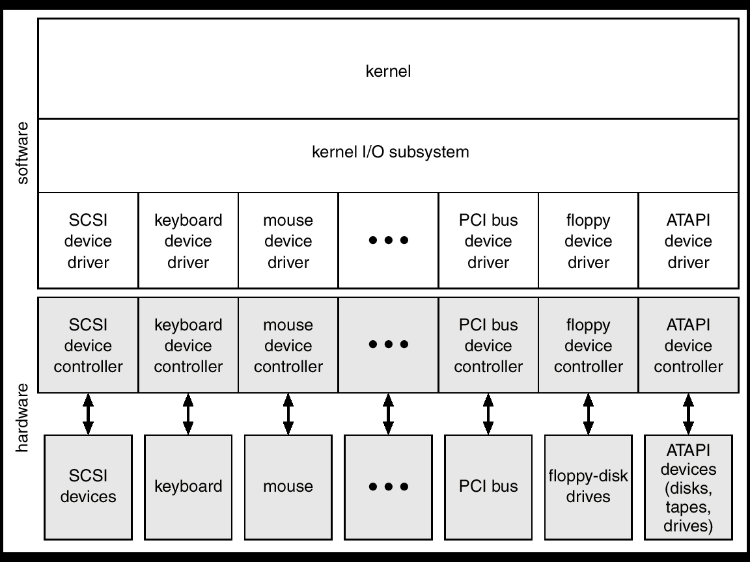
A Kernel I/O Structure

Slide 14
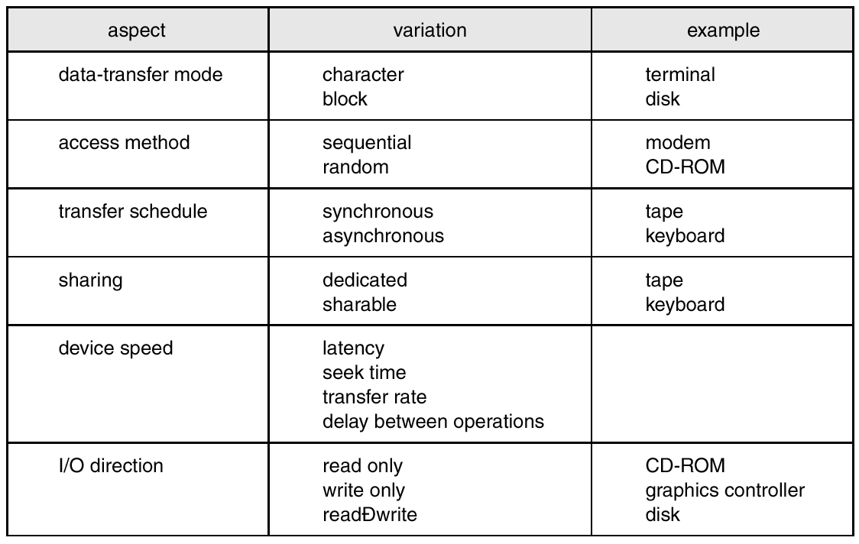
Characteristics of I/O Devices
predictable response time
by several processes

Slide 15
Block and Character Devices
Block devices include disk drives
  Commands include read, write, seek
  Raw I/O or file-system access
  Memory-mapped file access possible
Character devices include keyboards, mice, serial ports
  Commands include get(), put()
  Libraries layered on top allow line editing

Slide 16
Network Devices
Varying enough from block and character to have own interface
Packet, send(), receive()
Unix and Windows NT/9x/2000 include socket interface
  Separates network protocol from network operation
  Includes select() functionality, eliminates the need of busy waiting
Approaches vary widely (pipes, FIFOs, streams, queues, mailboxes)
make a connection

Slide 17
Clocks and Timers
Provide current time, elapsed time, timer
Programmable interval timer used for timings, periodic interrupts
ioctl (on UNIX) covers odd aspects of I/O such as clocks and timers

Slide 18
Blocking and Nonblocking I/O
Blocking - process suspended until I/O completed
  Easy to use and understand
  Insufficient for some needs
Nonblocking - I/O call returns as much as available
  User interface, data copy (buffered I/O)
  Implemented via multi-threading
  Returns quickly with count of bytes read or written

Slide 19
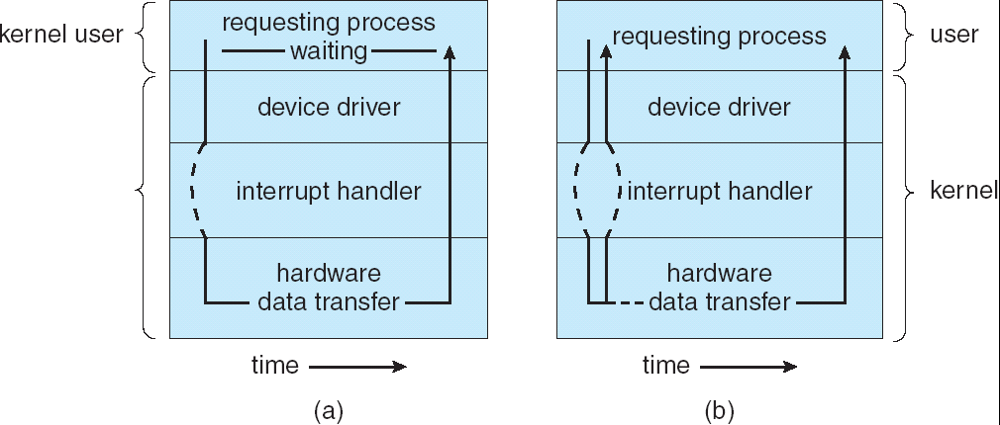
Two I/O Methods
Synchronous
Asynchronous

Slide 20
Kernel I/O Subsystem (1)
Scheduling
  Some I/O request ordering via per-device queue
  Some OSs try fairness
Buffering - store data in memory while transferring between devices
  To cope with device speed mismatch
  To cope with device transfer size mismatch
  To maintain “copy semantics”
  copy semantics: the version of the data written to disk is guaranteed to be the version at the time of the application call, independent of any subsequent changes in the application’s buffer
Kernel buffer
not simultaneously

Slide 21
Kernel I/O Subsystem (2)
Caching - fast memory holding copy of data
  Always just a copy
  Key to performance
Spooling - hold output for a device
  If device can serve only one request at a time
  i.e., Printing
Device reservation - provides exclusive access to a device
  System calls for allocation and deallocation
  Watch out for deadlock

Slide 22
Error Handling
Devices and I/O transfers can fail in many ways,
transient, or permanent
OS can recover from disk read, device unavailable, transient write failures
Most return an error number or code when I/O request fails
System error logs hold problem reports
read again
resend()
Detail info does not convey (by OS) usually.

Slide 23
Kernel Data Structures
Kernel keeps state info for I/O components, including open file tables, network connections, character device state (in-kernel data structures)
Some use object-oriented methods and message passing to implement I/O
  Windows NT uses a message-passing implementation for I/O
  an I/O request is converted into a message
  sent to the Kernel: I/O message → device driver
  message-passing vs. procedure technique: ☹ overhead, ☺ simple and flexibility
UNIX provides file-system access to a variety of entities, such as files, raw devices, sockets and the address spaces of processes (images).

Slide 24
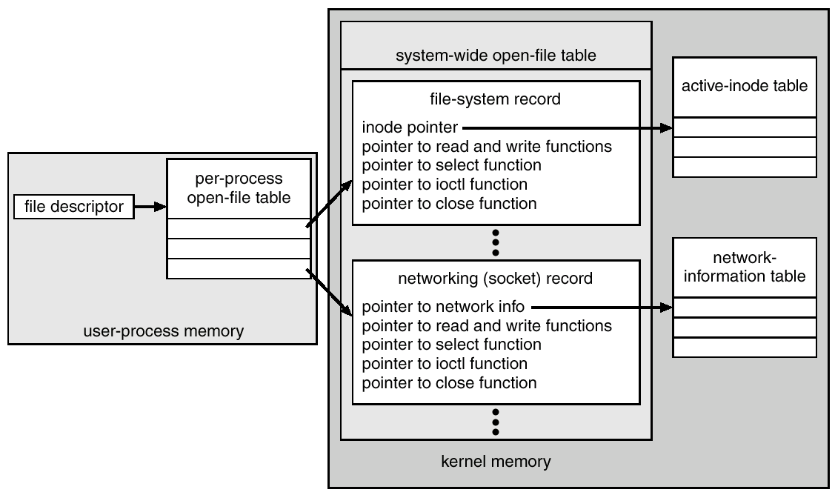
UNIX I/O Kernel Structure

Slide 25
Summary of Services in I/O Subsystem
The management of the name space for files and devices
Access control to files and devices
Operation control
File system space allocation
Disk allocation
Buffering, caching, and spooling
I/O scheduling
Device status monitoring, error handling, and failure recovery
Device driver configuration and initialization

Slide 26
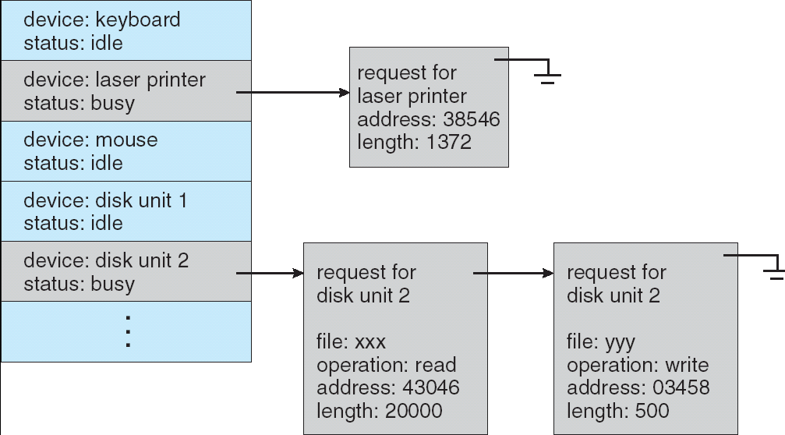
Device-status Table

Slide 27
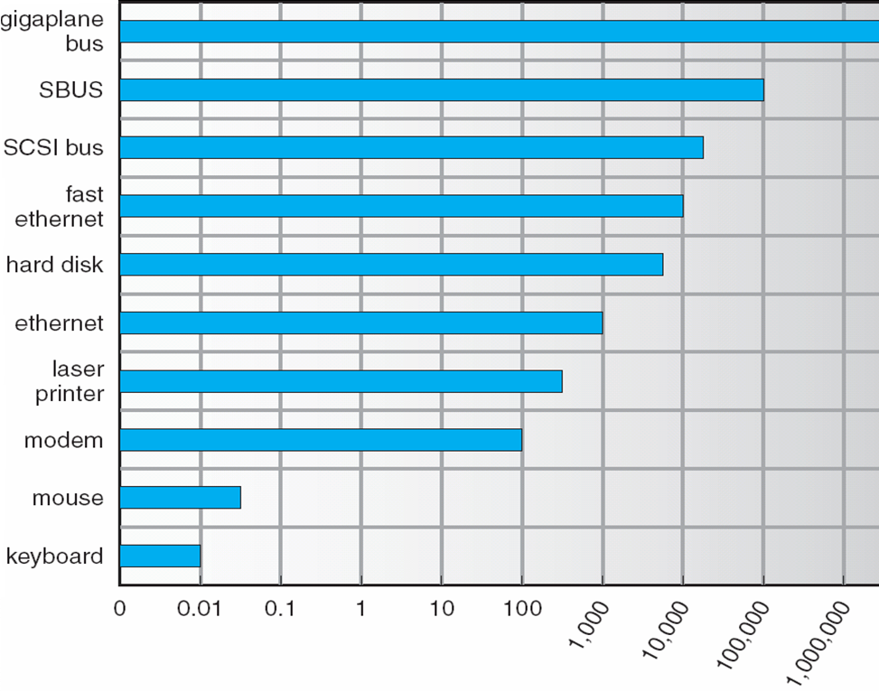
Sun Enterprise 6000 Device-Transfer Rates

Slide 28
I/O Requests to Hardware Operations
Consider reading a file from disk for a process
  Determine device holding file
  Translate name to device representation
  Physically read data from disk into buffer
  Make data available to requesting process
  Return control to process

Slide 29
Layered File System revisited
file name
Application Programs
write(data_file, item)
Given a symbolic file name,
use directory to provide
values needed by FOM
Logical File System
information
of data_file
Transform logical address to
physical block address
File-Organization Module
2144th block
Basic File System
Numeric disk address
driver 1, cylinder 73,
surface 2, sector 10
I/O Control
Driver: hardware instructions
Devices

Slide 30
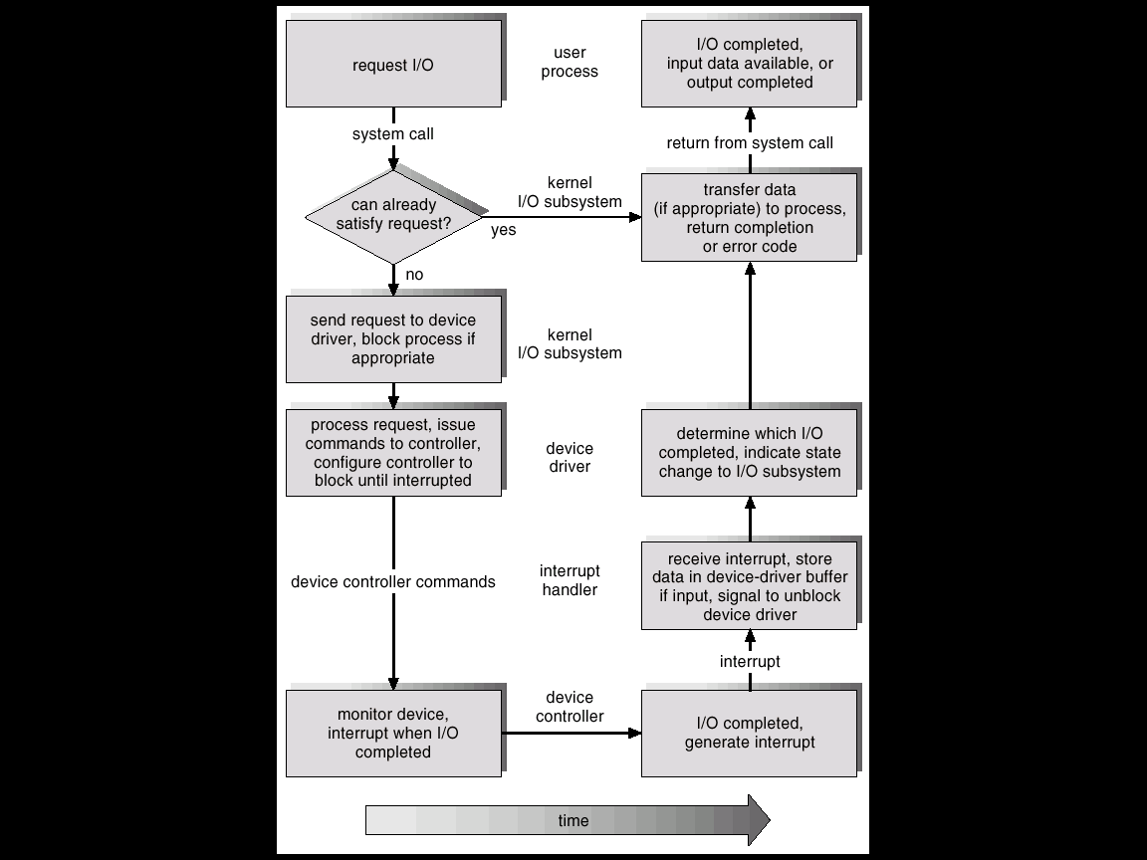
Life Cycle of An I/O Request
In buffer
Pages
579-580
Physical I/O
Perform data transfer

Slide 31
STREAMS (UNIX System V and most UNIX variants) Non-Blocking
STREAM – a full-duplex communication channel between a user-level process and a device
A STREAM consists of:
  STREAM head interfaces with the user process
  driver end interfaces with the device
    support flow control, drops incoming messages if necessary
  zero or more STREAM modules between them
Each module contains a read queue and a write queue
Message passing is used to communicate between queues
Provides a framework to a modular and incremental approach to writing drivers and network protocols

Slide 32
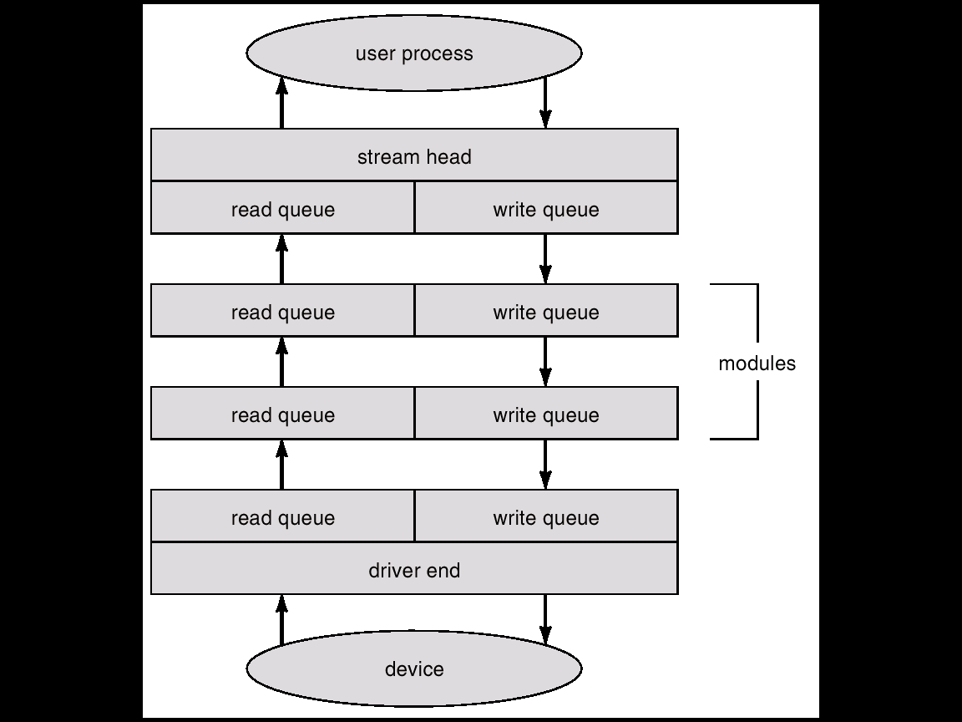
The STREAMS Structure

Slide 33
Performance
I/O is a major factor in OS system performance
  It places heavy demands on the CPU to execute device driver code, and to schedule processes fairly and efficiently as they block and unblock
  The resulting context switches stress the CPU and its hardware caches
  I/O also exposes any inefficiencies in the interrupt-handling mechanism in the kernel, and I/O loads down the memory bus during data copy between controllers and physical memory, …
  Although the modern computers can handle many thousands of interrupts, interrupt handling is a relatively expensive task.
  Network traffic can also cause a high context-switch rate, see a demonstrative example in the next slice.

Slide 34
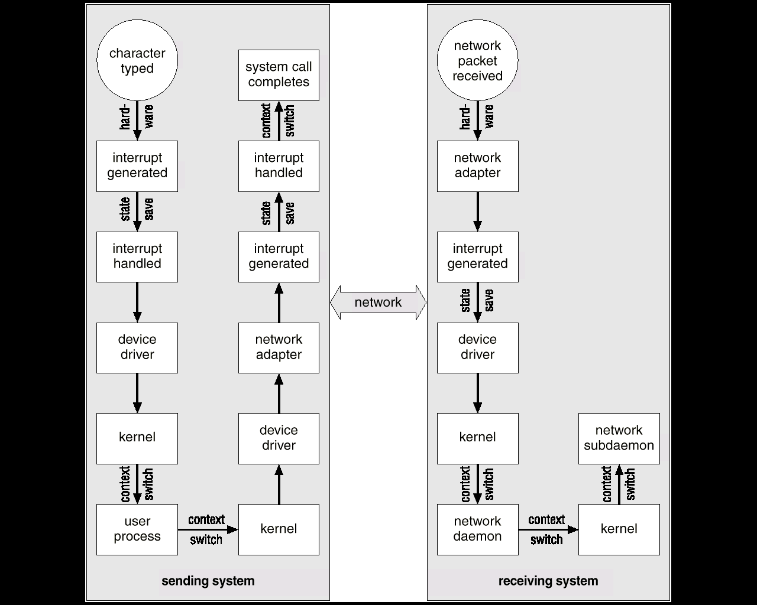
Intercomputer Communications
Remote Control: every char typed on local must be transported to remote

Slide 35
Improving Performance
Reduce number of context switches
Reduce data copying
Reduce interrupts by using large transfers, smart controllers, polling
Use DMA
Balance CPU, memory, bus, and I/O performance for highest throughput

Slide 36
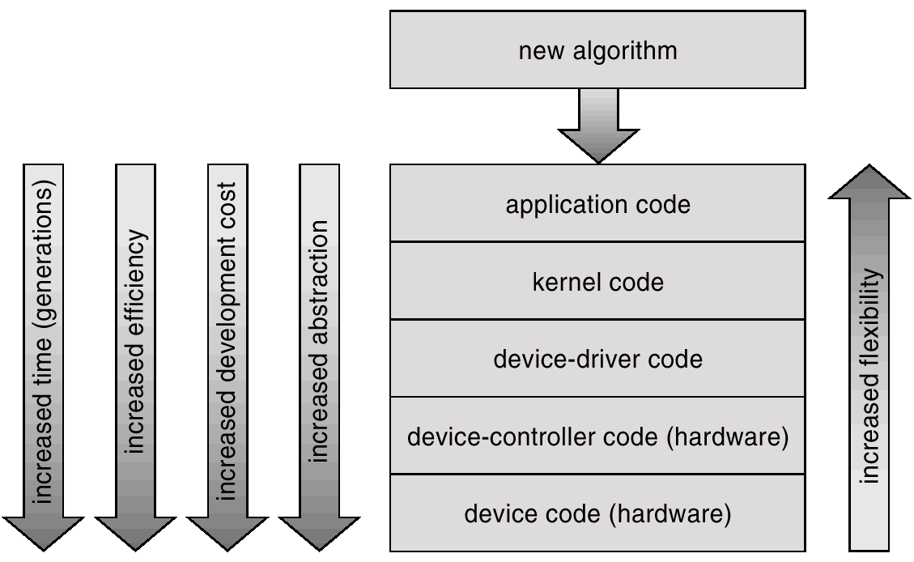
Device-Functionality Progression
flexible,
application bugs are unlikely to cause system crashes,
avoid reboot or reload,
inefficient: context switches,
difficulty and expense of fixing bugs

Slide 37
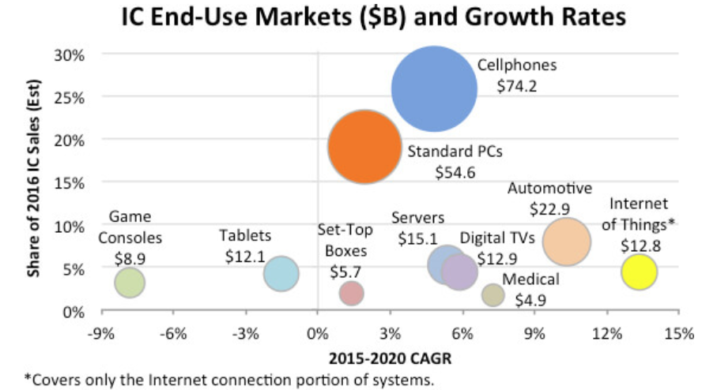
2018/5/21

Slide 38
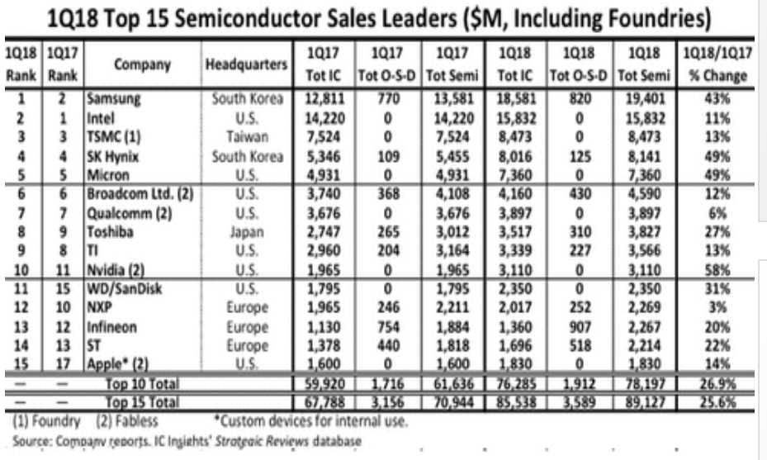
2018/5/21

Slide 39
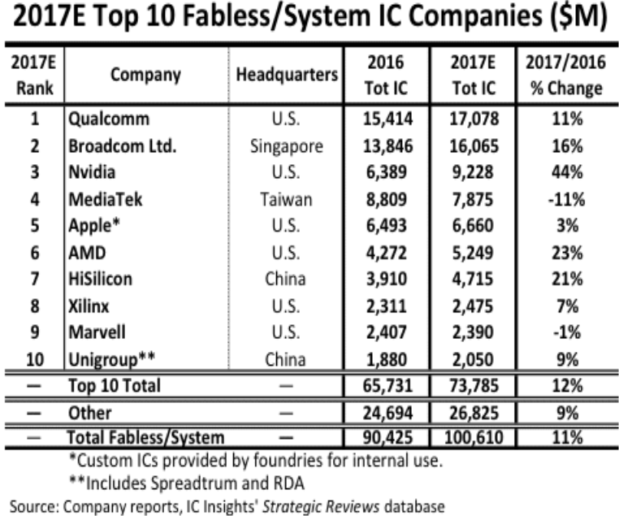
2018/5/21

