Slide 1
The 7 Habits of Highly Effective Researchers
Dr. Steve Wallace

Slide 2
Introduction
Taught at CUHK, NCTU, NTHU and ITRI
13 textbooks used in 28 universities
“How to write and submit your paper in 18 weeks: a textbook for Taiwanese academic writers”
華樂絲學術英文編修: works with over 200 Colleges, Universities and Research Institutes in Taiwan, HK and China

Slide 3
Faculty Writing
A survey of 40,000 U.S. faculty:
26% spent zero hours per week writing
27% never published a peer reviewed journal paper
43% had published nothing in the last 2 years
62% never published a book
Only 28% had produced two publications in the past two years
Only 25% of faculty spent more than eight hours a week writing. (Lindholm 2005)
15% of faculty are productive writers (Moxley and Taylor)

Slide 4

Method
Interviews by phone, met at conferences and universities
Position as editor has allowed opportunity
Compiled into 7 basic “habits” which summarize advice and tips in 7 areas

Slide 5
Overview of Researchers
An effective researcher = five or more SCI or SCCI papers a year for five years
Total 146 effective researchers interviewed:
34 - Engineering
17 - Management and Business
11 - Foreign Language and Literature
10 - Education
31 - Natural sciences
20 - Medicine
12 - Social sciences
6 - Law
5 - History and Liberal Arts

Slide 6
Habit #1
Effective researchers have a publication supply chain.
More than one step
More than one paper
Begins by thinking about the customer

Slide 7
Capturing raw material when away from the computer:
Collect ideas: - Notebook, Post It notes
Transfer to project files
Notes are organized and edited a paper
Easier to begin writing when you already have collected ideas

Slide 8
Master’s students
Generate papers from your thesis
Generate papers from the most important chapters of your thesis
Easier than writing a new paper from nothing
Work with your advisor to submit your papers

Slide 9
Maintain papers under review constantly
If the acceptance rate of the top-ranking journals is 15%, you need about 7 papers under review at all times to have one paper accepted per year
This does not mean that you should write 7 new papers each year

Slide 10
Don't put two good ideas in one paper
You will get a paper accepted sooner
  Editors like short papers
  Referees will return the report faster
  Short papers are cheaper for the journal to publish

Slide 11

Consider different subtopics
Could be a year or two between research and publication
Learn fast through journal rejection

Slide 12
Develop template sentences
Sentences from the introduction, methods, results and discussion can be recycled in a new paper
Copy, paste, revise
Keep a database of words and phrases to use in different parts of your paper

Slide 13
Use English editing before submission
Use professional editorial assistance, particularly if you are not a native English speaker
Even a non-native editor will identify many of your mistakes
Hard to find your own errors

Slide 14
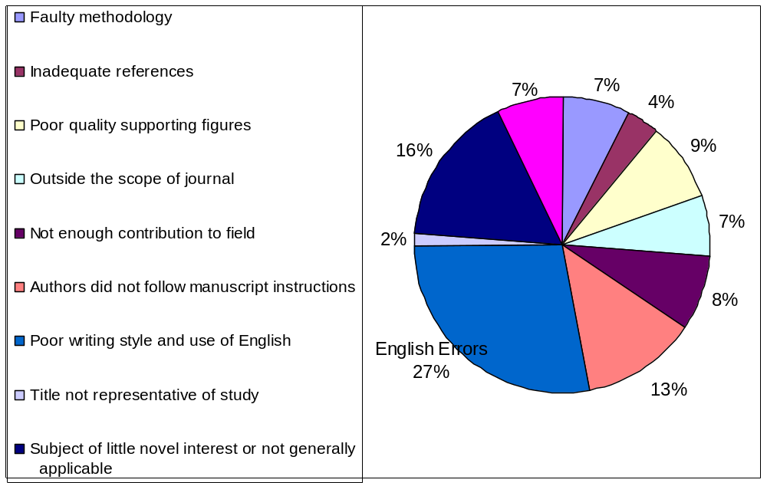
Reasons for major revision or rejection of Taiwanese journal papers
Notes:
Sample taken from 175 reviewers and editor’s comments in the Electrical and Mechanical Engineering field over a 3 year period. Individual author’s errors will differ. Other factors influenced by poor English as well.

Slide 15
Habit #2
Sacrifice other interests
When you play, play hard; when you work, don't play at all.
Theodore Roosevelt

Slide 16
Habit #3
Practice research writing
Aspects of the publishing game:
Research findings, method, grammar, structure of Introduction, methods, results, discussion, choosing a journal, talking to editors and reviewers

Slide 17
Quote on specific skills
“Traditionally my introduction is a bit weak; I have a challenge selling the problem to reviewers. I’ve got to be able to present the problem better if I want people to be interested in my solution. I’m getting better but I’m constantly aware that this is a weakness, and I need to practice to improve.” – Mechanical Engineering Professor # 31

Slide 18
Imitate skillful writers
Find a model paper to use as a checklist
Imitate their words and phrases, and modify them to suit your topic

Slide 19
Habit #4
Dramatize process by creating mental models
Create a clear motivating picture of what you will get from your publication
Graduation?
Promotion?
Money?
Success?

Slide 20
Habit #5
Use the energy of other researchers
Supportive energy
Competitive energy
Political energy
Up to half of peer reviewed articles in top journals are never referenced
Low impact papers are often published in the best journals because the articles are reviewed by friends of the author (Holub, Tappeiner, and Eberharter, SEJ 1991)

Slide 21
Don’t Criticize References
I think that the author knows his subject better than I do. I usually use his references to find a suitable reviewer -Associate Editor, Journal of Retailing

Slide 22
Possibly offensive citations
"The deficiency of Smith's approach is..."
"The problems with Smith’s papers are…"
“A serious weakness with Smith’s argument, however, is that ......”
“The key problem with Smith’s explanation is that ......”
“It seems that Smith’s understanding of the X framework is questionable.”

Slide 23
A better (safer) citation
“Smith’s model was effective in the X problem, however in Y…”
“The X benefit of Smith’s approach is not applicable to Y…”

Slide 24
Pay attention to reviewers’ comments
“I don’t think you treated Smith fairly in your literature review, his insights deserve more respect.”
“You forgot to include Smith as a reference in your paper. His work is fundamental to understanding your research.”

Slide 25
Complement potential reviewers
Important references should be mentioned in the first page
Be generous to all authors and explain why their research is significant
This uses less than 1% of the space, but significantly affects the probability of acceptance

Slide 26
Meet 100 active researchers
There are less than one hundred people in your research field who are likely to be a referee for your paper
Prepare a list of one hundred active people in your research area
When attending conferences try to meet these people

Slide 27
Cite researchers who like you
Include references to people with who you met at conferences
They might become referees
This is to get a fair chance
Referees have to make an effort to be fair to unknown authors

Slide 28
Scan journal for related articles
Authors who published a paper on a related subject are likely to be referees
The editor still remembers them and has a connection to them
Even if they are slightly related, try to use them as references
Explain how your work is related in the cover letter to the editor

Slide 29
Habit #6
Get rejected
When rejected, try again
Nobel Laureates get rejection letters
You do not have to revise every time it is rejected. But if a paper is rejected 4 times, there is a serious flaw in the paper. Find and fix the problem
Why? The same referee might get it again

Slide 30
Emotions on rejected paper
1) Depression
2) Anger at editor
3) Anger at system
4) Consider changing job
5) Review manuscript and decide the reviewers had good points

Slide 31
Eliminate any trace of prior rejections
Do not show when the paper was first written
Do not show how many times the paper has been revised
Document property check
Add current references

Slide 32
Everyone gets rejected
Your options:
Abandon the article
Send the article with no changes to another journal
Revise the article and send to another journal
Protest the decision and try to resubmit the article to the rejecting journal

Slide 33
Avoid the journals which consistently reject your papers
  The editor still remembers bad comments about your papers
  Wait until a new editor is appointed
  If you think there is prejudice on the basis of sex, race, or nationality, you may consider using initials instead of spelling out the first and middle names

Slide 34
Waiting for the Journal’s decision
Causes of quick rejection:
Back-log
Previous paper on subject
Editor doesn’t like topic or style

Slide 35
When should you start contacting the editor about your paper?
After two months one email
Three months two emails
Six months every day – Email all emails you can find at the journal
After six months reviews may be negative
You may want to consider withdrawing to another journal
Editor’s feedback is key in making this decision

Slide 36
Reminder e-mail to editor
“I’m just e-mailing to inquire about the status of my article titled______, which I submitted to your journal on ( date ).”
Don’t get angrier over time
Sometimes editors appreciate the reminder

Slide 37
Habit #7
Writers write (and don’t always enjoy it)
Common misunderstanding that good writers enjoy writing
Many hate writing, but enjoy the results
Forced themselves into a daily writing routine

Slide 38
Building the Writing Habit
The same time
The same place
Carry a notebook
Get rid of negative thoughts
Sit alone in silence
Ideas, not grammar, for the first draft - Rewrite

Slide 39
Make writing a daily habit
Use timed bursts
Rational and reactive self
Lie to yourself

Slide 40
Do not use reading as an excuse not to write
You can’t read every paper ever written on a subject
Goal is to write and publish a paper, not to read everything
If you read a dozen papers on a topic, you should have enough material to start writing
Reading while writing directs your reading

Slide 41

For More Information
www.editing.tw
華樂絲學術英文編修
  Editing
  Translation
  Only Chinese speakers only research writing
www.editing.tw/blog

Slide 42
Reasons researchers don’t write
I am really too busy – 15 minutes a day
Teaching preparation takes all my extra time - Good teachers produce more writing (Sax 2002)
I will write just as soon as______ - You don’t have to be perfect first

Slide 43
Reasons continued
I’m going to make writing my number one goal in life - “the most valued activity carries demands for time and perfection that encourages its avoidance (Boice 1997)
I couldn’t get to my writing site – become flexible with your writing environment

Slide 44
Reasons continued
I have to read just one more paper - Mastery is an illusion
I just can’t get started - Reward yourself for writing, phone or e-mail partner. Plan an agenda for next writing session

Slide 45
Reasons continued
I’m afraid of writing because publication is so permanent- Peer review helps
I’m not in the mood to write right now - Behavior modification theory
My childcare responsibilities are preventing me from writing – Use small blocks of time, babysitters, more efficient (Sax 2002)

Slide 46
Reasons continued
My thesis advisor is a bigger problem than a help - Try writing without help first or change advisor
I can’t sit still - Short bursts with an alarm
I write so slowly that I never seem to get much done – Most people write slowly

Slide 47
Reasons continued
If I have a long productive writing day, I have a hard time getting started the next day – Do not burn yourself out
I am eager to write but I don’t have the material or scrolling resources – Some scholars have less and publish
I have to make progress on several writing projects at one time and I am in a panic? – Two projects = better

Slide 48
Reasons continued
I get distracted by Web surfing e-mailing and text messaging – Disconnect yourself
I need big blocks of time to write in my schedule doesn’t allow such blocks – Short blocks more productive

Slide 49
Researchers are proud of the term researcher and their total impact
We have benefited from previous research
Our duty to share
Unpublished research never happened
Publication benefits ourselves, our department, or college, or university, our domain

Slide 50
Conclusion: Effective Researchers
1) Publication “Supply Chain”
2) Sacrifice other interests
3) Practice research like golf
4) Dramatize process by creating mental models
5) Use competitive, political and supportive energy
6) Get rejected
7) Write, (and don’t always enjoy it)

Slide 51
For More Information
www.editing.tw
華樂絲學術英文編修
  Editing
  Translation
  Only Chinese speakers only research writing
www.editing.tw/blog

