Slide 1
EVALUATION:
Inspections,Analytics,and Models
107062563 資工碩一 蔡宸祐
107062541 資工碩一 鄭鈺敏
107062539 資工碩一 蔡孟廷

Slide 2
Outline
Introduction
Inspections: Heuristic Evaluation and Walkthroughs
Analytics
Predictive Models

Slide 3

Introduction
Sometimes users are the main factors which can’t be controlled:
  Not easily accessible.
  The more users you involve, the more cost you need to spend.
  Some users take too much time to finish a task.
Another Solutions？

Slide 4

Introduction
Inspection method：involve an expert role-playing the users for whom the product is designed.
Analytics：involve user interaction logging, which is often done remotely.
Predictive models：involving and analyzing the various physical and mental operation that are needed to perform particular tasks to predict users’ performances.
Users don’t need to be present during the evaluation.

Slide 5
Inspection Methods
Because of the previous circumstances, the inspection methods usually referred to as experts, can provide feedback. These experts who are knowledgeable about both interaction design and the needs and typical behavior of users.
Inspection Methods include heuristic evaluations and walkthroughs, in which experts examine the interface of an interactive product, often role-playing typical users, and suggest problems users would likely have when interacting with it.

Slide 6
Inspection Methods: Heuristic Evaluation
Heuristic Evaluation was developed by Nielsen and his colleagues.
Experts are guided by a set of usability principles known as heuristics, evaluate whether user-interface element, such as dialog boxed, menus, navigation structure, online help, and so on, conform to tried and tested principles.

Slide 7
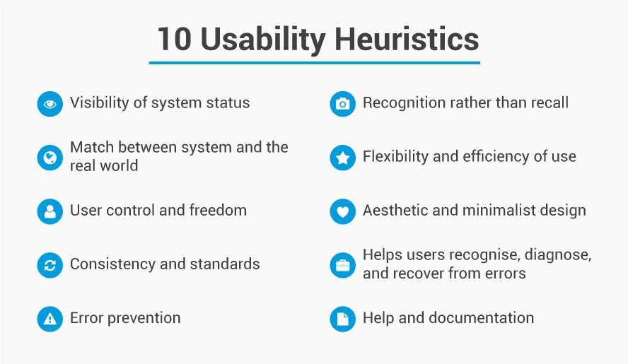
Inspection Methods: Heuristic Evaluation

Slide 8
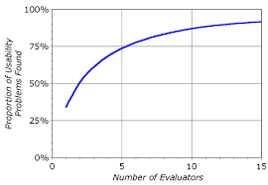
Inspection Methods: Heuristic Evaluation
These heuristics are intended to be used by judging them against aspects of the interface.
Exactly which heuristics are appropriate and how many are needed for different products is debatable and depends on the goals of the evaluation, but most sets of heuristics have between five and ten items. The number provides a good range of usability criteria by which to judge the various aspects of and interface.
For a quick evaluation of an early design, one or two experts can probably identify most potential usability problems but if a thorough evaluation of a fully working prototype is needed them having a team of experts conducting the evaluation and comparing their findings would be advisable.

Slide 9
Inspection Methods: Doing Heuristic Evaluation
Heuristic evaluation has three stages：
The briefing session, in which the experts are told what to do.
The evaluation period, in which each expert typically spends 1-2 hours independently inspecting the product, using the heuristics for guidance. The experts need to take at least two passes through the interface.
The debriefing session, in which the evaluators come together to discuss their findings and to prioritize the problems they found and suggest solutions.

Slide 10
Inspection Methods: Doing Heuristic Evaluation
The heuristics focus the evaluators’ attention on particular issues, so selecting appropriate heuristics is critically important.
There are fewer practical and ethical issues in heuristic evaluation than for other methods because users are not involved.

Slide 11
Inspection Methods: Walkthroughs(演練)
Offer an alternative approach to heuristic evaluation for predicting users’ problems without doing user testing.
Involve walking through a task with the product and noting problematic usability features.
Most walkthrough methods do not involve users. Others, such as pluralistic walkthroughs, involve a team that may include users, as well as developers, and usability specialists.

Slide 12
Inspection Methods: Cognitive Walkthroughs(認知演練)
Involve simulating a user‘s problem-solving process at each step in the human–computer dialog, checking to see if the user’s goals and memory for actions can be assumed to lead to the next correct action.
→Focus on evaluating designs for ease of learning.
Motivated by observations that users learn by exploration.

Slide 13
Steps in cognitive walkthroughs
1. The characteristics of typical users are identified and documented and sample tasks are developed that focus on the aspects of the design to be evaluated. A description, mockup, or prototype of the interface to be developed is also produced, along with a clear sequence of the actions needed for the users to complete the task.
2. A designer and one or more expert evaluators come together to do the analysis.
3. The evaluators walk through the action sequences for each task, placing it within the context of a typical scenario, and as they do this they try to answer “will users know what to do, see how to do it, and understand from feedback whether the action was correct or not?”

Slide 14
Steps in congnitive walkthroughs-CONT.
4. As the walkthrough is being done, a record of critical information is compiled in which:
  The assumptions about what would cause problems and why are identified.
  Notes about side issues and design changes are made.
  A summary of the results is compiled.
5. The design is then revised to fix the problems presented.
→We can modify or adapt the process above to meet our needs.

Slide 15
Cognitive Walkthroughs-CONT.
Compared with heuristic evaluation, this technique focuses more closely on identifying specific user problems at a high level of detail.
Hence, it has a narrow focus.
  Useful for focusing on certain types of system.
  Evaluating whole systems is not suggested due to consuming lots of time.
Other problems:
  Step 3 takes a lot of time to ask and answer questions.
  Designers tend to be defensive.
  Undermined the efficacy of the method and the social relationships of team members.
Solution: identify a leader to guide the team.

Slide 16
Pluralistic Walkthroughs(多元演練)
Another type of walkthrough in which users, developers and usability experts work together to step through a [task] scenario, discussing usability issues associated with dialog elements involved in the scenario steps.
Each one is asked to assume the role of a typical user.
Scenarios of use, consisting of a few prototype screens, are given to each evaluator who writes down the sequence of actions they would take to move from one screen to another alone.
A discussion takes place before moving on to the next round of screens.

Slide 17

Pluralistic Walkthroughs-CONT.
A very strong focus on users’ tasks at a detailed level.
The group brings a variety of expertise and opinions for interpreting each stage of an interaction.
Limitations include having to get all the experts together at once and then proceed at the rate of the slowest.
→More time-consuming.

Slide 18
Analytics(分析法)
A method for evaluating user traffic through a system.
  Mostly used for transactional systems, but also for systems not selling things.
When used to examine traffic on a website, it’s also called web analytics.
  Information can be collected locally or remotely across the Internet by logging user activity.
  Useful for evaluating the usability of a website, also valuable for business planning.
Analytics tools providers, such as Google and VisiStat.
  They let us understand large volumes of data by using graphs, tables, and other types of data visualizations.
Website owners using these tools can decide what to invest.

Slide 19
Predictive models
GOMS Model
Keystroke Level Model (KLM)
Benefits and Limitations of GOMS
Fitts’ Law
Notes:
predictive model和前面提到的兩種方法類似。
簡單來說就是用現有的一個模型去分析系統的效率，方便我們對於各種任務去比較不同系統的好壞。
接下來我會介紹GOMS model、Keystroke Level Model、GOMS的優點和限制，最後會講到費茲定律

Slide 20

GOMS
Goals
Operators
Methods
Selections
Notes:
GOMS是一種分析模型，可用來分析使用者與系統互動的過程。
其實是由四個單字的字首組合而成，分別是 .....
這四個部分就是他的核心概念，接下來會一一介紹

Slide 21
Goals
what the user intends to accomplish
Notes:
使用者希望達成的目標
以words為例
像是刪除某段文字、插入圖片、調整字體大小位置

Slide 22
Operators
the actions that are performed to reach the goals
Notes:
user達到目標所需要進行的動作
例如
我刪掉一段文字或插入圖片所需要的動作可能有
按鍵盤、移動滑鼠、點擊滑鼠

Slide 23
Methods
the sequence of operators that accomplish a goal
Notes:
將目標分成許多子目標，再用一連串operators分別完成這些子目標
比如 我們可以把刪掉一段文字分成幾個步驟
第一步先將滑鼠移到要刪除的文字前面，然後再按下滑鼠
接著按下delete鍵，這樣就成功刪除想要刪除的文字了

Slide 24
Selections
how to select a certain method to use
Notes:
如何選擇用什麼方法來達成目標
比如說 刪掉一段文字時，如果文字很短我可能會直接將滑鼠游標移到文字前面再按下delete鍵
但如果是一大段文字，我會先用滑鼠將整段文字選取，再刪除。

Slide 25
Ex : delete text using Microsoft Word
Goal | Method | Operator | Selection
Delete word in a sentence. | 1. put the cursor before the text to be deleted 2. press delete key | click mouse move mouse press key | short text -> move cursor long text -> select the text
Notes:
這邊用Microsoft Word的操作來舉例
那我們可以定義它的GOMS
Goal 可以是刪掉句子中的某個字
Methed 可以是先把光標移到要刪除的字前面，再按下刪除鍵
Operator 可能有點擊滑鼠移動滑鼠和按按鍵
Seletion 可以依照文字的長度來決定要用的method

Slide 26
Keystroke Level Model (KLM)
A branch of GOMS
provide numerical predictions of user performance
different systems and applications can be easily compared
Notes:
KLM是GOMS model的一個分支，這個模型運用於很多人機交互的領域，他可以通過任務的步驟和操作準確地計算出任務所需要的時間。
它的好處是讓我們可以很容易的比較不同系統和應用程式。
跟GOMS model相比，KLM更加強調Operator，也就是操作的部分。

Slide 27
Operators and Time
Operator name | Description | Time(s)
K | Pressing a single key or button Skilled typist (55wpm) average typist (40wpm) | 0.35 0.22 0.28
P | Pointing with a mouse or other device to a target on a display | 1.10
P1 | Clicking the mouse or similar device | 0.20
H | Homing hands on the keyboard or other device | 0.40
M | Mentally prepare to do something, e.g. make a decision | 1.35
Notes:
這個模型運用於很多人機交互的領域，他可以通過任務的步驟和操作準確地計算出任務所需要花費的時間。
KML定義了很多operation所需的時間，這張表格只有列出幾個常用的operation，像是按單一按鍵要花0.35秒，熟練的人打字花0.22秒，平均打字花0.28秒，甚至連心裡準備的時間都有定義。
wpm : Words per minute

Slide 28
Example : I’m a boy -> I’m not a boy
Mentally prepare (M) | 1.35
Reach for the mouse(H) | 0.40
Position mouse before the word “a” (P) | 1.10
Click mouse (P1) | 0.20
Move hands to home position on keys (H) | 0.40
Mentally prepare (M) | 1.35
Type “n” (good typist) (K) | 0.22
Type “o” (good typist) (K) | 0.22
Type “t” (good typist) (K) | 0.22
Type “space” (good typist) (K) | 0.22
Total predicted time | 5.68 seconds
Notes:
有了每個operation花費的時間後，就可以計算出一連串動作所需要的時間。
這邊舉一個例子，用words把一段句子 I’m a boy -> I’m not a boy
首先列出每個步驟的動作，然後把每個步驟花費的時間加起來就可以算出總共花費時間

Slide 29
Benefits and Limitations of GOMS
Benefits
  it allows comparative analyses to be performed for different interfaces,prototypes, or specification relatively easily.
  mobile device and phone developers are using the KLM to determine the optimal design for keypads.
Limitations
  it can only really model computer-based tasks.
  it can only make predictions about predictable behavior.
Notes:
優點:
可以很容易的比較不同系統不同介面的優劣
行動裝置和手機的開發者可以用KLM去優化按鍵的設計
限制:
只能對基於電腦操作的任務做分析
不能對不可預測的行為做計算，例如有的人會同時做很多事，邊打字邊看電視，或是打字打到一半有人突然跟自己說話。

Slide 30
Fitts’ Law
Fitts’ Law predicts the time it takes to reach a target using a pointing device.
It has been used to describe the time it takes to point at target , based in the size of the object and the distance to the object.
Notes:
費茲定律（Fitts‘ Law）是介面設計中常用的概念，用來計算指標物移到目標物所需的時間，藉此增加介面使用性與操作效率。
其概念為起始點(滑鼠游標)與目標物(按鈕或其他操控物件)之間的距離和目標物的大小，決定了從起始點移動到目標所花費的時間。

Slide 31

T : time to move the pointer to a target
D : distance between the pointer and the target
S : size of the target
k : a constant of approximately 200ms/bit
Notes:
這是費茲定律的公式
T是時間
D是指標到目標的距離
S是目標的大小
K是常數
從公式可以發現只要改變目標的大小和距離就能有效縮短時間。

Slide 32
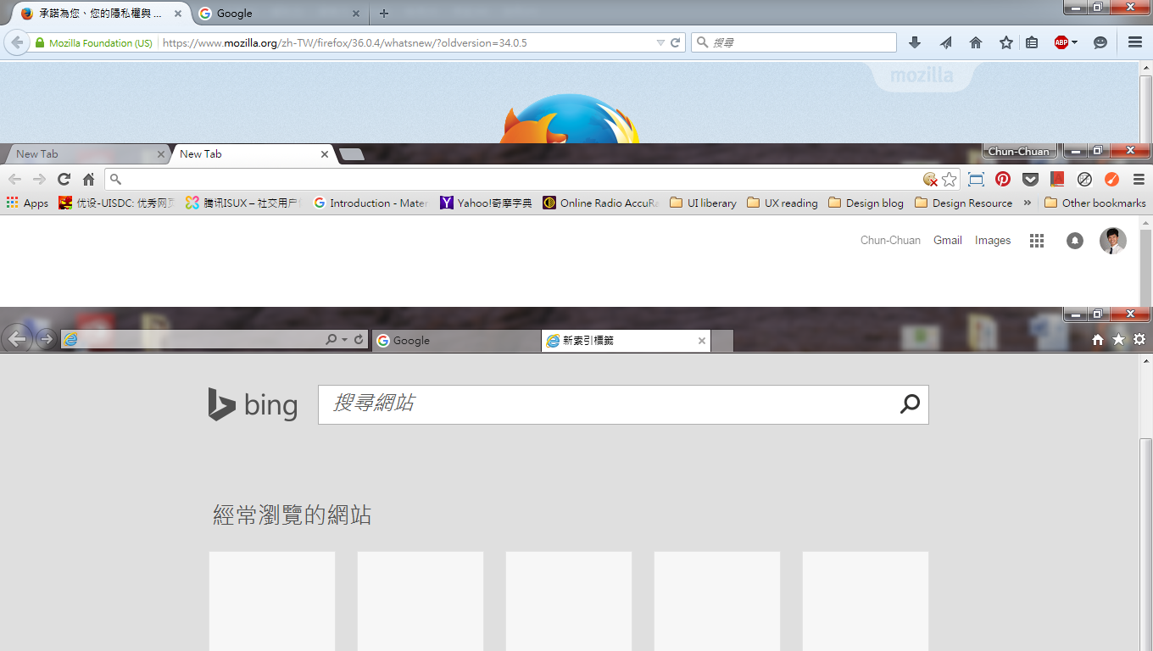
Chrome vs IE
Notes:
為什麼chrome比IE用起來順手？其實也和費茲定律有關，chrome視窗最大化後，其各分頁tab是在營幕邊界，滑鼠游標可以迅速上移頂到螢幕邊界停下，使用效率增高。而IE上方為視窗的Title Bar，往下一層才是tab，所以滑鼠去瞄準，較為花費心力。
位置在螢幕邊緣的目標，因為滑鼠移動距離很大時，會停在邊界，可視為目標物的寬度無限大，所以操作速率最快。

Slide 33
END

