Slide 1

Good Neighbor

Slide 2


People are becoming more and more lonely
Elder People
Young People
16-24 year olds experience loneliness more often than olds
Elderly People > 3380000
Elderly living alone > 520000
Technology decrease in face-to-face interaction among youth
Elderly living alone is more possible to suicide
> 25% suicide people are elders
Living alone is very boring

Slide 3
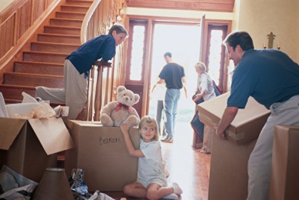
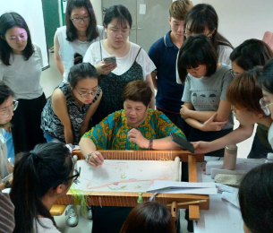
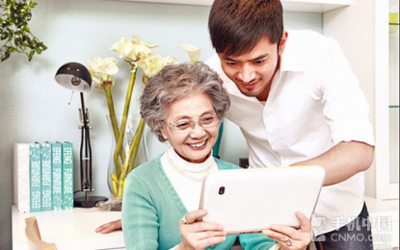
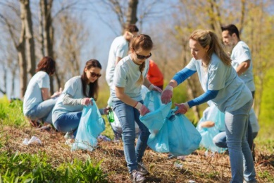

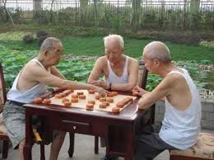

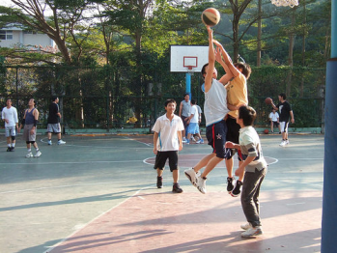
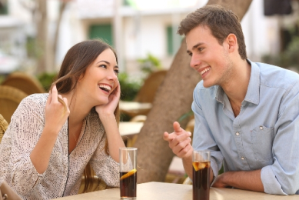
Assist and Inherited
Social quality
Activity
Interaction
Chatting
Connection

Slide 4
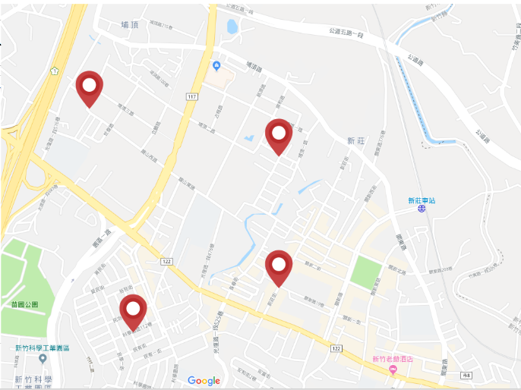
Dose anyone want to paly basketball?
I buy too many fruit.
Can anyone help me?
Here is a smartphone class for elder
We need volunteer as teacher.
- By community commissioner
Let’s go cleaning the beach.
We need more volunteers !

Slide 5
Reference
內政部統計資料
(https://www.moi.gov.tw/stat/news_detail.aspx?sn=14936)
衛生福利部統計資料 (http://health.gov.taipei/Default.aspx?tabid=36&mid=442&itemid=40700)
BBC 調查資料
(https://www.bbc.co.uk/mediacentre/latestnews/2018/loneliest-age-group-radio-4)
Literature
(https://www.elon.edu/docs/e-web/academics/communications/research/vol6no1/02DragoEJSpring15.pdf)
良醫健康網
(https://health.businessweekly.com.tw/AArticle.aspx?id=ARTL000116623)

