Slide 1

Personas: Setting the Stage for Building Usable Information Sites
Alison J. Head

Slide 2
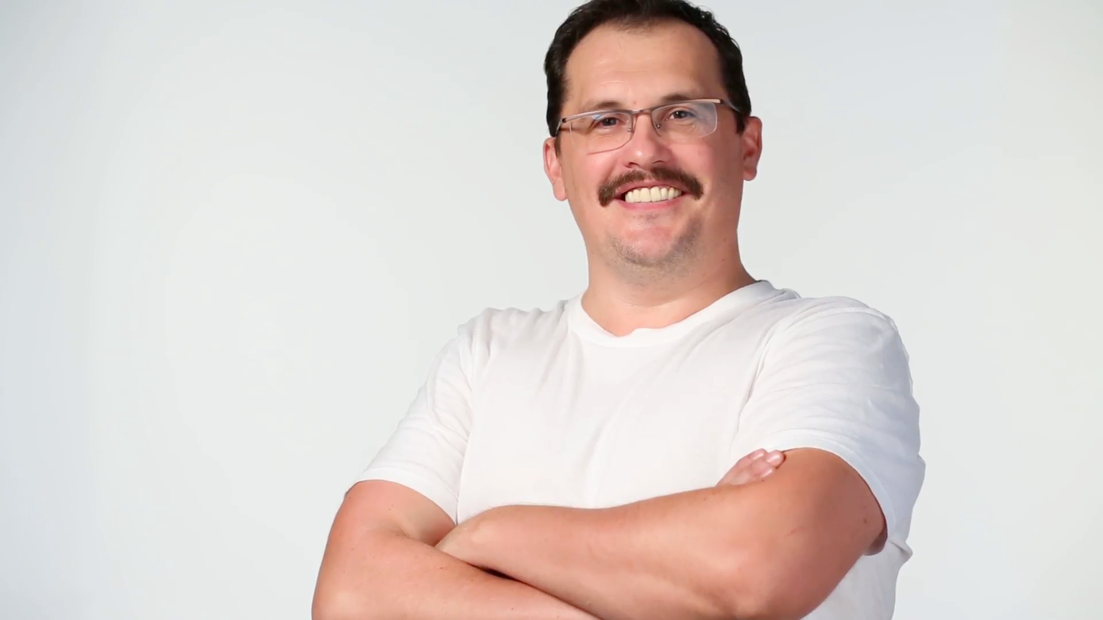
Meet Greg

Slide 3
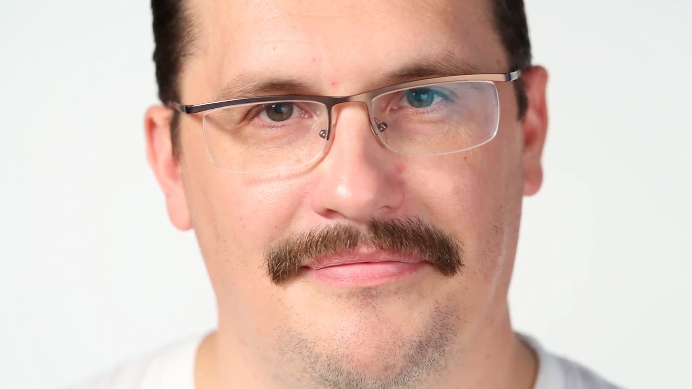
Greg is a 37 years old, busy senior loan manager for a bank in Santa Rosa. He was recently divorced and has joint custody of his two young children. During weekends Greg enjoys getting his kids away from the television, taking advantage of the nearby hiking trails, fishing, and canoeing available to them. He enjoys taking his girlfriend to one of the fine restaurants in his city.

Slide 4


Slide 5
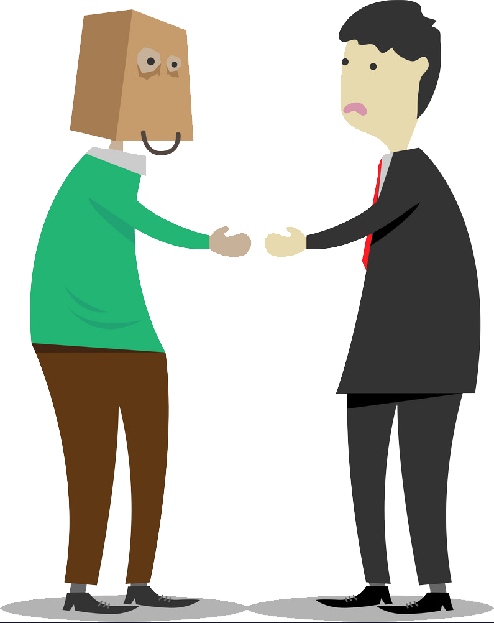
“... pulling together this site had the potential to be as awkward as needlepointing a three-piece suit.”

Slide 6
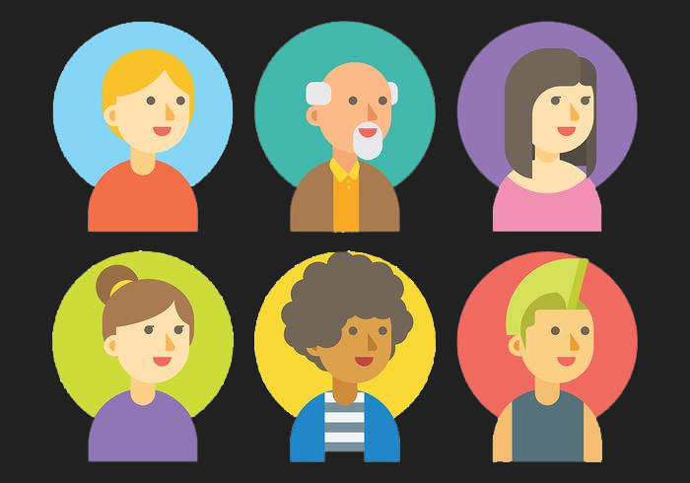
What are personas?
Personas are hypothetical archetypes, or "stand-ins" for actual users
Not “real” people, they represent them
Not “made up” but creating during investigation process

Slide 7
Essential elements of personas
Name that could exist in reality
Details like age
Personal informations
Work description (especially what kind of tools he/she uses)
Computer proficiency
Motivations
Habits
Quote

Slide 8
Why personas are useful?
Determine what a product should do and how it should behave.
Communicate with people in the team
Measure the design’s effectiveness
Contribute to marketing, sales, support, etc.

Slide 9
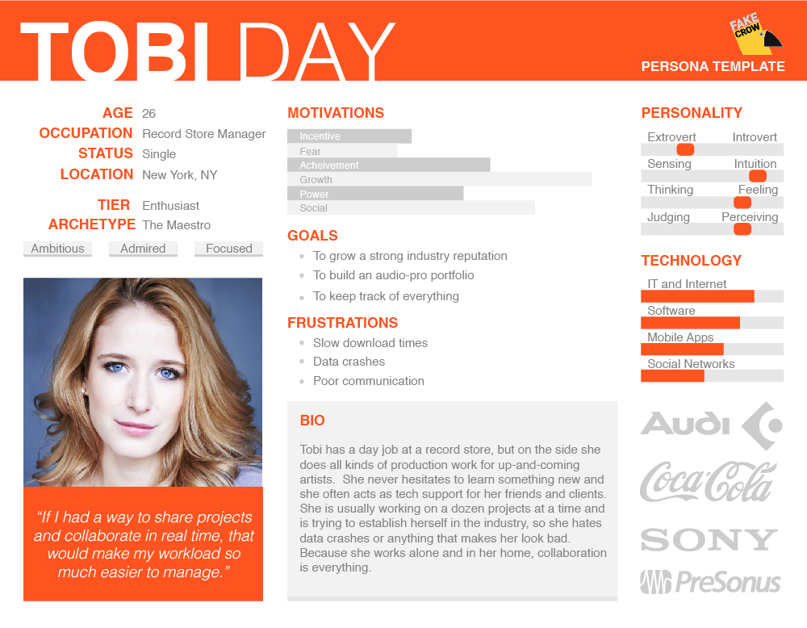

Slide 10








Persona 3: Raju Shrenma
Needs:
Bio:
Learn
Teach
Raju is a PhD student from India. He was very unhappy with the previous platform, because his knowledge of Mandarin is still basic. This year his professor asked him to be the Teaching Assistant for the computer science course. Raju hopes that the new platform won’t be an obstacle in his job.
Announce
Be informed
Demand
Submit
View
Post
Ask
Answer
“Work hard, your dreams depend on it”
English
Traditional Chinese
Demographics:
Daily Tasks:
Age: 29
Job: PhD Student
Status: Single
Location: Hsinchu
Archetype: The wise man
Traits: Friendly, Helpful, Assertive, Demanding
Motivation:
Goals:
Get professors position
To have his own laboratory
To invent something useful
Upload
Download
Grade
Incentive
Create Content
View Content
Fear
Achievement
Edit files
Check files
Send notification
Power
Frustrations:
Students that don’t listen
Doesn’t have enough time for his hobbies
Read notification
Contact Professor
Social
Contact students
Personality:
Devices and platforms:
Extrovert
Introvert
Technology:
Hobby:
Learning new programming
languages
Watching Bollywood movies
Cooking
Sensing
Intuition
IT and Internet
Software
Thinking
Feeling
Mobile Apps
Judging
Perceiving
Social Networks

Slide 11
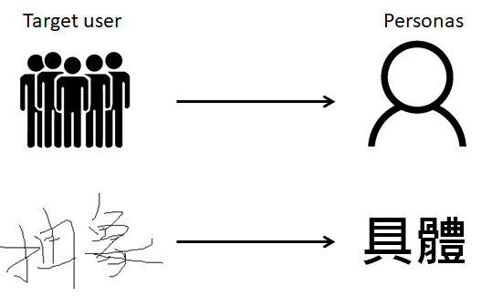
Goal of personas
Notes:
找痛點

Slide 12
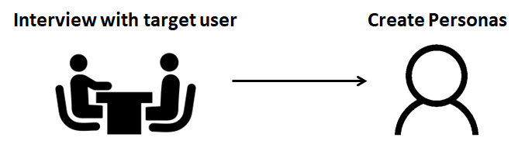
Design personas

Slide 13
Design personas - Interview
Interviewers need to ensure that useful details are collected for informing decisions about the design.
More information from interviews will be collected than can be used.
An interview for an information site is with an open-ended question
Goal
More
Detail
Notes:
目標
多
細節

Slide 14
Design personas - personas
Essential Details for Defining Personas
A name
Age
A photo
Personal information, including family and home life
Work environment (the tools used and the conditions worked under, rather than a job description)
Computer proficiency and comfort level with using the Web
Pet peeves and technical frustrations
Attitudes
Information-seeking habits and favorite resources
Personal and professional goals

Slide 15


Design personas - personas
Total number of personas should be kept relatively limited: 3 to 7 personas
Definite order for personas
(One persona needs to become the primary persona, primary focus of the design. The other key personas are secondary personas)
Prevent negative persona
O
X
Notes:
the primary persona who dictates key design decisions
the primary persona's needs cannot be met by an interface that may indeed satisfy a secondary persona
講出persona 就想到某些人

Slide 16

The Cast For Northbay.com
A hands-on interactive entertainment guide
The persona interviewing process took about 3 weeks to complete.
Interviews ran 1-2 hours each.

Slide 17



Four Personas For The Project
Greg
Robert
Sarah
Annette

Slide 18

Persona Chart Example - Greg
Background
Age: 37
Occupation: Senior Loan Manager, Construction and Mortgage Lending Group at Exchange Bank in Santa Rosa.
Home life: Divorced, single dad, two children (Erin, 12, and Kyle, 8), joint custody of kids.
Education: BS in Accounting
Greg
Notes:
He isn't willing to dig more than a link or two into the site.

Slide 19
Persona Chart Example - Greg
Lifestyle
Activities:
Goes out to dinner once a week with kids, three times a month for a nice dinner and a bottle of wine with a girlfriend. Fishes at local lakes, canoes, hikes, tries to take his kids on a different outing each weekend "to keep our time together special." Plans to take kids to an ox roast in Sonoma this weekend.
Ultimate goal:
To discover new things to do with his kids. To get his kids out and away from the TV. To be a good, caring parent in an increasingly crazy and busy world.
Greg
Notes:
He isn't willing to dig more than a link or two into the site.

Slide 20
Persona Chart Example - Greg
Web Use And Information Needs
Web usage: Checks e-mail five times a day, laptop, T1 line at work, plays fantasy sports on AOL account, reads restaurant and wine reviews a couple times a month.
Web competency: Intermediate. Thinks the Web is easy to use.
Frustrations with the Web: Spam and lack of credibility of information posted on sites.
What kind of information is hard to find: Local sports information, up-to-date information about community events that are happening this weekend, and non tourist practicalities, such as whether broccoli is available at the farmer's market.
Greg
Notes:
He isn't willing to dig more than a link or two into the site.

Slide 21
Persona Chart Example - Greg
Web Use And Information Needs
Frequent sources of information: Anything that'shandy, including clipped ads from the paper, magazine listings, local Websites, and other listings of upcoming events.
Quote: "I'm an explorer. I'mthe kind of guy who wants to know every road in the county and where it might take me."
Greg
Notes:
He isn't willing to dig more than a link or two into the site.

Slide 22
Primary Persona - Greg
The site's design needed to be accessible and quick to use.
On the first load of the home page or go other websites.
Local events information for both kids' activities and adult splurges.
Greg
Design
Notes:
He isn't willing to dig more than a link or two into the site.

Slide 23
Secondary Persona - Robert
Retired business executive
Active and adventuresome
Like to hike and take long drives on country roads with his wife.
Entertains family and friends coming to the wine country on weekends.
Robert
Personality
Notes:
He isn't willing to dig more than a link or two into the site.

Slide 24
Secondary Persona - Robert
Robert has the time, energy, and computer skills to browse.
Easy to use and current can satisfy Robert.
Robert
Design
Notes:
He isn't willing to dig more than a link or two into the site.

Slide 25
Secondary Persona - Sarah
A salesperson for Demptos Glass Company, Inc.
She regularly travels the North Bay region, "wining and dining" clients, as well as prospective customers.
She prides herself her expansive knowledge about wineries, the arts, restaurants, and the wine industry.
She sees herself as a trusted opinion leader within her circle of friends.
Sarah
Personality
Notes:
He isn't willing to dig more than a link or two into the site.

Slide 26
Secondary Persona - Sarah
As long as detailed and current restaurant and movie reviews are posted on Northbay, then, sure enough, she will find them.
Sarah
Design
Notes:
He isn't willing to dig more than a link or two into the site.

Slide 27
Negative Persona - Annette
Office manager and a creature of habit.
She takes her three kids once a week to the same Olive Garden restaurant.
She seeks stability and order in her busy life as a single mother.
Annette
Personality
Notes:
He isn't willing to dig more than a link or two into the site.

Slide 28
Negative Persona - Annette
Northbay is a site that Annette is not likely to use with any frequency.
Not the target user.
Annette
Design
Notes:
He isn't willing to dig more than a link or two into the site.

Slide 29
Design for Persona
Greg
Robert
Sarah
Target search-
filtered restaurant search
Target search
Top 10
Detailed "kid-friendly" rating
Top 10

Slide 30
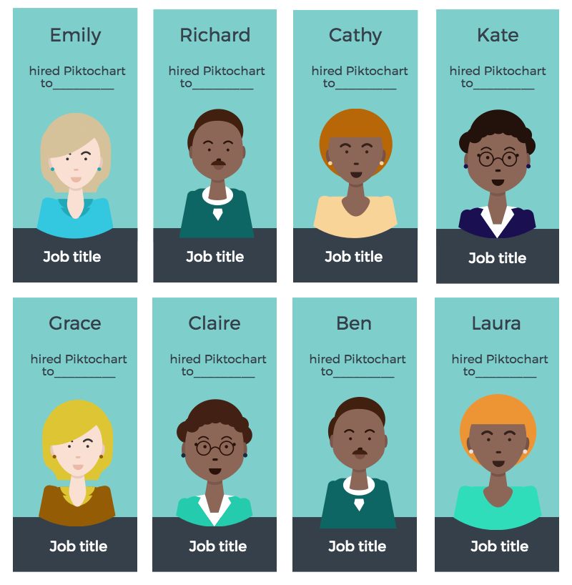
Talking with Persona Maven Kim Goodwin
Why use personas ?
A set of personas represents the key behaviors, attitudes, skill levels, goals, and workflows of real people we interview and observe, which we then use along with scenarios to guide the product's functionality and design.

Slide 31
Talking with Persona Maven Kim Goodwin
Who should conduct the persona interviews ? Who should be interviewed ?
The same people who will be doing the design should conduct the persona interviews.
In a sense, you're forming a hypothesis about who your personas might be. Ideally, interview a broad set of people, because you might find differences you didn't expect.

Slide 32

Talking with Persona Maven Kim Goodwin
How long it might take to do the interviews ?
Simple consumer products
  2 weeks
Complex enterprise application with multiple interface
  4 ~ 5 weeks

Slide 33
Talking with Persona Maven Kim Goodwin
Does the primary persona usually turn out to be the one that has the fewest skills or is the lowest common denominator in all of the people that are interviewed?
Fairly common for the simplest consumer products.
With productivity tools, the primary persona is more often perpetual intermediate.
In some cases, The choice of primary persona is not so much about skill level, but about how representative that person's goals and tasks are.

Slide 34


