Slide 1
Storyboarding
音樂所碩一 陳鵬安
資應所博一 黃小卉
資應所碩一 袁偉軒

Slide 2
Outline
01
介紹和準備(introduction and preparation)
陳鵬安
02
製作雛形(prototype)
黃小卉
03
修改雛形(revision)
袁偉軒
04
活動(Activity)
製作故事分鏡

Slide 3
介紹和準備(introduction and preparation)
01
Definition
04
Prepare the room, data, supplies
02
Key Concept
05
Gather people to storyboard
03
Process for storyboarding

Slide 4
Storyboarding
Storyboards take the broad view of the vision,
and work out in detail how a person accomplish specific tasks in the new design.
Ensure the team does not overlook any intents and steps that are critical to the work.

Slide 5
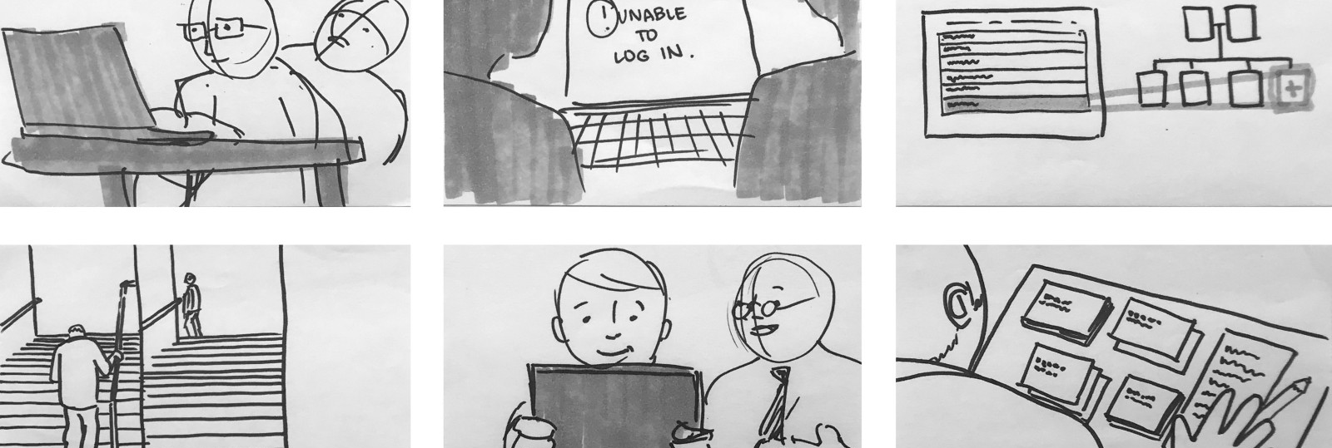
Definition
Like freeze-frame movies of the new work practice.
Step-by-step pictures of how people will work.
Include manual steps, rough user interface components, system activity and automation, and even documentation use.

Slide 6
Key concepts
Using drawings instead of text-based use cases.
Start with a low-level vision.
A
B
C
D
Storyboards are equivalent to future scenarios.
Identify which sequences are relevant to the vision.

Slide 7
Process for storyboarding
Preparation:
After storyboarding
  Room.
  Data.
  Supplies.
  People
  Review how to storyboard.
  Share the storyboard with stakeholders or members. of a larger team.
  Refine the storyboard.
  Go on to the next storyboard.
Refer to vision
  Create a low-level vision.
  Walk the consolidated vision.
  Collect issues from the affinity and consolidated sequence model.
  Create a low-level vision for one task to be storyboarded.
  Identify pluses and minuses for the low-level vision.
Start to storyboard
  Create the storyboards.
  Draw the storyboard frames.
  Check the storyboard against the consolidated sequence.

Slide 8
Step1: Prepare the room, data, and supplies
30%
Hang up the consolidated visions and sequences.
Flipcharts and papers (5.5 * 8.5 inches, about half of A4) for drawing.
Removable tape to hang the storyboard frames onto flipcharts for review.
50%
70%

Slide 9
Step2: Gather people to storyboard
30%
Better to have more people.
If more people, create several storyboards in parallel.
Be sure that one core team member works on every storyboard.
Same people are responsible for the same storyboard.
.
50%
70%
90%

Slide 10
Step3: Choose where to start
30%
Select the sequences you will storyboard starting with the work that is core to the system.
If more people, Assign two people in one sequence and ensure two sequences do not have overlapping activities.
Review your consolidated vision to see if there's more detailed data.
Vision alone is not a guide - people may argue about how an activity is accomplish in a complicated or unfamiliar task.
.
50%
70%
90%

Slide 11
製作雛形(prototype)
01
Choose where to start
04
example: eChalk
02
Review how to storyboard
05
identify pluses and minuses for the low-level vision
03
Draw the storyboard

Slide 12
Choose where to start

Slide 13
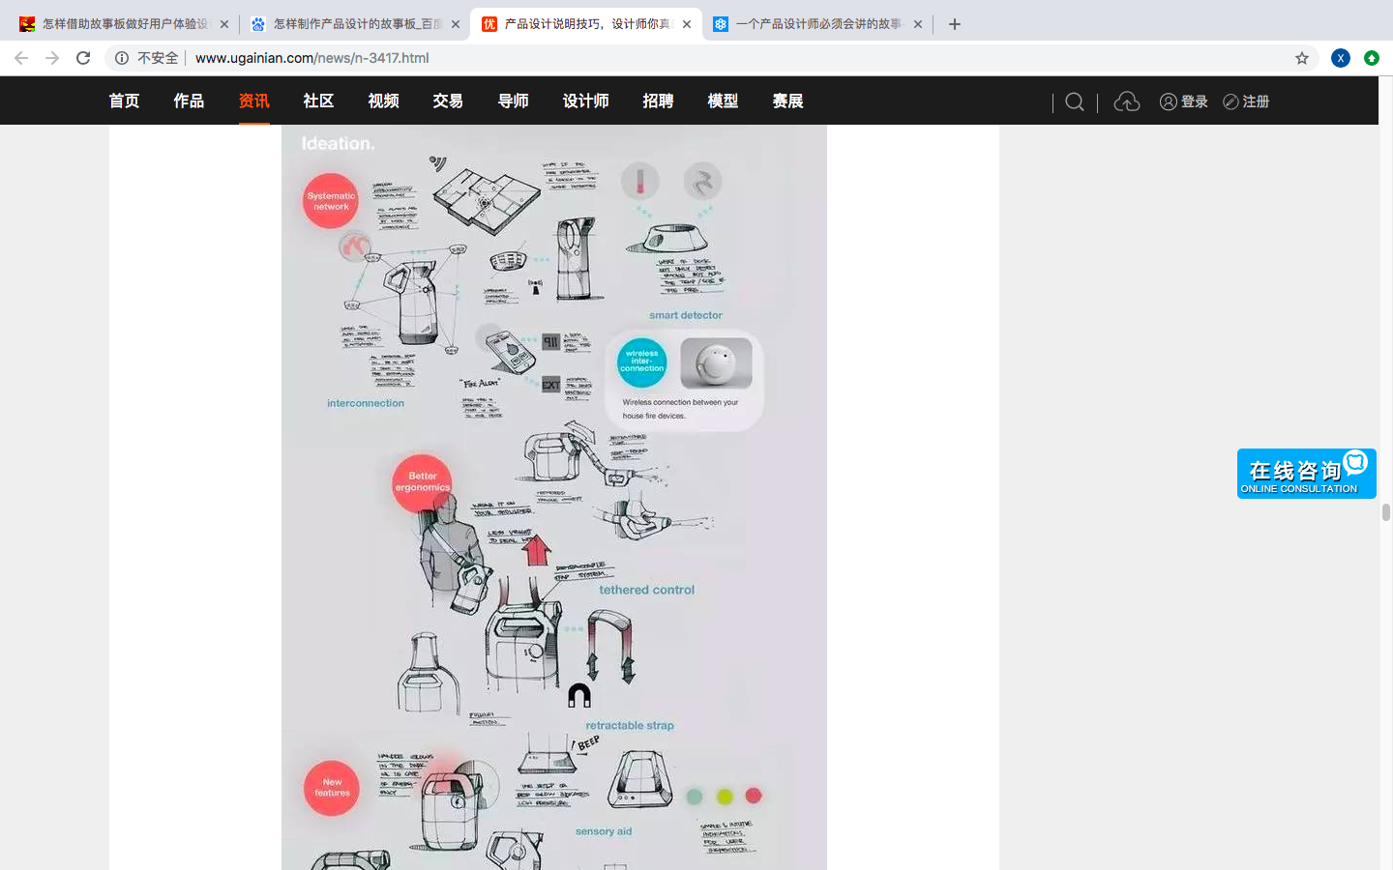
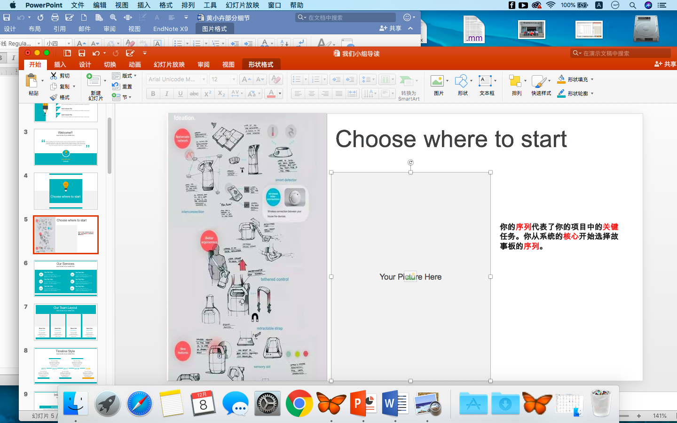
Choose where to start
流程代表了你項目中的關鍵任務。
從系統的核心開始選擇storyboard的流程。

Slide 14
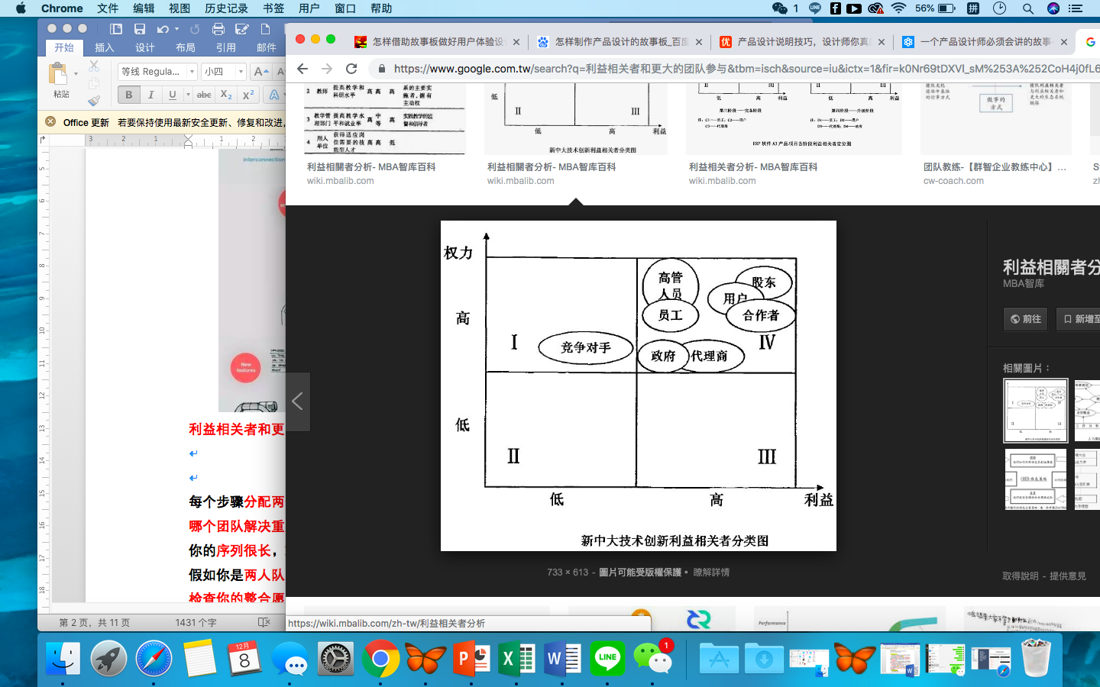
Choose where to start
利益相關者、團隊參與

Slide 15


Choose where to start
每個步驟分配兩個人
哪個團隊解決重疊的部分

Slide 16
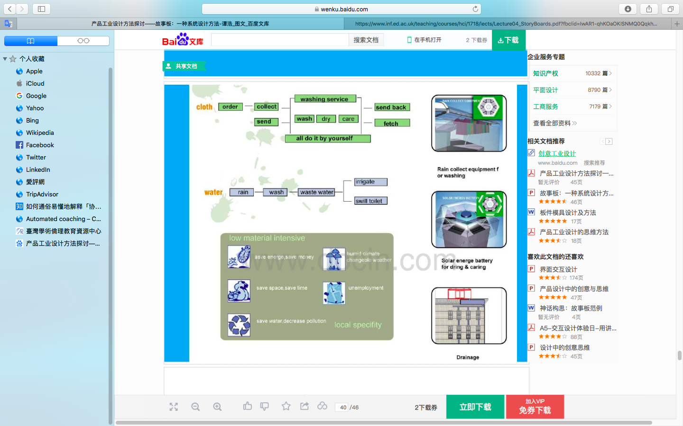
Choose where to start
流程很長，就要必需要切割

Slide 17
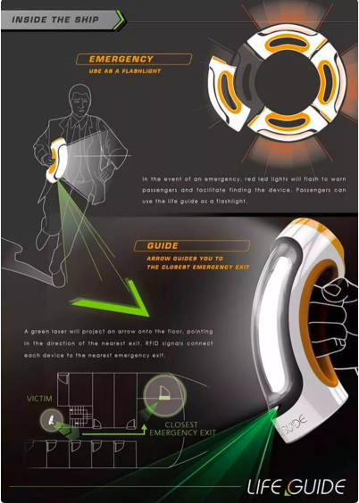

Choose where to start
假如你的隊伍有兩個人，只要從核心storyboard開始即可。
檢查你的整合願景，看看它的任務是否與你的流程相關。

Slide 18
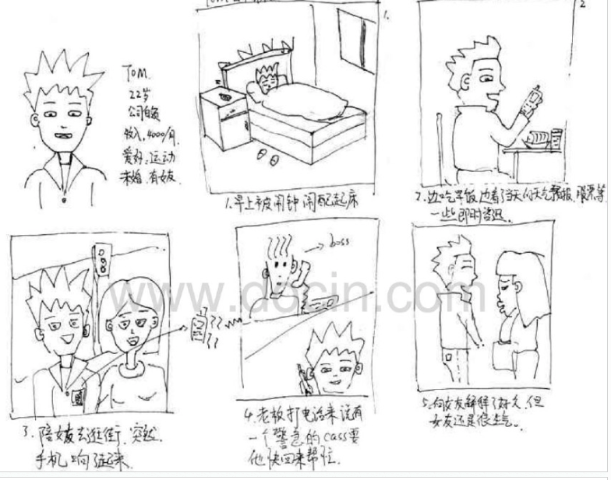
Choose where to start
一個實例去引導storyboard
也會比虛構的故事快且有效率

Slide 19
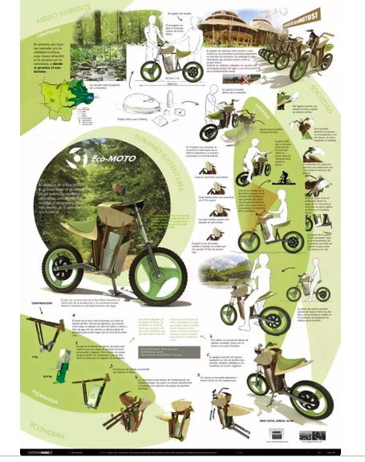
Choose where to start
產生爭論。對於復雜和不熟悉的領域，僅僅是視覺的呈現是不夠的。

Slide 20
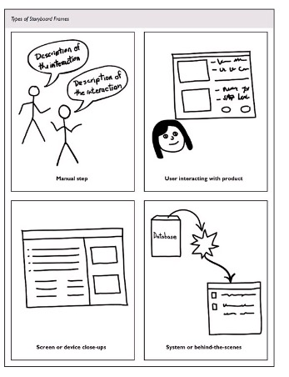
Choose where to start
業務範圍內的新流程設計將在不同的假設背景下講述故事板。列出願景、合併流程、任何流程計畫，最後用storyboard的方式總和。
審查不同案例和條件的願景。你的合併流程也將有不同的分支和策略。

Slide 21
Review how to
storyboard

Slide 22
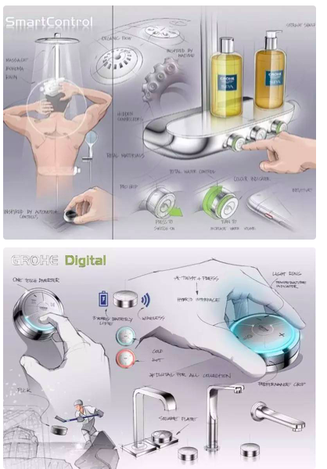
Review how to storyboard
Choose where to start
Review how to storyboard
Describe the order of the process
1.Storyboard是具體圖片和文字、
整個工作的程式，不僅是產品的互動。
Draw the storyboard
Example: eChalk
Identify pluses and minuses for the
low-level vision

Slide 23
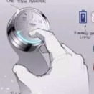
Review how to storyboard
Choose where to start
2. 手工畫的圖片，讓人確切的知道新的體驗將是怎樣工作的。
包括a.手動步驟，b.與新系統介面的互動，c.系統的自動化過程，d.系統的使用規則，e.與別的系統或產品的關聯。
Review how to storyboard
Describe the order of the process
Draw the storyboard
Example: eChalk
Identify pluses and minuses for the
low-level vision
a.手動步驟

Slide 24

Review how to storyboard
Choose where to start
2. 手工畫的圖片，讓人確切的知道新的體驗將是怎樣工作的。
它包括a.手動步驟，b.與新系統介面的互動，c.系統的自動化過程，d.系統的使用規則，e.與別的系統或產品的關聯。
Review how to storyboard
Describe the order of the process
Draw the storyboard
Example: eChalk
Identify pluses and minuses for the
low-level vision
b.與新系統介面的互動

Slide 25



Review how to storyboard
Choose where to start
2. 手工畫的圖片，讓人確切的知道新的體驗將是怎樣工作的。
它包括a.手動步驟，b.與新系統介面的互動，c.系統的自動化過程，d.系統的使用規則，e.與別的系統或產品的關聯。
Review how to storyboard
Describe the order of the process
Draw the storyboard
Example: eChalk
Identify pluses and minuses for the
low-level vision
c.系統的自動化過程

Slide 26
Review how to storyboard
Choose where to start
2. 手工畫的圖片，讓人確切的知道新的體驗將是怎樣工作的。
它包括a.手動步驟，b.與新系統介面的互動，c.系統的自動化過程，d.系統的使用規則，e.與別的系統或產品的關聯。
Review how to storyboard
Describe the order of the process
Draw the storyboard
Example: eChalk
Identify pluses and minuses for the
low-level vision
d.系統的使用規則

Slide 27
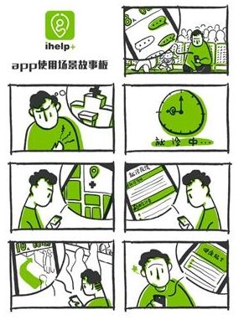
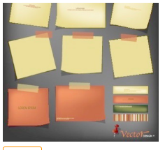
Review how to storyboard
Choose where to start
3.Storyboard由使用者資料構成。有親和力的資料和產品需要的數據。
Review how to storyboard
Describe the order of the process
Draw the storyboard
Example: eChalk
Identify pluses and minuses for the
low-level vision

Slide 28
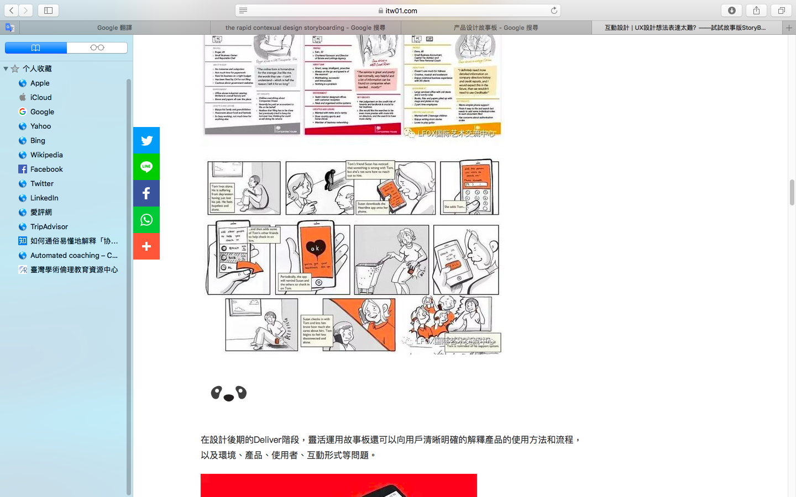
Review how to storyboard
Choose where to start
4. 每個storyboard的每一個frame都是故事中的一個步驟。
這個步驟代表著與系統的每一個互動；每一個與別人的互動；每一個手動的操作; 或者是系統內部的每一個反應。
Review how to storyboard
Describe the order of the process
Draw the storyboard
Example: eChalk
Identify pluses and minuses for the
low-level vision

Slide 29
Describe the order of the process

Slide 30
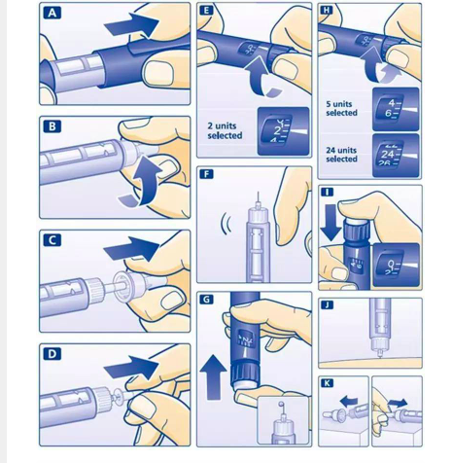
Describe the order of the process
Choose where to start
1. 選擇跟我們流程相關的數據。
2.創作storyboard流程的每一個步驟、活動、需求要得到願景和技術的支持。
Review how to storyboard
Describe the order of the process
Draw the storyboard
Example: eChalk
Identify pluses and minuses for the
low-level vision

Slide 31
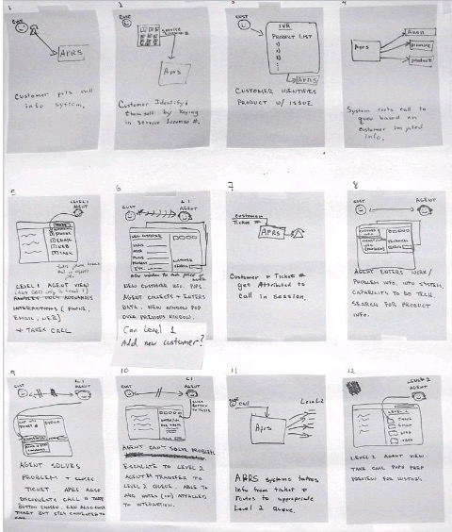
Describe the order of the process
Choose where to start
3.對每個願景進行不斷的修改和更正。
Review how to storyboard
4.產生故事板的每一個frame。
確認每一個畫面中只有一個互動或者步驟。
如圖12-2 就是完成的storyboard的例子。
Describe the order of the process
Draw the storyboard
Example: eChalk
Identify pluses and minuses for the
low-level vision
記著工作中不同類型的程序、界面、人機互動。

Slide 32
Describe the order of the process
Choose where to start
Review how to storyboard
5. 像是電影一樣，前進和後退。不是單一的流程。
6. storyboard必須有足夠的細節和內容。在這個事情中，你的顧客和雇員能通過看storyboard知道這個程序是什麼。
Describe the order of the process
Draw the storyboard
Example: eChalk
Identify pluses and minuses for the
low-level vision

Slide 33
Draw the storyboard

Slide 34
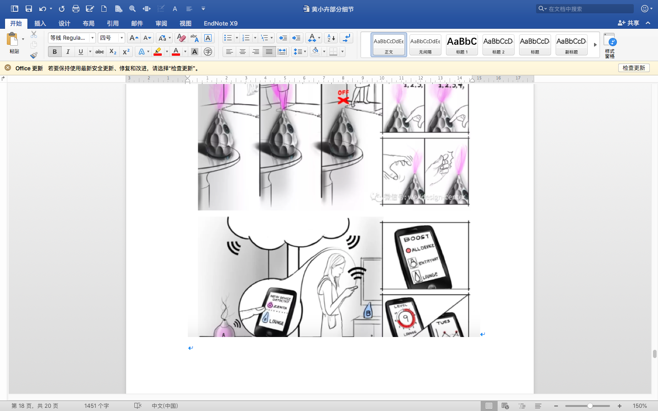
Draw the storyboard
Choose where to start
注意，每一個frame只有故事中的一個步驟，步驟如下：
1. 繪製粗略的使用者界面，要標上用法注解。
Review how to storyboard
Describe the order of the process
Draw the storyboard
Example: eChalk
Identify pluses and minuses for the
low-level vision

Slide 35
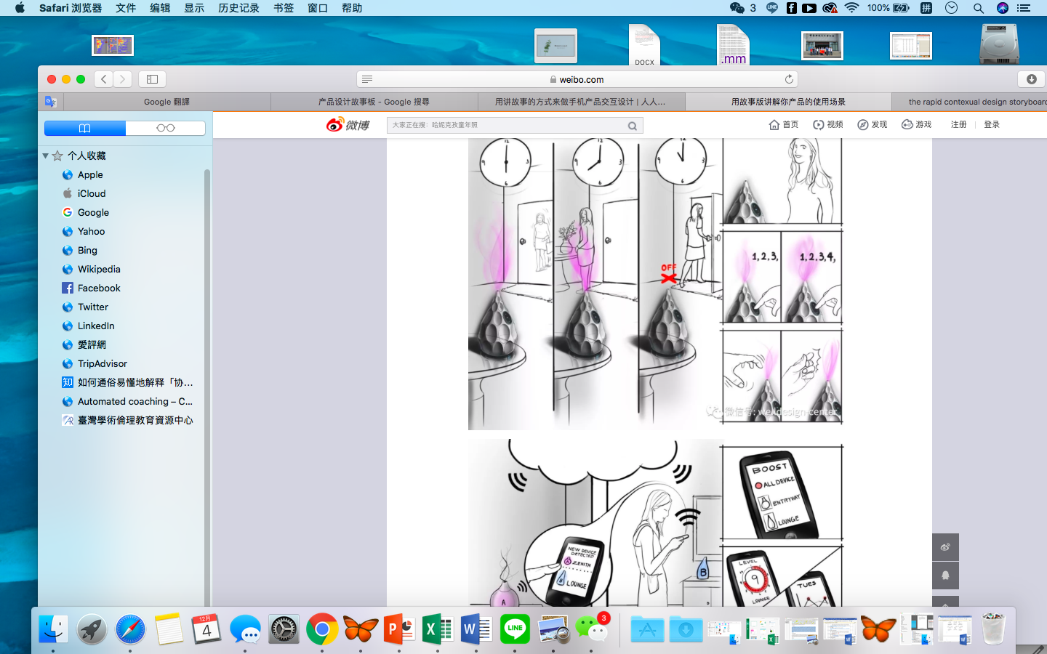
Draw the storyboard
Choose where to start
2.描述自動化過程，在需要更清晰的地方具體畫圖。
Review how to storyboard
Describe the order of the process
Draw the storyboard
Example: eChalk
Identify pluses and minuses for the
low-level vision

Slide 36
Draw the storyboard
Choose where to start
3. 使用草稿文檔。
4. 畫人物的卡通圖,這個卡通圖是關於人機互動的步驟。
Review how to storyboard
Describe the order of the process
Draw the storyboard
Example: eChalk
Identify pluses and minuses for the
low-level vision

Slide 37
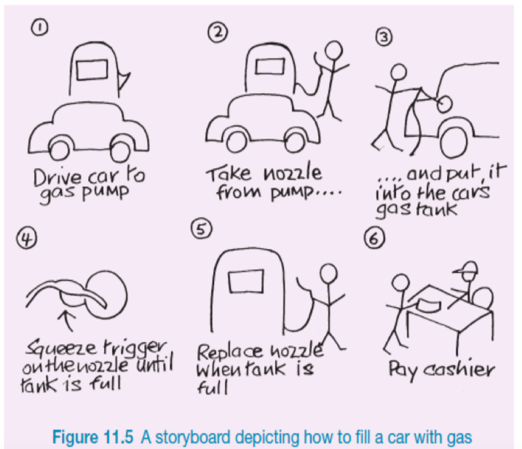
Draw the storyboard
Choose where to start
5. 如果系統是描述的運作的步驟，那麼要有數據支持。
6. 如果使用者做的是一系列的操作。那麼就一個步驟一個步驟的用草稿圖畫出來。
Review how to storyboard
Describe the order of the process
Draw the storyboard
Example: eChalk
Identify pluses and minuses for the
low-level vision
7. 註釋關於用戶操作每個步驟的名稱。見上圖

Slide 38
Draw the storyboard
Choose where to start
8. 寫注解的時候，要與商業規定、使用注釋、限制、硬體、軟體用法相一致。
9. 要包括將來發生什麼，假設陳述以及任何圖片包括沒放進去的內容。
10. 保證你正在創建在storyboard過程中的所有的 frame 能否讓沒有參加設計的人都能看懂。
Review how to storyboard
Describe the order of the process
Draw the storyboard
Example: eChalk
Identify pluses and minuses for the
low-level vision

Slide 39
Example: eChalk

Slide 40
Example: eChalk
Choose where to start
他們一共畫了34張圖片代表一下步驟：
a.創建一個課程日曆表
b.做計劃和接收計劃
c.製作課程事件
d.做計劃
e.上課
f.進入班級
g.與家長溝通
Review how to storyboard
Describe the order of the process
Draw the storyboard
Example: eChalk
Identify pluses and minuses for the
low-level vision

Slide 41
Identify pluses and minuses for the low-level vision

Slide 42
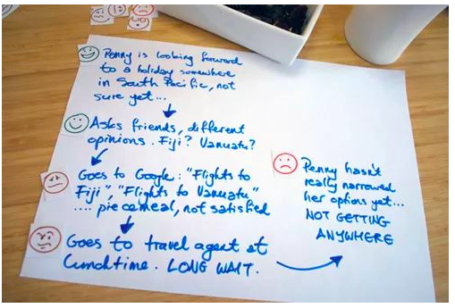
Identify pluses and minuses for the low-level vision
Choose where to start
Review how to storyboard
製作低願景圖的優缺點。這樣當你要進行捨棄抉擇的時候，就可以在根據優缺點做決定。
Describe the order of the process
Draw the storyboard
Example: eChalk
Identify pluses and minuses for the
low-level vision

Slide 43
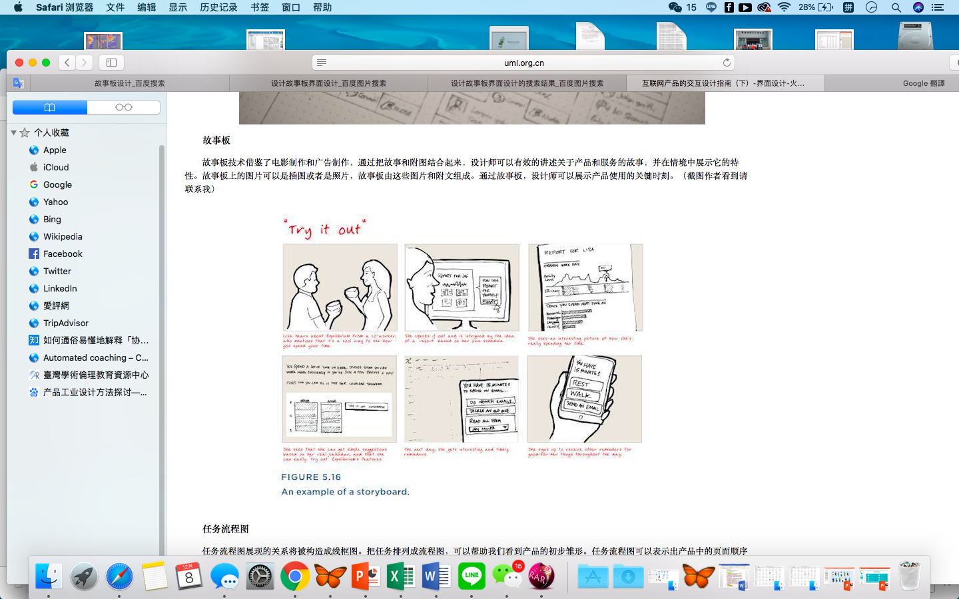
Identify pluses and minuses for the low-level vision
Choose where to start
要記錄你做選擇的記錄，因為當使用者不喜歡這個細節的時候，我們就要淘汰它。我們把這個過程叫做“選擇測試案例”。他們能幫助你關注紙板模型測試。所以一定要做記錄。
Review how to storyboard
Describe the order of the process
Draw the storyboard
Example: eChalk
Identify pluses and minuses for the
low-level vision

Slide 44
How to choose between
two ideas

Slide 45
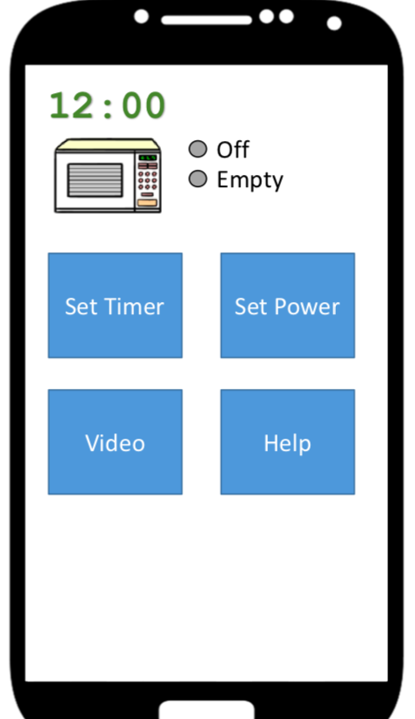

How to choose between two ideas
如果當兩個次級願景都很好的時候，怎麼選擇？促使紙模版的發展。
  a. 由用戶來測試。考慮到底選哪個？
  b. 一個原則就是選擇最基礎的功能。
  c. 如果你讓使用者看到他們想要的，你就不用重新修改了。最糟糕的是，使用者的反應是要麼積極或消極。遇到這個情形，你就得根據反應做一個改進。
  d. 在領域中，創建你想要測試功能的測試列表。最終的選擇權是使用者，不是你。

Slide 46
雛型修改(Revision)
01
identify pluses and minuses for the low-level vision
04
Rework the storyboard
02
Check storyboard against the consolidated sequence
05
Go on to the next storyboard
03
Share the storyboard

Slide 47
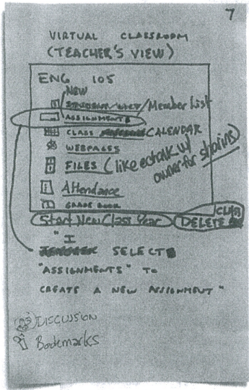
Identify pluses and minuses for the low-level vision
Different scenario were run for the same task
評分、評語
作業分數
繳交作業
Notes:
在作業評分任務中，會有學生跟老師兩個不同的，使用者情境組成。
或是不同分數的學生，會有不同作業

Slide 48
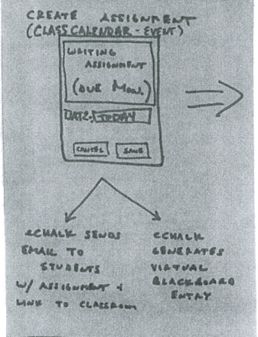
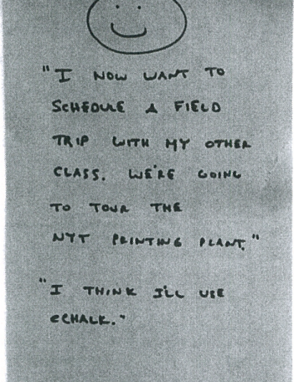
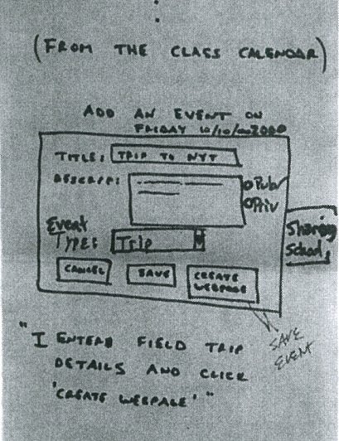
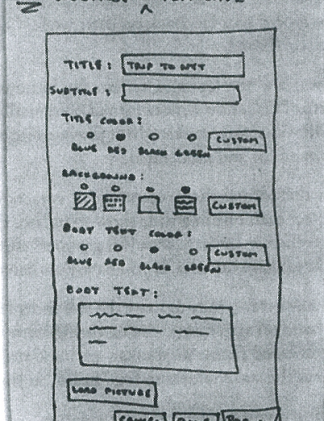
Identify pluses and minuses for the low-level vision
解釋在某個UI之下
哪些東西會處發哪些事件
使用者試用後的建議
需記錄下來用在之後的設計
畫出目前以功能為主的介面
不用太在意美觀
在每個任務間的過渡期
記下使用者需求
確保這個系統可以順利進行

Slide 49
Identify pluses and minuses for the low-level vision
Tips about storyboarding process
不需要太在意語言、圖示，只要著重在功能方面，UI日後還會再修改。
如果在畫的時候遇到困難，往回看low-level vision。
過程中你遇到的困難也有可能是使用者日後會遇到的困難，所以必須解決。

Slide 50
Check storyboard against the consolidated sequence
Last pass quality check
“
“
最後一次確認你的storyboard跟流程是否有可以用一樣的步驟達到一樣使用者的需求?
或是也可以增加新的步驟、技術，只要不要破壞這次的工程

Slide 51
Share the storyboard
When more than 2 people work in parallel
遺漏或是讓人疑惑的想法
技術可行性
違反使用者習慣的步驟
是否違反企業流程
各自的vision是否有矛盾
是否使企業任務不一致
是否有能改進的地方
使用者的接受度

Slide 52
Rework the storyboard
Go on to the next storyboard
設計者間提出的建議再做修改
沒什麼問題則使用者間不需要再做一次討論
沒討論仔細，讓更多使用者來測指會更浪費時間
完成一部分vision的storyboard就可以往其他storyboard繼續做
每個主要任務都會有一個storyboard，也都會有自己的分支
目標就是要用你設計的新流程、技術讓使用者在意的工作有更好的成效

Slide 53
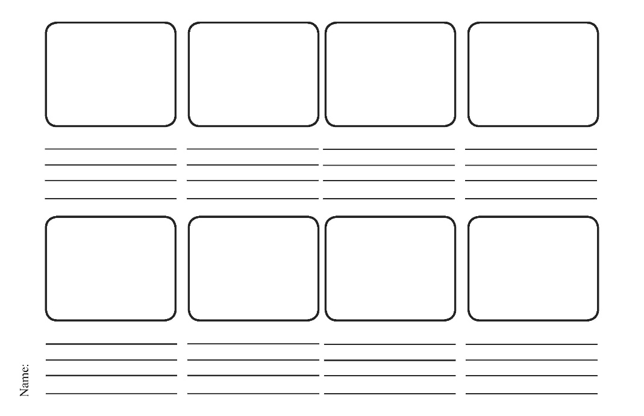
活動(Activity)
題目:用鬧鐘設定鬧鈴，和隔天起床的情境

Slide 54
Thank you

