Slide 1
Foundations of Integrated Corporate Carbon Accounting
CASI WHITEPAPER · NO. 1
C. Ernst · S. Reichelstein · G. Ormazabal · T. Sellhorn
The Carbon Accounting Standards Initiative (CASI) · October 2025, revised December 2025

Slide 2
1 The Quest for Corporate Carbon Accounting
Section 1

Slide 3
Executive Summary
Businesses in a wide range of industries are increasingly considered responsible not only for their own direct carbon emissions but also for the emissions embodied in their sales products. This whitepaper describes the structure of Integrated Corporate Carbon Accounting (ICCA) systems that track an entity’s direct (Scope 1) and indirect (Scope 2 and upstream Scope 3) emissions over time in order to calculate key carbon emission metrics.
Akin to product costing in financial accounting, ICCA systems determine the cradle-to-gate Product Carbon Footprints (PCFs) of products sold in the current time period on the basis of the company’s actual direct emissions, its operational activities, and the PCFs attributed to production inputs sourced from suppliers. The aggregate PCFs of products sold then become a central building block for determining a company’s periodic Corporate Carbon Footprint (CCF). By separating carbon stock variables from carbon flow variables, ICCA systems track emissions consistently across different time periods. Double-entry bookkeeping enables a particular ICCA architecture that records the carbon stock variables on a CO2 balance sheet, resulting in overall CO2 statements that are structurally similar to financial statements.

Slide 4
3 Core Principles of Integrated Corporate Carbon Accounting
Completeness
Companies account and assume responsibility for their own direct (Scope 1) emissions and the indirect emissions embodied in acquired inputs and services (Scope 2 and upstream Scope 3) during an accounting period. An ICCA system is therefore complete if the carbon ledger records all direct and upstream indirect emissions corresponding to incoming goods and services received by the business.
Timely Recognition
Direct (Scope 1) emissions and direct removals are recorded in the carbon ledger for the accounting period in which they occur. Indirect emissions are recorded in the carbon ledger in the same time period in which customers acquire (take control of) goods and services. The carbon ledger must include accounts for carbon stock variables that capitalize any incoming emissions that are not recorded directly in the current CCF metric.

Slide 5
Introducing the Carbon Accounting Standards Initiative (CASI)
This whitepaper provides the foundational statement for a newly formed initiative, termed the Carbon Accounting Standards Initiative (CASI). We are a working group of company representatives and academics from the fields of accounting, corporate reporting, and climate sustainability. We are united by the belief that effective decarbonization depends on reliable investor-grade emissions data and that the principles of financial accounting offer a useful foundation for reliable carbon accounting at the corporate level. Ultimately, corporate carbon accounting must evolve to the point where emissions are tracked, allocated, and reported with the same rigor and structure as financial transactions.
In this first whitepaper we introduce the framework of Integrated Corporate Carbon Accounting (ICCA). Such accounting systems ensure that product-level carbon footprints (PCFs) seamlessly integrate with company-level carbon footprints (CCFs). Unlike existing approaches, ICCA applies rigorous accounting logic to GHG emissions and offsets, thereby enabling a coherent, reconcilable, and audit-ready infrastructure for carbon reporting.

Slide 6
3 Core Principles of Integrated Corporate Carbon Accounting
Accuracy
ICCA systems become more accurate as data inputs about indirect supply chain emissions are increasingly based on primary data that represent the actual emissions incurred in the supply chain. Accuracy will therefore improve as more companies in an entity’s supply network adopt their own ICCA systems. Recent contributions have proposed to quantify the level of accuracy by means of a Data Quality Scoring (DQS) index.
Unbiasedness
In most industries, the calculation of CCFs and PCFs requires pools of overhead emissions to be prorated (allocated) among different time periods and products. Such pools of overhead emissions frequently emerge in connection with shared assets or consumable inputs (e.g., electricity) that are used by multiple products. The principle of unbiasedness requires the applicable allocation rules to capture the causal link between emissions associated with specific production activities and the extent to which different products require these activities. While allocation rules that reflect the underlying causal links are intended to limit selective greenwashing, companies will generally retain some discretion in choosing among alternative allocation rules which meet this criterion.

Slide 7
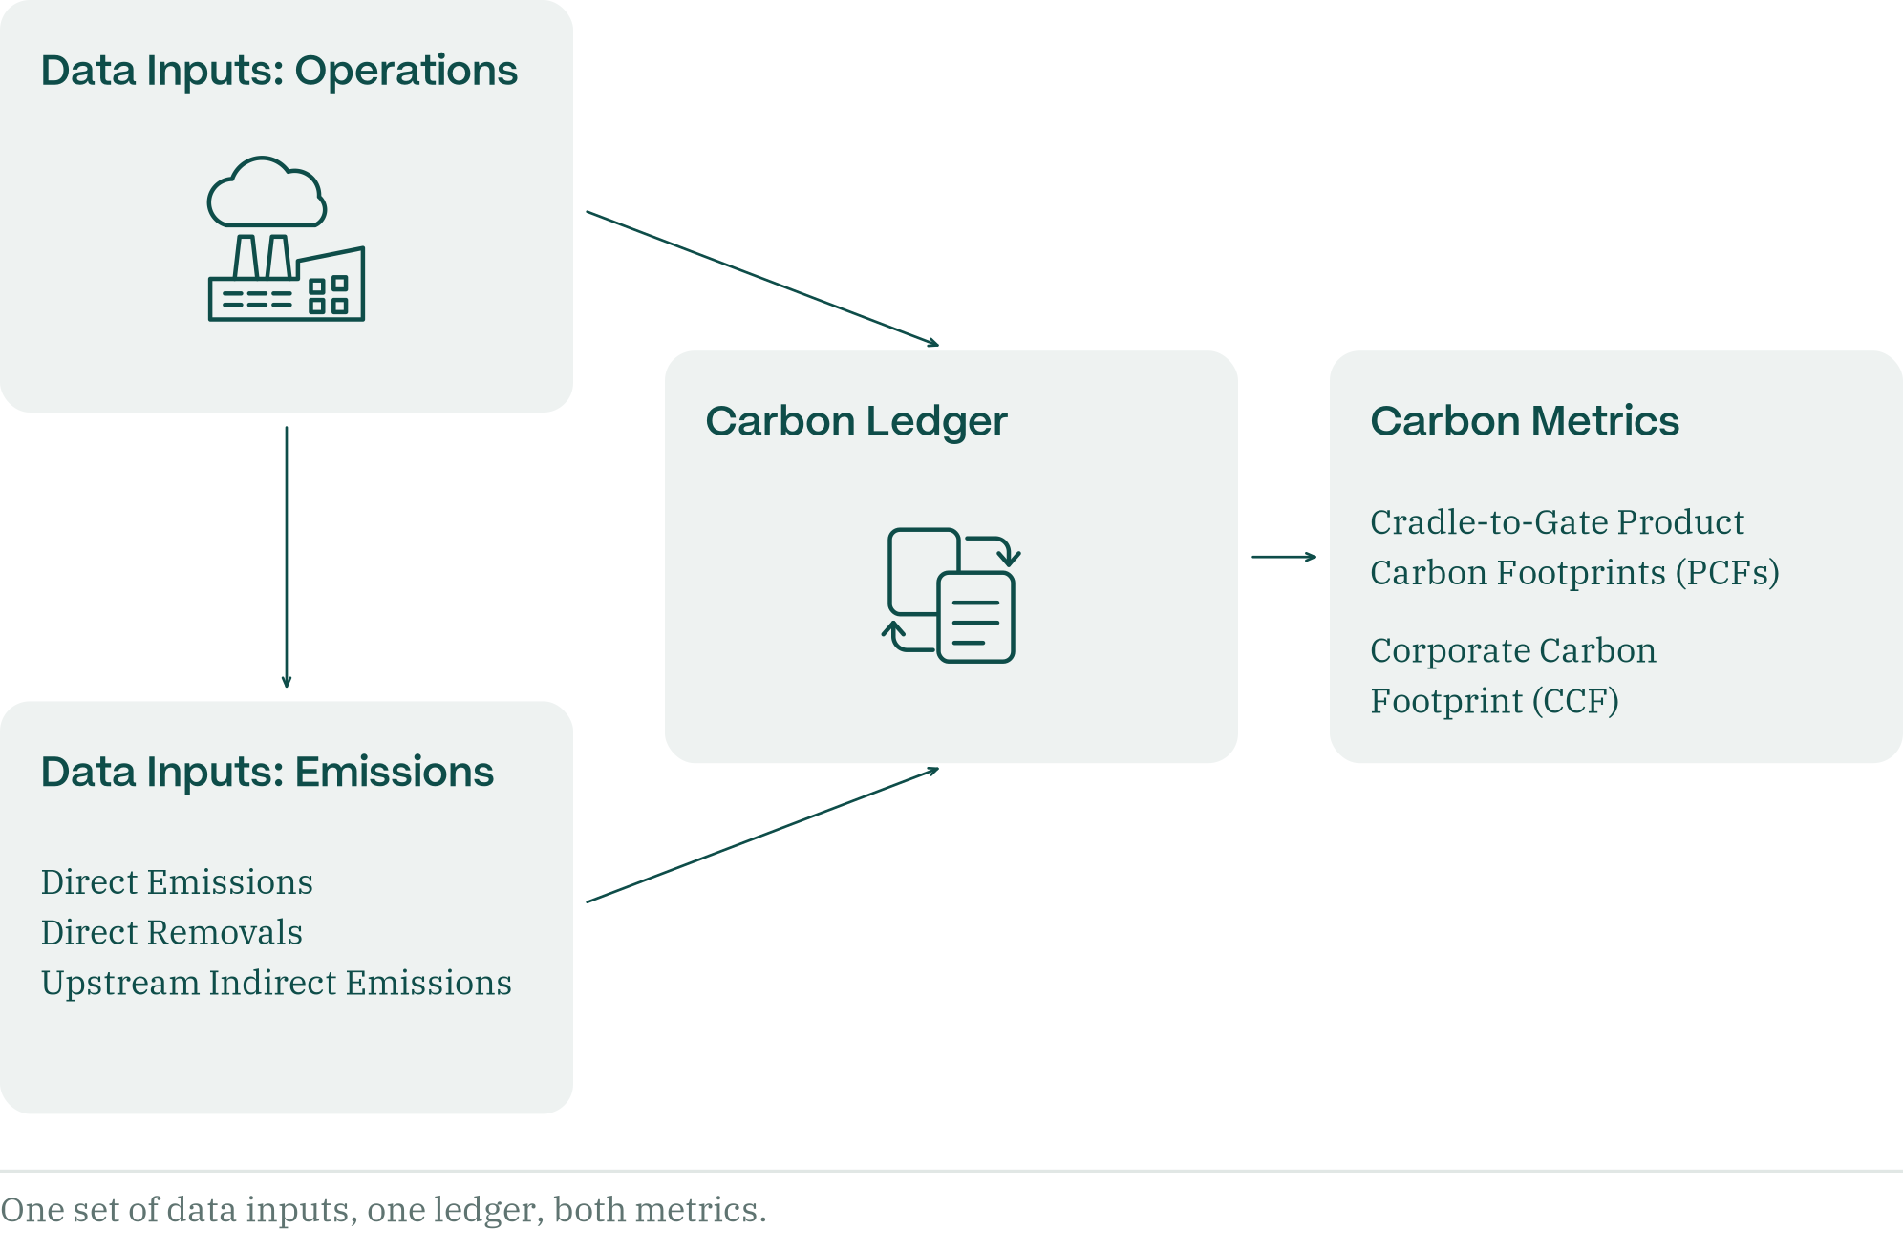
2 The Structure of Integrated Corporate Carbon Accounting (ICCA) Systems
Figure 3 Schematic for Integrated Corporate Carbon Accounting: data inputs, the carbon ledger and the resulting carbon metrics.

Slide 8








Integrated Corporate Carbon Accounting (ICCA)
CO2 Balance
Sheet
Direct
Emissions
Net CO2
Contribution
Direct
Removals
CO2 Ledger
Net CO2
Flow
Upstream
Emissions
Product
Carbon
Footprints

Slide 9
CO2 Balance Sheet
CO2 Balance Sheet
Emissions in Assets
Source of Emissions
+
Buildings, Machinery & Equipment
−
−
Direct Emissions
+
A
E
D
+
Materials
−
−
Direct Removals
+
B
C
H
+
Work-in-Process
−
−
Upstream Emissions
+
C
F
A
D
B
E
G
+
Finished Goods
−
−
Legacy Emissions
+
F
I
J

Slide 10
Strong Incentives
Iron ore producer
Direct
=
PCF Iron
Steel producer
PCF Iron
+
Direct
=
PCF Steel
Body producer
PCF Steel
+
Direct
=
PCF Body
Car manufacturer
PCF Body
+
Direct
=
PCF Car
PCF Car
+
Downstream Indirect
=
Life-cycle PCF Car

Slide 11




Lower Cost
Integrated Corporate Carbon Accounting (ICCA)
ESRS
CO2 Balance
Sheet
EPDs
EU ETS
Net CO2
Contribution
CDP
CBAM
CO2 Ledger
SBTi
Net CO2
Flow
CA SB253
Product
Carbon
Footprints
TCFD
ISSB
…

Slide 12
We look forward to entering a dialogue with you as we work toward a new era of corporate carbon accounting.
Carbon Accounting Standards Initiative
casinitiative.org

