Slide 1
Tone Contours and Context Effects in Singapore Mandarin
Leslie Lee and Lucien Carroll

Slide 2
Overview
Motivations
Background
Method
Results
Discussion

Slide 3
Motivations
“Standard Mandarin” includes:
  Beijing-based “Putonghua” official in China
  Taiwan Mandarin (“Guoyu”)‏
  Singapore Mandarin (“Huayu”)‏
BMC and TMC are subtly different, e.g.:
  Different canonical tone contours
  Different reduced tones
How is SMC different from the other two?

Slide 4
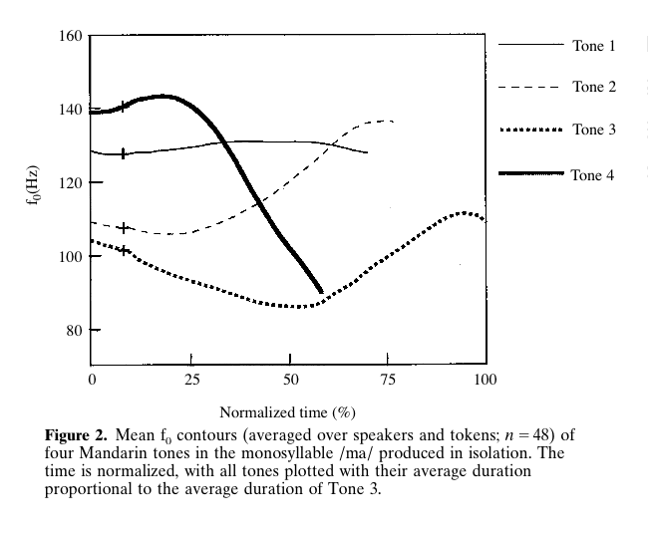
Tones in Isolation
BMC (Xu 1997)‏

Slide 5
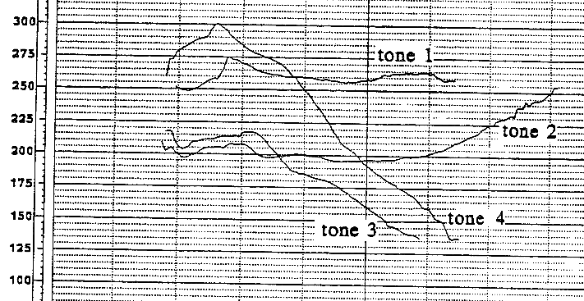
Tones in Isolation
TMC (Shih 1988)‏

Slide 6
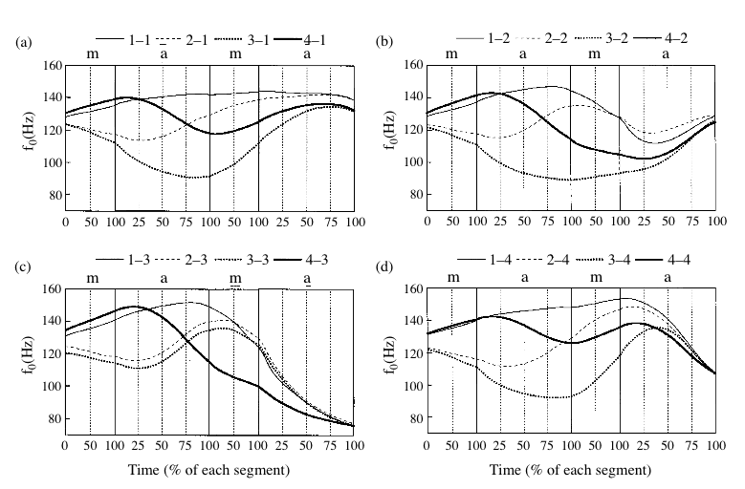
Tones in Context
Perseveratory Assimilation (Xu 1997)‏

Slide 7
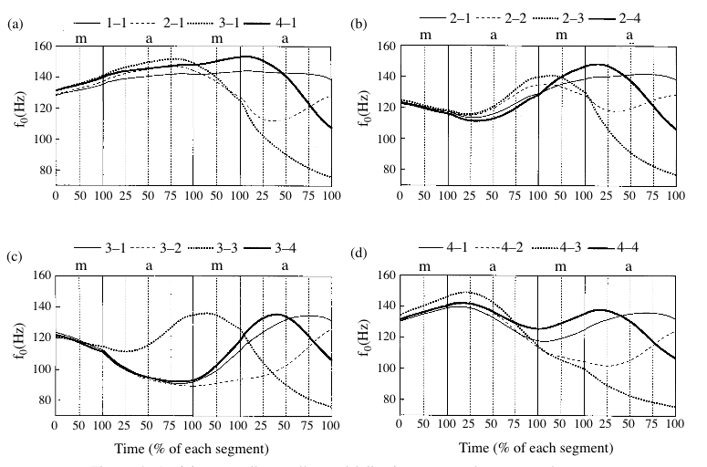
Tones in Context
Anticipatory Dissimilation (Xu 1997)‏

Slide 8
Hypotheses
H1: Tone contours differ from BMC (or not)‏
H2: Tone contours differ from TMC (or not)‏
H3: Perseveratory assimilation (or not)‏
H4: Anticipatory dissimilation (or not)‏
H5: T3 sandhi (?)‏

Slide 9
Experiment
Speakers
  Bilingual Singaporeans (L1 English, L2 SMC)‏
  2 male, 2 female
Method follows Xu (1997)‏
Tokens are segmented by hand in Praat
F0 and time measured made by Xu's script

Slide 10
Experiment A: Method
Stimuli
  'Ma' with each of 4 tones
  In 4 order-balanced repetitions
Procedure
  Slides presented on computer screen
  Each slide has a written Chinese dialog:
    A: How do you read this character?
    B: Ma.
  Speaker reads part B aloud

Slide 11
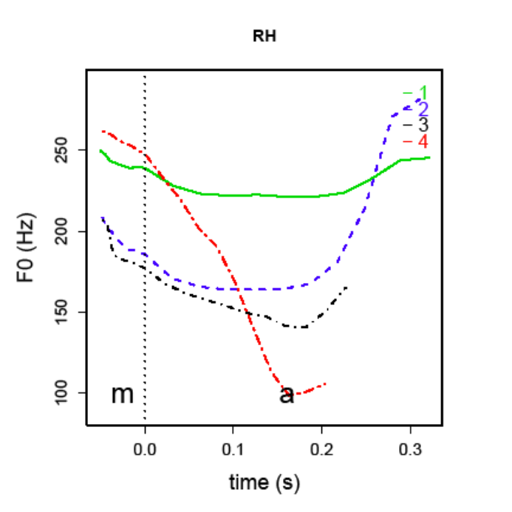
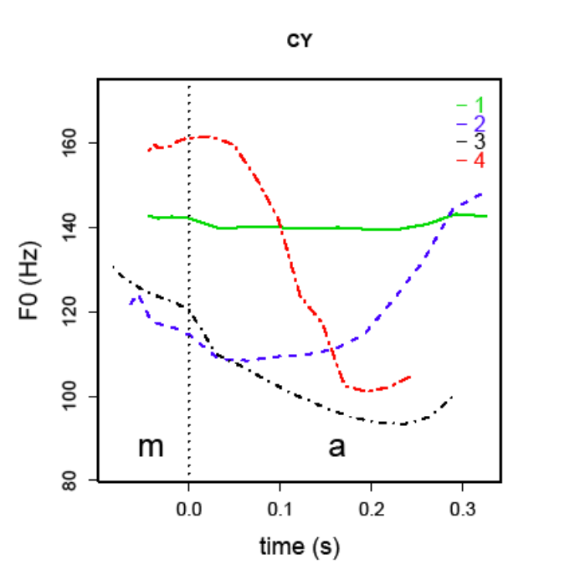
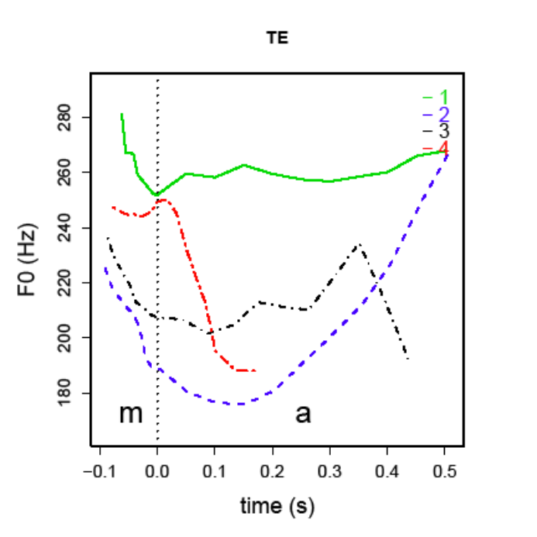
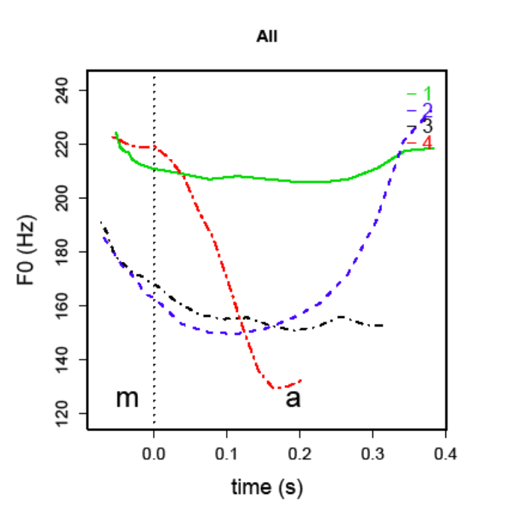
Experiment A: Results

Slide 12

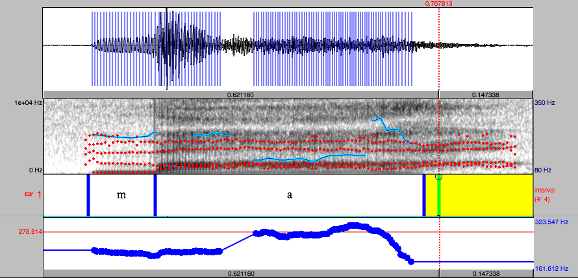
Experiment A: Issues
Creaky voice

Slide 13
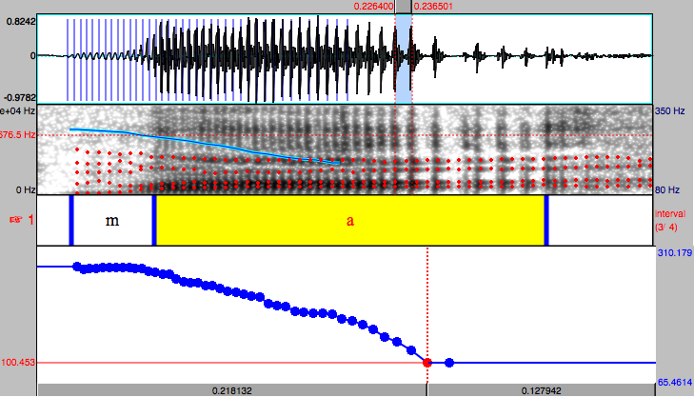
Experiment A: Issues
Full glottalization

Slide 14
Experiment B: Method
Stimuli
  'Mama' with 16 combinations of 4 tones
  In four carrier sentences:
    Wǒ qiú māmā liánxi (I beg mama to connect)‏
    Wǒ qiú māmā liànxí (I beg mama to practice)‏
    Wǒ jiào māmā liánxi (I told mama to connect)‏
    Wǒ jiào māmā liànxí (I told mama to practice)‏
Procedure
  Speaker reads once silently and 4 times aloud

Slide 15
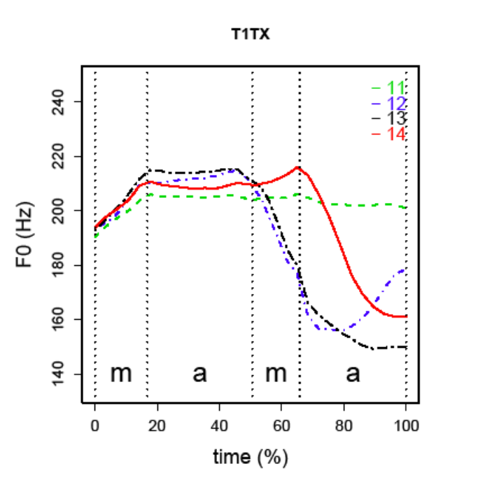
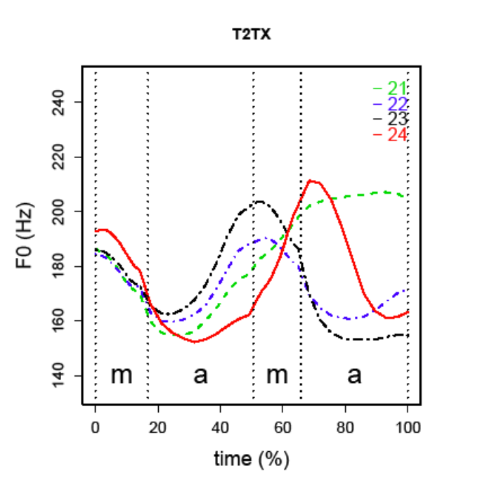
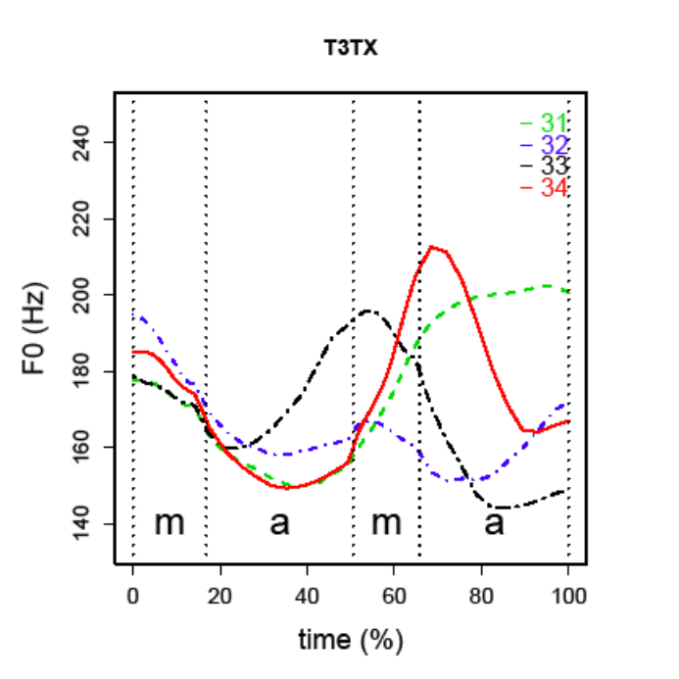
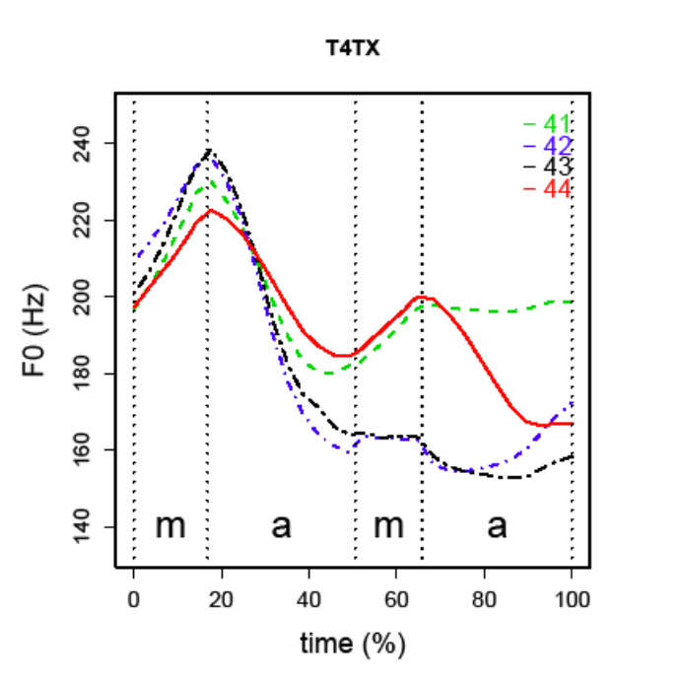
Experiment B: Results

Slide 16
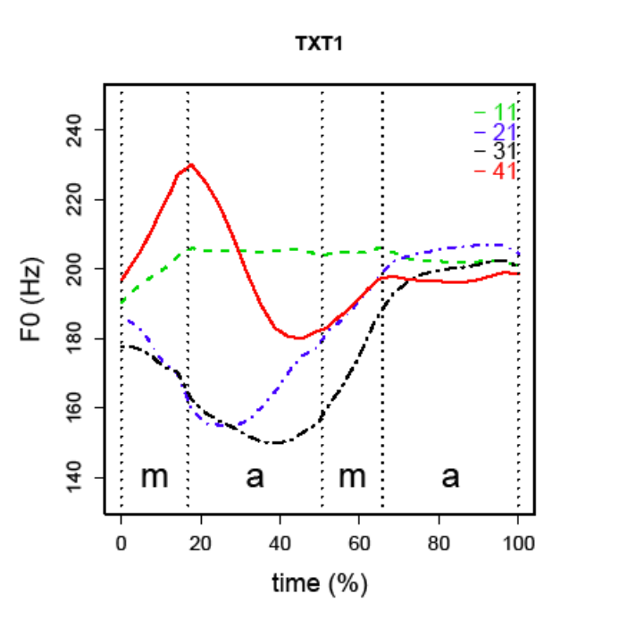
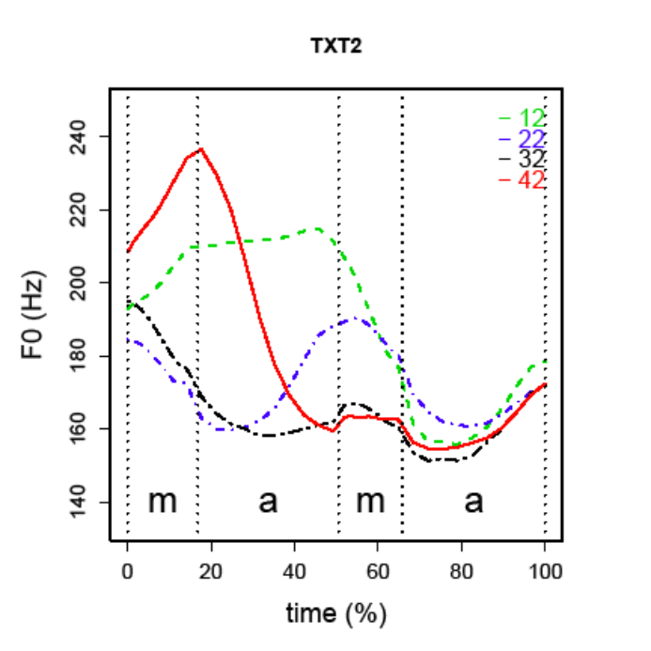
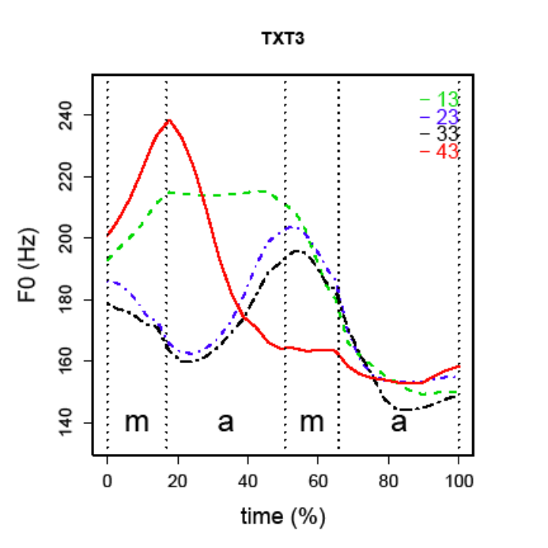
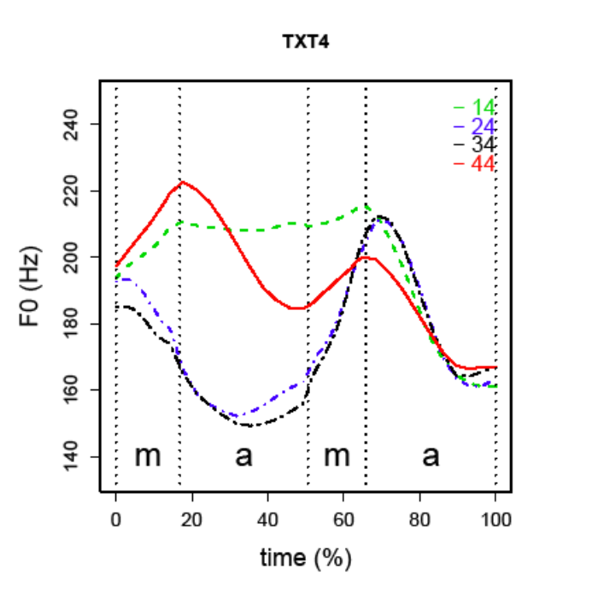
Experiment B: Results

Slide 17
Experiment B: Issues
Unreliable pitch readings on glottalized portions

Slide 18
Conclusions
H1 true (SMC different from BMC)‏
H2 unknown (SMC <?> TMC)‏
H3 unknown (Might assimilate weakly)‏
H4 probably (All except T4 dissimilate)‏
H5 false (T3.T3 ~ T2.T3)‏
Maybe also T3.T4 ~ T2.T4

