Slide 1

Crime in Space City E.T.L Project
Sergey Astvatsaturov
John Burke

Slide 2
1) Crime is a major concern for residents. 2) People need to know where crime is most likely to happen. 3) This project looks to collect, transform, and analyze data, to create visualizations which can be used to see which sections of Houston have the largest instances of crime and what may be the possible conditions which influence crime. afaf
Introduction:
This project focuses on specifically violent crimes, utilizing address and locations which can be confirmed using a national database.

Slide 3
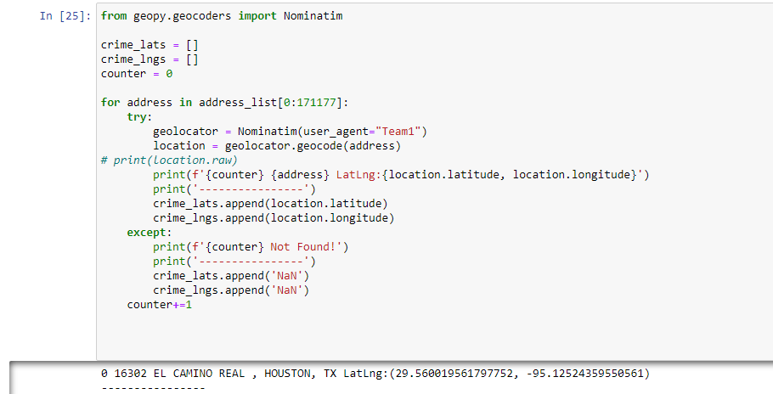
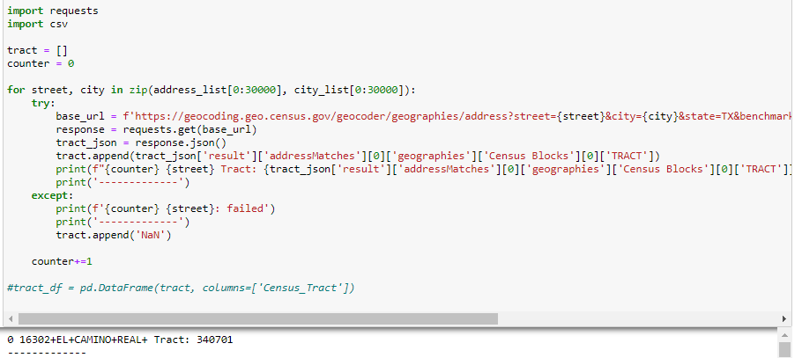
Four main sources for data collection were used. 1) Houston Police Department’s archives – Excel Files 2) Latitude and Longitude information was collected utilizing nominatim.org using Python’s GeoPy Library 3) Tract information was retrieved from geocoding.geo.census.gov using API calls. 4) Median economic data was acquired from census.gov Future Fur
Extraction:
(Nomatim.org)
(Geocoding.geo.census.gov)
Future considerations:
Detailed economic and racial data can be acquired from census.gov
Weather Data can be pulled from openweathermap.org

Slide 4
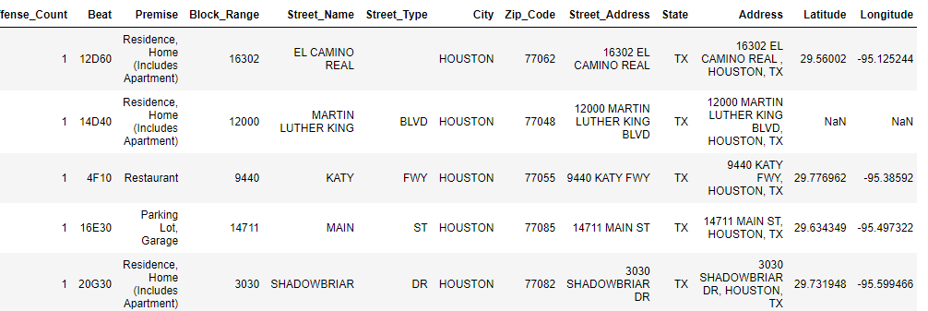
Initial transformation:
Data was converted from .xls format to .csv
Column Headers were renamed
Uncessary columns were dropped
NaN in street type column were replaced with a blank space
Non-Violent crimes and misdemeanors were discarded
Zip Codes given in a range were split
7) New column called State was created
8) New column called address was created using the: (Block_range, Street_Name, Street_Type, City, and State columns)
9) The data frame was then appended with the lat long data

Slide 5
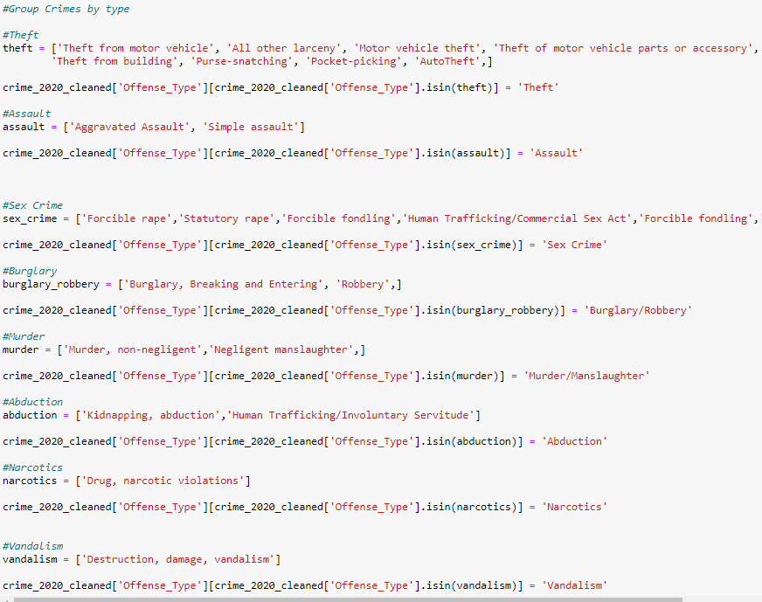
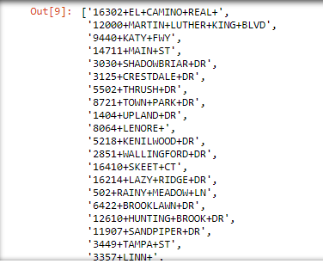
Transformation Part 2:
Crimes were grouped by “type”
New columned called Street_Address was created

Slide 6
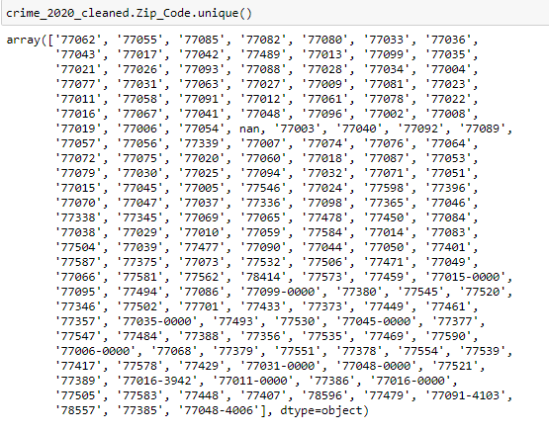
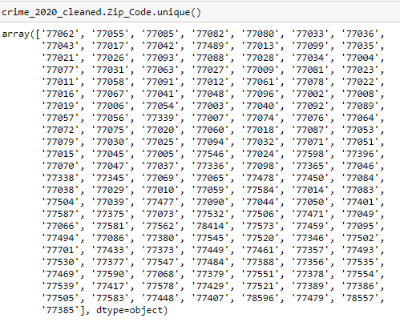
1)Lat/Long columns that contained nan were dropped 2)Zip codes were cleaned up
Final Transformation:

Slide 7
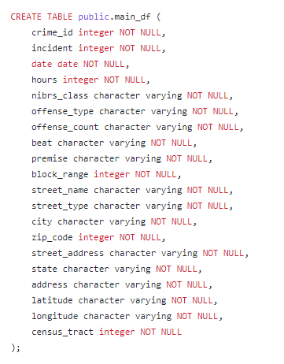
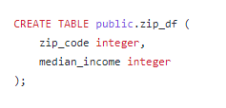
Loading:
Table and columns were created

Slide 8
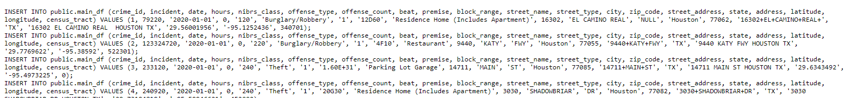
Loading:
Cleaned CSV data was loaded into DB

Slide 9
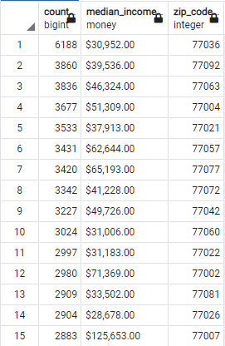
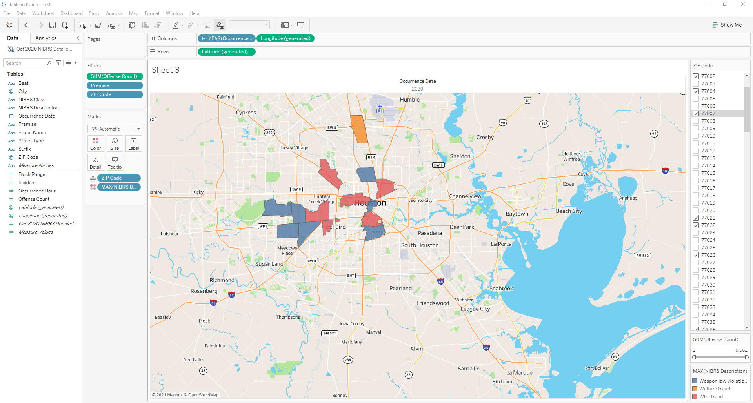
Conclusion:

