Slide 1

Introduction To
Selenium

Slide 2

Table of Contents
What is Selenium?
Selenium Components
Who developed Selenium?
Selenium IDE
  Benefits of Selenium IDE
  Drawbacks of Selenium IDE
Selenium RC
Selenium WebDriver
  Selenium WebDriver Architecture

Slide 3

Selenium Grid
  Features
  When to use Selenium Grid
8 Platforms supported by Selenium
  Operating Systems
  Browsers
  Programming Languages
  Testing Frameworks
Advantages of Selenium
Disadvantages of Selenium
Advantages of Selenium over QTP

Slide 4
What is Selenium?
SELENIUM is a free (open-source) automated testing framework used to validate web applications across different browsers and platforms. You can use multiple programming languages like Java, C#, Python etc. to create Selenium Test Scripts. Testing done using the Selenium tool is usually referred to as Selenium Testing.
Selenium Integrated Development Environment (IDE)
Selenium Remote Control (RC)
WebDriver
Selenium Grid

Slide 5
Selenium Components
Selenium is not just a single tool but is a combination of different suites of software. Selenium has four components.
01
Selenium IDE (Integrated Development Environment)
02
Selenium RC (Remote Control) – deprecated now
03
Selenium WebDriver
04
Selenium Grid

Slide 6
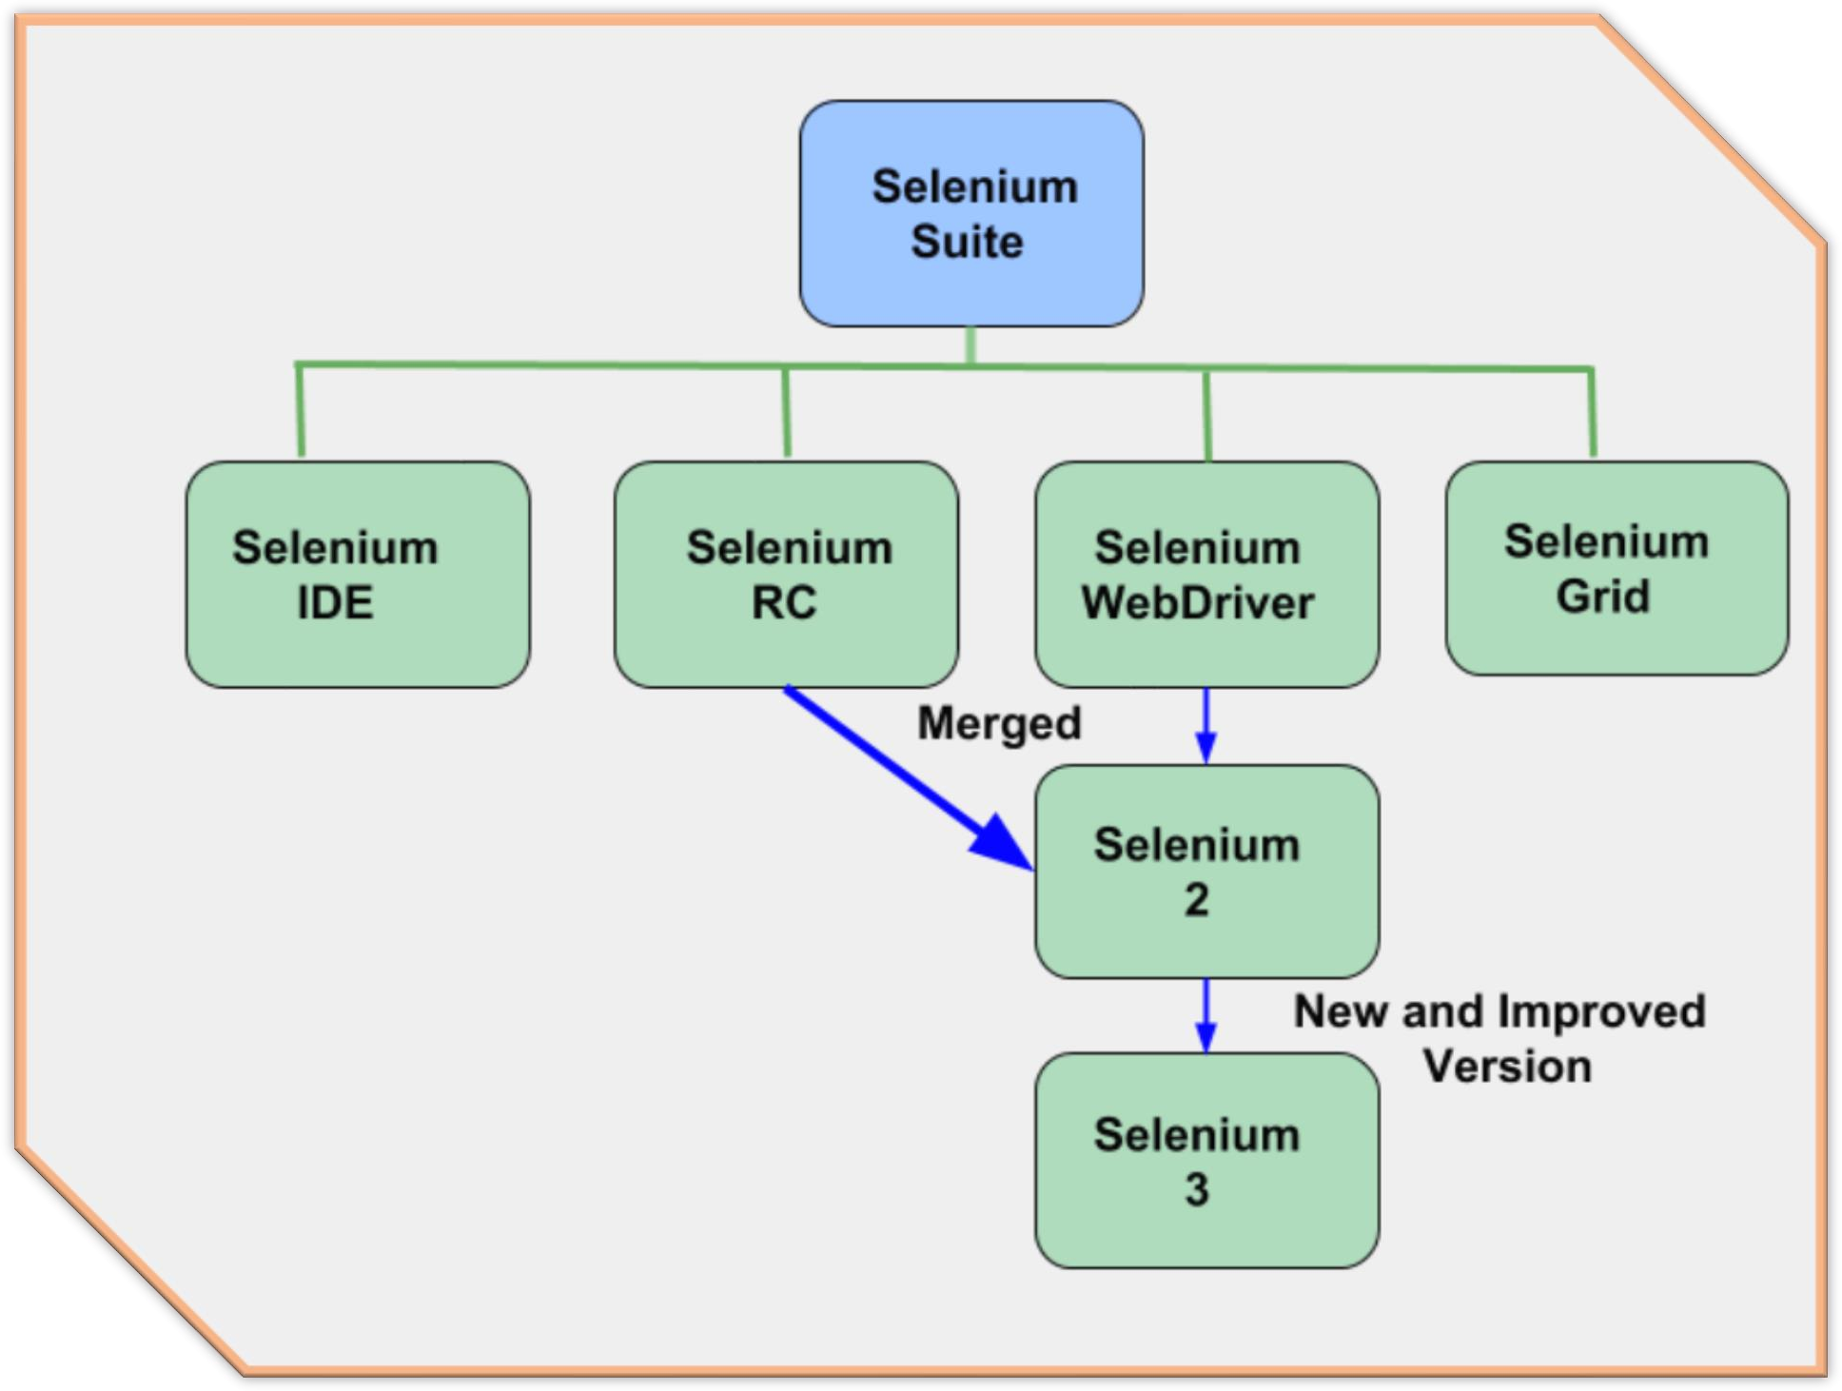

Slide 7

Who developed Selenium?
Since Selenium is a collection of different tools, it had different developers as well. Below are the key persons who made notable contributions to the Selenium Project
Primarily, Selenium was created by Jason Huggins in 2004.

Slide 8
An engineer at ThoughtWorks, he was working on a web application that required frequent testing. Having realized that the repetitious Manual Testing of their application was becoming more and more inefficient, he created a JavaScript program that would automatically control the browser's actions. He named this program as the "JavaScriptTestRunner“.
Seeing potential in this idea to help automate other web applications, he made JavaScriptRunner open-source which was later re-named as Selenium Core.

Slide 9
Selenium IDE
Selenium Integrated Development Environment (IDE) is the simplest framework in the Selenium suite. It is a browser plugin to record and playback the operations performed on the browser. Selenium IDE plugins are available for Chrome and Firefox browsers. It doesn’t support the programming features. Selenese is the language which is used to write test scripts in Selenium IDE.

Slide 10























Benefits of Selenium IDE
It is used to create and execute Test cases using Firefox or Chrome browsers
Very easy to use and install
Has built- in test results reporting module
No programming experience is required
The user can easily record the Test scripts
The user can edit the Test scripts
The user can create Test Suites.

Slide 11
Selenium RC
Selenium RC is a testing tool used for web applications testing. It supports programming using RC. Using RC, we can test out applications in multiple browsers and also in multiple operating systems.

Slide 12
Selenium RC
Selenium RC has complex architecture hence
slow in
automation test execution. In Selenium RC, we need to launch a separate application called Selenium RC Server before we can start testing. Selenium RC server acts as a middleman between selenium commands and your browser. Selenium RC has been officially deprecated, you should use WebDriver or IDE to test your web applications.

Slide 13
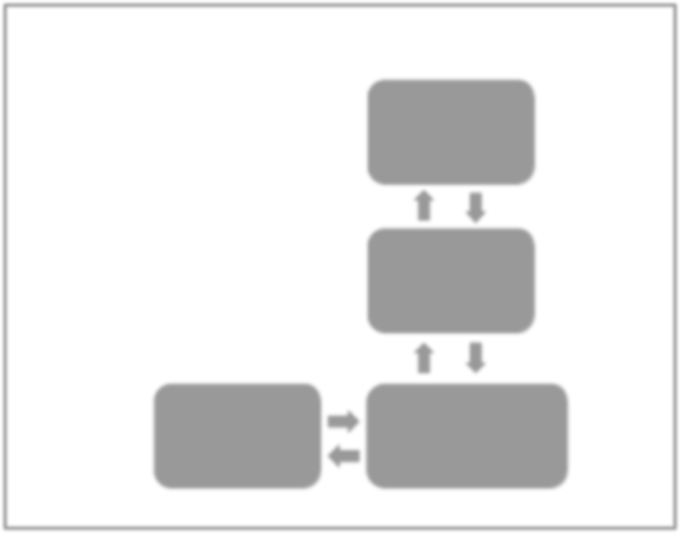
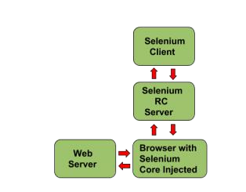
Selenium RC

Slide 14
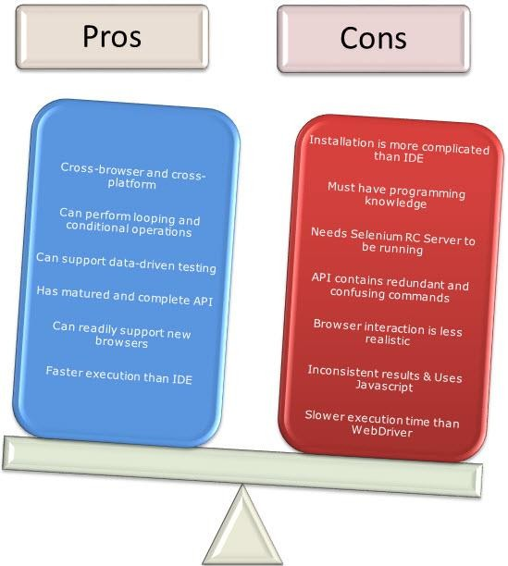
Selenium RC

Slide 15

Selenium WebDriver
Selenium WebDriver is a web application testing tool introduced by eliminating the drawbacks of IDE and RC. It is simple in architecture and also easy to understand and use.

Slide 16
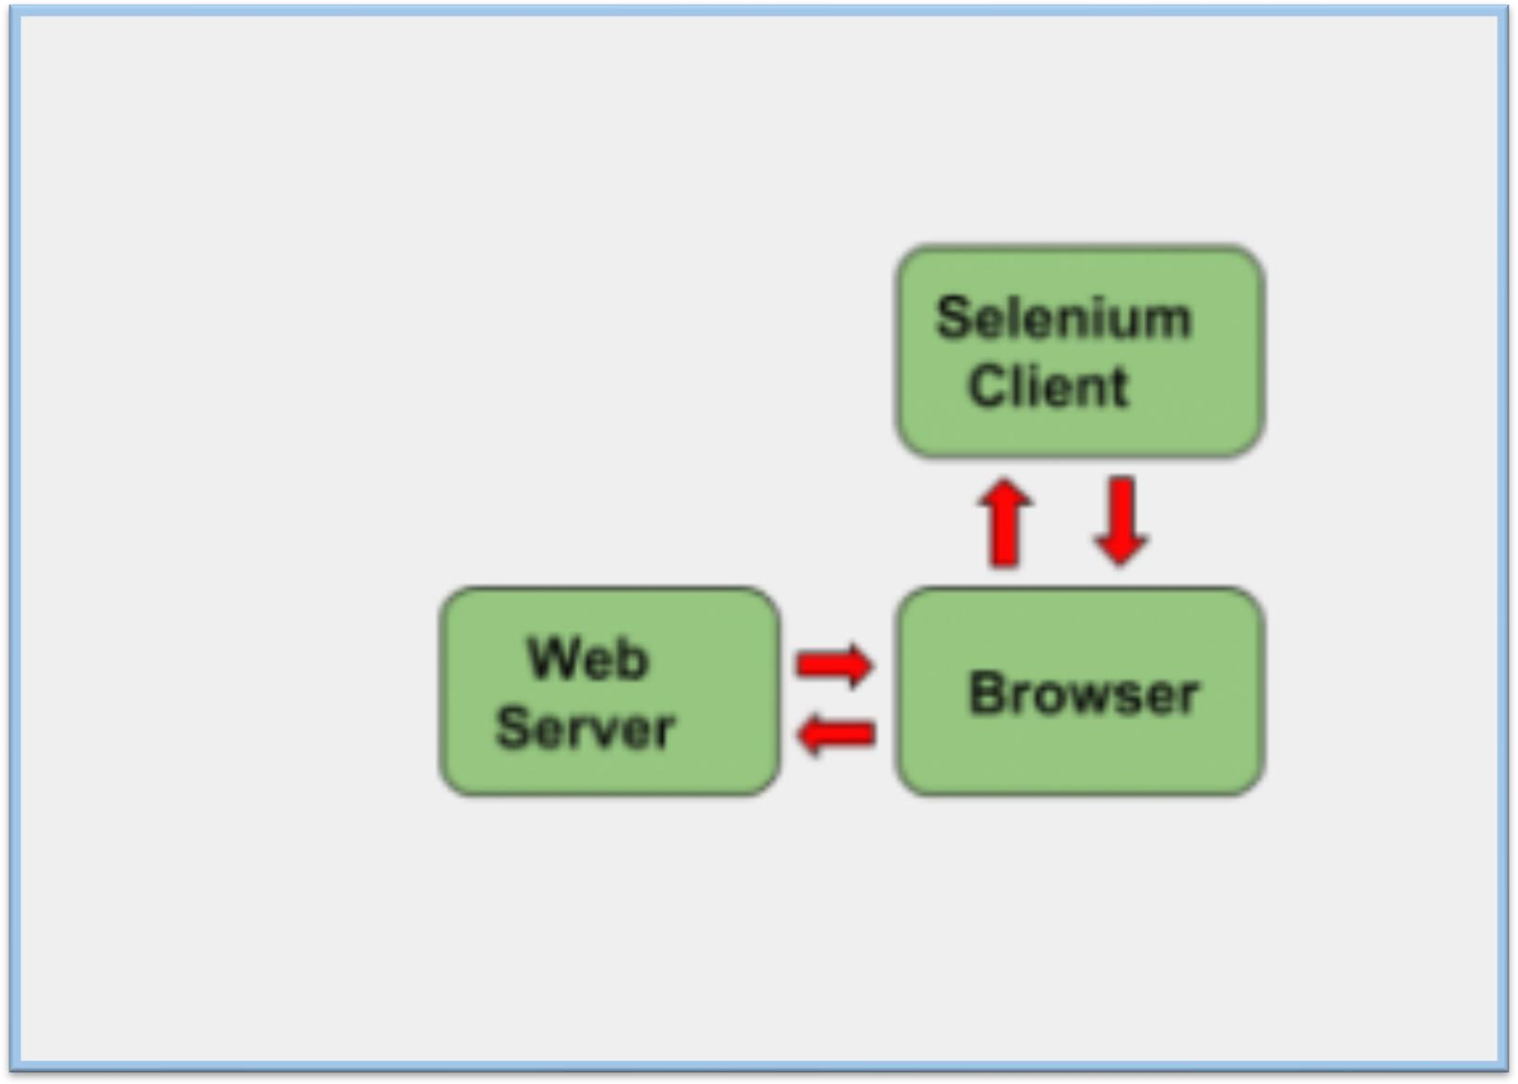
Selenium WebDriver Architecture

Slide 17
Selenium WebDriver Architecture
It is a well-designed object-oriented API developed to automate web and mobile software applications testing process
It is faster than Selenium RC
Selenium WebDriver directly talks to the browser
It’s API is more concise than Selenium RC

Slide 18
Selenium WebDriver Architecture
It cannot readily support new browser, but RC can
It doesn’t have a built-in command for automatic generation of test results
It doesn’t support window base apps
It needs outside support for report generation activity like dependence on TestNG or Jenkins.

Slide 19
Selenium Grid
Selenium Grid is used to run Automation tests on multiple browsers across multiple operating systems, machines simultaneously. It supports Parallel Testing. It is used only for Test Execution.

Slide 20








Features
Allows simultaneous running of tests in various web browsers, environmen ts and machines.
01
02
Saves time enormously.
It speeds up the test suite completion time as it is capable of running variou s tests in parallel.
03
04
Perform cross browser testing.

Slide 21
When to use Selenium Grid
You should use Selenium Grid when you want to do either one or both of the following:
When you run your tests against various browsers, operating systems, and machines all at the same time. This will ensure that the application you are testing is fully compatible with a wide range of browser operating system combinations.
Save execution time of your test suites. If you set up Selenium Grid to run, say, 5 tests at a time, then you would be able to finish the whole suite around 5 times faster.

Slide 22
Platforms supported by Selenium
Selenium works with different Operating systems, browsers, programming languages and Testing Frameworks.
Operating Systems:
Microsoft Windows
Macintosh
Linux
Browsers:
Mozilla Firefox
Google Chrome
Internet Explorer
Safari
Opera etc.

Slide 23
Programming Languages
Testing Frameworks
Java
C#.Net
Perl
Python
Ruby
PHP
C#.Net – NUnit
Java – JUnit or TestNG
Python – unittest, pyunit
PHP – Behat + mink

Slide 24


Advantages of Selenium
1
It is an Open Source Software, you can check out its source code from its GitHub Repository.
2
It supports multiple Programming languages
3
It supports multiple Operating systems
4
It supports multiple browsers
5
It supports parallel testing.

Slide 25

Advantages of Selenium over QTP
Selenium | QTP
Open source, free to use, and free of charge. | Commercial.
Highly extensible | Limited add-ons
Can run tests across different browsers | Can only run tests in Firefox, Internet Explorer and Chrome
Supports various operating systems | Can only be used in Windows
Supports mobile devices | QTP Supports Mobile app test automation (iOS & Android) using HP solution called - HP Mobile Center
Can execute tests while the browser is minimized | Needs to have the application under test to be visible on the desktop
Can execute tests in parallel. | Can only execute in parallel but using Quality Center which is again a paid product.

Slide 26
Advantages of Selenium over QTP
Integrates with frameworks like TestNG, JUnit, PyTest, Behave.
Works with CI/CD tools like Jenkins, GitHub Actions, GitLab CI.
Supports custom waits, event listeners, and browser extensions.
Can be extended with tools like Allure for reporting, Appium for mobile testing, and Docker for containerized test execution.
Common use cases:
Functional testing of web applications.
Regression testing.
Cross-browser testing.
Data scraping (with caution and legality).

