Slide 1
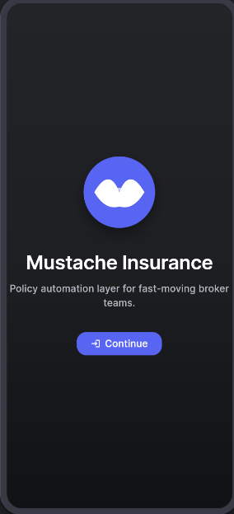

Slide 2
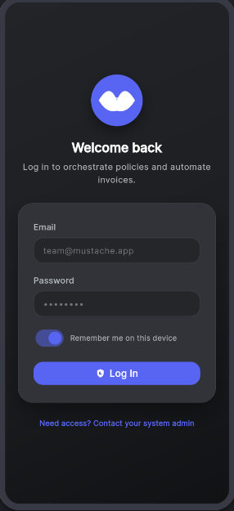

Slide 3
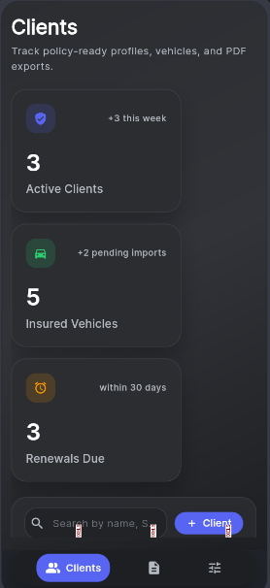

Slide 4
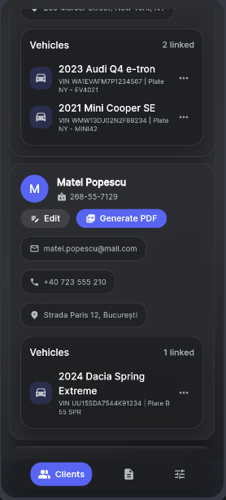

Slide 5

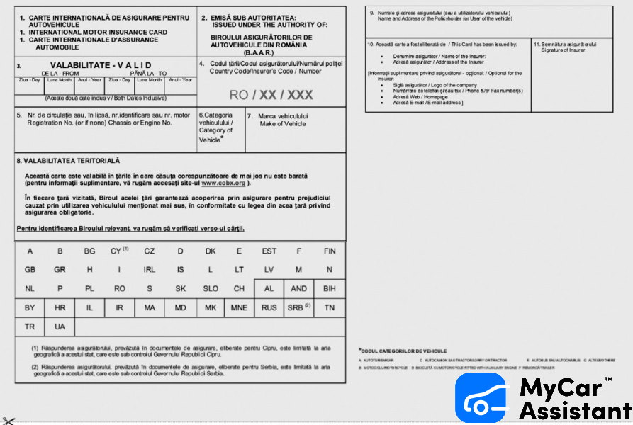
Auth, data
FRONTEND (FLUTTER)
O bozmeg rendorsheg!
(*speech recog supports a variety of languages)
FIREBASE
DB
FIREBASE CLOUD FUNCTIONS
Print insurance

