Slide 1
Producer Consumer Problem

Slide 2
What is the producer consumer problem?
A classic synchronization challenge that involves coordinating processes that share a common buffer.
The problem consists of two types of processes:
Producers
Consumers

Slide 3
Key points of the problem
To Manage shared buffer between producers and consumers.
Synchronize access to prevent data corruption.
Use semaphores, mutexes, or condition variables.
Ensure efficient resource management and process coordination.

Slide 4
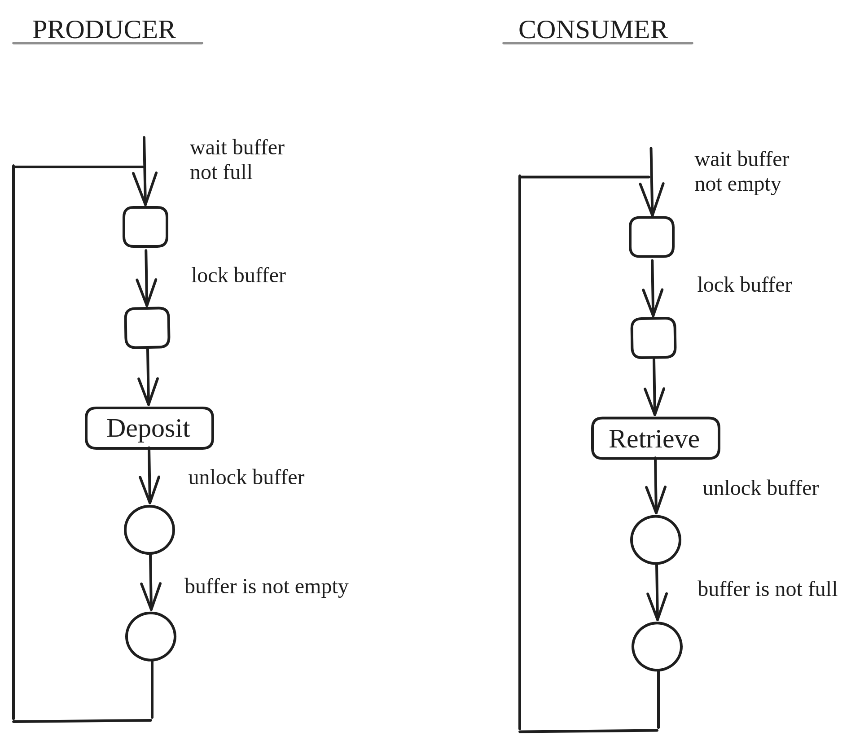
Visual Representaion

Slide 5
Goal of Simulation
Interactive simulation of the producer-consumer problem.
Learn mutual exclusion through hands-on experience.
Visualize buffer management and synchronization.

Slide 6
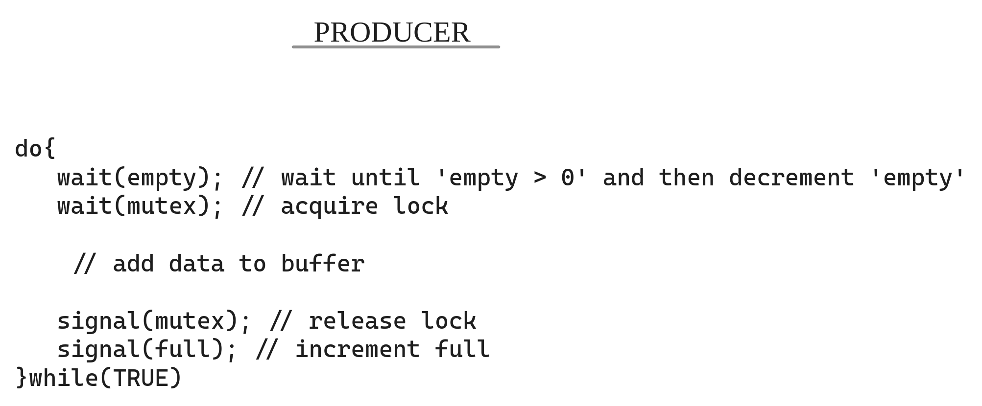
Code Reference
Variables : empty, full, mutex

Slide 7
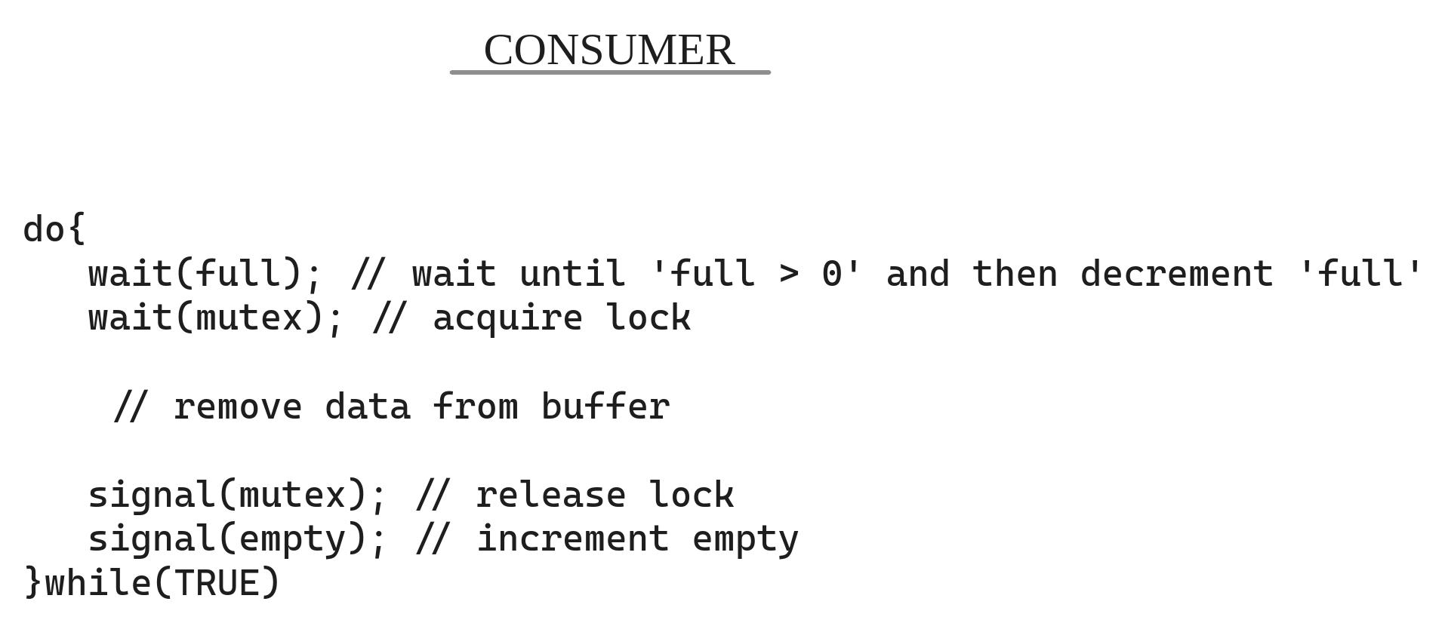
Code Reference
Variables : empty, full, mutex

Slide 8
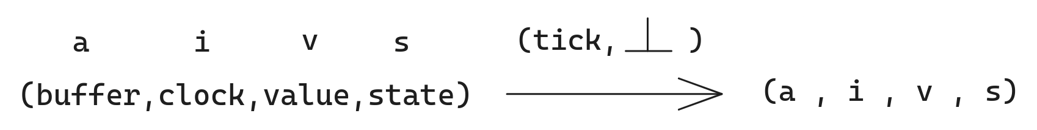
System Design
Default State
Possible Actions( ) : Produce( put(v) ) , Consume( get(v) )
Possible States( s ) : Ready , Busy , Ok
Variables : empty, full, mutex

Slide 9
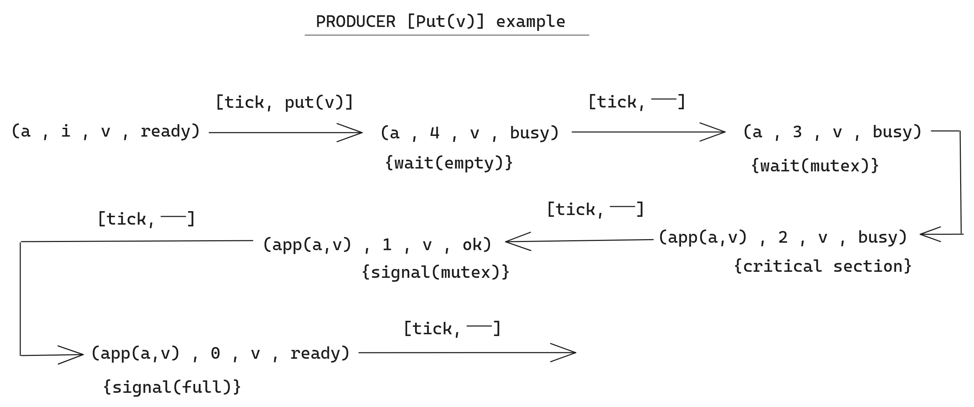
System Design
Syncronization Parameters: Start, wait(empty), wait(mutex), Critical State,
signal(mutex), signal(full), wait(full), signal(empty)

Slide 10
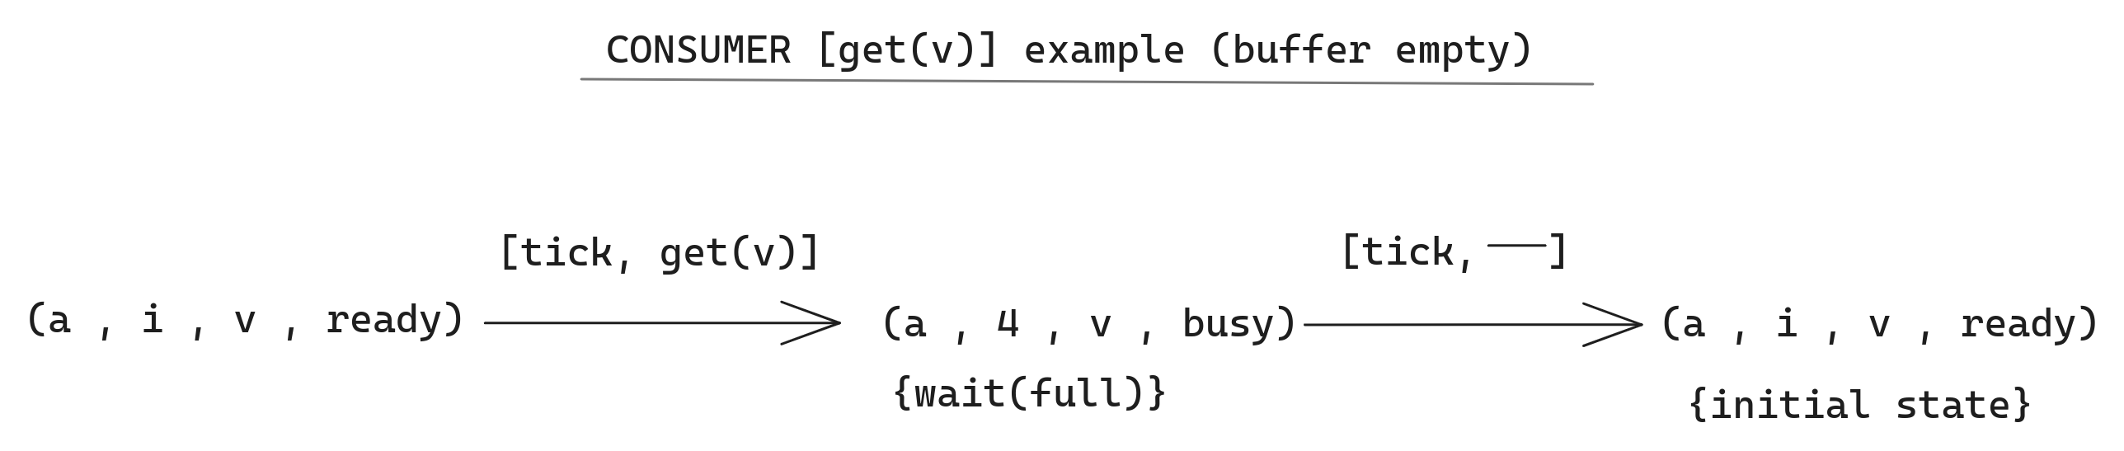
System Design

Slide 11
Thank You.

