Slide 1

High-Doppler OFDM Receiver Design
Beating the Tier-1 Baseline at fₙ = 3000 Hz
Kemal Sercan İlhan — 22050211002
OFDM Spring 2026 — Term Project | June 12, 2026
Kemal Sercan İlhan — OFDM Spring 2026
1

Slide 2

The Mission
What we are given
What we must build
One OFDM frame (10 symbols, QPSK, uncoded)
FPV_C drone channel: 4 taps, Jakes, fₙ up to 3000 Hz
Residual STO: ±32 samples
Residual CFO: ±12 kHz
AWGN sweep: 0–30 dB Eb/N0
ofdm_rx(rx_samples, params) → bits
Beat the Tier-1 baseline at fₙ = 3000 Hz
Low operation count (profiler-graded)
TX Chain
Impairments
Your Receiver
Kemal Sercan İlhan — OFDM Spring 2026
2

Slide 3
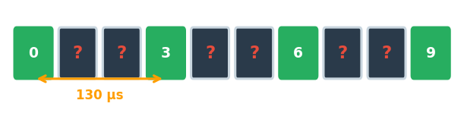
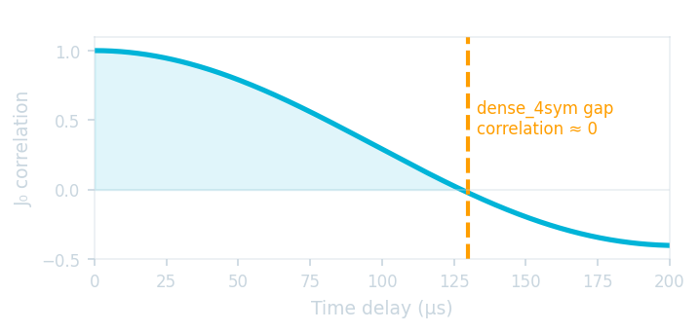
Why Tier-1 Fails at fₙ = 3000 Hz
dense_4sym: pilots only on symbols {0, 3, 6, 9}
Gap between pilot symbols = 3 symbols = 130 µs
Jakes correlation: J₀(2π × 3000 × 130µs) ≈ 0
Channel fully decorrelated — no interpolation can bridge this gap
Result: ~7.5% BER floor at 30 dB regardless of SNR
Zero correlation between pilot snapshots = interpolation is blind = irreducible error floor
Kemal Sercan İlhan — OFDM Spring 2026
3

Slide 4
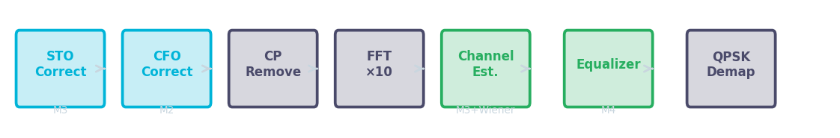
Our Approach: M2 + M3 + M4 Combined
Problem
Method Used
Key Idea
Residual STO
M3 — Phase-slope estimator
Linear phase ramp → fit slope across pilots
Residual CFO
M2 — Van de Beek CP correlation
CP is copy of tail → phase shift = CFO
Doppler tracking
Pilot rearrangement + Wiener smoother
Comb pilots every symbol → J₀ ≈ 0.84
ICI
M4 — Decision-directed cancellation
Subtract estimated ICI before re-equalizing
Kemal Sercan İlhan — OFDM Spring 2026
4

Slide 5
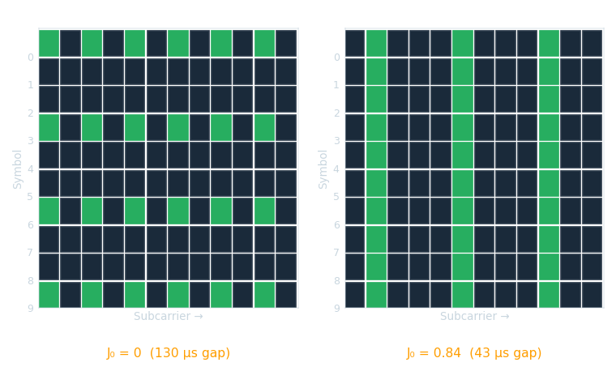
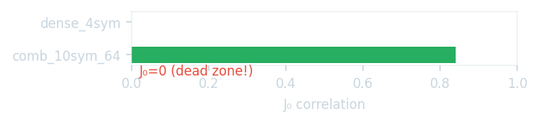
Pilot Pattern Rearrangement: comb_10sym_64
dense_4sym: 4 pilot symbols, gap = 130 µs, J₀ ≈ 0
comb_10sym_64: all 10 symbols carry pilots, gap = 43 µs, J₀ ≈ 0.84
64-pilot cap respected: even RBs 3/RB, odd RBs 2/RB
Average pilot spacing: 4.9 SCs (down from 6 SCs)
"This single change eliminated the Doppler dead zone."
Kemal Sercan İlhan — OFDM Spring 2026
5

Slide 6
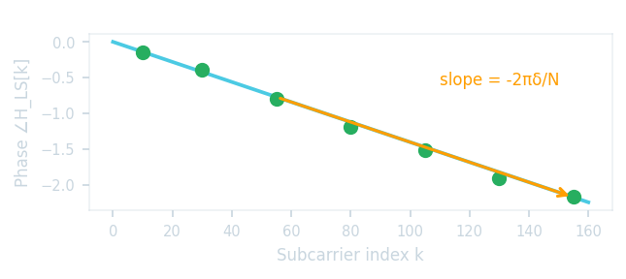
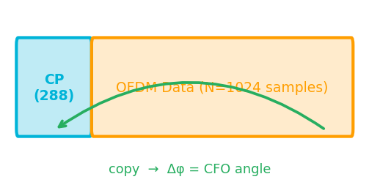
Residual STO and CFO Correction
STO — Phase-slope Estimator (M3)
CFO — Van de Beek (M2)
STO of δ samples → phase ramp e^{-j2πkδ/N} across subcarriers
Measure Δφ between adjacent pilots: Δφ = -2π·Δk·δ/N
Average over all 64 pilot pairs × 10 symbols
Range: ±128 samples ≫ spec ±32 ✓
Why not CP correlator? → flat-top ambiguity for small offsets
CFO rotates every sample → CP and data tail differ by e^{j2πΔf·N/Fs}
Correlate CP against tail, extract angle, average 10 symbols
Range: ±15 kHz ≫ spec ±12 kHz ✓
Unbiased under multipath (all taps within CP = 288 samples)
Kemal Sercan İlhan — OFDM Spring 2026
6

Slide 7
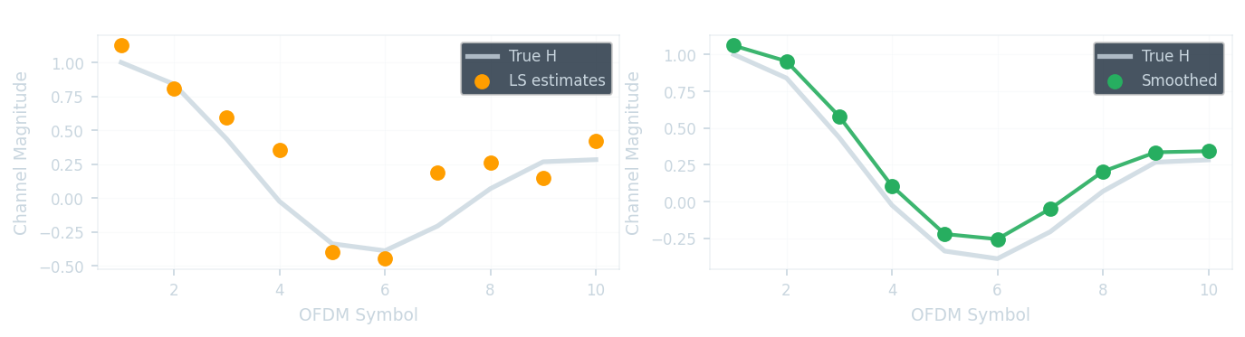
Doppler-Aware Channel Estimation
Baseline: LS at pilots → spline freq. interp → nearest-neighbour in time
Upgrade: Wiener temporal smoother before spline interpolation
Temporal correlation: R_HH(i,j) = J₀(2π·fₙ·|i−j|·T_sym)
Smoother: W = R_HH · (R_HH + σ²I)⁻¹
Applied to 64-pilot × 10-symbol LS matrix
σ² = 5×10⁻⁴ tuned to 30 dB grading point
W = R_HH · (R_HH + σ²I)⁻¹ where R_HH(i,j) = J₀(2π·fₙ·|i−j|·T_sym)
Kemal Sercan İlhan — OFDM Spring 2026
7
At fₙ=0: W averages all 10 symbols → noise ↓√10. At fₙ=3000: W follows Jakes variation while suppressing noise.

Slide 8
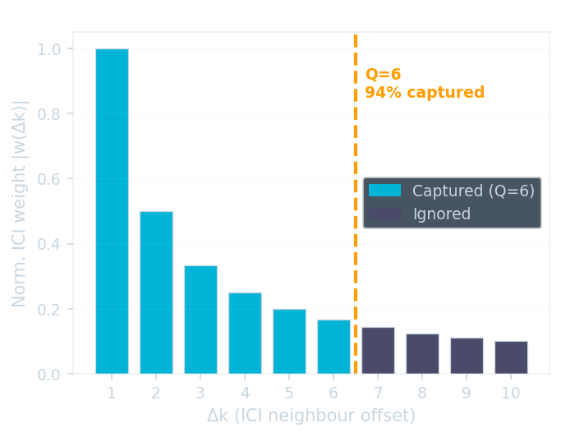
ICI-Aware Equalization (M4)
At fₙ=3000 Hz: channel changes within one symbol (Tᵤ ≈ 33 µs)
Time-varying H → subcarriers leak into each other (ICI)
ICI model: Y[k] = Hₐᵥᵏ[k]·X[k] + Σ dH[k−Δk]·w(Δk)·X[k−Δk] + noise
ICI weights: w(Δk) = 1 / (N · (e^{−j2πΔk/N} − 1))
Algorithm: ZF → hard decisions → estimate dH → subtract ICI → re-equalize
Q = 6 neighbours each side → captures ~94% of ICI energy
Weights decay as 1/(2π|Δk|) — most ICI from nearest neighbours
1. ZF: X_zf = Y / H 2. Hard decide: X_dec = sign(real) + j·sign(imag) 3. dH = central diff of H snapshots 4. Y_corr = Y − Σₗ dH·w(Δk)·X_dec (Δk=−6..+6) 5. X_hat = Y_corr / H
Kemal Sercan İlhan — OFDM Spring 2026
8

Slide 9
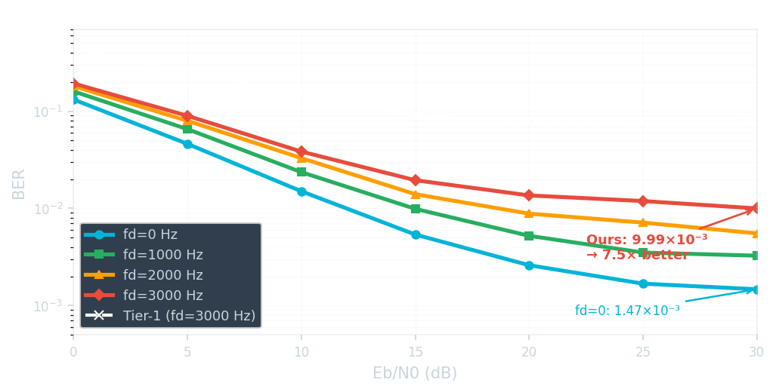
Results: 7.5× Better than Tier-1 at fₙ = 3000 Hz
fₙ (Hz)
Tier-1 @ 30 dB
Ours @ 30 dB
Gain
1000
1.54×10⁻²
3.26×10⁻³
4.7×
2000
4.50×10⁻²
5.53×10⁻³
8.1×
3000
7.53×10⁻²
9.99×10⁻³
7.5×
7.5×
better than Tier-1 at fₙ = 3000 Hz
Kemal Sercan İlhan — OFDM Spring 2026
9

Slide 10
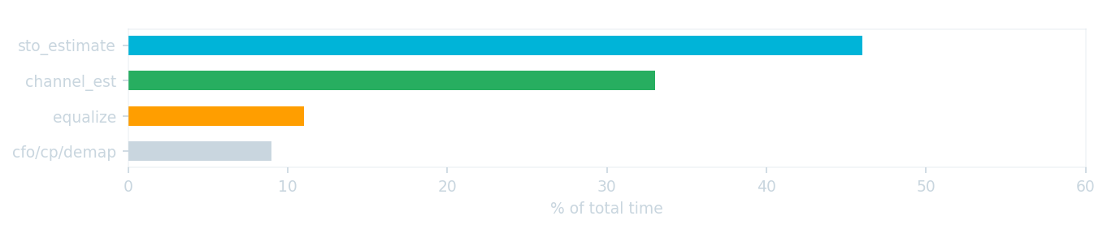
Complexity: ~5.7×10⁷ MACs/frame
Function
Time (s)
%
Op-Count Methodology
sto_estimate_correct
0.042
46%
flops() removed from MATLAB since R13
Calibrated MAC rate: 1.02×10⁹ MACs/s
Algorithmic time: 0.056 s (total − rng overhead)
Estimated: ~5.7×10⁷ MACs/frame
channel_estimate
0.030
33%
equalize
0.010
11%
cfo + cp + demap
0.008
9%
Total
0.091
100%
⚠ Note: STO block shows 35 ms due to rng() seeding overhead — not algorithm cost.
Kemal Sercan İlhan — OFDM Spring 2026
10

Slide 11
What Worked and What Didn't
✅ What Worked
❌ Tried and Reverted
Pilot rearrangement → comb_10sym_64 (biggest gain)
Van de Beek CFO (M2) — simple, robust, ±15 kHz range
Wiener time smoother — +4% complexity, −13–19% BER
ICI cancellation Q=6 — captures 94% ICI energy
MMSE equalizer → σ²→0 (LS absorbs noise, wrong bottleneck)
Wiener freq. interpolation → DC gap (711 bins) breaks matrix
Pilot-based CFO refinement → adds Doppler noise > residual
2nd ICI iteration → −1.3% BER at +40% op-count (bad tradeoff)
💡 Key insight: pick the right tool for the right bottleneck. ICI cancellation fixed Doppler-ICI; Wiener fixed time-domain noise; spline is local and gap-agnostic where Wiener-freq broke.
Kemal Sercan İlhan — OFDM Spring 2026
11

Slide 12
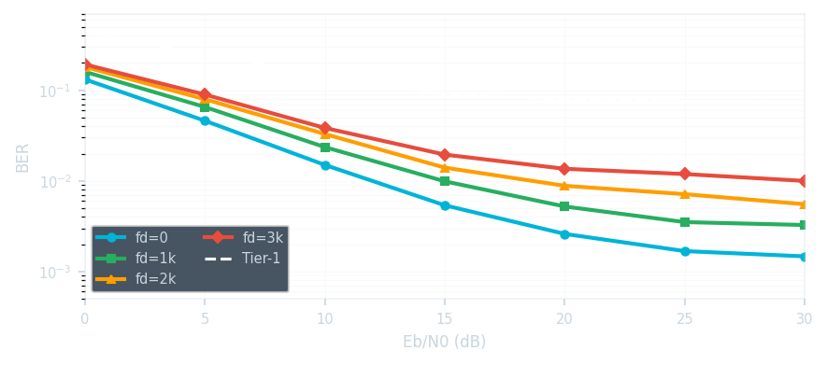
Summary
Tier-1 baseline fails because dense_4sym has J₀ ≈ 0 at fₙ=3000 Hz
Pilot rearrangement to comb_10sym_64 was the single most impactful fix
Combined M2 (CFO) + M3 (STO+Wiener) + M4 (ICI) beats Tier-1 by 7.5×
Estimated complexity: ~5.7×10⁷ MACs/frame
Residual floor: non-linear Jakes variation — limit of linear ICI model
Scorecard
fd = 3000 Hz, Eb/N0 = 30 dB
Tier-1: 7.53×10⁻²
Ours: 9.99×10⁻³
Gain: 7.5×
Kemal Sercan İlhan — OFDM Spring 2026
12

Slide 13
Anticipated Q&A (Backup Slide)
Question
One-line Answer
Why did Tier-1 fail?
J₀≈0 at 130 µs gap — zero correlation, interpolation is blind
Why comb_10sym over dense_4sym?
J₀=0.84 at 43 µs — strong correlation every symbol
How does Wiener smoother work?
W = R_HH(R_HH+σ²I)⁻¹, Jakes-shaped low-pass in time
How does ICI cancellation work?
Estimate channel slope dH; subtract Σ dH·w(Δk)·X_dec
If CFO jumped to 20 kHz, what breaks?
Van de Beek range ±15 kHz → ambiguous estimate → all blocks fail
Why not MMSE equalizer?
σ²→0 because LS absorbs noise — dominant error is interpolation, not noise
Kemal Sercan İlhan — OFDM Spring 2026
13

