Slide 1
Emerging Technologies
Term Project Presentation
Project Title : Collab
Group 3
Student Name: Sercan Dinckal
Student ID: C0818636

Slide 2
Introduction
The idea behind creation of ‘Collab’ is a Project Management web application, developed to make collaborating easier. It provides a platform where users can login and work together on a single project such that any changes or updates from one member will be accessed by all the members of the team. This reduces the need for redundant file sending and updating for each member of a team. This saves time and increases efficiency in group work and incorporates a sense of organized monitoring of each and every step of the progress of projects.

Slide 3
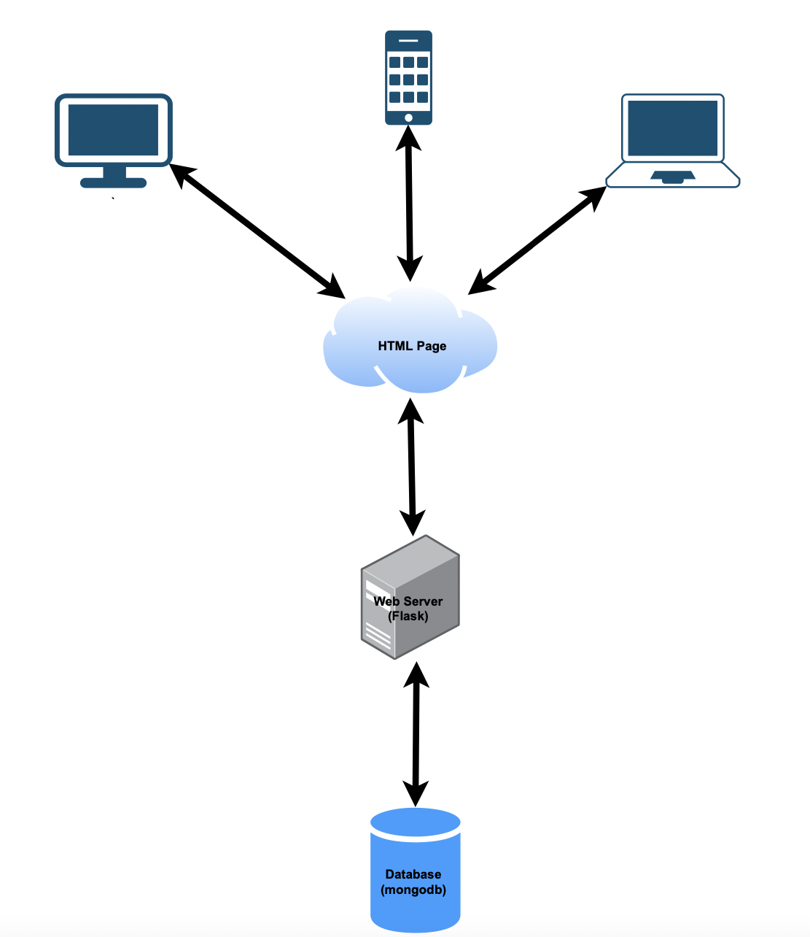
Basis of Collab
To create any web application, we require the front-end for interaction with the users. To enable interactivity, we require a server and a database for storage of information which can be pulled up by a trigger from the server. In this project, we made use of the following:
Html
JavaScript
Css
MongoDB
Pycharm for code editing
Flask ( to run the project on server)
Heroku (for deployment of the app)
Python packages like pymongo, python-dateutil, dnspython

Slide 4
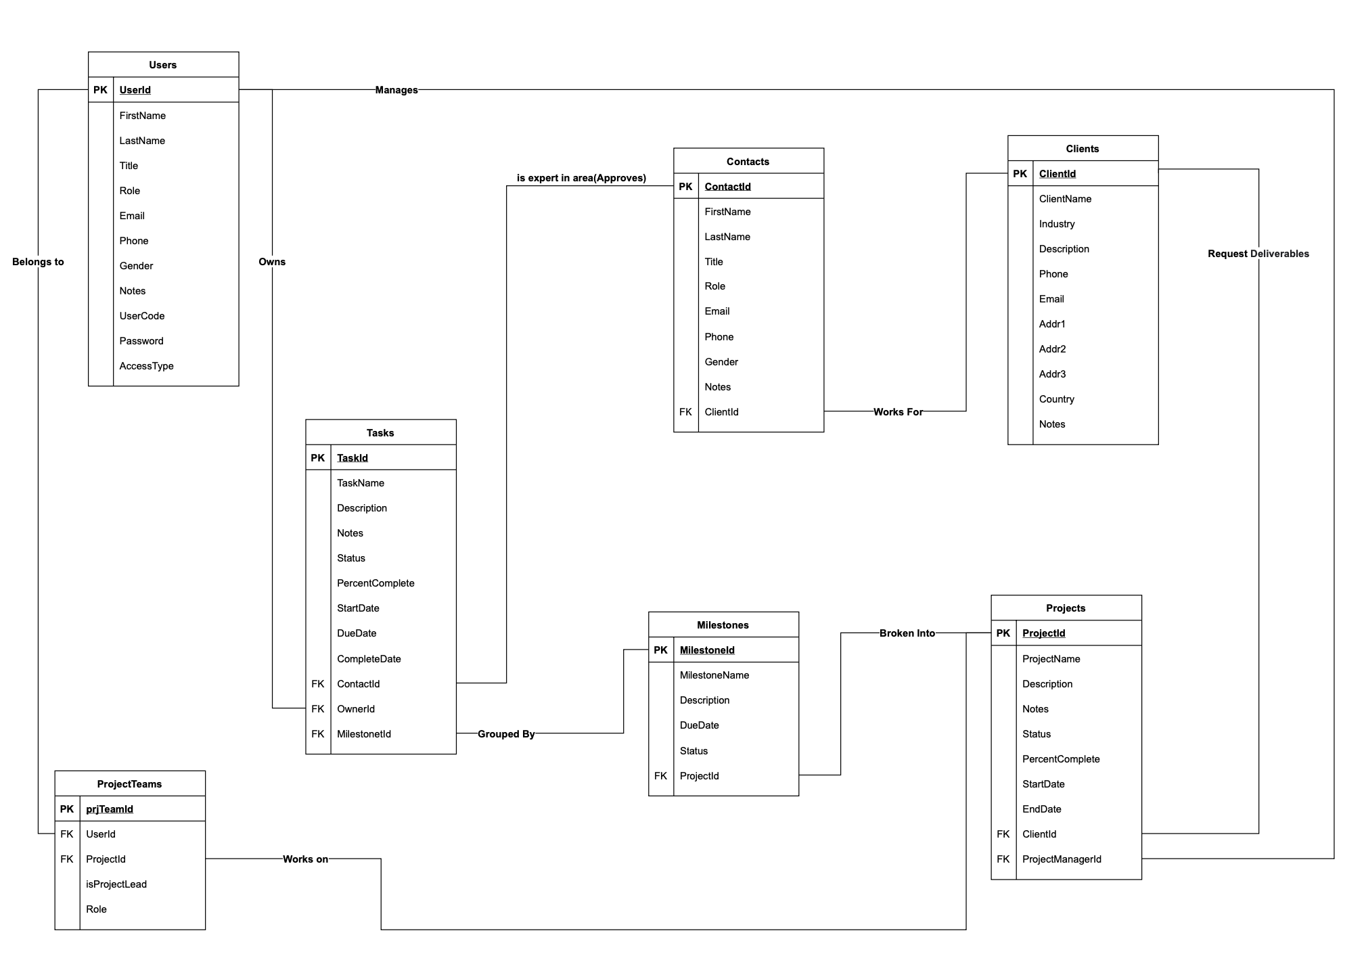
Structural View of Collab

Slide 5
Implementation
Login Page
Dashboard
Access Types and views
Projects Functionality
Deployment using Heroku
Proposed Future Enhancement

Slide 6
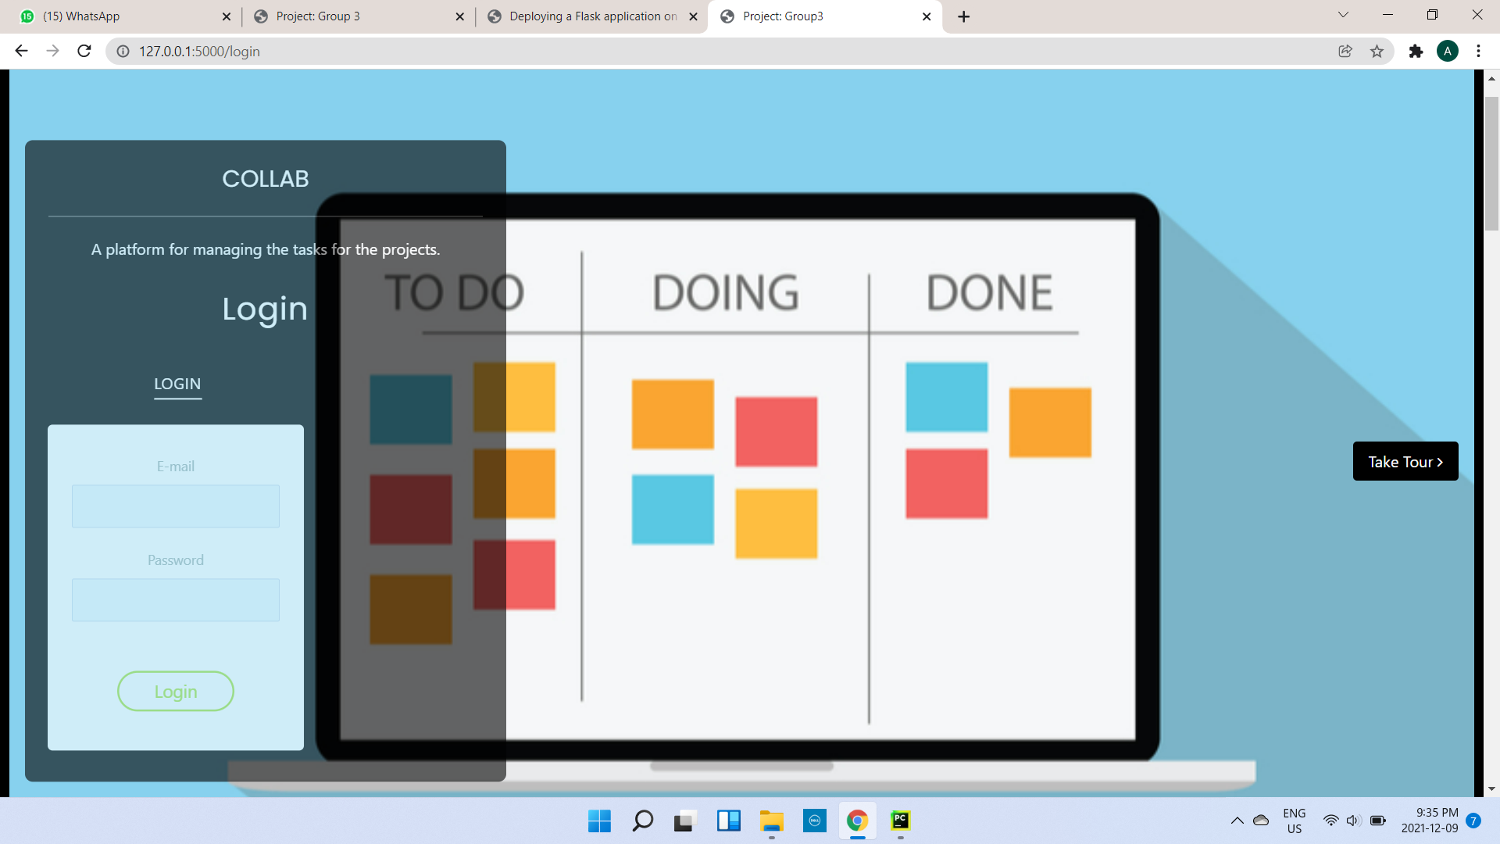
Login Page

Slide 7
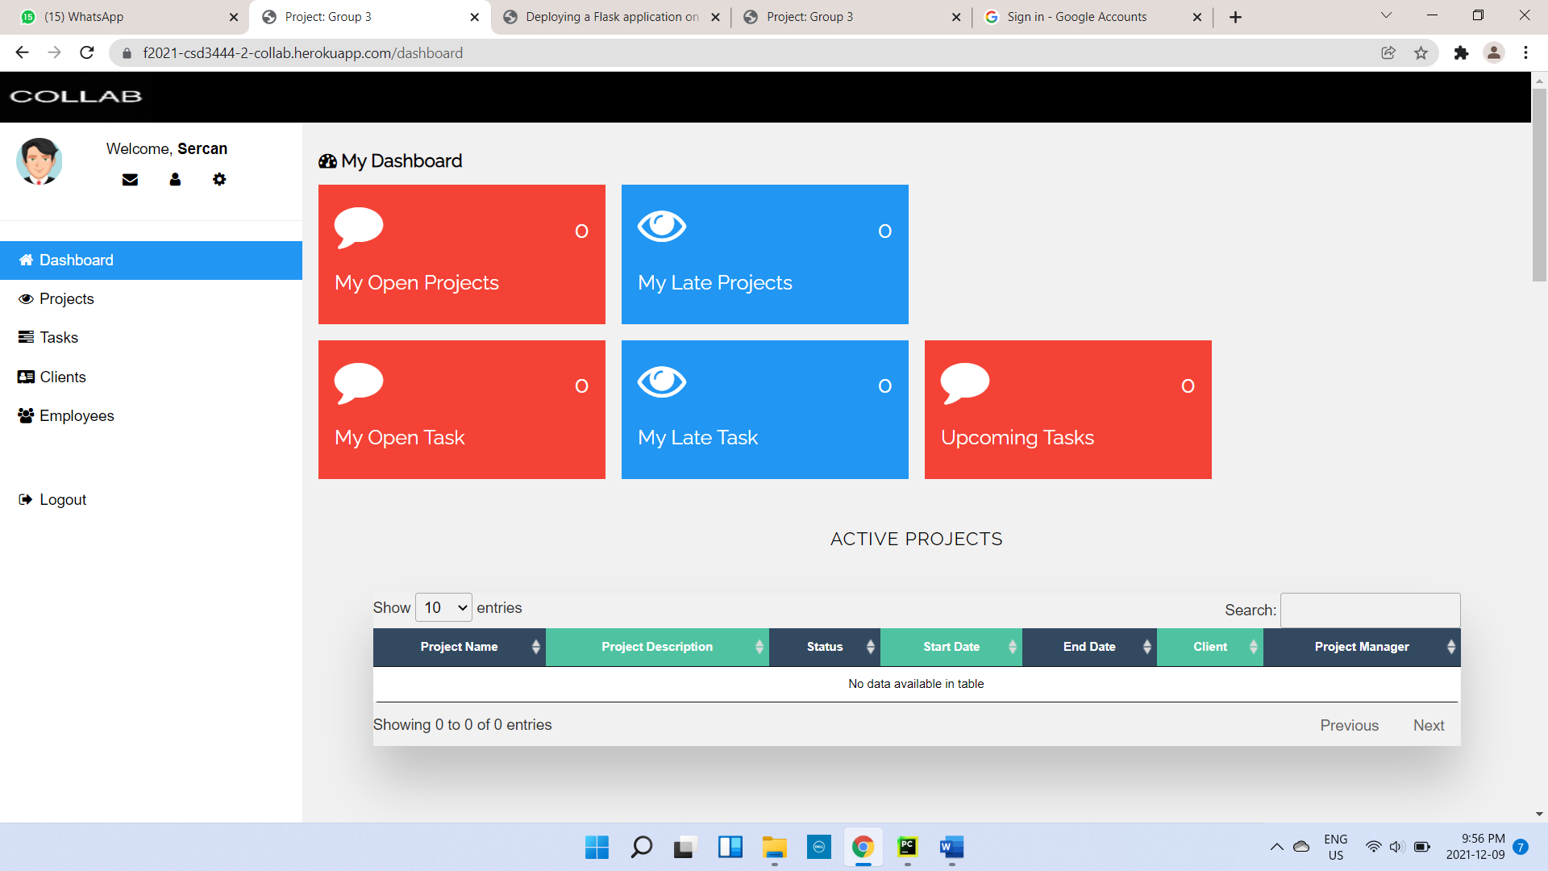
Dashboard

Slide 8
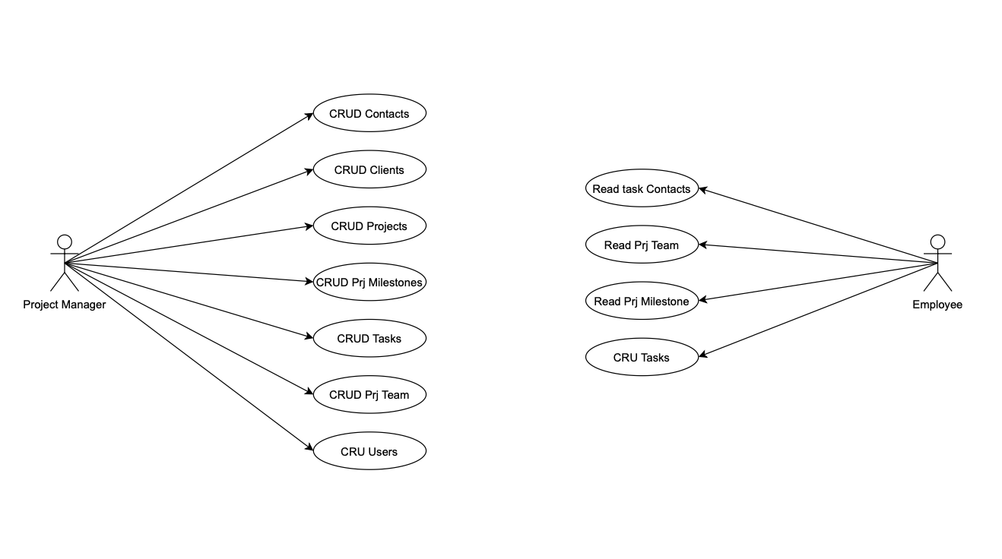
Access types and views
The figure depicts how an employee access is limited to viewing contacts, project team, milestones and Create, Update or Read Tasks. On the other hand, the project manager in Collab has the ability to view and manipulate more things, Create, Read, Update and Delete are the CRUD functions of any web application. In Collab, a project manager may CRUD contacts, clients, projects, milestones, tasks, project team, as well as users. This employs the idea of an admin of a project and their authority over a team.

Slide 9
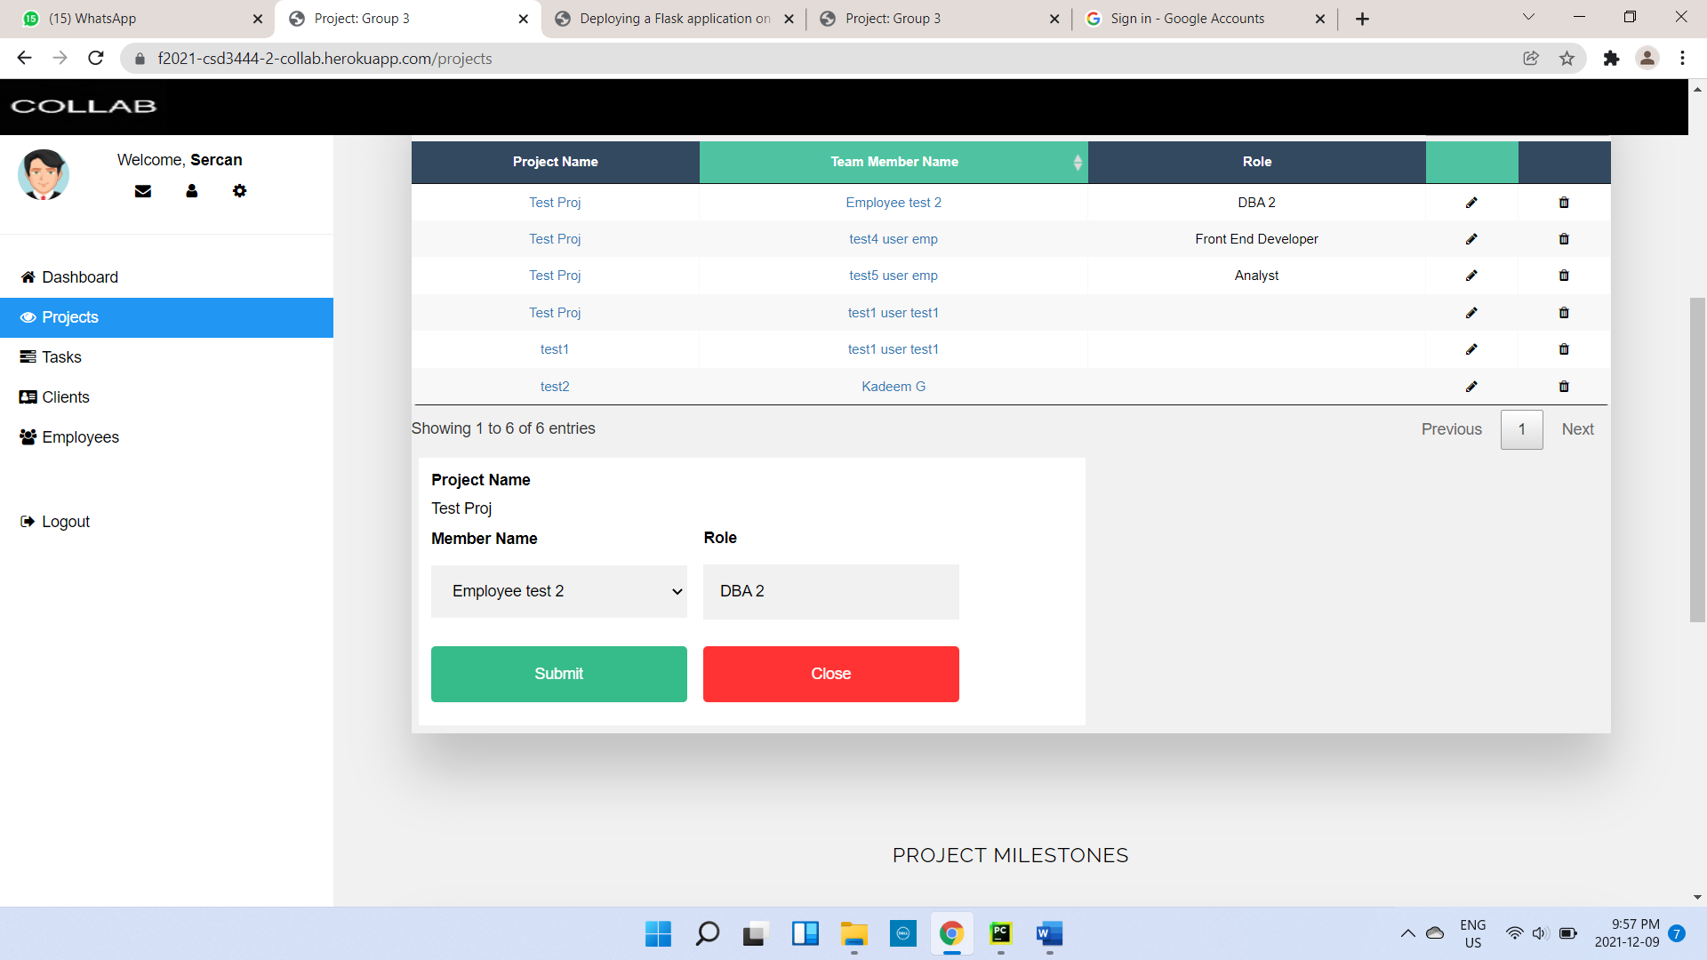
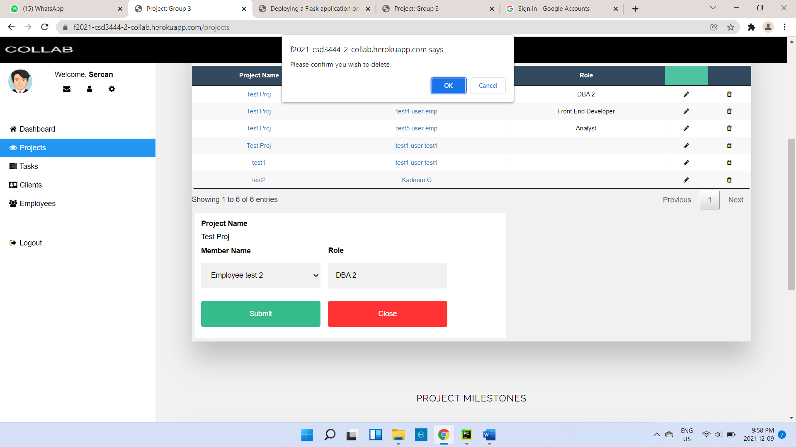
Functionality of Projects
Create, Read, Update
Delete

Slide 10
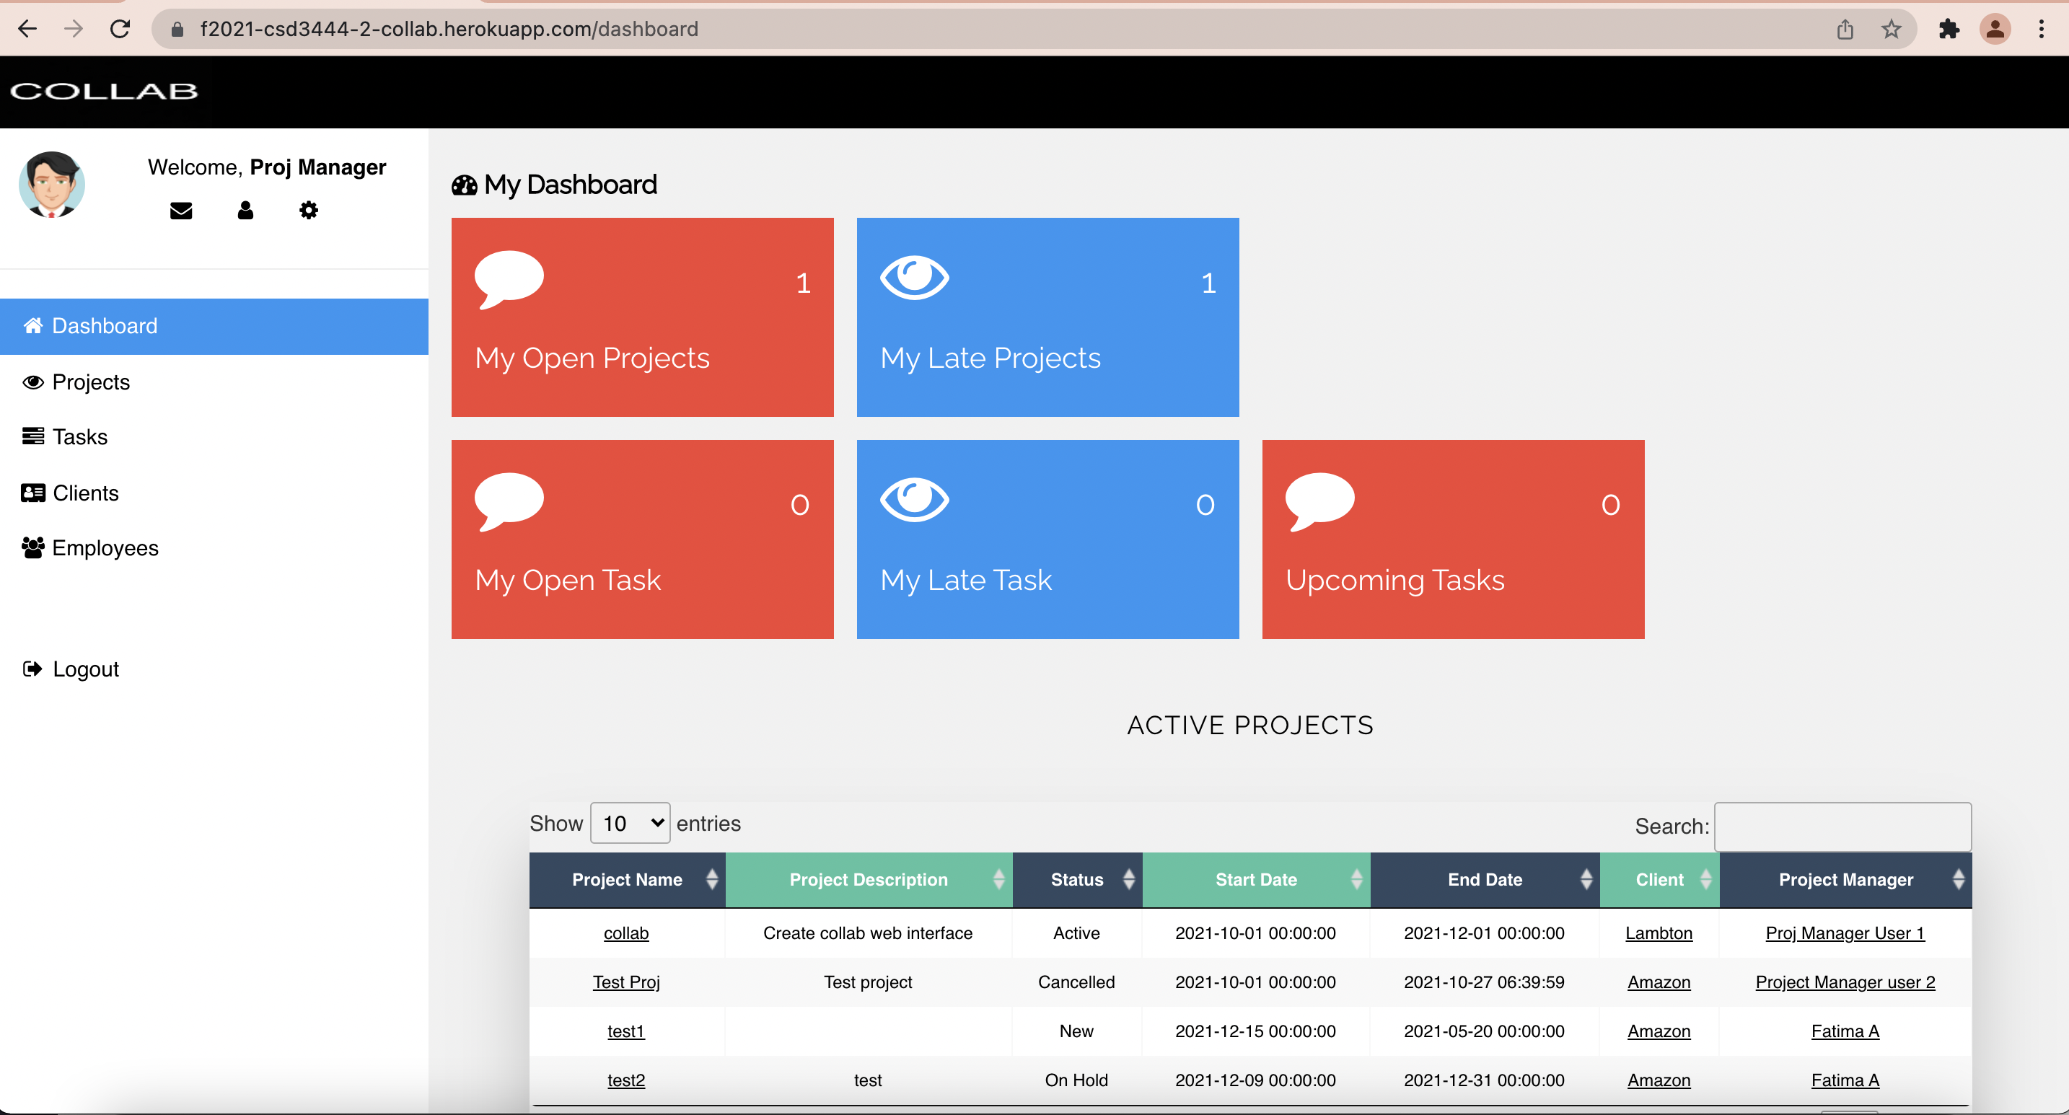
Deployment using Heroku
For our project implementation, we deployed the Software as a Service to Heroku. It works similar to Git where we create a report and then commit and push to the server.
Publish link:
https://f2021-csd3444-2-collab.herokuapp.com/login
Notes:
References:
https://medium.com/@gitaumoses4/deploying-a-flask-application-on-heroku-e509e5c76524
Publish link: https://f2021-csd3444-2-collab.herokuapp.com/login

Slide 11
Proposed Future Enhancement
Acquire an online server (for example: Microsoft Azure) - Install it and then run the application on that machine. We will need to acquire a public IP address & configure a DNS name to point to the service being ran.
Decouple the different pieces (the database tier, middle /python controller layer and the front-end code) and publish to be ran as separate services.
Implementation of various security features in the cloud
A cascading delete would be best so the reference to that object is removed from all related components. For example, if we were to delete a project, all the tasks associated with that project should also be deleted.

Slide 12
THANK YOU!

