Slide 1
KARADENIZ TECHNICAL UNIVERSITY
THE GRADUATE SCHOOL OF NATURAL AND APPLIED SCIENCES • COMPUTER ENGINEERING GRADUATE PROGRAM
Analysis of Smart Antenna Based
Scheduling Algorithms for IoT Networks
IoT Ağlar İçin Akıllı Anten Tabanlı Çizelgeleme Algoritmalarının İncelenmesi
PHD DEFENSE
Sercan KÜLCÜ PhD Candidate
Supervisor Assoc. Prof. Sedat GÖRMÜŞ
September 2022 • Trabzon, Türkiye

Slide 2
AGENDA
What We'll Cover Today
01
Introduction, Motivation and Problem Statement
04
Steerable Antenna with Distributed Scheduling
Resource constraints in IoT networks
Chapter 5
02
Smart and Directional Antennas
05
Steerable Antenna with Centralized Scheduling
Conceptual background and the 6TiSCH protocol stack
Chapter 6
03
Switchable Antenna with Distributed Scheduling
06
Overall Evaluation, Conclusion and Future Work
Chapter 4
Summary of contributions
Analysis of Smart Antenna Based Scheduling Algorithms for IoT Networks
2

Slide 3
01 · INTRODUCTION
The Internet of Things and Resource Scarcity
The IETF 6TiSCH protocol stack uses time-slot and frequency-channel resources in a planned way to create reliable, deterministic, low-power wireless IoT networks.
THE IDEA
Spatial Reuse
The 2.4 GHz ISM band is shared with Wi-Fi, Bluetooth and other IEEE 802.15.4 networks → frequency resources are limited
If antennas with adjustable coverage are used, a third dimension — space — is added to scheduling, in addition to time and frequency.
Dense, high-traffic networks also face limited time-slot resources
Time × Frequency × Space
Omni-directional antennas share resources without exploiting the spatial dimension
→ Higher packet delivery ratio
→ Lower end-to-end latency
→ Lower energy consumption
Analysis of Smart Antenna Based Scheduling Algorithms for IoT Networks
3

Slide 4
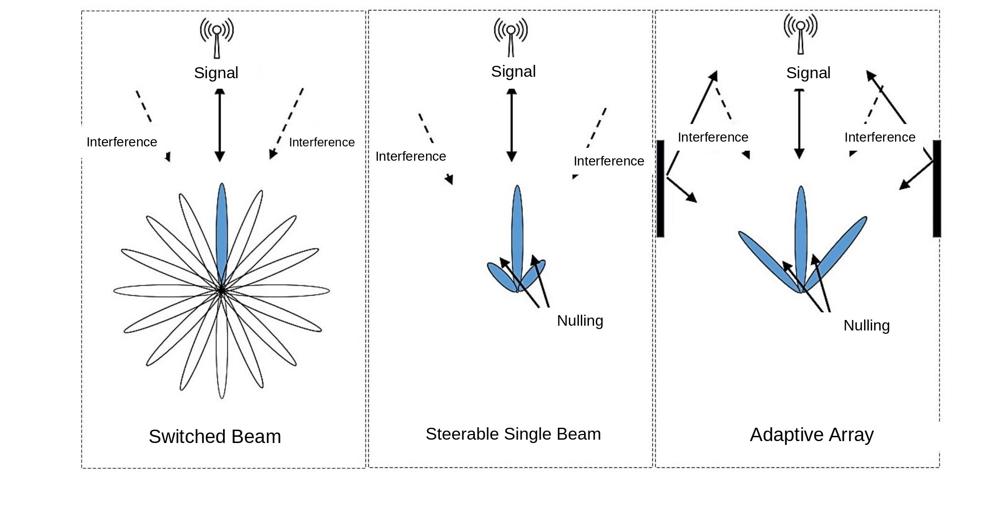
02 · BACKGROUND
Types of Smart and Directional Antennas
Omni-directional antennas are exposed to signals (and interference) from every direction. Smart/directional antennas focus energy toward one direction, raising SINR, and can apply "nulling" toward interference sources.
Figure: Switched Beam · Steerable Single Beam (Steerable Directional) · Adaptive Array (adapted from thesis Fig. 8)
Analysis of Smart Antenna Based Scheduling Algorithms for IoT Networks
4

Slide 5
02 · AIM AND CONTRIBUTIONS
Thesis Aim and Contributions to the Literature
Aim: To develop a low-complexity, smart/directional-antenna-based resource scheduling mechanism for IETF 6TiSCH networks that also exploits the spatial dimension.
1
Neighbor Discovery Mechanism
2
Best Antenna Direction Detection
A novel method that lets nodes discover each other before they are synchronized to the network.
A new method for finding the antenna direction that yields the maximum signal strength between neighboring nodes.
3
Two Hybrid Scheduling Algorithms
4
Antenna Models Added to COOJA
For healthy delivery of control and data packets: (i) distributed + autonomous, (ii) centralized + autonomous scheduling.
Integration of the switchable-beam and steerable-directional antenna models into the open-source COOJA simulator.
Analysis of Smart Antenna Based Scheduling Algorithms for IoT Networks
5

Slide 6
02 · ROADMAP
Structure of the Thesis
Background &
Literature Review
Switchable Antenna +
Distributed Scheduling
Steerable Antenna +
Centralized Scheduling
1-2
3
4
5
6
7
Developed
Antenna Models
Steerable Antenna +
Distributed Scheduling
Conclusion and
Future Work
The rest of this talk focuses directly on the thesis's original contributions in Chapters 4, 5 and 6 (shown in gold).
Analysis of Smart Antenna Based Scheduling Algorithms for IoT Networks
6

Slide 7
02 · LITERATURE
The 6TiSCH Protocol Stack
On top of the IEEE 802.15.4 TSCH MAC layer sit routing (RPL), compression (6LoWPAN) and the 6top (6P) sublayer, which integrates the Scheduling Function with the upper layers.
CoAP
6LoWPAN ND
RPL
UDP
ICMPv6
IPv6
6LoWPAN HC
Scheduling Function
6top (6P)
IEEE 802.15.4 TSCH
This thesis adds a spatial dimension to the Scheduling Function
Analysis of Smart Antenna Based Scheduling Algorithms for IoT Networks
7

Slide 8
02 · LITERATURE
Scheduling Approaches in 6TiSCH
A
Autonomous
D
Distributed
C
Centralized
Autonomous
Distributed
Centralized
Each node independently determines its own cells via a hash function of its ID/address. No signaling required; scalable.
Neighboring nodes negotiate cell allocation on the fly using the 6P protocol. Traffic-aware.
A node with full network topology knowledge (PCE) computes and distributes the entire schedule. Optimal, but limited scalability.
This thesis combines all three approaches in a hybrid fashion across chapters — with autonomous scheduling as the common foundation.
Analysis of Smart Antenna Based Scheduling Algorithms for IoT Networks
8

Slide 9
02 · METHOD
Two Developed Antenna Models
Switchable Beam Antenna
Steerable Directional Antenna
Anahtarlanabilir Huzme Anten
Döner Yönlü Anten
One of several pre-defined fixed radiation patterns is selected
The beam is steered toward the target, with "nulling" applied toward interference sources
Low hardware complexity
Higher SINR and range
Used together with distributed scheduling in Chapter 4
Used with both distributed and centralized scheduling in Chapters 5 and 6
Both models were added to the open-source COOJA network simulator and tested on Contiki OS.
Analysis of Smart Antenna Based Scheduling Algorithms for IoT Networks
9

Slide 10
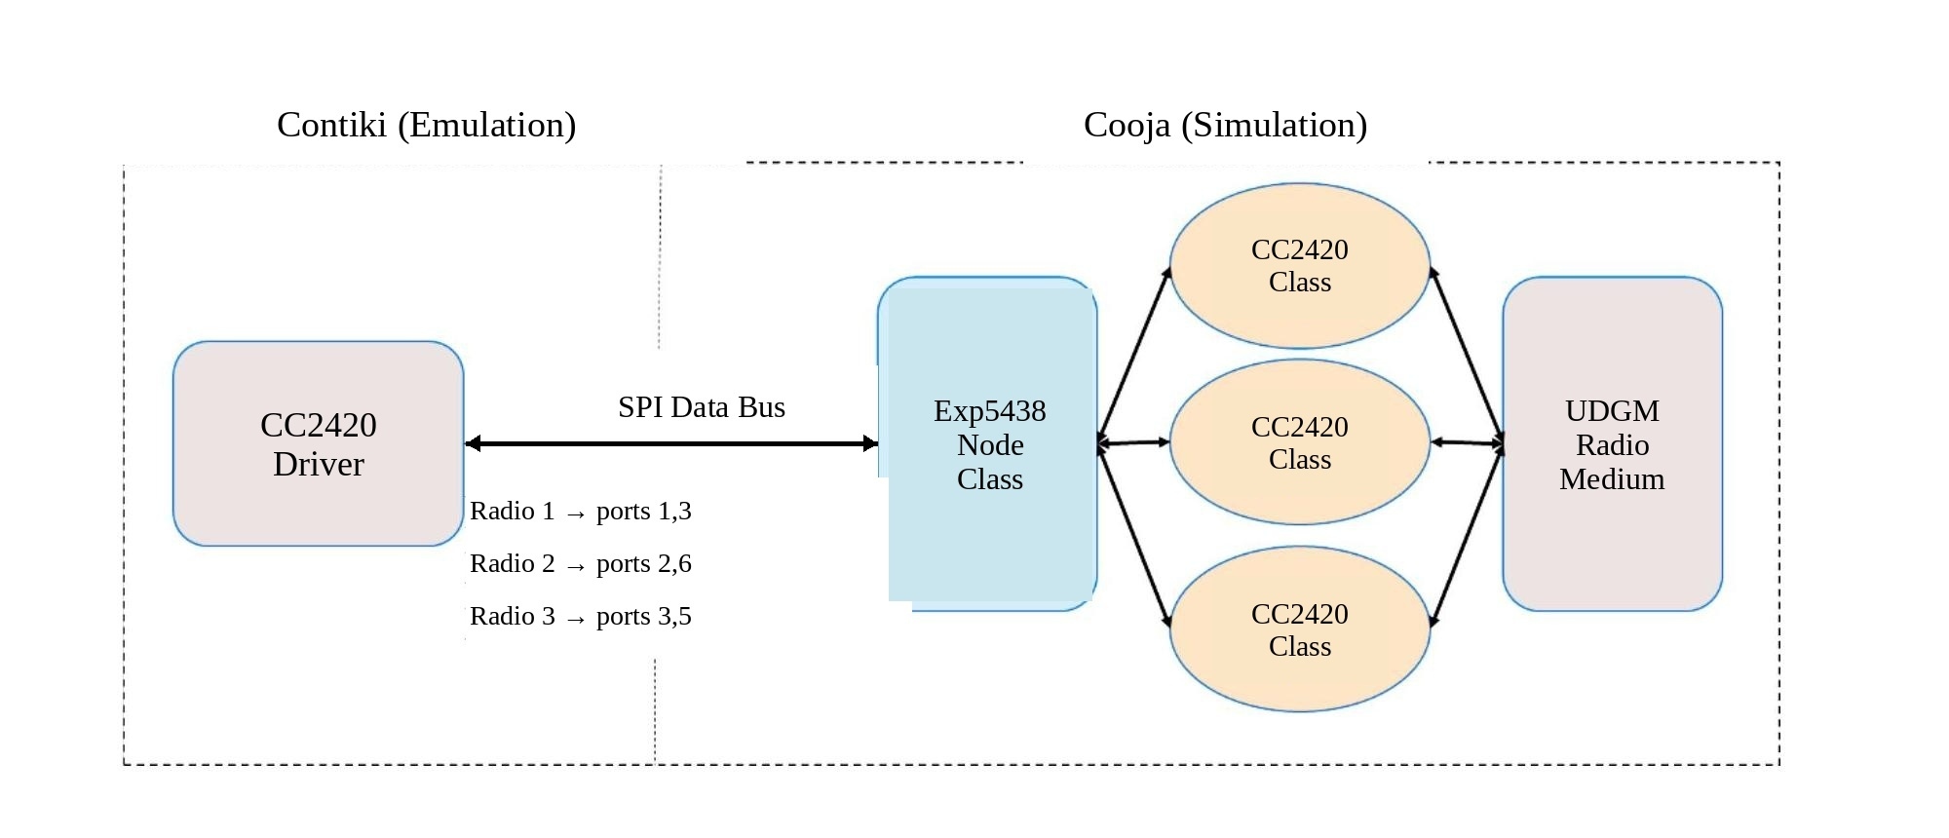
02 · METHOD
Simulation Infrastructure: COOJA + Contiki
Platform: TI EXP430F5438 (MSP430F5437 MCU + CC2420 radio). COOJA's radio module was extended to manage multiple virtual antenna interfaces over SPI ports.
(adapted from thesis Fig. 13)
Analysis of Smart Antenna Based Scheduling Algorithms for IoT Networks
10

Slide 11
CHAPTER 4
Switchable Antenna with
Distributed Scheduling
SF-DA: Directional-Antenna-Based Scheduling Function
All antennas active on shared cells; only the correct antenna active on dedicated cells
Compared against 6TiSCH Minimal Configuration and Orchestra
Analysis of Smart Antenna Based Scheduling Algorithms for IoT Networks
11

Slide 12
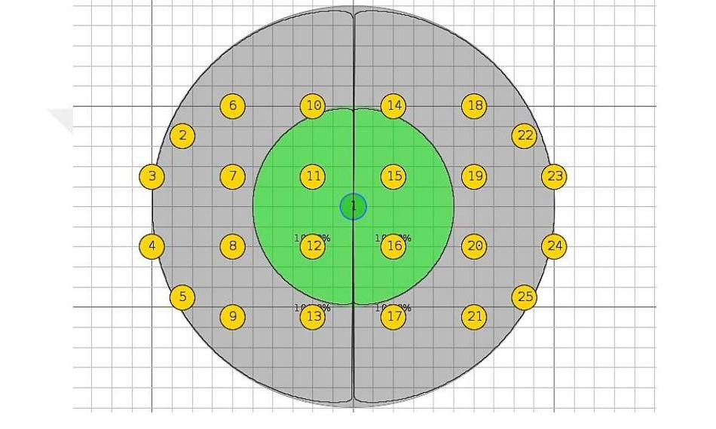
CHAPTER 4 · PROPOSED ALGORITHM
Space-Time Based Distributed Scheduling
On shared cells: all antenna directions are activated → guarantees communication with every neighbor
On dedicated cells: only the correct-direction antenna is activated → reduces interference and collisions
Result: collision rate on shared cells drops significantly, and network stability improves
Fig. 18. Example network of 25 nodes (green: coverage area)
Analysis of Smart Antenna Based Scheduling Algorithms for IoT Networks
12

Slide 13
CHAPTER 4 · TEST RESULTS
Packet Delivery Ratio vs. Number of Antennas
~10%
PDR improvement
(with directional antenna)
~50%
Reduction
in latency
~60%
Reduction in energy
consumption (25 nodes)
Analysis of Smart Antenna Based Scheduling Algorithms for IoT Networks
13

Slide 14
CHAPTER 5
Steerable Antenna with
Distributed Scheduling
Solving the new challenges created by a narrow coverage area
Problem: narrow beam → long synchronization time, delayed network formation
Problem: broadcast control packets cannot reach all neighbors at once
Analysis of Smart Antenna Based Scheduling Algorithms for IoT Networks
14

Slide 15
CHAPTER 5 · HYBRID SOLUTION
A Hybrid Approach Supported by Autonomous Scheduling
Fake Beacon Packet
Broadcasting via Autonomous Cells
A new mechanism that lets nodes discover their neighbors before synchronizing to the network.
Broadcast packets are sent repeatedly over autonomously scheduled cells so they reach all neighbors.
Best Transmit Power / Direction Update
Scalable Synchronization
Tracking and updating over time the antenna direction giving maximum signal strength between node pairs.
Autonomous scheduling provides a synchronization time that is scalable and independent of network density.
Result
Clear improvement in network performance metrics over omni-directional antennas; autonomous scheduling solves the synchronization problem in a scalable way.
Values read from thesis Fig. 26
Analysis of Smart Antenna Based Scheduling Algorithms for IoT Networks
15

Slide 16
CHAPTER 6
Steerable Antenna with
Centralized Scheduling
Adapting the TASA algorithm and bidirectional scheduling
A central node (PCE) computes the entire schedule from the network topology
The path a data packet takes from source to sink is taken into account
Analysis of Smart Antenna Based Scheduling Algorithms for IoT Networks
16

Slide 17
CHAPTER 6 · CENTRALIZED SCHEDULING
Adapting TASA and Bidirectional Scheduling
1
Connectivity / Interference / Conflict Matrices
The steerable antenna's direction information is used to derive a graph representation of the network.
2
Adapting the TASA Algorithm
Time, frequency and antenna direction are jointly assigned to produce a conflict-free schedule.
3
Path-Based Schedule Generation
Cells are allocated in sequence along the multi-hop path a packet follows from source to sink.
4
Bidirectional Centralized Scheduling
Upstream and downstream traffic are scheduled simultaneously, reducing end-to-end latency.
Analysis of Smart Antenna Based Scheduling Algorithms for IoT Networks
17

Slide 18
CHAPTER 6 · TEST RESULTS
Centralized vs. Distributed Scheduling
Observation
Centralized scheduling achieves lower end-to-end latency and energy consumption than distributed scheduling.
However, the centralized solution is not scalable → best suited to small, sparse, static networks.
The algorithm is validated against the TASA algorithm adapted for the steerable antenna.
Analysis of Smart Antenna Based Scheduling Algorithms for IoT Networks
18

Slide 19
OVERALL EVALUATION
Overall Comparison of Antenna Models
Overall Finding
By using the spatial dimension in addition to time and frequency, smart/directional antennas outperform omni-directional antennas on all three metrics (PDR, delay, energy). The gap is most pronounced in dense networks (81 nodes).
Analysis of Smart Antenna Based Scheduling Algorithms for IoT Networks
19

Slide 20
CONCLUSION
Conclusion and Evaluation
Switchable Antenna (Ch.4)
Reduced collisions/interference on shared cells and improved network stability; improved PDR, energy and delay under limited frequency resources.
Steerable Antenna (Ch.5)
The hybrid autonomous+distributed solution solved the synchronization-time problem in a scalable way and improved performance over omni-directional antennas.
Centralized Scheduling (Ch.6)
Path-based and bidirectional scheduling achieved lower delay/energy than the distributed solution; scalability is limited to small networks.
Overall:
Nodes equipped with smart/directional antennas, scheduling bandwidth resources across the time-frequency-space dimensions, deliver superior network performance compared to the traditional omni-directional approach.
Analysis of Smart Antenna Based Scheduling Algorithms for IoT Networks
20

Slide 21
FUTURE WORK AND ACADEMIC OUTPUT
Future Work and Publications
FUTURE WORK
PUBLICATIONS
1
Validating the simulation results on a real hardware testbed
IEEE Access (2021)
Kulcu, S., Gormus, S., Jin, Y. "Integration of Steerable Smart Antennas to IETF 6TiSCH Protocol for High Reliability Wireless IoT Networks", IEEE Access, 9, (2021) 147780-147790.
2
Analyzing performance in a high-interference environment shared with other technologies in the 2.4 GHz band
3
Developing machine-learning-based algorithms for best antenna direction and cell selection
TJEECS (2019)
Görmüş, S. and Külcü, S. "Enabling space time division multiple access in IETF 6TiSCH protocol", Turkish Journal of Electrical Engineering and Computer Sciences, 27, 6, (2019) 4151-4166.
4
Integrating multipath communication with steerable antenna solutions
This thesis was supported by TÜBİTAK project no. 118E289 (Program 1001).
Analysis of Smart Antenna Based Scheduling Algorithms for IoT Networks
21

Slide 22
Thank You
I welcome your questions
Sercan KÜLCÜ • Supervisor: Assoc. Prof. Sedat GÖRMÜŞ
Karadeniz Technical University · Graduate School of Natural and Applied Sciences · Computer Engineering

