Slide 1

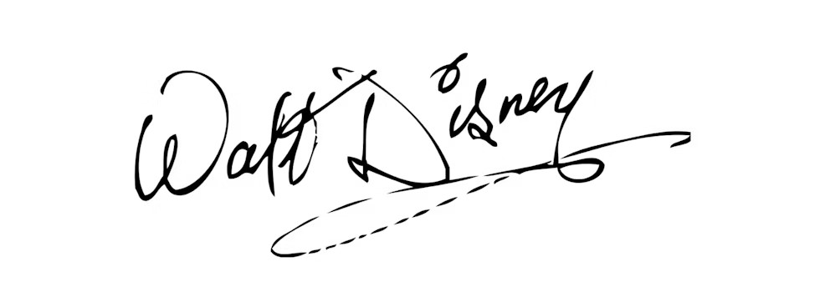
MISSION ACCOMPLISHED
This certificate is awarded to
for a stellar performance in the IQ Test ( pts) at Doruk IQ Test Center.
Test conductor
Date

