Slide 1
Constrainted Optimization Using Lagrange Multipliers
TOR SERCAN
308466
AGH University of Science and Technology

Slide 2
What Are Lagrange Multipliers Used For
To optimize a function on a given constraint.

Slide 3
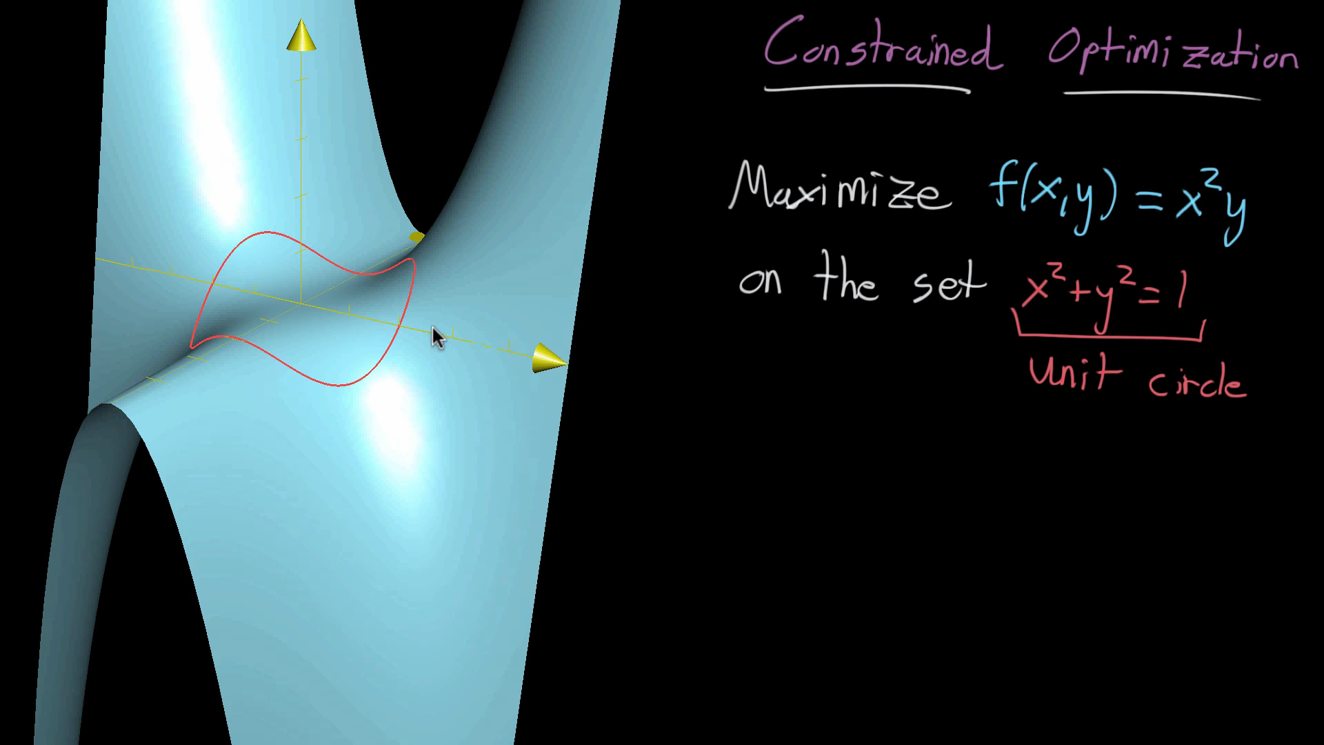

Slide 4
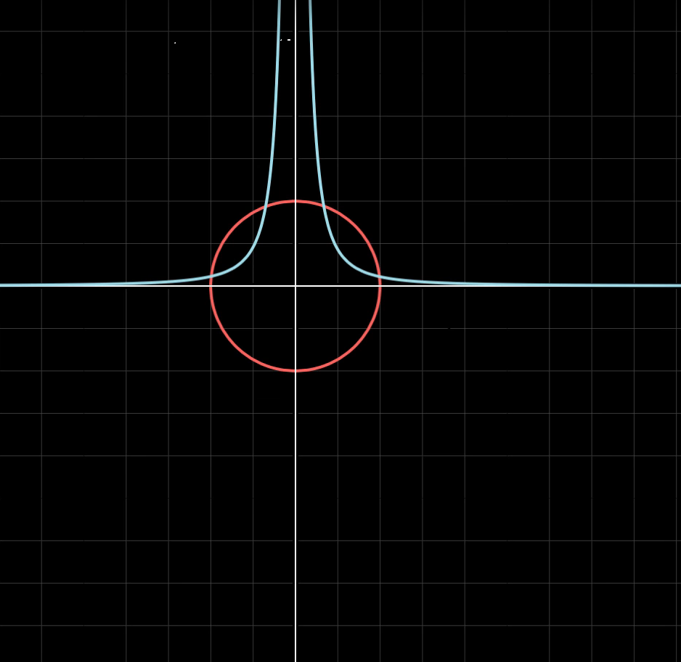

Slide 5
