Slide 1
Research Proposal
Toward Reliable Machine Learning: Understanding, Explaining, and Repairing Model Predictions
Krishna Khadka
Supervisor: Dr. Yu Lei
Committee:
Dr. Allison Sullivan
Dr. Christoph Csallner
Dr. Junzhou Huang
4/30/2026
The Department of Computer Science and Engineering
The University of Texas at Arlington

Slide 2
Agenda
The Research Theme
Why reliable ML matters, and four contributions toward it
Feature Interactions
How few features actually drive a prediction?
ABLE: Tabular Local Explanations
Bracketing the decision boundary with adversarial pairs
DD-CAM: Vision Local Explanations
Minimal sufficient explanations via delta debugging
EGMR: Repairing Models
Explanation-guided model repair via targeted augmentation
Summary and Timeline

Slide 3
Research Theme
Deep neural networks are deployed widely, yet three questions remain open:
Which features actually drove the prediction?
Can we produce an explanation we can trust: stable and faithful to the model?
When the model is systematically wrong, can we fix it?
Methodological thread: treat the trained model as a system under test to drive interpretability and repair.
This proposal addresses these three questions across four chapters.

Slide 4
Four Research Questions
Understand | Explain | Repair
RQ1: Quantify feature sufficiency for predictions. IWCT 2024 (Published) ^{[1]} | RQ2: Produce stable, faithful local explanations for tabular models. KDD 2026 (Accepted) ^{[2]} | RQ4: Locate, validate, and repair systematic model failures using interpretability. Targeting AAAI 2027
 | RQ3: Extract minimally sufficient internal units for concise vision explanations. Targeting NeurIPS 2026 ^{[3]}
Shared methodology across all four: minimality + sufficiency.

Slide 5
Feature Interactions
Assessing the Degree of Feature Interactions that Determine a Model Prediction^{[1]}
Krishna Khadka, Sunny Shree, Yu Lei, Raghu Kacker, D. Richard Kuhn
IWCT 2024

Slide 6
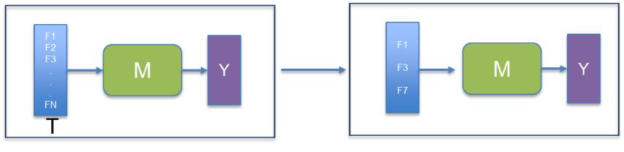
Problem Statement
Given a model M and test instance T with features F₁, F₂, …, F_{N}, identify a minimum number of features that preserve M's prediction on T.
This is a model-explanation problem cast as a minimization: find the smallest sufficient subset.
Figure: Given n features, can a small subset (e.g., 3) preserve the prediction? If yes, those features are what actually drive this instance's output.

Slide 7
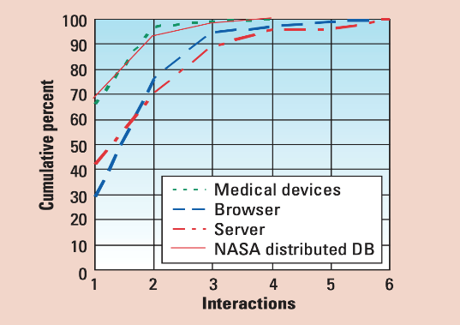
Feature Interaction Hypothesis
Most model predictions can be determined by a few feature interactions.
A t-way interaction is a combination of t features whose joint values trigger a behavior.
Software testing observation^{[4]}: most bugs are triggered by 4–6-way interactions.
Our hypothesis: most ML predictions are determined by similarly small feature subsets.
Figure: Cumulative error detection rates for four- to six-way interactions in four application domains: medical devices, a Web browser, an HTTP server, and a NASA distributed database. ^{[4]}

Slide 8
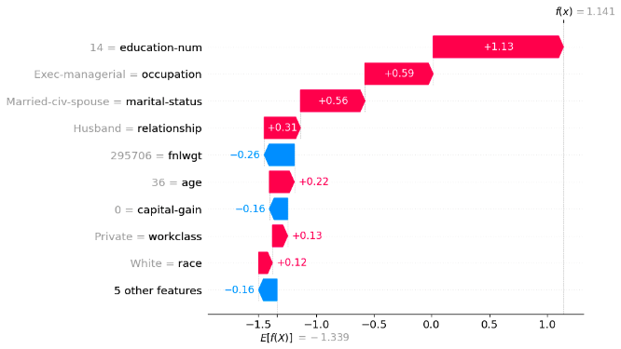
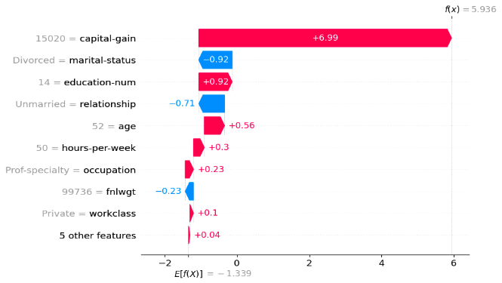
Motivating Examples Adult Income
Example 1
Example 2
Label: 1 (≥50K) Min features: education-num, occupation, marital-status
Label: 1 (≥50K) Min features: capital-gain
Bars are SHAP values (log-odds contributions)^{[5]}. Red pushes the score up, blue down. Decision rule: f(X) > 0 → class 1, else class 0. Different instances need different and often very few features.

Slide 9
Related Work: Instance-level Feature Importance Methods
 | SHAP^{[5]} | LIME^{[6]} | Ours (this paper)^{[1]}
Output | Per-feature contributions | Per-feature weights | Sufficient subset
Mechanism | Shapley values | Linear surrogate | SHAP + margin-based stopping
Identifies minimum sufficient set? | No | No | Yes
SHAP and LIME rank features. Neither asks: what subset is enough to preserve the prediction?

Slide 10
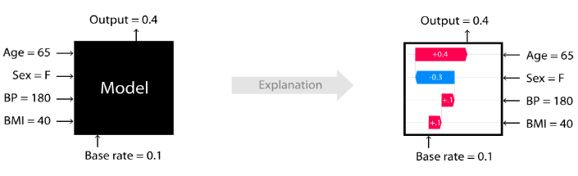
SHAP Additivity
SHAP Additivity (building block)
FP = BV + Σᵢ ϕᵢ ^{[5]}
FP = final prediction · BV = base value · ϕᵢ = SHAP value of feature i
Key property our algorithm exploits: we can compute the prediction from any subset of features by adding only those ϕᵢ values plus BV.
Figure. SHAP additivity: per-feature attributions sum to the model's output ^{[5]}
Worked example (subset = Age, BP):
FP = BV + ϕ_Age + ϕ_BP
= 0.1 + 0.1 + 0.1 = 0.3
FP = Final Prediction, BV = Base Value, $φ_{\left\{i\right\}}$ = Individual SHAP Values

Slide 11
Main Idea
Given a model prediction, calculate the importance value of each feature for the prediction.
Sort the features in a non-increasing order of their importance values.
Iteratively select the top features until they are sufficient to preserve the prediction.
The goal is to identify a minimal set of important features that preserve the model’s prediction.

Slide 12

Step 1: Compute and Sort SHAP Values
Compute SHAP values
Compute ϕ for an instance in the test set using a SHAP explainer.
Sort by predicted-class contribution
Class 1: sort positive ϕ descending; negative ϕ are opposing.
Class 0: sort negative ϕ by |ϕ| descending; positive ϕ are opposing.
Example (Adult Income, predicted = 1)
education-num +1.13 · occupation +0.59 · marital-status +0.56 · relationship +0.31 · age +0.22 · workclass +0.13 · race +0.12

Slide 13
Step 2: Margin-based Iterative Identification
Margin
M = BV + Σᵢ₌₁ᵗ ϕ₍ᵢ₎ − T
BV base prediction value
Σϕ₍ᵢ₎ SHAP sum of the top t features
T classification threshold
Setup: BV = −1.339 · T = 0 · |O| = 0.58 (fnlwgt, capital-gain, 5 others)
t | Added feature | M | Action
1 | education-num | −1.339 + 1.13 = −0.21 | continue
2 | + occupation | −1.339 + 1.72 = 0.38 | continue
3 | + marital-status | −1.339 + 2.28 = 0.94 | stop
Iterative identification
Start at t=1; compute M from the top t SHAP values.
Stop when |M| > sum of |opposing ϕ|.
Identified subset: {education-num, occupation, marital-status} — 3 of 14 features.

Slide 14
Experimental Design^{[1]}
Research Questions:
How many features are needed to determine the prediction of an instance?
Dataset | # of Features | Total Instances | Training Instances | Test Instances | Task
Breast Cancer | 30 | 569 | 455 | 114 | Classification
Adult Income | 14 | 48842 | 39074 | 9768 | Classification
Mushroom | 22 | 8124 | 6499 | 1625 | Classification
ML Models: Logistic Regression, XGBoost, SVM (9 model–dataset configurations)
Validation: retrain using only the identified features and check that the predictions still hold (100 random test instances per dataset).

Slide 15
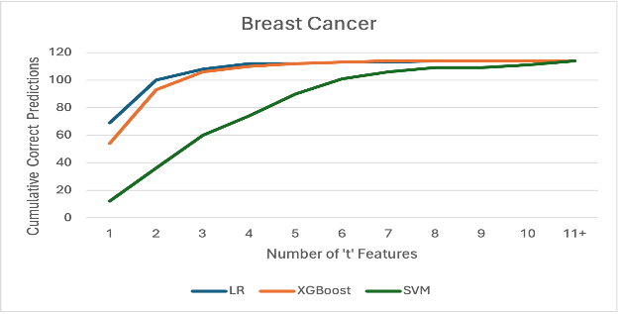
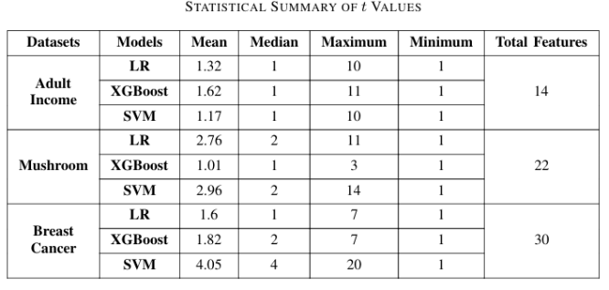
Results
Instance level: 90% of instances have fewer than 5 identified features; cumulative correctness plateaus beyond t = 6. ^{[1]}
Similar graphs with both Adult income and Mushroom dataset
Dataset level: across 9 (model, dataset) pairs, median t ≤ 2 in 8 of 9. ^{[1]}
Validation: retraining on the identified subset matches original accuracy within 6%.

Slide 16
ABLE: Tabular Local Explanations
ABLE: Using Adversarial Pairs to Construct Local Models for Explaining Model Predictions^{[2]}
Krishna Khadka, Sunny Shree, Pujan Budhathoki, Yu Lei,Raghu Kacker, D Richard Kuhn​
Accepted at KDD 2026

Slide 17
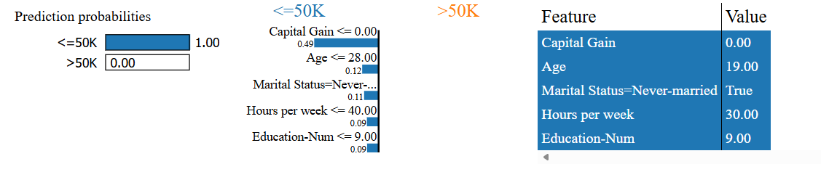
Local Explanation
Local explanation methods build an interpretable surrogate around a single test point. LIME^{[6]} is the most widely used method.
Figure. Local explanations turn an opaque prediction into a human-readable per-feature story.^{[6]}

Slide 18
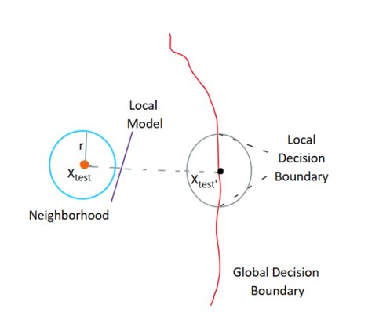
Problem: Why LIME's Local Surrogates Fail
Input: trained classifier f, test instance x
Output: local feature importances w
Issues ^{[7]}:
Low fidelity — when x is far from the decision boundary, sampled points share one class and the surrogate misses the boundary and has unlimited freedom.
Instability — random neighborhood sampling makes the explanation change across re-runs.
Figure. LIME perturbations sample a neighborhood that misses the decision surface when x is far from it ^{[2]}.

Slide 19
Related Works
Method | Sampling strategy | Year
LIME^{[6]} | Random Gaussian around x | 2016
GLIME^{[7]} | Globally Gaussian | 2023
USLIME^{[8]} | Uniform | 2024
CALIME^{[9]} | Cluster-aware | 2024
ABLE (ours)^{[2]} | Adversarial pairs straddling the decision boundary | 2026
All four LIME variants sample without regard to the decision boundary. ABLE is the first to construct the local model directly from boundary-anchored points.

Slide 20
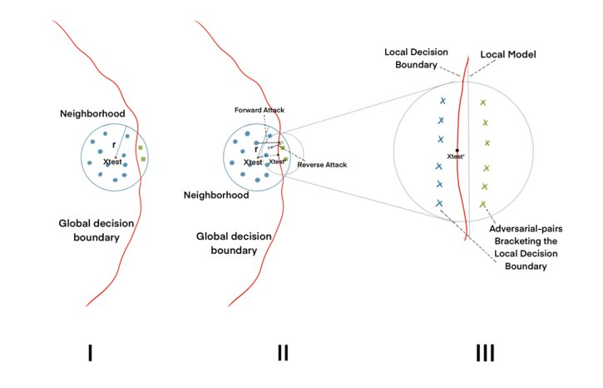
Our Approach: Adversarially Bracketed Local Explanation (ABLE)
An adversarial perturbation is a minimal input change that flips the model's prediction. An adversarial pair (original, perturbed) sits on opposite sides of the local boundary.
Step 1 — Neighborhood construction: sample n points around x_test.
Step 2 — Adversarial pair generation: forward attack → reverse attack → boundary-bracketing pair.
Step 3 — Local surrogate fit: fit a linear model on the pairs; coefficients are the feature importances.
Figure. ABLE local boundary. Pairs that straddle the boundary → surrogate that hugs the boundary. ^{[2]}

Slide 21
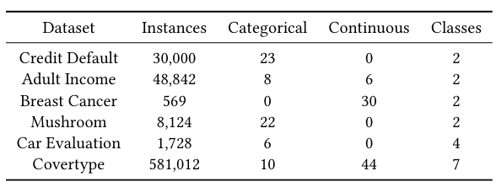
Experimental Design^{[2]}
Research Questions
RQ1 — Fidelity: How accurately does ABLE replicate the model in the local neighborhood?
RQ2 — Stability: How consistent are explanations under small input perturbations?
RQ3 — Sensitivity: How do neighborhood radius and number of adversarial pairs affect performance?
Target Models
MLP, TabNet, TabTransformer
Attack Variants
White-box: PGD, FGSM, etDF
Black-box: HopSkipJump (HSJ)
Baselines
LIME, GLIME, USLIME, CALIME
Metrics
R² (fidelity), Jaccard@5 (stability), Runtime
Table. Binary-class (CreditDefault, AdultIncome, BreastCancer, Mushroom) and multi-class (CarEvaluation, Covertype) datasets. The table summarizes instances, categorical and continuous features, and class distributions. ^{[2]}

Slide 22
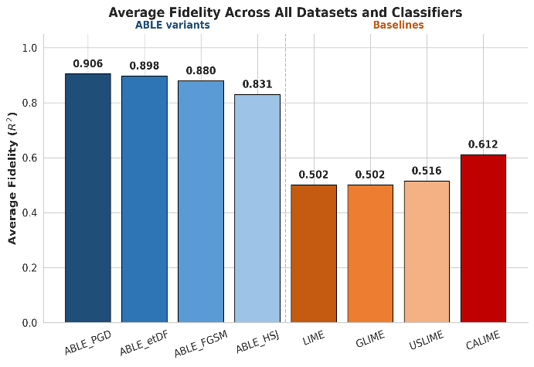
Fidelity Results
ABLE achieves the highest fidelity in 16 of 18 (model × dataset) configurations. Average R² = 0.91 vs. 0.61 for the best baseline (CALIME), a 48% relative gain.
White-box attacks (e.g., PGD) achieve higher fidelity than black-box attacks (e.g., HSJ).
Figure. Higher is better. Fidelity = R² of the local surrogate against the model in the local neighborhood. ^{[2]}

Slide 23
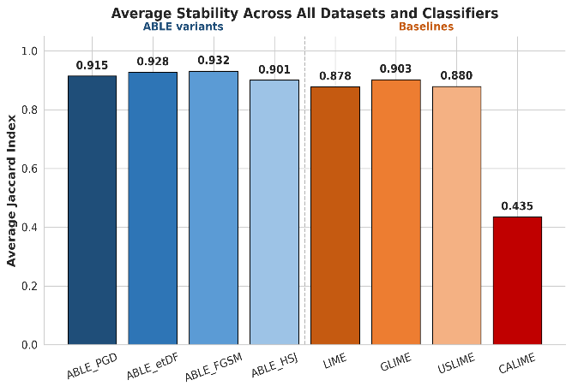
Stability Results
ABLE variants are more stable than baselines in 12 of 16 (model × dataset) configurations.
White-box attacks (e.g., PGD) deliver more stable explanations than black-box attacks (e.g., HSJ).
Figure. Higher score is better. Stability measured across re-runs of the local explainer. ^{[2]}

Slide 24
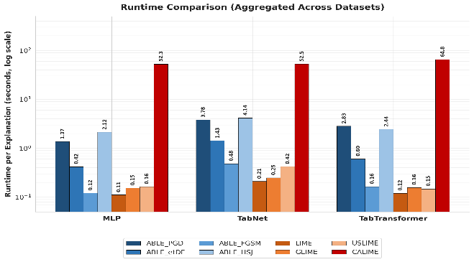
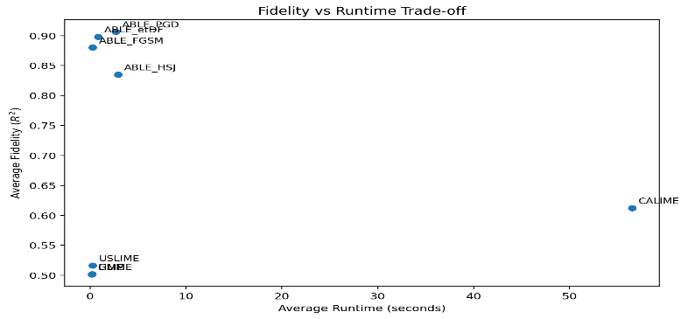
Runtime Analysis
Figure. A. Lower runtime is better. B. Fidelity vs. runtime trade-off across methods. ^{[2]}
White-box ABLE variants (e.g., PGD) are slower than baselines, while black-box variants (e.g., HSJ) are the slowest. FGSM, a faster ABLE variant, is comparable to baselines in runtime while still beating them on fidelity and stability.

Slide 25
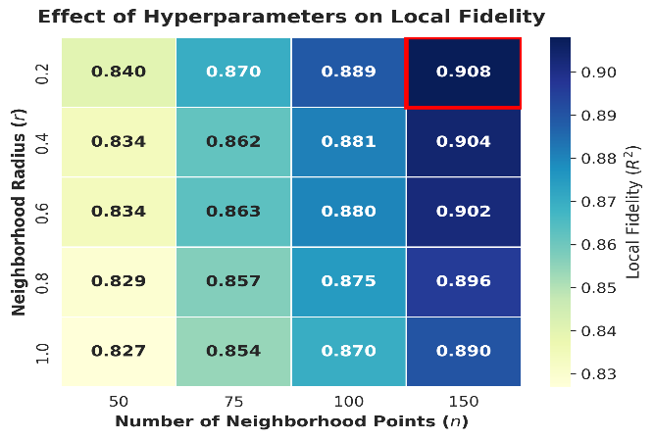
Neighborhood Samples and Radius Sensitivity
Tightening the neighborhood radius keeps the surrogate close to the true local boundary.
Increasing samples within that radius further sharpens the fit, with diminishing returns past a few hundred points.
Compared with LIME / GLIME's 5,000 sampled points, ABLE-FGSM needs only 300 query points while achieving stronger fidelity.
Figure. Local fidelity vs. neighborhood radius and sample count. Higher is better. ^{[2]}

Slide 26
DD-CAM: Vision Local Explanations
DD-CAM: Minimal Sufficient Explanations for Vision Models Using Delta Debugging ^{[3]}
Krishna Khadka, Yu Lei, Raghu Kacker, D Richard Kuhn​
Targeting NeurIPS 2026

Slide 27
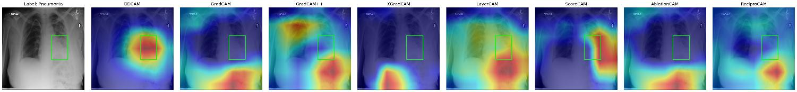
Problem
Class Activation Maps (CAMs) highlight image regions a CNN uses to classify: the standard saliency tool for vision models.
Input: vision model M, image x, predicted class ĉ.
Output: a saliency map highlighting the minimum sufficient input region driving ĉ.
Figure. Existing CAM methods spread attention diffusely. We want a tighter, sufficient region. ^{[3]}

Slide 28
Delta Debugging Analogy
Figure: Like Delta debugging ^{[10]} indentifies a failing input to the minimal bug-inducing fragment in software debugging, in explanation it shrinks a model prediction to the minimal region that preserves the prediction.

Slide 29
Key Idea: Minimal Sufficient Set
Find the smallest set of internal units that alone preserves the model's prediction.
Sufficient: activating only S keeps prediction ĉ.
1-minimal: removing any one unit breaks it.
Same notion of minimality as 1-minimal failure-inducing inputs in program debugging.
Why internal units?
~512 channels vs. ~150,000 pixels, much smaller search.
Figure. Minimal sufficient set: smallest internal-unit subset that alone preserves the prediction.

Slide 30
Related Work
Family | Methods | How it weights feature maps
Gradient-based | Grad-CAM ^{[11]}, Grad-CAM++ ^{[12]}, XGrad-CAM ^{[13]}, Layer-CAM ^{[14]} | Gradient of class score w.r.t. activations
Perturbation-based | Score-CAM ^{[15]}, Ablation-CAM ^{[16]} | Mask each map, measure score drop
Reciprocity-based | Recipro-CAM ^{[17]} | Spatial reciprocity between maps and predictions
Delta Debugging (ours) | DD-CAM ^{[3]} | Minimal sufficient subset via delta debugging
All seven baselines weight all K feature maps. DD-CAM selects a small subset and discards the rest.

Slide 31
Approach
Figure. DD-CAM pipeline: starting from all K feature maps, delta debugging searches for a 1-minimal subset whose activation alone preserves the predicted class; the weighted sum of the preserved maps gives the heatmap.
Figure. Worked example of delta debugging: iteratively halve the candidate set, keep the half whose activation alone preserves the prediction, until a 1-minimal sufficient subset remains.

Slide 32
Experimental Setup ^{[3]}
Research Questions:
RQ1 — Faithfulness: Do the saliency maps reflect the model’s decisions, and how does our method compare to state-of-the-art CAM across architectures?
RQ2 — Localization: Do the saliency maps align with human-annotated regions, and how does our method compare to state-of-the-art localization accuracy?
Datasets:
ImageNet (2000 validation images, class-balanced),
ChestX-ray14 (1000 radiologist-annotated)
Architecture:
CNN Linear Heads: ResNet-50, EfficientNet-B0, Inception-v3
CNN Non-Linear Heads: VGG-11, VGG-16, VGG-19
Vision Transformers: ViT-B/16, ViT-L/16
Metrics:
RQ1: Average Drop ↓, Coherency ↑, Complexity ↓, Average DCC ↑, Increase in Confidence ↑, Drop in Deletion ↑, Time ↓
RQ2: IoU ↑, Precision ↑, Recall ↑, Regions ↓
Baselines:
Grad-CAM, Grad-CAM++, Score-CAM, Ablation-CAM, LayerCAM, XGradCAM, Reprico-CAM

Slide 33
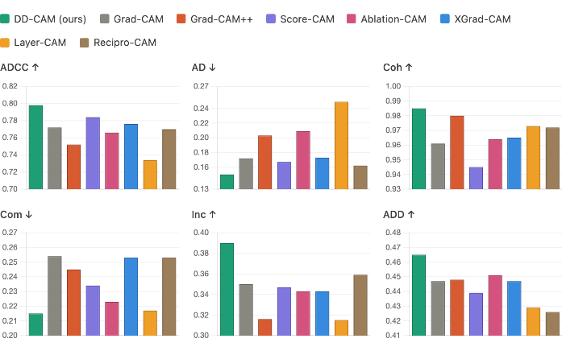
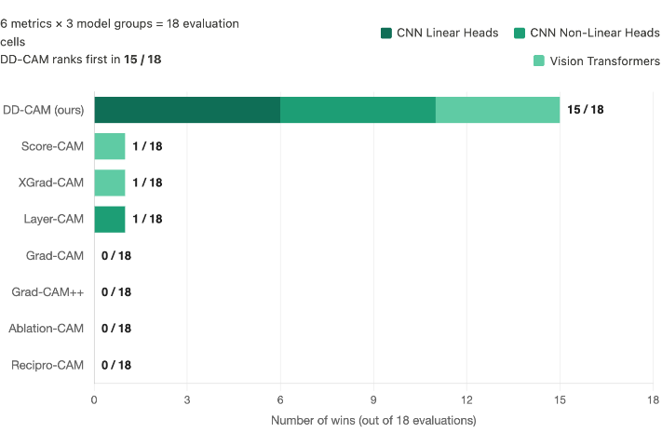
Faithfulness Results
Figure. DD-CAM ranks first in 15 of 18 evaluation cells (6 metrics × 3 architecture families). ^{[3]}

Slide 34
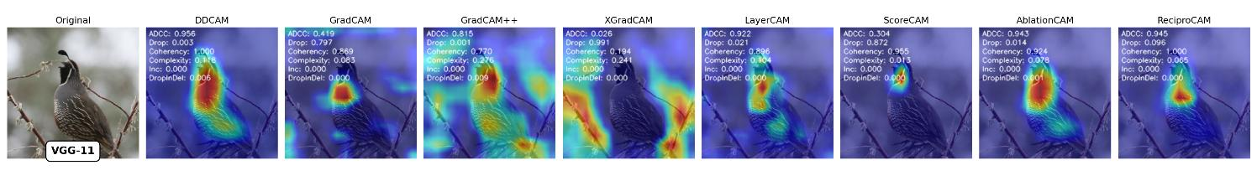
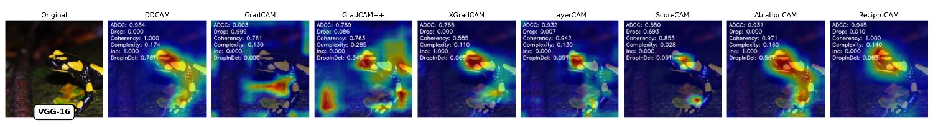
Visualizations
Figure. DD-CAM produces less complex, less noisy saliency maps on ImageNet samples. ^{[3]}

Slide 35
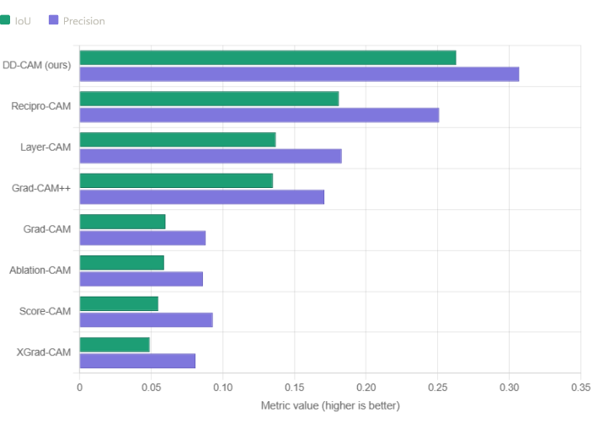
Localization Results
Figure. DD-CAM achieves a 45% improvement over the next-best Recipro-CAM on radiologist-annotated regions. ^{[3]}

Slide 36
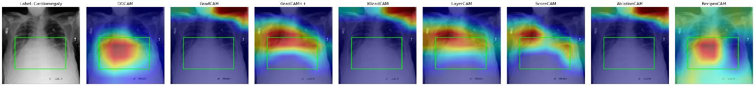

Visualizations
Figure. DD-CAM lands inside the bounding box; baselines drift outside. ^{[3]}

Slide 37
Extensions for Final Resubmission
Expand baselines beyond CAM families:
Integrated Gradients ^{[19]}, RISE ^{[18]}, SHAP ^{[5]}, LIME ^{[6]}, Extremal Perturbations ^{[20]}
Stability analysis of 1-minimal set.
Can we prove something about the models internal working mechanism with help of DD-CAM?
ViT Masking Ablation by replacing zero masking with −∞ attention masking.

Slide 38
EGMR: Repairing Models
Explanation-Guided Model Repair
Targeting AAAI 2027

Slide 39
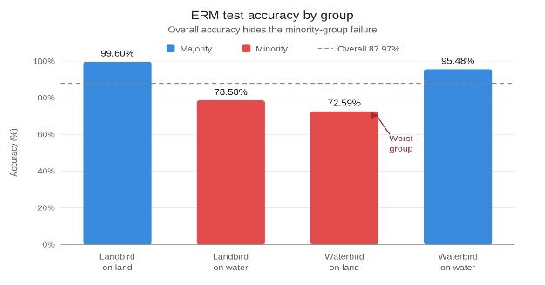
Why Waterbirds Is Hard
Class imbalance pushes the model onto a background shortcut, and the minority pays for it.
The training set is unbalanced. Most waterbirds appear over water and most landbirds over land; the off-context groups are heavily under-represented.
The model takes the shortcut. ERM exploits the strong background-to-class correlation instead of bird features.
Worst-group accuracy collapses. Average looks fine; minority subgroups fail systematically (right).
Figure. ERM accuracy by group on Waterbirds: 99.6% majority vs 72.6% worst group, a 27-point gap.

Slide 40
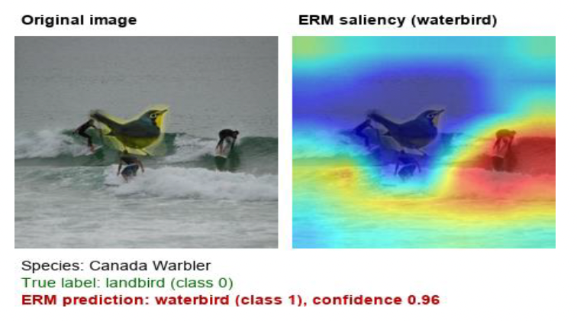
How the Failure Looks Inside the Model
Saliency on a misprediction shows the model attending to background, not bird.
Figure. Post-hoc explanations (e.g., GradCAM^{[21]}) highlight surrounding water instead of the bird, exposing reliance on background shortcuts.

Slide 41
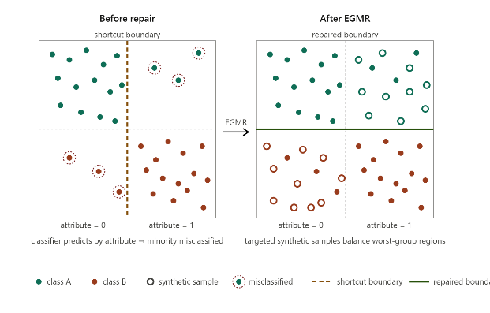
Problem Statement
Repair a classifier that takes shortcuts, without group labels, without retraining from scratch.
Input
Trained classifier with low worst-group accuracy
Validation set with mispredictions
Output
Updated classifier with reduced shortcut reliance and higher worst-group accuracy
Research Question
Can explanations on mispredictions identify where to generate targeted synthetic data that repairs the model?
Figure: Targeted EGMR edits move the decision boundary fixing minority-group errors

Slide 42
Related Work
Prior approaches to Waterbirds-style shortcuts, and where EGMR differs.
Approach family | Fix on Waterbirds | Limitation EGMR addresses
Reweighting / GroupDRO ^{[22]} | Up-weight minority groups in the loss; needs group labels. | No new minority examples; ceiling set by what little exists.
Just Train Twice ^{[23]} | Identify mis predictions without group labels; up-weight them and retrain. | Still resamples existing data; no new contexts.
Generic augmentation (CutMix, Mixup, crops) | Add invariance to random perturbations. | Context-blind; cannot target the water/forest shortcut.
Interpretability-only (TCAV, SpLiCE ^{[24]}) | Surface that the model relies on background concepts. | Diagnoses the bug; does not repair it.
Generative augmentation (full-image diffusion) | Synthesize new bird-on-context images globally. | Edits the whole image; can drift class identity.
EGMR: explanation-guided local inpainting. Adds new minority contexts (vs. reweighting), targets the shortcut concept (vs. random augmentation), preserves the bird (vs. full-image gen), and acts on the diagnosis (vs. interpretability alone).

Slide 43
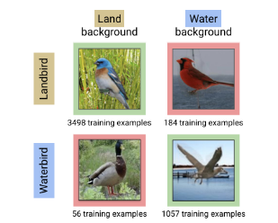
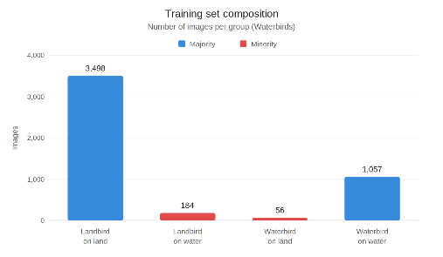
From Explanations to Repair
The gap is in the data distribution.
Reweighting 56 minority images cannot create diversity the model never saw.
EGMR’s move: explanations give us where (mask) and what (concept) causes failure.
Diffusion fills the mask; fine-tune on the augmented set.
Novelty: explanations choose what to vary and where to put the mask because random variations can hurt the existing predictions which can perturb essential features.
Figure. Waterbird dataset class imbalance ^{[23]}
UTA

Slide 44
The EGMR Pipeline ( Work in Progress)
Each row shows what flows through the pipeline. OUT of one stage is IN of the next.
1. Encode
2. Diagnose
3. Localize
4. Repair
IN
Training images.
Concept bank.
Suspect concept + misclassified images.
Images + masks.
DO
Run SpLiCE per image to get sparse interpretable concept decompositions.
Rank class-shared concepts by asymmetry A(v).
Partition keeps pelican/swan out; asymmetry keeps balanced concepts out.
Difference saliency on misclassified images, kept only if recurrent.
Edit margin-driving regions, not one-off artifacts.
Diffusion generates variants of the masked region; fine-tune on original + variants.
More essential × non-essential combinations break the shortcut.
OUT
Concept bank: image → {water, forest, beak, wing…}
Suspect concept (e.g., forest).
Inpainting masks (e.g., the forest region).
Repaired classifier.
Asymmetric concept = appears much more in one class than the other (e.g., “forest" in landbirds). These are the ones the model is tempted to use as shortcuts.
Concept embeddings via SpLiCE ^{[24]}
Notes:
A(v) = | how often concept v appears in class 1 − how often it appears in class 0 |
High score = suspect shortcut. Low score = probably a real feature of the object. We rank concepts by this score and flag the top ones for the next stage.

Slide 45
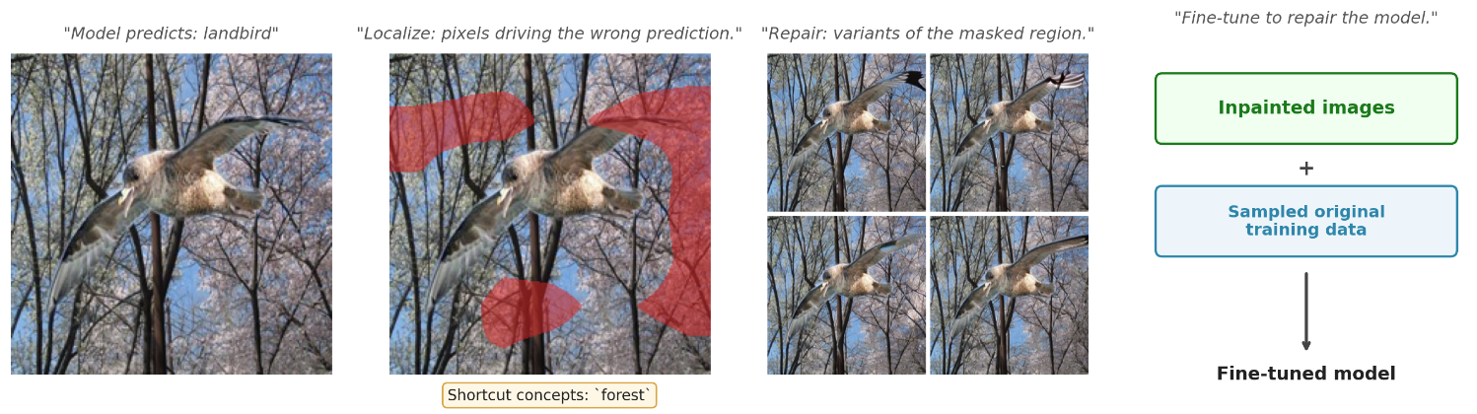
EGMR Pipeline on a single misprediction (Northern Fulmar)
Figure: Original image: model predicts landbird. Diagnose flags ‘forest’ as the suspect concept. Localize masks the forest region. Repair generates diffusion variants and fine-tunes
Repeated across all mispredicted validation images to build the repair set.

Slide 46
Preliminary Results on Waterbirds
+1.6 pts worst-group, +3.2 pts overall over JTT, without group labels.

Slide 47
Remaining work, Experimental plan
Benchmarks
CelebA — gender→ blond shortcut
ImageNet-9 — texture/shape bias
ColorMNIST — sanity check
Baselines
Deep Feature Reweighting ^{[27]}
Discover and Cure ^{[25]}
Correct-N-Contrast ^{[26]}
GroupDRO (oracle upper bound) ^{[22]}
Ablations
Concept bank size
Asymmetry threshold
Inpainting quality → performance
Recurrence threshold
Notes:
Deep Feature Reweighting – Last layer retraining for robustness to spuriousness correlations
DISC – identify concepts and generate more instances, need to predefine concepts
Compare and contrast: The intuition: samples in the same class but different groups (e.g., a landbird-on-water vs a landbird-on-land) look different in feature space because the model leans on the spurious feature (background). CNC pulls them together and pushes apart same-group / different-class pairs, so the representation stops encoding the shortcut.

Slide 48
Summary and Timeline

Slide 49
Publications
■ Included in this proposal
2026
ABLE: Adversarial Boundary Local Explanations for ML Predictions · KDD 2026 CORE A*
K. Khadka, S. Shree, P. Budhathoki, Y. Lei, R. Kacker, D.R. Kuhn
A Combinatorial Approach to Synthetic Data Generation for ML · SN Computer Science
K. Khadka, J. Chandrasekaran, Y. Lei, R. Kacker, D.R. Kuhn
TabKD: Tabular Knowledge Distillation via Feature-Bin Interaction Diversity · IJCAI 2026 Under Review
S.N. Pereira, K. Khadka, Y. Lei
DD-CAM: Minimal Sufficient Explanations for Vision Models via Delta Debugging · arXiv:2602.19274 Preprint
K. Khadka, Y. Lei, R.N. Kacker, D.R. Kuhn
2024
Constructing Surrogate Models Using Combinatorial Testing · ASE 2024 CORE A*
S. Shree, K. Khadka, Y. Lei, R.N. Kacker, D.R. Kuhn
A Combinatorial Approach to Hyperparameter Optimization · CAIN 2024 Distinguished Paper Candidate
K. Khadka, J. Chandrasekaran, Y. Lei, R.N. Kacker, D.R. Kuhn
Assessing Feature Interactions in Model Predictions · ICSTW 2024
K. Khadka, S. Shree, Y. Lei, R.N. Kacker, D.R. Kuhn
2023
Synthetic Data Generation Using Combinatorial Testing and VAE · ICSTW 2023
K. Khadka, J. Chandrasekaran, Y. Lei, R.N. Kacker, D.R. Kuhn

Slide 50
Timeline
Apr 2026
Now
Jul 2026
EGMR submission (AAAI)
Nov 2026
Defense
May 2026
EGMR pilots + DD-CAM (NeurIPS 2026)
Sep–Oct
Dissertation write-up
Completed
Feature Interactions (ICSTW 2024)
ABLE (KDD 2026)
DD-CAM initial paper
EGMR: Waterbirds pilot
Next Up
DD-CAM resubmission
EGMR full benchmarks, paper submission
Dissertation draft

Slide 51
Questions & Discussion

Slide 52
Citations
Khadka, Krishna, et al. "Assessing the degree of feature interactions that determine a model prediction." 2024 IEEE International Conference on Software Testing, Verification and Validation Workshops (ICSTW). IEEE, 2024.
Khadka, Krishna, et al. "ABLE: Using Adversarial Pairs to Construct Local Models for Explaining Model Predictions." Proceedings of the 32nd ACM SIGKDD Conference on Knowledge Discovery and Data Mining V. 1. 2026.
Khadka, Krishna, et al. "DD-CAM: Minimal Sufficient Explanations for Vision Models Using Delta Debugging." arXiv preprint arXiv:2602.19274 (2026).
Kuhn, Rick, Yu Lei, and Raghu Kacker. "Practical combinatorial testing: Beyond pairwise." It Professional 10.3 (2008): 19-23.
Lundberg, Scott M., and Su-In Lee. "A unified approach to interpreting model predictions." Advances in neural information processing systems 30 (2017).
Ribeiro, Marco Tulio, Sameer Singh, and Carlos Guestrin. "" Why should i trust you?" Explaining the predictions of any classifier." Proceedings of the 22nd ACM SIGKDD international conference on knowledge discovery and data mining. 2016.
Tan, Zeren, Yang Tian, and Jian Li. "GLIME: general, stable and local LIME explanation." Advances in neural information processing systems 36 (2023): 36250-36277.
Hamid Saadatfar, Zeinab Kiani-Zadegan, and Benyamin Ghahremani-Nezhad. 2024. US-LIME: Increasing fidelity in LIME using uncertainty sampling on tabular data. Neurocomputing 597 (2024), 127969.
Martina Cinquini and Riccardo Guidotti. 2024. Causality-aware local interpretable model-agnostic explanations. In World Conference on Explainable Artificial Intelligence. Springer, 108–124.
Zeller, Andreas, and Ralf Hildebrandt. "Simplifying and isolating failure-inducing input." IEEE Transactions on software engineering 28.2 (2002): 183-200.
Ramprasaath R Selvaraju, Michael Cogswell, Abhishek Das, Ramakrishna Vedantam, Devi Parikh, and Dhruv Batra. Grad-cam: Visual explanations from deep networks via gradient-based localization. In Proceedings of the IEEE international conference on computer vision, pages 618–626, 2017.
Aditya Chattopadhay, Anirban Sarkar, Prantik Howlader, and Vineeth N Balasubramanian. Grad-cam++: Generalized gradient-based visual explanations for deep convolutional networks. In 2018 IEEE winter conference on applications of computer vision (WACV), pages 839–847. IEEE, 2018.
Ruigang Fu, Qingyong Hu, Xiaohu Dong, Yulan Guo, Yinghui Gao, and Biao Li. Axiom-based grad-cam: Towards accurate visualization and explanation of cnns. arXiv preprint arXiv:2008.02312, 2020

Slide 53
Citations
14. Peng-Tao Jiang, Chang-Bin Zhang, Qibin Hou, Ming-Ming Cheng, and Yunchao Wei. Layercam: Exploring hierarchical class activation maps for localization. IEEE transactions on image processing, 30:5875–5888, 2021
15. Haofan Wang, Zifan Wang, Mengnan Du, Fan Yang, Zijian Zhang, Sirui Ding, Piotr Mardziel, and Xia Hu. Score-cam: Score-weighted visual explanations for convolutional neural networks. In Proceedings of the IEEE/CVF conference on computer vision and pattern recognition workshops, pages 24–25, 2020
16. Harish Guruprasad Ramaswamy et al. Ablation-cam: Visual explanations for deep convolutional network via gradientfree localization. In proceedings of the IEEE/CVF winter conference on applications of computer vision, pages 983– 991, 2020
17. Seok-Yong Byun and Wonju Lee. Vit-reciprocam: gradient and attention-free visual explanations for vision transformer. arXiv preprint arXiv:2310.02588, 2023.
18. Petsiuk, Vitali, Abir Das, and Kate Saenko. "Rise: Randomized input sampling for explanation of black-box models." arXiv preprint arXiv:1806.07421 (2018).
19. Sundararajan, Mukund, Ankur Taly, and Qiqi Yan. "Axiomatic attribution for deep networks." International conference on machine learning. PMLR, 2017.
20. Fong, Ruth, Mandela Patrick, and Andrea Vedaldi. "Understanding deep networks via extremal perturbations and smooth masks." Proceedings of the IEEE/CVF international conference on computer vision. 2019.
21. Selvaraju, Ramprasaath R., et al. "Grad-cam: Visual explanations from deep networks via gradient-based localization." Proceedings of the IEEE international conference on computer vision. 2017.
22. Sagawa, Shiori, et al. "Distributionally robust neural networks for group shifts: On the importance of regularization for worst-case generalization." arXiv preprint arXiv:1911.08731 (2019).
23. Liu, Evan Z., et al. "Just train twice: Improving group robustness without training group information." International Conference on Machine Learning. PMLR, 2021.
24. Bhalla, Usha, et al. "Interpreting clip with sparse linear concept embeddings (splice)." Advances in Neural Information Processing Systems 37 (2024): 84298-84328.
25. Wu, Shirley, et al. "Discover and cure: Concept-aware mitigation of spurious correlation." International Conference on Machine Learning. PMLR, 2023.
26. Zhang, Michael, et al. "Correct-n-contrast: A contrastive approach for improving robustness to spurious correlations." arXiv preprint arXiv:2203.01517 (2022).
27. Kirichenko, Polina, Pavel Izmailov, and Andrew Gordon Wilson. "Last layer re-training is sufficient for robustness to spurious correlations." arXiv preprint arXiv:2204.02937 (2022).

Slide 54
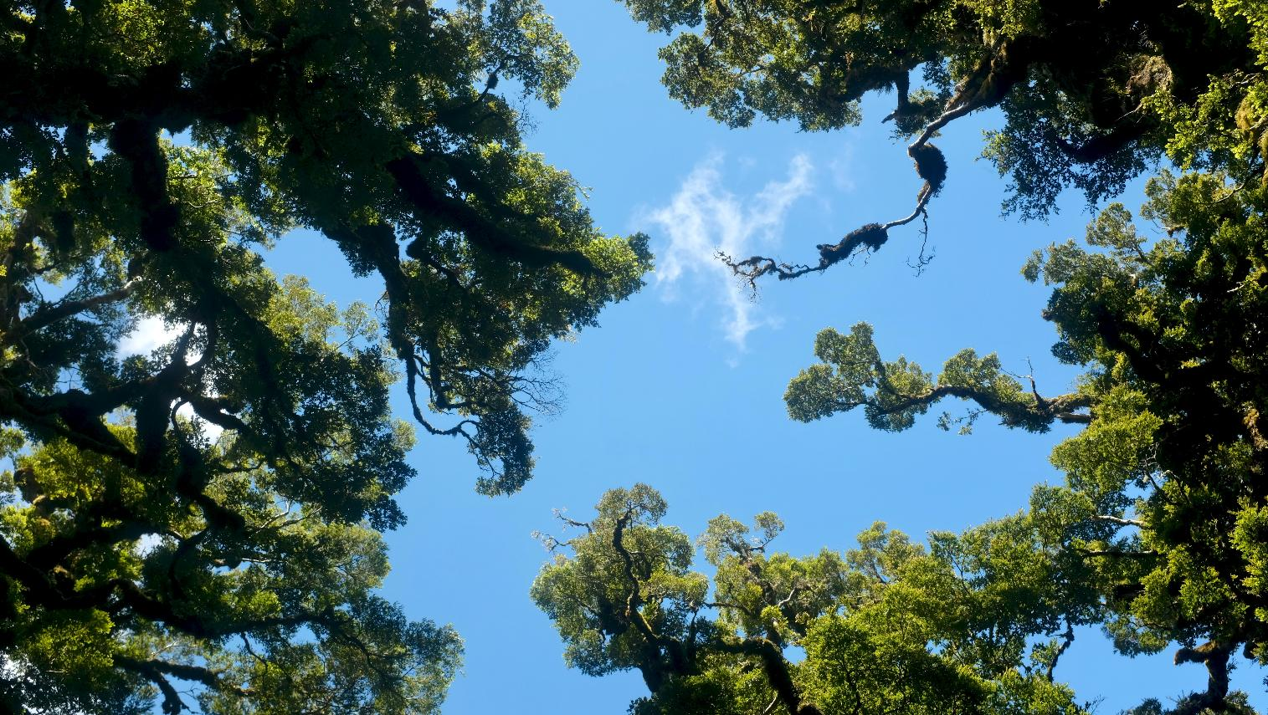
Thank You

