Slide 1
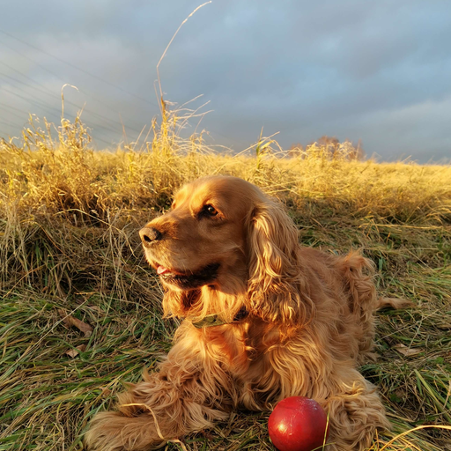
NERA
The Robo Dog
Ring → Greet → Arrive
AI Robot-Dog Concierge for Home of Innovation Vienna
START Hack Vienna '26 · HOIV Robo Dog Track

Slide 2





TEAM
LINKS
Federico
Trinish
Gerald
Franck
GitHub Repository
github.com/sercinci/nera-the-robo-dog
Architecture Docs
Project Info
github.com/sercinci/nera-the-robo-dog/blob/main/ARCHITECTURE.md
Track: HOIV Robo Dog — START Hack Vienna '26
Status: Hackathon prototype — active development
Go2 Integration Guide
License: MIT — Public repository
github.com/sercinci/nera-the-robo-dog/blob/main/Go2_Integration_Guide.pdf

Slide 3

Visitors get no instant welcome
A doorbell rings — nobody answers right away. Visitors stand at the entrance unsure where to go.
Manual reception is costly & inconsistent
THE
PROBLEM
Front desks can't be staffed 24/7. Human greeters forget names, rooms, and schedules.
Innovation hubs need an innovative entrance
HOIV's brand is about future tech — yet their lobby experience is... a buzzer and a wait.

Slide 4




THE SOLUTION
A fully autonomous AI concierge that greets visitors, understands them, and guides them — by voice, screen and robot.
1
2
3
4
5
Ring
Listen
Think
Speak
Guide
Doorbell
summons Nera
ElevenLabs
Agent
AI agent
resolves intent
Voice reply
< 1 second
Screen map
+ robot walks

Slide 5

TECH STACK
🎤 Voice Pipeline
🧠 AI Agent
ElevenLabs Conversational Agent — end-to-end voice AI
STT + AI + TTS unified in one managed pipeline
Replaces separate STT + OpenRouter + TTS stack
Low-latency, built-in interruption handling
OpenRouter (fast tool-calling text model)
Fallback: Groq / OpenAI / Anthropic native
Custom skill registry: find_place, find_person
Zod contracts — model can NEVER invent a room
🖥️ Display & Screen
🤖 Robot (Go2)
WebSocket broadcast — Destination JSON
Laptop kiosk (rich UI + latency overlay)
Pi Zero 2 W → 4K TV (lean display-only)
Yodeck Web Page player (live WS, not content-push)
Unitree Go2 robot dog
Foxglove WS Bridge + CDR PoseStamped
@foxglove/ws-protocol + rosmsg2-serialization
Mock-verified protocol (no dog needed to demo)

Slide 6
SYSTEM ARCHITECTURE
ORCHESTRATOR
(Node 24 + TS)
Doorbell
Trigger
Audio Kiosk
(Browser AEC)
ElevenLabs Agent → Sinks → State Machine
ElevenLabs
ElevenLabs
ElevenLabs
Voice Out
Conv. Agent
AI Agent
Pi Zero → TV
+ Yodeck
Unitree Go2
(Foxglove CDR)
Hero KPI: ring → voice reply < 1 second

Slide 7
Nera is ready.
Ring the bell. Say where you want to go. She's on it.
github.com/sercinci/nera-the-robo-dog

