Slide 1
Comparing Models for Number of Bookings
Serdar Altok, PhD

Slide 2
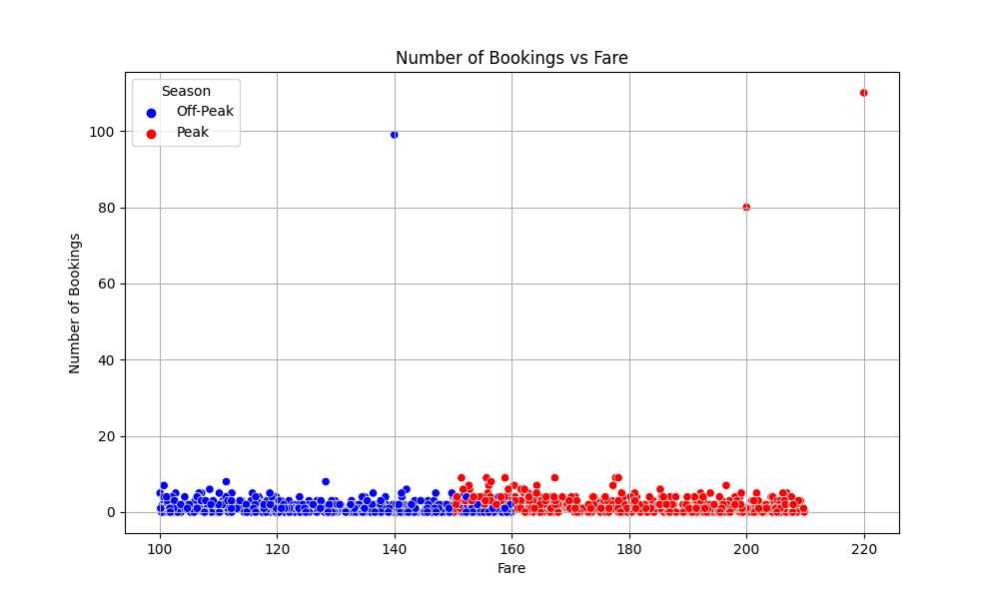
3 outliers and 1 data point with missing booking information removed

Slide 3
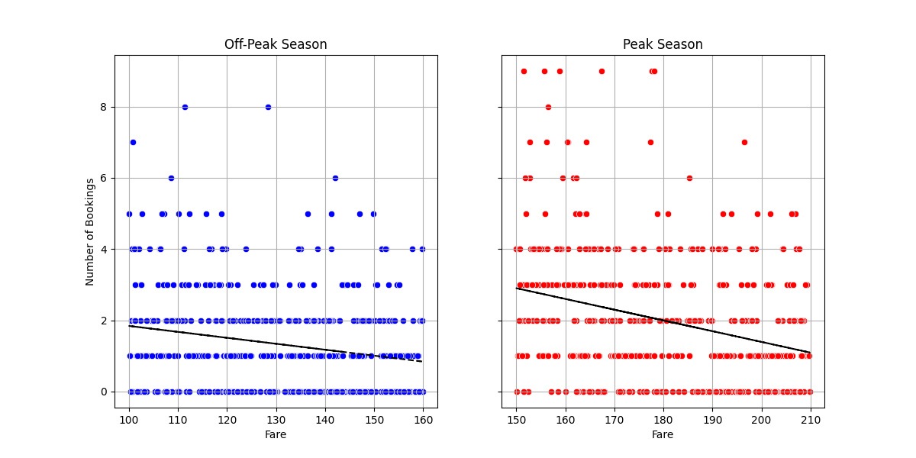
Both means and variances decrease as Fare increases

Slide 4
Given fare, each booking can be assumed to be independent with small probability
This situation is usually well modeled by Poisson distribution
Conditional means and variances going down in parallel also supports the conditional distribution of number of bookings is Poisson
Linear models assume constant variance
To explore this idea, we divide fare into bins of length 10 and check whether these assumptions are supported by the data

Slide 5
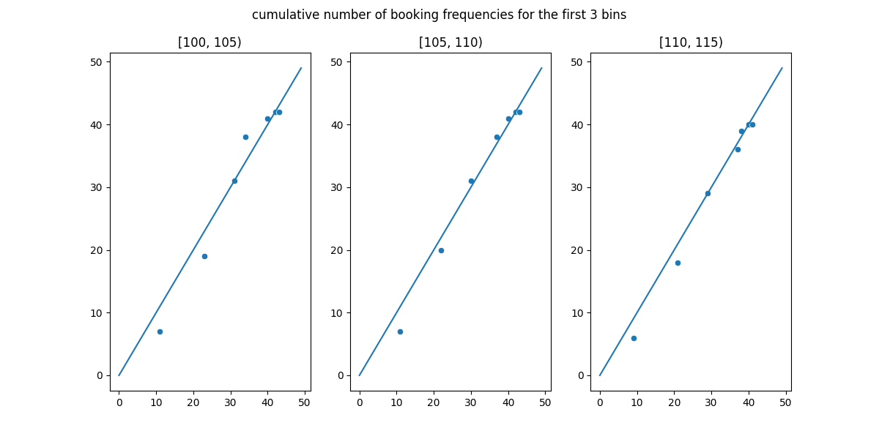

Slide 6
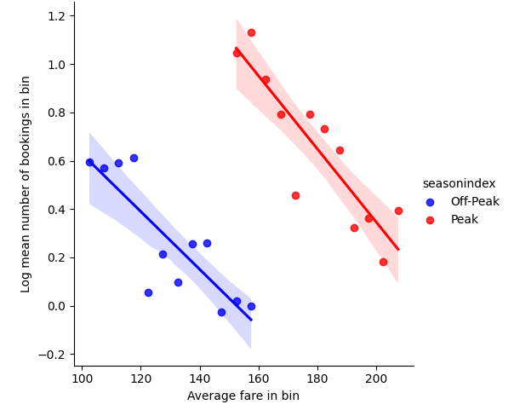
Log linearity of bin means
Log of mean number of bookings is roughly linear

Slide 7
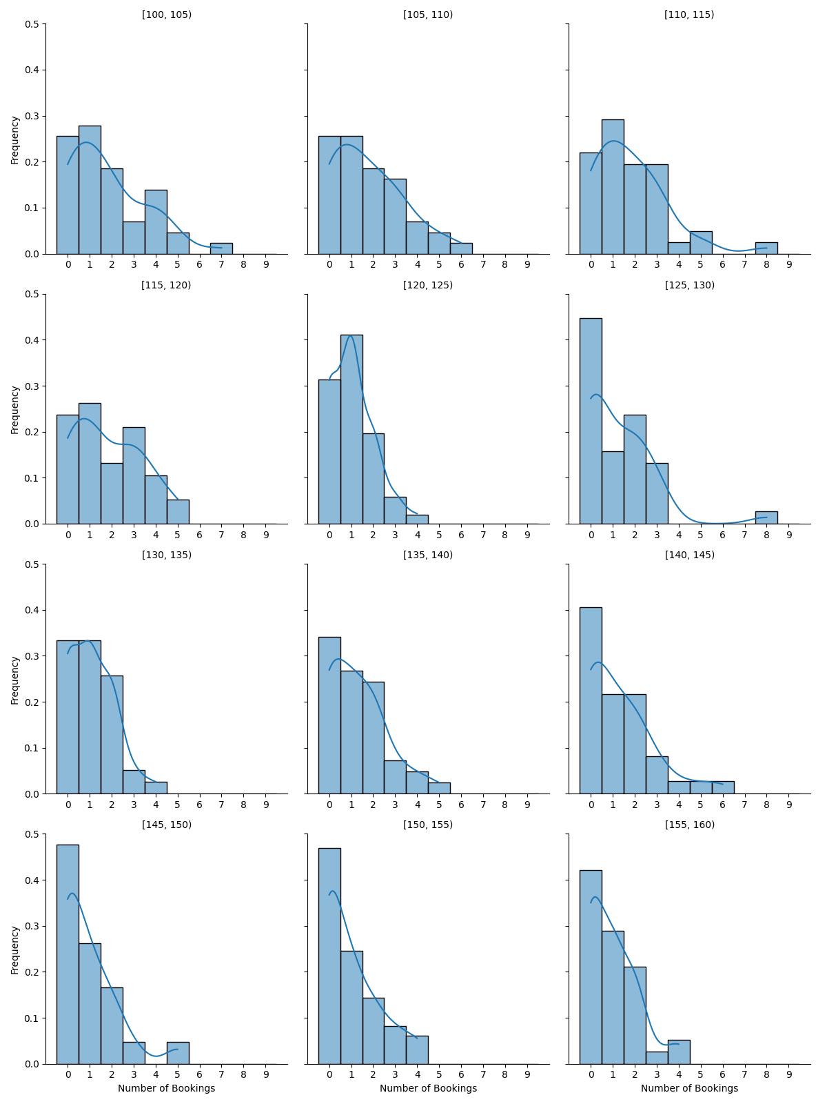
Histogram of bins for the off-peak season

Slide 8
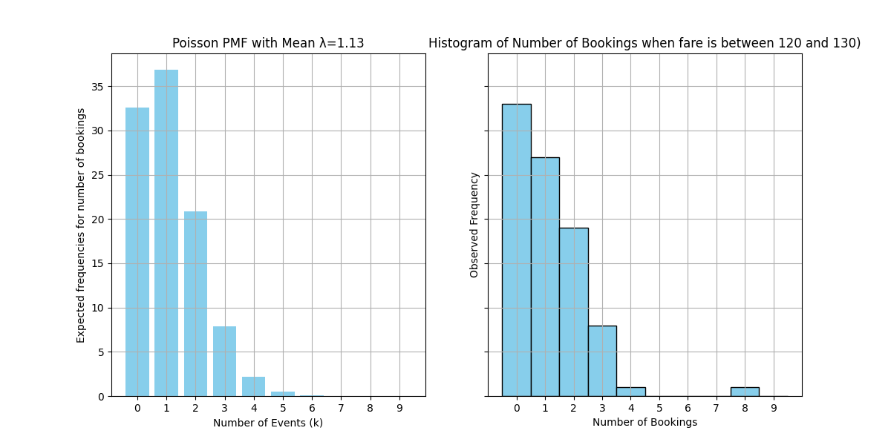
Sample bin histogram compared to theoretical Poisson frequencies

Slide 9
Model selection
Find optimal power function
Compare cross-validated errors from models
Estimate errors on test set

Slide 10
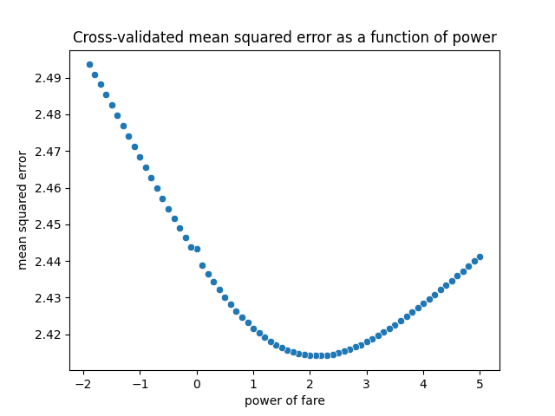
Bookings ~ a*(Fare^b)
The minimum error corresponds to a quadratic term

Slide 11
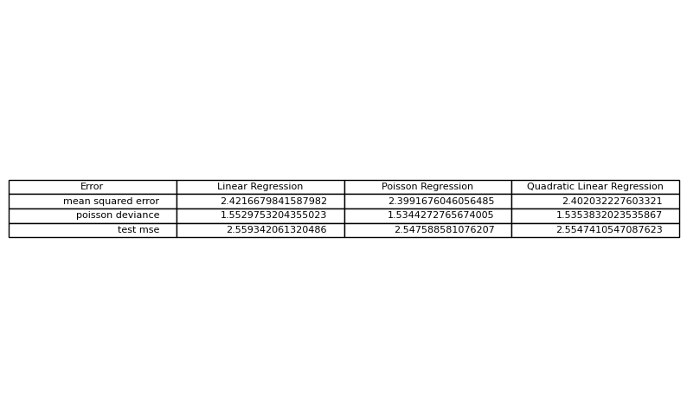
10-fold Cross-validation errors on models

Slide 12
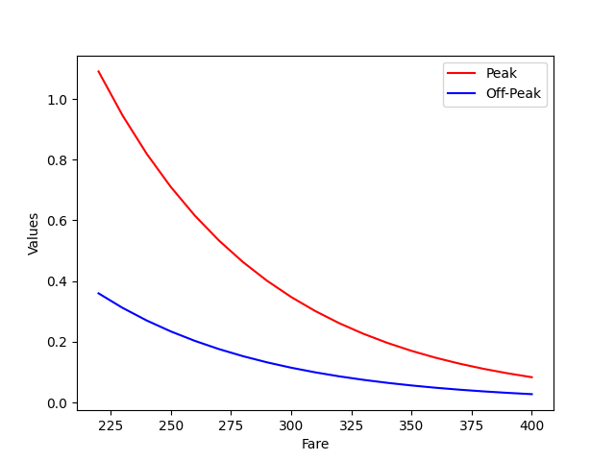
Scikit-learn Poisson regressor model
$10 increase in price corresponds to 13% decrease in average number of bookings
$1 increase in price corresponds to 1.42% decrease in average number of bookings

Slide 13
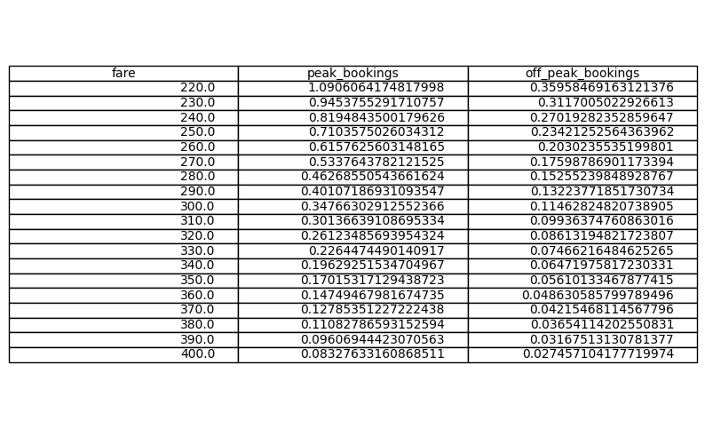
PoissonRegressor predictions for higher prices

Slide 14
Final thoughts
Collect more data and get tighter estimates for coefficients
The models heavily extrapolates to higher fares, collecting more data with higher fares can result in better models for higher prices

