Slide 1
Check for similarity of several cities
Presentation by
Serdar MAMIYEV

Slide 2

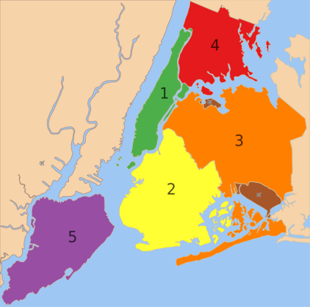
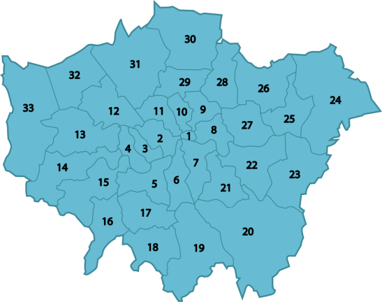
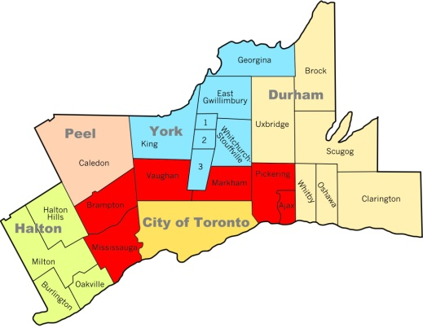
Introduction
Imagine, you work in New York and have been proposed a position in a company that has branches in Toronto and London
Moreover, you were given a chance to choose among them
Definitely, you'd choose the most similar one to New York
NEW YORK
LONDON
TORONTO

Slide 3
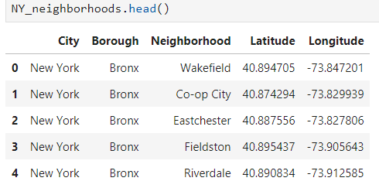
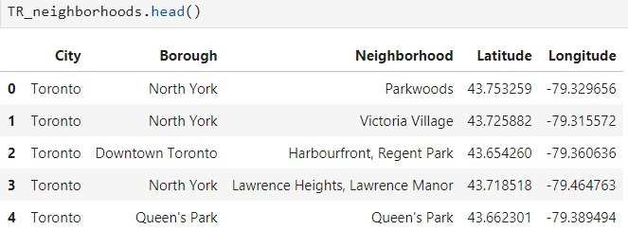
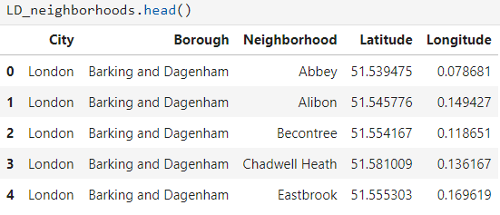
Data
I will retrieve data about all the three cities
Then join it to make a single dataframe
My data will consist of the city name, boroughs, neighborhoods and coordinates of the neighborhoods

Slide 4
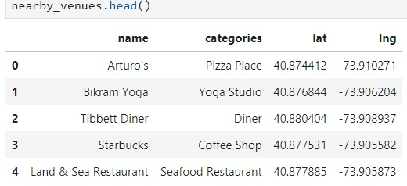
Also, I will use the Foursquare API to explore neighborhoods in the cities. I will use the explore function to get the most common venue categories in each neighborhood, and then use this feature to group the neighborhoods into clusters
In each element of the json file we get the data needed for our work:
Names of the venues
Categories
Now we are ready to join it to our neighborhoods data and sent it for clustering

Slide 5
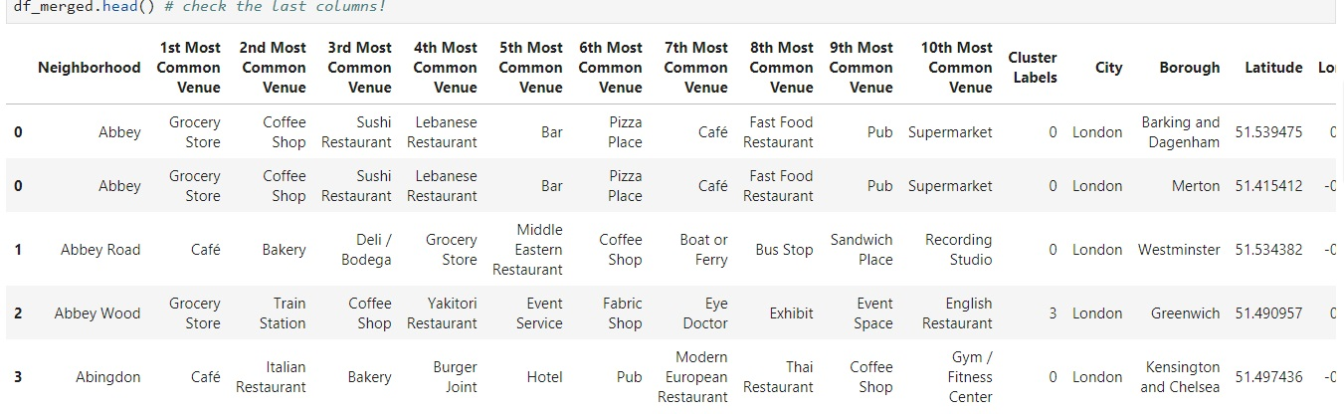
Methodology
In methodology section we use a machine learning technique called k-means clustering
Using k-means clustering we get a list of clusters as a result and join it to the neighborhood data

Slide 6
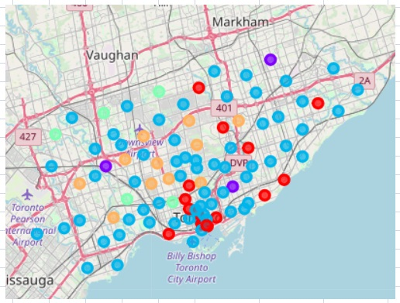
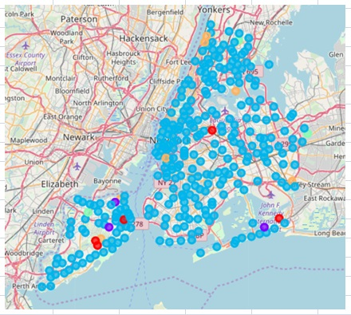
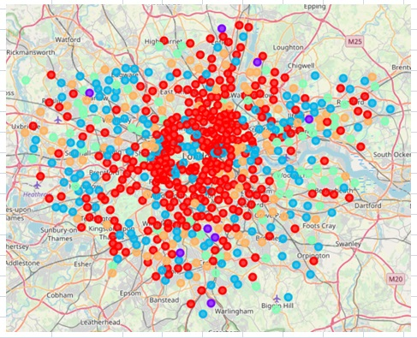
Results
As we can see, New York city is mostly composed of cluster 2 (in blue)
Although, we have plenty of cluster 2 in both London and Toronto, in Toronto cluster 2 seems to comprise major portion of neighborhoods in the city
We will use Folium library to visualize the clusters of neighborhoods illustrated on the city maps

Slide 7
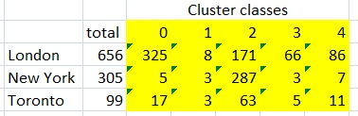
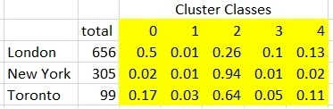
Results
Let’s look at the distribution of all the clusters in the cities
Indeed, 287 neighborhoods out of 305 in New York fall into cluster 2. Let’s get the percentages

Slide 8
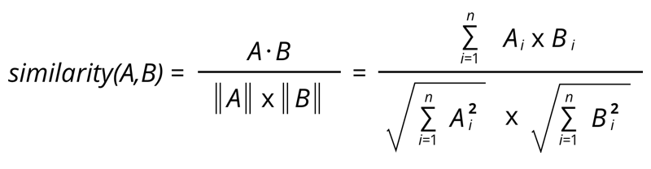
Results
Using the Cosine similarity test we find out the closeness of the cities to each other
This formula of cosine similarity divides the scalar product of to vectors by the product of the magnitudes of the vectors
Here, components of the vectors are the clusters of each city
Values range between 0 and 1, where 0 is perfectly dissimilar and 1 is perfectly similar.

Slide 9
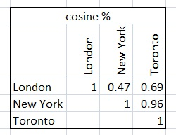
Results
As a result of the Cosine similarity test we can see how cities’ stuctures are close to each other
Recall that New York was all blue, and blues were in Toronto than in London

Slide 10
Conclusion
Findings were decided to be precise and close to the reality as New York and Toronto are cities composed of 100% of immigrants and have history of few centuries only, their inhabitants would have similar interests.
That is affirmed by the Cosine similarity result which is 0.960.96.
While Cosine similarities between London and New York are 0.470.47
According to the findings, if anyone wants to move from New York to London or Toronto, he or she must opt for Toronto as it is very much alike to his or her city with respect to its famous places

