Slide 1
WALMART / CONVERSION AND THE NORTH FACE E-COMMERCE PROJECT
Serdar CEKINMEZ
serdarcekinmez@gmail.com
https://github.com/serdarcekinmez

Slide 2
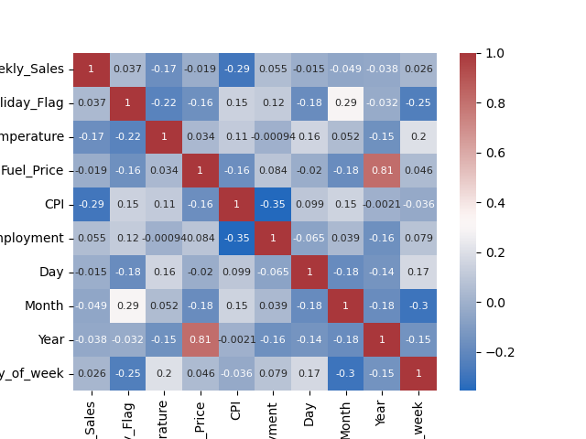
WALMART PROJECT
Creating new columns like day of the week.
Cleaning the dataset:
Converting Datetime Values
We will work with the following columns:
0 Date
1 Weekly_Sales
2 Holiday_Flag
3 Temperature
4 Fuel_Price
5 CPI
6 Unemployment
7 Day
8 Month
9 Year
10 day_of_week

Slide 3
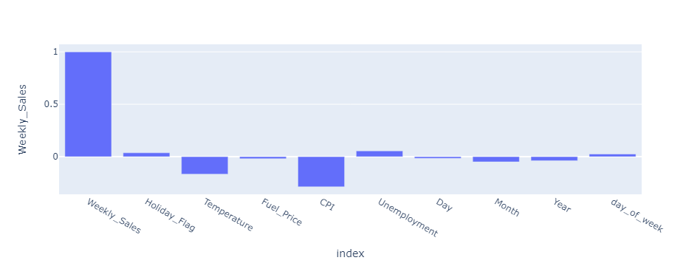
Correlations with Weekly Sales
Correlation of the other columns with our target : Weekly Sales

Slide 4
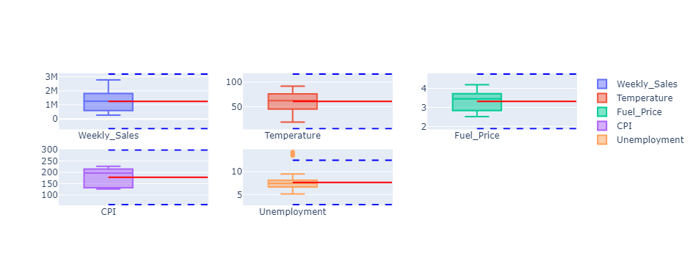
Walmart Outliers
this graphic gives us insights about outliers to be removed (such as in the Unemployment line)
outliers are mean +/- *3std

Slide 5
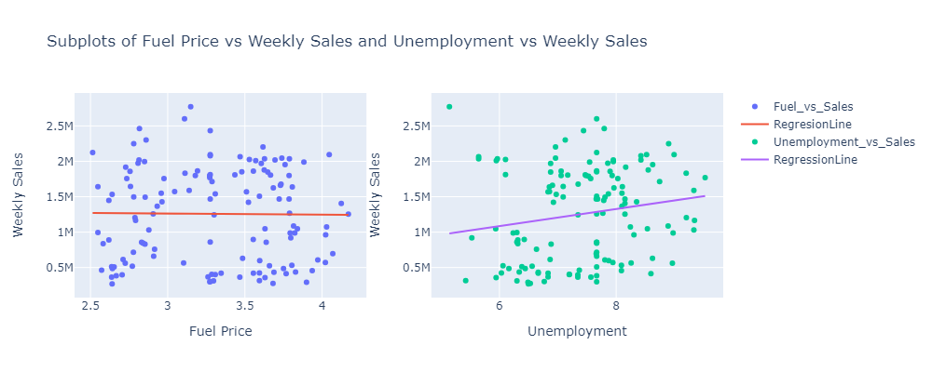
FUEL AND UNEMPLOYMENT VS WEEKLY SALES

Slide 6
Brievly EDA
Temperature, CPI, Fuel_Price are normalized with a mean of winter and Summer:
Winter from October to March
Summer from April - September
Holiday Flag is normalized with Nan values = 0 , because as far as my researches the Walmarts were not closed those days. But I noted just before Mothers’ Day, 8 May , Black Friday and a few important days are coincided.

Slide 7
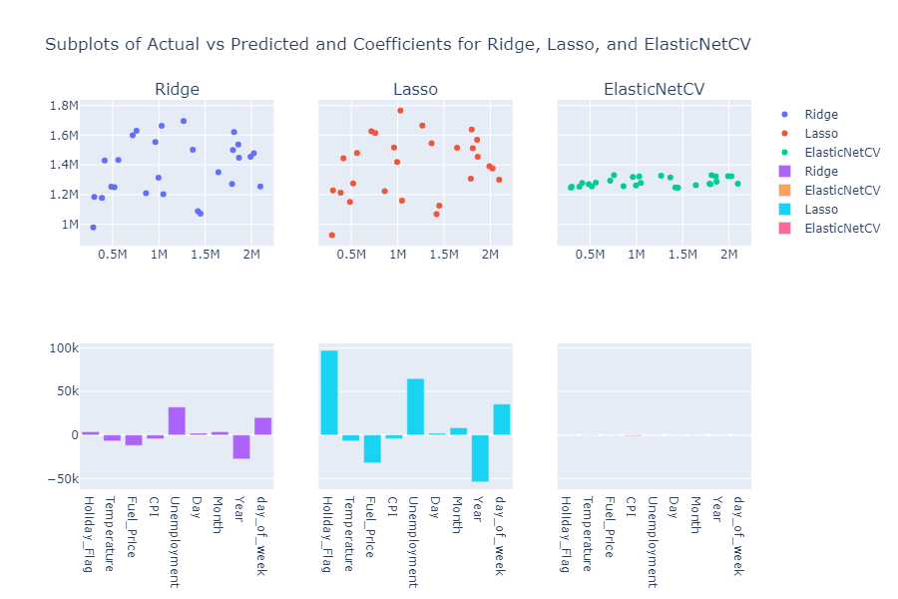
Plots for Predictions and Coefficients

Slide 8
ElasticNet is the best Regulator vs Ridge and Lasso
Lasso Model:
Mean Squared Error: 372319533307.2878
Root Mean Squared Error: 610179.9188004205
R-squared: -0.07183879579651786
Ridge Model:
Mean Squared Error: 372685810172.0375
Root Mean Squared Error: 610479.9834327392
R-squared: -0.07289323887167454
ElasticNetCV Model:
Mean Squared Error: 347323134287.34247
Root Mean Squared Error: 589341.2714949993
R-squared: 0.00012119509301466991
But the model needs to be improved
Lately , we will take only the columns :
'CPI', 'Unemployment', 'Month', 'Temperature'
and this will return the best predictions.
Below Graphic : Elasticnet actual coefficients.
Following Graphic : Final Predictions

Slide 9
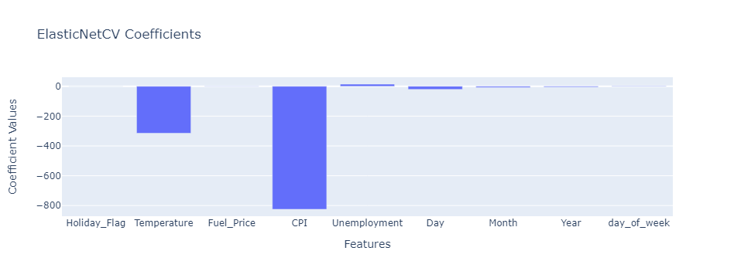
Elasticnet Coefficient

Slide 10
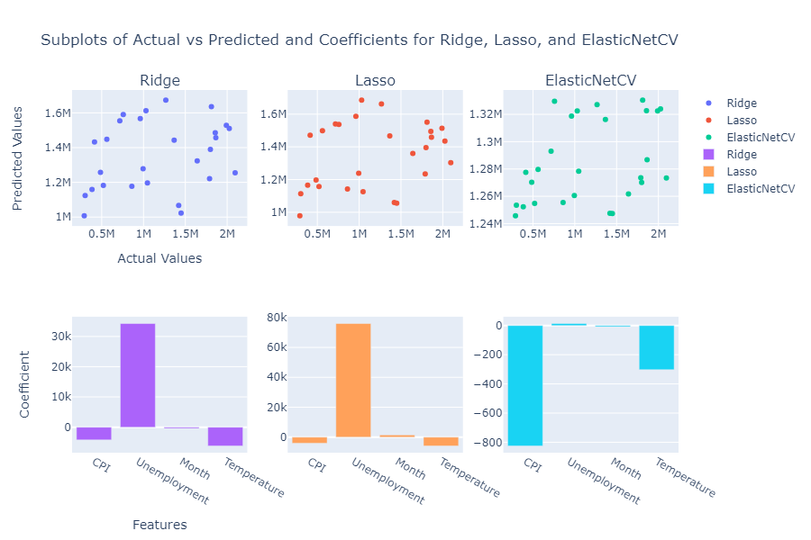
FINAL PREDICTIONS AND COEFFICIENTS

Slide 11
Conclusion
Conclusion: The CPI (Consumer Price Index) value appears to be the most influential factor. When considering only the CPI value, the R-squared value is 0.0037, but it does not show a significant increase. The other parameters, whether included or not, result in an R-squared value of around 0.00018. Due to the small number of rows in the dataset, the model's efficiency is limited. It performs well for values near the mean but struggles to accurately predict very high or very low values. In the coefficient graphics, we observe that CPI and Temperature have negative effects. The negative effect of Temperature is also confirmed by Ridge and Lasso methods. On the other hand, Ridge and Lasso predict a positive coefficient for the unemployment rate.
ElasticNetCV Model with Best Parameters:
Mean Squared Error: 347301130801.0758
Root Mean Squared Error: 589322.6033346046
R-squared: 0.00018453904387827347
Best parameters for Ridge: {'alpha': 100}
Best parameters for Lasso: {'alpha': 100}
Coefficients for Ridge:
[-4211.21753598 34293.00631652 -377.57192154 -6192.43450034]
Coefficients for Lasso:
[-4010.57433843 75978.34345006 1423.32192505 -5847.65439926]
Coefficients for ElasticNetCV:
[-825.07527468 14.2627622 -7.19953058 -302.5614322 ]

Slide 12
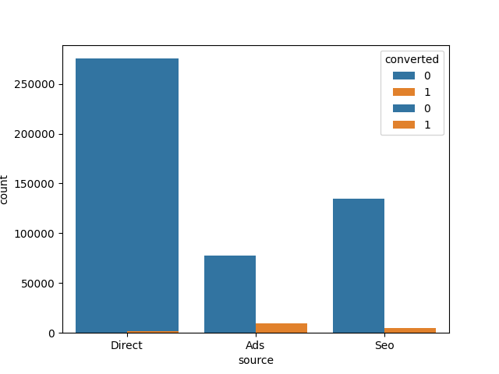
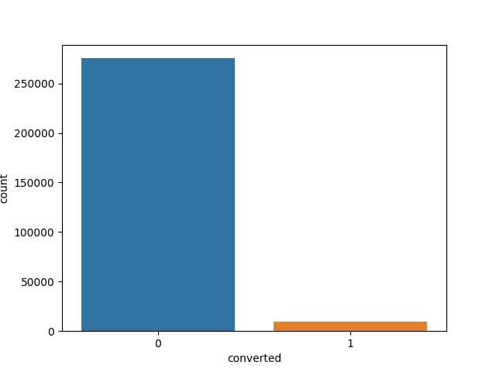
Conversion Rate Project by Serdar CEKINMEZ
Predict if users will subscribe
Conversion rate is highly small. Thus it will be challenging to make predictions.

Slide 13
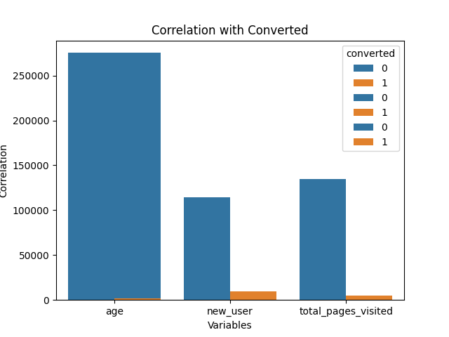
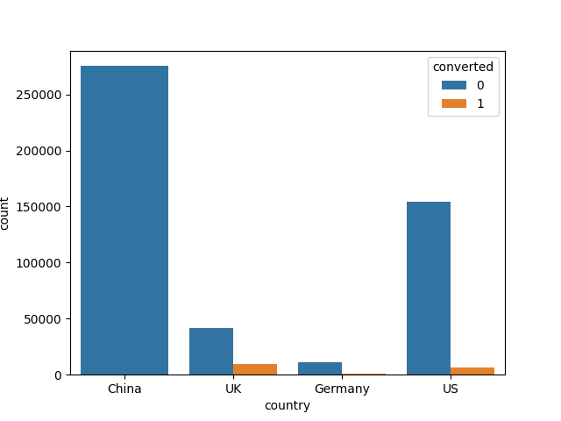
Conversion rate is a relatively significant in new users. UK and US are the countries mostly conversion rated. Chinese converted customers are pretty few.

Slide 14
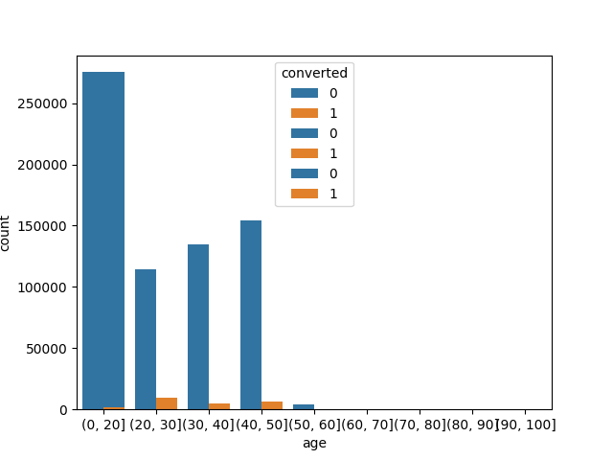
Zoom on the age parameter :

Slide 15
Best Predictions
Among the various models we experimented with, three of them displayed higher accuracy compared to others: RandomForest, LogisticRegression, and Gradient Boosting. I evaluated the models based on their F1 scores, and after careful consideration, I have selected Logistic Regression as the preferred model.
Best parameters found: {'C': 1.0}
Highest F1 score found: 0.7661084501403798
model f1_train f1_test
0 Logistic Regression 0.766432 0.758671
1 Random Forest 0.807847 0.733954
2 Gradient Boosting 0.765245 0.753044

Slide 16
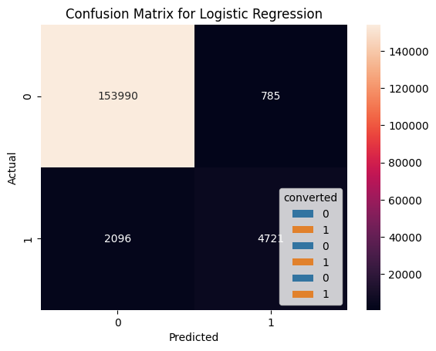
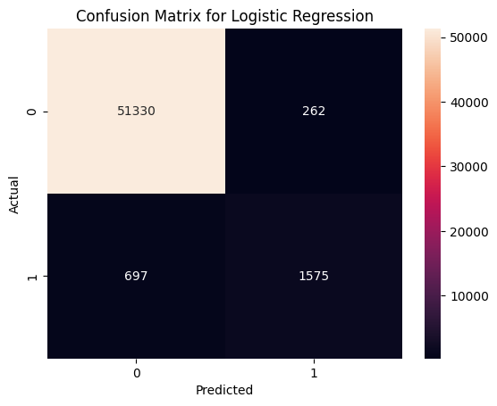
Confusion Matrix / Logistic Regression / Train & Test

Slide 17
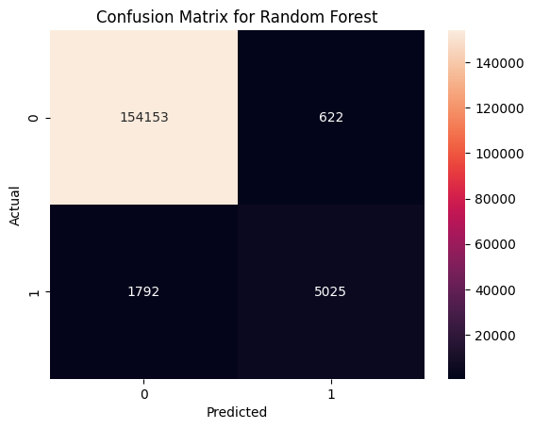
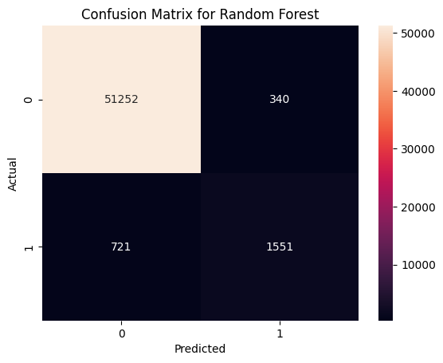
Confusion Matrix / Random Forest / Train & Test

Slide 18


Confusion Matrix / Gradient Boosting / Train & Test

Slide 19
Conclusion:
Our model predicts certitude of %76 if user will be adhered to the newsletter of www.datascienceweekly.org . Thanks to LogisticRegression Model. An output of predictions is ready as file : conversion_data_test_predictions_SERDAR_model_3.csv

Slide 20
The North Face Recommandation Project - by Serdar CEKINMEZ
In this section , I developed a recommendation system, that detects the similar products on NorthFace E-commerce- website.
Main goals are to find out word clusters with DBScan and visualise them by wordcloud, then a similar product detection program, and finally present Topic clusters by wordcloud.
Here they are

Slide 21
Sparse Matrix and DBScan Clusters on wordcloud
[ 0 -1 -1 1 1 1 1 2 1 -1 1 1 -1 1 1 1 -1 0 0 0 0 0 0 0
0 1 1 1 1 1 1 1 1 1 1 1 1 1 1 1 1 1 1 1 1 1 1 3
-1 1 1 1 1 -1 1 1 0 1 1 0 0 1 1 1 1 1 1 1 3 1 1 1
1 -1 4 1 4 1 5 5 5 0 1 1 1 1 6 6 6 6 1 1 1 1 1 1
1 1 -1 1 1 1 1 1 0 0 1 1 1 1 -1 -1 7 7 1 1 1 1 1 1
1 1 -1 1 1 1 1 1 1 -1 1 1 -1 -1 -1 7 -1 1 1 -1 1 -1 1 1
-1 1 1 5 8 9 1 1 9 9 -1 -1 1 -1 1 1 1 1 -1 -1 10 1 1 1
1 1 0 0 0 0 0 0 1 1 1 1 1 1 -1 1 1 1 1 1 1 1 1 12
-1 12 4 1 1 1 1 6 6 6 6 1 -1 -1 1 1 1 1 0 1 1 1 11 1
1 1 2 2 2 2 1 1 1 4 1 1 1 1 11 1 -1 1 1 1 1 3 1 2
2 2 2 -1 1 11 11 1 1 1 1 2 -1 2 2 1 1 -1 1 6 2 2 0 0
6 6 1 1 6 6 -1 -1 -1 1 1 1 0 -1 1 1 1 1 1 1 1 1 1 1
1 -1 2 -1 1 1 -1 1 1 1 -1 -1 -1 1 1 -1 1 1 1 1 1 1 1 1
12 12 1 10 10 10 3 -1 1 1 1 1 1 1 1 1 1 1 1 3 1 1 1 1
1 5 5 0 0 1 1 8 1 1 1 1 1 1 1 1 1 1 9 1 1 1 0 0
4 1 1 1 1 1 9 1 1 1 3 1 1 1 -1 1 1 0 1 0 0 1 5 1
5 1 1 1 1 1 1 1 1 1 1 3 1 7 1 -1 1 1 1 1 1 6 6 1
1 -1 1 1 0 1 1 1 -1 4 1 7 1 -1 1 1 -1 -1 1 1 -1 1 1 1
1 -1 -1 1 1 1 1 0 0 0 0 1 1 0 1 1 8 1 1 1 1 1 9 1
5 1 1 1 1 1 1 1 1 1 1 9 1 1 1 1 1 1 1 1 1 1 8 1
1 1 1 1 1 1 0 0 1 3 1 1 1 0 0 0 0 1 1 1]
Cluster 0: 44 products
Cluster -1: 55 products
Cluster 1: 320 products
Cluster 2: 15 products
Cluster 3: 8 products
Cluster 4: 6 products
Cluster 5: 9 products
Cluster 6: 15 products
Cluster 7: 5 products
Cluster 8: 4 products
Cluster 9: 7 products
Cluster 10: 4 products
Cluster 12: 4 products
Cluster 11: 4 products
Sparse Matrix and Clusters. See the 11 clusters by wordcloud subplots below:

Slide 22
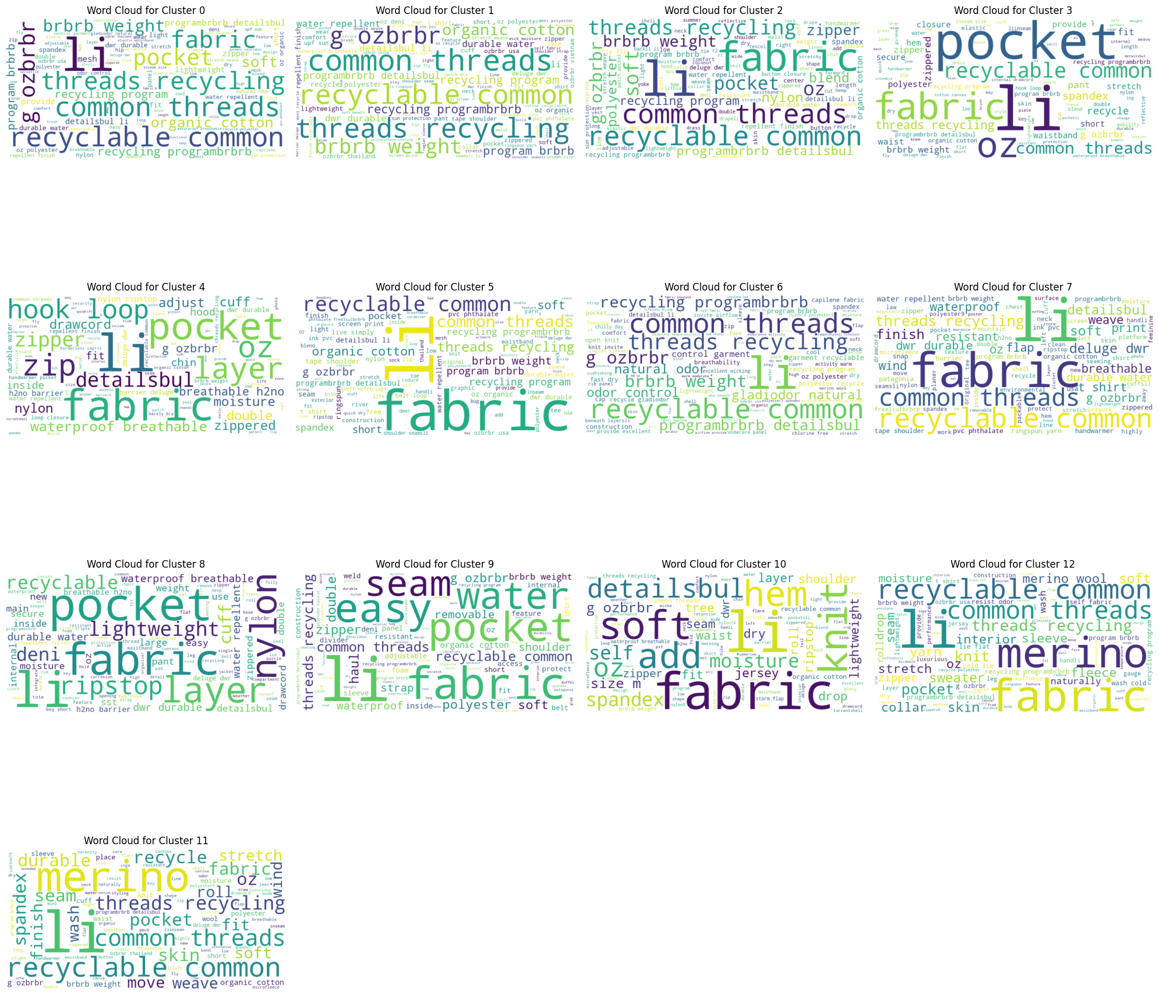

Slide 23
This time, I performed lemmatization on the dataset. The dataset was only cleaned by removing special characters and potentially some extra spaces. Additionally, I lemmatized certain words such as 's, 've, 'll, will, 're for data cleaning purposes. This cleaning method was applied to both the product names and product descriptions.
After vectorization, we obtained a sparse matrix with slightly over 4935 words. We utilized the DBScan clustering algorithm with cosine distance as the metric. A cosine distance of 1 indicates identical vectors, 0 represents no link, and -1 signifies opposite vectors.
The given code segment finds similar items to a given item within a dataset. It first retrieves the product name of the given item based on its ID, then it finds all items in the dataset that share the same product name, under the assumption that items with the same name are considered similar (clusters).
Once the user input his choice “Id_number” - 1 ,2,3,4,..., 10…’ etc… - similar product detections begins: It is designed to perform topic modeling on the cleaned product descriptions in the dataset using the TruncatedSVD (Singular Value Decomposition) method, which is a dimensionality reduction technique often used in natural language processing. The descriptions are transformed into a matrix of 20 topics, and each description is then assigned a main topic based on the highest corresponding topic weight. Finally, the code generates word clouds to visualize the top words (n_top_words = 10 / 10 most popular for each cluster ) for each of the 20 topics, giving a clearer insight into the dominant themes in the product descriptions. Here are the Topic clusters . For this example I choosed 10th item:

Slide 24
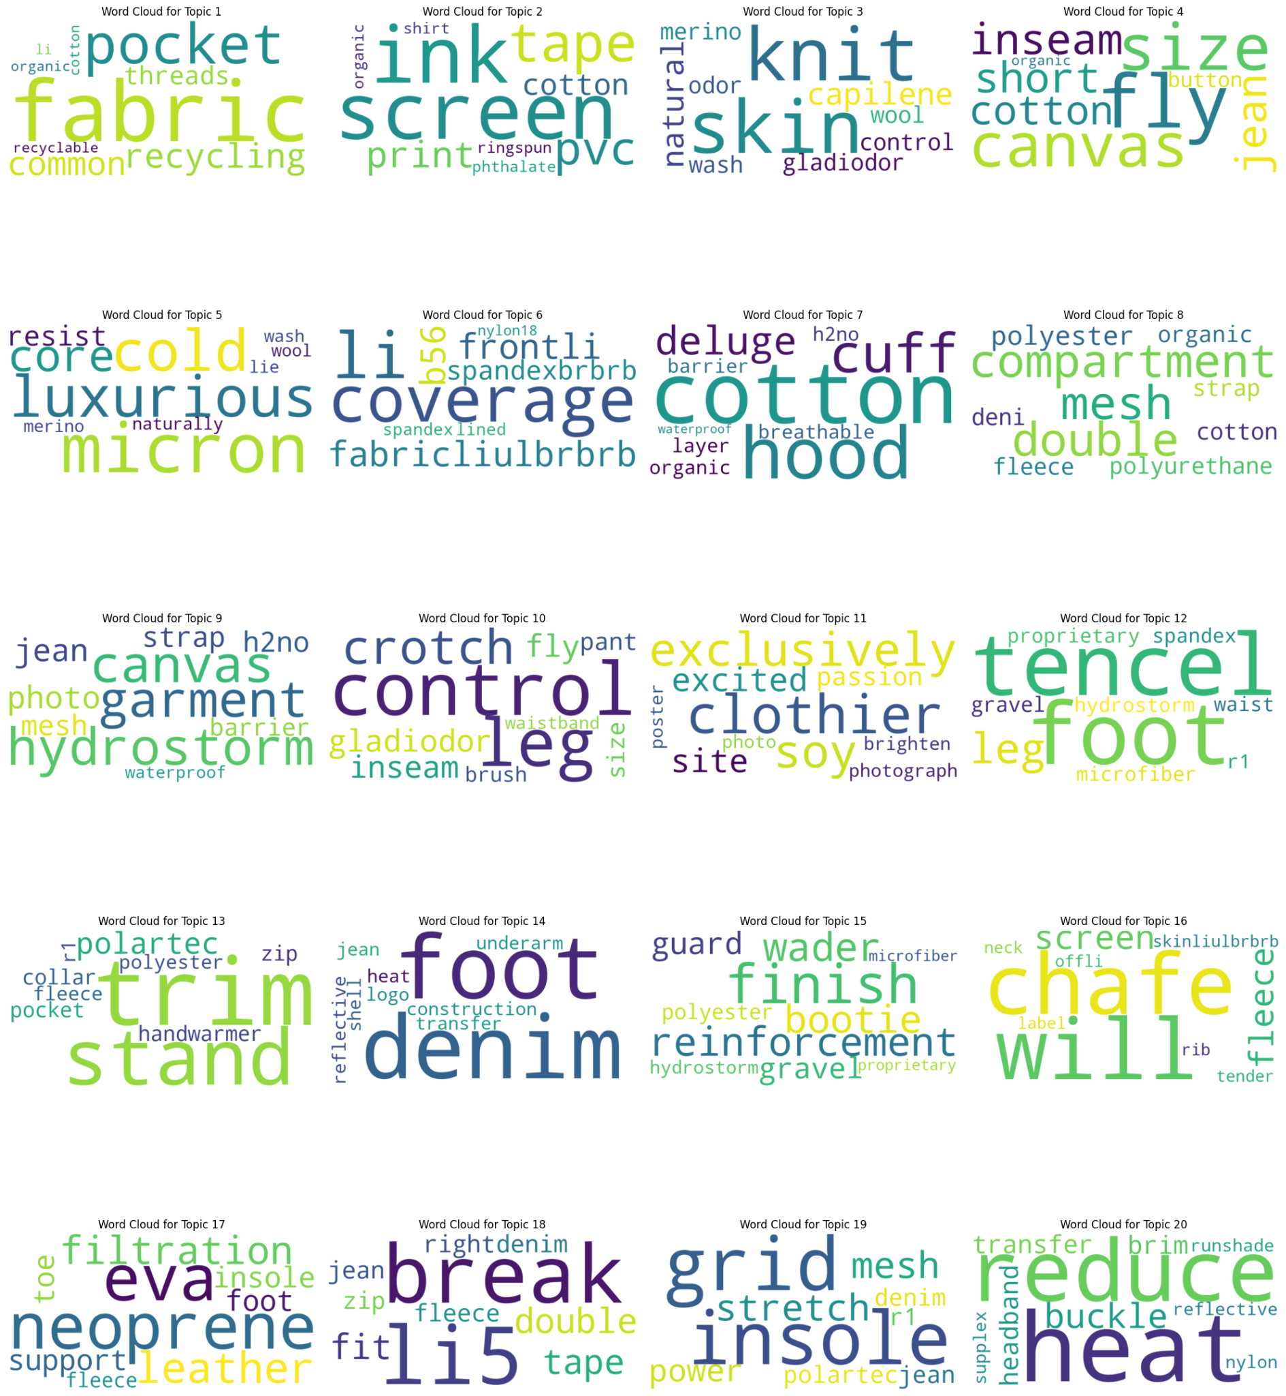

Slide 25
TruncatedSVD Model Outputs
You may also be interested in these products: Product ID: 13, Product Name: Beach bucket Product ID: 425, Product Name: Trim brim hat Product ID: 135, Product Name: Surf brim Product ID: 10, Product Name: Baby sun bucket hat Product ID: 466, Product Name: Baby baggies shorts
0 270 7 14 16 5
1 54 6 9 4 5
2 38 10 8 13 2
3 23 11 7 8 1
5 22 14 7
12 15 15 6
19 14 Name: class_pred, dtype: int64 topic_1 270 class_pred 230 Name: main_topic, dtype: int64
the 17th product we have chosen was Baby baggies . You can find the similar products suggested by recommandation system.

