Slide 1
KAYAK PROJECT
By Serdar CEKINMEZ
serdarcekinmez@gmail.com
https://github.com/serdarcekinmez/

Slide 2
Code Architecture
AWS
BUCKET
Fetching Information
Frenchhotels.csv
French Maps
Location
Weather
Creer SQL
5
Best
city
with
weather
20
Best
hotels
with
overall
stars
Hotels
french_hotels.db
10
Best hotels
in clear sky weather condition
with best overall stars
and
highest temperatures

Slide 3
Fetching
Taking the best cities information
Getting the location information City name/ Lat / Long
Getting the weather information Weather= Clear / Cloudy / Rainy and temperatures
Getting the hotel informations in the indicated cities
Creating a csv file

Slide 4
Sources for fetching
One Week In.com
https://nominatim.org/release-docs/develop/api/Search/
https://openweathermap.org/appid
https://hotels-com-provider.p.rapidapi.com
Once the informations are taken they are cumulated in a csv file with the following information. I choosed only the available hotels are stated in the dataframe ‘frenchhotels.csv. These dataframe includes :
city,lat, lon,hotel['id'],overall_rank,availability,temperature, weather, name , tag .

Slide 5
Converting sql file
As the size of the dataset is relatively small, it was the fastest method to convert them sql databases by sqlite3 .
Once it is converted to a sql fle , I made a test query :
query = "SELECT * FROM french_hotels WHERE temperature > 29 AND overall_rank > 8.5"
The best hotels over 29 Celcius : city lat lon weather temperature
0 Bormes les Mimosas 43.150697 6.341928 clear sky 29.86
1 Bormes les Mimosas 43.150697 6.341928 clear sky 29.86
2 Bormes les Mimosas 43.150697 6.341928 clear sky 29.86
3 Bormes les Mimosas 43.150697 6.341928 clear sky 29.86
4 Aix en Provence 43.529842 5.447474 broken clouds 29.55
5 Aix en Provence 43.529842 5.447474 broken clouds 29.55

Slide 6
Storing in S3 Bucket
the csv file is uploaded by jupyter notebook with a boto3 code:
https://frenchhotels.s3.eu-west-3.amazonaws.com/frenchhotels.csv
sql data base file is uploaded directly on the frenchhotel s3 bucket:
https://frenchhotels.s3.eu-west-3.amazonaws.com/french_hotels.db

Slide 7
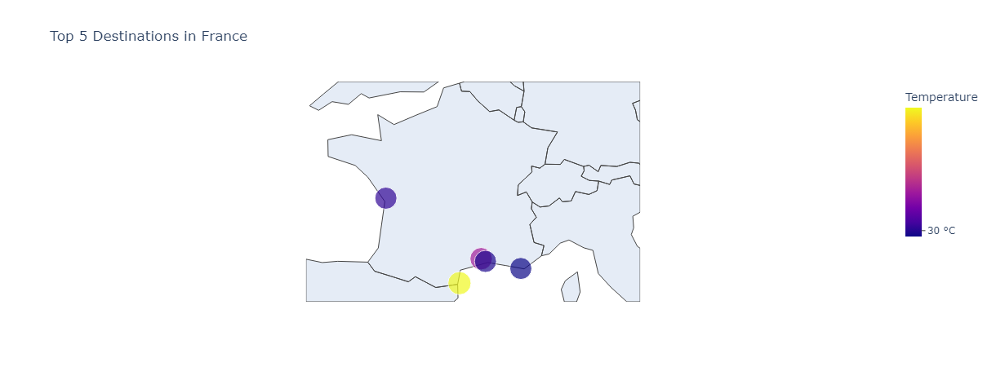
FRENCH MAPS
This is the top 5 cities map in the order of weather temperature conditions

Slide 8
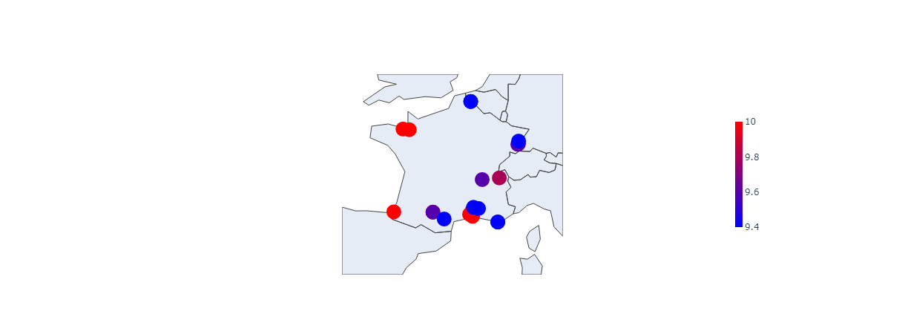
French Best Hotel
This is the Best 20 Available French Hotels with their Overall Scores

Slide 9
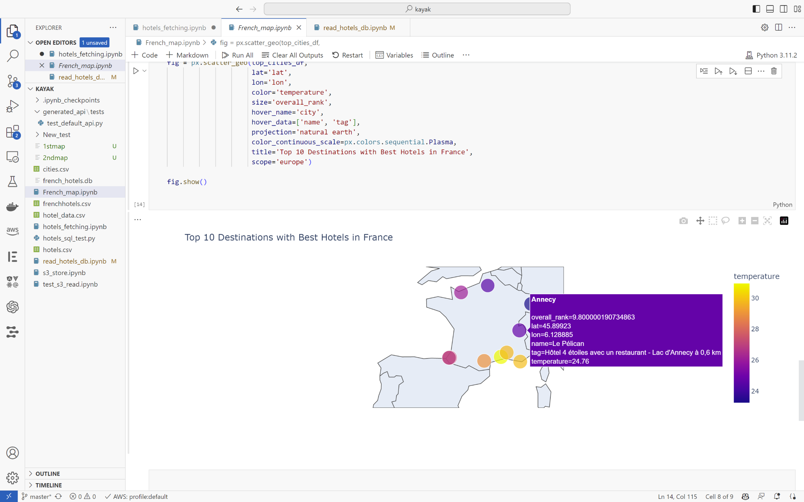
Best Hotels in Best Holiday Locations
This map returns the 10 best available hotels in 10 different cities to give the most choice to the user. All hotels are chosen in “available” and “clear sky” conditions. Then sorted with best temperature and highest over-all scores of the hotels. The hotel name and a small description of hotel is included for users rapid and practical use.

Slide 10
Thank you for your listening
https://github.com/serdarcekinmez/

