Slide 1
Jedha Speed Dating Data Analysis Project
Presented by Serdar CEKINMEZ
serdarcekinmez@gmail.com
Please refer to the following code for more details :
https://github.com/serdarcekinmez/speed_dating_project

Slide 2
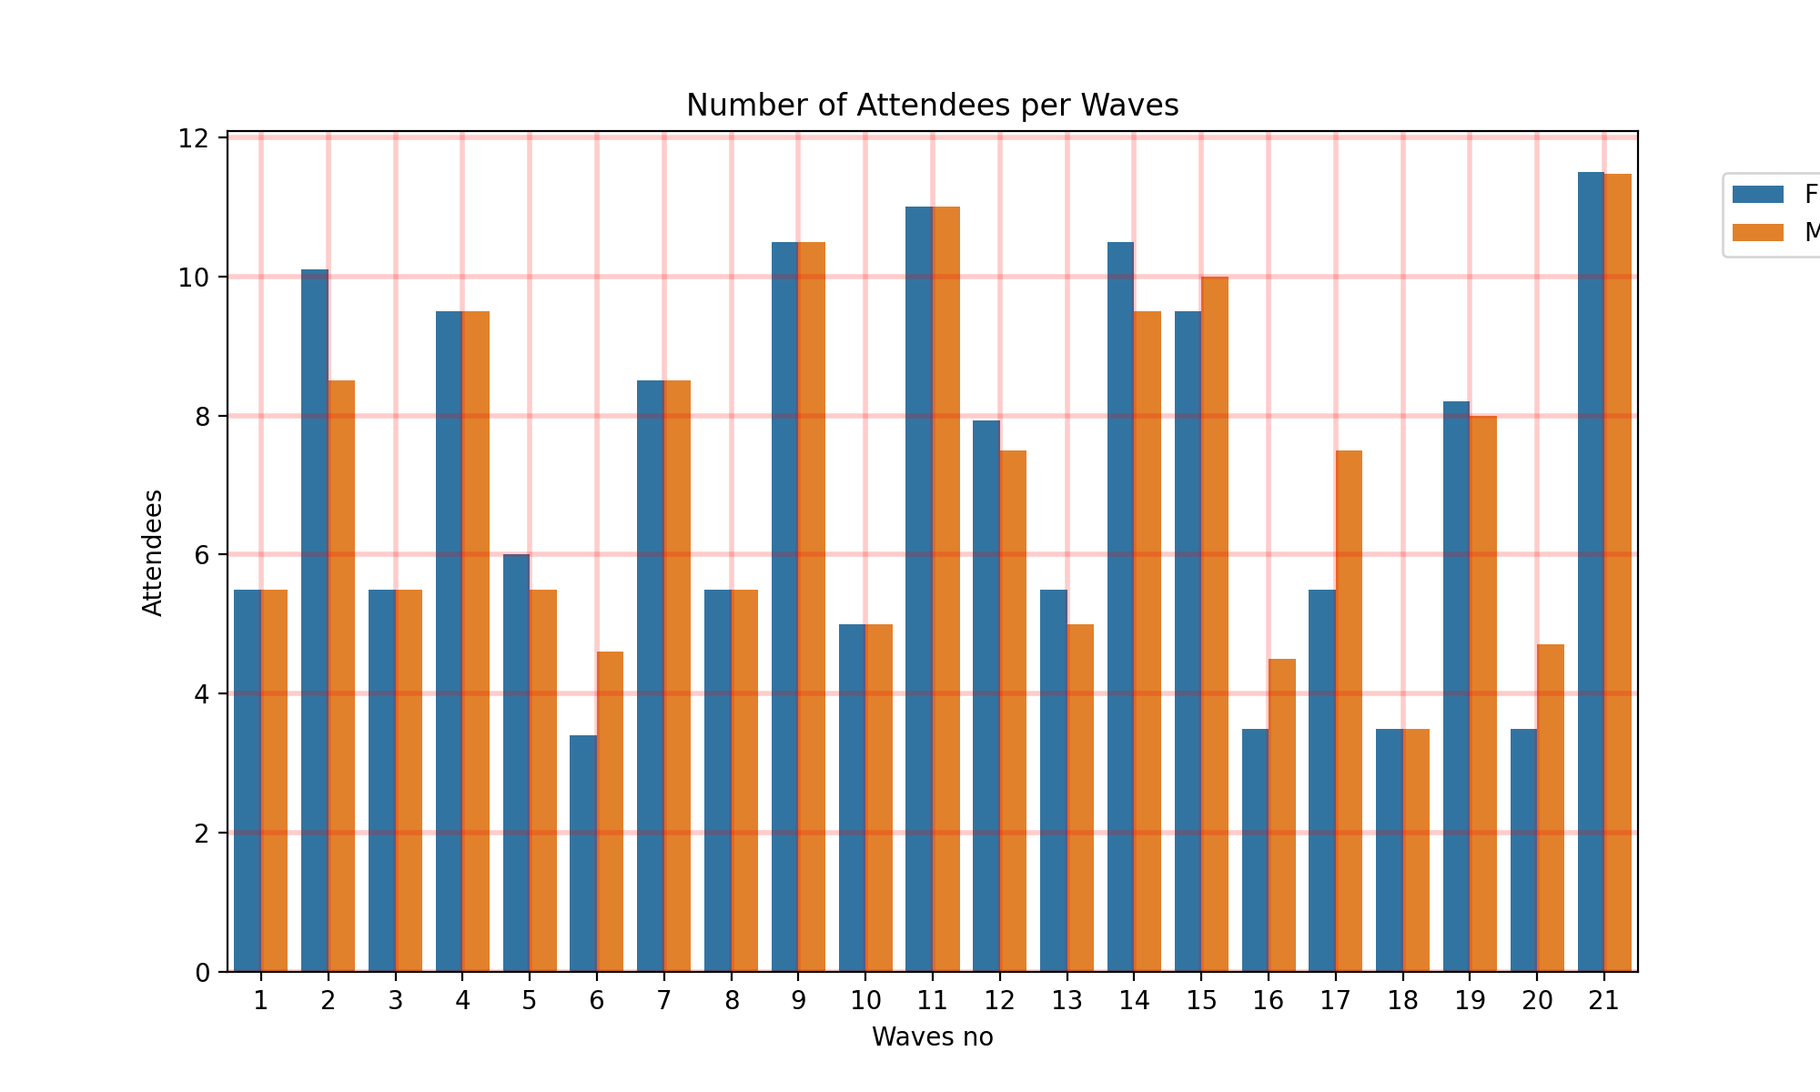
A Global Look at the Attendees of Speed Dating per Wave
We can observe that there is an equal number of female and male attendees per wave. However, some waves have a smaller number of participants overall. In the next pages, we will delve deeper into the analysis.

Slide 3
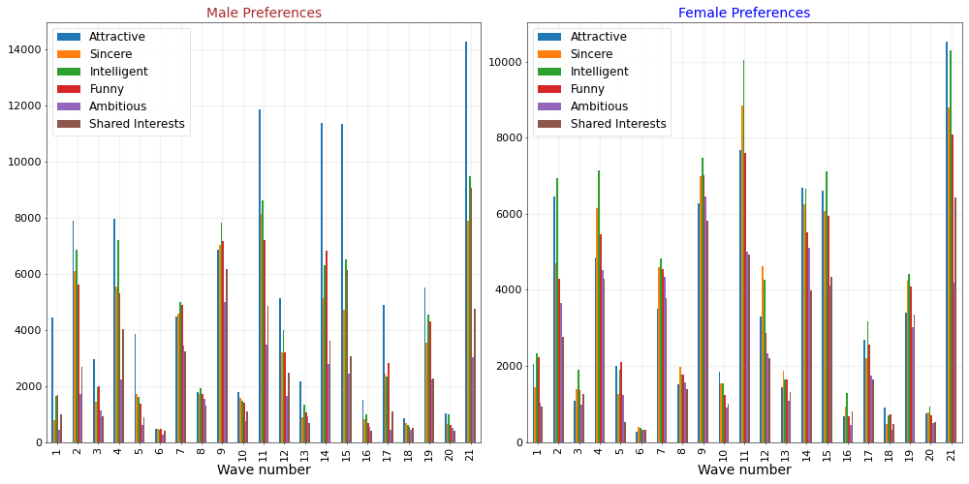
Attribute Preferences per Wave
Notes:
Male preferences is attractiveness. Female opinions are shared between Intelligence and Attractivity. We will deepen this analysis in the next slight as it returns a more global insight.

Slide 4
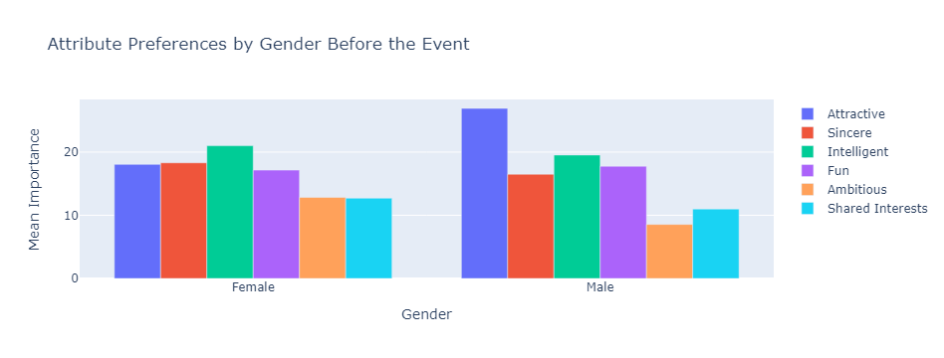
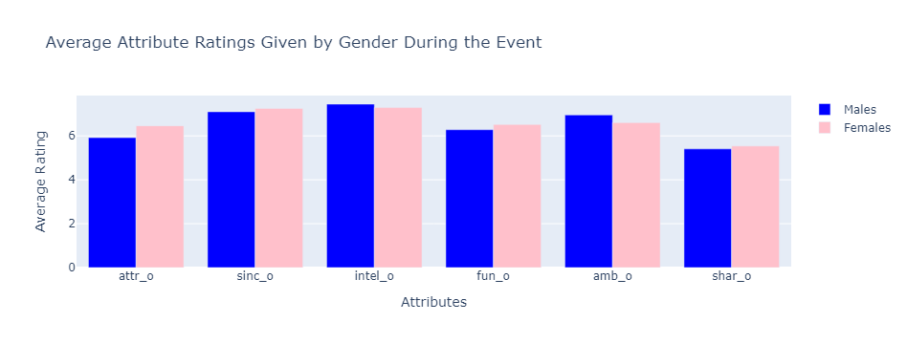
The Most Desirable Attributes Global View :
Before the event, "Attractiveness" is the most popular attribute among male candidates, while for female candidates, "Intelligence" is the most popular attribute, followed by "Sincerity" and "Sense of humor".
However, during the event, the importance of attractiveness diminishes for both male and female participants, and attributes such as “Intelligence”,"Sincerity," "Ambition," and "Sense of humor" become more favored.

Slide 5
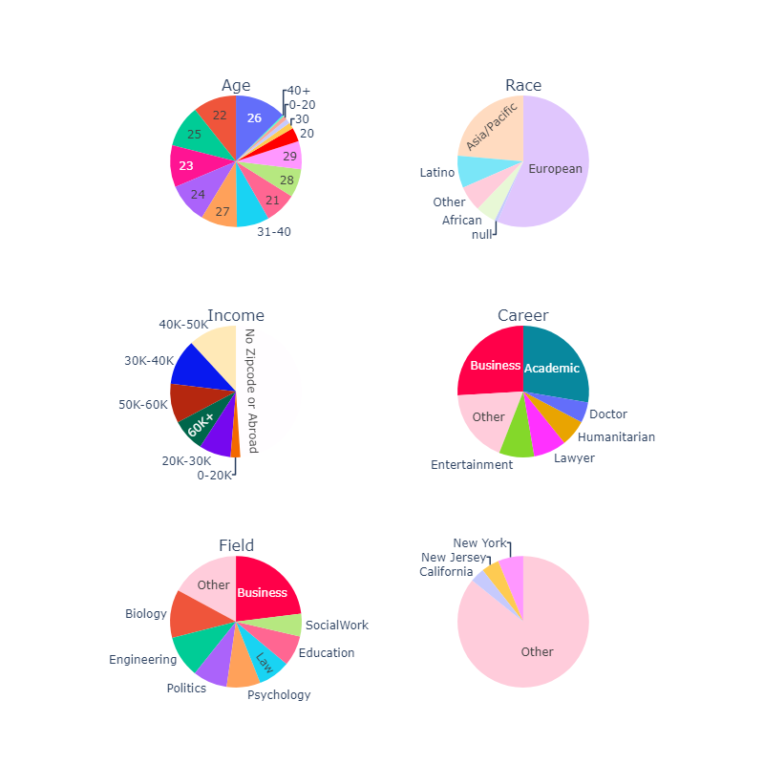
Attendees Profiles
Grafics : Age- Race - Income- Career - Field - Locations
The majority of participants in speed dating events are in their 20s. A typical participant is in their 20s and is either an academician or a businessman. They predominantly originated from European and Asia-Pacific regions. Their wage range is mostly between 30k-60k, and fields such as business, biology, engineering, politics, and psychology are dominant among them.
While participants primarily come from cities like New York, New Jersey, and California, overall, people from all over the globe are interested in speed dating events.

Slide 6
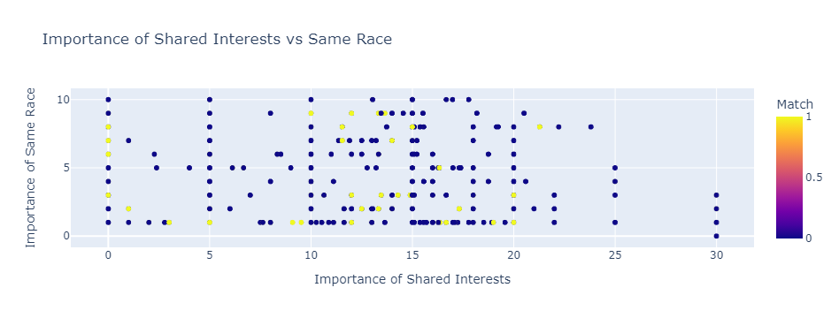
Sharing Interest or the Same Race ?
At the beginning being in the same race may some importance but gradually sharing interests become more conclusive for matching

Slide 7
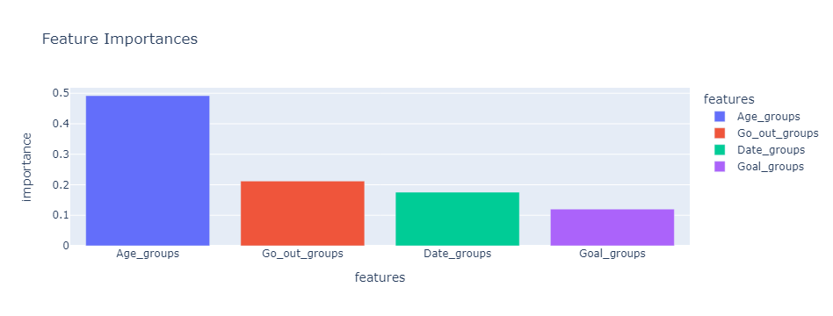
When we group participants based on age, it appears to be the most influential factor in determining matches.
However, there is also a noteworthy correlation between individuals who frequently go out or actively engage in dating and their likelihood of finding a match. While this factor may have less significance compared to age, those who regularly socialize and date are more likely to find a compatible partner.

Slide 8
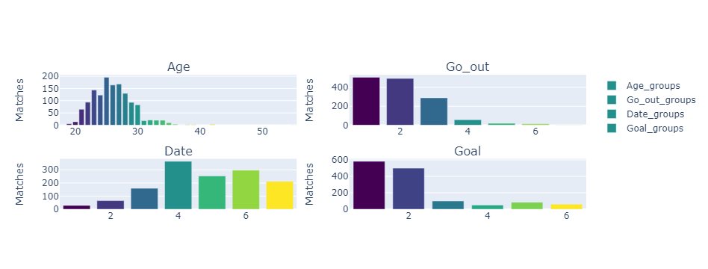
We can clearly observe that individuals in their 20s, specifically around the ages of 25, 26, and 27, have a higher likelihood of achieving a match. Furthermore, attendees who frequently go out and engage in multiple dates per week are more likely to find a match. Interestingly, those who date less frequently, ranging from twice a month to several times a year, have a higher probability of achieving a match. This suggests that the speed dating event provided an opportunity for them to meet potential partners.
Additionally, while regular daters were more selective in their choices, attendees who viewed the event as a fun night out and came with the intention of meeting new people had a greater chance of achieving a match.

Slide 9
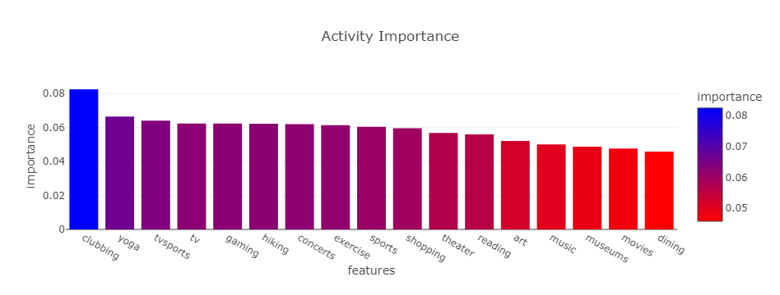
Which activity is most likely to result in a match?

Slide 10
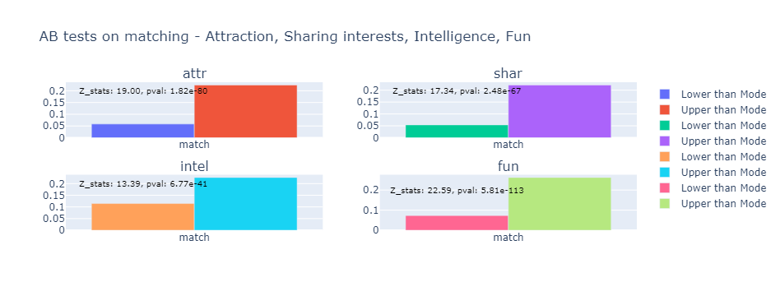
When an attribute increases, do attendees have a higher chance of matching?
Attendees who are more attractive, funny, and share common interests are more likely to find a match. Similarly, being more intelligent can contribute to the likelihood of a match, although this factor is relatively less significant. While intelligence is important, it does not necessarily require a high level. (Regarding the P_values / Z_stats - Matches compared the mostly noted - - mode)

Slide 11
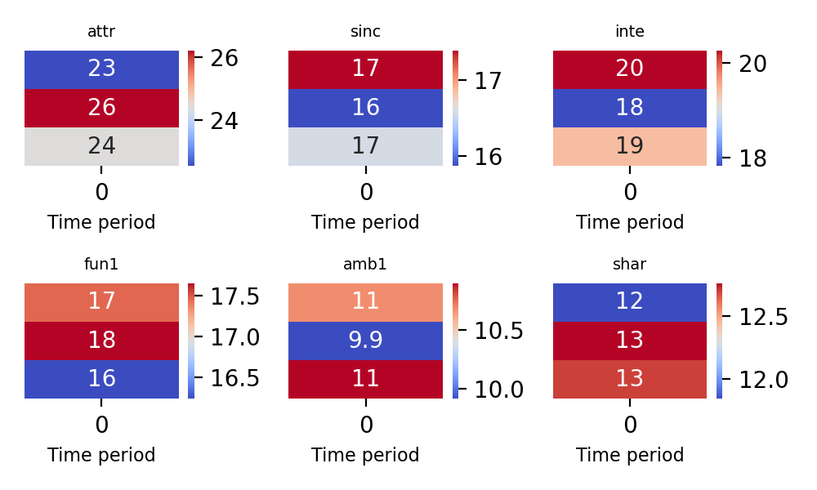
In a global view, the importance of attractiveness decreased as the event progressed. On the other hand, intelligence and sense of humor (funny) gained more importance among the attendees.
How did attendees' preferences change during the event?

Slide 12
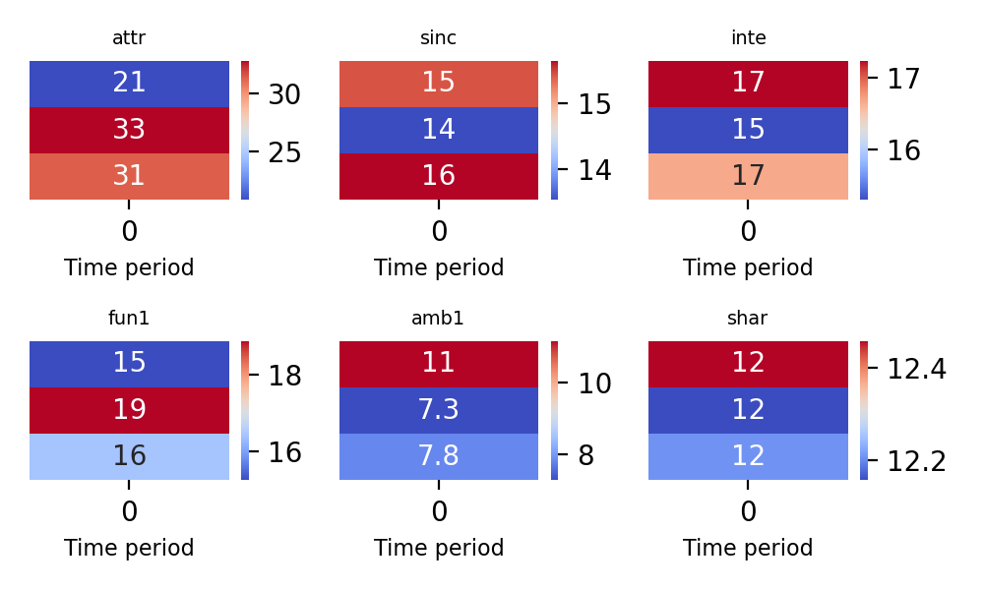
Initially, attendees believed that attractiveness would be the determining factor in concluding a date. However, as the event progressed, the significance of attractiveness decreased significantly in decision-making. Instead, attributes such as intelligence, a sense of humor (funny), and ambition played a more decisive role in forming connections and concluding matches. Shared interests, regardless of the level, maintained their relative importance throughout the event
The way best reflects actual decisions

Slide 13
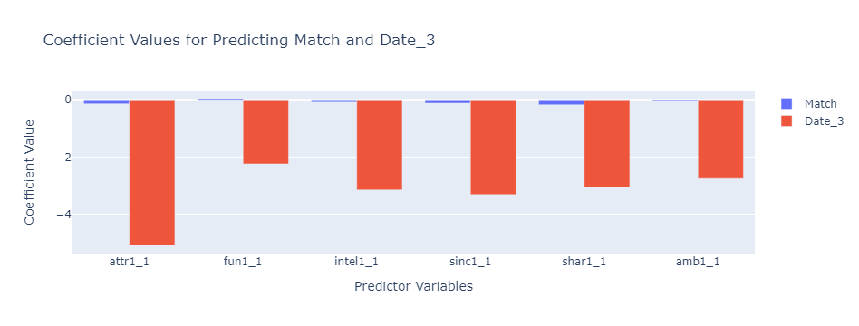
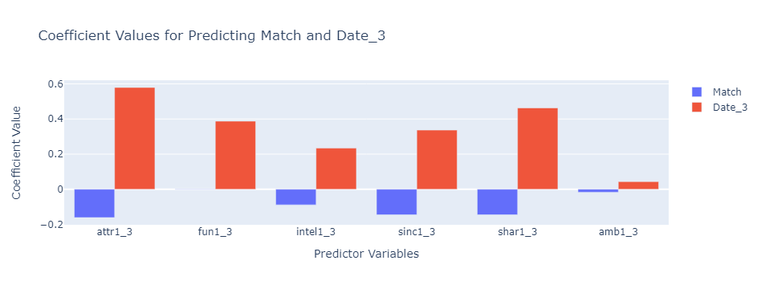
Beginning Values vs Latest Values
The change of perception of participants about partners indicates positive correlations on date. Positive correlations of participants who rate highly or perceive the others positively, are more likely to go on dates with their matches.

Slide 14
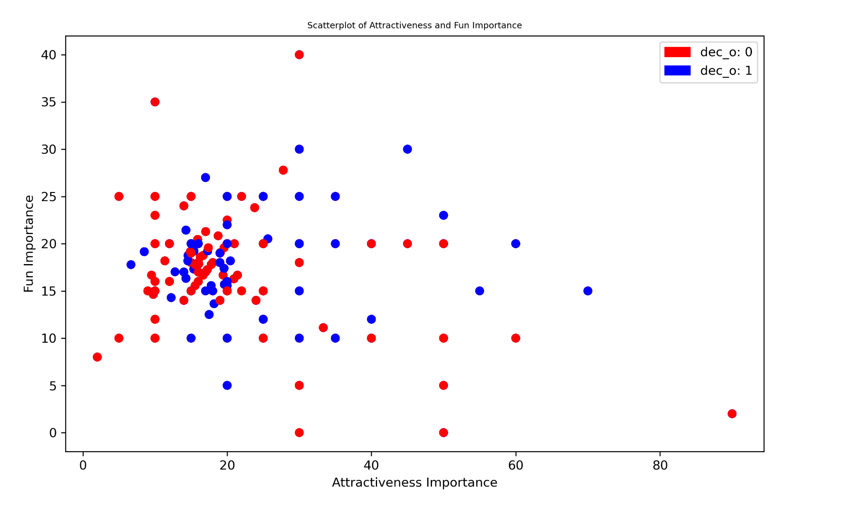
Attractive or Funny?
Wee see that the extreme points such as Very Attractive / Not Funny and Very Funny but not Attractive do not conclude a match.
But rather, mid-funny and mid-attractive profiles are more likely to to have positive decision

Slide 15
Thank you for your interest
https://github.com/serdarcekinmez

