Slide 1
CTG Machine Learning
The Millennium Development Goals

Slide 2
Our Team
Serdar Goler
modeling
Kacper Krzyskow
presentation
Piotr Sokol
data preparation
Teymur Mahmudov
problem identification

Slide 3
Child mortality rates
WHO Millennium goal was to Reduce child mortality rates
Death of a fetus or neonate is a major problems in the developing countries
2000
Establishment of the WHO Millennium goal to Reduce by two-thirds, between 1990 and 2015, the under-five mortality rate
2015
Failure in achieving previously stated goal by the deadlined
2021
By application of Machine Learning techniques, a group of Kozminski Students has developed a breakthrough model that allow detecting suspected and pathological changes during fetal CTG

Slide 4
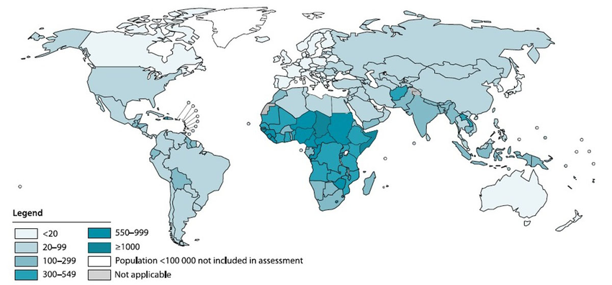
Problem Overview
Prevalence
Under 5 yrs old death age
47%
Neonatal
47% of deaths among children occurs within the first weeks of life – proper fetal examination, especially in developing countries may improve the mortality
5,600,000
Children deaths per year (most of therm is preventable)

Slide 5
Dataset - Cardiotocography data
Features are Different Scale
1 - Normal
2 - Suspect
3 – Pathological
Multiclass
Imbalanced
31 features
2160 observations
Normal – 78%
Suspect – 14%
Pathological – 8%
Multicollinearity
Lack of NAs
8 variables dropped (B, AC, FM, UC, DL, DS, DP, DR)

Slide 6
CTG - Cardiotocography
FHR Baseline
Accelerations
Decelerations
Variability
No. of standard heart beats per minutes.
A normal fetal heart rate is between 110-160 bpm.
Accelerations are an abrupt increase in the baseline fetal heart rate of greater than 15 bpm for greater than 15 seconds
Decelerations are an abrupt decrease in the baseline fetal heart rate of greater than 15 bpm for greater than 15 seconds
Variation of fetal heart rate from one beat to the next. Variability can be categorized as either reassuring, non-reassuring or abnormal
Notes:
is a technical method for recording (-graphy) the foetal heartbeat using ultrasound (cardio-) and the uterine contractions (-toco-) during pregnancy, typically in the third trimester.

Slide 7
Models used
Logistic Regression
Random Forest
Naïve Bayes
KNN
LDA
SVM Linear
QDA
SVM Radial
XGBOOST
Model Ensemble
Tree

Slide 8
Comparison of the Best Model Adaptation
Over-Sampling Under-Sampling Feature Scaling Tuning
Logistic Regression
KNN
LDA
QDA
Naïve Bayes
SVM Linear
SVM Radial
Tree
Random Forest
XGBOOST
Ensemble Learning

Slide 9
Performance
 | PRECISION |  |  | RECALL |  |  | F-SCORE |  |  | MACRO-AVG |  |  | WEIGHTED-AVG |  |  | ACCURACY
 | NORMAL | SUSPECT | PATHOLOGICAL | NORMAL | SUSPECT | PATHOLOGICAL | NORMAL | SUSPECT | PATHOLOGICAL | PRECISION | RECALL | F-SCORE | PRECISION | RECALL | F-SCORE
LOGIT | 96% | 48% | 64% | 86% | 70% | 77% | 91% | 57% | 70% | 69% | 78% | 72% | 87% | 84% | 85% | 84%
KNN | 96% | 71% | 83% | 95% | 77% | 81% | 96% | 74% | 82% | 84% | 85% | 84% | 92% | 92% | 92% | 92%
LDA | 96% | 53% | 72% | 89% | 77% | 77% | 92% | 63% | 74% | 74% | 81% | 76% | 89% | 86% | 87% | 86%
QDA | 96% | 53% | 72% | 89% | 77% | 77% | 92% | 63% | 74% | 74% | 81% | 76% | 89% | 86% | 87% | 86%
NAÏVE BAYES | 95% | 46% | 67% | 86% | 73% | 65% | 90% | 56% | 66% | 69% | 74% | 71% | 86% | 82% | 84% | 82%
SVM-L | 97% | 65% | 86% | 94% | 84% | 72% | 95% | 73% | 79% | 83% | 83% | 82% | 92% | 91% | 91% | 91%
SVM-R | 96% | 80% | 83% | 97% | 77% | 81% | 97% | 79% | 82% | 87% | 85% | 86% | 93% | 93% | 93% | 93%
TREE | 96% | 74% | 93% | 96% | 71% | 93% | 96% | 73% | 93% | 88% | 87% | 87% | 93% | 93% | 93% | 93%
RF | 96% | 90% | 93% | 99% | 75% | 91% | 97% | 82% | 92% | 93% | 88% | 90% | 95% | 95% | 95% | 95%
ENSEMBLE | 95% | 83% | 100% | 99% | 75% | 79% | 97% | 79% | 88% | 93% | 84% | 88% | 94% | 94% | 94% | 94%
XGB | 97% | 92% | 95% | 99% | 81% | 91% | 98% | 86% | 93% | 95% | 90% | 92% | 96% | 96% | 96% | 96%

Slide 10
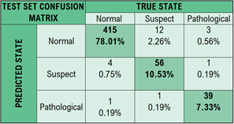
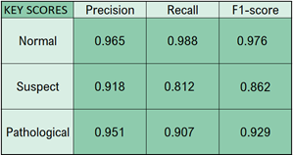
Final model
XGBoost – best perfomance

Slide 11
Important Features
260
171
153
138
130
ASTV
ALTV
AC
Mean
UC
Percentage of time with abnormal short-term variability
Percentage of time with abnormal long-term variability
No. of accelerations per second
Histogram mean
No. of uterine contractions per second

Slide 12
Thanks
Do you have any questions?

