Slide 1
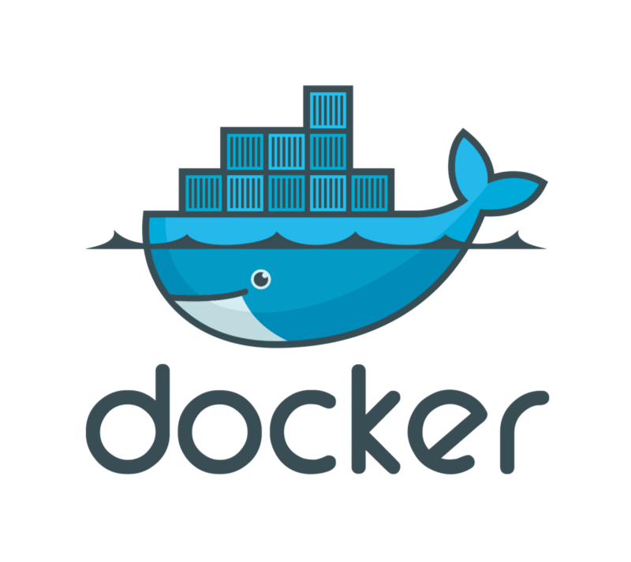
Outline – Docker at a Glance
Cloud Problems Overview
What is Container?
What is Docker?
Docker Benefits
Docker Terminology
Docker Installation
Docker CLI Usage
Dockerfile
Docker Compose
Docker Machine
Docker Swarm

Slide 2

Cloud Problems Overview
Performance
Algorithms
Disk I/O
Architecture
Tools (Redis, NoSQL, Elasticsearch)
Bandwidth Utilization
DB Connection Pooling
Bundle / minify / mundle
SSL validation
Caching
Gzip
CDN Usage
Single Page Application
Scaling
Stateless
Message Queuing
Lightweight Mechanisms
Auto-scaling

Slide 3
Cloud Problems Overview
Security
DOS / DDOS
SQL Injection
Monitoring
Real-time monitoring
Usability
UI/UX
Deployment
CI / CDelivery
CDeployment (zero-downtime deployments)
Blue-Green deployment
Testing
Unit Tests
Automated Tests
Performance Tests
Load Tests
Stress Tests
Risk Management
Hardware failures
High Availability
Costs Minimization (Especially Cloud Providers)
- Hardware Utilization
Portability
- Migration to another cloud providers easily

Slide 4
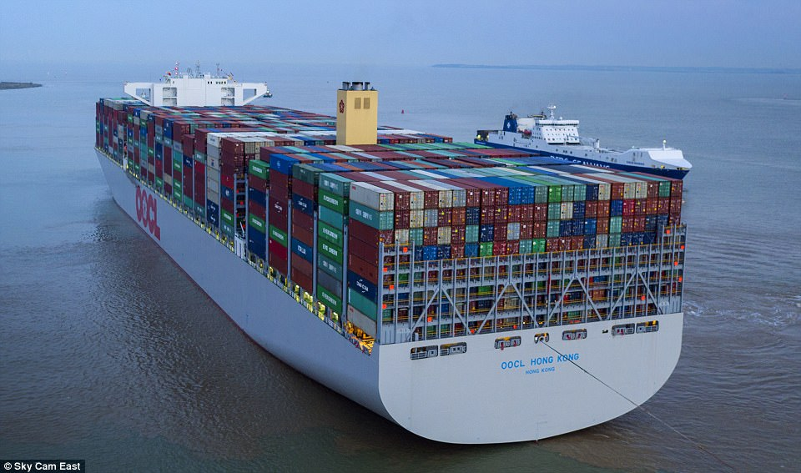
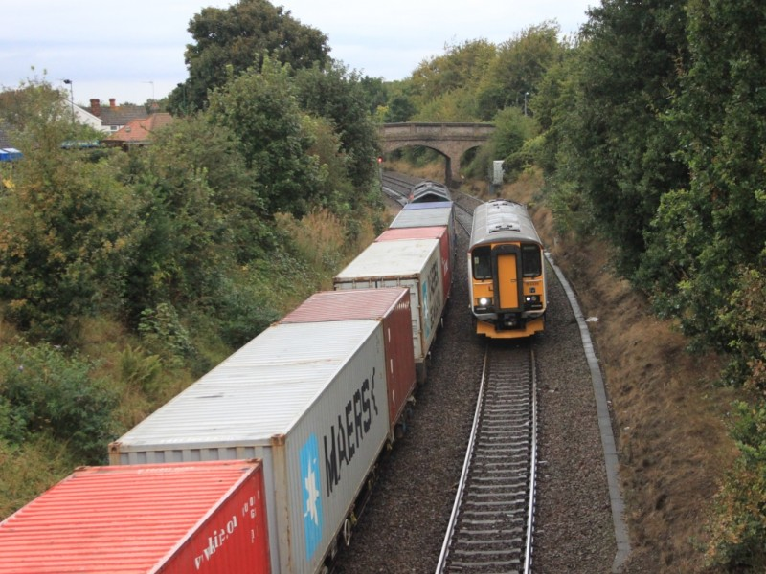
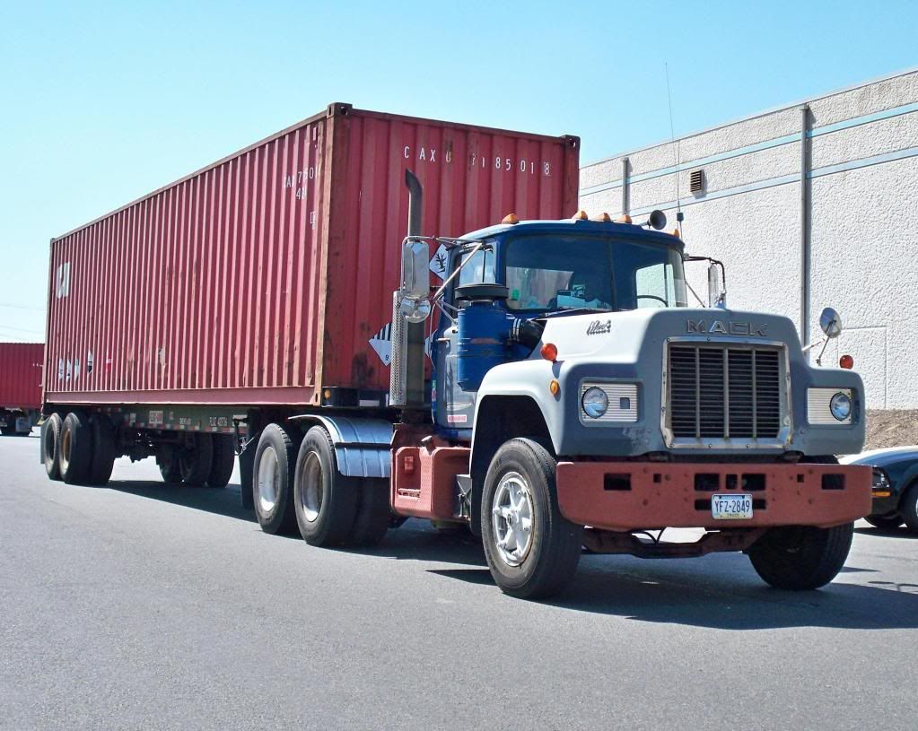
What is a Container?

Slide 5
What is Docker?
Solomon Hykes
Since 2013
Docker Inc.
Written in Go
Moves very fast

Slide 6
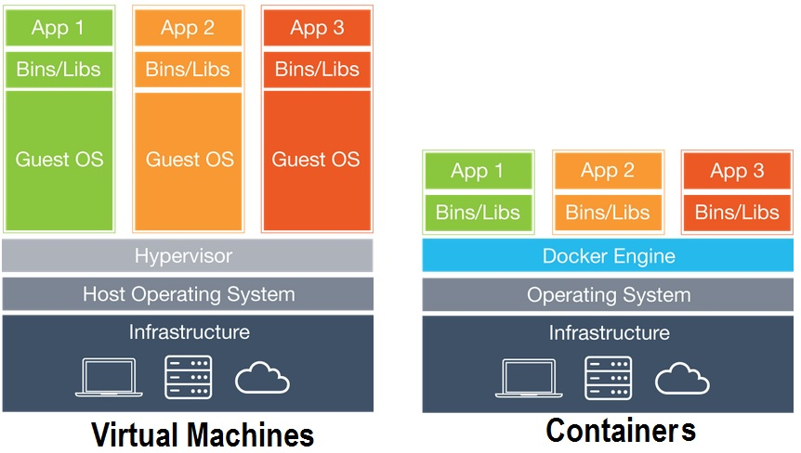
VMs vs. Containers

Slide 7
Benefits of Docker
Dev-Prod Parity
Easy Developer Onboarding
Infrastructure Utilization
Fast and Easy Deployments
Microservices Support
Support for Cont. Int/Del.
Learning new technologies
Portability

Slide 8
Docker Terminology
Docker Image
Docker Container
Docker Volume
Docker Registry
Docker CLI
Docker Daemon (Engine)

Slide 9
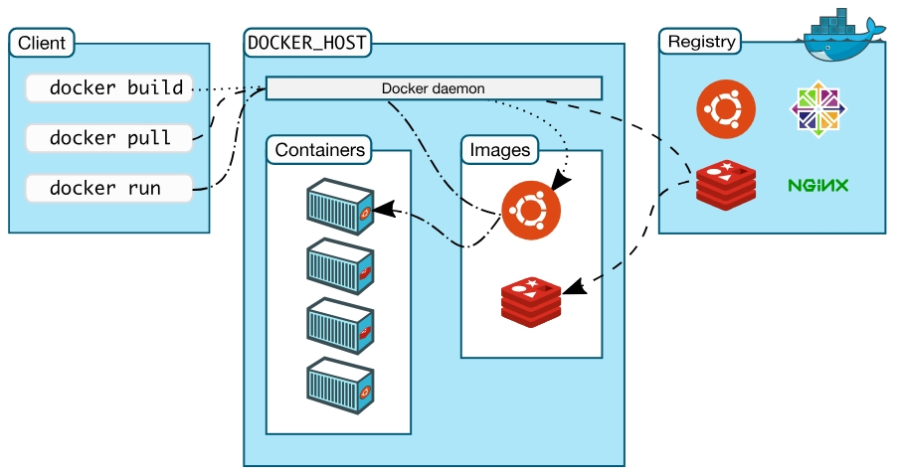
Docker Architecture

Slide 10
Docker Installation
Linux (Natively supported)
Windows 10 Pro/Ent (Hyper-V)
Mac OS (HyperKit)
Windows 7/8/8.1 or Older Mac Versions – Docker Toolbox

Slide 11
Docker CLI
docker version / docker info
docker / docker --help
docker container run --rm
docker image ls
docker volume ls
docker ps

Slide 12
Docker CLI
docker container run -p 8080:80 nginx:v1.14

Slide 13
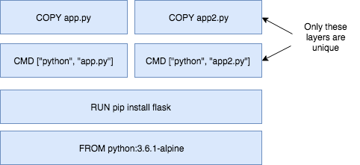
Dockerfile
Image: App binaries and dependencies (No kernel, no kernel modules)
Image layers
docker history nginx:latest

Slide 14
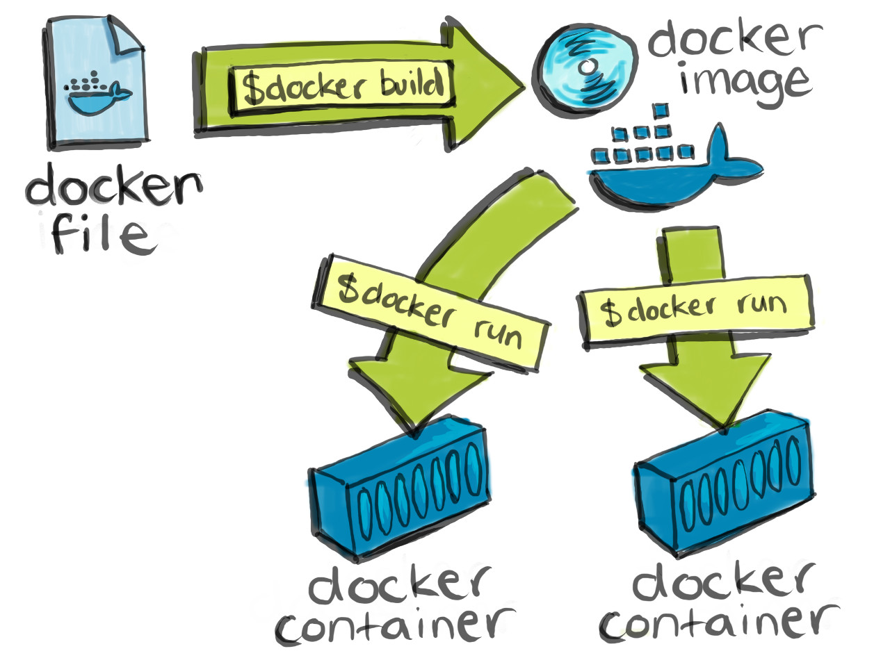
Dockerfile
Dockerfile
FROM
ENV
RUN
COPY
EXPOSE
CMD

Slide 15
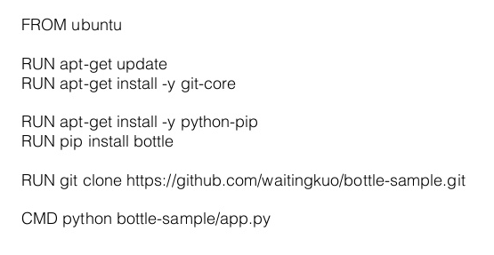
Dockerfile
docker image build –t serdarmumcu/customnginx .

Slide 16
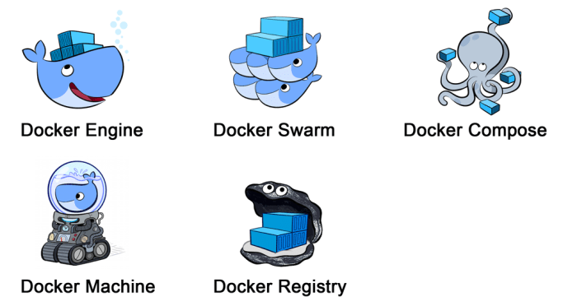
Other Docker Tools

Slide 17
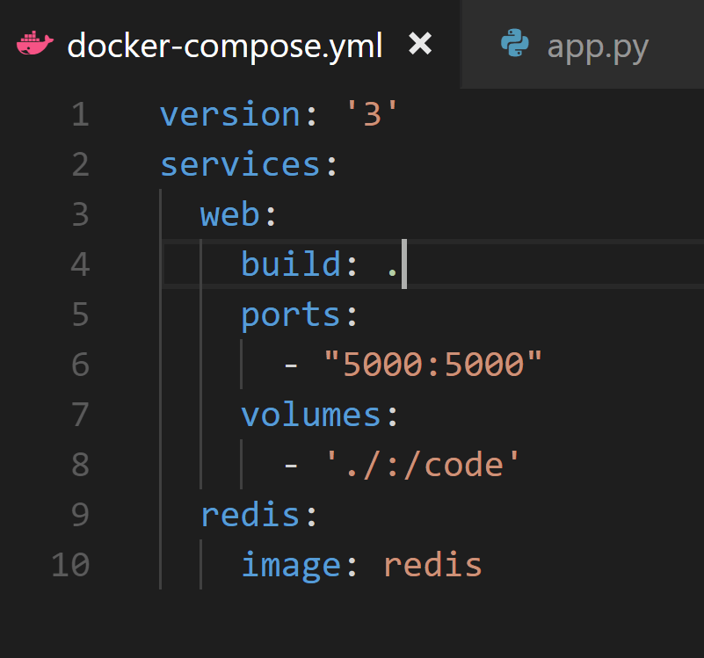
Docker Compose
docker-compose up/down

Slide 18
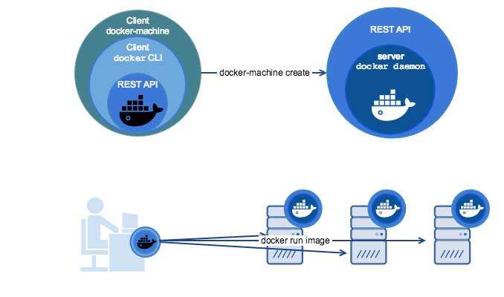
Docker Machine
docker-machine create --driver digitalocean --digitalocean-access-token $DIGITALOCEAN_ACCESS_TOKEN --digitalocean-ssh-key-fingerprint $DIGITALOCEAN_SSH_KEY_FINGERPRINT --digitalocean-image $DIGITALOCEAN_IMAGE --digitalocean-region $DIGITALOCEAN_REGION

Slide 19
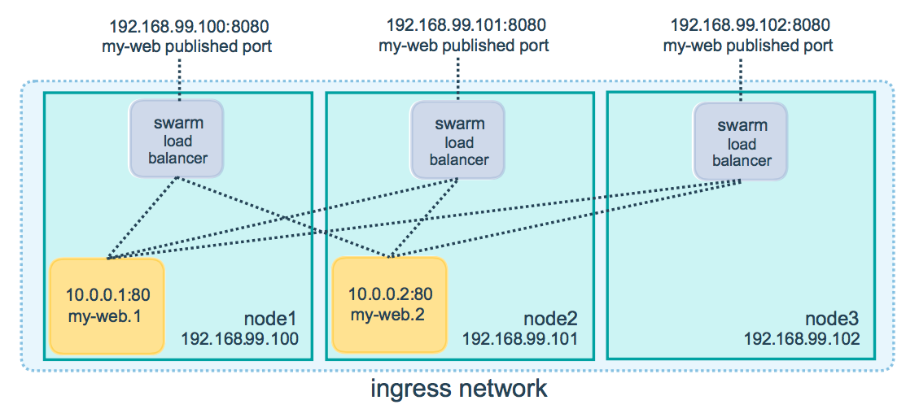
Docker Swarm
Healthcheck / Auto-restart
Autoscaling /Desired State Reconciliation

