Slide 1
LIS751 Final Project Sveta Bartholomew

Slide 2
Introduction
My database is loosely based on a blogging and digital publishing website Medium.com.
Medium.com is an extensive publishing platform where over 100 million readers come to find insightful and dynamic thinking.
The principle behind my database architecture:
any member of the platform can become an author of a post,
before publishing, an author selects publication name (if it has one) where the story is going to be featured in,
the platform also employs editors who moderate content and make sure members follow the guidelines.

Slide 3

Give a brief overview of wat you’ll cover in your presentation.

Slide 4
Mission Statement
The purpose of the Medium.com website database is to maintain the data we generate, and to supply information that supports the publishing services we provide to our writing members and browsing services we provide to our reading audience.
Objectives:
Maintain complete membership information.
Keep track of all posts published.
Maintain information on our editors.
Maintain information on publications.

Slide 5
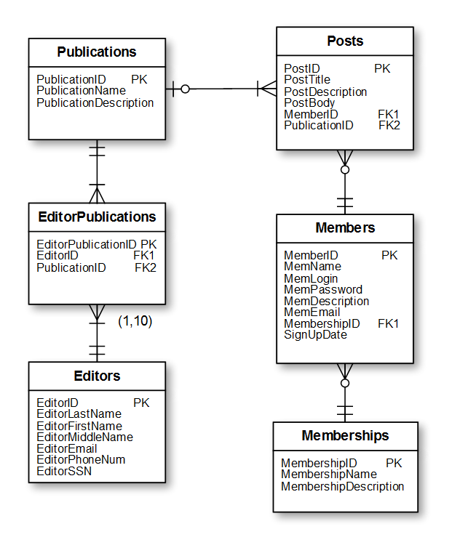
Conceptual Design ER diagram

Slide 6
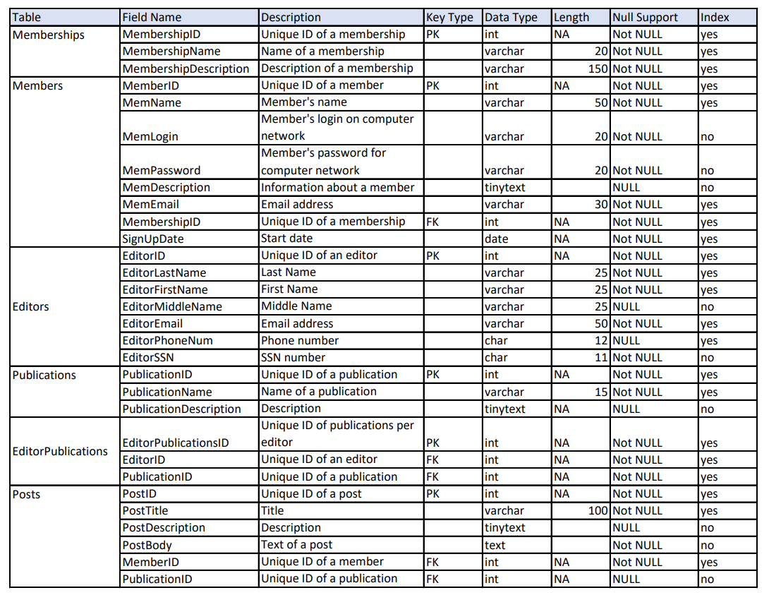
Logical Design

Slide 7
Business Rule
Rule Information Rule Statement: Each Editor can have no more than 10 publications. Constraint: A single record in Editors table can be associated with up to 10 records in EditorPublications table. Type: ☒Database Oriented Category: ☐Field Specific ☐Application Oriented ☒Relationship Specific
Structure Affect: Field Names: Table Names: Editors, EditorPublications
Field Elements affected: ☐Data Type ☐Character Support ☐Data length ☐Null Support ☐Decimal Points ☐Range of Values ☐Key Type ☐Default Value
Relationship Characteristics Affected ☒ Degree of Participation ☐Type of Relationship ☐ Deletion Rule
Actions Taken The degree of participation was changed to (1, 10).
Trigger:
BEGIN
DECLARE dummy, baddata INT;
SET baddata = 0;
IF COUNT(NEW.EditorPublicationsID) > 10 THEN
SET baddata = 1;
END IF;
IF COUNT(NEW.EditorPublicationsID) < 1 THEN
SET baddata = 1;
END IF;
IF baddata = 1 THEN
SELECT concat('Cannot Insert This Because Value', COUNT(NEW.EditorPublicationsID), 'exceeds the allowed number of publications per editor')
INTO dummy FROM information_schema.tables;
END IF;

Slide 8
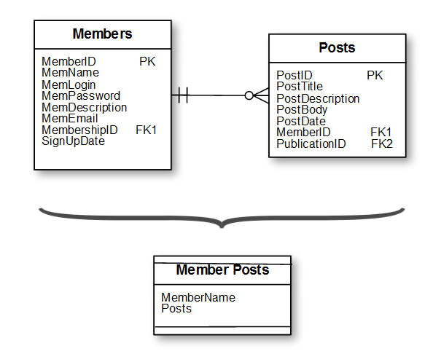
Security and Privacy: Integration of Views
CREATE VIEW MemberPosts AS
SELECT m.MemName, COUNT(p.PostID) AS Posts
FROM Members AS m
INNER JOIN Posts AS p ON p.MemberID = m.MemberID
GROUP BY MemName
ORDER BY Posts desc;

Slide 9
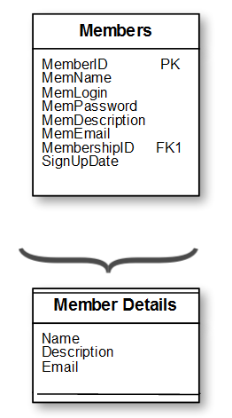
Security and Privacy: Integration of Views
CREATE VIEW MemberDetails AS
SELECT MemName AS Name,
MemDescription AS Description,
MemEmail AS Email
FROM Members;

Slide 10
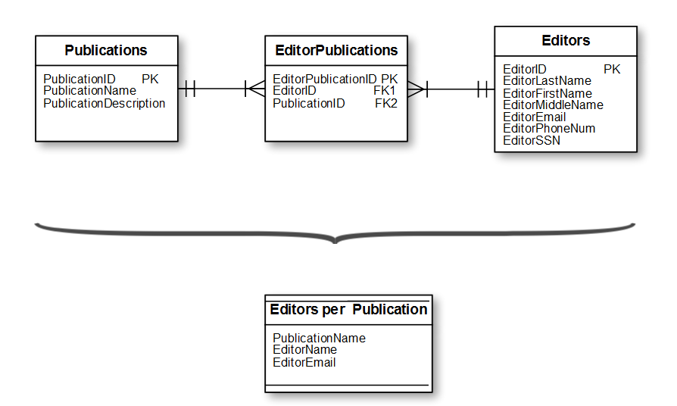
Security and Privacy: Integration of Views
CREATE VIEW EditorsPerPublication AS
SELECT p.PublicationName, CONCAT(e.EditorLastName,', ', e.EditorFirstName) AS EditorName, e.EditorEmail
FROM Publications AS p
INNER JOIN EditorPublications AS ep ON p.PublicationID = ep.PublicationID
INNER JOIN Editors AS e ON e.EditorID = ep.EditorID;

Slide 11
SQL Queries: (1) I want to know the information on Editors (their names and email addresses) and how many publications they review. I would like to limit my search to the editors who lead 5 or more publications at once. (2) I need information on posts, publications these posts appear in and names and description of members who wrote them. (3) I want to know what publication has the most posts. (4) Who wrote the greatest number of posts? (5) Names and Emails of members who pay yearly subscription fee.

Slide 12
PHP/HTML page:
https://orson.ischool.wisc.edu/~badger1/lis751Project/search.php

Slide 13
Questions & answers

