Slide 1
The Great Web
An alternative vision for freedom from digital feudalism
Simanovsky Sergey

Slide 2
Got web 3.0?
The development of what once upon a time was just a mere search via a centralized server that connected a network of peers, to highly efficient, decentralized networks and on-line storage facilities, with motivated nodes, that are cooperating with each other in a coordinated manner with the help of code.
Their direct (no third party involved) coordination and cooperation between each other, a direct and obvious motivation of the user and the node, the coordination of actions with the help of smart contracts and the safe routing of packets and data, etc.
Welcome to the Great Web!

Slide 3
That’s not normal...
23% of the internet is free (Freedom house)
47% of world population have some social media blocked (Internet trends)
42% of world population have internet cuts due to political reasons (Internet trends)
Russia, China, USA, Germany, Kazakhstan, New Zealand, Australia, UK, Iran… and many more countries have some kind of internet restriction laws

Slide 4
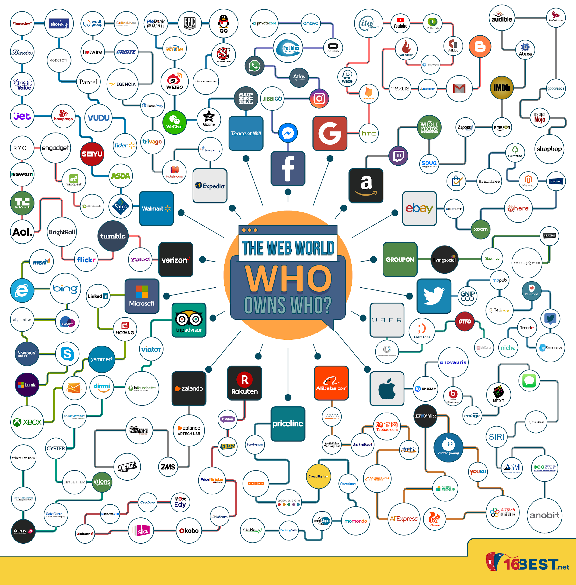
Dante's worst nightmare
Centralized top level domains
No interest of solving security
Data reselling
Few beneficiaries
Uncontrolled data loss
HTTP - DNS - URL

Slide 5
That’s not normal...
Name, sex, date of birth, profession, education, interests, preferences, what makes you angry, what makes you happy, when you watch movies, what you like, your heart beat rate, your location, your phone book, your texts and messages, your work and home address, your day schedule, where you rest, what you search for, what websites you visit, what you did in the past days \ months \ years, what you have in your apartment, where and what food you buy, what you buy in general, what you hate, who you talk to and when, who are your relatives and what do they do, your psychological profile, your voice, your friends, what you see before you, what makes you tick, your “secret” searches...

Slide 6
The Great Web
Offline browsing
Local data cashing | Trusted storage
Local servers
Reputation and efficiency
Token Curated Registries
Miners and service providers
IPFS
Indexation and Ranking
Decentralization
Consensus mechanisms
DAO’s

Slide 7
Cyber
Cyber is a decentralized google. It is an innovative search protocol that can provide provable answers to questions without an intermediary opinion.
Cyber solves the problem of opening up the centralised semantics core of the internet. It does so by providing an open and accessible semantic core, created, taught and managed by the users...

Slide 8
cyber~Congress
cyber~Congress is a DAO
Launch Cyber
Create the initial allocation
Work on Cyber as one of the community participants
Aragon | GitHub | Roadmap | History | Manifest

Slide 9
cyber~Foundation
cyber~Foundation is a DAO
Help govern Cyber
Independent, non-jurisdiction based entity
In charge of its own ETH
A foundation that has no borders
DeVC managed by a collective mind
Aragon | GitHub | History | Technicalities

Slide 10
cyber~Foundation
No CEO’s or stuff
No bureaucracy
Own ETH
Onchain governance
Decentralized launch
Own apps: Auction | Vesting | Evangelism
test~Auction: https://cyber.page/gol/faucet
Cross chain mechanics

Slide 11
cyber~Foundation
Community matters: cyber~Foundation IS the community!
Video 1 | Video 2 | Video 3
Ambassador program: Register | Learn
Gamified mechanics
Collective decisions
Decentralization
Sustainability
Diversification
What’s next?

Slide 12
QUESTIONS...
https://github.com/cybercongress

