Slide 1
Persentation
GAME 2048

Slide 2
Group members
Nguyen The Duy Khanh ITITRG17016
Bui Hoang Thien Bao ITITWE17026
Vo Nguyen Khoi ITITRG17008
Ha Khanh Lam ITITWE17003
Ho Thai An ITITRG17017

Slide 3
Content
Menu
Game play screen
Win - Lose screen

Slide 4
1.
Menu

Slide 5
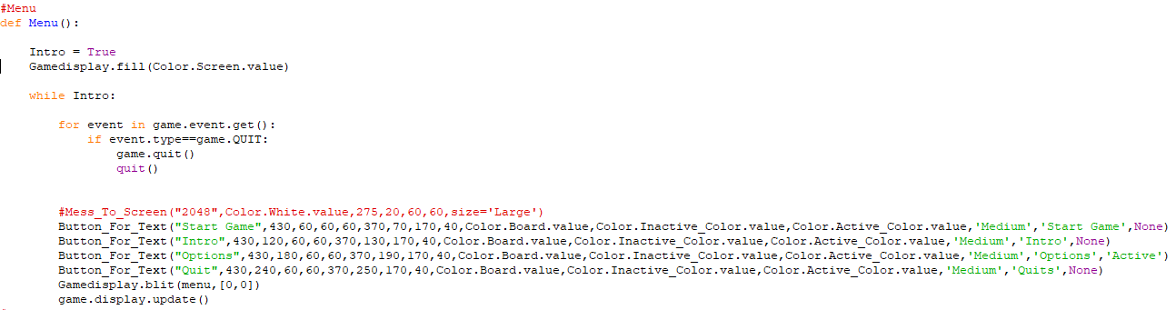
Create a menu with 4 buttons:
Start game
Go to main game
Intro
Intro how to play this game
+
3. Options
Turn on/off music or sfx
4. Quit
Quit the game

Slide 6
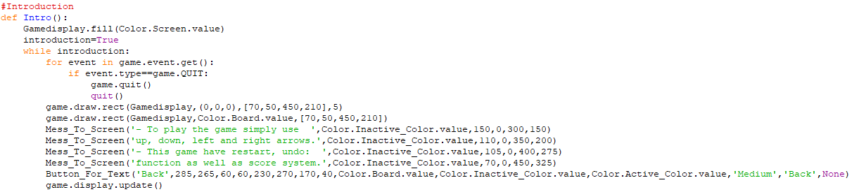
Introduction about how to play game 2048

Slide 7
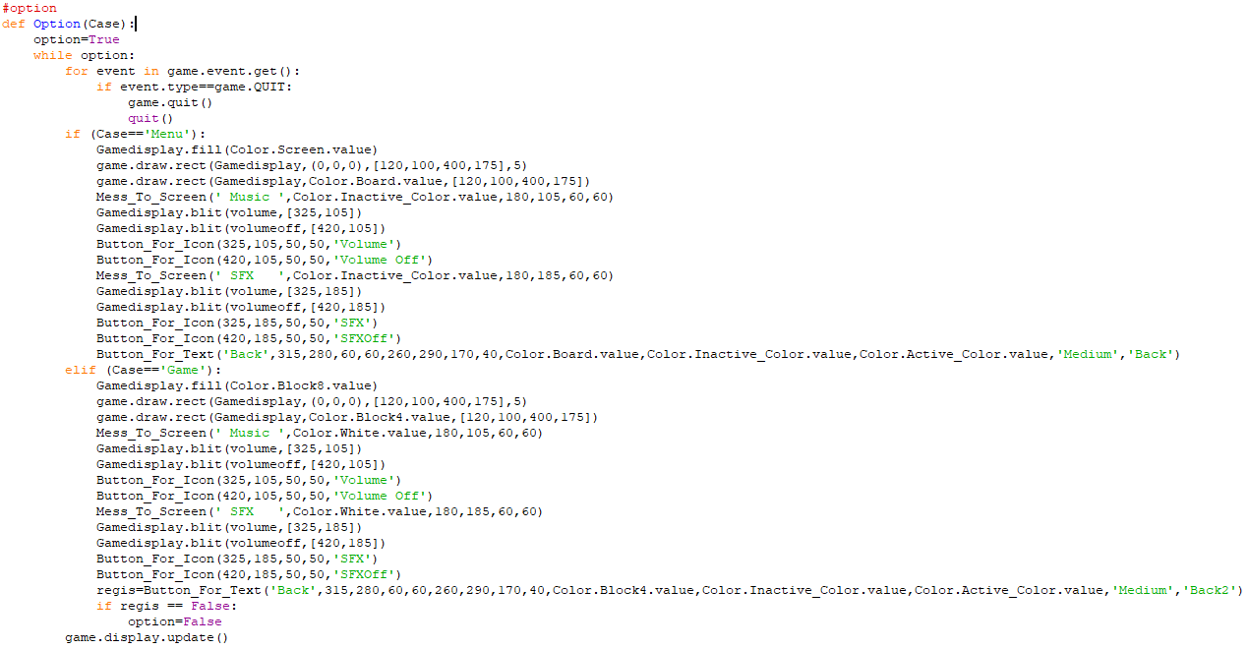
There are 2 options :
Option 1 has the screen color of the menu and turns on/off music or sfx
Option 2 has the screen color of the game play screen and turns on/off music or sfx

Slide 8
2. Game play screen

Slide 9
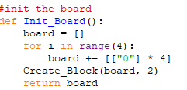
A picture is worth a thousand words
Create a 4x4 board with 2 dimensional array with an initial value of 0 and create 2 blocks have value of 2 or 4 within the play board

Slide 10
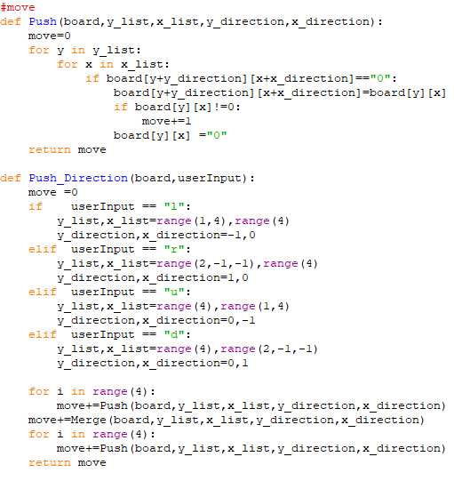
👆

Slide 11
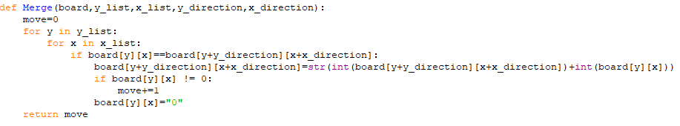
If the input of the user is left, right, up, down; the system will check if the 2 blocks next to each other in the direction of the user’s input , it will merge 2 blocks into 1 block with having the sum of the 2 previous blocks

Slide 12
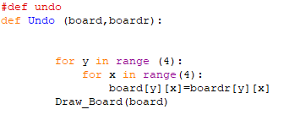
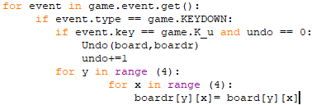
Creating the method named Undo with two parameters(board and boardr), then we create 4x4 matrix using two For loops, which contains the value of the previous board stored in boardr then assigns it to board which is the current board.
Declare “U” as the undo button then compare if undo is equals to zero, the game will execute the undo method then increase by 1 to limit the undo times.
We store the current value of board to temporary board, then anytime we call the undo method , we have previous value from the temporary board.

Slide 13
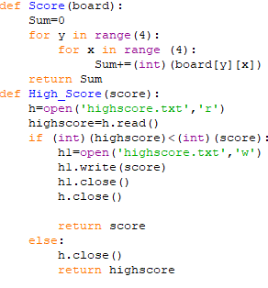
Score method:
Sum is declared and initialized to zero, then create 4x4 matrix using two for loops and sum up all element of board each time converted from String to Int.
HighScore method:
Create a text file to read and store the highest score, if the highestscore is smaller than the current score, it will be written in the text file, if not return highestscore

Slide 14
3. Win-Lose screen

Slide 15
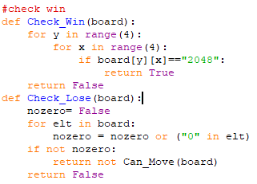

Slide 16
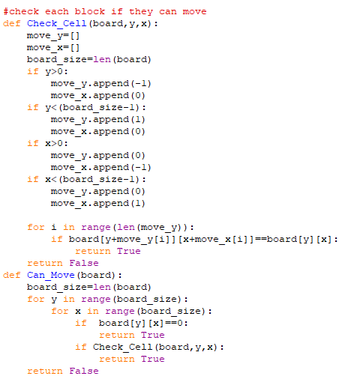

Slide 17
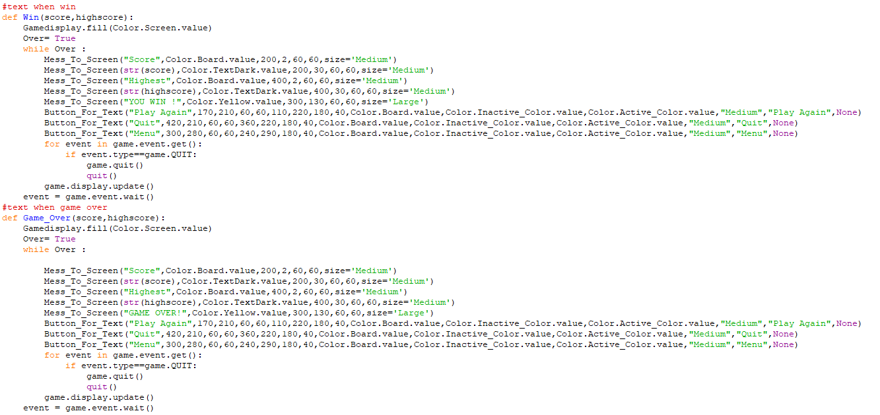

Slide 18
THANK YOU SO MUCH
Any questions?

Slide 19
In two or three columns
Yellow
Is the color of gold, butter and ripe lemons. In the spectrum of visible light, yellow is found between green and orange.
Blue
Is the colour of the clear sky and the deep sea. It is located between violet and green on the optical spectrum.
Red
Is the color of blood, and because of this it has historically been associated with sacrifice, danger and courage.

Slide 20
Presentation design
This presentation uses the following typographies:
Titles: Walter Turncoat
Body copy: Sniglet
You can download the fonts on these pages:
https://www.fontsquirrel.com/fonts/walter-turncoat
https://www.fontsquirrel.com/fonts/sniglet
You don’t need to keep this slide in your presentation. It’s only here to serve you as a design guide if you need to create new slides or download the fonts to edit the presentation in PowerPoint®

