Slide 1
Persentation
GAME 2048

Slide 2
Group members
Nguyen The Duy Khanh ITITRG17016
Bui Hoang Thien Bao ITITWE17026
Vo Nguyen Khoi ITITRG17008
Ha Khanh Lam ITITWE17003
Ho Thai An ITITRG17017

Slide 3
Content
Menu
Game play screen
Win - Lose screen

Slide 4
1.
Menu

Slide 5
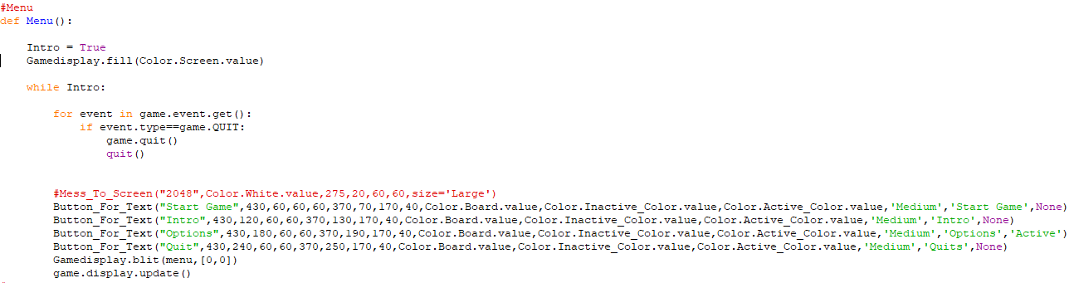
Create a menu with 4 buttons:
Start game
Go to main game
Intro
Intro how to play this game
+
3. Options
Turn on/off music or sfx
4. Quit
Quit the game

Slide 6
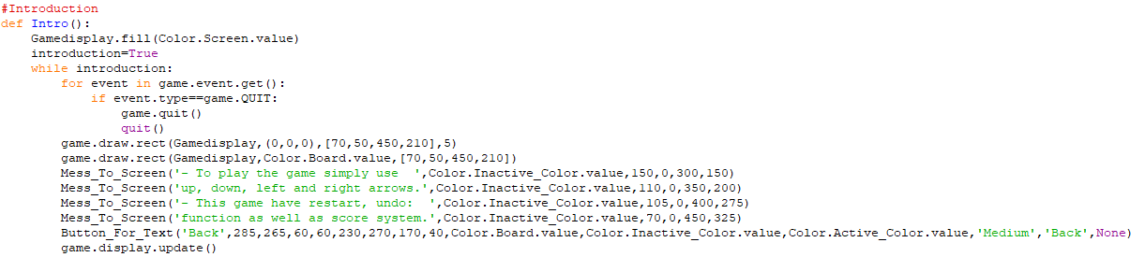
Introduction about how to play game 2048

Slide 7
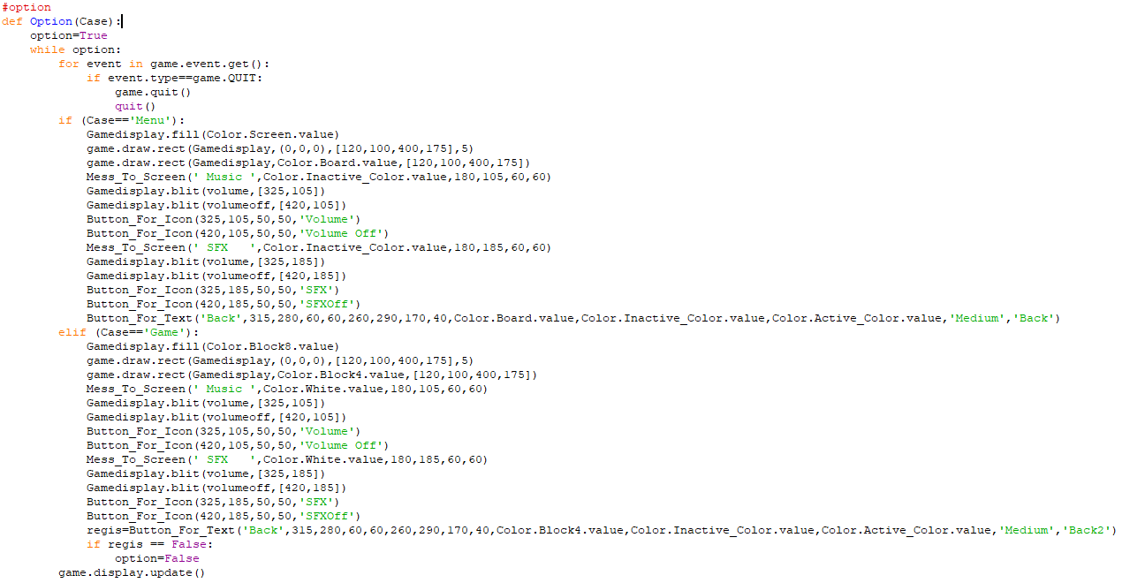
There are 2 options :
Option 1 has the screen color of the menu and turns on/off music or sfx
Option 2 has the screen color of the game play screen and turns on/off music or sfx

Slide 8
2. Game play screen

Slide 9
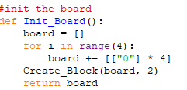
A picture is worth a thousand words
Create a 4x4 board with 2 dimensional array with an initial value of 0 and create 2 blocks have value of 2 or 4 within the play board

Slide 10
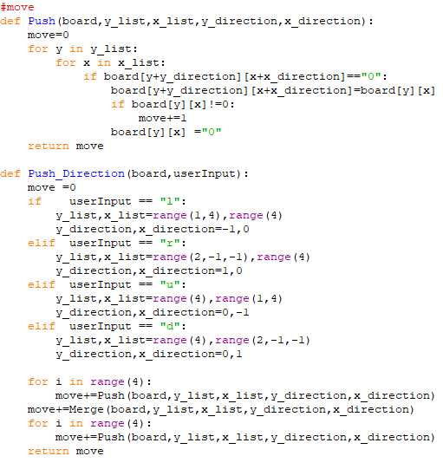
👆
Push and Push Direction:
Take command from user to move the blocks up , down , left, right

Slide 11
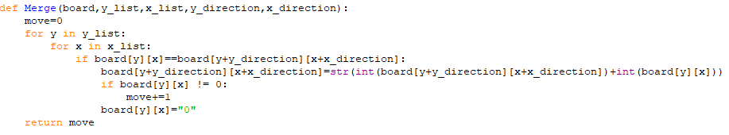
If the input of the user is left, right, up, down; the system will check if the 2 blocks next to each other in the direction of the user’s input , it will merge 2 blocks into 1 block with having the sum of the 2 previous blocks

Slide 12
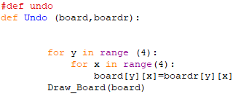
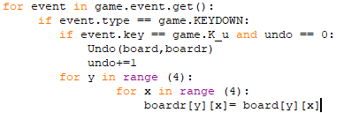
Undo method:
Construct a temporary board to save the value of the current board and whenever the player presses U button the current board will load the value from the temporary board

Slide 13
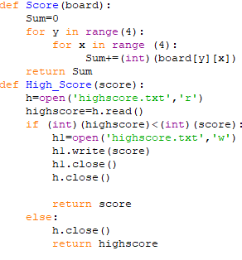
Score method:
Sum is declared and initialized to zero, then create 4x4 matrix using two for loops and sum up all element of board each time converted from String to Int.
HighScore method:
Create a text file to read and store the highest score, if the highestscore is smaller than the current score, it will be written in the text file, if not return highestscore

Slide 14
3. Win-Lose screen

Slide 15
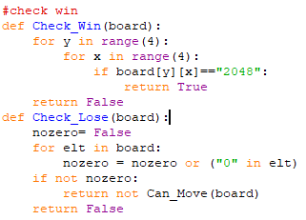
Check win:
If there are any blocks reach 2048 the game has to end at that time and go to win screen
Check lose:
Check the board if there are any no-value blocks if not the player cannot move and go to lose screen

Slide 16
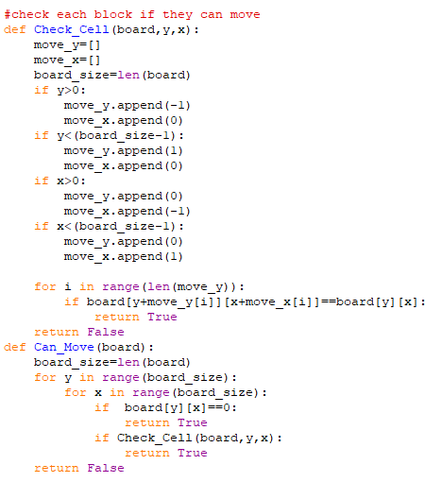
Check_Cell:
To check if each block in the board can move in the up,down,left,right directions .
Can_Move:
If the board has a or many no-value blocks or if each block in the board can move,the game will constantly run until the conditions are false.

Slide 17
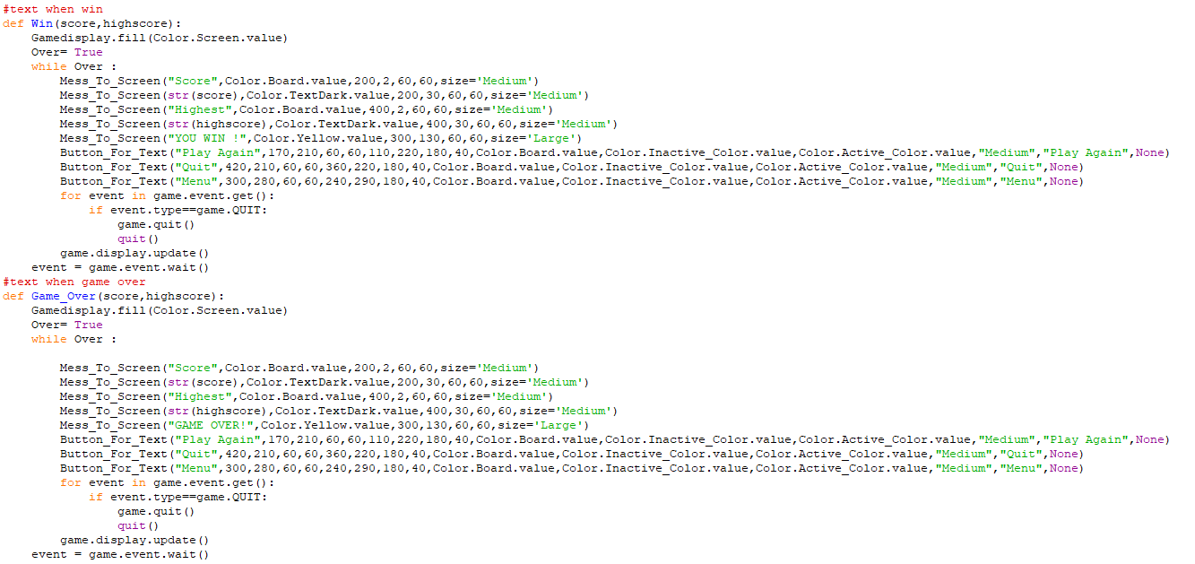
Win and Game Over:
Creating the win or lose screen whenever players win or lose the game respectively

Slide 18
References
This presentation uses the following sources:
https://github.com/ijl0322/2048-with-pygame
https://github.com/serema12/2048-Game(our github)
https://vi.wikipedia.org/wiki/2048_(tr%C3%B2_ch%C6%A1i)
https://www.youtube.com/watch?v=K5F-aGDIYaM&list=PL6gx4Cwl9DGAjkwJocj7vlc_mFU-4wXJq&fbclid=IwAR31fcnTe480IK7b2tXAB9k4YRw9q1Z9KYgfkELLN1U82BccJ1Ran6T3PyU

Slide 19
THANK YOU SO MUCH
Any questions?

