Slide 1
Persentation
GAME 2048

Slide 2
Group members
Nguyen The Duy Khanh ITITRG17016
Bui Hoang Thien Bao ITITWE17026
Vo Nguyen Khoi ITITRG17008
Ha Khanh Lam ITITWE17003
Ho Thai An ITITRG17017

Slide 3
Content
Menu
Game play screen
Win - Lose screen

Slide 4
1.
Menu

Slide 5
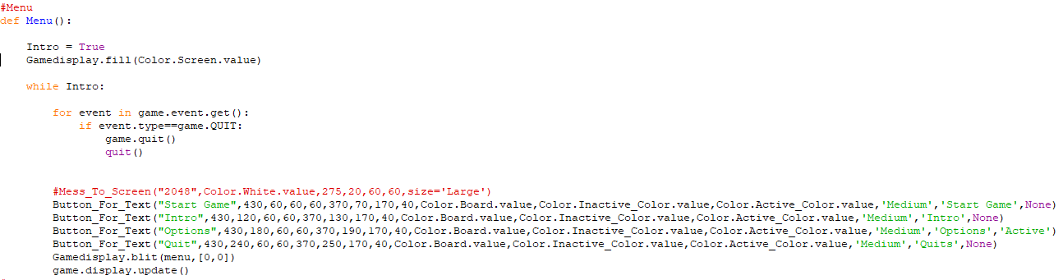
Create a menu with 4 buttons:
Start game
Go to main game
Intro
Intro how to play this game
+
3. Options
Turn on/off music or sfx
4. Quit
Quit the game

Slide 6
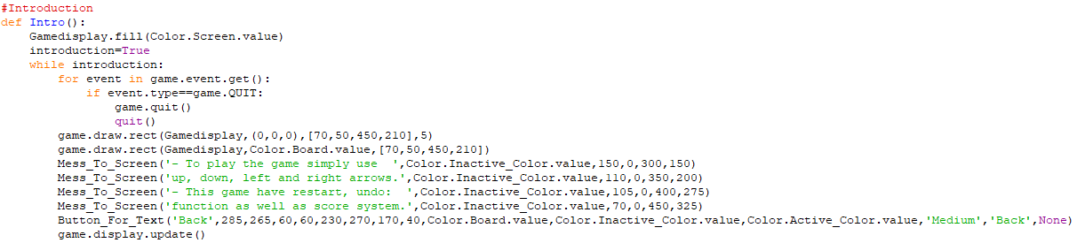
Introduction about how to play game 2048

Slide 7
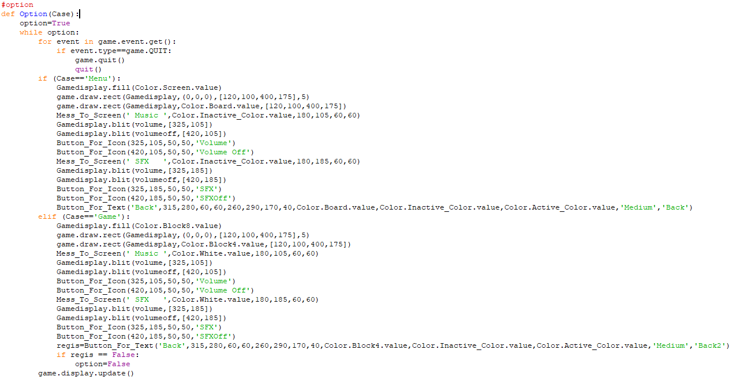

Slide 8
2. Game play screen

Slide 9
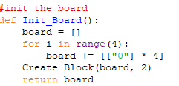
A picture is worth a thousand words

Slide 10
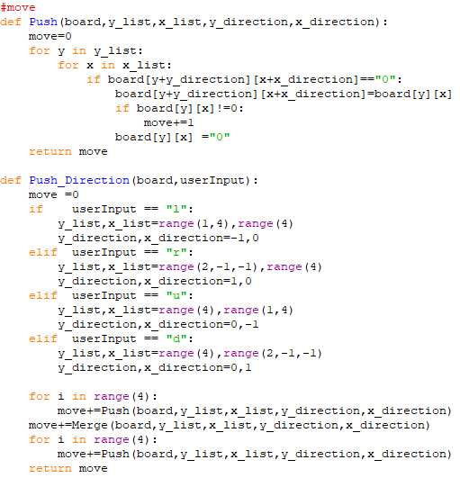
👆

Slide 11
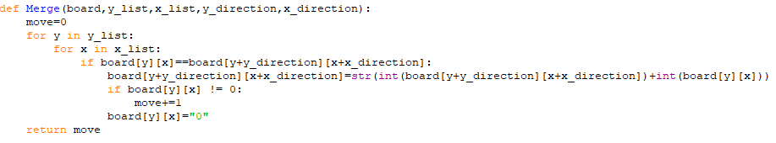

Slide 12
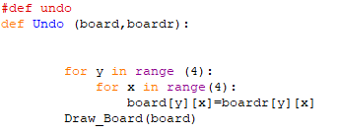
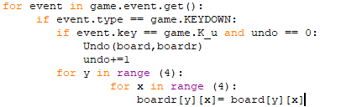

Slide 13
3. Win-Lose screen

Slide 14
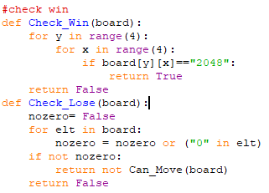

Slide 15
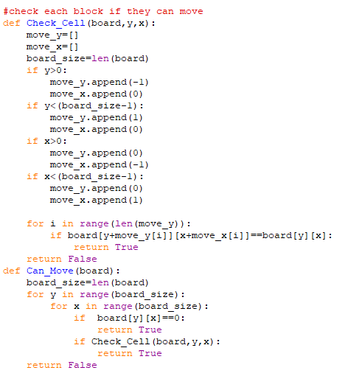

Slide 16
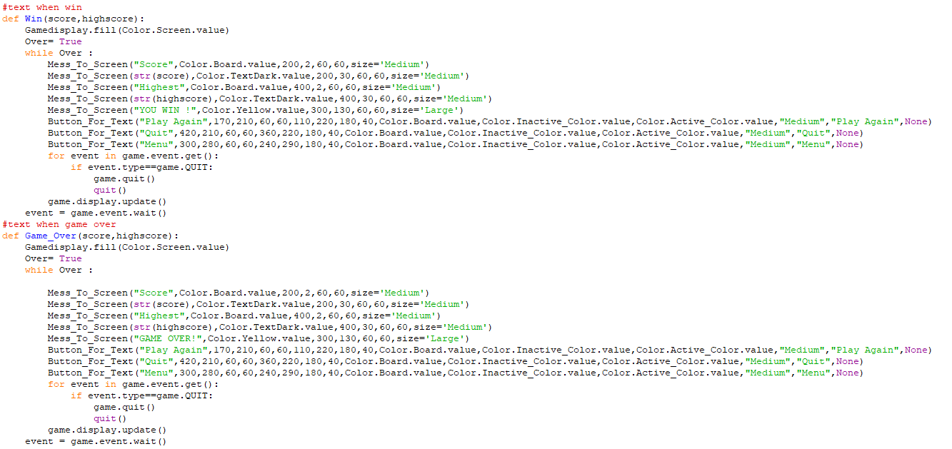

Slide 17
THANK YOU SO MUCH
Any questions?

Slide 18
In two or three columns
Yellow
Is the color of gold, butter and ripe lemons. In the spectrum of visible light, yellow is found between green and orange.
Blue
Is the colour of the clear sky and the deep sea. It is located between violet and green on the optical spectrum.
Red
Is the color of blood, and because of this it has historically been associated with sacrifice, danger and courage.

Slide 19
Presentation design
This presentation uses the following typographies:
Titles: Walter Turncoat
Body copy: Sniglet
You can download the fonts on these pages:
https://www.fontsquirrel.com/fonts/walter-turncoat
https://www.fontsquirrel.com/fonts/sniglet
You don’t need to keep this slide in your presentation. It’s only here to serve you as a design guide if you need to create new slides or download the fonts to edit the presentation in PowerPoint®

