Slide 1

Peer-graded Assignment: Capstone Project - The Battle of Neighborhoods
Frankfurt visitors venue recommendation

Slide 2





Problem description
! Find neighborghood with cheaper hotels as in the main city centre, but still in nearness of our firm Headquarter and good opportunities to go out

Slide 3
Segmenting and Clustering Neighborhoods in Frankfurt am Main:
Frankfurt am Main is segmented into 12 boroughs
Take one borough (we take Innenstadt II) near the firm headquarter and explore neighborhoods there
Examine the venues of neighborhoods which come into consideration for the our problem purpose

Slide 4
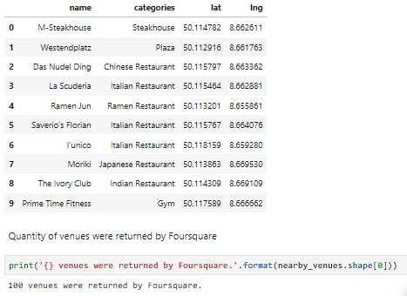
Find venues for INNENSTADT II via Foursquare
Foursquare found 100 venues in different categories in borough Innenstadt II

Slide 5
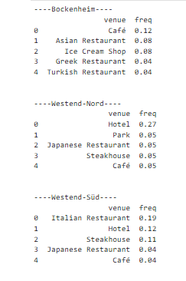
Group neighborhoods by taking the mean of the frequency of occurrence of each category

Slide 6
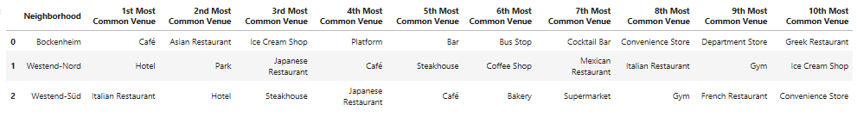
Display the top 10 venues for each neighborhood

Slide 7
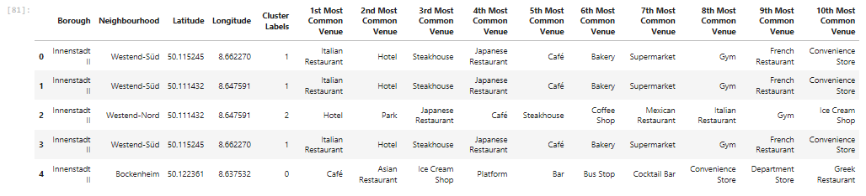
Cluster Neighborhoods via k-means

Slide 8
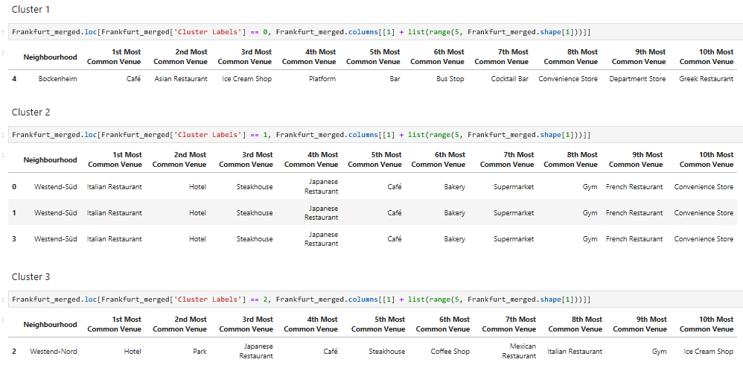
Results
Cluster 1:
Cluster 1 shows that in neighbourhood Bockenheim most common venues are Caffes, Restaurants and Bars. There are also some stores.
Cluster 2:
Here we can see that in all Westend-Süd neighbourhood different kitchens restaurants are most common venues. But Hotel is also common venue. There is also supermarket and gym.
Cluster 3:
Here we see that Westend-Nord is like Westend-Süd, but here is also park listed as 2nd common venue, but not a supermarket.

Slide 9
Conclusion
Bockenheim is probably the best neighbourhood to go out, but there are not so many good Hotels and it’s also furthest located from our firm headquarter.
I would recommend our colleagues to stay in hotels in Westend-Süd or Westend-Nord neighbourhood, because there is a white range of hotels to choose and these both neighbourhoods are closer to our firm headquarter.
There are also possibilities to choose between different kitchens: like Japanese or Italian restaurant.
We can also find there other activities expect of eating, like Parks and Gym.
In my opinion Westend-Süd and Westend-Nord offer better opportunities to go out.

