Slide 1
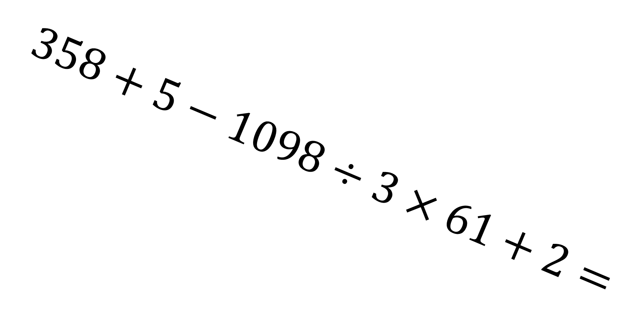
$$358+5−1098÷3×61+2=$$

Slide 2
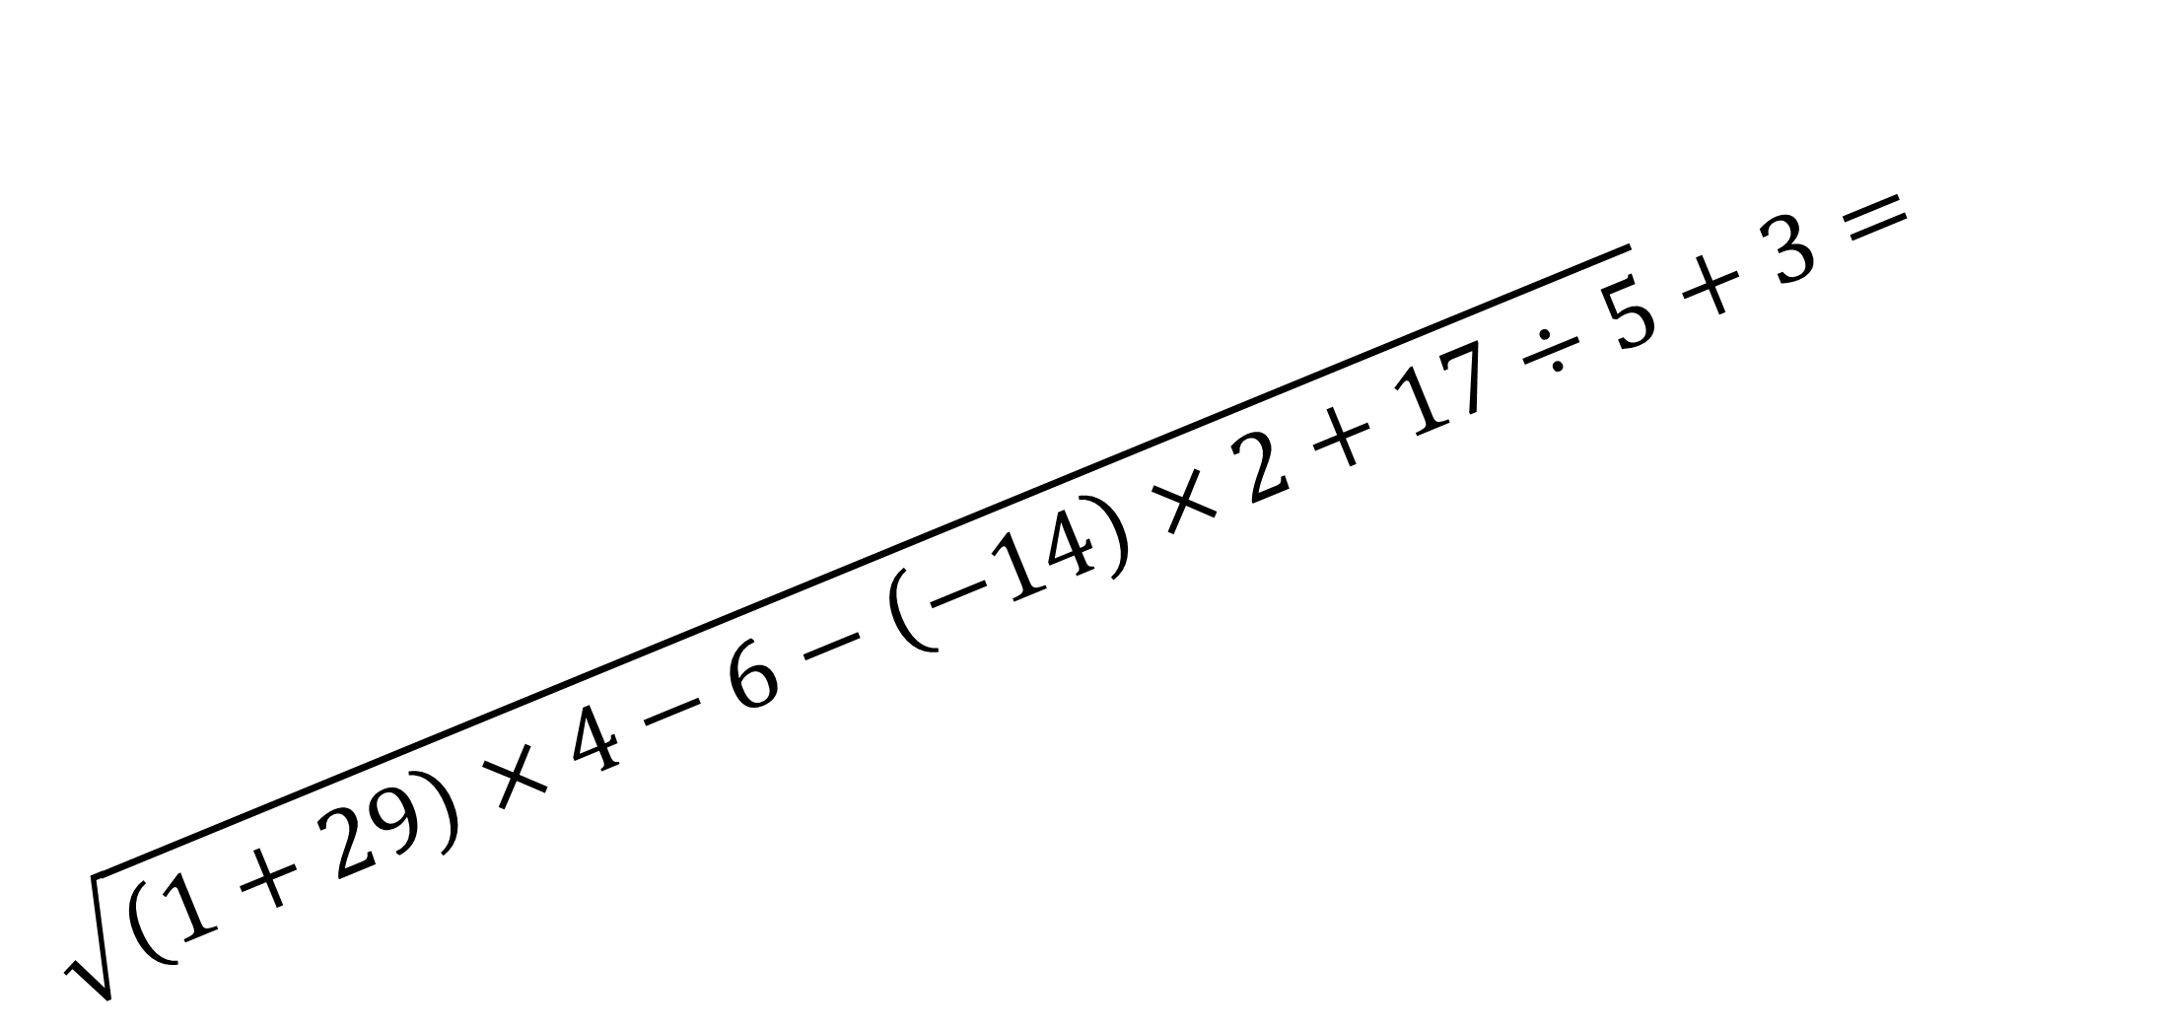
$$\sqrt{\left(1+29\right)×4−6−\left(−14\right)×2+17÷5}+3=$$

Slide 3
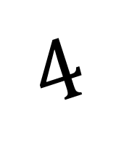
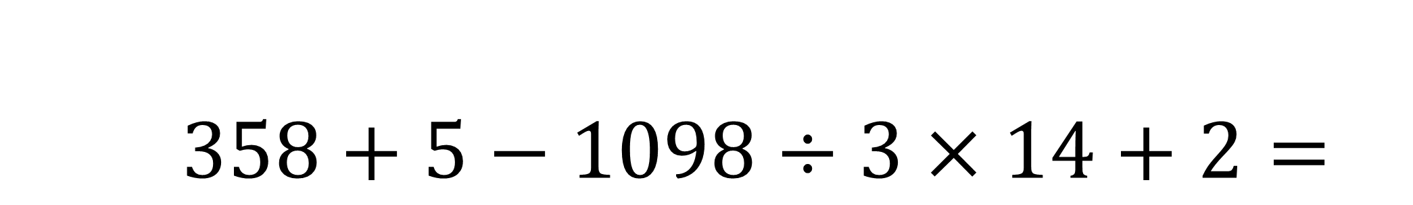
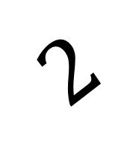
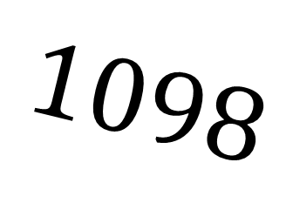
$$358+5−1098÷3×14+2=$$
$$4$$
$$1098$$
$$2$$

Slide 4
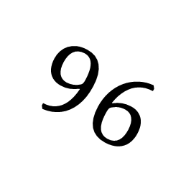

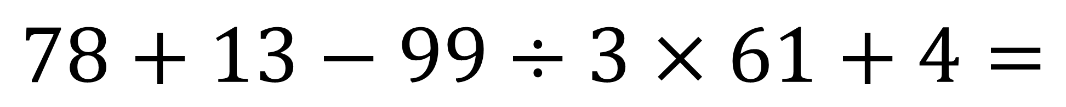
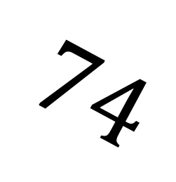


$$78+13−99÷3×61+4=$$
$$74$$
$$13$$
$$96$$
$$5$$
$$1$$

Slide 5

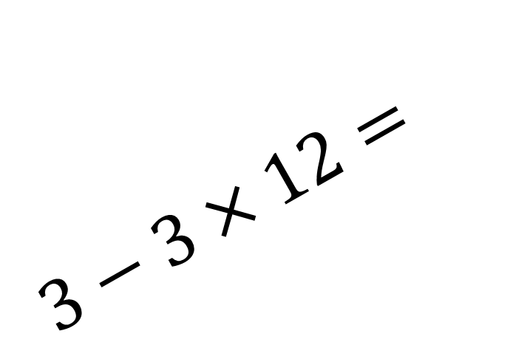
$$3−3×12=$$
$$18+(42−83)÷$$

Slide 6

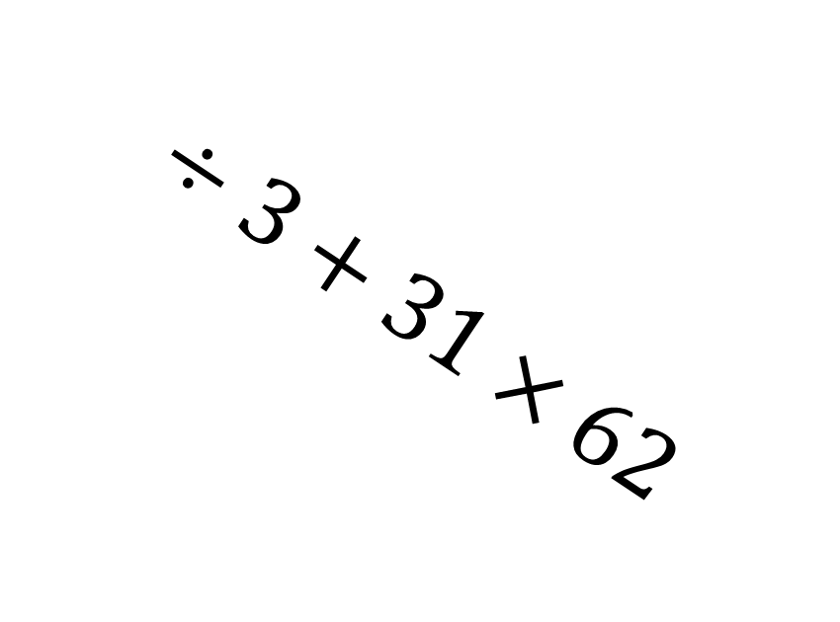
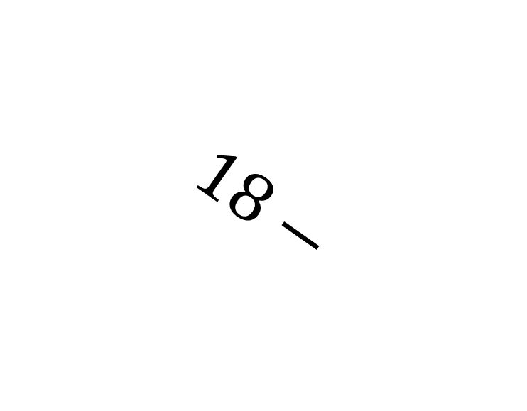
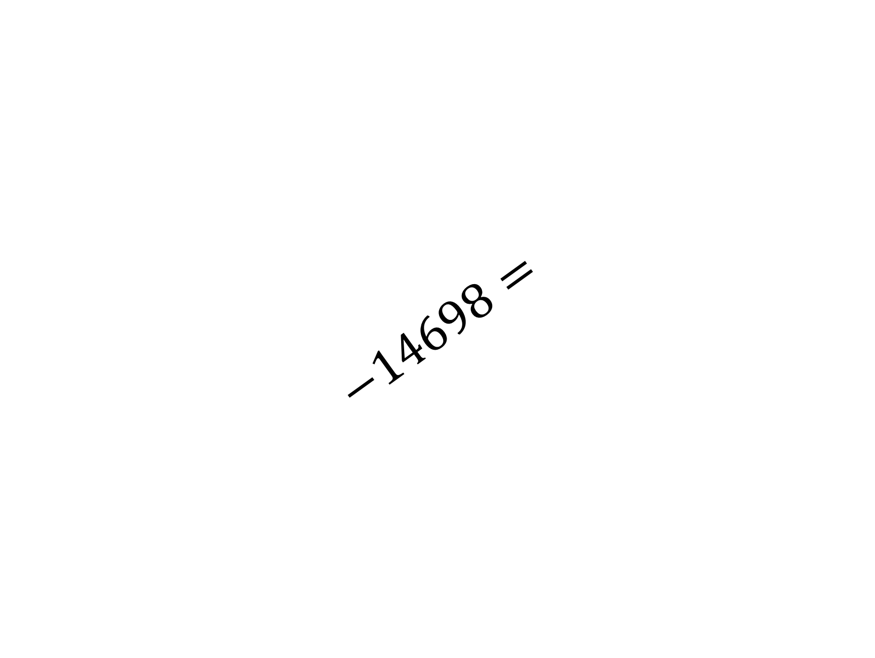
$$18−$$
$$(15−79)$$
$$−14698=$$
$$÷3+31×62$$

