Slide 1
Angular
Presented by Carolyn Chow

Slide 2
Topics
Introduction
Angular Architecture
Advantages
Code Management
Artifact Management
Deployment
Appendix
Notes:
-There is a separation between the front-end and the backend.
-The translation is completed in the front-end and not the back-end.
-The back-end is purely used for processing database requests to webservices.
- Replace the use of the freemarker which is java based.

Slide 3
Introduction
The purpose of this presentation is to describe the development process of an angular application from creation to deployment. I will not be describing how to code using Angular.
The main concepts and ideas are as follows:
What is Angular
What are some basic building blocks and architecture
Can I see a working Angular application
What advantages does Angular offer
How do I create an application
How do I manage the code
How do I manage artifacts
How do I build the application
How do I create a package for production
How do I deploy the application

Slide 4
Introduction
Demonstration Applications
HTML5 AngularJS web forms application
I was a member of the Health Canada Radar (Regulatory Application Depot) development team who created the forms application. This application offers the Canadian public a means of reporting incident reports concerning Consumer and Cosmetic products.
This application is also used to report information about food and cosmetic products and Medical devices prior to entry into the market.
HTML5 Angular web forms application
I created an application which is an upgrade of the HTML5 AngularJS application. The framework was changed to the Angular 2 framework. Angular is a complete re-write of AngularJS.
I later migrated the application to Angular 6

Slide 5
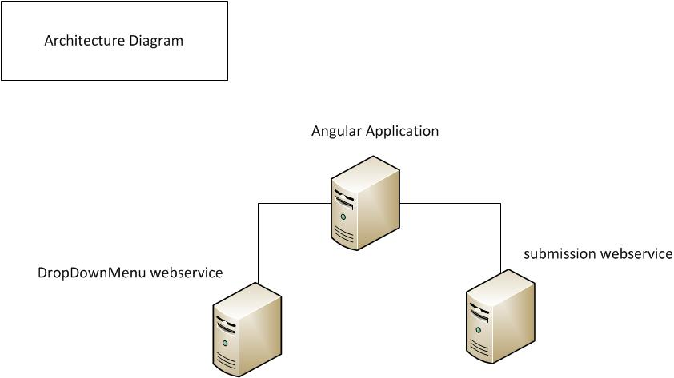
Angular Application

Slide 6
Angular Architecture
What is Angular?
Angular is a frontend framework that is used to create applications using HTML and Typescript.
Typescript is a superset of JavaScript.
It provides a separation between the frontend and the backend (i.e webservices).
Angular architecture
Modules
Known as NgModules that contain a set of code dedicated to a specific feature, capability or workflow
Can contain components, service providers and other code files
Demonstration
Components
Defines views and services
Demonstration
Views
Screen elements defined by templates that describe how to render a component
HTML
Demonstration
Services
Required features and/or functionality
Web services
HTTPClient to service XHR (XMLHttpRequest) calls
Processes JSON payloads
Demonstration
Notes:
Angular and HTML.
-no need to have knowledge about JSP, PHP

Slide 7
HTTP Requests
Web applications vs Single-Page applications
Tradition web applications
The server returns dynamically generated HTML
The HTML page is generated by the server
Single-Page applications
The server returns a static HTML page with other template files.
In addition, the data is returned from REST servers as JSON data.
The browser client will generate the HTML page using the static HTML page, other template files and JSON data.

Slide 8
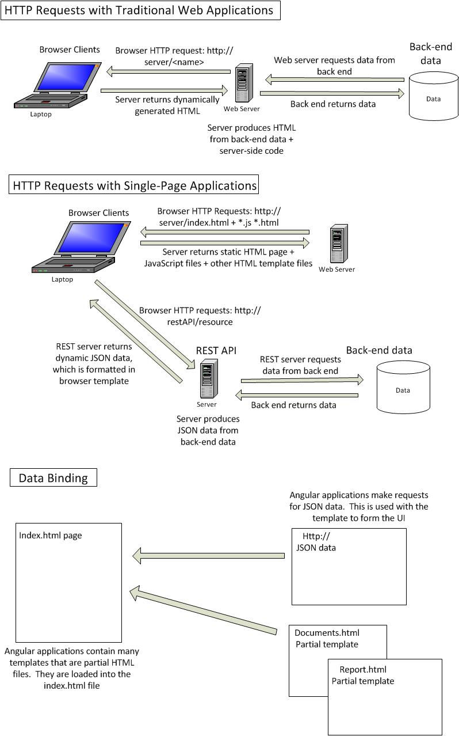
HTTP
Requests

Slide 9
Advantages Offered by Angular
WET Compliancy
Browse Compatibility
Cross Platform Portability
Angular packages are small in size.
The demo application is 2MB
Angular packages are composed of JavaScript bundles and an html file.

Slide 10
WET Compliancy
Angular uses pure HTML5 files for the views which lends itself to adapt well with WET4
WET 4 Template
CDTS (Centrally deployed template solution)
Look and Feel
Demo (form elements)
JQuery validation
WET4 validation
Demo (error messages, success message)
Translation
Bilingual (french and english)
In addition to the CDTS template, the application also uses an angular node module called angular-l10n
Demo (toggle link,angular-l10n in code)
Notes:
Demo the UI: Validation, modal dialogue, layout

Slide 11
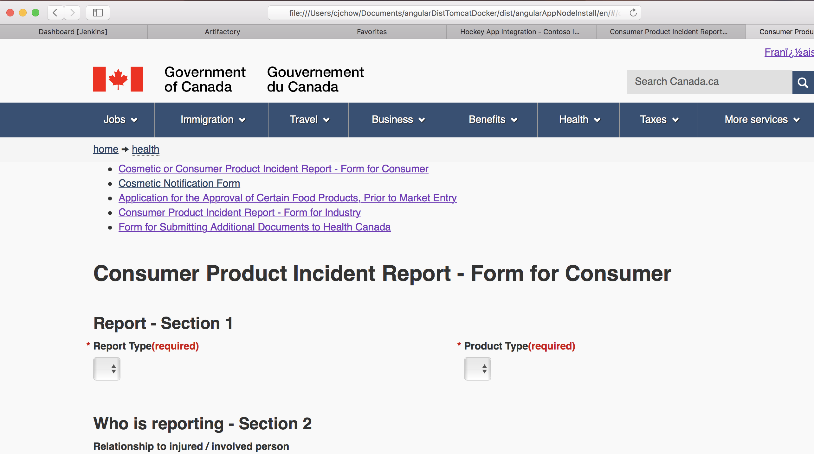
WET 4 (English)

Slide 12
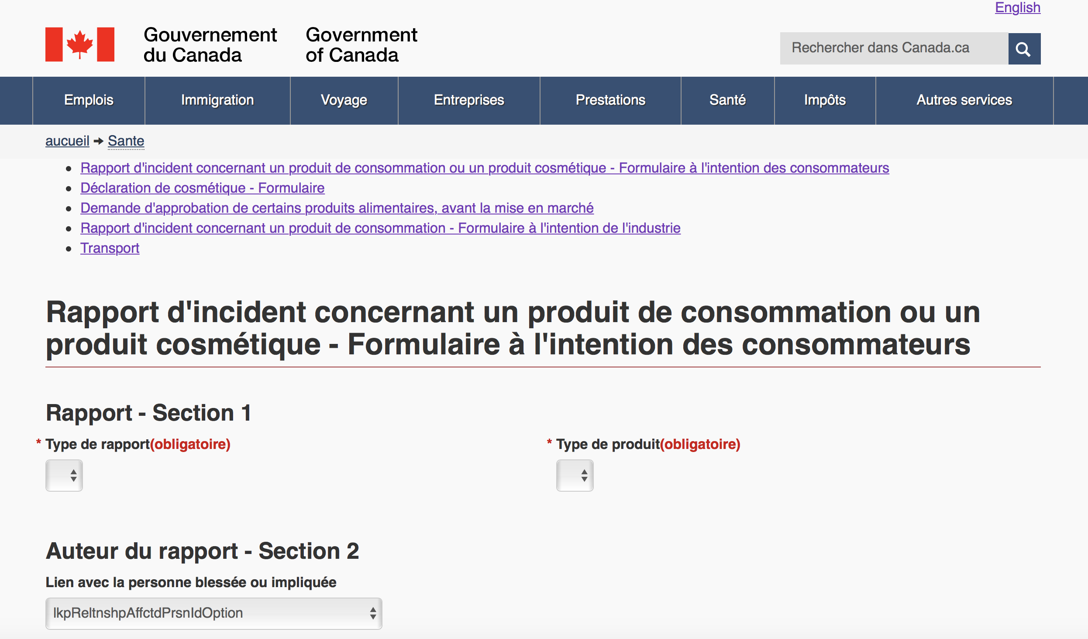
WET 4 (French)

Slide 13
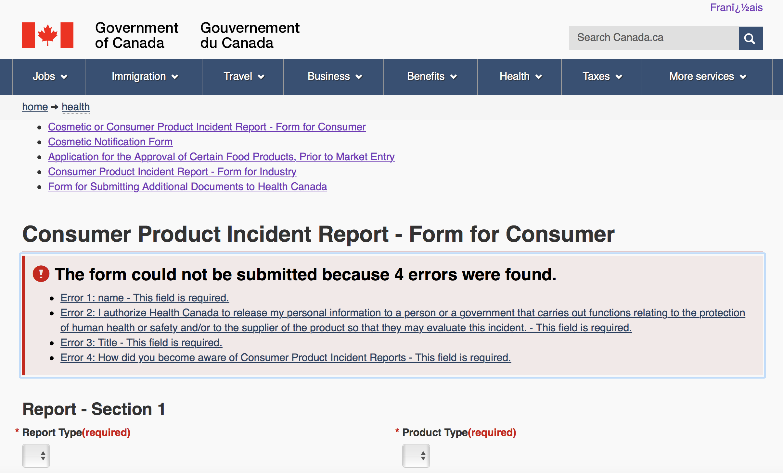
WET 4 Validation (English)

Slide 14
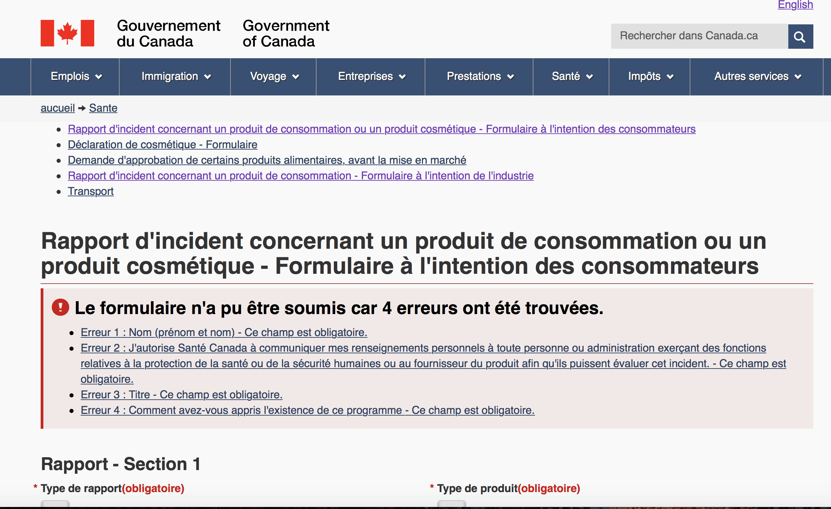
WET 4 Validation (French)

Slide 15
Browser Compatibility
Angular is compatible with the following browsers:
Firefox
Internet IE11
Note: polyfills must be manually applied.
Change the settings in the polyfills.ts file in angular application
Default is set to the latest version of browsers
Microsoft Edge
Chrome
Chromium
Safari

Slide 16
Cross Platform Portability
Angular packages are comprised of javascript bundles and an index.html file.
These applications can be deployed to various platforms using the same code base.
Some platforms include:
Webservers
Desktop
Mobile
There is no need to maintain two versions of the same application, one for the web and one for mobile.

Slide 17
Create an application
Download NodeJS (>=8)
Install angular-cli (application used to created an application with a default structure)
npm install –g @angular/cli
Type the following commands into a command prompt:
Create application
ng new <name of application>
Move into the application folder
cd <name of application>
Test the application
ng serve
Tips: Some commands to look at are:
ng generate component
ng generate services
Demonstration
Most important file is package.json (similar to pom.xml)
Defines the dependencies (node modules) and additional configuration for the application
Running the command npm install will process this file

Slide 18
Code Management
Angular application code can be stored in a version control system
GitLab or GitHub
Demonstration
Angular application stored in a local GIT repository
Angular application stored in a remote GIT repository in GitLab
Tips:
Ensure that a gitignore file exists to filter specific directories and files including:
node_modules folder (generated dynamically)
“dist” folder (used for deployment)
Sample of gitIgnore file

Slide 19
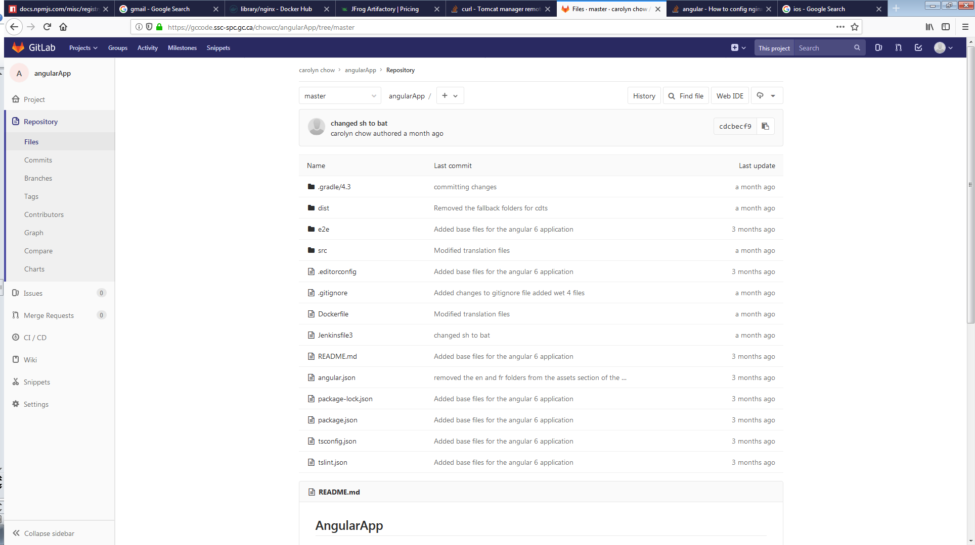
Git lab/ Git Hub

Slide 20
Artifact Mangement
Angular application packages can be managed from a public NPM repository
https://registry.npmjs.org
Must pay for an account
A private NPM repository is another option.
Verdaccio is a lightweight npm proxy registry
It can be installed using “npm install –global verdaccio”
There is also a docker image called “verdaccio/verdaccio”
An NPM repository can be configured in Artifactory Pro.
Packages can be published to a repository using the following command:
npm publish –-registry http://<localhost>:<port >
The package will be saved as gzipped tar file in the repository
Tip:
Change the property “private” in the package.json file from “true” to “false”. NPM will not publish a package is the value is true.

Slide 21
Deployment
Packaging
Local
Production
Deployment
Manual
Automated
Platforms
Webservers
Desktop
Mobile
Notes:
Webservers
-Demonstrate how the dist folder is deployed to a tomcat container on desktop
-Demonstrate how the dist folder is deployed to docker (tomcat and dist folder)
-Include the dockerfile and jenkinsfile
Desktop
-Demonstrate example of

Slide 22
Packaging
Local
To package the application for local testing run the following command:
ng serve (package is deployed on npm server)
To view the application use url: localhost:4200/<name of application>
Demonstration
Production
To package the application for production run the following command:
ng build –-prod
To view the application use url: <localhost>:<port>/<name of application>
By default a “dist” folder is created to contain the application.
Tip: The directory can be modified in the file angular.json
“build”:{…”outputPath”:”dist”}
Demonstration
Note the application contains two folders “en” and “fr”. Each folder also contains an index.html file. This structure was used to accommodate WET 4.

Slide 23
Manual build and deployment process
The process to manually build and deploy an angular application is as follows:
Package the application
Run a command similar to the following:
ng build --prod --output-path=dist/angularAppNodeInstall/fr/ --index=src/fr/index.html --deploy-url=./
Copy the resulting “dist” folder to a specific platform
Demonstration
Tomcat web server

Slide 24
Automated build and deployment process
Jenkins can be used to automate the process of building and deploying Angular applications
Build automation
Package the application
Demonstration
Jenkins pipeline (jenkinsfile)
Deployment automation
Jenkins pipeline (jenkinsfile)
Demonstration
Describe jenkinsfile and docker file
Notes:
The pipeline will a git checkout from the specified git repository and store the code into a jenkins workspace.

Slide 25
Platforms
Webservers
Tomcat server, Apache server, npm server
Demonstration
application running in tomcat webserver
Desktop
Electron
A framework, created by GitHub, that is used to create native cross-platform desktop applications.
The runtime environment is comprised of Chromium (web browser) and Node.js.
Demonstration
electron application
Docker
An enterprise containerized platform
Jenkins (pipeline)
Dockerfile
docker-compose yml file
Demonstration
Docker container that contains tomcat and angular application (inside the tomcat webapps folder)
Docker compose network that contains the docker container

Slide 26
Platforms
Mobile
Portable devices
Tablets
Cellphones
Mobile platforms
Android
iOS
Development framework
Cordova
PhoneGap
Development IDE
Visual Studios Community
Create application
Use Visual Studio Community (Cordova)
Demonstration
cordova project and the resulting apk
Application distribution
HockeyApp
A tool used to build, test and release mobile applications
Moving to App Center
Demonstration
uploading an apk file to Hockey app.
Show the mobile application installed on an android tablet

Slide 27
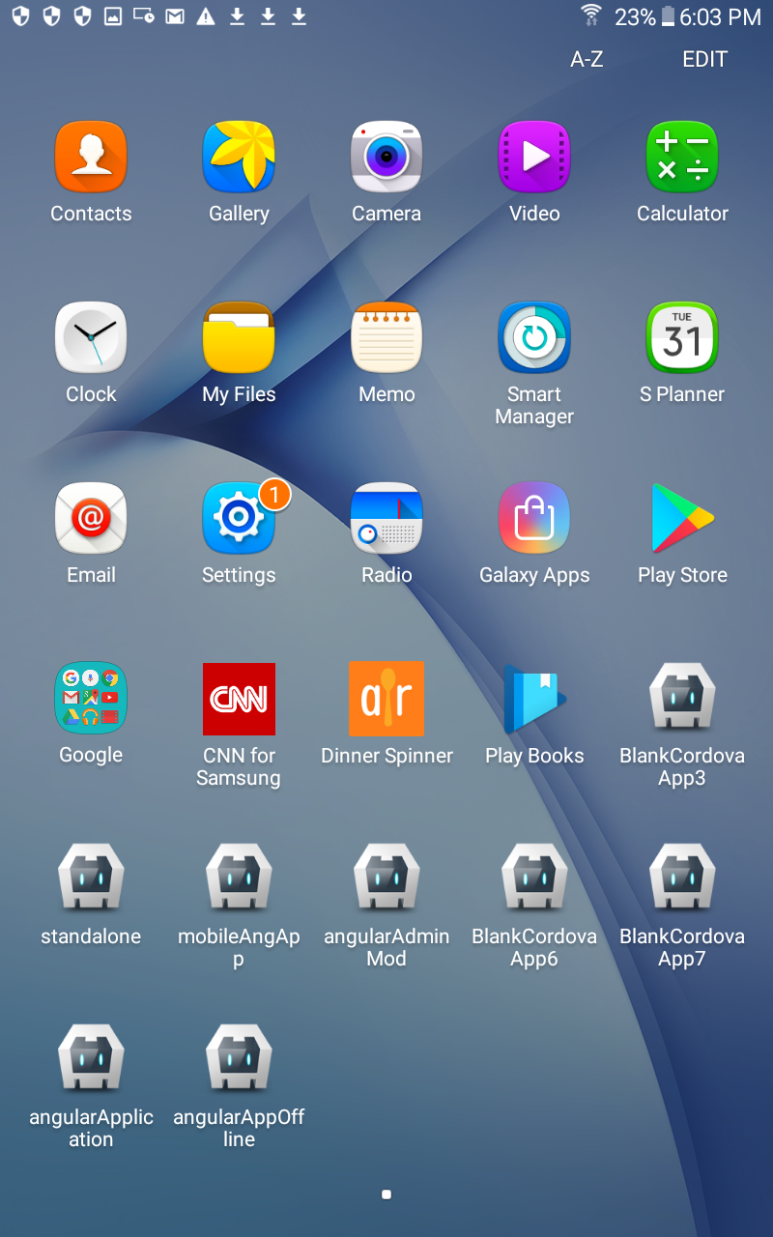
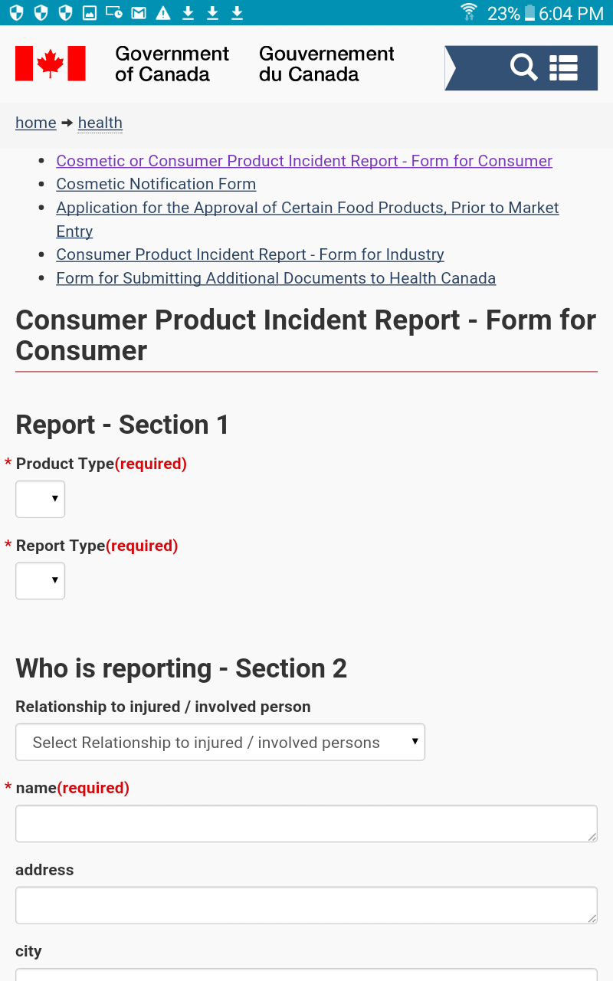
Mobile application on Android tablet

Slide 28
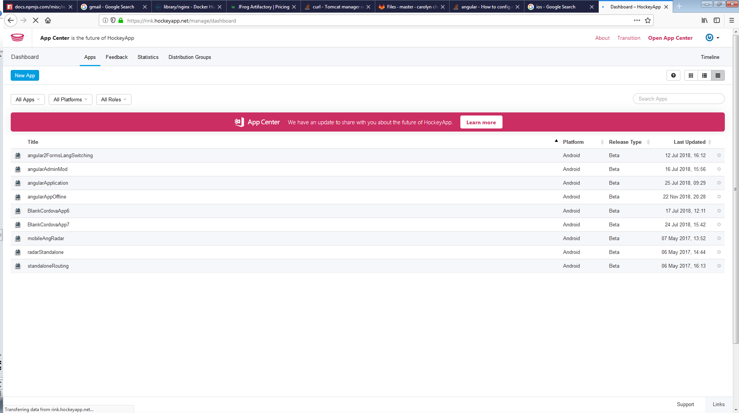
Mobile application distribution
Hockey App/Visual Studio App Center

Slide 29
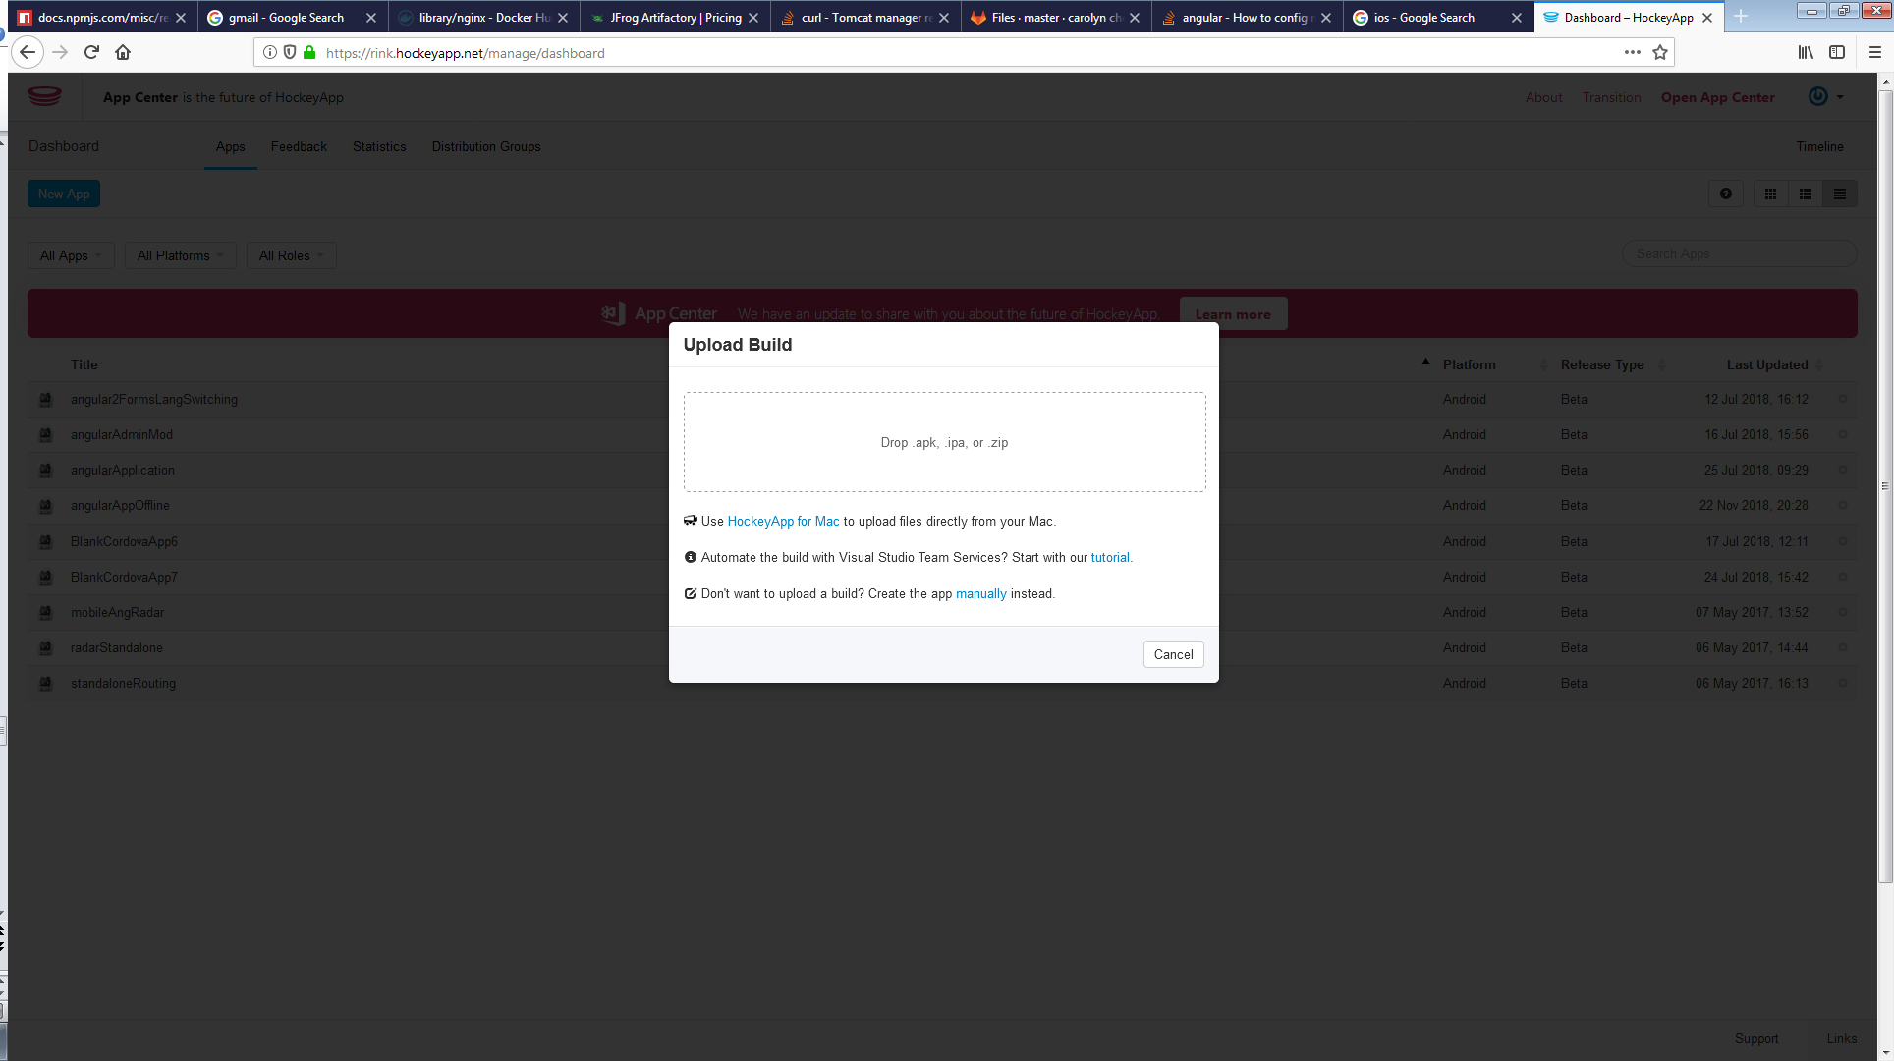
Mobile application distribution

Slide 30
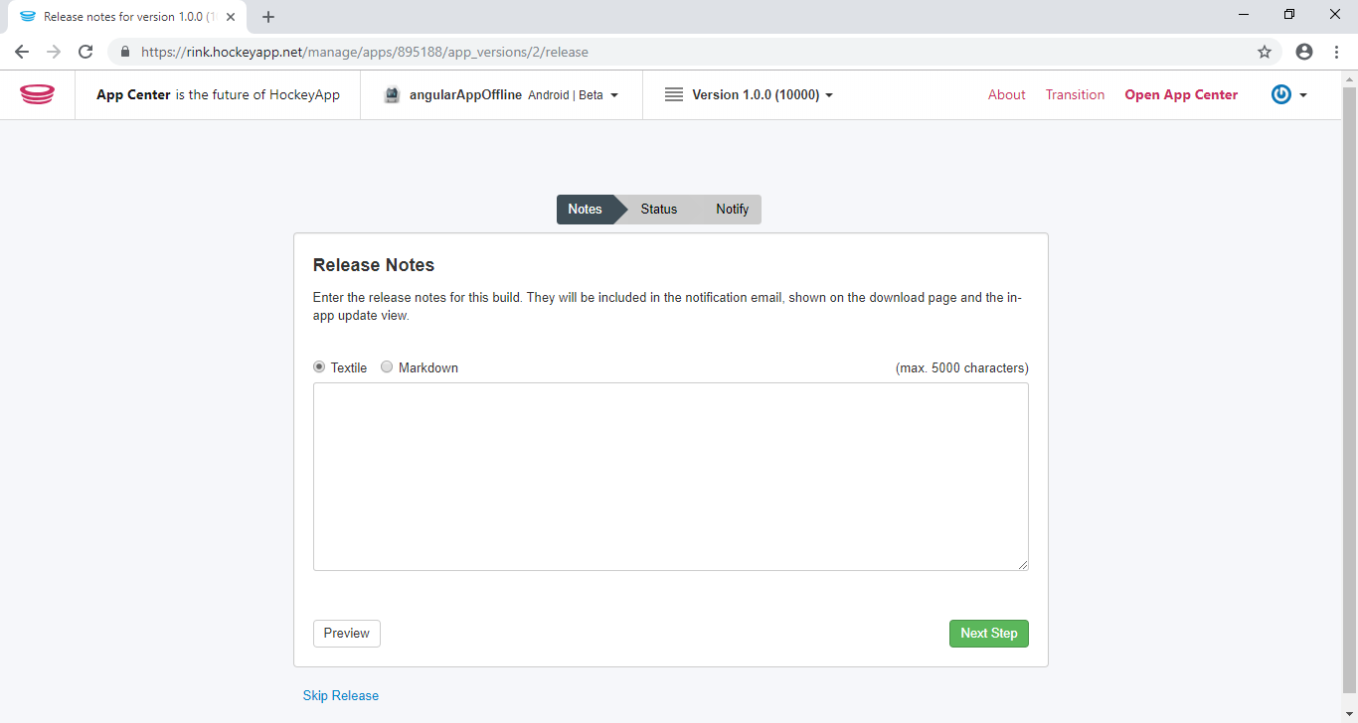
Mobile application distribution

Slide 31
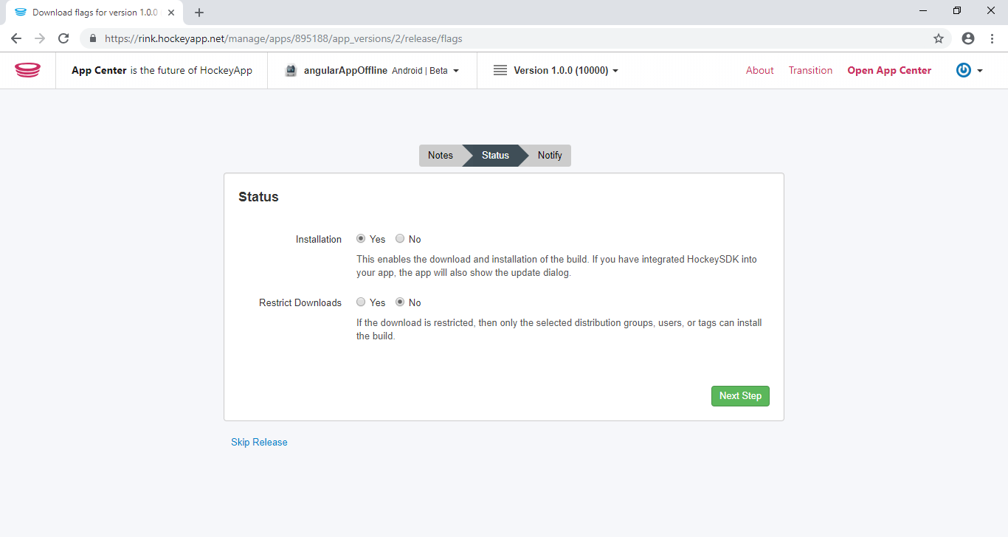
Mobile application distribution

Slide 32
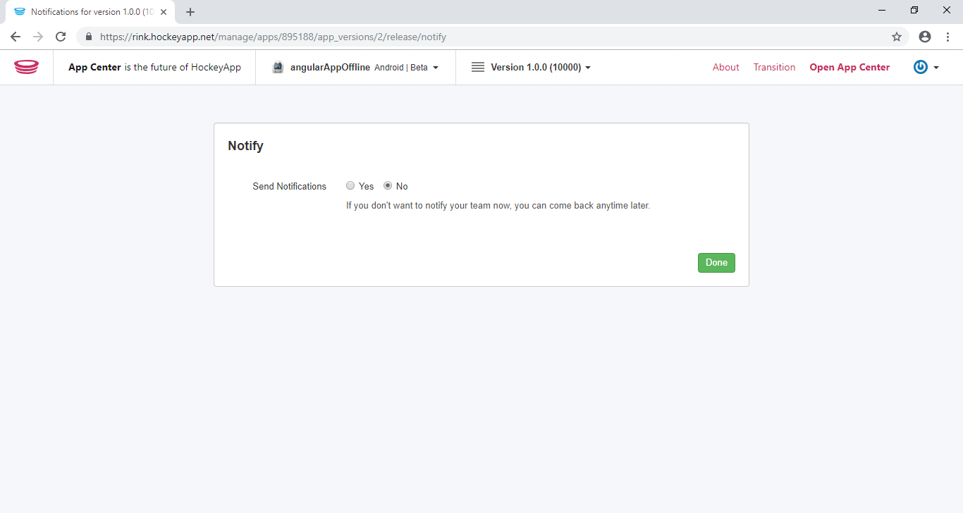
Mobile application distribution

Slide 33
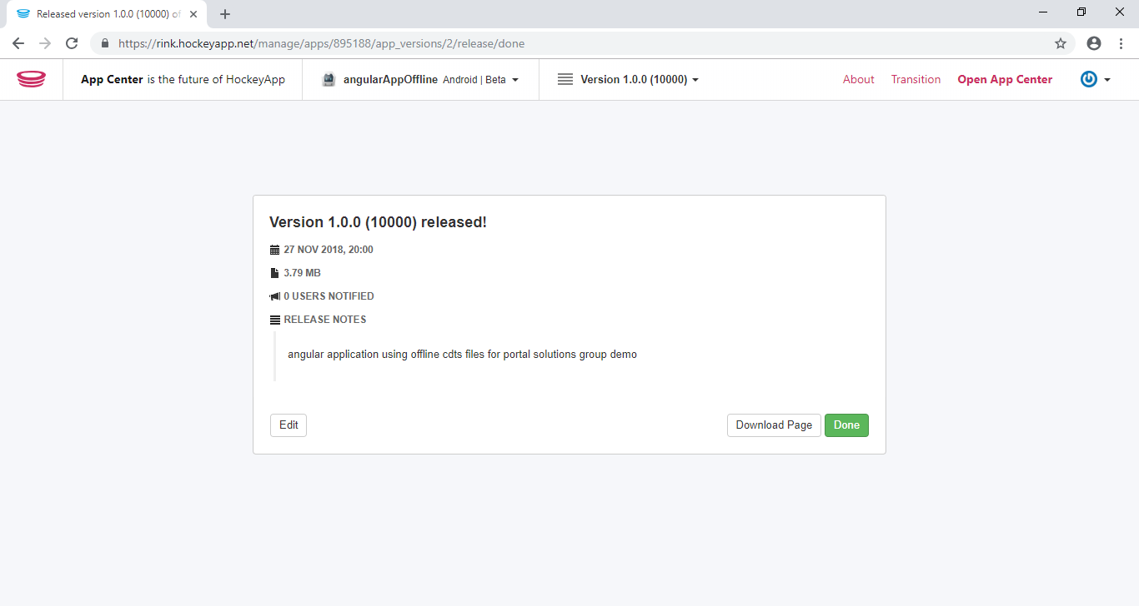
Mobile application distribution

Slide 34
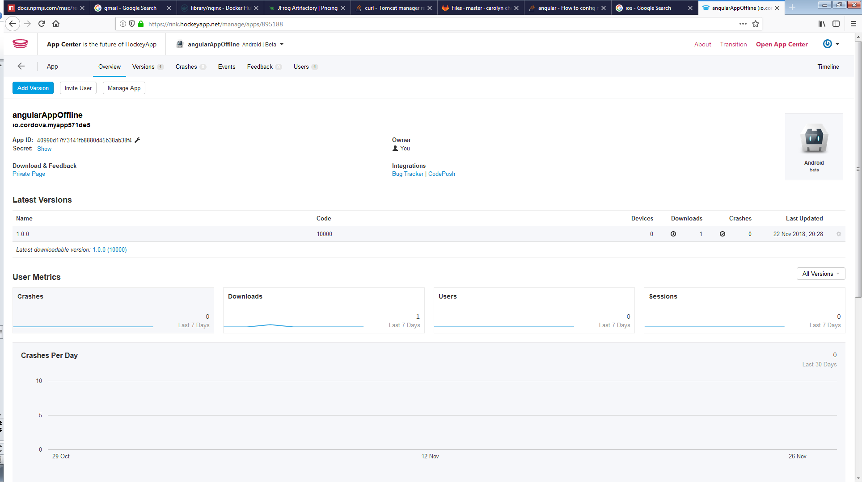
Mobile application distribution

Slide 35
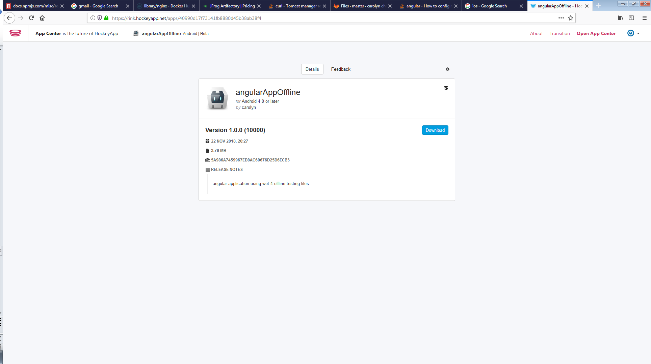
Mobile application distribution

Slide 36
Appendix 1
How to install and create Angular application
Install node.js version 8 and higher
Install angular cli
Follow the instructions from the website https://angular.io/guide/quickstart
How to install and create an Electron application
Follow the instructions from the website https://www.npmjs.com/package/electron-cli
To integrate angular application, move the contents of the dist folder into the main project folder
How to create a cordova application using Visual Studios Community
Download the application from the website https://visualstudio.microsoft.com/vs/features/cordova/
Install the Visual Studio Community Edition that includes Cordova
Create a cordova project and move the contents of the dist folder to the www folder
How to create a phoneGap application
Follow the instructions for the website https://phonegap.com/getstarted/
How to Install Docker
Follow the instruction for the website https://www.docker.com/get-started
How to install Tomcat
Follow the instructions from the website http://tomcat.apache.org/
How to distribute application to HockeyApp/Visual Studios App Center
Follow the instructions from the website https://hockeyapp.net/ to create an account
Follow the instructions to upload a mobile application from the website: https://azure-samples.github.io/ContosoInsurance/resources/2001/06/02/hockey-app-integration.html
WCAG and WET Validation
W3C validator (https://validator.w3.org/)
WAVE (https://wave.webaim.org/)

Slide 37
Appendix 2
Development IDE options
Microsoft Visual Studio Code
Microsoft Visual Studios
Webstorm
IntellJ
Eclipse

