Slide 1
How Many People will be Taking Uber near the Central Park?
Wei Zou

Slide 2
Data
Uber Pick-up Data
Weather Data
Big Event Data (to be collected)

Slide 3
Uber Data
Source: Taxi & Limousine Trip Record Data
http://www.nyc.gov/html/tlc/html/about/trip_record_data.shtml
Regular Taxi & Uber
Uber
Jan 2014 ~ June 2015
Pick-up location (264 zones)
Pick-up time (dd:hh:mm)

Slide 4
Weather Data
Source: National Centers for Environmental Information
http://www.ncdc.noaa.gov/cdo-web/datatools/findstation
Daily weather record for each station
Precipitation, Snow, Max Temp, Min Temp

Slide 5
Big Event Data
Sports, Music, Festival, etc

Slide 6
This Study
Uber Pick-up @ the Central Park Area (Subset)
Daily pick-up (Aggregate): 2015 Jan – June (181 days)
Key Questions:
What influencing factors can we use to predict uber travel demand?
Weather? Big events?

Slide 7

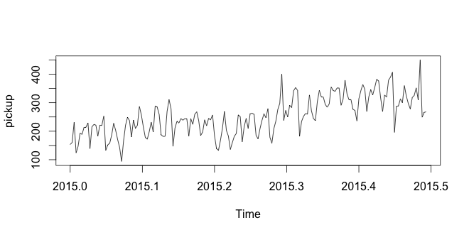
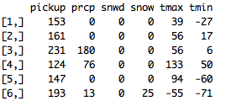
Initial Data Analysis

Slide 8
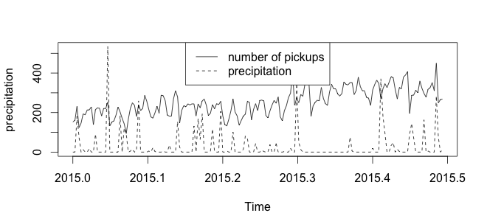
Initial Data Analysis

Slide 9
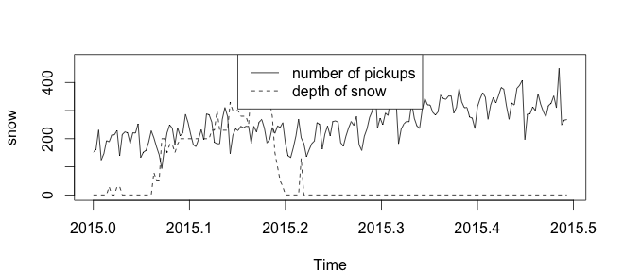
Initial Data Analysis

Slide 10
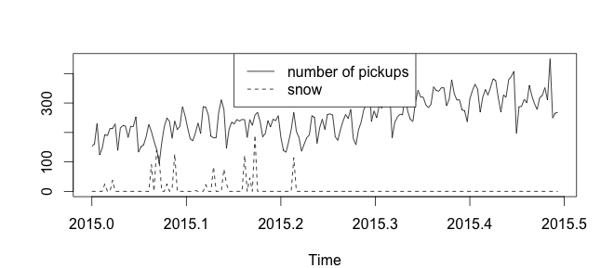
Initial Data Analysis

Slide 11
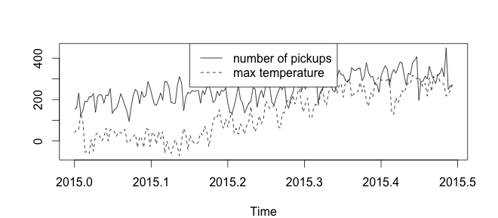
Initial Data Analysis

Slide 12
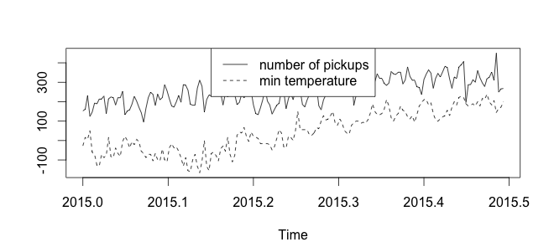
Initial Data Analysis

Slide 13
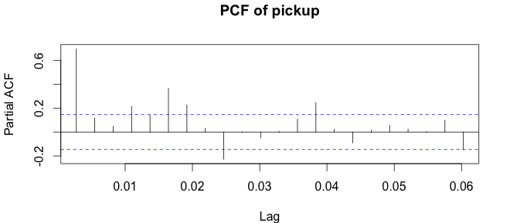
Initial Data Analysis

Slide 14
Modeling Idea
LR
Dependent Variable: # of customer pickups per day
Independent Variables: Precipitation, Snow, Temp, Dummy variables for seasonality (Monthly)

