Slide 1
Team 12
Project Presentation
2046024 이예원
2217015 신은지
2271034 신유진
2391028 조승연

Slide 2
Index
Preprocessing
Training
Further ensemble & Validation
Issues

Slide 3
Preprocessing
Handling Missing Value
: One-hot encoding including ‘unknown’
'unknown’ may also have some meaning
No special handling.

Slide 4
Preprocessing
Handling Missing Value
: One-hot encoding including ‘unknown’
'unknown’ may also have some meaning
No special handling.
But, We also tried changing ‘unknown’ to the average or mode.

Slide 5
Preprocessing
Delete Columns - categorical
: Check the relationship between all categories and y=1 for each column.

Slide 6
Preprocessing
In all case where housing = ‘no’,
> about 12% of the data is y=1
In all case where housing = ‘yes’,
> about 13% of the data is y=1
Cannot distinguish y=1 using ‘housing’

Slide 7
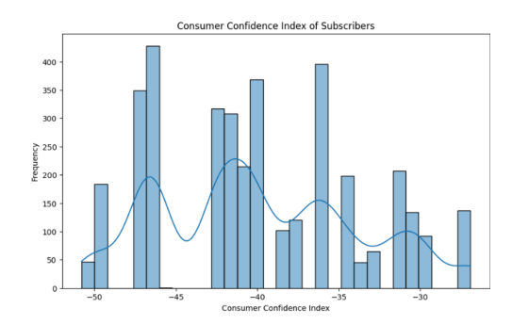
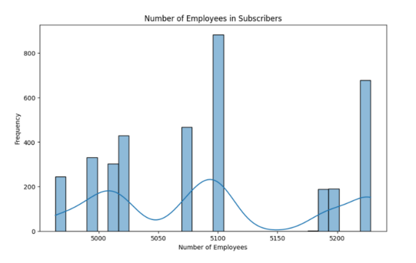
Preprocessing
Delete Columns – numerical
: check the distribution

Slide 8
Preprocessing
one-hot encoding & additional delete
: Apply to all categorical columns
Check y=1 ratio for each category -> delete

Slide 9
Preprocessing
['marital_divorced',
'marital_married', 'marital_single', 'marital_unknown', 'job_admin.',
'job_blue-collar', 'job_entrepreneur', 'job_housemaid',
'job_management', 'job_self-employed', 'job_services',
'job_student', 'job_technician', 'job_unemployed', 'job_unknown',
'education_basic.4y', 'education_basic.6y', 'educaztion_basic.9y',
'education_high.school',
'education_professional.course', 'education_unknown', 'default_unknown', 'default_yes’,
'contact_telephone', 'month_apr', 'month_aug’,
'month_jul', 'month_jun', 'month_may',
'month_nov’, 'poutcome_failure',
'poutcome_nonexistent']

Slide 10
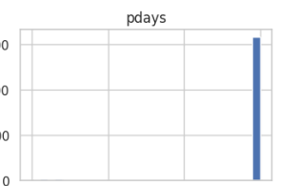
Preprocessing
Scaling ‘pdays’
: 999 -> -1
999 : have not been contacted

Slide 11
Preprocessing
Data Spliting & Oversampling SMOTEENN
: class imbalance of target
smoteenn = SMOTEENN(random_state=12)
X_smoteenn, y_smoteenn =
smoteenn.fit_resample(X_train, y_train)

Slide 12
Training
Model Training
Random Forest
Gradient Boost
Adaboost
LightGBM

Slide 13
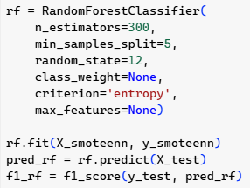
Model Training
1
Random Forest
Random Forest
Base : decision tree
Ensemble
Parameter optimizing
F1score : 0.4621643612693246

Slide 14
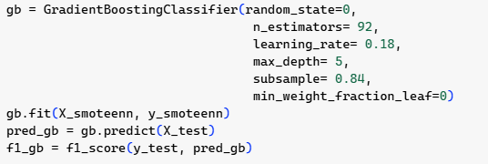
Model Training
2
Gradient Boost
Gradient Boost
Ensemble
Independent trees
Correcting err.
With gridSearchCV

Slide 15
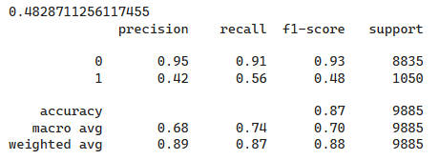
Gradient Boost – result
Model Training
2
Gradient Boost

Slide 16
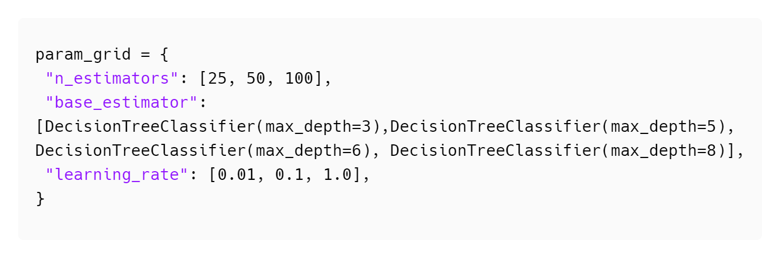
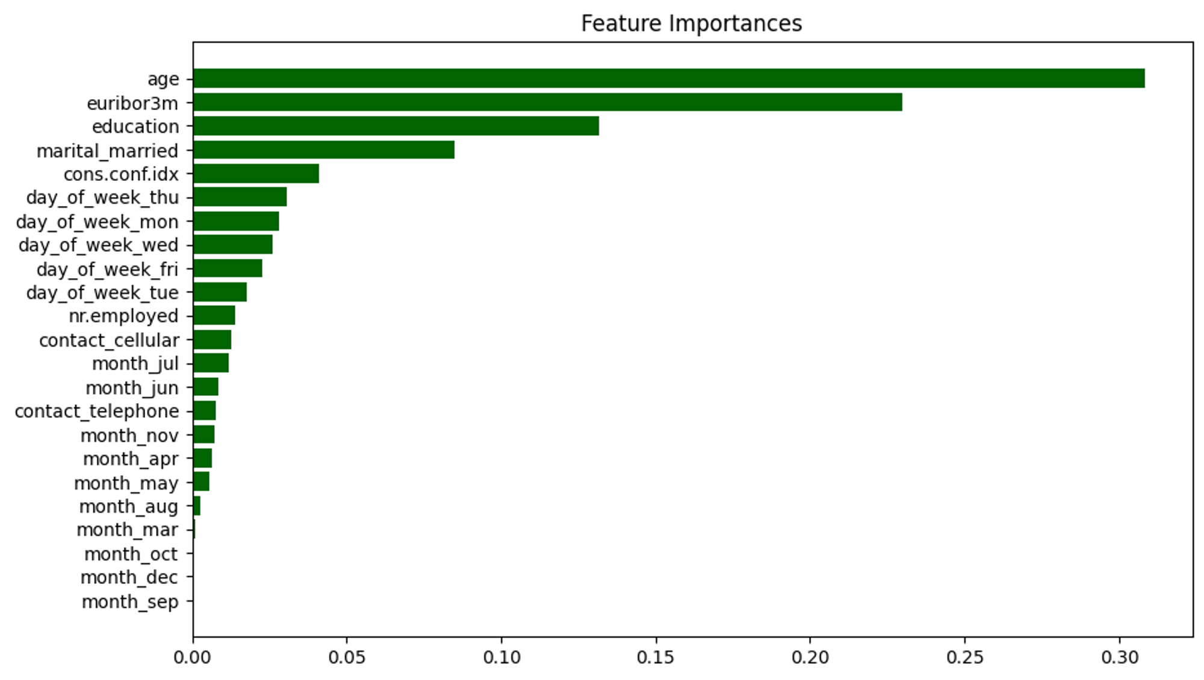
Model Training
Ada Boost
3
- Boosting by giving weight to error data of the weak learner
from sklearn.ensemble import AdaBoostClassifier
Feature Importance
GridSearchCV
n_estimators
Specifies the number of learners. Larger values increase complexity,
improve performance, and risk of overfitting.
base_estimator
The deeper the depth, the greater the complexity, the risk of overfitting.
learning_rate
Adjusts contribution. The higher it is, the higher the learning speed.
Risk of model not being optimized.

Slide 17
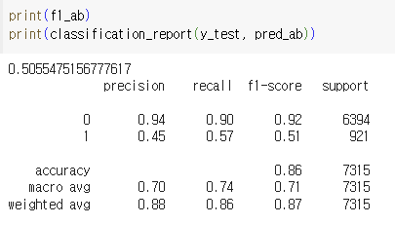
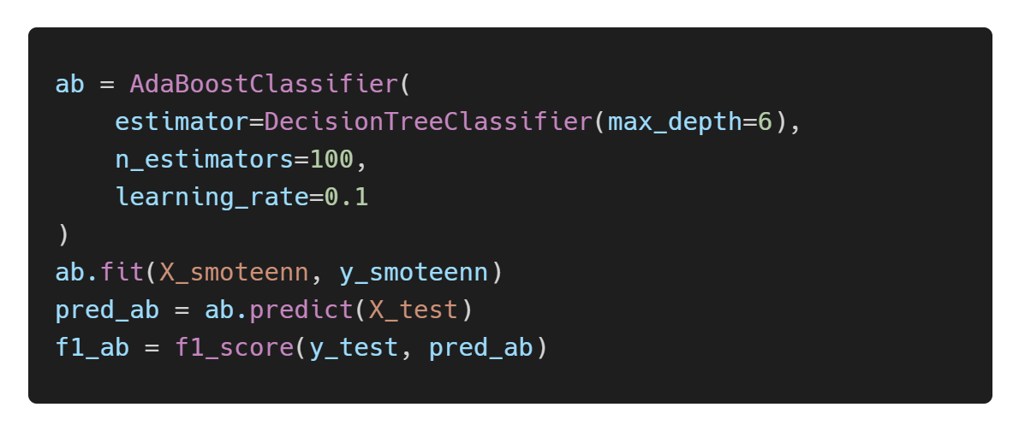
Model Training
Ada Boost
3
- Boosting by giving weight to error data of the weak learner
from sklearn.ensemble import AdaBoostClassifier
Result
Optimal Model

Slide 18
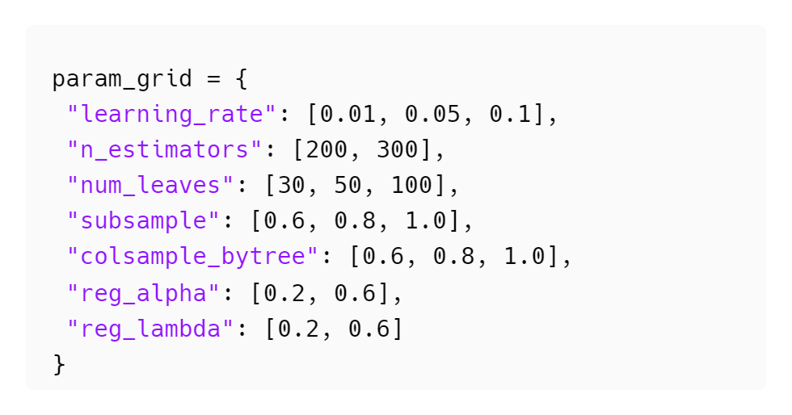
Model Training
LightGBM
4
- automatically finds rules in data through learning and creates tree-based classification rules
- the tree size must be appropriately adjusted to prevent complexity and overfitting
from lightgbm import LGBMClassifier
learning_rate
weights multiplied for each iteration of boosting.
GridSearchCV
n_estimators
number of trees.
num_leaves
the maximum number of leaves per tree.
subsample
Fraction of data to consider for each iteration.
colsample_bytree
Fraction of features to consider for each iteration.
reg_alpha
adjust L1 regularization.
reg_lambda
adjust L2 regularization.

Slide 19
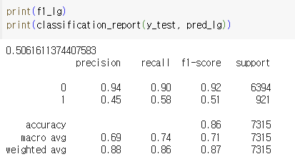
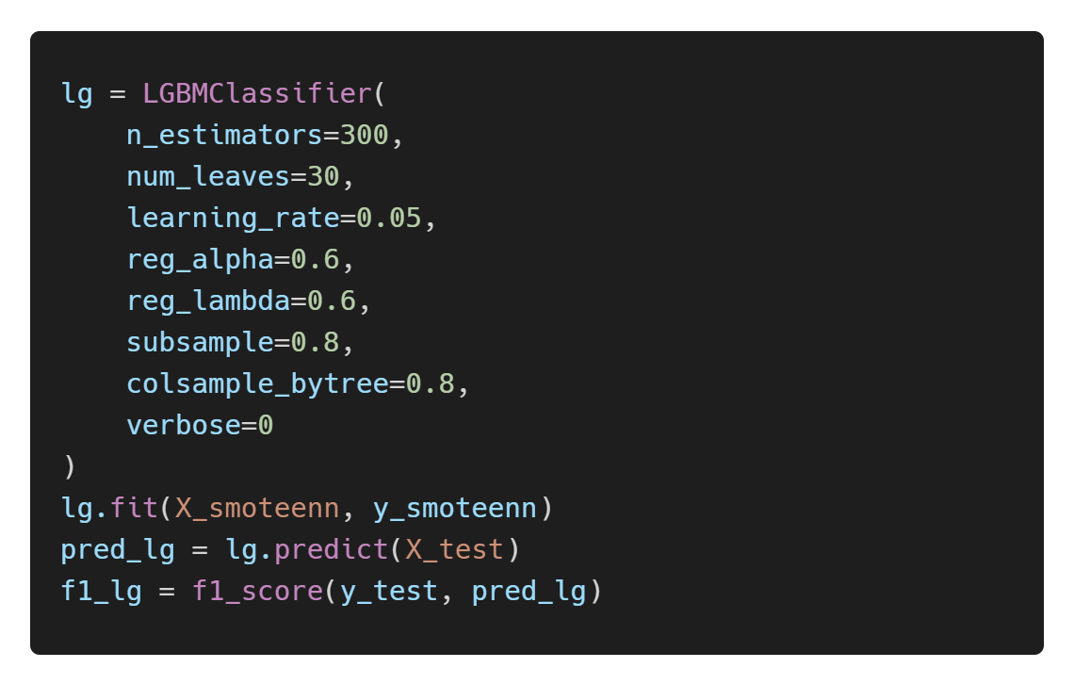
Model Training
LightGBM
4
- automatically finds rules in data through learning and creates tree-based classification rules
- the tree size must be appropriately adjusted to prevent complexity and overfitting
from lightgbm import LGBMClassifier
Result
Optimal Model

Slide 20
Further ensemble & Validation
Soft Voting
Random Forest
Gradient Boosting
Voting
output
Ada Boost
combines predictions from multiple machine learning models
to improve performance and reduce overfitting.
LightGBM
Hard Voting
The final voting result is determined
by the decision value chosen by the majority of classifiers.
Soft Voting
The final voting result is determined
by averaging the decision probabilities calculated by each classifier.

Slide 21
Further ensemble & Validation
Soft Voting
Random Forest
Gradient Boosting
Voting
output
Ada Boost
combines predictions from multiple machine learning models
to improve performance and reduce overfitting.
LightGBM
We chose Soft voting to reflect the probability differences in predictions,
even when the final outcomes are the same.
Hard Voting
The final voting result is determined
by the decision value chosen by the majority of classifiers.
Soft Voting
The final voting result is determined
by averaging the decision probabilities calculated by each classifier.

Slide 22
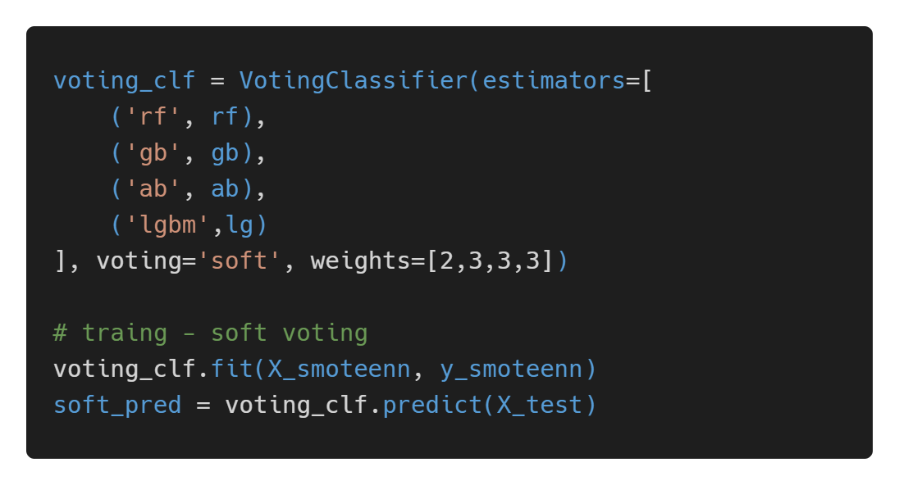
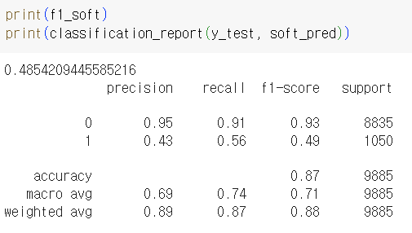
Further ensemble & Validation
Soft Voting
from sklearn.ensemble import VotingClassifier
Models
Optimal Model
RandomForest, GradientBoosting, AdaBoost, LightGBM
Reflection Ratio
2:3:3:3 (determined experimentally)
Result
Performance
The soft voting model achieved an F1 score of 0.49

Slide 23
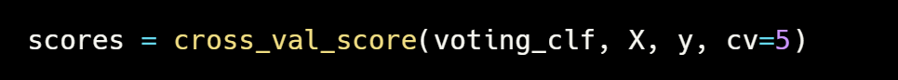
Further ensemble & Validation
Validation
- To ensure that the model is trained evenly across all data samples
Cross Validation
A method of repeating training and validation by dividing the data multiple times to more accurately evaluate model.
K-Fold Cross Validation
Divide the dataset into K fold and use each fold as a validation dataset
Fold 1~5 Score
[0.89908953 0.90242792 0.89878604 0.89802731 0.89575114]
Mean Score
mean score: 0.8988163884673748

Slide 24
Issues
Problem
Standard
Scaler
SMOTEEEN
Issue !!
:The ratio of target values during training was the opposite of that during testing.

Slide 25
Issues
Solution
1. Consistent Use of Scaler for Both Training and Testing Data
df_train = scaler.fit_transform(df_train)
...
df_test = scaler.fit_transform(df_test)
df_train = scaler.fit_transform(df_train)
...
df_test = scaler.transform(df_test)
'fit' the scaler only on the training data

Slide 26
Issues
Solution
2. Switching from StandardScaler to MinMaxScaler
scaler = StandardScaler()
standardizes features by centering them around a mean of 0
and scaling them to have a standard deviation of 1
The generated samples tend to cluster around a mean of 0, potentially making the model more sensitive to the input data.
SMOTEEEN
Oversampling technique

Slide 27
Issues
Solution
2. Switching from StandardScaler to MinMaxScaler
scaler = StandardScaler()
scaler = MinMaxScaler()
adjusts the minimum and maximum values of the data to fit within the range of [0, 1]

Slide 28
Thank you

