Slide 1
Fridays and holidays impact on Stock Trends
• Alex Burch • Martin Hrbac • Roderick Reynolds • Rodney Kirkendoll • Serena Leung • Sunil Joshi •

Slide 2
Research question
Do weekends actually affect the market? Does it affect industries differently?
Ho=Weekends have no impact on the stock market
Ha=Weekends will cause the market to have a fluctuation (up or down) right before the weekend or the holiday

Slide 3
Exploratory data analysis

Slide 4
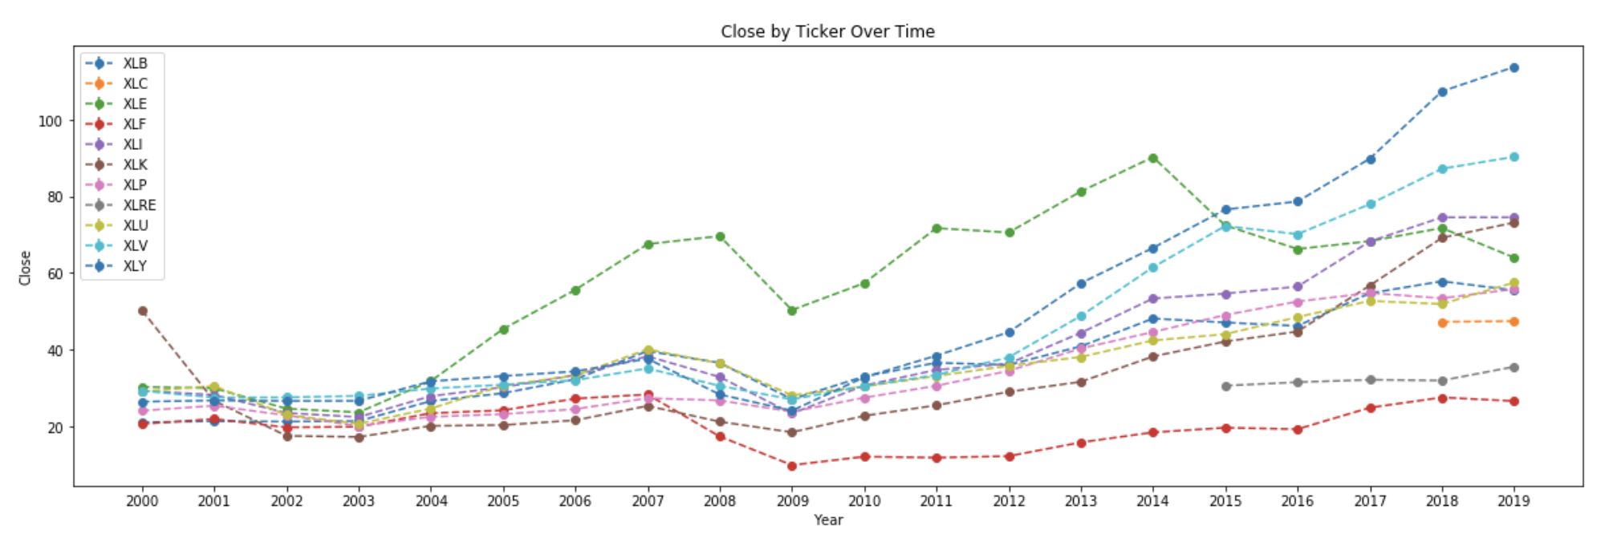
Close by Ticker over time
While the Energy sector had historically high returns, it has recently been surpassed by Consumer Discretionary, Healthcare, Industrials, and Technology

Slide 5
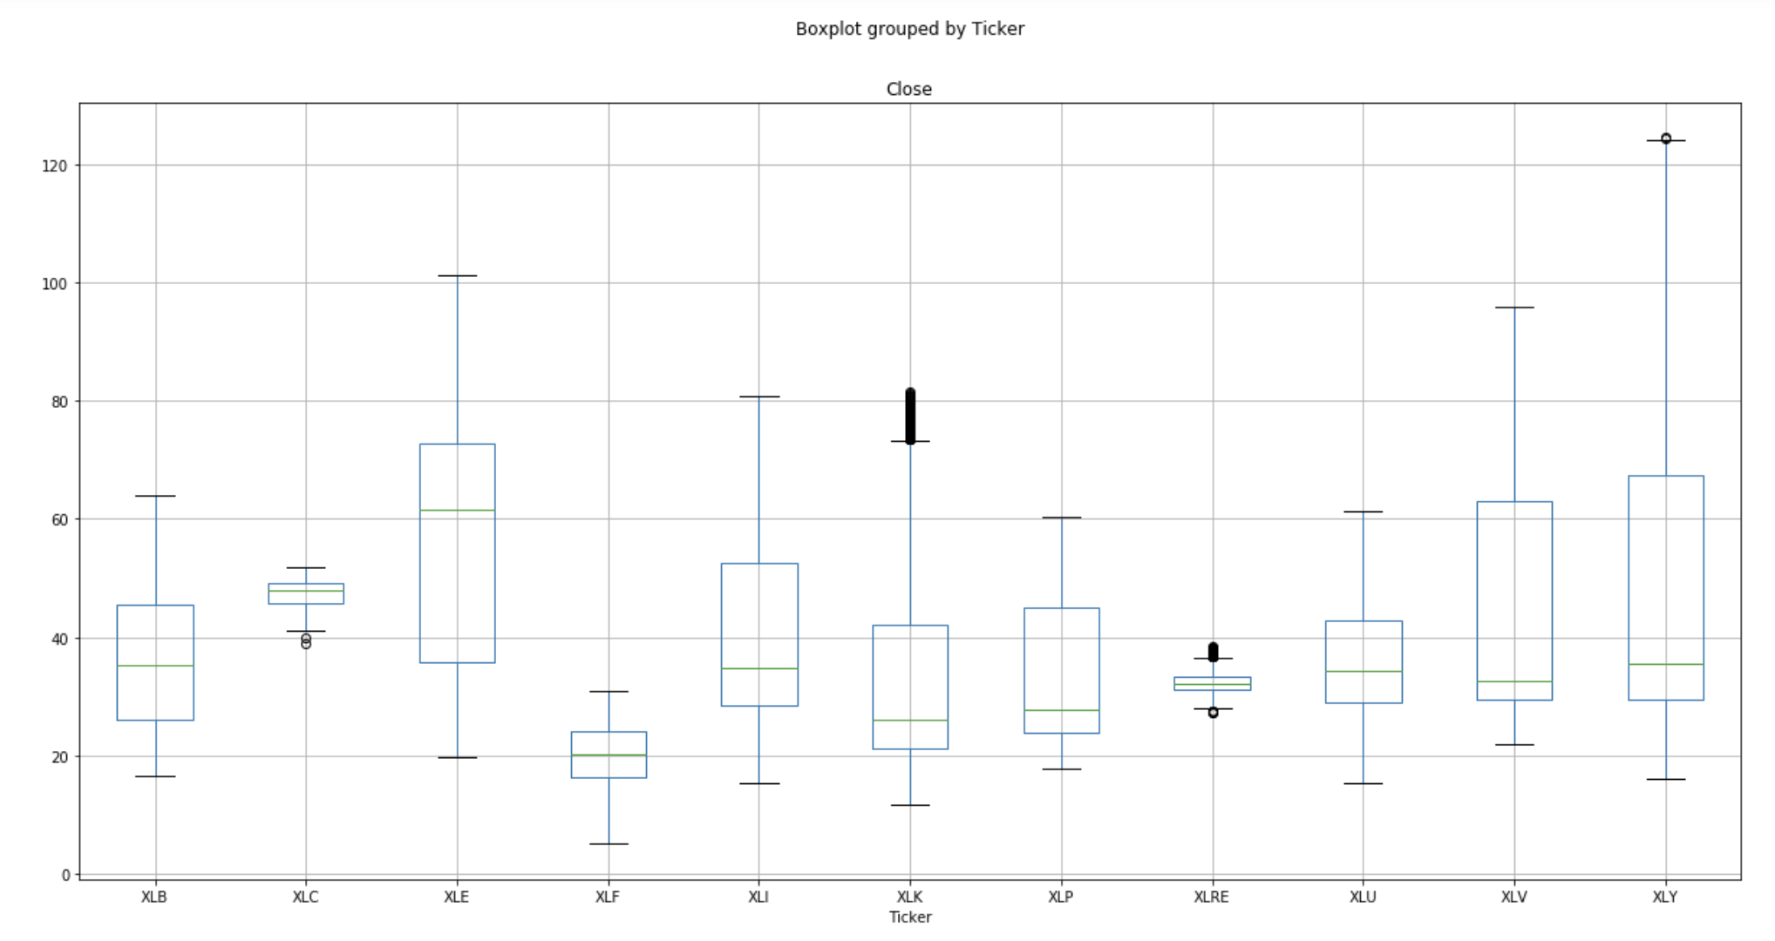
Exploratory Data Analysis: Boxplot by Ticker
Median closing price is highest for the Energy sector. Telecomm. and Real Estate Sector’s close have a very tight spread. Energy, Healthcare, and Consumer Discretionary sectors have higher variance in closing price.
Materials Sector
Telecomm. Svcs. Sector
Energy Sector
Financial Sector
Industrials Sector
Technology Sector
Consumer Staples Sector
Real Estate Sector
Utilities Sector
Healthcare Sector
Consumer Discretionary Sector

Slide 6
data analysis

Slide 7
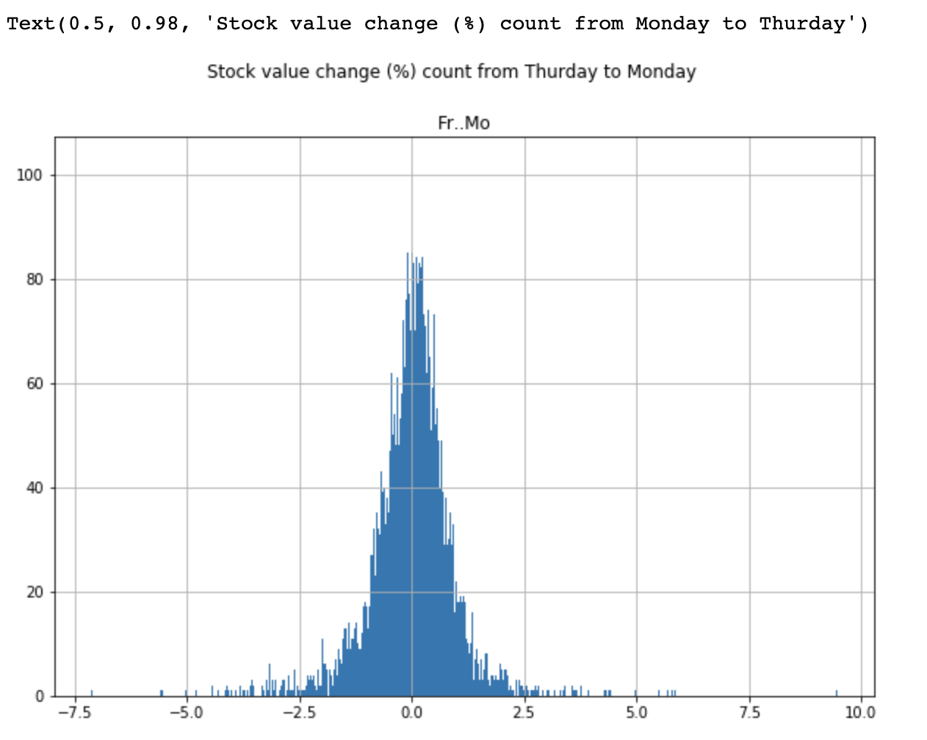
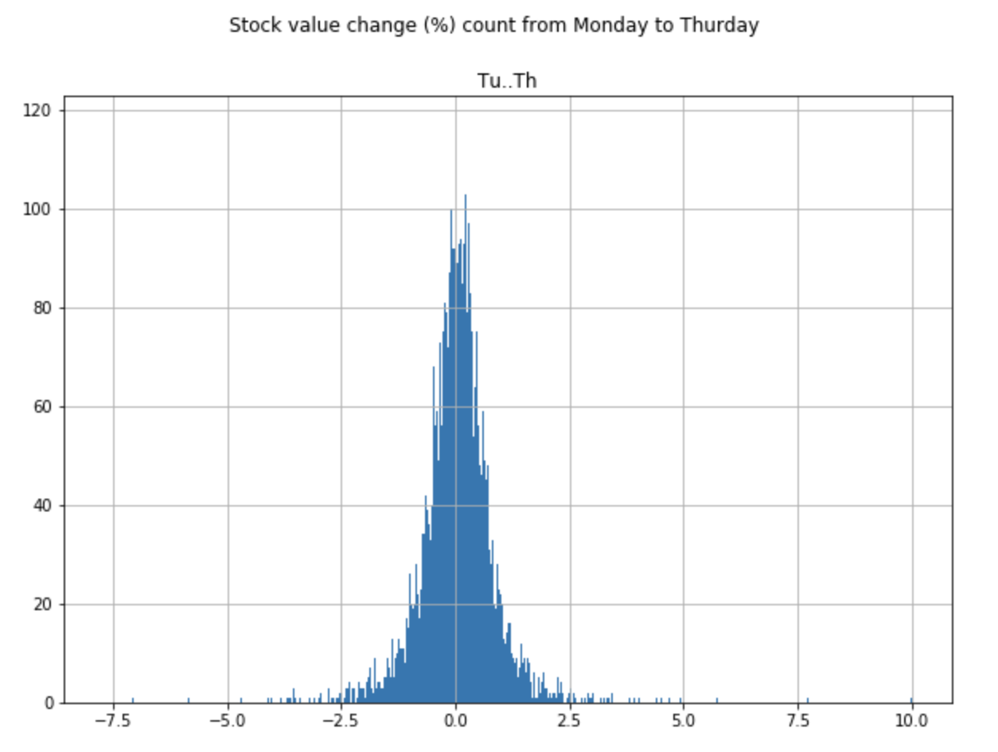
Distribution of % change
% change from Thursday to Monday and Monday to Thursday appears to be normally distributed

Slide 8
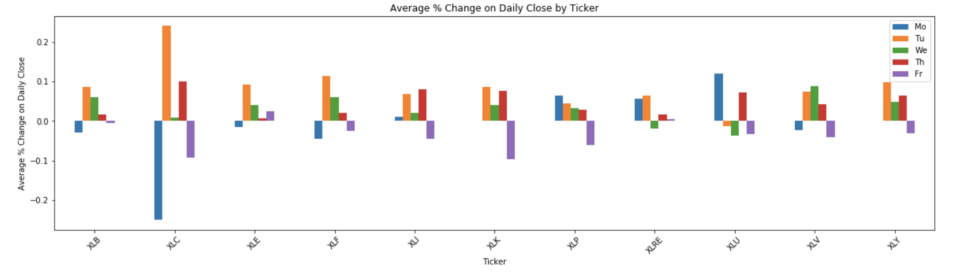
Daily Close % change shows spike on Tuesdays for most Sectors
Materials Sector
Telecomm. Svcs. Sector
Energy Sector
Financial Sector
Industrials Sector
Technology Sector
Consumer Staples Sector
Real Estate Sector
Utilities Sector
Healthcare Sector
Consumer Discretionary Sector

Slide 9
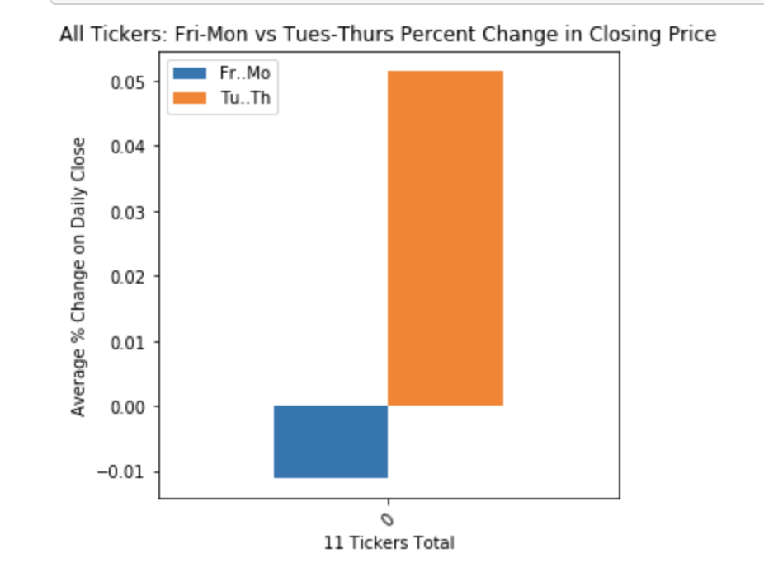
Overall Market: Tues. to Thurs. vs Fri. to Mon. Comparison
Significantly higher returns are seen from Tuesday to Thursday than Friday to Monday
T-statistic=-4.39
p-value=0.00001
Significantly different at 0.05 level

Slide 10
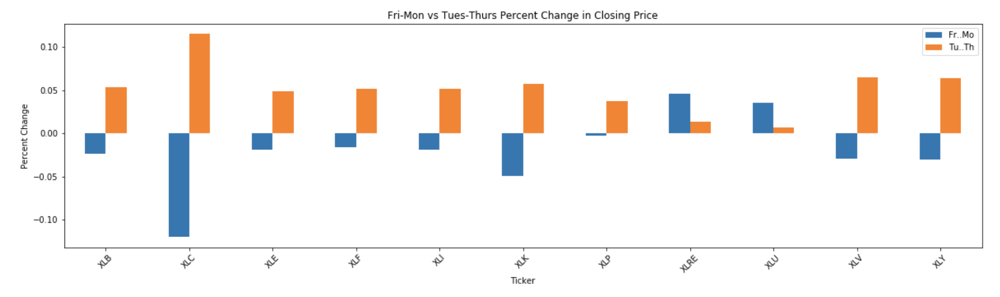
Historical data shows Fri-Mon change is only higher on two tickers
Differences in time periods of interest are only significant for Technology, Healthcare, & Consumer Discretionary sectors
Red = significantly different at 0.05 level
Materials Sector
Telecomm. Svcs Sector
Energy Sector
Financial Sector
Industrials Sector
Technology Sector
Consumer Staples Sector
Real Estate Sector
Utilities Sector
Healthcare Sector
Consumer Discretionary Sector
t-statistic 1.56
p-value=0.12
t-statistic 1.28
p-value=0.20
t-statistic 1.24
p-value=0.21
t-statistic 1.18
p-value=0.24
t-statistic 1.66
p-value=0.10
t-statistic 2.16
p-value=0.03
t-statistic 1.40
p-value=0.16
t-statistic -0.44
p-value=0.66
t-statistic -.79
p-value=0.42
t-statistic 2.67
p-value=0.007
t-statistic 2.16
p-value=0.03

