Slide 1
Sexual Violence in the U.S.
Serena Lee

Slide 2
AGENDA
Background & Data
Incidents over time
Demographic Analysis
Reporting
Conclusions

Slide 3
Background & Data

Slide 4
Background
Rape:
1 in 4 women; 1 in 26 men
Unwanted sexual contact:
1 in 2 women; 1 in 5 men
Barriers:
Most cases go unreported
Nondisclosure in surveys
Data sources:
National Intimate Partner and Sexual Violence Survey; CDC
National Sexual Violence Resource Center

Slide 5
Dataset: National Crime Victimization Survey
Incident reports from 1992-2024
Incident level data (household and individual available)
Nationally representative sample of about 240,000 persons in 150,000 households
Offender, crime, reporting/reasoning, experiences in justice system

Slide 6
Distribution
Type of Crime | Count
Completed Rape | 1237
Attempted Rape | 683
Sexual attack with assault | 343
Sexual assault; no injury | 643
Unwanted sexual contact without force | 313
Sexual Harassment | 541
Total incidents: 329,678
Total SV incidents: 3,760

Slide 7
Incidents over time

Slide 8
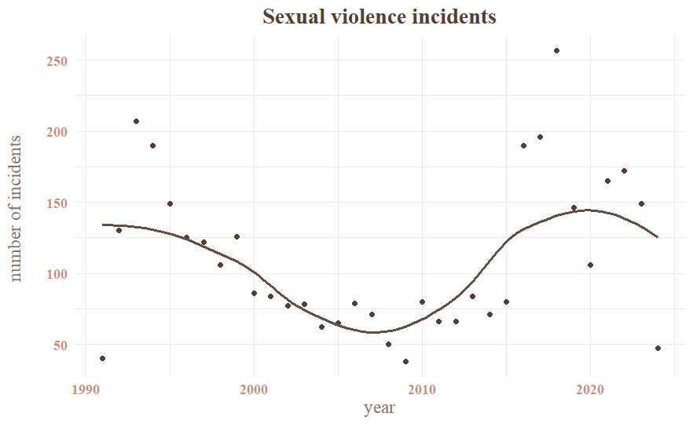

Slide 9
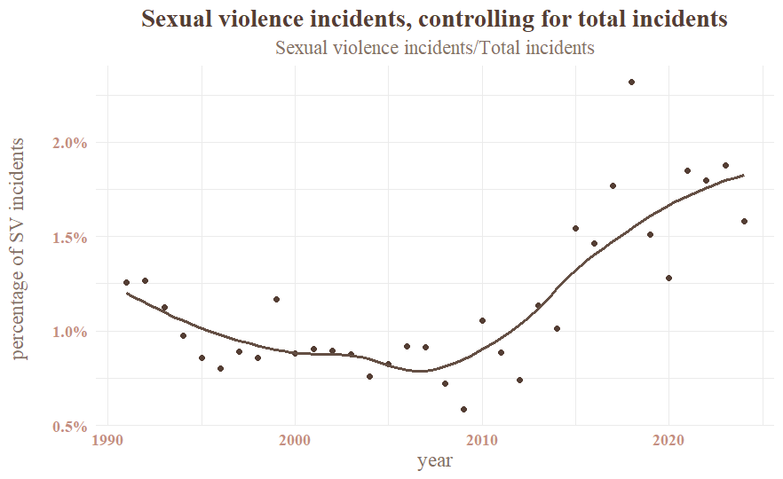

Slide 10
Demographic analysis: age

Slide 11
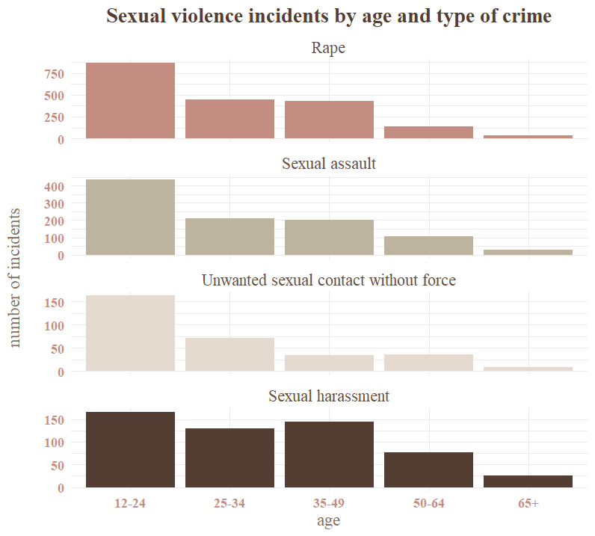

Slide 12
Reporting

Slide 13
Quick stats
On average, 33% reported crime to police
  Consistent with estimated averages
Of 3,760 incidents
Reported: 1177
Not reported: 2531
Who reported the incident?
Respondent | 64.7%
Household member | 11.6%
Someone else | 10.4%
Someone official | 9.3%
Police were at the scene | 1.9%

Slide 14
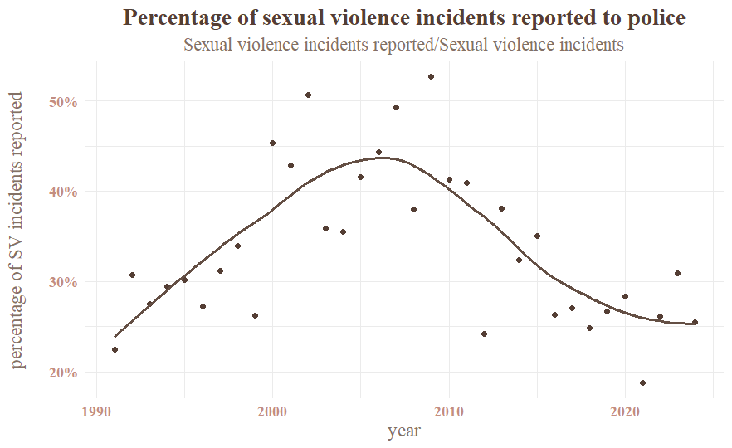

Slide 15
Why do people choose to report or not?
Why was the crime reported?
To prevent crimes by offender | 28.0%
To stop incident from happening | 25.0%
Because it was a crime | 22.3%
To punish offender | 5.4%
Needed help after incident | 3.0%
Catch or find offender | 2.8%
Why was the crime not reported?
Took care of it informally | 20.1%
Afraid of reprisal | 12.2%
Don’t want offender in trouble | 7.8%
Reported to another official | 7.5%
Minor or unsuccessful crime | 6.5%
Police would think unimportant | 5.9%

Slide 16
Conclusions

Slide 17
Conclusions
Incidents of SV are increasing; % reported decreasing
Younger population at higher risk for most forms of SV
  Exception: harassment
Strategies to increase reporting
  Educate on importance of protecting others; protection for victims; non-police care
Plan to continue research: predictive model

Slide 18
Questions/thoughts?
Thank YOU

