Slide 1
Research Updates

Slide 2
Understanding the Limits of Modelling MSMS with ML

Slide 3
High Resolution Liquid Chromatography - Mass Spectrometry
An analytical technique used for separation, identification, and quantification of both unknown and known compounds
  Elucidate the structure and chemical properties of different molecules
  Applications: screening for drugs, identifying toxins in the environment, and detecting certain metabolic disorders in infants

Slide 4
Paper Motivation
Paper outline:
  Description of current workflows / methods for performing structural elucidation
  Consolidation and quantification of previously highlighted limitations of ML methods to perform chemical structure elucidation given MS
  Identification of other questions related to understanding the performance of ML for MS
  Possible way forward to modelling MS with ML

Slide 5
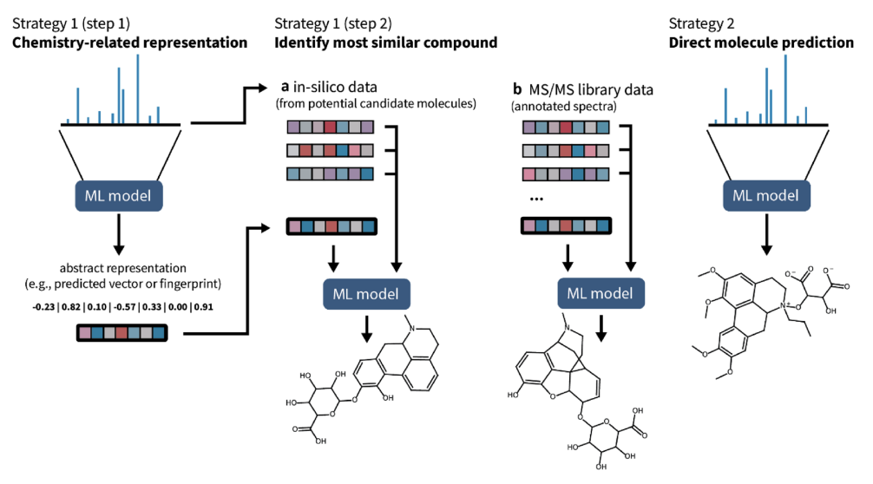
Current Workflow for ML Methods for MS

Slide 6
Dataset used for analysis
Consolidation of datasets from four different sources: 1. GNPS, 2. Massbank, 3. Mona and 4. dataset from Roman

Slide 7
Research Questions
Claim: Limited reference MS/MS is a key problem with the lack of ability to elucidate MS
  Different experiment platforms can lead to different fragmentation patterns, leading to difficulty in matching MS
  There is a strong dataset bias towards [M+H]+ or [M-H]- ions leading to 95% of unidentified spectra

Slide 8
Percentage of mismatched MS
Research Question:
  How many percent of mismatched MS is due to limited reference MS/MS?
  How many percent of MS can still be matched even when the platforms are different?
  Can learnt embeddings (spec2vec) alleviate this problem?
  How else can we alleviate this problem?

Slide 9
Paper Motivation
This paper first explores some of the limitations of ML for MS that were pointed by previous papers
This paper then explores some other important questions:
  Is there an issue with the current workflow: the current workflow of ML to modelling MS is one of the following:
    First learn an embedding for the MS and molecule and match them OR
    First learn to predict the molecular FP to represent the molecule then match against DB
    Directly generate the molecule from the MS
  Modelling choice: is the ability to perform partial annotation helpful for elucidation?
  What causes generalization gap? Are we able to transfer across different chemical ontology?
  Is the lack of data the key reason for poor performance? Can synthetic data be used for this case?
  Is noise the reason for poor performance?

Slide 10
Experimental Results
General finding:
  Difficult to generalize across platforms
  Difficult to generalize across chemical classes based on cassyfire ontology
To-do:
  Does adding of pseudo MS to the training set cause a reduction in generalization gap?

Slide 11
Experimental Results
[WIP] 0% of the MS can be matched at recall at 1 when we look up against DB of different platform
Learning molecular FP with different methods to represent MS:
Model | Recall at 1 | Recall at 5 | Recall at 20
Binned MS | 9.40% | 9.4% | 23.4%
Spec2vec | 12.5% | 18.6% | 50.5%
Spec2vec + Pseudo MS generated | 12.6% | 20.2% | 53.2%

Slide 12
Research Questions
Claim: Difficulty in resolving molecules with higher molecular masses
  Parent masses of the MS/MS spectra in the GPNS library show a clear bias towards lower masses; This might explain why around 14,000 MS/MS spectra in GNPS do not have a fully resolved structure
  Canopus were restricted to spectra below 860Da and Spec2vec only works well for spectra below 600Da
Research Question:
  What is causing the difficulty in resolving molecules with higher molecular messes?
    Is it purely due to the lack of data?
  Can this be due to more noise in the MS rather than not having sufficient data?

Slide 13
Research Questions
Claim: Cleaning up spectra
  GNPS tend towards larger numbers of high entropy spectra due to higher spectral noise
Research Question:
  How much does spectra noise affect lookup performance?
  Getting fragmentation tree; how does noise affect the ability to get trees? Can we quantify that?

Slide 14
Research Questions
Claim: Dark matters and generalizability
  Lose substantial structural information when converting to bit strings
  Similarity values when comparing large and small structures have very different behaviours
  Different bits have different discriminating power; “good bits” are bits that help to differentiate molecules and have high amount of training instances
Research Question:

Slide 15
Research Questions
Claim: Molecular fingerprints are limited in representing molecules1,2
  Lose substantial structural information when converting to bit strings
  Similarity values when comparing large and small structures have very different behaviours
  Different bits have different discriminating power; “good bits” are bits that help to differentiate molecules and have high amount of training instances
Research Question:

Slide 16
Limitation of ML methods; Consolidated Arguments Made by Other Papers
Dataset bias1,3
  For ML models to be helpful, training datasets need to be subsets of known biomolecular structures and need to contain all the compound classes based on the ClassyFire ChemOnt ontology
  There is a strong dataset bias towards [M+H]+ or [M-H]- ions leading to 95% of unidentified spectra
Limited reference MS/MS data
  The effectiveness of this method is contingent on the quality of the generated MS/MS spectra; the effectiveness of this method was displayed in MassGenie

Slide 17
Limitation of ML methods; Consolidated Arguments Made by Other Papers
Molecular fingerprints are limited in representing molecules1,2
  Lose substantial structural information when converting to bit strings
  Similarity values when comparing large and small structures have very different behaviours
  Different bits have different discriminating power; “good bits” are bits that help to differentiate molecules and have high amount of training instances

Slide 18
Limitation of ML methods; Consolidated Arguments Made by Other Papers
Different experiment platforms can lead to different fragmentation patterns – this leads to difficulty in matching MS
  This problem can be alleviated by partial annotation. I.e, peak annotation
Cleaning up spectra
  GNPS tend towards larger numbers of high entropy spectra due to higher spectral noise
  Most papers suggest a simple thresholding method to remove any signals with less than x% of intensity (typically 1% or 5%)

Slide 19
Limitation of ML methods; Consolidated Arguments Made by Other Papers
Difficulty in resolving molecules with higher molecular masses
  Parent masses of the MS/MS spectra in the GPNS library show a clear bias towards lower masses.
  This might explain why around 14,000 MS/MS spectra in GNPS do not have a fully resolved structure
  Canopus were restricted to spectra below 860Da and Spec2vec only works well for spectra below 600Da

Slide 20
Limitation of ML methods; Consolidated Arguments Made by Other Papers
Benchmarking (train and test sets)
  The dataset to be used VS the metrics to be used
  Could try to study how generalizable the models are vs how well it works for a specific subset
  Groups for sampling could include chemical classes, mass taxonomic clades, instruments, analytical methods
  Selecting / reporting results for different mass ranges and chemical classes can be used to illustrate if a tool has differences in performance

Slide 21
Experiments

Slide 22
Experiments performed to understand the limits of ML methods
Running of learning to split code to understand factors that limit generalizability of FP prediction with MS
Running of SIRIUS software (SOTA for chemical structure elucidation with MS) with different preprocessing steps:

Slide 23
Modelling Noise in MSMS

Slide 24
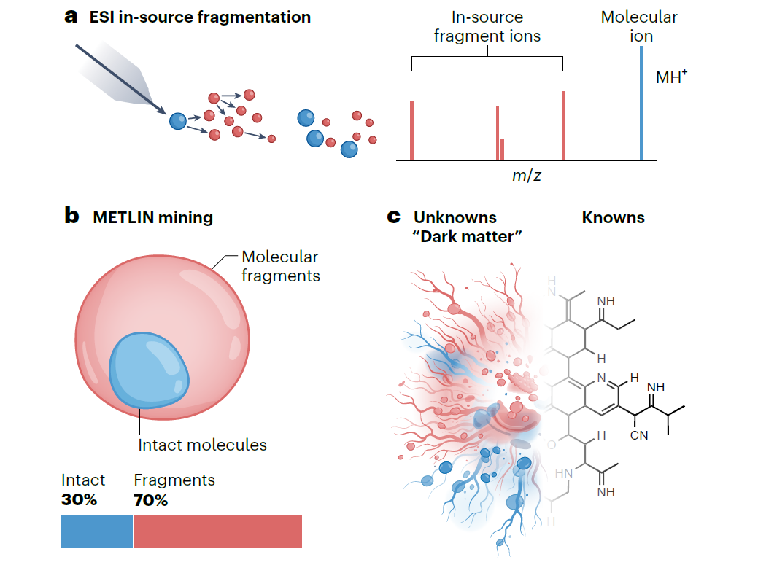
In-Source Fragmentation (ISF)
ISF as a source of noise:
  Peaks are generated from fragments of the original molecule
  MS that we observe from experiments is a forest instead of a tree
Current method to denoise:
  Thresholding: remove peaks if the intensity falls below a certain 5% of the base peak
  Convenient but insufficient to perform proper denoising; good threshold to set often varies greatly with instrument used etc
Question:
  How can we use methods / algorithms from signal processing to denoise the MS?
  Can we perhaps recover individual trees from the MS?

Slide 25
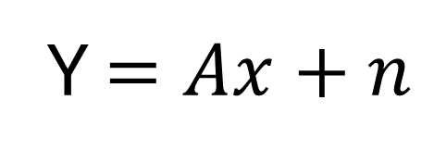
Signal Processing for Denoising
Start with a mathematical model representing the MS
Y $=Ax+n$
Y: a vector of intensity for a list of masses for theoretically possible fragments
x: a binary vector for chemically* possible fragments
n: noise
* We can use molecular dynamics / quantum chemistry theories to obtain chemically possible fragments

Slide 26
Signal Processing for Denoising
Modelling relationships between the fragments
  Sparse: there is a difference between theoretically possible and chemically possible fragments
    Some fragments are unstable and would bond with other fragments to form a stable compound
    Requires energy above bond dissociation energy for the bond to break
  Graph structure:
    Assumptions of fragmentation that occurs; tree structure? Subsets of formula?

Slide 27
Add in MS2deepscore 2 as part of the analysis
Reason for bad performance
Pretrained model for MS
  Invariance and a different unsupervised task
    Denoising

