Slide 1
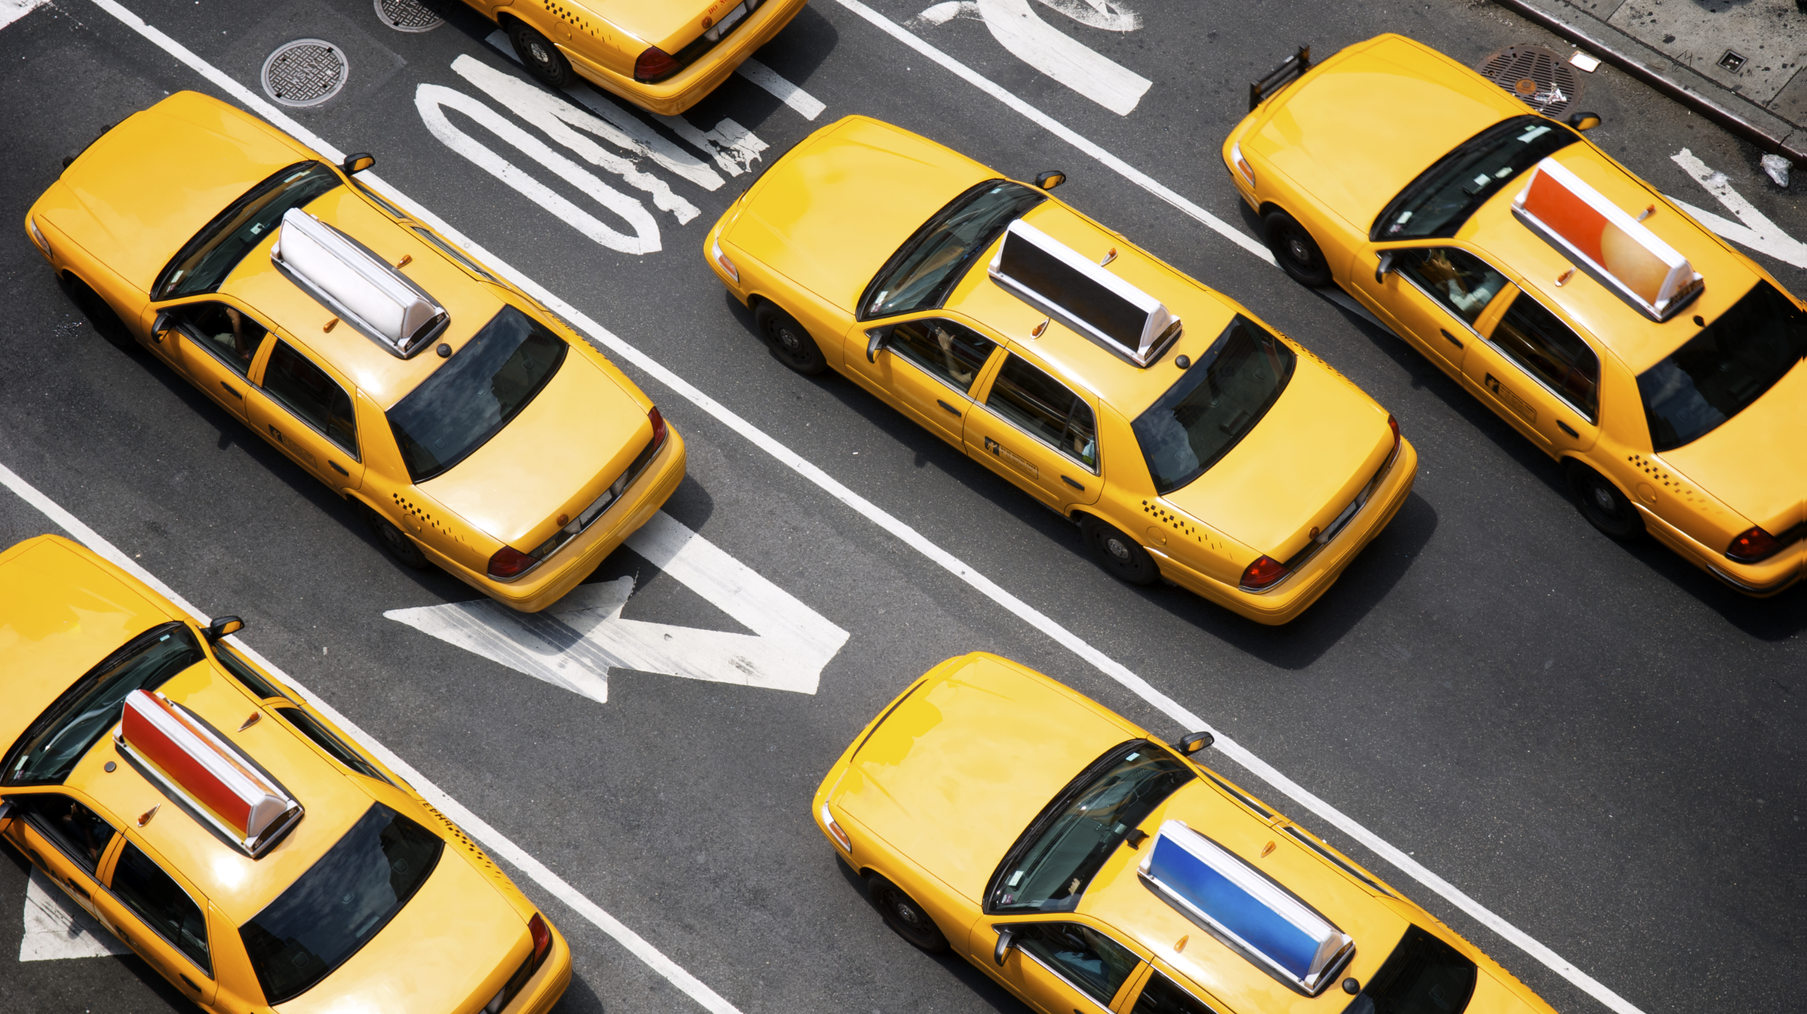
Taxi Planning
Giovanni Di Nola 1894682
Serena Ragaglia 1941007

Slide 2

Domain
The goal is to manage the movement of a taxi in a map of interconnected location, handling traffic, clients’ requests and battery level.
Passengers are in different locations and have an active request to reach a destination. The taxi has to reach the location, pick up the passenger, move to passenger’s destination and drop them off.
The taxi has limited battery, that can be recharged by reaching a recharge station, a specific type of location.
Traffic lights and congestions increase the cost of crossing specific locations and roads.

Slide 3
PDDL
(road ?l1 ?l2 – location)
Indicates that there is a direct road connection from location `?l1` to location `?l2`. This represents the physical infrastructure allowing the taxi to travel between two locations.
(trafficLight ?l1 ?l2 - location)
Indicates that there is a traffic light controlling the road from location `?l1` to location `?l2`. The taxi must check the light color before passing through.
(lightColor ?c - color ?l1 ?l2 - location)
Specifies the current color `?c` of the traffic light on the road from `?l1` to `?l2`. Used to determine if the taxi can proceed through a traffic light.
(taxiAt ?l - location)
Indicates the current location of the taxi. The taxi can only be at one location at a time.

Slide 4
PDDL
(passengerAt ?p - passenger ?l - location)`
Indicates that passenger `?p` is currently at location `?l`. Used to track passenger positions when they are not in the taxi.
(requestTo ?p - passenger ?l - location)`
Indicates that passenger `?p` has requested transportation to location `?l`. This represents the passenger's desired destination.
(onTaxi ?p - passenger)
Indicates that passenger `?p` is currently riding in the taxi. Only one passenger can be in the taxi at a time in this domain.
(congested ?l - location)
Indicates that location `?l` is congested (high traffic). Travel costs are increased when entering congested locations.
(chargeStation ?l - location)
Indicates that location `?l` has a charging station where the taxi can recharge its battery.

Slide 5
Actions
Move (?l1 ?l2 - location) | Taxi must be at location ?l1. A road must exist from ?l1 to ?l2. Battery level must be sufficient to cover the distance. If there's a traffic light, it must be green. | Taxi is now at location ?l2 (no longer at ?l1). Battery level decreases by distance × cost-per-distance. If ?l2 is congested: total cost increases by distance × 5. If ?l2 is not congested: total cost increases by distance. If there was a green traffic light: it switches to red.
switchLight (?l1 ?l2 - location) | A traffic light must exist between ?l1 and ?l2. The light must currently be red. | Light color changes from red to green. Total cost increases by 3.
Recharge (?l - location) | Location ?l must have a charging station. Taxi must be at location ?l. Battery level must be less than 100. | Battery level is set to 100. Total cost increases by 10.

Slide 6
Actions
pickUp (?p - passenger ?l - location) | Passenger ?p must be at location ?l. Taxi must be at location ?l. Passenger must have an active request. No other passenger can be in the taxi. | Passenger is no longer at location ?l. Passenger is now on the taxi.
getOff (?p - passenger ?l - location) | Passenger ?p must be on the taxi. Taxi must be at location ?l. Location ?l must be the passenger’s requested destination. | Passenger is no longer on the taxi. Passenger is now at location ?l. Passenger's request to location ?l is fulfilled.

Slide 7
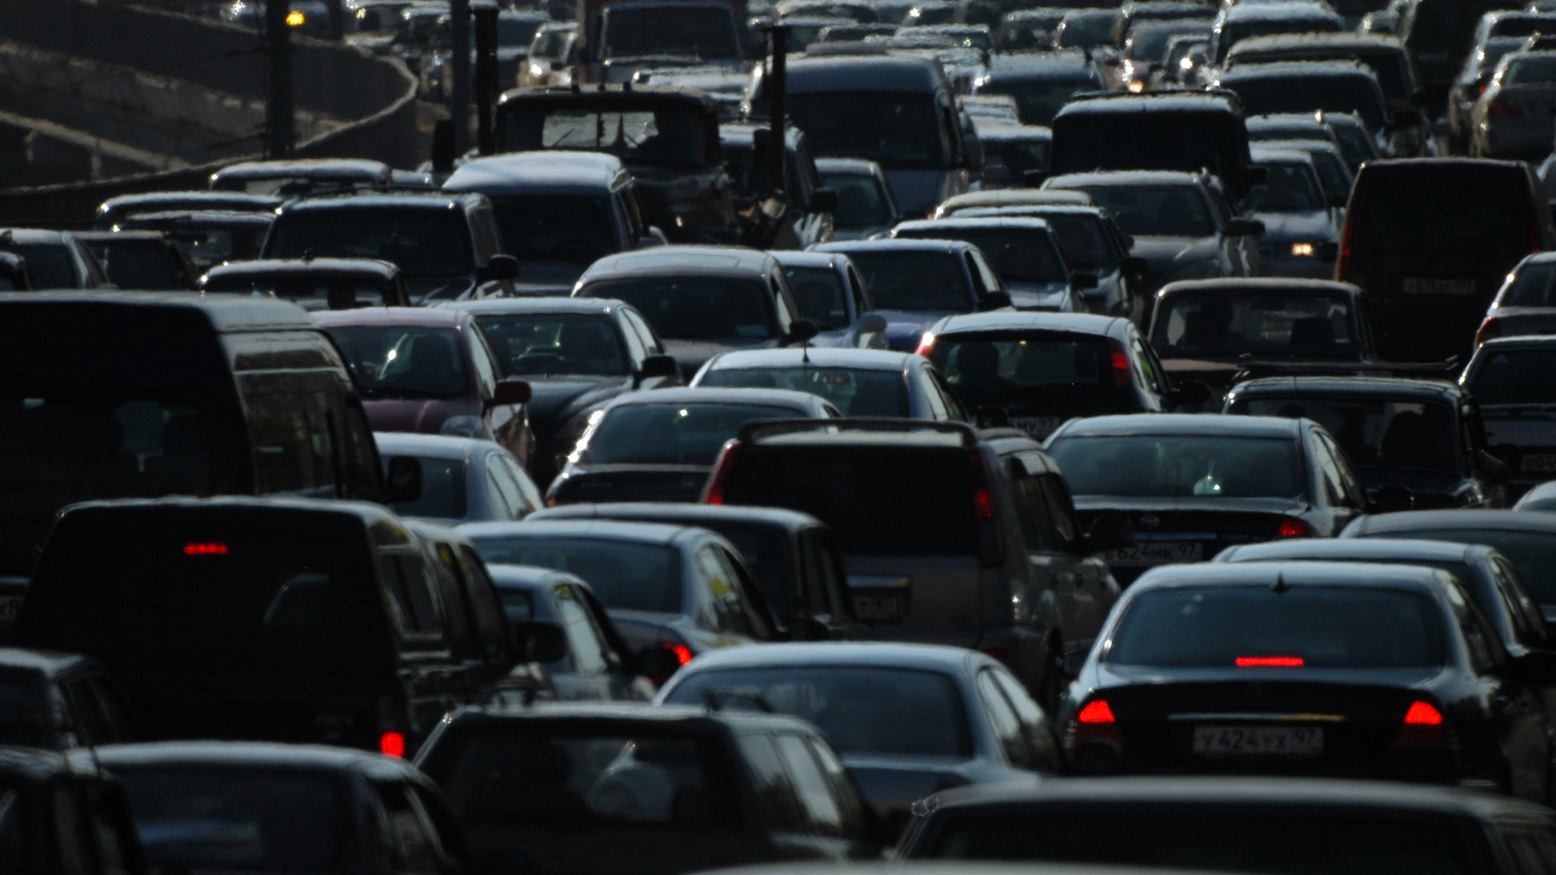

Problems
In the problem files the various initial states change based on:
Number of locations
Number of requests
Presence of congested roads
Presence of traffic lights

Slide 8
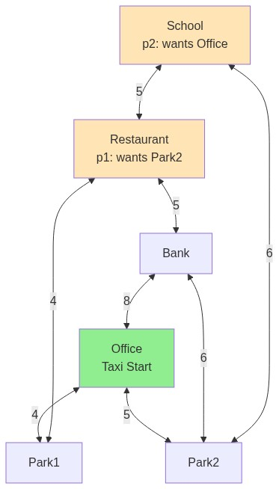
Problem 1
 | Plan length | Metric | Planning Time (ms) | Heuristic Time (ms) | Search Time (ms) | Expanded Nodes | States Evaluated
A* h_add | 13 | 288.0 | 81 | 35 | 72 | 264 | 322
A* h_max | 13 | 288.0 | 83 | 31 | 73 | 313 | 422
Greedy h_add | 13 | 288.0 | 76 | 28 | 71 | 264 | 322
Greedy h_max | 13 | 288.0 | 171 | 77 | 156 | 313 | 422
WA* h_add | 11 | 216.0 | 63 | 15 | 59 | 37 | 91
WA* h_max | 11 | 216.0 | 74 | 29 | 69 | 143 | 278

Slide 9
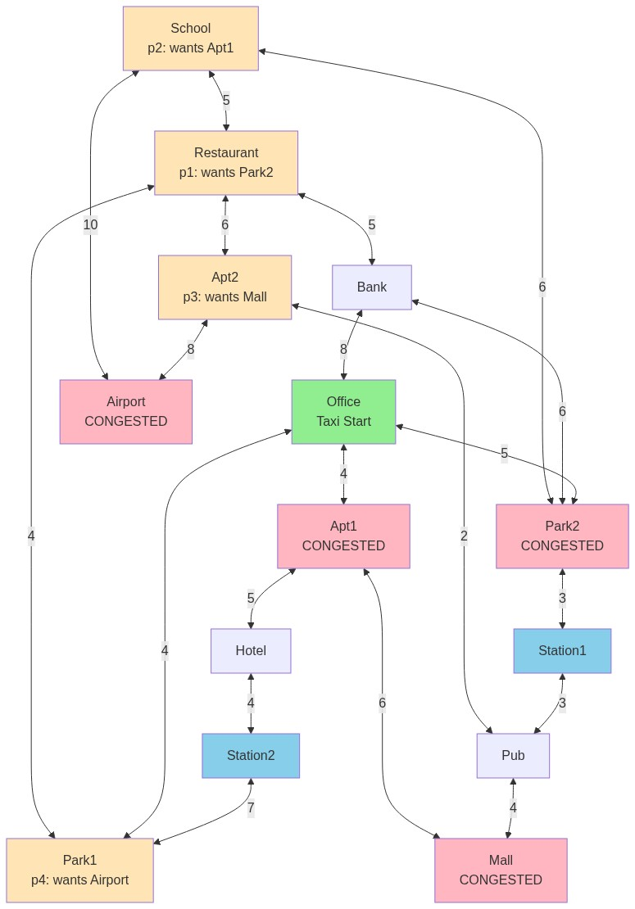
Problem 2
 | Plan length | Metric | Planning Time (ms) | Heuristic Time (ms) | Search Time (ms) | Expanded Nodes | States Evaluated
A* h_add | 45 | 888.0 | 223 | 151 | 217 | 1063 | 2113
A* h_max | 53 | 966.0 | 782 | 646 | 777 | 14814 | 24028
Greedy h_add | 45 | 888.0 | 195 | 116 | 190 | 1063 | 2113
Greedy h_max | 53 | 966.0 | 1031 | 794 | 794 | 1023 | 14814
WA* h_add | 35 | 614.0 | 195 | 122 | 190 | 653 | 1503
WA* h_max | 27 | 526.0 | 925 | 606 | 920 | 12742 | 15640

Slide 10
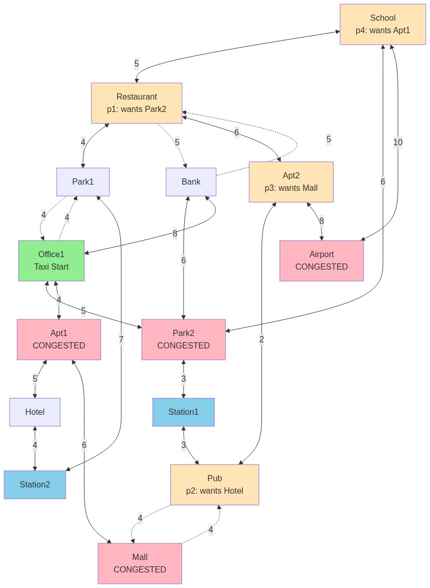
Problem 3
 | Plan length | Metric | Planning Time (ms) | Heuristic Time (ms) | Search Time (ms) | Expanded Nodes | States Evaluated
A* h_add | 83 | 1648.0 | 14943 | 12987 | 14939 | 250202 | 401887
A* h_max | 81 | 1616 | 238624 | 203052 | 238619 | 4910931 | 7168511
Greedy h_add | 83 | 1648.0 | 15443 | 13029 | 15438 | 250202 | 401887
Greedy h_max | 81 | 1616.0 | 250125 | 211018 | 250121 | 4910931 | 7168511
WA* h_add | 39 | 779.0 | 8494 | 7117 | 8490 | 118341 | 211332
WA* h_max | 36 | 674.0 | 39047 | 30356 | 39040 | 741790 | 935732

Slide 11
Comparing planning times

Slide 12
Comparing planning times

Slide 13
Comparing planning times

Slide 14
Comparing planning times

Slide 15
Problem 1
WA* h_add
WA* h_max
(move office park1)
(move park1 restaurant)
(pickUp p1 restaurant)
(move restaurant school)
(move school park2)
(getOff p1 park2)
(move park2 school)
(pickUp p2 school)
(move school park2)
(move park2 office)
(getOff p2 office)
(move office park1)
(move park1 restaurant)
(pickUp p1 restaurant)
(move restaurant bank)
(move bank park2)
(getOff p1 park2)
(move park2 school)
(pickUp p2 school)
(move school park2)
(move park2 office)
(getOff p2 office)

Slide 16
Problem 2
WA* h_add
(move office park2)
(move park2 chargeStation1)
(move chargeStation1 pub)
(move pub apartment2)
(pickUp p3 apartment2)
(move apartment2 pub)
(move pub mall)
(getOff p3 mall)
(move mall pub)
(move pub apartment2)
(move apartment2 restaurant)
(pickUp p1 restaurant)
(move restaurant apartment2)
(move apartment2 pub)
(move pub chargeStation1)
(recharge chargeStation1)
(move chargeStation1 park2)
(getOff p1 park2)
(move park2 school)
(pickUp p2 school)
(move school park2)
(move park2 office)
(move office apartment1)
(getOff p2 apartment1)
(move apartment1 office)
(move office park1)
(pickUp p4 park1)
(move park1 office)
(move office park2)
(move park2 chargeStation1)
(recharge chargeStation1)
(move chargeStation1 pub)
(move pub apartment2)
(move apartment2 airport)
(getOff p4 airport)

Slide 17
Problem 2
WA* h_max
(move office park1)
(pickUp p4 park1)
(move park1 restaurant)
(move restaurant apartment2)
(move apartment2 airport)
(getOff p4 airport)
(move airport apartment2)
(pickUp p3 apartment2)
(move apartment2 pub)
(move pub mall)
(getOff p3 mall)
(move mall pub)
(move pub chargeStation1)
(recharge chargeStation1)
(move chargeStation1 pub)
(move pub apartment2)
(move apartment2 restaurant)
(pickUp p1 restaurant)
(move restaurant bank)
(move bank park2)
(getOff p1 park2)
(move park2 school)
(pickUp p2 school)
(move school park2)
(move park2 office)
(move office apartment1)
(getOff p2 apartment1)

Slide 18
Problem 3
WA* h_add
(switchLight office1 park1)
(move office1 park1)
(move park1 restaurant)
(pickUp p1 restaurant)
(move restaurant school)
(move school park2)
(switchLight pub mall)
(getOff p1 park2)
(move park2 chargeStation1)
(move chargeStation1 pub)
(pickUp p2 pub)
(move pub mall)
(move mall apartment1)
(move apartment1 hotel)
(getOff p2 hotel)
(move hotel chargeStation2)
(recharge chargeStation2)
(move chargeStation2 park1)
(move park1 restaurant)
(move restaurant school)
(pickUp p4 school)
(move school park2)
(move park2 office1)
(move office1 apartment1)
(getOff p4 apartment1)
(move apartment1 hotel)
(move hotel chargeStation2)
(recharge chargeStation2)
(move chargeStation2 park1)
(move park1 restaurant)
(move restaurant apartment2)
(pickUp p3 apartment2)
(switchLight park1 office1)
(move apartment2 restaurant)
(move restaurant park1)
(move park1 office1)
(move office1 apartment1)
(move apartment1 mall)
(getOff p3 mall)

Slide 19
Problem 3
WA* h_max
(switchLight office1 park1)
(move office1 park1)
(move park1 restaurant)
(move restaurant apartment2)
(pickUp p3 apartment2)
(move apartment2 restaurant)
(move restaurant school)
(move school park2)
(switchLight pub mall)
(move park2 chargeStation1)
(recharge chargeStation1)
(move chargeStation1 pub)
(move pub mall)
(getOff p3 mall)
(switchLight mall pub)
(move mall pub)
(pickUp p2 pub)
(switchLight pub mall)
(move pub mall)
(move mall apartment1)
(move apartment1 hotel)
(getOff p2 hotel)
(move hotel chargeStation2)
(recharge chargeStation2)
(move chargeStation2 park1)
(move park1 restaurant)
(pickUp p1 restaurant)
(move restaurant school)
(move school park2)
(getOff p1 park2)
(move park2 school)
(pickUp p4 school)
(move school park2)
(move park2 office1)
(move office1 apartment1)
(getOff p4 apartment1)

Slide 20
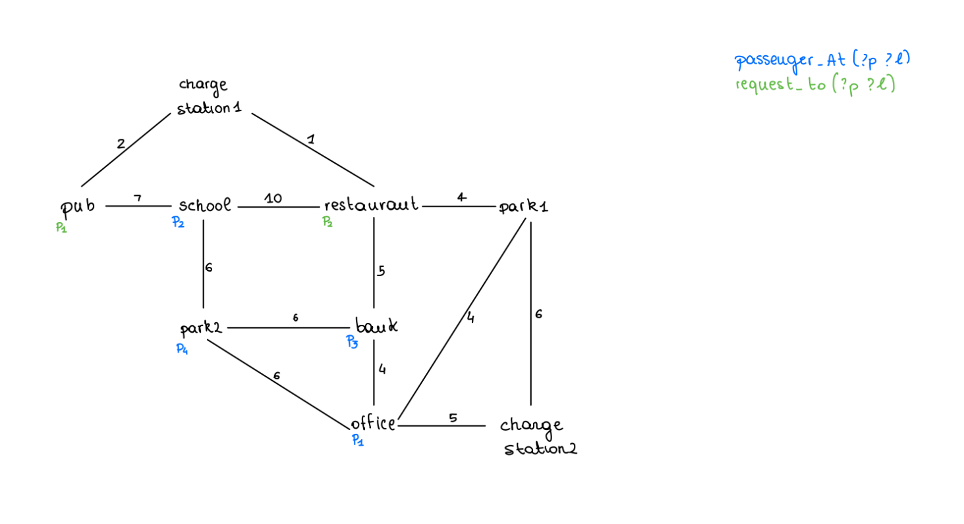
Indigolog
To perform the reasoning task with indigolog, we simplified the domain by using a map similar to the first problem, removing the possibility of traffic lights and congested locations.
We implemented 2 exogenous actions and we studied the behavior of our controllers in response to them.

Slide 21
Relational and functional fluents
taxi_at
rel_fluent(taxi_at(L)) :- location(L).
causes_true(move(_, L2), taxi_at(L2), true).
causes_false(move(L1, _), taxi_at(L1), true).
congested
rel_fluent(congested(L)) :- location(L).
on_taxi
rel_fluent(on_taxi(P)) :- passenger(P).
causes_true(pickUp(P, _), on_taxi(P), true).
causes_false(getOff(P, _), on_taxi(P), true).
request_to
rel_fluent(request_to(P, L)) :- passenger(P), location(L).
causes_false(getOff(P, L), request_to(P, L), true).
battery_level
fun_fluent(battery_level).
causes_val(recharge(_), battery_level, 100, true).
passenger_at
rel_fluent(passenger_at(P, L)) :- passenger(P), location(L).
causes_false(pickUp(P, L), passenger_at(P, L), true).
causes_true(getOff(P, L), passenger_at(P, L), true).

Slide 22
Actions
prim_action(move(L1, L2)) :- location(L1), location(L2).
poss(move(L1, L2),
and(taxi_at(L1),
and(road(L1, L2),
(battery_level > (D * C)))))
:- distance(L1, L2, D), cost_per_distance(C).
prim_action(recharge(L)) :- location(L).
poss(recharge(L),
and(charge_station(L),
and(taxi_at(L),
battery_level < 100))).
prim_action(pickUp(P, L)) :- passenger(P), location(L).
poss(pickUp(P, L),
and(passenger_at(P, L),
and(taxi_at(L),
neg(some(j, on_taxi(j)))))).
prim_action(getOff(P, L)) :- passenger(P), location(L).
poss(getOff(P, L),
and(on_taxi(P),
and(taxi_at(L),
request_to(P, L)))).

Slide 23


Exogenous actions
We added three exogenous actions to test our reactive controller:
call: creates a new request, deleting the old one from the same passenger.
move_p: makes a passenger move from its location to another, like a teleportation. This action has been introduced in order to see how the taxi reacts when a passenger moves.

Slide 24
Legality task
To test the domain, we selected a series of actions as input to the legality task, to check its executability.
The first task: [move(park1, restaurant), move(restaurant, school), pickUp(p2, school), move(school, restaurant), getOff(p2, restaurant)].
proved legal.
The second task:
[move(park1, restaurant), move(restaurant, school), pickUp(p2, school), getOff(p2, school)].
proved illegal, due to the lack of a request of p2 to reach school.

Slide 25
Projection task
For the projection task we wanted to check if a series of actions led to a desired state.
Write the condition 'and(f1(), neg(f2())).':
|: and(taxi_at(office), neg(request_to(p1, pub))).
Write the sequence of actions '[a1(), ..., an()].':
|: [move(park1, office), pickUp(p1, office), move(office, park2), move(park2, school), move(school, pub), getOff(p1, pub), move(pub, school), move(school, park2), move(park2, office)].
Condition and(taxi_at(office),neg(request_to(p1,pub))) HOLDS after executing [move(park1,office),pickUp(p1,office),move(office,park2),move(park2,school),move(school,pub),getOff(p1,pub),move(pub,school),move(school,park2),move(park2,office)] true.

Slide 26

Controllers
We decided to create different types of controllers.
The wander controller performs random actions and has to end up at the restaurant location.
The dumb controller also preforms random actions, until it completes all passenger’s requests.
The basic-battery controller has the goal to satisfy all requests, but has to keep an eye on the taxi’s battery that can go below a certain level and when it does, it needs to be charged.
The reactive controller has to respond to exogenous actions.

Slide 27

Controllers
proc(control(wander), search(wander)).
proc(wander, [
star(random_action),
?(taxi_at(pub))
]).
Execution of control(wander)
move(school,pub),move(restaurant,school),move(park1,restaurant)

Slide 28
Controllers
proc(control(dumb), search(dumb)).
proc(dumb, [
star(random_action),
?(final_condition)
]).
Execution of control(dumb)
getOff(p1,bank),move(office,bank),pickUp(p1,office),move(park1,office),move(restaurant,park1),move(park1,restaurant),move(restaurant,park1),getOff(p2,restaurant),move(school,restaurant),pickUp(p2,school),move(restaurant,school),move(park1,restaurant)

Slide 29

Controllers
proc(control(basic-battery), search(basic-battery)).
proc(basic-battery,
while(neg(final_condition),
if(battery_level =< 70,
go_to_recharge,
serve_some_passenger))).
Execution of control(basic-battery)
getOff(p2,restaurant),move(school,restaurant),pickUp(p2,school),move(pub,school),move(charge_station1,pub),recharge(charge_station1),move(restaurant,charge_station1),move(bank,restaurant),getOff(p1,bank),move(office,bank),pickUp(p1,office),move(park1,office),move(restaurant,park1),move(school,restaurant),move(restaurant,school),move(park1,restaurant)

Slide 30

Controllers
proc(control(reactive), [
prioritized_interrupts([
interrupt(neg(final_condition), [
unset(has_changed),
gexec(neg(has_changed), search(basic-battery))]),
interrupt(true, say("Waiting...")),
interrupt(true, ?(wait_exog_action))
])
]).
This controller handles the changes inside the world that can be caused by exogenous actions like the movement or the creation of a new request.

Slide 31
Controllers
Execution of control(reactive)
getOff(p3,restaurant),move(bank,restaurant),move(park2,bank),pickUp(p3,park2),move(school,park2),move(restaurant,school),move(school,restaurant),move(pub,school),move(charge_station1,pub),recharge(charge_station1),move(restaurant,charge_station1),move(park1,restaurant),move(restaurant,park1),move(school,restaurant),move(restaurant,school),call(p3,restaurant),move_p(p3,park2),getOff(p2,restaurant),move(school,restaurant),pickUp(p2,school),move(pub,school),move(charge_station1,pub),recharge(charge_station1),move(restaurant,charge_station1),move(bank,restaurant),getOff(p1,bank),move(park2,bank),move(school,park2),move(restaurant,school),move(school,restaurant),move(pub,school),pickUp(p1,pub),move(charge_station1,pub),recharge(charge_station1),move(pub,charge_station1),call(p1,bank),getOff(p1,pub),move(charge_station1,pub),move(restaurant,charge_station1),move(bank,restaurant),move(office,bank),pickUp(p1,office),move(bank,office),move(park2,bank),move(school,park2),move(restaurant,school),move(park1,restaurant),unset(has_changed)

Slide 32
Thank you for the attention
https://github.com/serenaragaglia/taxi_planning.git

