Slide 1
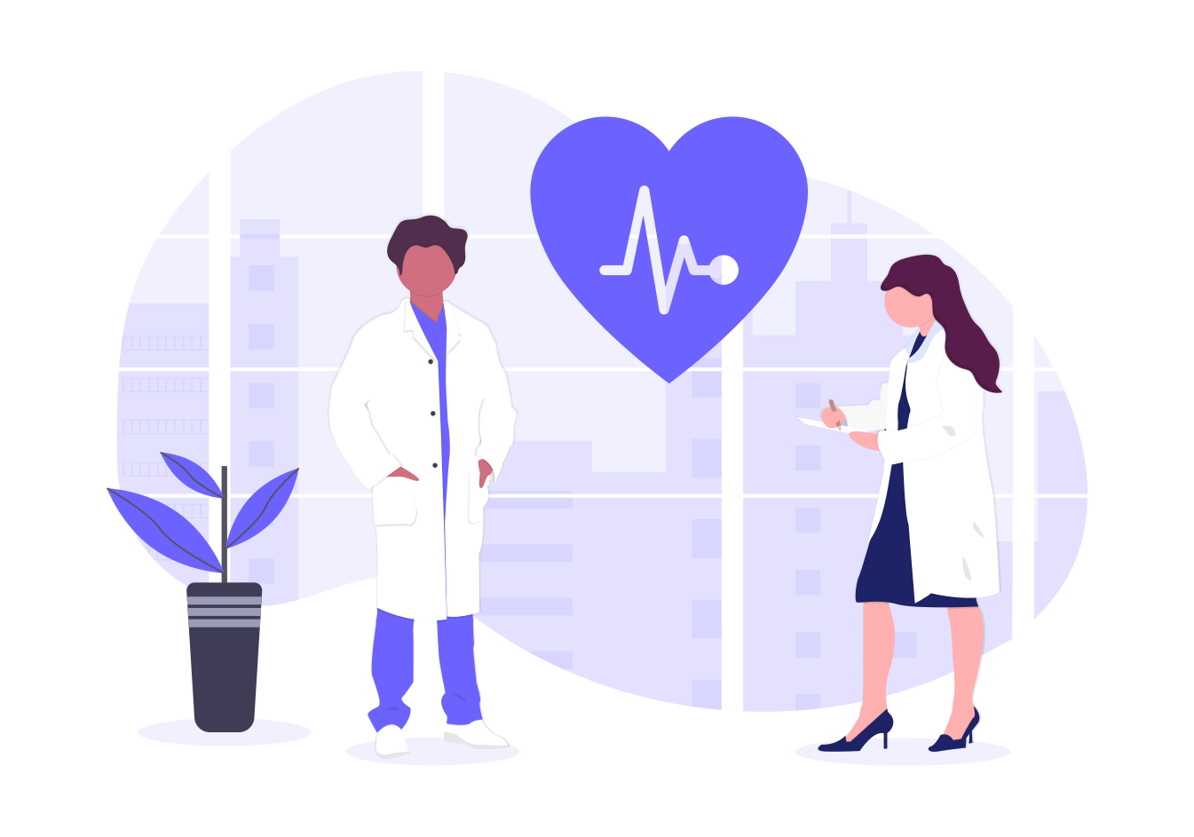
salubr.t
Your health care assistant

Slide 2
PROBLEM STATEMENT
During these tough times, there are several people who are in critical need of health care. Be it mental or physical.
The need of the hour is to provide evaluation facilities to each and every person in a convenient way that is available to maximum number of Indians.
In India, we have innumerable people who are concerned about symptoms they might be facing.
There should be a quick and easy way to alleviate the panic of the masses and to guide people on whether they need to seek medical help or not.

Slide 3
OUR SOLUTION
Presenting to you, salubr.t, a healthcare assistant that will guide you with all your pandemic related health care worries physical as well as mental.
Unsure about your illness symptoms? Do not panic! Let salubr.t, a chatbot integrated in your go-to messaging app, guide you to understand whether or not you should consult a doctor!
salubr.t will let you know if you need to go to the hospital or if you need to contact a doctor.
Facing worries related to mental health? Are you feeling down or stressed? Let salubr.t help you out! salubr.t is always there for your worries

Slide 4
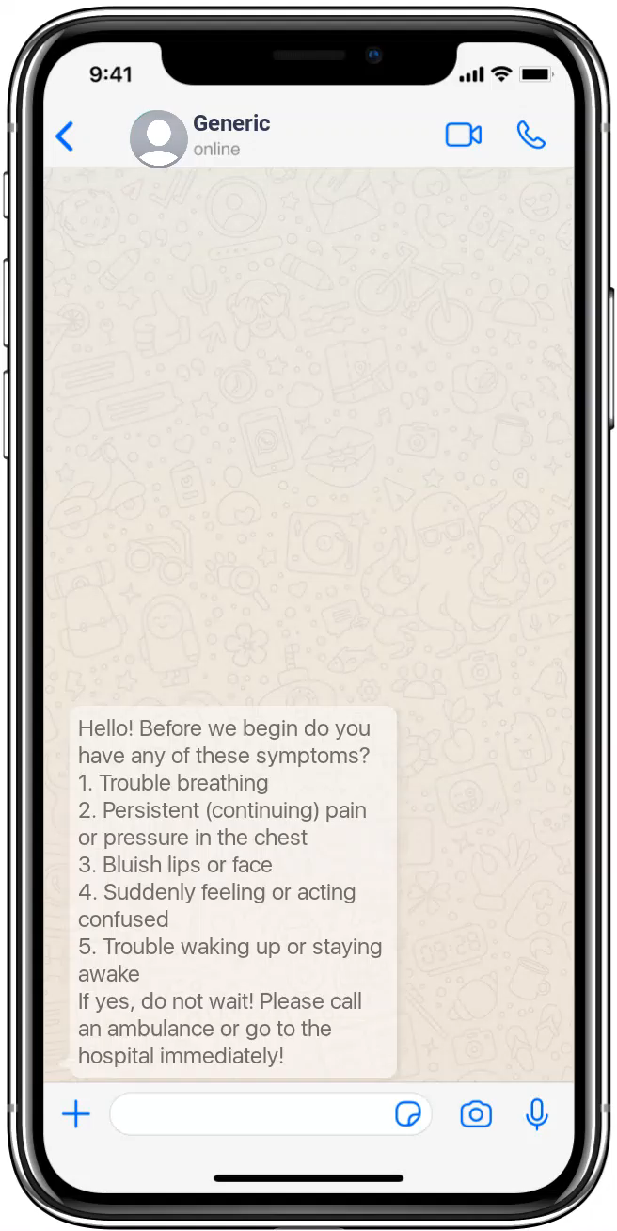
FEATURES:
1. We know these are trying times. People are panicking and are concerned about the various symptoms they might be facing. The question that arises is, should I go to the hospital? What if I contract the disease there?
2. But don’t worry, we have a solution! You can talk to salubr.t and it will guide you through a self check up so you clearly understand what must be done.
3. A prototype is provided on the right.

Slide 5
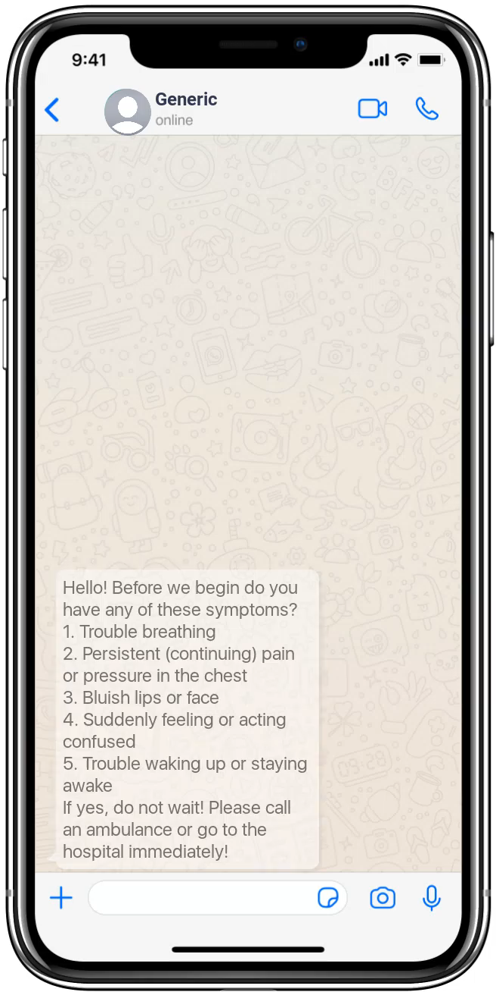
FEATURES:
5. We know these are trying times. Isolation makes us lonely and this situation has mentally affected a lot of people.
6. But don’t worry, we have a solution! You can talk to salubr.t and it will guide you through your worries.
7. A prototype is provided on the right.

Slide 6
BENEFITS
In India, a lot of people are not rich enough to afford a lot of internet data to download additional apps or don’t have phones which provide a lot of storage. Our bot is integrated into Telegram and can also be integrated in Facebook messenger and Whatsapp as well. Whatsapp is used by most of the Indians and we believe user experience and convenience is the top priority for any product.
For business professionals who are facing difficulties with their symptoms or depression or anxiety, we can also integrate it with Slack.
There are people who are panicking and going to the hospital for various ailments, when in reality it is not required or recommended at all! Different situations demand for different ways to deal with it. Another case is a person was in contact with a COVID patient and thinks it is not necessary for them to take a test. This mentality is also not recommended!
Our chatbot, salubr.t, will guide these people with their doubts. The spread of the virus can drop significantly and the doctors can be helped substantially because through these chatbots, a good percentage of the doctor’s tasks are automated through these common evaluation questions.

Slide 7
BENEFITS
Because of stress and anxiety, students, business professionals and many other employees and employers in various fields are facing a loss. This directly affects the productivity and hence the country itself faces an economic loss.
To alleviate these feelings and to provide help to the suffering individuals this chatbot will provide guidance and help so that they understand what they need to do and it will try to elevate and boost morale.
True and accurate information will be provided backed up by good resources.

Slide 8
TECH STACK:
RASA - An open source framework to create chatbots. This
Python - As our coding language.
.md files for storing the intents.
Telegram and Facebook Messenger APIs to deploy our chatbot so that the user doesn’t have to download an additional app. The user can use our bot with the help of the apps the user already has! Talk about convenience!

Slide 9
TECH STACK
RASA - An open source framework to create chatbots. This is built on TensorFlow which is a framework for creating Deep Learning models.
Python - As our coding language.
.md files for storing the intents.
Telegram and Facebook Messenger APIs to deploy our chatbot so that the user doesn’t have to download an additional app. The user can use our bot with the help of the apps the user already has! Talk about convenience!

Slide 10

FUTURE SCOPE
Our bot can be used to hand over the control to a real doctor based on the symptoms faced, for example, if he is facing problems like stomach ache the control will be handed over to a real gastroenterologist.
Our bot can also be used to transfer control to a real delivery boy/girl, who can collect a prescription from the address of the user and collect medicines for the user from a nearby local pharmacy. This is to improve social distancing and to help diseased patients, especially the ones in their old age who find it really difficult to do these tasks.

Slide 11

FUTURE SCOPE
Our bot can be deployed for the entire country by including more number of languages and all the hospitals and ambulance providers and their phone numbers can be provided right at the user’s fingerprints if sufficient data is procured.
Our bot can also be used to provide many more features like an inbuilt form to schedule test appointments, information on precautions to be taken, count of active cases, and so on.

