Slide 1

salubr.t
Your health care assistant

Slide 2
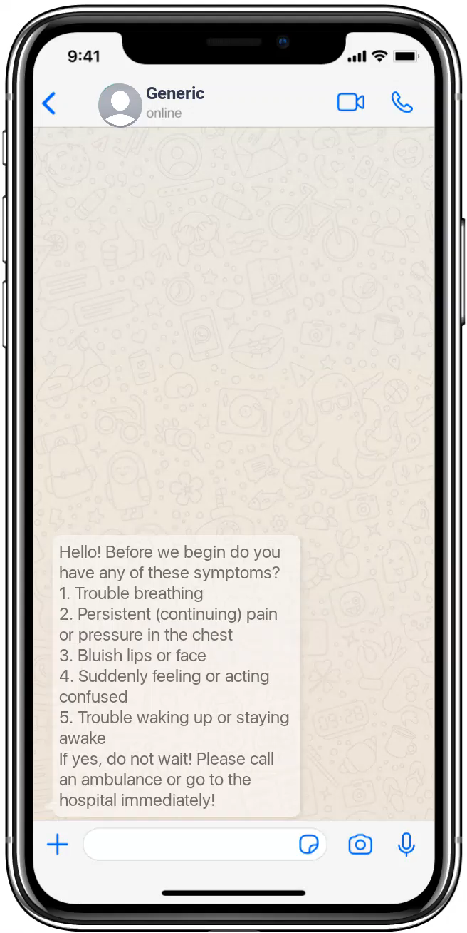
FEATURES:
Presenting to you, salubr.t, a healthcare assistant that will guide you with all your health care worries.
Unsure about your illness symptoms? Do not panic! Let salubr.t guide you!
salubr.t will let you know if you need to go to the hospital or if you need to contact a doctor.
Go ahead! Say a Hi!

Slide 3
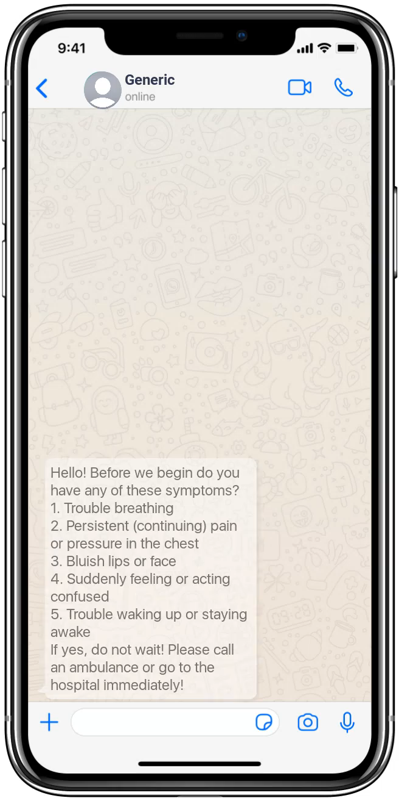
FEATURES:
5. We know these are trying times. Isolation makes us lonely and this situation has mentally affected a lot of people.
6. But don’t worry, we have a solution! You can talk to salubr.t and it will guide you through your worries.
7. A prototype is provided on the right.

Slide 4
TECH STACK:
RASA - An open source framework to create chatbots.
Python - As our coding language.
.md files for storing the intents.
Telegram and Facebook Messenger APIs to deploy our chatbot so that the user doesn’t have to download an additional app. The user can use our bot with the help of the apps the user already has! Talk about convenience!

