Slide 1
COMPSYS 302 Project B
Serena Toon

Slide 2
Overview
Social network
Security
Requirements
Log in
Automatically find other users
Profile
Messaging
Files

Slide 3
Network model
Central server drawbacks
Vulnerable to hacking
Reliant on uptime
High load
Pure P2P
Hard to keep track of users
Difficult on-the-go access
Login server
Authentication – can identify users
Once authenticated, communication is P2P
Decoupled from central server, not reliant

Slide 4
Implemented system

Slide 5
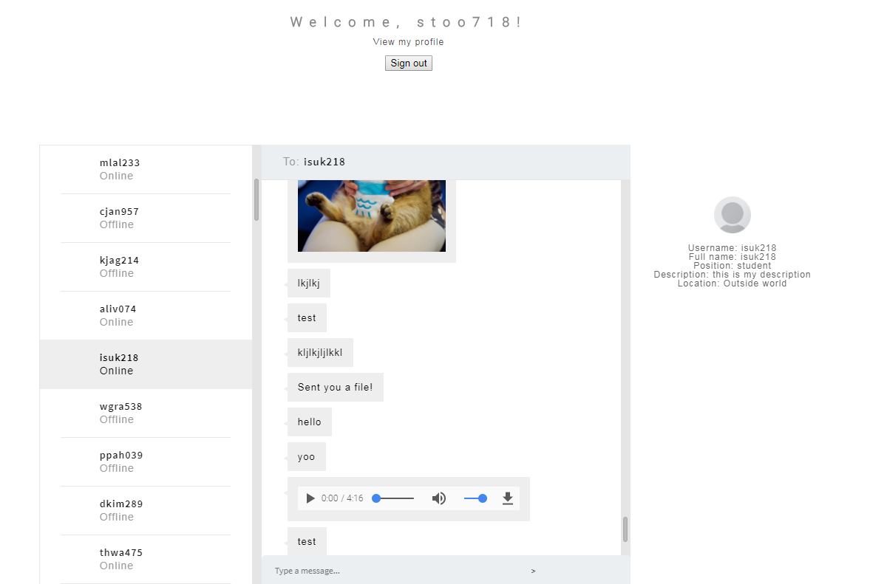
Features
Interactive, dynamic UI
Stay on one page
Embedded media player
Regularly reports to login server

Slide 6
Summary
Met minimum spec
Improvements

