Slide 1



Impact of COVID-19 on Airline Flights From ORD
Group Final Presentation
Sky Team: Ashish Gare
Serena Yang
Jared Young
Shuo Wang
Hiwot Gebreyohannes
Notes:
The presentation should focus on the data story and should be presented for a non-technical audience. Remember, the visualizations should be explanatory rather than exploratory, so when you present them, you should be using them to tell your data story. The final slides of your presentation can contain a show-and-tell of your best exploratory/technical images if you like, but note that time will probably be short.

Slide 2
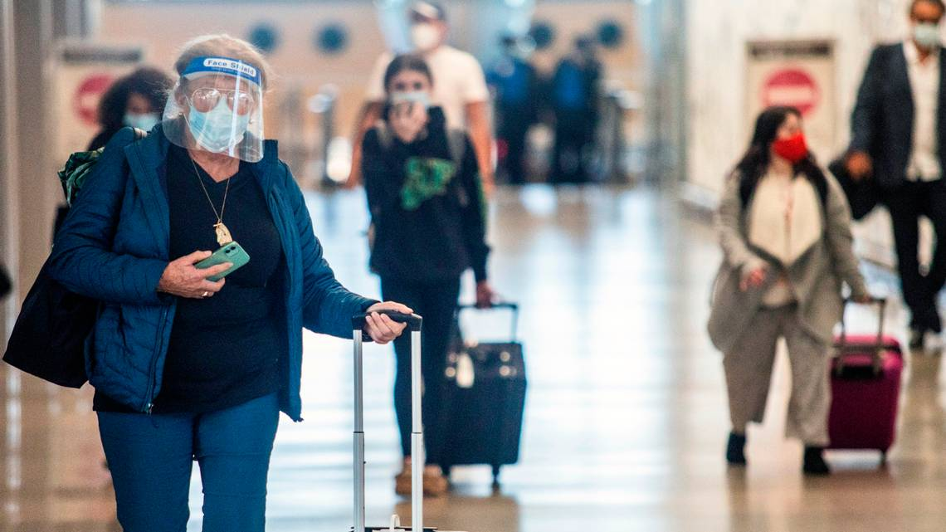
Introduction
While no sector has escaped the impacts of COVID-19 – one of the most immediately affected was the airline industry. Travel restrictions for both International and Domestic travel were among the first actions taken to curb the spread of the virus, and the extended stay-at-home orders and aversion to travel have combined to restrict the demand for air travel to extreme lows as compared to previous years.
Our analysis seeks to track, measure, and detail the ways in which COVID-19 has had an impact on air travel in the United States. Where, When, and to what degree these restrictions appear, and the overall effects that the virus has had on this aspect of American life.
Notes:
Why we chose this data

Slide 3
Dataset
The dataset from the United States Department of Transportation’s (DOT) Bureau of Transportation Statistics tracks the on-time performance of airlines and we downloaded it from the Kaggle website.
The data collected is from January - June 2020 and contains relevant flight information (on-time, delayed, canceled, diverted flights) from the Top 10 United States flight carriers.
The dataset was contained 2.7 million rows. We filtered the data in SQL for flights originating out of Chicago’s O’Hare International Airport (ORIGIN=’ORD’).
After Filtered | 47 Columns
127k Rows | Categorical | Numerical | Ordinal | Time-series
 | 9 | 27 | 10 | 1

Slide 4
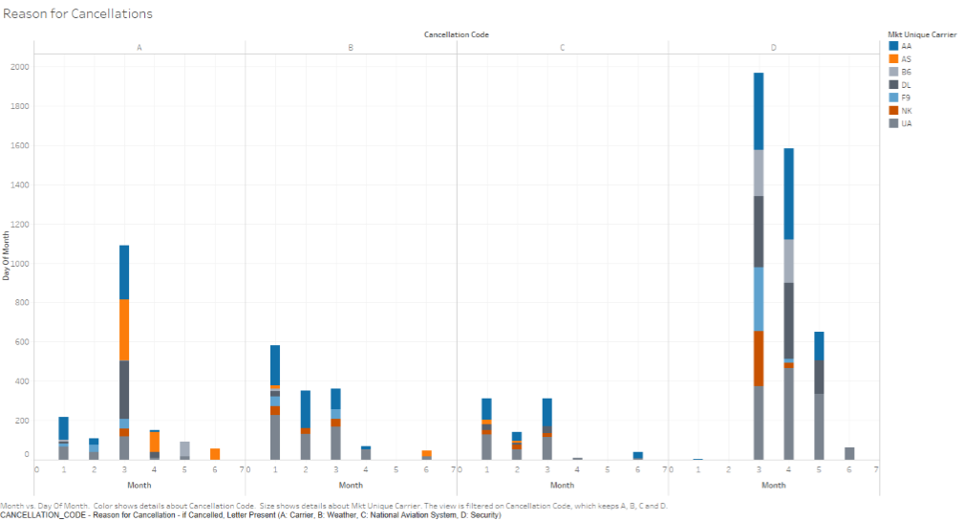
Reason for Cancellations
The number of Cancellations in this increase in March and April.
Some of the major cancellations are mostly due to security (D) and less compared to other reasons of cancellations(A,B,C).
Carrier cancellation in the Month of March and followed by weather. The major reason of cancellations was due to security.

Slide 5
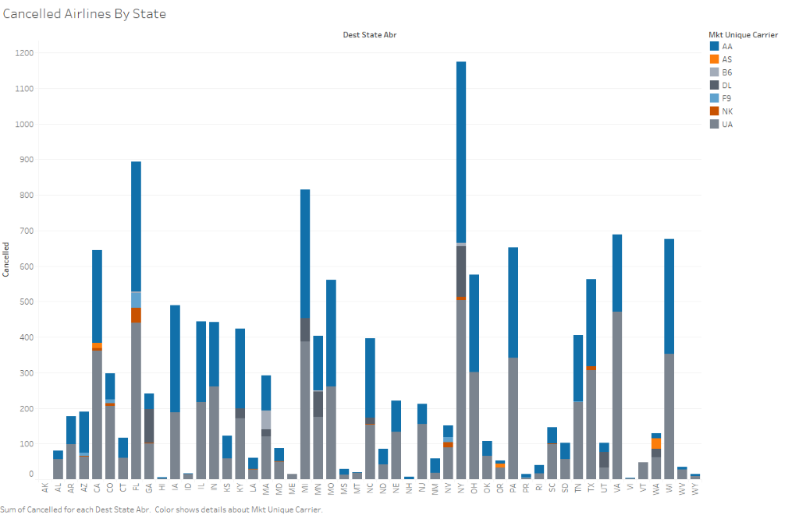
Airlines Cancelled by State
NY has one of the highest as NY had the first outbreak in the country and can see the number of cancellations rise in this between these domestic flights.
Two of the highest number of airline carriers UA and AA are mostly cancelled during these times followed by DA.
Notes:
From the visualizations we can see the States that had the greatest number of cancellations. NY has one of the highest as NY had the first outbreak in the country and can see the number of cancellations rise in this between these domestic flights. Two of the highest number of airline carriers UA and AA are mostly cancelled during these times followed by DA.

Slide 6
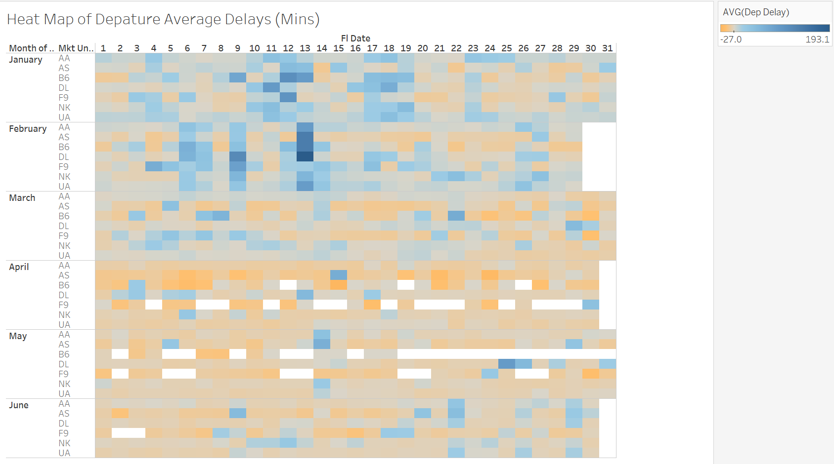
Heat Map of Departure Average Delays
This is a heat map with average delay time (mins) of departure from Chicago ORD. In this plot, we can clearly see the variation trend of delay time by month, exact date, and flight carriers. The audiences can check with one single day, but also can have a first impression on how the delay time changes.
Each color grid means the average delay time (mins) with flight numbers. Dark blue means positive delay time, and the dark orange means early departure.
As we can see in this map, February has the most serious delay, and April is the best for early departure.
Notes:
From the visualizations we can see the States that had the greatest number of cancellations. NY has one of the highest as NY had the first outbreak in the country and can see the number of cancellations rise in this between these domestic flights. Two of the highest number of airline carriers UA and AA are mostly cancelled during these times followed by DA.

Slide 7
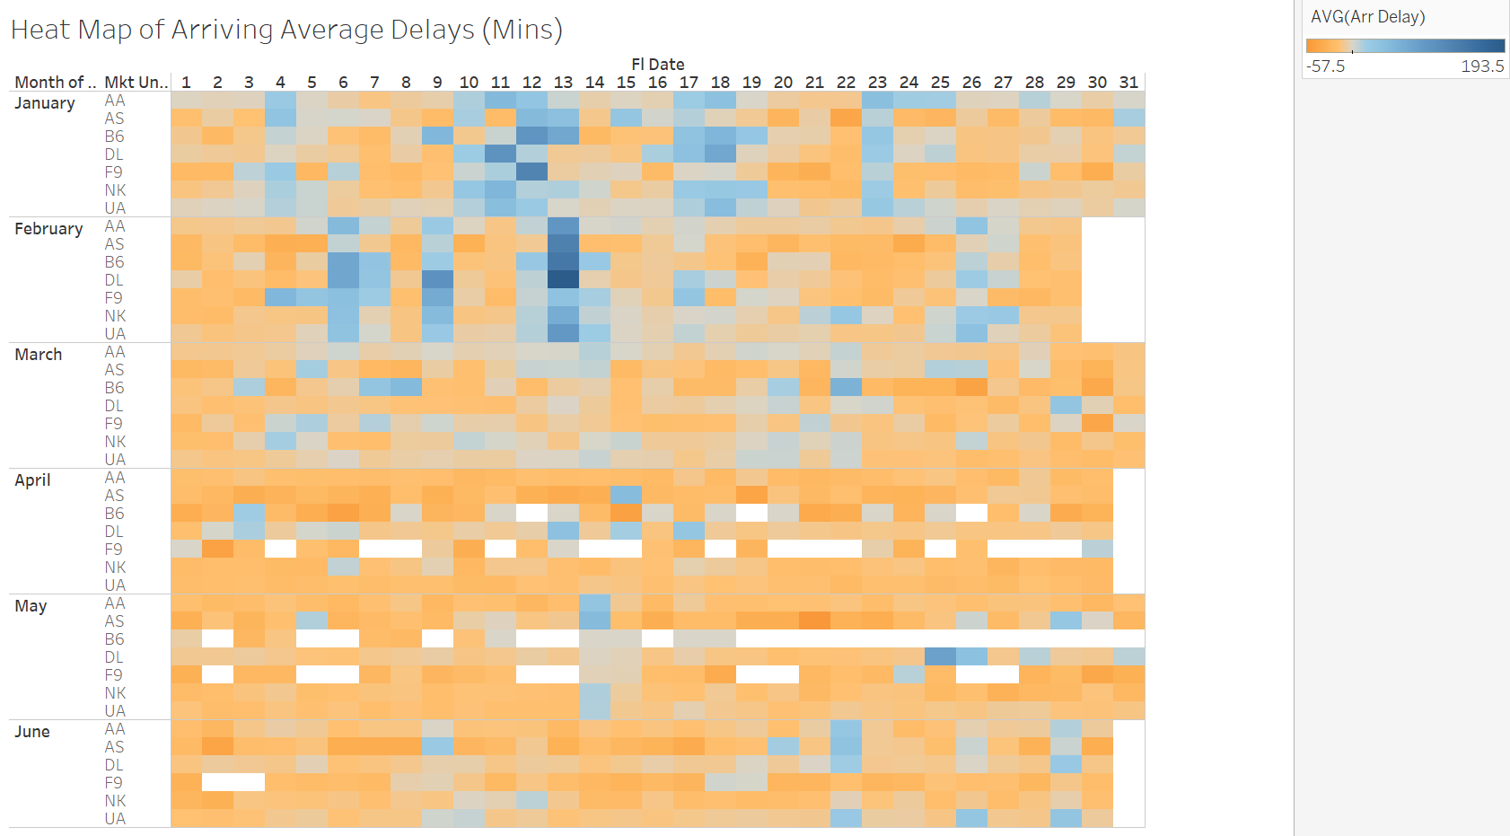
Heat Map of Arriving Average Delays
This is a heat map with average delay time (mins) of arriving to Chicago ORD.
As we can see in this map, February has the most serious delay and April to May has the best early departure time.
Comparing with the departure average delay map, in obviously, the delays on arriving to ORD becomes much better. One reason is that the arriving time is also affected by the departure airport not just ORD. And the other reason could be the time schedule arranged by the ORD.
Notes:
From the visualizations we can see the States that had the greatest number of cancellations. NY has one of the highest as NY had the first outbreak in the country and can see the number of cancellations rise in this between these domestic flights. Two of the highest number of airline carriers UA and AA are mostly cancelled during these times followed by DA.

Slide 8
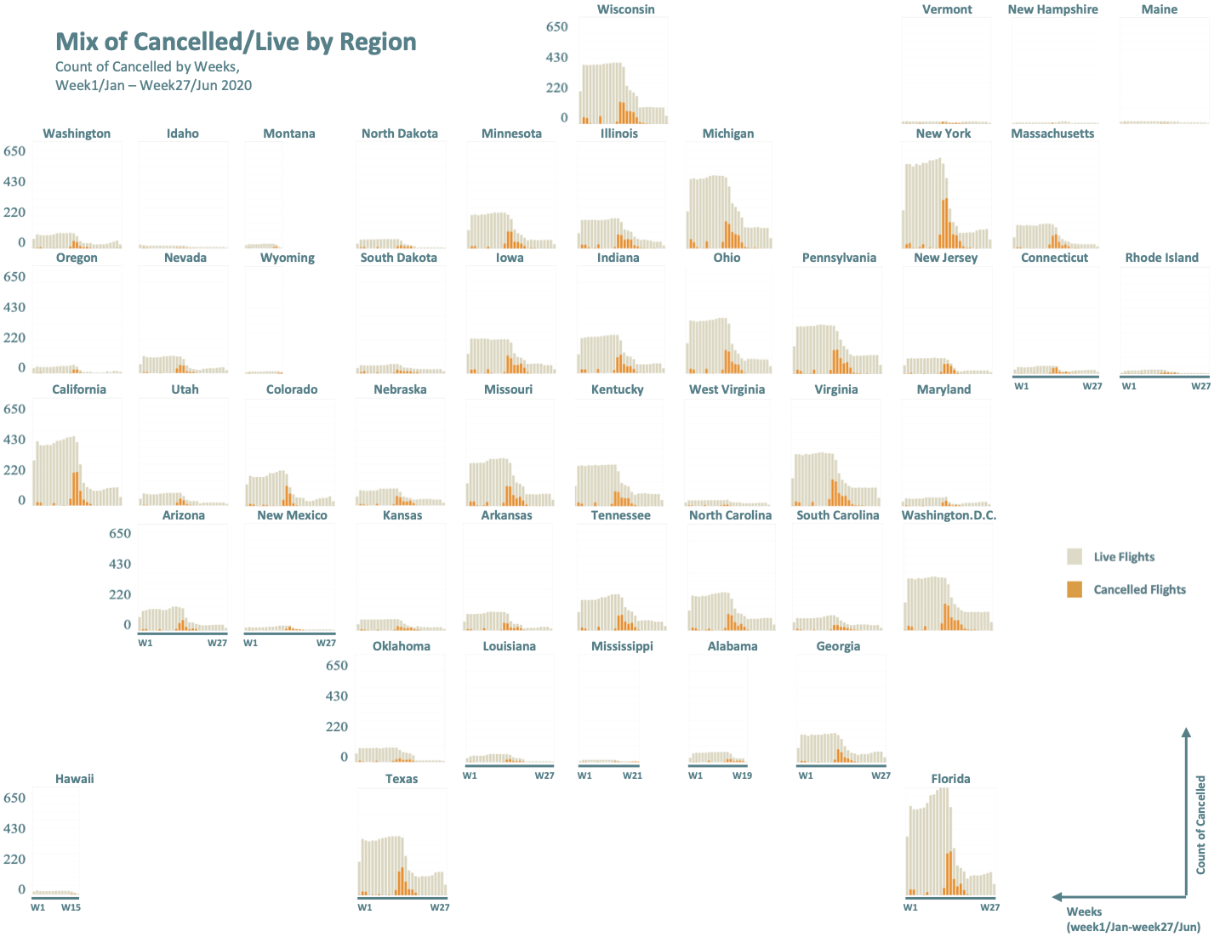
Mix of cancelled/live by Region
There was a significant decline in the total flights from Chicago to each destination state after week 15.
After the big increase in canceled flights, those flight lines got closed for some states like Montana, Hawaii, and Wyoming. Therefore, in the second graph for those states’ data were not enough.
Notes:
The first graph shows the count of canceled and live flights by region. The x-axis is the timeline from week 1 to week 27, which is from January 1st to the end of June in 2020, and the y-axis is the count of canceled. Based on this graph, although the total number of flights for each state is not the same, the overall trend is very similar. There was a significant decline in the total flights from Chicago to each destination state after week 15. After the big increase in canceled flights, those flight lines got closed for some states like Montana, Hawaii, and Wyoming. Therefore, in the second graph for those states’ data were not enough.

Slide 9
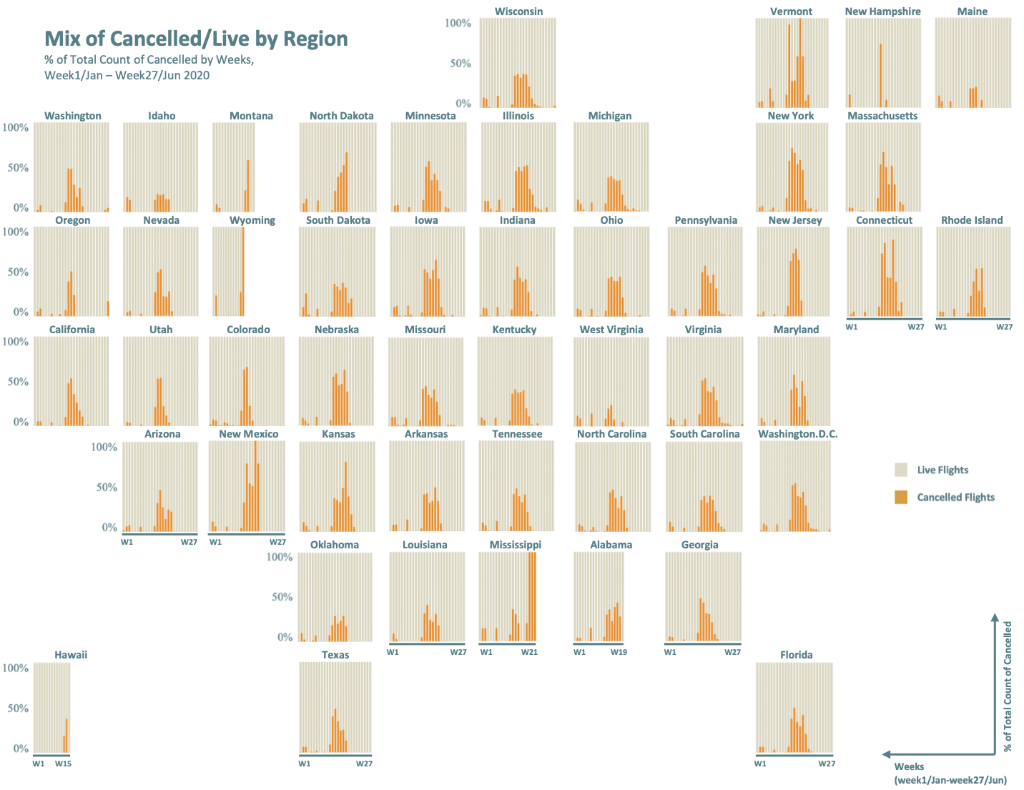
Mix of cancelled/live by Region
From week 2 to week 3, some flights got canceled due to some weather situation.
Starting from around week 10 flights started to take big hits as the rate of cancellations raise by a big percentage, and the large cancellation stayed around for almost 2 months.
Notes:
The second graph talks about the % of canceled flights of the total count, we can also see that the overall trend looks very similar for all the states, and this trend can further prove that the impact of COVID on flights. From week 2 to week 3, some flights got canceled due to some weather situation. Starting from around week 10, which was the beginning of the pandemic, flights began to take big hits as the cancellations rate raise by a significant percentage. The large cancellation stayed around for almost 2 months.

Slide 10
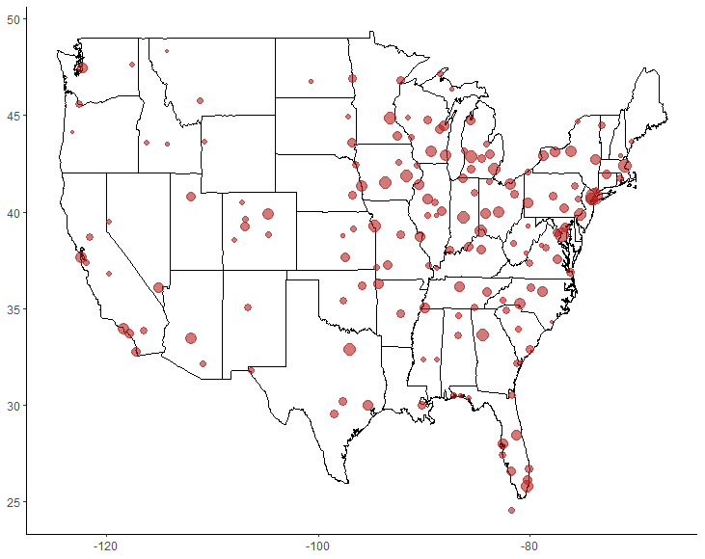
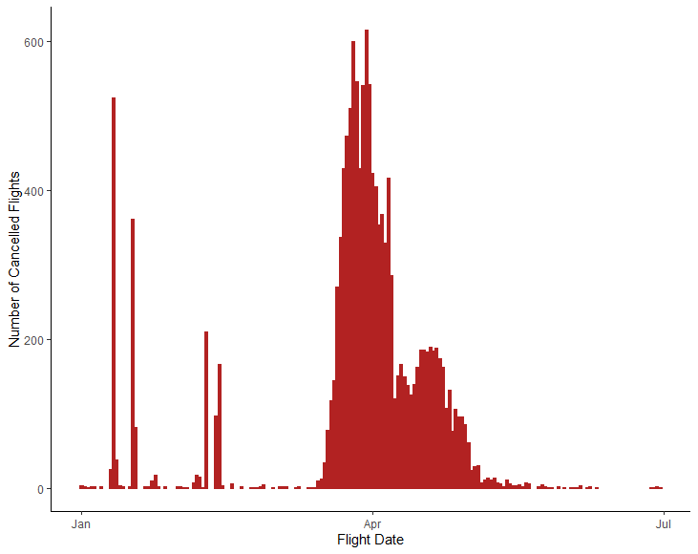
Flight Cancellations Over Time
Cancelled Flights from ORD (1/1/2020 - 6/30/2020)
The geographical and time series plots show flight cancellations over time for flights originating out of O'Hare International Airport from January 2020 to June 2020.
Initially there were only few flight cancellations but in early-mid March cancellations pop-up all-over US. Most stay-at-home and state of emergency orders were declared around this time period.
During the months of March to April there was longer period cancellations due to COVID-19 compared to prior months.
There were few cancellations before March, but most were due to weather.
State of emergency was declared on March 9 and the travel ban, that saw long waits and overcrowded facilities at ORD, took effect on March 14. This lines up with the initial turn of events on the plot.
Excluding [HI, PR, VI, AK]

Slide 11
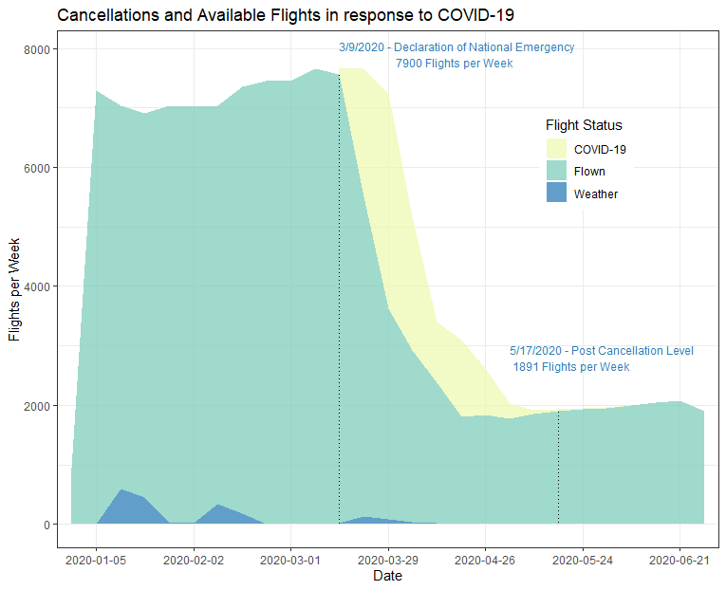
Adaptation of Airlines to COVID-19
Prior to the declaration of emergency on 3/9/2020, there were an average of 7900 flights from O'Hare airport per week
While flight cancellations did occur pre-COVID, they were primarily in winter months and used codes distinct from the cancellations seen in March.
Beginning with the declaration of emergency and extending into May of 2020, a wave of Cancellations tracks the effect of restrictions and reduced demand due to stay at home orders and quarantine on flight counts.
After the wave of cancellations, weekly flights from O'Hare averaged only 1891 per week.

Slide 12
Conclusion
Flight cancellations drastically increased between March and May
Initial cancellations occurred for flights to major cities on the East Coast. But right after state of emergency was declared in Illinois, flights were essentially cancelled to all states.
Improved departure and arrival delay times were observed in April and May.
By June 2020, normal flight volume had not resumed and remained only 30% of the pre COVID-19 volume.

